Slide 1
CS 6825: Deep Learning and CNN

Slide 2
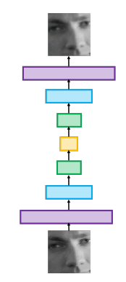
Deep Learning Architectures
feed-forward networks
auto-encoders (output want to recover input image, middle layer smaller - use results of middle layer for compression)
recurrent neural networks (RNNs) (backward feeding at run time as part of input into middle layer)
convolutional neural networks (CNNs)

Slide 3
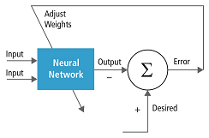
Deep Learning Topics
Neural Networks: perceptrons, activation functions, and basic neural networks. recall from discussion of NN - you train with input and desired outputs and use error to adjust weights in some kind of "learning algorithm".

Slide 4
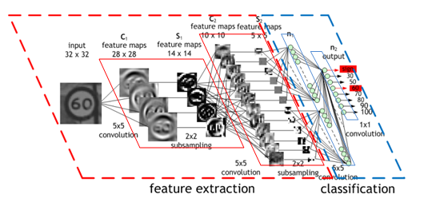
Deep Learning Topics
Logistic Classifier: this is a NN that the output layer has nodes that sum up to 1.0 --- meaning 100% probability. So each output node represents probability of that "thing it represents" occurring.

Slide 5
Deep Learning Topics
Convolutional Neural Networks:building blocks of convolutional neural networks, including filters, stride, and pooling. Capture local patterns →good for imaging applications

Slide 6
Characteristic of Deep Learning for Imaging
Input = raw pixels
CNN or regression (time feedback)

Slide 7
Convolutional Neural Network
We will discuss the idea behind CNN

Slide 8
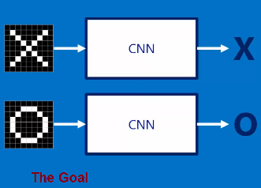
Motivation
SIMPLE example –want to detect X or O

Slide 9
Input
Image (or part of image—somehow segmented)

Slide 10
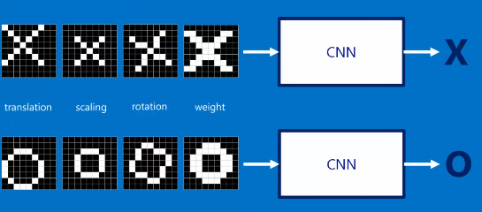
What we need –training data
Need LOTS, LOTS of data
How much training data --- examples for some forms of object recognition - could go into 1x00,000 samples or more. Sometimes like 10,000 or maybe for the really really simple example we show here we might get away with 200?
Google Open Image database – 9 million urls to labeled images

Slide 11
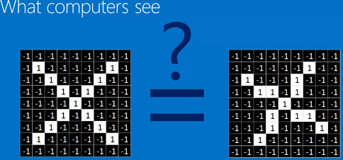
Understanding CNN
What a computer sees

Slide 12
Understanding CNN

Slide 13
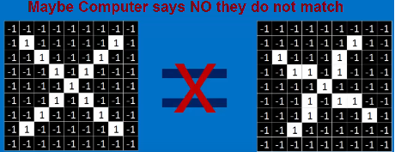
So a computer might say

Slide 14
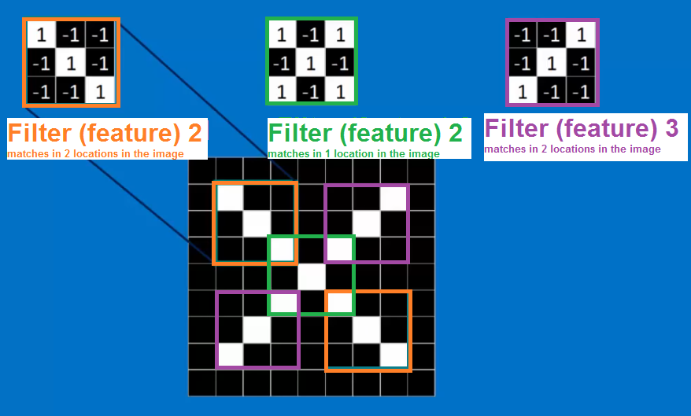
What if instead of matching everything at once ---we only try to match parts (local) of the X

Slide 15
This idea of part = feature or results of a local filter
Here we have a filter looking for just diagonal part of the X

Slide 16
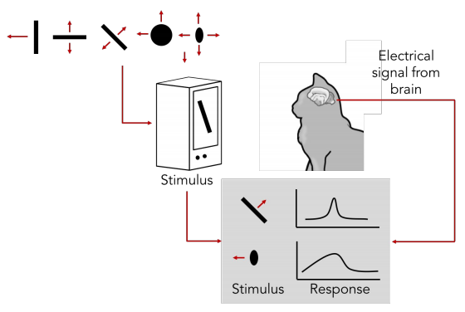
What should the filters be?
The CNN will LEARN THIS through training input = desired output
Interesting there is research showing the brain filters image data –this is not new and where edge detection etc. comes from

Slide 17
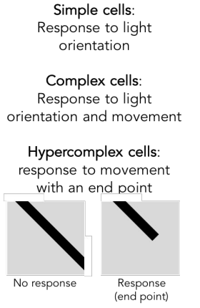
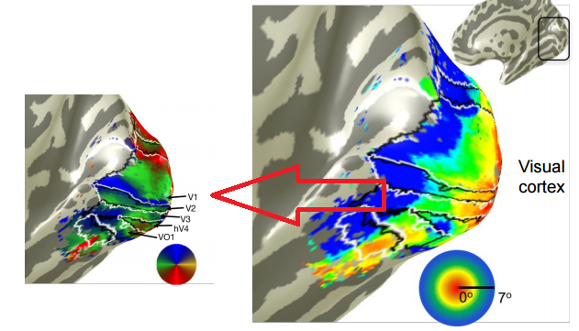
Again filters not new –evidence human brain
Here shows human brain and filtering in visual cortex V1 response

Slide 18
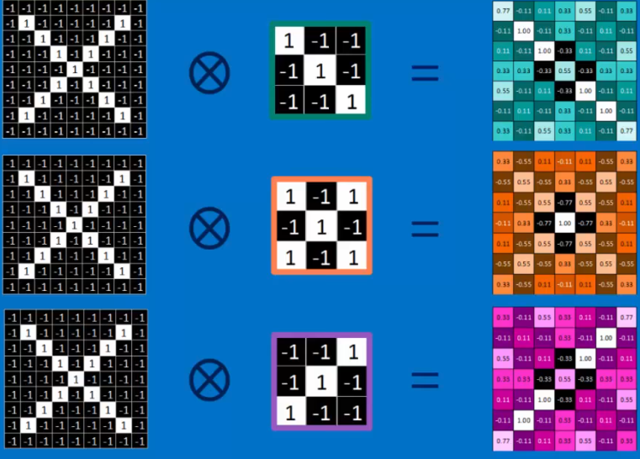
How many filters
Current implementations of CNN you must decide (for each layer) how many filters. Minimum 1

Slide 19
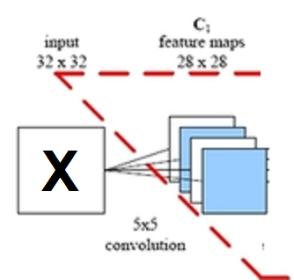
These are CONVOLUTION MxM filters
Example apply Three 5x5 filters to a 32x32 image
Output = Three 28x28 data values
NOTE: we loose 2 rows at top & bottom and 2 columns at left and right borders as can not process those with 5x5 mask → so output goes from 32x32 to 28x28

Slide 20
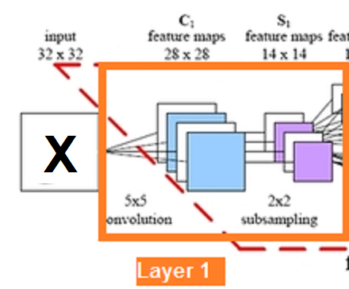
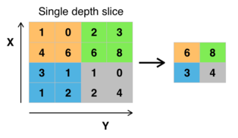
Yikes –we have MORE data if number filters > 1
Reduce data through Max Pooling
Space every 2x2 window and take max value
go from 28x28 → 14x14
Typically, 2x2 could be 3x3 windows –parameter you must choose

Slide 21
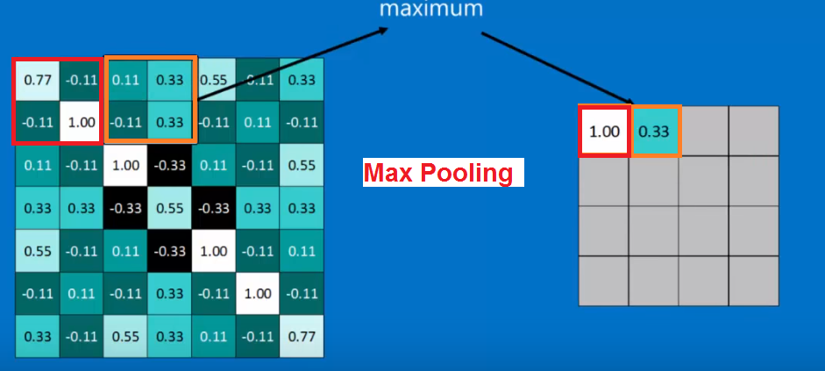
Max pooling illustrated

Slide 22
Max pooling illustrated

Slide 23
Max pooling illustrated

Slide 24
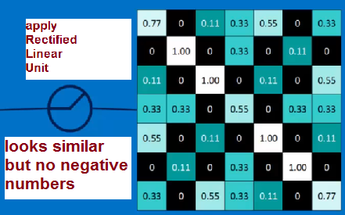
Not done yet with what a CNN does in a layer –NON-LINEARITY
--- we must introduce a non-linearity and do so for CNN at each data sample by applying Rectified Linear Units: set values < 0 to 0
This seems like magic –how did they come up with this? Why this?
Answer: in NN (came before) more elaborate functions like sigmas are used

Slide 25
LAYER means…
= Convolution with set of (1-*) MxM filters + nonlinear + max pooling (downsample)

Slide 26
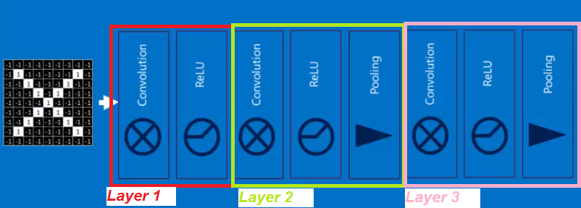
Example with 3 layers
Three Convolutional Layers

Slide 27
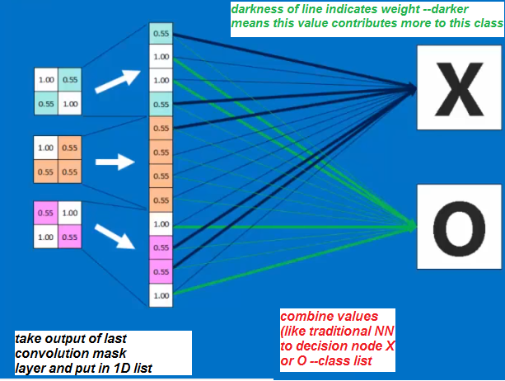
But the output does not say X or Y → Decision Layer (fully connected layer)
Last Layer -decision Layer (you can have more than one layer at the end that is fully connected like this --but, minimum is 1)
Weights will be learned through training

Slide 28
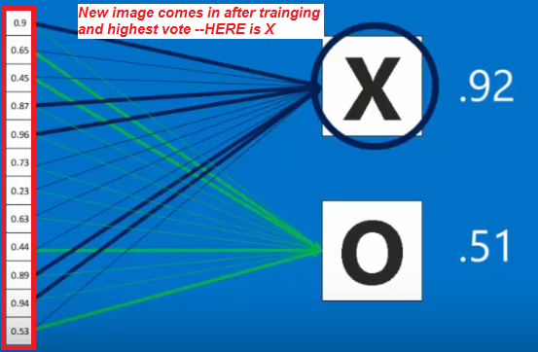
After training –using the CNN –what happens at last layer
Get a vote

Slide 29
Final structure to our example CNN
5 layers – 3 convolutional and 2 fully connected

Slide 30
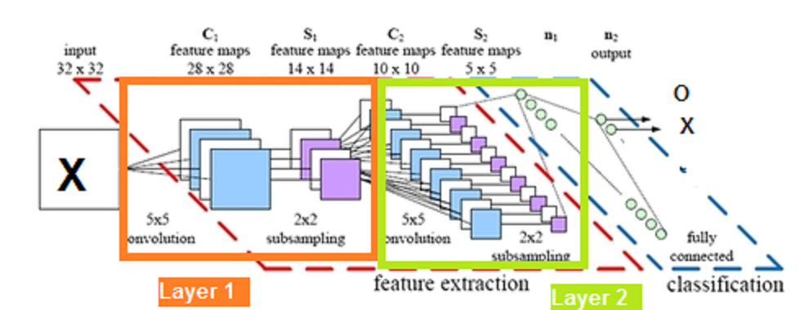
Smaller CNN possibility for our example
3 layers – 2convolutional, 1 fully connected
Layer 3

Slide 31
Question 1: How many layers of each type (convolution and fully connected)?
hard to answer - minimum 3 largest maybe 6-15 (but, that is changing) . For sure the more layers, the longer to train and in general more data needed. More complex the problem more layers. Simpler the problem less layers needed. Minimum 1 fully connected layer. NOT LEARNED, you decide

Slide 32
Question 2: How many masks at each layer?
hard to answer - could learn this. Minimum obviously 1. Not too many or too many parameters. Can have more masks if they are small (3x3) than the number you would have if they were large (7x7)
Could have Three 3x3 masks OR One 7x7 mask?
Typically NOT LEARNED, you decide
This is one of the more difficult “parameters” to set—add more if results are bad

Slide 33
Question 3: what size is the mask?
Another hard question
minimum is 3x3 to 7x7??
Too big and too much to learn. Larger mask means larger scale pattern looking to match via convolution.
Typically NOT LEARNED, you decide

Slide 34
Question 4: What is content of MxM mask?
you learn this through training (backpropogation like traditional NN, use error between output and desired output to alter the parameters) LEARNED

Slide 35
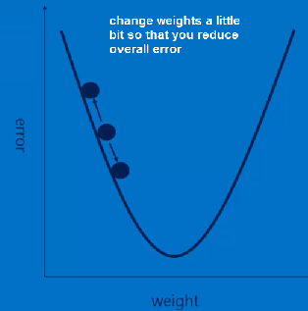
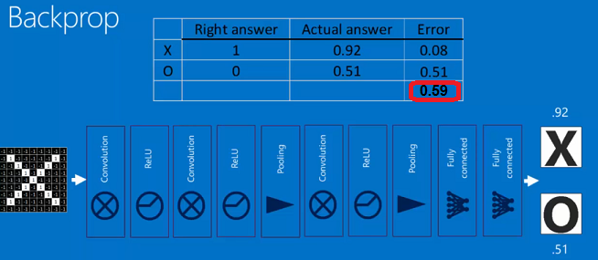
Question 5: What are the weights in the fully connected layers?
you learn this through training (backpropogation like traditional NN, use error between output and desired output to alter the parameters) LEARNED

Slide 36
Number of Parameters for just One Layer you need to learn
Assume 10 filters at this layer
Each 5x5 and applied to Red, Green, Blue = 3 fields of input
Number paramenters for 1 filter = 5x5x3 =75
For 10 filters = 10x75 =750 parameters

Slide 37
OUTCOME
CNN capture "local" spatial patterns at different scales (downsampling-max pooling) --- good for Image Applications

Slide 38
Totally different example
Face detection

Slide 39
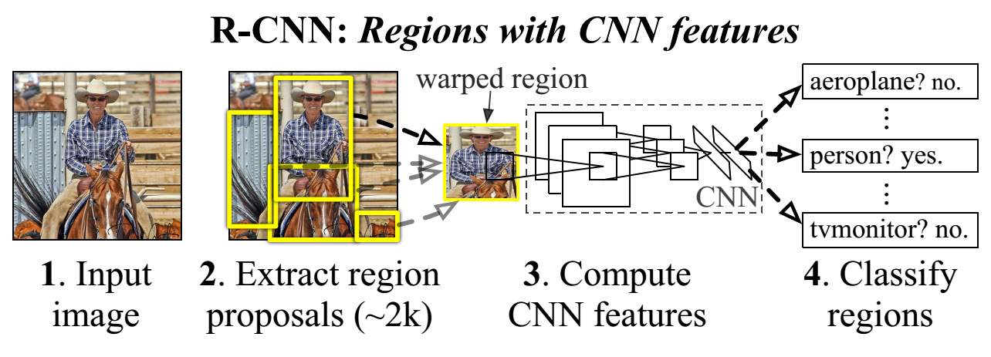
Yet another example
Note here only parts of image fed in

Slide 40
CNN frameworks

Slide 41
TensorFlow by Google
is a library for CNN that is supported by Google
offers distributed computing.
tensorflow official site
tutorial site
install instructions

Slide 42
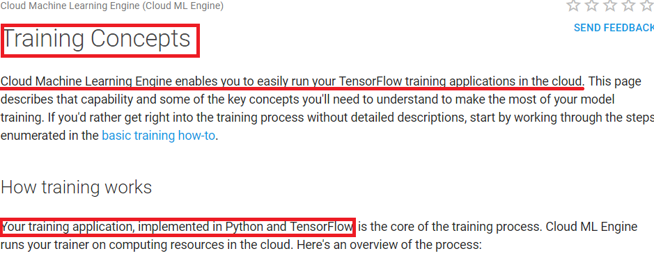
TRAINING Options
Use on Google Cloud Machine Learning directly
OR Download and setup on your machine(S) –will take long time to train even in multi machine setup like days to week(s) when have large data sets. Even in cloud same time period. MUCH worse on single machine
Programming Interface – supports number of languages but, main is Python for training

Slide 43
History of Python as Machine Learning Language
NumPy package = numerical analysis like Matlab
matplotlib package= plotting functionality from Matlab was ported to Python
SciPy package = Libraries for scientific computing were built around NumPy and matplotlib
Python's support for Matlab-like array manipulation and plotting is a major reason to prefer it over Perl and Ruby.

Slide 44
TRAINING Options in Python
Can use CNN framework in Python called Keras
Front End Wrapper = library with backend of either TensorFlow or Theano
Google TensorFlow is offically supporting Keras

Slide 45
Keras – front end wrapper for CNN training
from keras.models import Sequential
from keras.layers import Dense, Activation
# Simple feed-forward architecture
model = Sequential()
model.add(Dense(output_dim=64, input_dim=100))
model.add(Activation("relu"))
model.add(Dense(output_dim=10))
model.add(Activation("softmax"))
# Optimize with SGD (learning process)
model.compile(loss='categorical_crossentropy', optimizer='sgd', metrics=['accuracy'])
# iterate training data in batches
model.fit(X_train, Y_train, nb_epoch=5, batch_size=32)
# alternatively feed in training data in one batch model.train_on_batch(x_batch, y_batch)
# Evaluate model
loss_and_metrics = model.evaluate(X_test, Y_test, batch_size=32)
# create predicitions on new data
classes = model.predicts(X_test, batch_size=32)
2017 – google
Announced support for Keras in TensorFlow to come

Slide 46
Other popular ML languages
C/C++, Java
But, google seems to prefer Python for TensorFlow at base level (C++ also….some newer support for Java and Go)

Slide 47
TRAINING in Google Cloud ML
create a TensorFlow application that defines your computation graph and trains your model.
Cloud ML Engine has almost no specific requirements of your application during the training process, so you build it as you would to run locally in your development environment.
Get your training and verification data into a source that Cloud ML Engine can access.
usually means putting it in Google Cloud Storage, BigTable, or another Google Cloud Platform storage service associated with the same Google Cloud Platform project that you're using for Cloud ML Engine.

Slide 48
TRAINING in Google Cloud ML
3) application is ready to run
it must be packaged and transferred to a Google Cloud Storage bucket that your project can access. This is automated when you use the gcloud command-line tool to run a training job.
4) The Cloud ML Engine training service sets up resources for your job. Allocates one or more virtual machines (sometimes called training instances) based on your job configuration. Each training instance is set up by:
Applying the standard machine image for the version of Cloud ML Engine your job uses.
Loading your trainer package and installing it with pip.
Installing any additional packages that you specify as dependencies.

Slide 49
TRAINING in Google Cloud ML
5) Training service runs your trainer, passing the command-line arguments you specify when you create the training job.
6) You can get information about your running job in three ways:
On Stackdriver Logging
Requesting job details or running log streaming with the gcloud command-line tool.
Programmatically making status requests to the training service.

Slide 50
TRAINING in Google Cloud ML
7) When trainer succeeds or encounters an unrecoverable error, Cloud ML Engine halts all job processes and cleans up the resources.
This is an investment of time to learn and Money to run
--no real solution but, you can download package and “try” to run
Small amounts of data on your local machine –but, CNNs generally depend on large amounts of data to work
GPU versus CPU –running on GPU(s) on machines faster and they are primed to do image / graphics type operations like convolution

Slide 51
TRAINING in Google Cloud ML -Example
“SMALL” example
https://www.tensorflow.org/tutorials/deep_cnn small CNN takes hours to train on a GPU with 86% accuracy on 24x24 input training images:
CLASSES: airplane, automobile, bird, cat, deer, dog, frog, horse, ship, and truck.
4 layers: 2 convolutional + 2 fully connected
1,068,298 learnable parameters
requires about 19.5M multiply-add operations to compute inference on a single image.

Slide 52
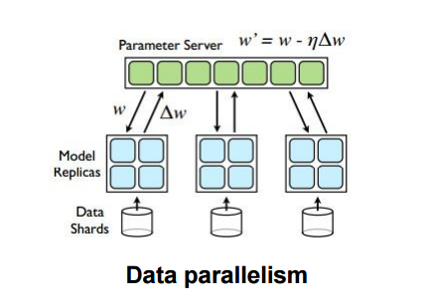
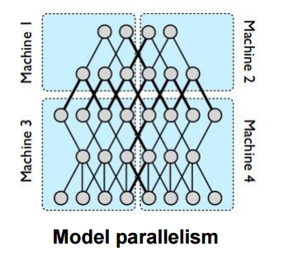
TRAINING –fastest is in cloud (distributed computing)

Slide 53
RUNTIME: Program to Use Trained CNN (TensorFlow)
Supports: Python, Java, Go, Android and more
Can use as a service from cloud or run inside client

Slide 54
Special Purpose Hardware - GPUs
Nvidia (chip manufacturer) has TESLA chip
Build your own special purpose on board RUNTIME hardware (embedded system)

Slide 55
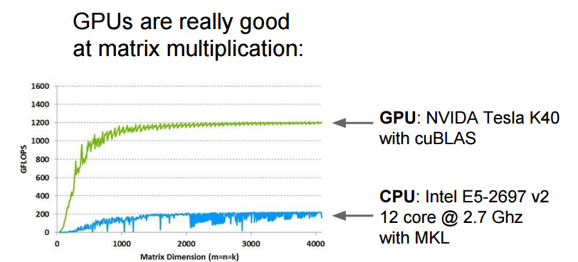
GPUs faster at Matrix calculations (apply filter) than CPU

Slide 56
Intel wants to compete with Nvidia

Slide 57
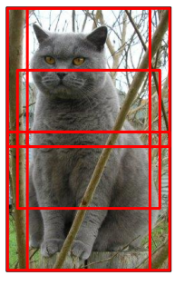
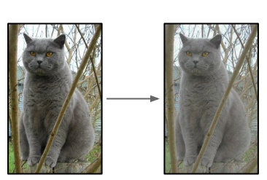
Special Note about “Artificially” increasing amount of training data
Can take random croppings or selections of original training data
Can alter image (example shown –alter contrast)

Slide 58
Get started????
Look at tutorials on Google TensorFlow site
Do small example they show on your own machine (could take hours to train)
Next – move to cloud (more time to learn and may cost $)

Slide 59
Special Note
There are a number of variations to CNN
Example – stride = don’t apply convolution mask at each pixel skip every X pixels. Will reduce size of output

Slide 60
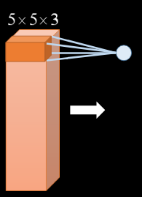
Special Note – Filters are 3D
You can apply your filter –say on the original input 64x64x3 (where 3 is red, green, blue) to be say a 5x5x3 filter (a spacial filter 5x5 in full depth 3 channels)
This can be true at ANY layer –can be 3D take in multiple results (depth)

Slide 61
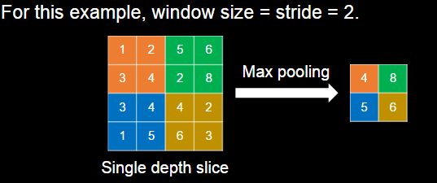
In Max Pooling: have concep t of stride
This is the way we had before to reduce size

Slide 62
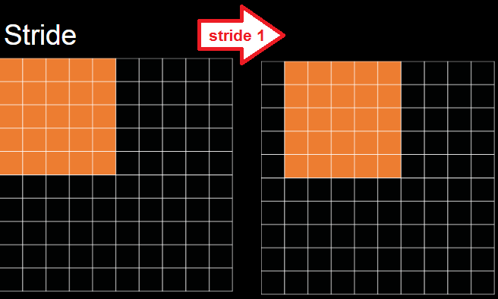
Special Note- Stride NOW in Convolution filter process
we can choose to apply our filter not at every pixel but, skip
Past example shows stride = 1 meaning apply at every pixel (this is what we did before)

Slide 63
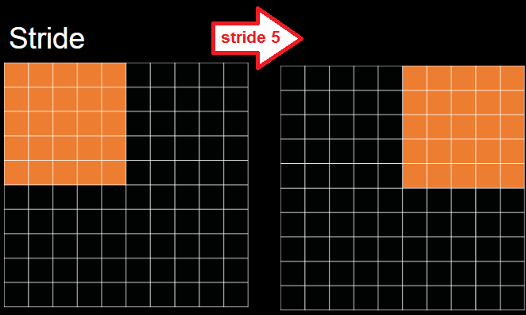
Special Note- Stride of 5
Stride of 5 (skip 5 pixels to apply filter next)
INPUT NxN, MASK MxM
Output length = (N-M)/stride + 1 = (10-5)/5 + 1 = 2 Output size = Output length x Output length = 2x2
OUTPUT
2x2

Slide 64
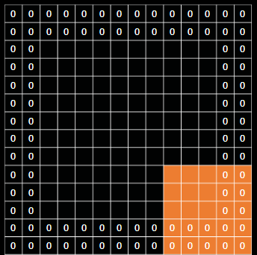
Special note- border and filtering
Pad with 0s (size of output does not change –still function of input, filter and stride sizes)

Slide 65
Special Note and Overfitting
Problem in all NN including CNN
Dropout = technique to help stop overfitting to training data
Set to zero the output of each hidden neuron with probability 0.5.
The neurons which are “dropped out” in this way do not contribute to the forward pass and do not participate in backpropagation.
This technique reduces complex co-adaptations of neurons, since a neuron cannot rely on the presence of particular other neurons.
You might choose to do this only on some of the convolution layers (maybe early on)

Slide 66
History
A reflection --- CNN is not new

Slide 67
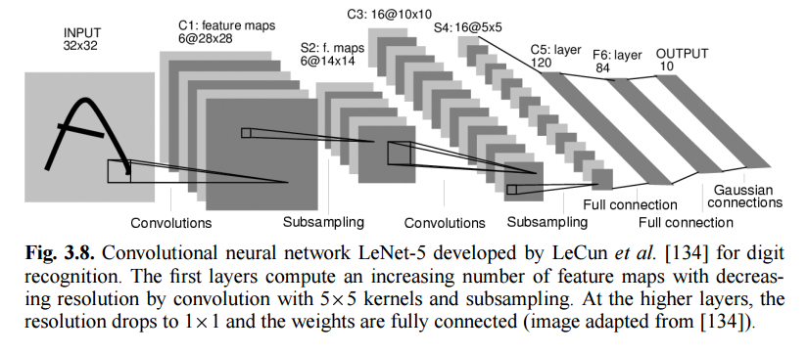
Some History to reflect on
The concept of learning Convolution mask and fully connected NN layers that make one network comes from 1998 paper by Y. LeCun

Slide 68
Deep learning and term CNN start
Results –hmmm On the test data, top-1 and top-5 error rates of 37.5% and 17.0% which is considerably better than the previous state-of-the-art at that time
They went “deeper” –
more layers (“7 layers” versus “4”)
Number of filters larger
Larger data sets (1.2 million images)
used GPUs to handle computation
2012 A. Geoffrey Hinton….
“ImageNet Classification with Deep Convolutional Neural Networks “
Shows success on bigger data sets, makes filters 3D (spacial + multichannel/depth)

Slide 69
Deep learning and term CNN start
Layer 1 : 224×224×3 input image with 96 masks of size 11×11×3 with stride of 4 (skip window placement every 4) → output 55x55x 96
Output size = (Original_Size –Mask_size)/Stride + 1
= (224-11)/4 + 1 = 213/4 + 1 = 54 + 1 = 55
**apply max pooling in depth** → 55x55x48

Slide 70
Deep learning and term CNN start
Layer 2: input = 55x55 x 48
convolution with 256 masks of size 5x5x48
→ output 51x51x256 (output length = (55-5)/1 + 1 =51 )
max pooled to output 27x27x128 and also applied nonlienar
(output length from max pooling = 51/2 +1 =26 +1 =27 output depth = 256/2 = 128)

Slide 71
Deep learning and term CNN start
Layer 3 :384 kernels of size 3 × 3 × 256 connected to the (normalized, pooled)
output length = (27-3)/1 + 1 = 25
after max pooling output length = (25/2) = 13 output depth =384/2=192
→ output = 13x13x192

Slide 72
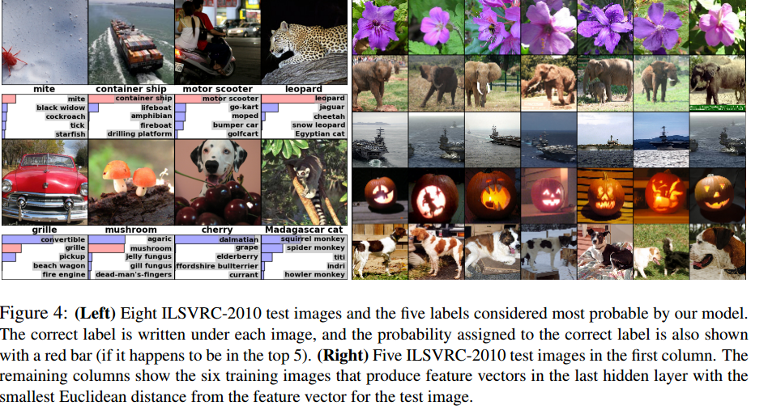
Hinton results
Results –hmmm On the test data, top-1 and top-5 error rates of 37.5% and 17.0% which is considerably better than the previous state-of-the-art at that time

Slide 73
AlexNet -Hinton main points
Deeper&Bigger
Trained ImageNet data, eventually 15 million annotated images from a total of over 22,000 categories.
Used ReLU for the nonlinearity functions (Found to decrease training time as ReLUs are several times faster than the conventional tanh function).
Used data augmentation techniques that consisted of image translations, horizontal reflections, and patch extractions.
Implemented dropout layers in order to combat the problem of overfitting to the training data.
Trained the model using batch stochastic gradient descent, with specific values for momentum and weight decay.
Trained on two GTX 580 GPUs for five to six days.

Slide 74
Next up- ZF Net
similar architecture to AlexNet, except for a few minor modifications.
trained on only 1.3 million images.
11.2% error rate in its reduced domain
Instead of using 11x11 sized filters in the first layer (which is what AlexNet implemented), ZF Net used filters of size 7x7 and a decreased stride value. The reasoning behind this modification is that a smaller filter size in the first conv layer helps retain a lot of original pixel information in the input volume. A filtering of size 11x11 proved to be skipping a lot of relevant information, especially as this is the first conv layer.
As the network grows, we also see a rise in the number of filters used.
Used ReLUs for their activation functions, cross-entropy loss for the error function, and trained using batch stochastic gradient descent.
Trained on a GTX 580 GPU for twelve days.
Developed a visualization technique named Deconvolutional Network, which helps to examine different feature activations and their relation to the input space. Called “deconvnet” because it maps features to pixels (the opposite of what a convolutional layer does).

Slide 75
Next up-VGG Net
Simpler and smaller filters - 19 layer CNN that strictly used 3x3 filters with stride and pad of 1, along with 2x2 maxpooling layers with stride 2
Worked well on both image classification and localization tasks.
trained on 4 Nvidia Titan Black GPUs for two to three weeks.
7.3% error rate

Slide 76
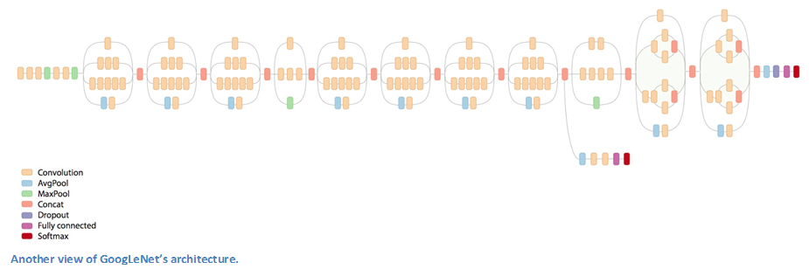
Next -- GoogLeNet
22 layer CNN (separating convoluting and pooling and activation/nonlinear)
a top 5 error rate of 6.7%
first CNN architectures that really strayed from the general approach of simply stacking conv and pooling layers on top of each other in a sequential structure

Slide 77
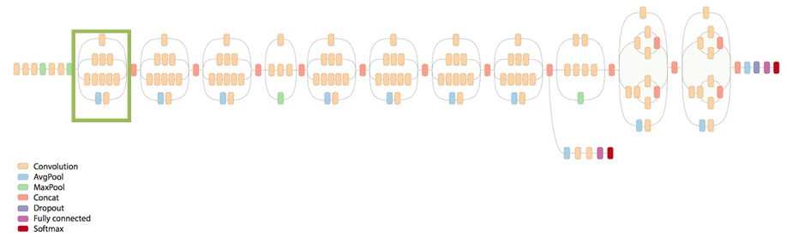
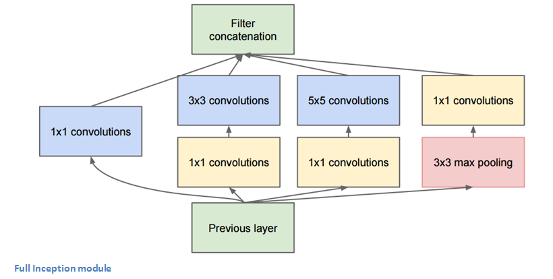
GoogLeNet -non sequential Inception model
strayed from the general approach of simply stacking conv and pooling layers on top of each other in a sequential structure
OUTPUT
NOT
Sequential
INPUT

Slide 78
GoogLeNet
Used 9 Inception modules in the whole architecture, with over 100 layers in total! Now that is deep…
No use of fully connected layers! They use an average pool instead, to go from a 7x7x1024 volume to a 1x1x1024 volume. This saves a huge number of parameters.
Uses 12x fewer parameters than AlexNet.
During testing, multiple crops of the same image were created, fed into the network, and the softmax probabilities were averaged to give us the final solution.
Trained on “a few high-end GPUs within a week”.

Slide 79
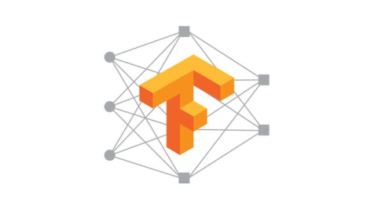
TensorFlow
Google released 2016 open source Machine Learning framework
Features GoogleNet CNN technology (can have different architectures of CNNs)
Languages: Python and C++ and now Java, Go (but, level of support unclear)
New Languages: new support for higher level front-end language like Keras (python based)
Other ML: Adding other Machine Learning algorithms: K-Means, Support Vector Machines, Random Forest, etc.
Train on your own machineS (gpus) or cloud
Run on any device (mobile/embedded, machines, special purpose GPUs) or run on service in cloud

Slide 80
XLA:
Experimental TensorFlow Compiler

Slide 81
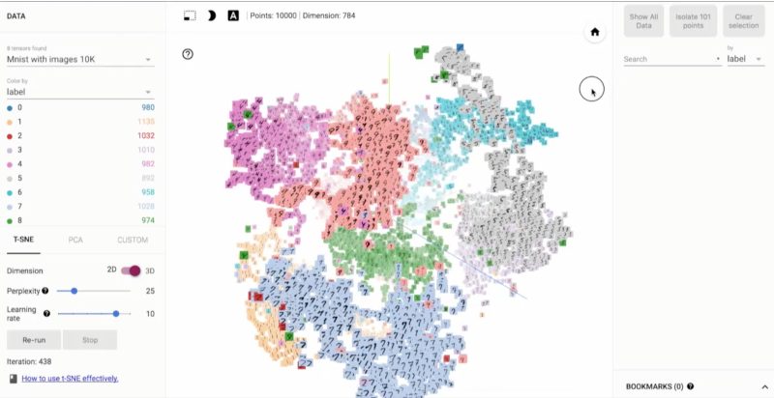
And much more since them….
Even tools like for TensorFlow there is TensorBoard:
Visualizer: visualize your TensorFlow graph
operates by reading TensorFlow events files, which contain summary data that you can generate when running TensorFlow
https://www.tensorflow.org/images/embedding-mnist.mp4
See your tensor flow graph

Slide 82
So why almost 20 years later?
High performance distributed computing / cloud makes it work with larger networks and LOTs of data → enter 2015 Google TensorFlow
Special hardware for deployment beyond cloud CPUs.
Still can take weeks to train one CNN for big problems
Good accuracies for constrained problems

