Slide 1
Attention w/ RNNs to → Vision Transformers

Slide 2
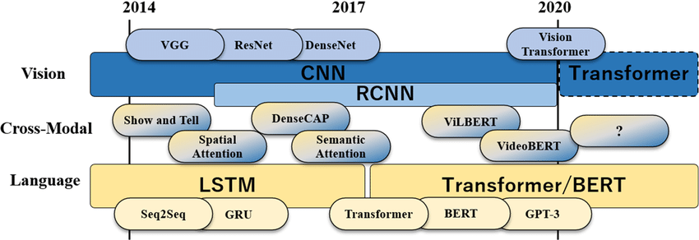
A timeline

Slide 3
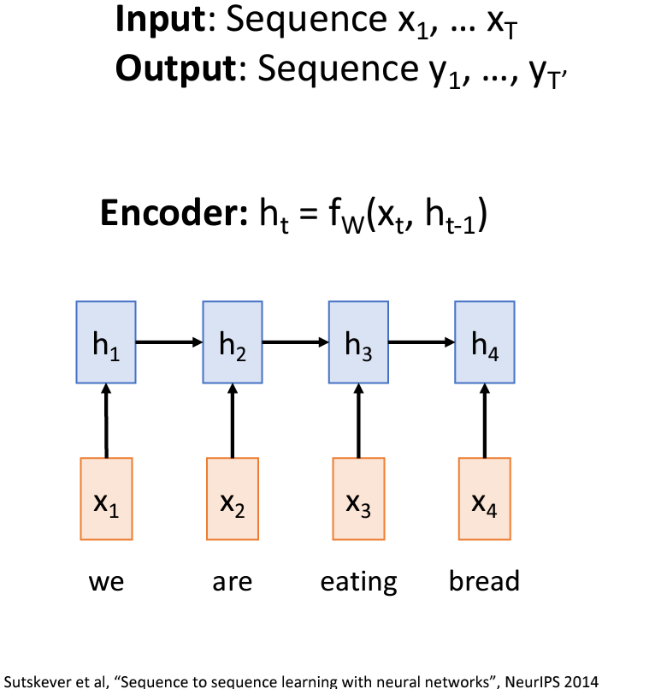
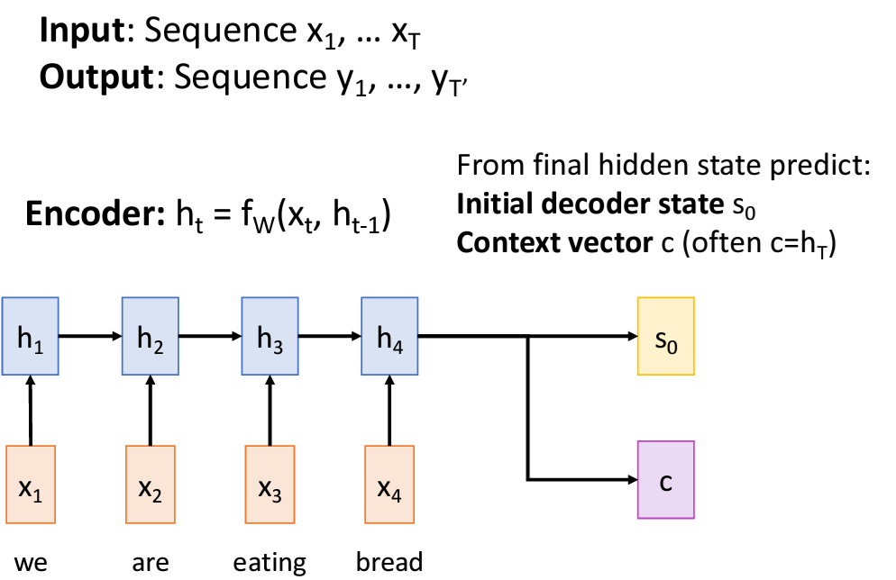
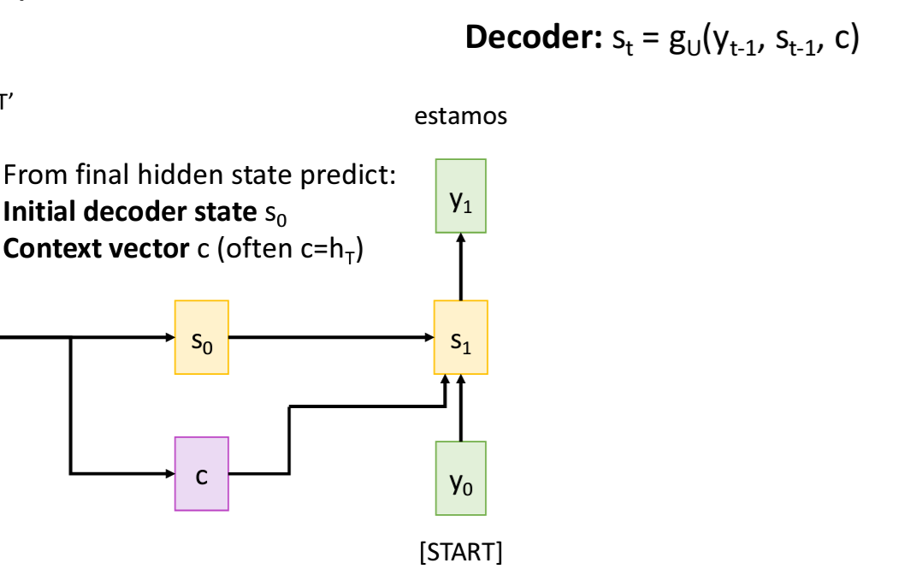
Look at how NLP translation (English to Spanish) might work with RNNs prior to Attention or Transformers
Step 1 – input sequence
Step 2 – create initial decoder state, calculate context vector c
Step 3 – decoder calculate first sequence word (estamos)

Slide 4
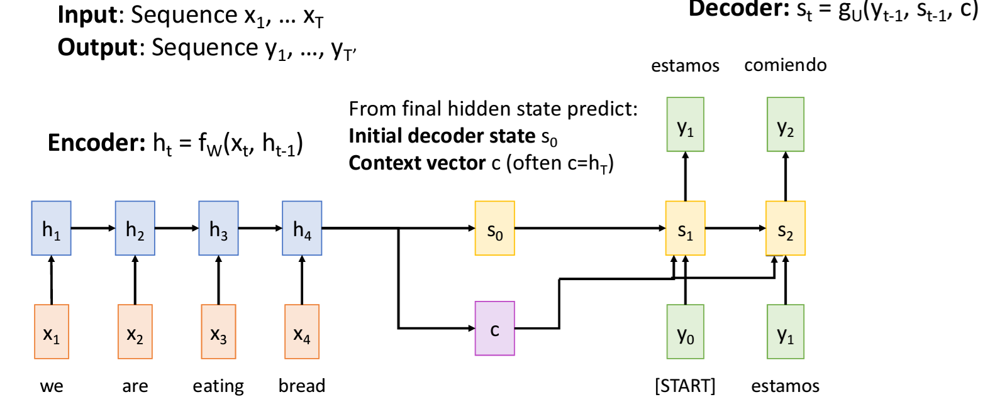
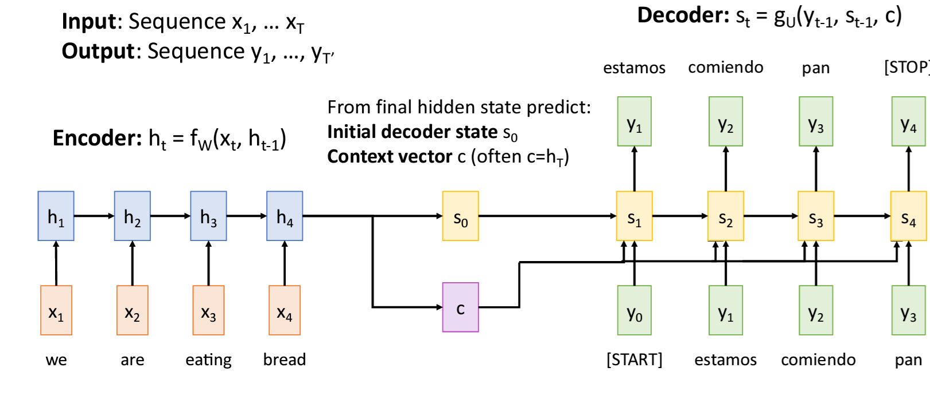
Lets look at how NLP translation (English to Spanish) might work with RNNs prior to Attention or Transformers
Step 4 – decoder calculate 2nd sequence word (comieno)
Step 6 – end of sequence determined

Slide 5
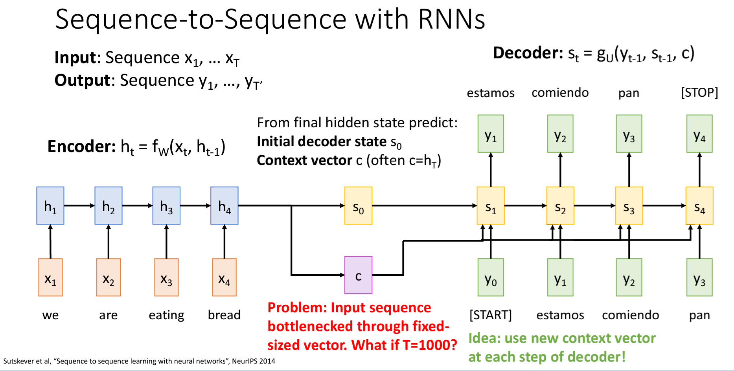
Leading to Transformers –the introduction of Attention
What is the problem (the origin):
The idea- Encoder: Processes the input sequence (e.g., a sentence in the source language) and compresses it into a fixed-size context vector. Decoder: Uses this context vector to generate the output sequence (e.g., a sentence in the target language).
PROBLEM- main issue is the context vector bottleneck. This bottleneck arises because the entire input sequence must be condensed into a single, fixed-size vector (the context vector), regardless of the length or complexity of the input. As a result, crucial information can be lost, especially for long or complex sentences. This limitation hampers the model’s ability to capture and retain important details, leading to suboptimal performance.

Slide 6
Leading to Transformers –the introduction of Attention
A SOLUTION → introduction of Attention:
The idea- The attention mechanism mitigates the context vector bottleneck by allowing the model to dynamically access different parts of the input sequence during the generation of each output element. Instead of relying on a single fixed-size context vector, the attention mechanism computes a weighted combination of all the encoder’s hidden states. This weighted sum acts as the context for each output step, enabling the model to focus on the most relevant parts of the input sequence.
Bahdanau-Attention : Bahdanau, Cho, and Bengio (2014)

Slide 7
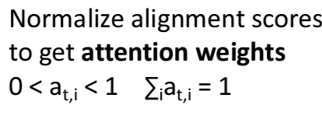

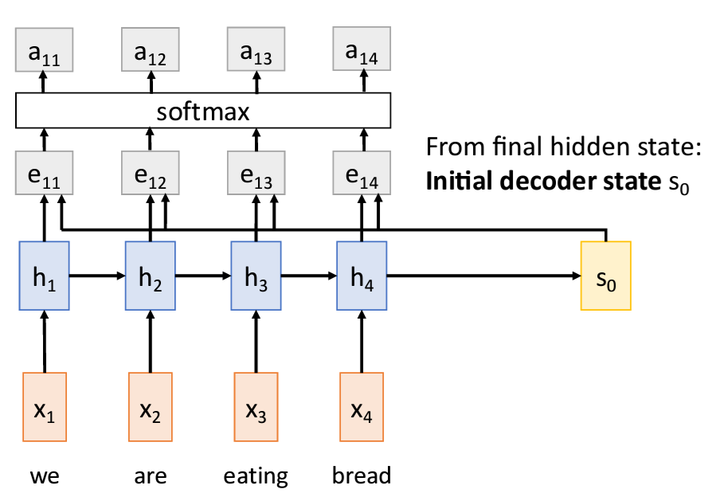
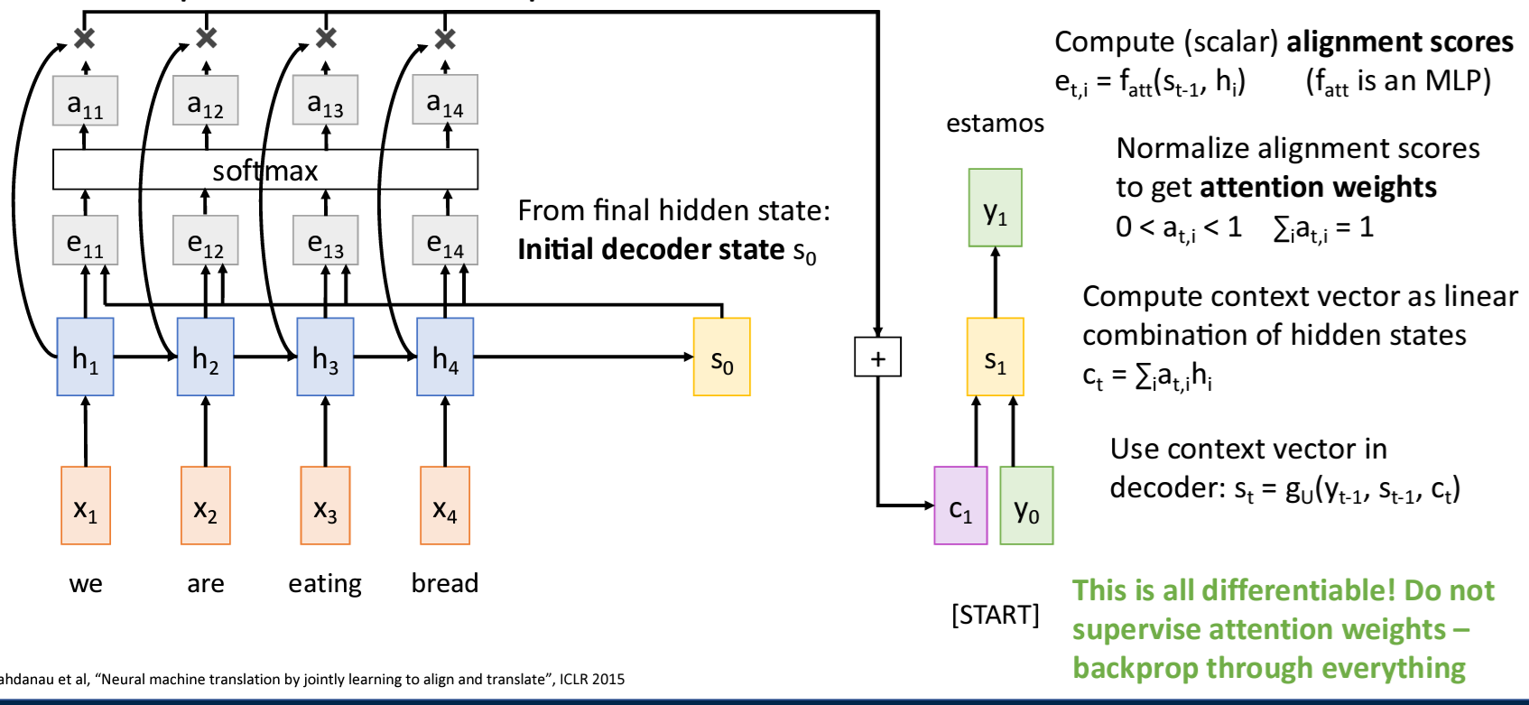
Bahdanau-Attention
Everything is learned
Attention changes the context vector c that a decoder uses for translation from a fixed length vector c of a sequence of hidden states h₁,…,h_{T} to a sequence of context vectors c_{i}.
There are a number of attention mechanism algorithms
Step 2 – attention weights = normalized alignment scores
Step 3 – compute 1st context vector c₁
As a linear sum of hidden states weighted by attention weights
Step 1 – compute alignment scores
This context vector lets the attention weights determine the importance of
each hidden state (corresponding to an input sequence element)

Slide 8
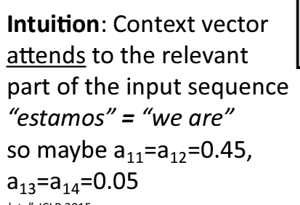
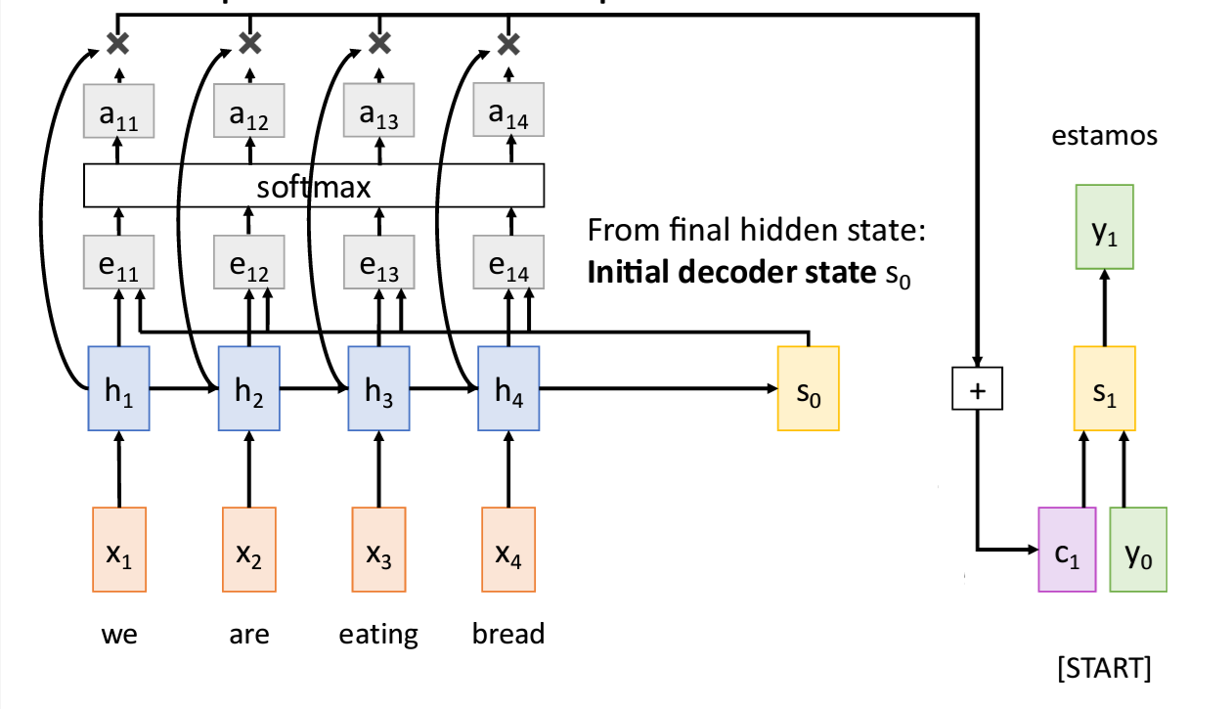
Bahdanau-Attention
Everything is learned
Attention changes the context vector c that a decoder uses for translation from a fixed length vector c of a sequence of hidden states h₁,…,h_{T} to a sequence of context vectors c_{i}.
Step4 – generate output y₁
- A function of previous s₁ which is a function of the context vector c₁ and previous output sequence element y₀ [start]
This context vector lets the attention weights determine the importance of
each hidden state (corresponding to an input sequence element)
c₁ = a₁₁h₁ + a₁₂h₂ + a₁₃h₃ + a₁₄h₄

Slide 9
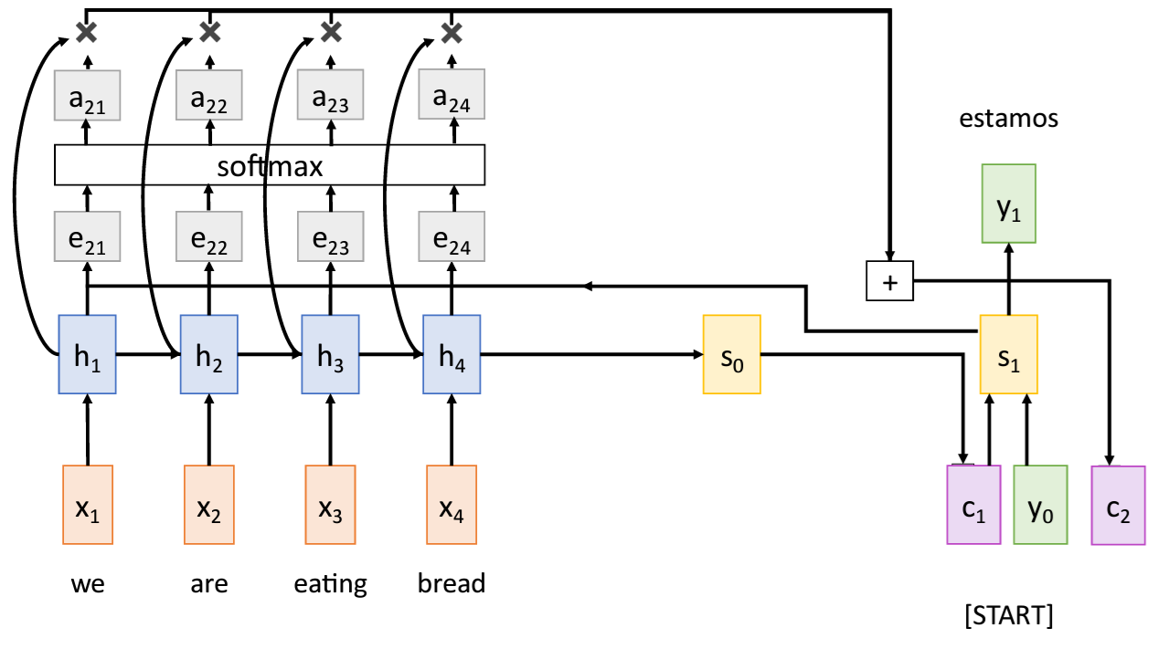
Bahdanau-Attention
Everything is learned
Attention changes the context vector c that a decoder uses for translation from a fixed length vector c of a sequence of hidden states h₁,…,h_{T} to a sequence of context vectors c_{i}.
Step 5 – compute c₂
- A function of new a_{2x} attention weights again.
c₂ = a₂₁h₁ + a₂₂h₂ + a₂₃h₃ + a₂₄h₄

Slide 10
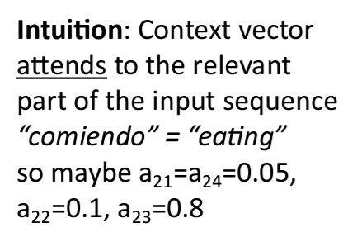
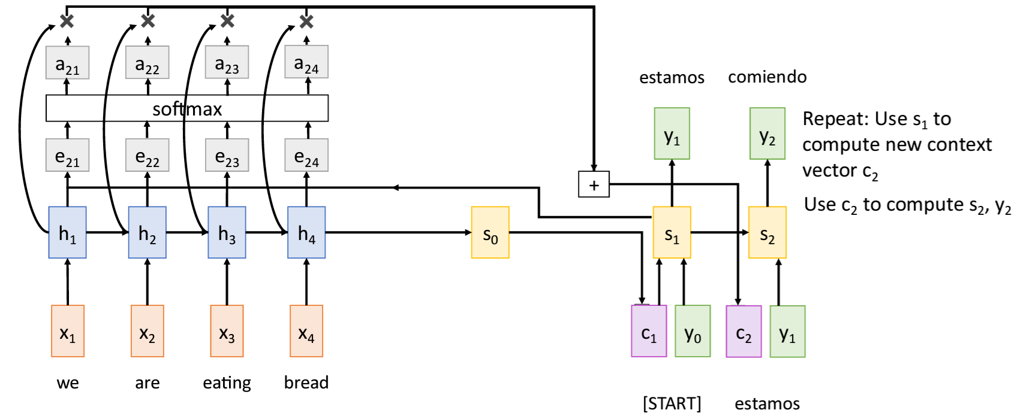
Bahdanau-Attention
Step6 – generate output y₂
- A function of s₂ which is a function of the context vector c₂ and previous output sequence element y₁ [estamos]
This context vector lets the attention weights determine the importance of
each hidden state (corresponding to an input sequence element)
c₂ = a₂₁h₁ + a₂₂h₂ + a₂₃h₃ + a₂₄h₄
= 0.05h₁ + 0.1h₂ + 0.8h₃ + 0.05h₄

Slide 11
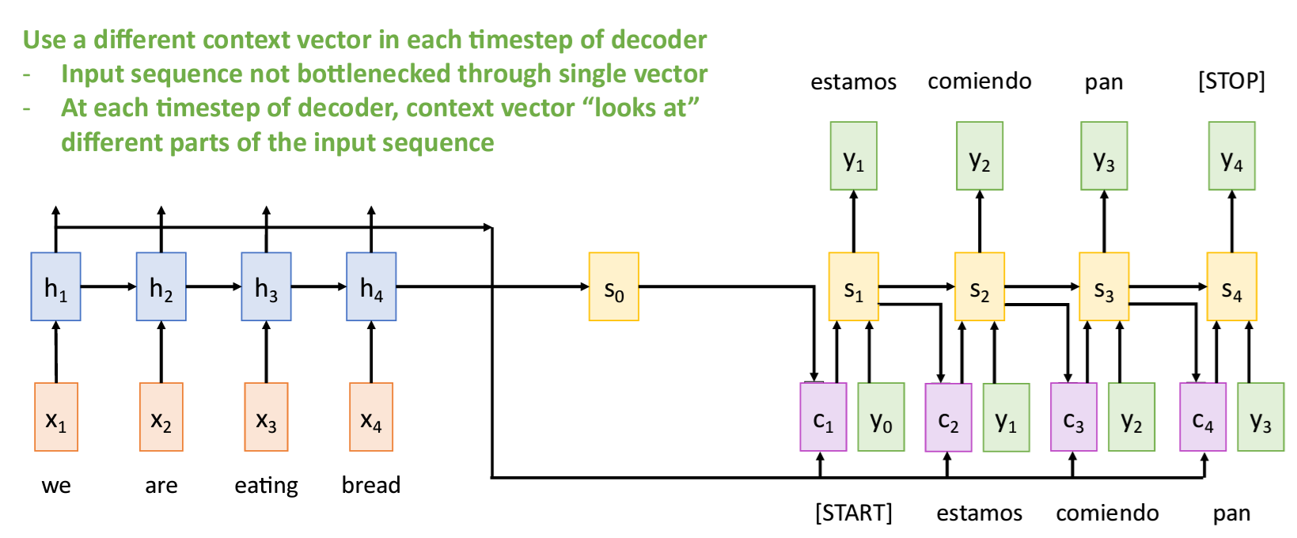
Bahdanau-Attention
Step9 – generate last element of output y₄
- A function of s₄ which is a function of the context vector c₄ and previous output sequence element y₃ [pan]
s₄ = f(c₄ , y₃)
= f(c₄ , pan)

Slide 12
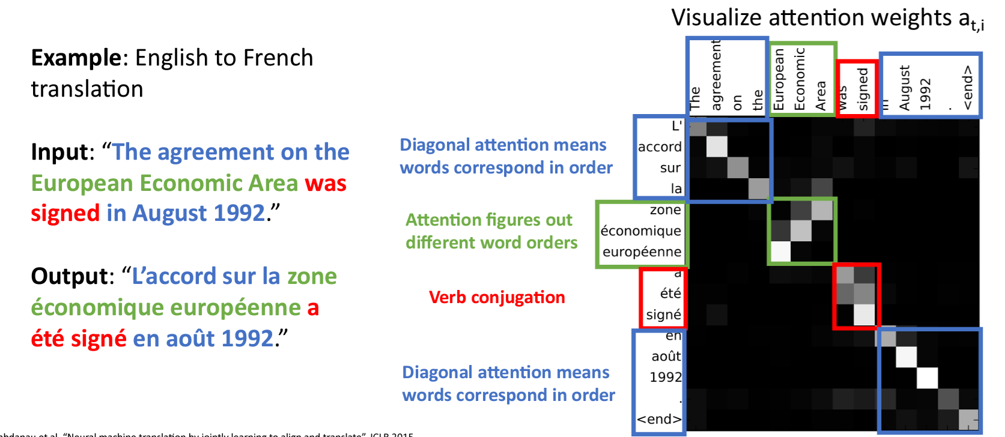
An example and some “visualization” of Attention weights

Slide 13
RNN w/ Attention for Images
Lets look at this → Xu, et. al. “Show, Attend and Tell: Neural Image Caption Generation with Visual Attention” [2016]

Slide 14
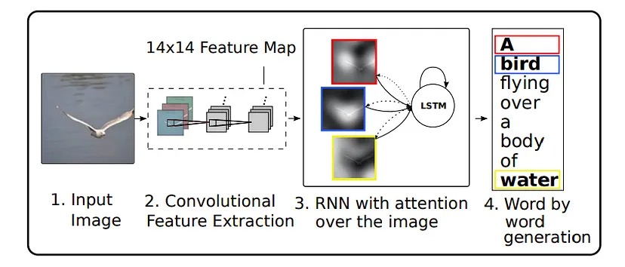
RNN w/ Attention –similar concept except notice the CNN(feature extractor is used to create “vision input encoding/embeddings” for IMAGE CAPTIONING

Slide 15

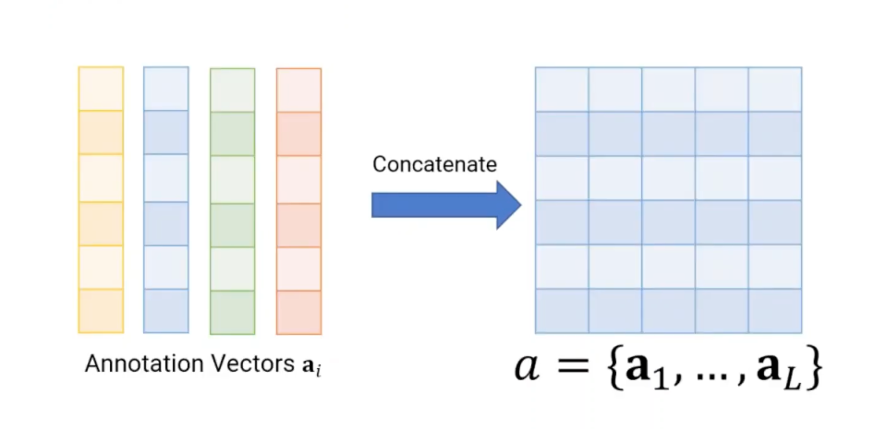
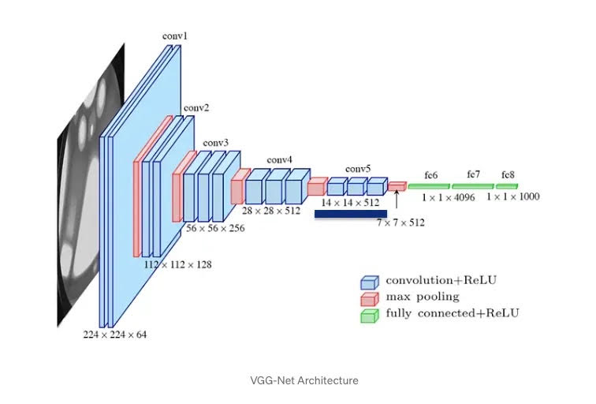
The Encoding part of Show,
Attend + Tell
Uses the “early” stage CNN layers
(before fully connected layers) to create a series of L feature vectors (called annotation vectors)
Uses VGG CNN (could be any general CNN model)
e.g.: the 14×14×512 feature map of the
fourth convolutional layer before max
pooling in ImageNet-Pretrained VGGNet is used.
used the single last (top) layer of the CNN as input to RNNs for
Image captioning

Slide 16

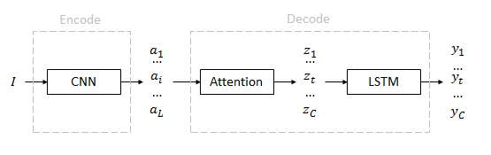

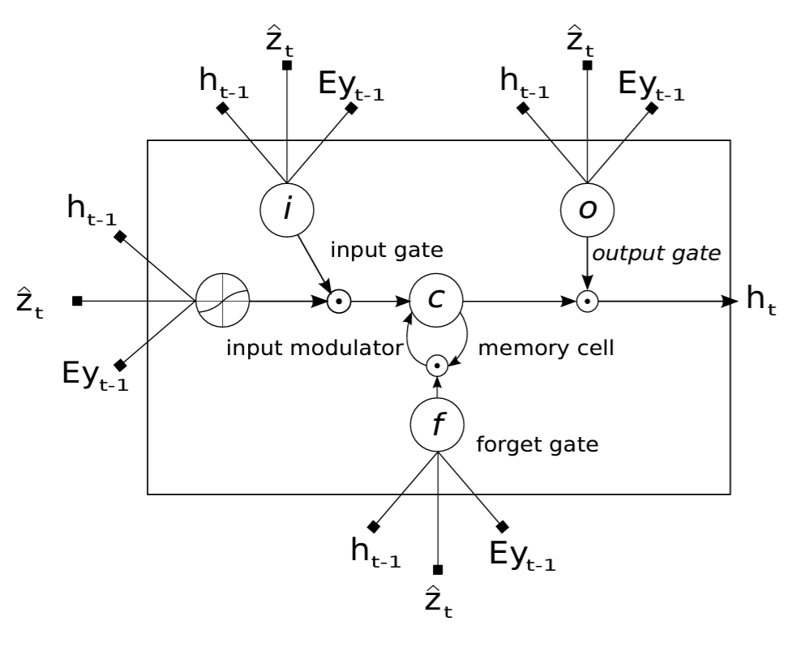
The Decoder w/ Attention of
Show, Attend + Tell
RNN = LSTM model
LSTM cell
a_{i} are annotation vectors where i=1,...,L
Corresponding to the features extracted
at different image locations.
z_{t} is the context vector and is a function of a_{i}
and (which is an attention weight)
z_{t} is the context vector at step/time t in sequence
i_{t} is the input
h_{t} is the hidden state at t
f_{t} is the forget gate
c_{t} is the memory
o_{t} is the output
E is the embedding matrix

Slide 17
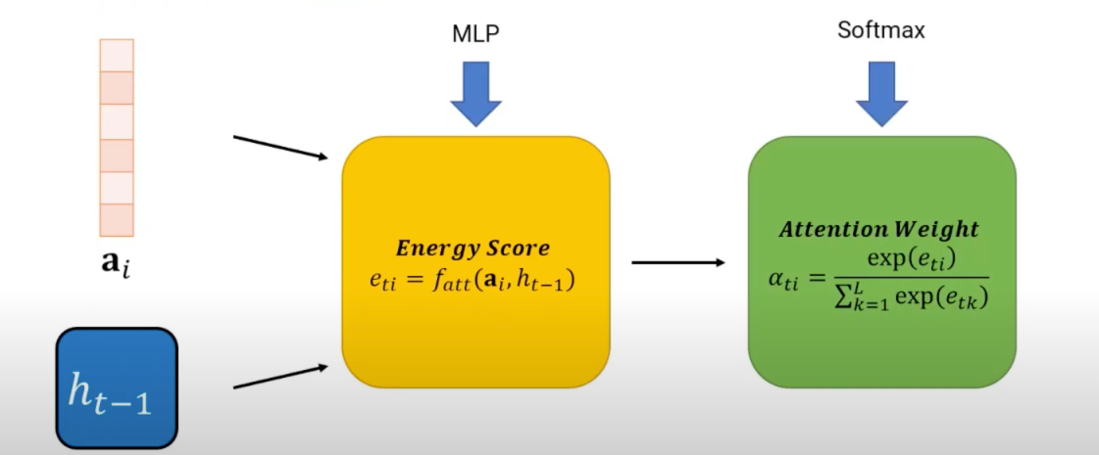
The Decoder w/ Attention
Attention weights are calculated using
an attention model which is a MLP (multi-layer perceptron, i.e. 3 layers) f_{att}
which is learned during training and is a function of energy scores e_{ti} which are a function of the input (annotation vectors a_{i} )and hidden states h_{i} of RNN

Slide 18
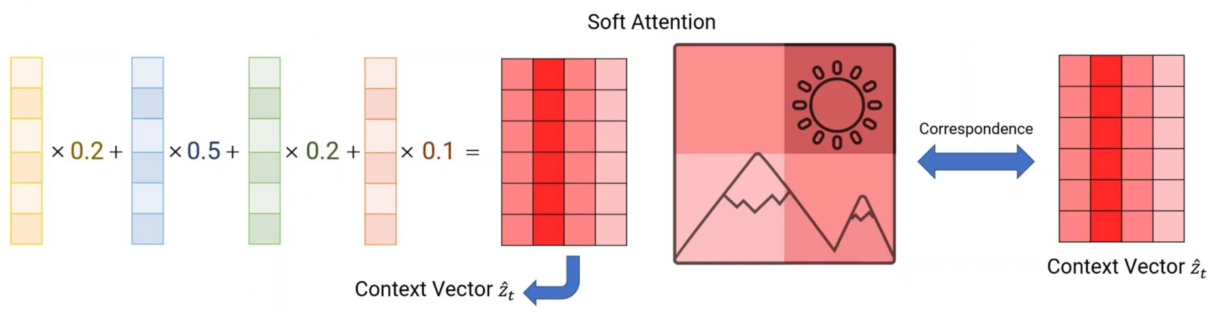
The Decoder w/ Attention
2 Different Attention Models
Soft = weighted sum of annotation vectors (input), weighted by the attention weights → this is Bahdanau Attention we saw before
a_{i} are annotation vectors where i=1,...,L
Corresponding to the features extracted
at different image locations.
z_{t} is the context vector and is a function of a_{i}
and (which is an attention weight)

Slide 19
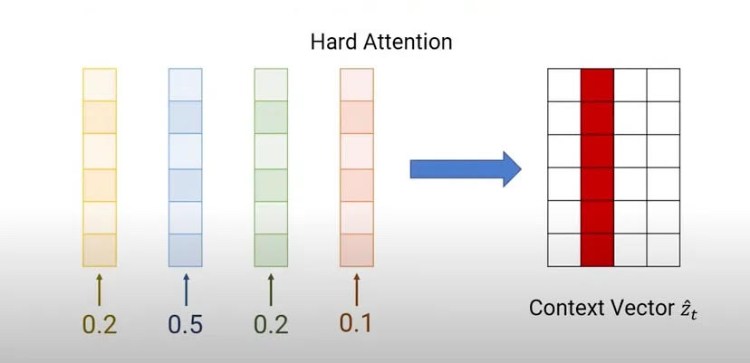
The Decoder w/ Attention
2 Different Attention Models
Hard = select the annotation vector with the maximum attention weight
a_{i} are annotation vectors where i=1,...,L
Corresponding to the features extracted
at different image locations.
z_{t} is the context vector and is a function of a_{i}
and (which is an attention weight)

Slide 20
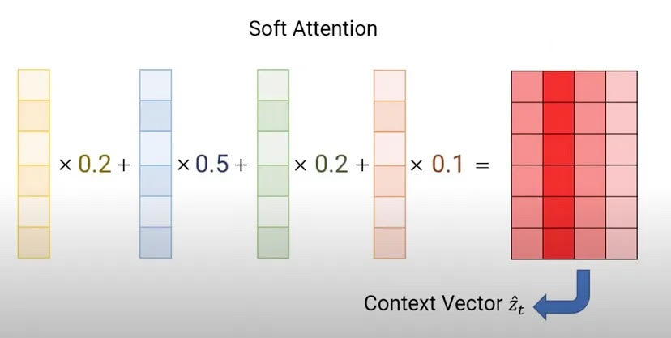
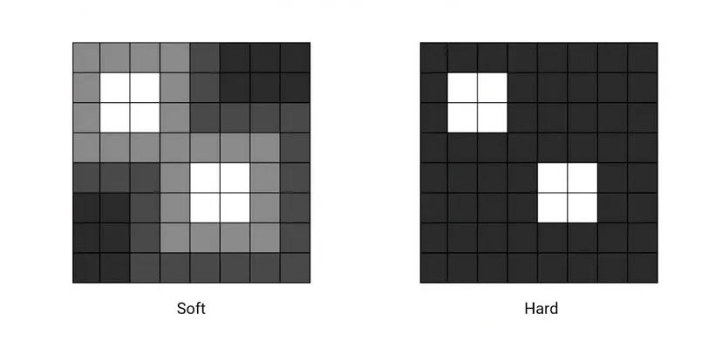
SOFT vs HARD Attention
Soft = weighted sum of annotation vectors, weighted by the
attention weights → this is Bahdanau Attention we saw before
Hard = pick annotation vector with max attention weight
a_{i} are annotation vectors where i=1,...,L
Corresponding to the features extracted
at different image locations.
z_{t} is the context vector and is a function of a_{i}
and (which is an attention weight)

Slide 21
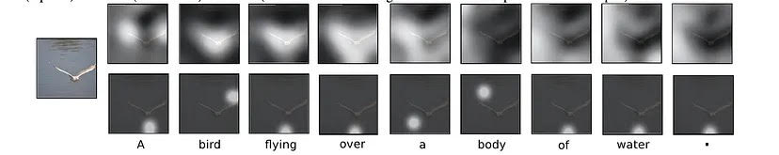
Visualization SOFT vs HARD Attention
Soft = weighted sum of annotation vectors, weighted by the
attention weights → this is Bahdanau Attention we saw before
Hard = pick annotation vector with max attention weight
SOFT
HARD

Slide 22
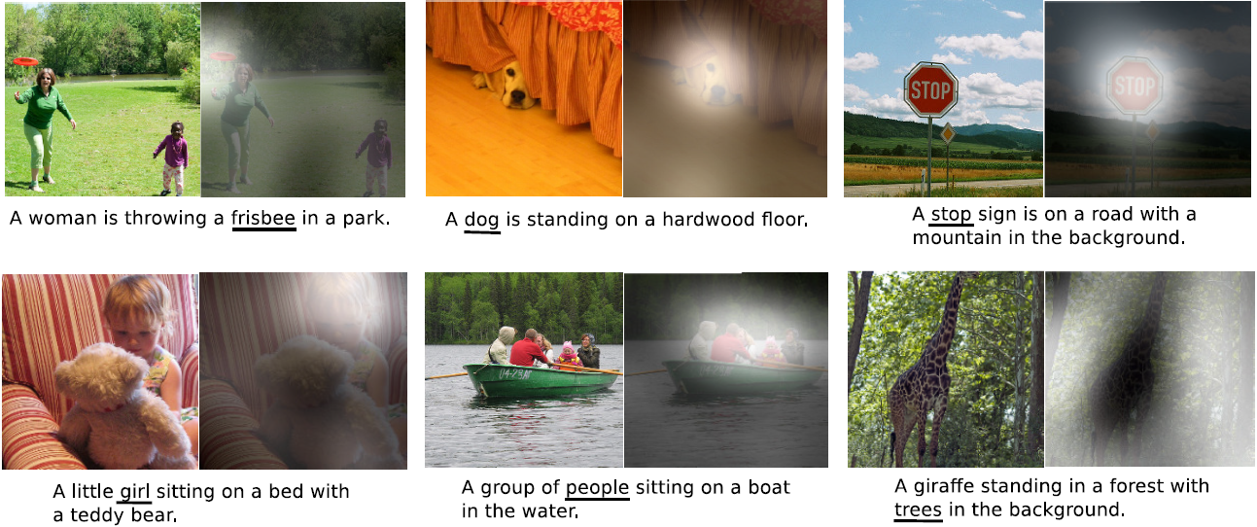
RESULTS –Show,Attend +Tell

Slide 23
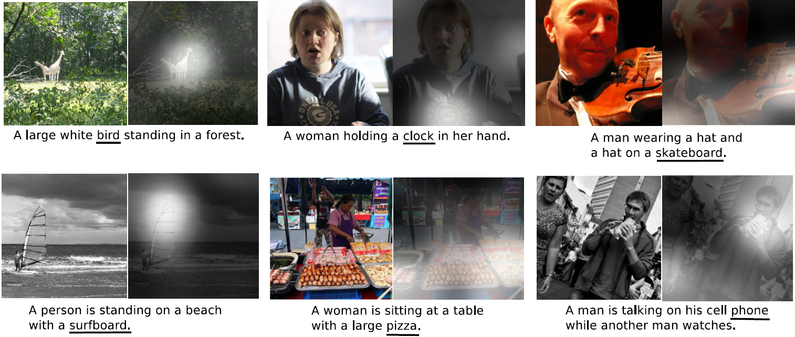
RESULTS –Show,Attend +Tell → errors

Slide 24
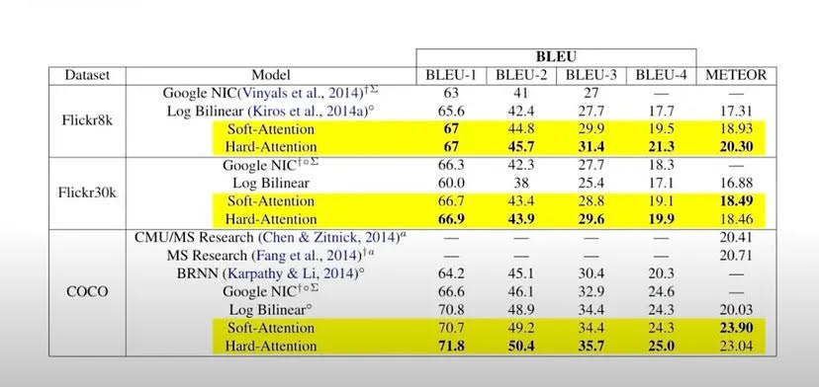
Results of Show, Attend + Tell
Bilingual Evaluation Understudy (BLEU) score = metric used to evaluate the similarity between a machine-translated text and a reference translation.
The score is a number between 0 and 1, with higher scores indicating greater similarity

Slide 25
Now what is transformer –did you know Google wanted to call it an “Attention Network” rather than Transformer early on
Transformers are neural networks consisting of an encoder-decoder architecture with self-attention mechanisms.
Some similarities to RNN w/ Attention as is based on the attention mechanism proposed in 2014 by Bahdanau et al and has encoder/decoder
“Attention is All you Need” , Google [2017] → The Transformer Architecture

Slide 26
Transformers in NLP
Transformers are highly effective for tasks like language translation, text generation, etc, due to their efficient capture of long-range dependencies in data
Introduced by Google in 2017 paper.
2021 Stanford calls transformer NLP models , “foundational models” as it is a “foundational” shift in NLP.
Vision: Transformers can process images for tasks like image captioning, object detection,
and even generating art.

Slide 27
Transformers introduced in NLP in late 201Xs
transformers, which are a deep learning component that attends over an entire sequence in parallel in contrast to the sequential dependencies of RNNs. This enables much larger data sets to be analyzed and models to be trained more quickly. Transformers process words in relation to all the other words in a sentence at once rather than individually, using attention mechanisms to gather information about the relevant context of a word and encoding that context in a rich vector that represents it. The model learns how a given word’s meaning is derived from every other word in the segment.

Slide 28
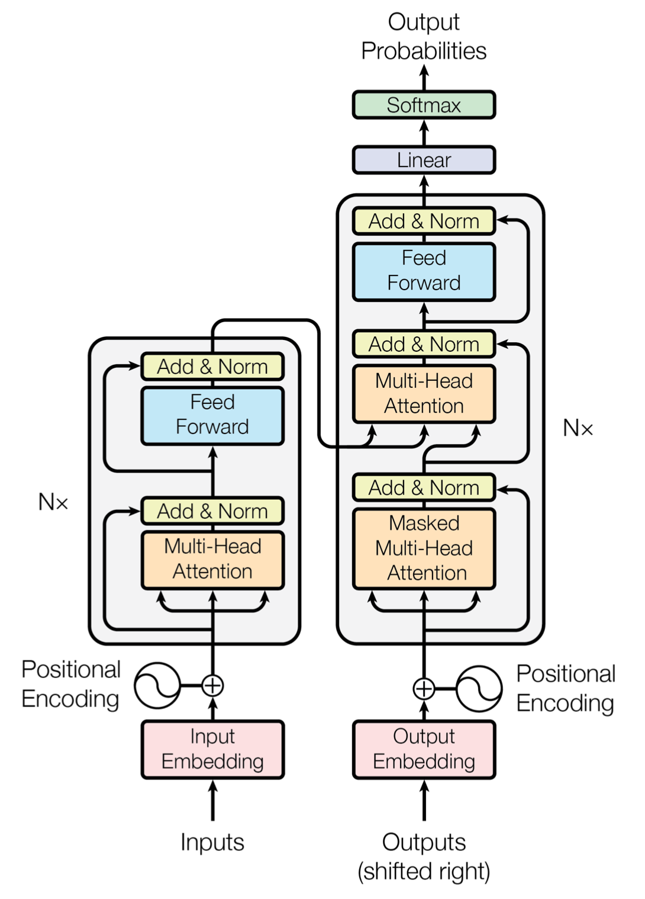
Original Concept (encoder/decoder like seen before)
decoder
Encoder/Decoder = encoder (on the left) processes the input sequence and generates a hidden representation summarizes the input information. The decoder (on the right) uses this hidden representation to generate the desired output sequence. The encoder and decoder are trained end-to-end to maximize the likelihood of the correct output sequence given the input sequence.
Input Embedding = Input sequences are transformed into numerical embeddings, which capture the semantic meaning of words or tokens.
Positional Encoding – keep track of order of words coming in sequence
Multi-Head Attention – can run in parallel each part of the sequence
encoder
ENCODER = takes input data (such as a sentence in English) and transform it into a higher, more abstract representation- that captures the semantic and syntactic properties of input data.
DECODER = takes this encoded data and generates the output (such as a translated sentence in French). Uses a mechanism called attention, which allows it to focus on different parts of the input when generating each part of the output.

Slide 29
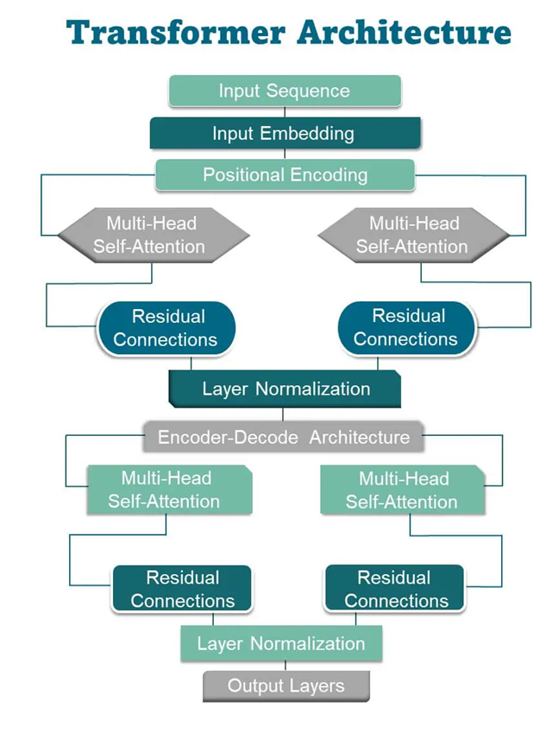
Transformer Concepts
Input Embedding: Input sequences are transformed into numerical embeddings, which capture the semantic meaning of words or tokens. These embeddings serve as model’s input.
Positional Encoding: Positional encoding is added to the input embeddings to account for the order of words in a sequence
Multi-Head Self-Attention: Self-attention mechanisms assign importance to different words in the input sequence, improving prediction accuracy. The “multi-head” aspect involves performing self-attention multiple times in parallel, enabling the model to focus on different parts of the input simultaneously.
Position-wise Feed-Forward Networks: After self-attention mechanism, position-wise feed-forward networks are applied independently to each position in the sequence.
Residual Connections: Residual connections, inspired by the ResNet architecture, help mitigate the vanishing gradient problem during training. They involve adding the input embeddings to the output of the multi-head self-attention and feed-forward network layers.
Layer Normalization: Layer normalization is used to stabilize training by normalizing the output of each layer
Encoder-Decoder Architecture (Optional): Transformers use an encoder-decoder architecture in sequence-to-sequence tasks, such as machine translation. The encoder processes the input sequence while the decoder generates the output sequence. The encoder’s final hidden state is used to initialize the decoder.
Output Layers: Different output layers can be added depending on the specific task. For example, a softmax layer is used to predict the next word in a sequence in language modeling.
Don't you love 🤗 Transformers? We sure do. →
["▁Don", "'", "t", "▁you", "▁love", "▁", "🤗", "▁", "Transform", "ers", "?", "▁We", "▁sure", "▁do", "."]

Slide 30
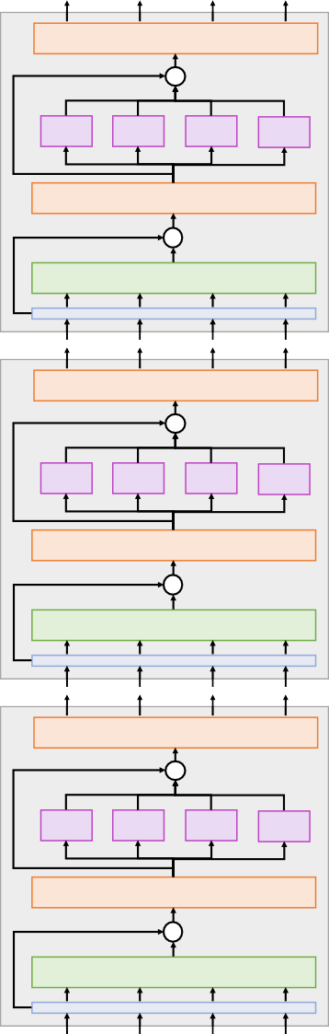
Transformer
Layer Normalization
+
MLP MLP MLP MLP
Layer Normalization
Transformer Block: Input: Set of vectors x Output: Set of vectors y
+
Self-Attention
Layer Normalization
+
MLP MLP MLP MLP
Layer Normalization
+
Self-Attention
Hyperparameters:
Number of blocks
Number of heads per block
Width (channels per head, FFN width)
Layer Normalization
+
MLP MLP MLP MLP
Layer Normalization
+
Self-Attention
Vaswani et al, “Attention is all you need”, NeurIPS 2017

Slide 31
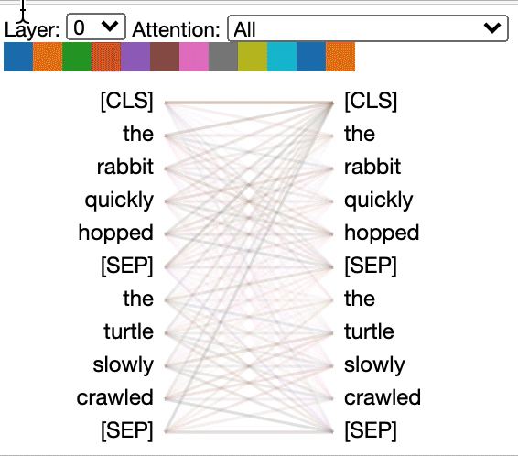
Multi-Head Attention
Just like a person might pay attention to different aspects of a conversation at the same time, multi-head attention allows AI models to focus on multiple parts of the data simultaneously.

Slide 32
Multi-Head Attention
How Multi-Head Attention Works:
Input Representation -> Q,K,V
Multiple Attention Heads
Scaled Dot-Product Attention
Concatenation and Final Linear Layer
Instead of using a single attention mechanism (a single set of weights), multi-head attention divides the attention mechanism into multiple “heads.”
Each head performs its own attention calculation on the input, and then these heads are combined

Slide 33
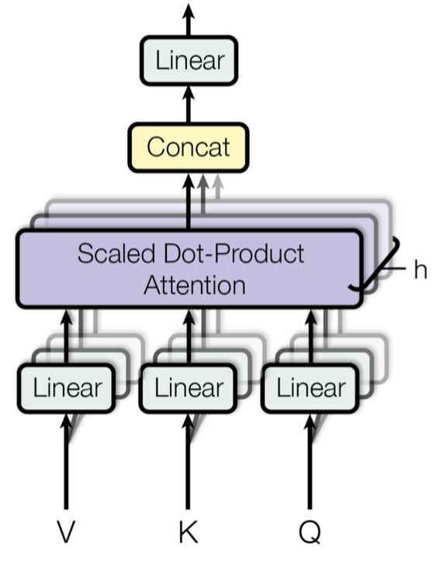
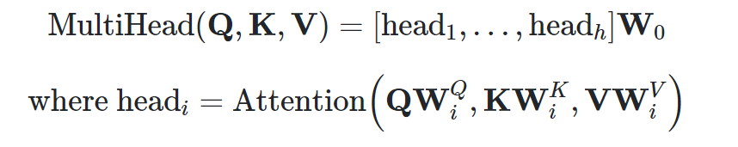
How Multi-Head Attention Works
Input Representation -> Q,K,V (3 matrices)
Multiple Attention Heads
Scaled Dot-Product Attention
Concatenation and Final Linear Layer
where Ws are learned
input is split into multiple subspaces, and each subspace is assigned a separate attention head.
Each attention head applies the attention mechanism independently.
This results in different heads focusing on different parts of the sequence, enabling the model to capture diverse information at various positions in the sequence.
The outputs from all the attention heads are concatenated and passed through a final linear layer to combine the results.

Slide 34
Multi-Head Attention: Input Representation
Input is transformed into three different matrices: Query (Q), Key (K), and Value (V).
These represent different parts of the input, --with
  Q determining what to focus on,
  K being compared with Q to compute relevance
  V holding the actual information we want to retrieve.

Slide 35
Input -> Query, Key and Value
Token Embedding:
  The input text is first tokenized, meaning each word (or subword in some cases) is converted into an integer token. These tokens are then converted into high-dimensional vectors called embeddings. These embeddings capture semantic information about the words.
Position Encoding:
  Since the Transformer does not process the input sequentially like an RNN, positional encodings are added to these embeddings to provide the model with information about the position of each word in the sequence. This ensures that the model knows the order of the words in the sentence. → X is the name embedded sequence
Linear Transformation into Q,K,V
  The embedded input sequence (let’s call it X) is linearly transformed into three different matrices: Query (Q), Key (K), and Value (V).
  This transformation is done by multiplying the input with learned weight matrices:
    Q = X * W_Q
    K = X * W_K
    V = X * W_V
W_Q, W_K, and W_V are different weight matrices (learned parameters) = that map the input embeddings to queries, keys, and values respectively.

Slide 36
EXAMPLE: Input -> Query, Key and Value
Input = "The cat sat on the mat."
Token Embedding:
The input text is tokenized and embedded into vectors, resulting in matrix X.
Suppose we have a 3-word sequence ("The cat sat"). After embedding, it might look like this:
X = [e1, e2, e3] where1, e2, e3 are the word embeddings for "The", "cat", and "sat", respectively.
2. Linear Transformation into Q,K,V
  Q = X * W_Q = [q1, q2, q3]
  K = X * W_K = [k1, k2, k3]
  V = X * W_V = [v1, v2, v3]
    Each vector q, k, v corresponds to different representations of the words.
W_Q, W_K, and W_V are different weight matrices (learned parameters) = that map the input embeddings to queries, keys, and values respectively.

Slide 37
Why Separate Q, K, and V (repeat w/example)
Query (Q): Represents the "question" we are asking. What information do we want to extract?
Key (K): Represents the "database" of potential answers. It defines what each word represents in the context of the sentence.
Value (V): Holds the actual content of the words. Once attention is applied (using Q and K), the result is a weighted sum of the Value vectors, giving us the final output.
Example - input = "The cat sat on the mat."
Let’s say we want to compute attention for the word "sat" (corresponding to q3). The model will:
Compute dot products between q3 and each key vector k1, k2, k3 to determine how relevant each word is to "sat."
Apply a softmax to these results to get attention scores.
Use these attention scores to weight the corresponding Value vectors v1, v2, v3 and sum them to produce the output.

Slide 38
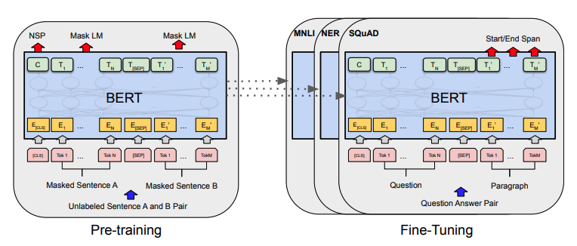
Encoder only
Example BERT
The Encoder-only architecture is used when only encoding the input sequence is required and the decoder is not necessary. Here the input sequence is encoded into a fixed-length representation and then used as input to a classifier or a regressor to make a prediction.
Text classification
Sentiment analysis
Named entity recognition

Slide 39
Decoder only
Example GPT/generative
In the Decoder-only architecture, the model consists of only a decoder, which is trained to predict the next token in a sequence given the previous tokens.
Text completion
Text generation
Translation
Question-Answering
Generating image captions
Example
Chat GPT
The decoder in a GPT model uses a specific type of attention mechanism known as masked self-attention. In a traditional transformer, the attention mechanism allows the model to focus on all parts of the input when generating each part of the output. However, in a decoder-only transformer like GPT, the attention mechanism is “masked” to prevent it from looking at future parts of the input when generating each part of the output. This is necessary because GPT models are trained to predict the next word in a sentence, so they should not have access to future words.

Slide 40
Decoder only –GPT – training (and fine tuning)
Input = Only text, lots of it. (the whole Internet – ChatGPT)
Data Cleaning and Pre-processing: must be prepared by cleaning and preprocessing -- remove extraneous data, including HTML elements, punctuation, and special characters. Also, for data simplification, divide it into manageable chunks, such as words or subwords.
Pre-training: model must be pre-trained on a significant amount of text input before it can be tailored for a particular purpose. The model is trained to anticipate the following word in a line of text as part of the pre-training phase. In order to do this, a random word from the sequence is taken out, and the model is trained to anticipate the missing word.
Fine-tuning: Once the model has been pre-trained, it can be fine-tuned for a specific task, such as text classification or language translation. In order to do this, the model must be trained on a smaller dataset that is relevant to the given task. The model’s parameters are changed during the fine-tuning procedure to increase its accuracy for the given task.

Slide 41
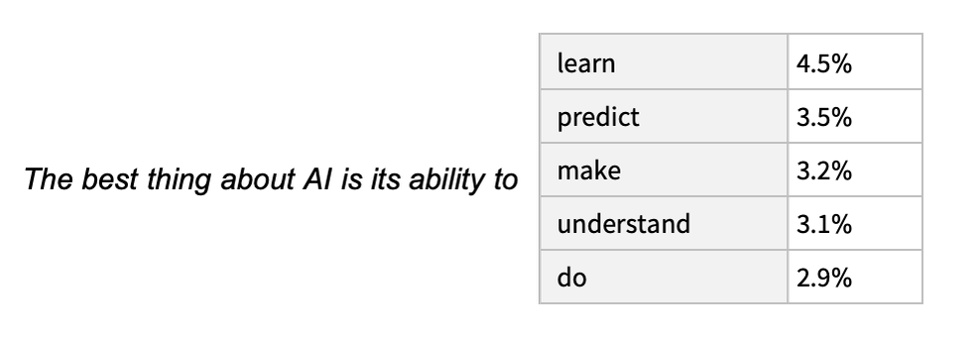
Decoder only –GPT – generative text what is the output → what is selected
Input = “The best thing about AI is its ability to”.
Output = produces a ranked list of words that might follow, together with “probabilities”:
Decision → Temperature = a parameter that controls the randomness of the responses. A higher temperature (like 0.8) makes the output more creative and varied, while a lower temperature (like 0.2) makes it more focused and deterministic.

Slide 42
Wait GPT Decoder only model can do translation (typically an encoder/decoder problem) –what is going on?
The answer lies in the power of the transformer’s decoder and the training method used for GPT models.
Even without an encoder, the decoder in a transformer is capable of understanding the input data and generating appropriate output. This is because the decoder uses self-attention, which allows it to focus on different parts of the input when generating the output.
Moreover, GPT models are trained using a method called unsupervised learning. They are trained to predict the next word in a sentence, given all the previous words. This training method allows GPT models to learn a lot about the structure and semantics of the language, which enables them to perform tasks like translation, summarization, and Q&A.

Slide 43
Many NLP Transformer Models
Google’s Bidirectional Encoder Representations from Transformers (BERT): → BARD → Gemini
  One of the pioneering language models using transformers, BERT excels in understanding bidirectional contexts within text, contributing to various natural language processing tasks.
OpenAI’s GPT Series (GPT-2, GPT-3, GPT-3.5, GPT-4, ChatGPT)
  GPT models, spanning from GPT-2 to GPT-4 and ChatGPT, leverage large-scale transformer architectures for diverse language generation tasks, showcasing advancements in natural language understanding and text generation.
Meta’s Llama:
  A compact model achieving remarkable performance, Llama demonstrates efficiency by matching larger models’ performance in various tasks despite being significantly smaller in size.

Slide 44
In NLP Potential benefits of Transformers over RNN/CNNs
Parallelization: Transformers process input data in parallel, allowing more efficient training than RNNs. This results in faster convergence.
Long-Range Dependencies: The self-attention mechanism enables Transformers to capture long-range dependencies in data, which is challenging for RNNs due to vanishing gradient problems.
Contextual Understanding: Transformers excel in capturing contextual information, making them highly effective for natural language processing tasks where understanding context is crucial.
Global Information: Unlike CNNs, which focus on local patterns, Transformers consider the entire input sequence simultaneously, capturing international relationships and improving performance in tasks like sequence-to-sequence learning.
Scalability: Transformers scale well to handle short and long sequences without the performance degradation often observed in RNNs and CNNs.
Ease of Training: The attention mechanism reduces the likelihood of vanishing or exploding gradients, simplifying training compared to the challenges associated with training deep RNNs.
Versatility: Transformers are versatile and applicable to various tasks without significant architectural changes, facilitating transfer learning and adaptation to different domains.
Interpretable Representations: The attention mechanism in Transformers provides interpretability, allowing for a better understanding of how the model processes input data compared to the more opaque internal representations of RNNs.
Performance – for LLM have outperformed previous architectures

Slide 45
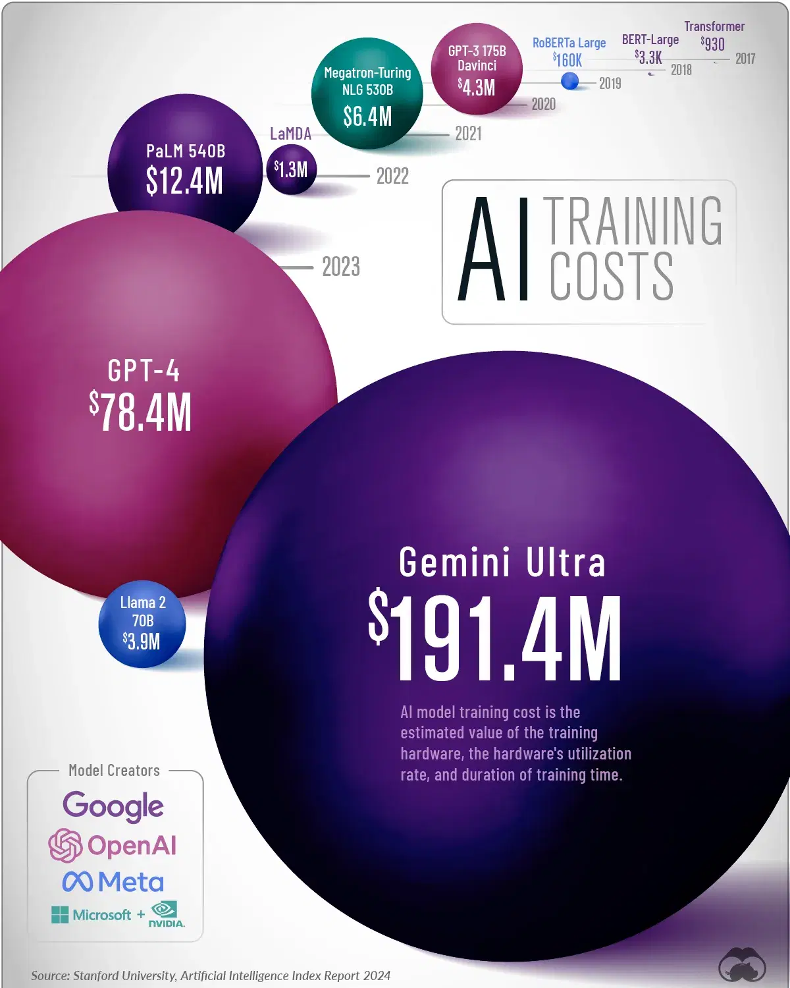
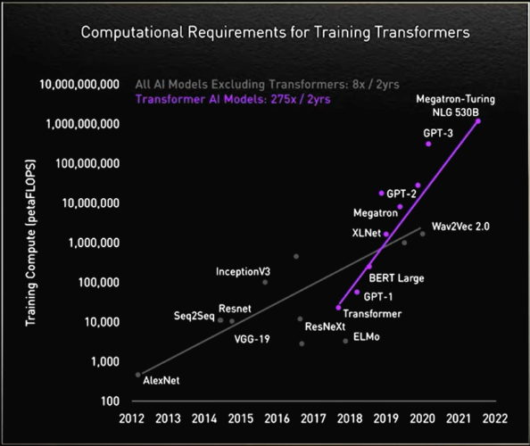
Tranformers –the problem $$$$$$
“You can train a transformer model with a couple hundred million parameters from scratch for around $1000 (on AWS) –anonymous 2024”
How much data & resources?

Slide 46
Vision Transformers
Image / Video

Slide 47
Summary of Key Trends in ViT
2020: The first application of transformers in vision (ViT), showing their potential for image classification.
2021: Many improvements, such as DeiT, Swin, and TNT, making vision transformers more data-efficient, hierarchical, and generalizable to tasks beyond classification.
2022: Hybrid architectures like ConvFormer attempt to merge CNN and transformer benefits.
2023: SAM demonstrates transformers' versatility in unsupervised, generalizable segmentation tasks.

Slide 48
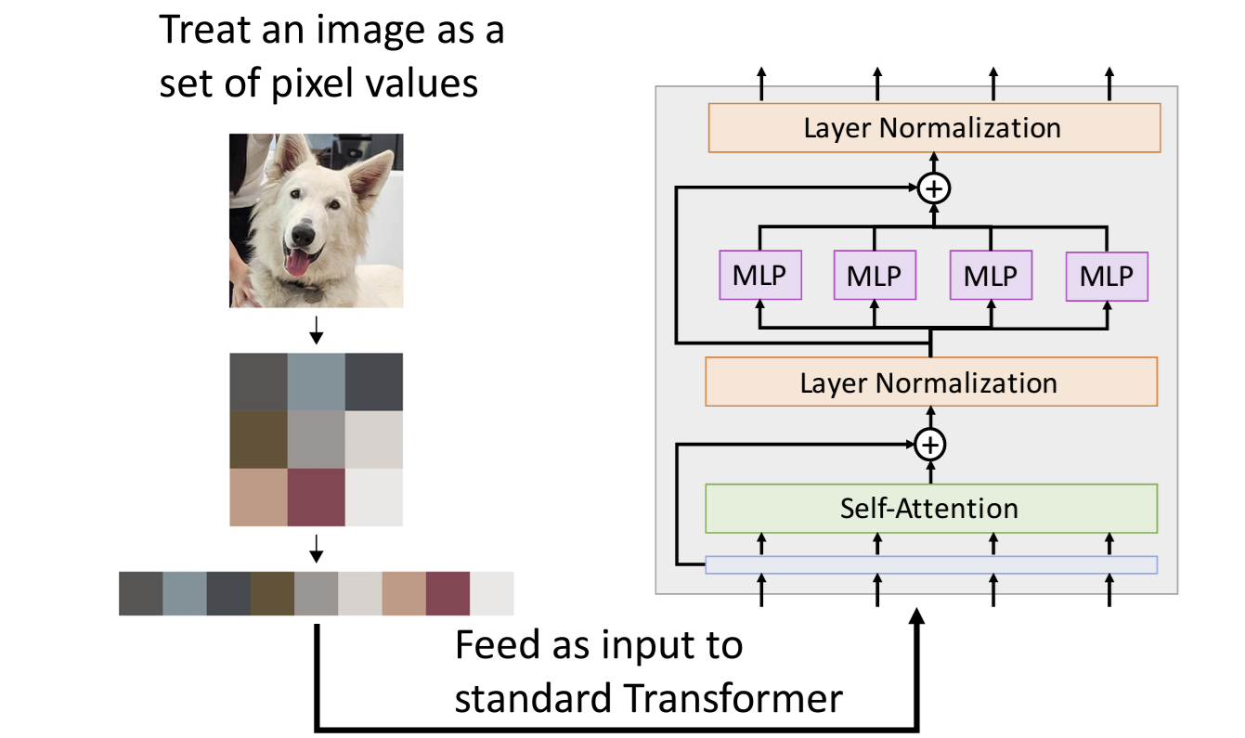
Image/Vision Transformers
Problem: Memory use!
MLP R x R image needs R^4 elements per attention matrix
R=128, 48 layers,
16 heads per layer takes 768GB of memory for attention
matrices for a single example…
One Idea: break up into pixels as input (mimicking RNN/attention dev)
Positional encoding is the position
of pixel in image
MLP = multi-layer perceptron is a Feed Forward Network (FFN)

Slide 49
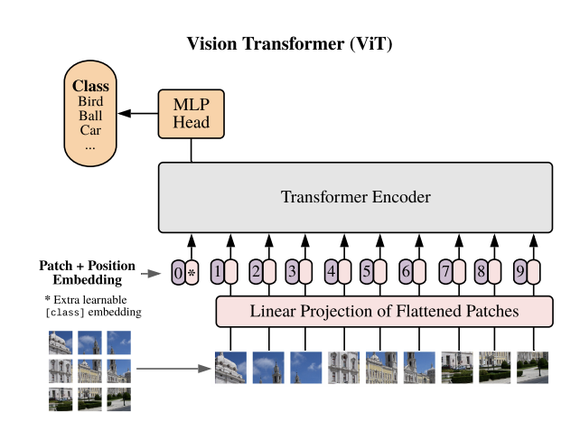
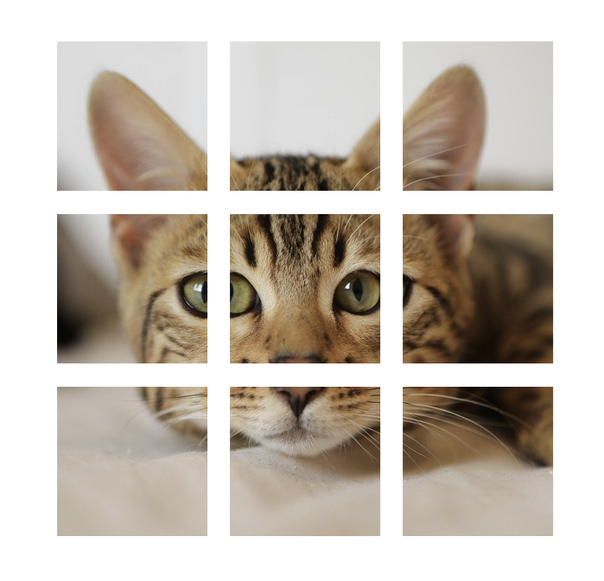
Image/Vision Transformers
Over previous example reduces parameters
2nd Idea: Break the image up
into non-overlapping sub-images,
(mimicking RNN/attention dev)
Positional encoding is the position
of each sub-image.

Slide 50









Step 1: divide image into patches
N input patches, each of shape 3x16x16
Dosovitskiy et al, “An Image is Worth 16x16 Words: Transformers for Image Recognition at Scale”, ICLR 2021

Slide 51
Step 2: project to a D-dimensional vector
Linear projection to D-dimensional vector
N input patches, each of shape 3x16x16
Dosovitskiy et al, “An Image is Worth 16x16 Words: Transformers for Image Recognition at Scale”, ICLR 2021

Slide 52
Step 2: project to a D-dimensional vector → What is D?
The patch embedding dimension 𝐷 is the size of the vector representation for each image patch after applying the linear projection (similar to a Conv2D operation) to each patch.
For each patch of size 𝑝×𝑝, the image channels (e.g., RGB with 3 channels) are flattened and projected into a vector of size 𝐷.
This embedding dimensionality 𝐷 is fixed for the entire transformer architecture and does not depend on the patch size or the size of the input image.
The paper introduces different ViT model variants with different values of DDD. The three most common model configurations are:
ViT-B (Base): D=768D = 768
ViT-L (Large): D=1024D = 1024
ViT-H (Huge): D=1280D = 1280
Linear projection to D-dimensional vector
N input patches, each of shape 3x16x16
Dosovitskiy et al, “An Image is Worth 16x16 Words: Transformers for Image Recognition at Scale”, ICLR 2021

Slide 53
Step 2: project to a D-dimensional vector → What is D?
The choice of D is generally driven by the computational resources available and the complexity of the task. Larger values of D typically lead to better performance, as the model can encode more information about each patch.
However, they also result in:
  Higher memory usage.
  Longer training times.
  More computational resources required.
selecting D is a trade-off between model capacity and resource constraints.
Linear projection to D-dimensional vector
N input patches, each of shape 3x16x16
Dosovitskiy et al, “An Image is Worth 16x16 Words: Transformers for Image Recognition at Scale”, ICLR 2021

Slide 54
Step 2: project to a D-dimensional vector → What is D?
D is also the embedding size used throughout the transformer encoder layers.
In each transformer block, the multi-head self-attention mechanism and feedforward layers operate on vectors of size D.
The number of heads in multi-head attention is often set as a factor of D.
  in ViT-B with D=768, there are typically 12 attention heads, so each head operates on vectors of size 768/12=64
Linear projection to D-dimensional vector
N input patches, each of shape 3x16x16
Dosovitskiy et al, “An Image is Worth 16x16 Words: Transformers for Image Recognition at Scale”, ICLR 2021

Slide 55
Step 2: project to a D-dimensional vector → What is D?
In practice, D is a hyperparameter that needs to be selected during model design or experimentation
Guidelines “to be ignored”
on a smaller dataset or with limited resources, a smaller model like ViT-B (with D=768) might be preferred.
For larger datasets and tasks requiring high accuracy (e.g., ImageNet), a larger model like ViT-L or ViT-H might be used, with D=1024 or D=1280D = 1280
Linear projection to D-dimensional vector
N input patches, each of shape 3x16x16
Dosovitskiy et al, “An Image is Worth 16x16 Words: Transformers for Image Recognition at Scale”, ICLR 2021

Slide 56
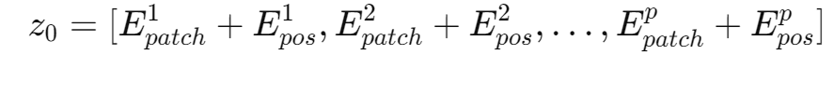
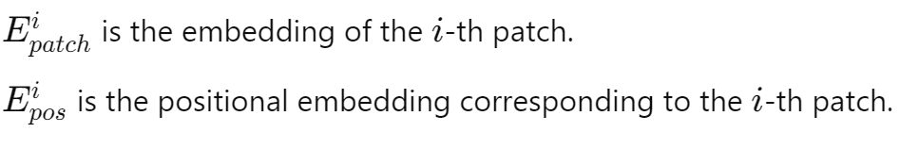
Step 3: add positional embedding
A D-dimensional vector,
the final input to the transformer is the sum of the patch embedding and its corresponding positional embedding:
where
Learnable Parameters
Unlike earlier works in transformers for NLP (such as BERT or GPT), which use fixed, predefined functions (like sine and cosine functions) for positional embeddings, ViT uses learnable positional embeddings. These are a set of parameters that are learned jointly with the rest of the model during training.
The positional embeddings are initialized randomly and learned over time, allowing the model to flexibly learn the best positional encoding strategy for the task at hand.
Add positional embedding: learned D- dim vector per position
+ + + + + + + + +
Linear projection to D-dimensional vector
N input patches, each of shape 3x16x16
Dosovitskiy et al, “An Image is Worth 16x16 Words: Transformers for Image Recognition at Scale”, ICLR 2021

Slide 57
Step 3: add positional embedding
use positional embeddings to inject information about the spatial order of the image patches into the Vision Transformer (ViT) model. This represents the structural information of these patches in the image.
After patch embeddings are generated, a positional embedding is added to each patch embedding. This ensures that the transformer knows the relative position of each patch within the grid. The positional embedding has the same dimension as the patch embedding (D) and is learned during training as a set of learnable parameters. This allows the model to capture the spatial structure of the image by encoding positional information, ensuring that patches are distinguished not only by their content but also by their location.
Add positional embedding: learned D- dim vector per position
+ + + + + + + + +
Linear projection to D-dimensional vector
N input patches, each of shape 3x16x16
Dosovitskiy et al, “An Image is Worth 16x16 Words: Transformers for Image Recognition at Scale”, ICLR 2021

Slide 58
Step 3: add positional embedding –why learned parameters → learn complex notion of spatial patterns
Learned positional embeddings allow the model to flexibly capture spatial relationships in the data based on the task at hand. Instead of relying on a fixed, predefined positional encoding (like sine/cosine functions), the model can adapt the embeddings to the specific vision task during training. This flexibility enables the positional embeddings to encode both absolute and potentially more nuanced, task-specific relationships between patches.
tasks can involve complex spatial dependencies (e.g., objects at different scales, rotations, or deformations), and learned embeddings allow the model to better adapt to these variations.
Add positional embedding: learned D- dim vector per position
+ + + + + + + + +
Linear projection to D-dimensional vector
N input patches, each of shape 3x16x16
Dosovitskiy et al, “An Image is Worth 16x16 Words: Transformers for Image Recognition at Scale”, ICLR 2021

Slide 59
Step 3: add positional embedding –why learned parameters → independence from patch size /resolution
Predefined positional embeddings (like sine/cosine) are often designed for a fixed grid size or resolution. For example, if the positional encodings are based on sine/cosine functions, changing the resolution of the input (or the patch size) could require recalculating or adjusting the encodings.
In contrast, learned positional embeddings can be trained and fine-tuned for a specific image resolution and patch size without having to worry about fitting a fixed mathematical pattern. This gives ViT more flexibility when dealing with different resolutions and patch sizes during training and inference.
Add positional embedding: learned D- dim vector per position
+ + + + + + + + +
Linear projection to D-dimensional vector
N input patches, each of shape 3x16x16
Dosovitskiy et al, “An Image is Worth 16x16 Words: Transformers for Image Recognition at Scale”, ICLR 2021

Slide 60
Step 3: add positional embedding –why learned parameters → empirical better results than fixed positional embedding
The ViT authors conducted experiments with fixed positional encodings (like the sine/cosine approach used in NLP transformers) but found that learned embeddings performed better.
Learned embeddings can capture both absolute positions and complex patterns that are specific to the dataset and task, which deterministic methods might not fully capture. Since vision tasks tend to involve highly structured data, such as the spatial relationships between pixels and patches, learned embeddings are better suited to capture this complexity.
Add positional embedding: learned D- dim vector per position
+ + + + + + + + +
Linear projection to D-dimensional vector
N input patches, each of shape 3x16x16
Dosovitskiy et al, “An Image is Worth 16x16 Words: Transformers for Image Recognition at Scale”, ICLR 2021

Slide 61
Step 4: Pass through Transformer model (like NLP) – more parameters to learn
Output vectors
Exact same as NLP Transformer!
Transformer
Add positional embedding: learned D- dim vector per position
Linear projection to
+ + + + + + + + +
D-dimensional vector
N input patches, each of shape 3x16x16
Dosovitskiy et al, “An Image is Worth 16x16 Words: Transformers for Image Recognition at Scale”, ICLR 2021

Slide 62
Step 4: Pass through Transformer – note the special extra input – classification token
Output vectors
Exact same as NLP Transformer!
Transformer
Add positional embedding: learned D- dim vector per position
Linear projection to
Special extra input: classification token (D dims, learned)
+ + + + + + + + +
D-dimensional vector
N input patches, each of shape 3x16x16
Dosovitskiy et al, “An Image is Worth 16x16 Words: Transformers for Image Recognition at Scale”, ICLR 2021

Slide 63
Step 4: Pass through Transformer – note the special extra input – classification token
often referred to as the [CLS] token is a special, learnable token that is introduced to the input sequence before it is processed by the transformer. by the [CLS] token used in models like BERT for natural language processing (NLP).
Purpose:
  The classification token is used to aggregate the information from all the patch embeddings during the transformer’s self-attention operations.
  After the transformer processes all the patches and the [CLS] token, the final representation of the [CLS] token is used as the input to a classification head (a fully connected layer followed by softmax) for making the final prediction (e.g., classifying the image into one of the predefined categories).
Transformer
Special extra input: classification token (D dims, learned)
+ + + + + + + + +

Slide 64
Step 4: Pass through Transformer – note the special extra input – classification token → output aggregate of information
often referred to as the [CLS] token is a special, learnable token that is introduced to the input sequence before it is processed by the transformer. by the [CLS] token used in models like BERT for natural language processing (NLP).
Purpose:
  The classification token is used to aggregate the information from all the patch embeddings during the transformer’s self-attention operations.
  After the transformer processes all the patches and the [CLS] token, the final representation of the [CLS] token is used as the input to a classification head (a fully connected layer followed by softmax) for making the final prediction (e.g., classifying the image into one of the predefined categories).
Transformer
Special extra input: classification token (D dims, learned)
+ + + + + + + + +

Slide 65
Step 4: Pass through Transformer – note the special extra input – classification token → aggregate of information
Linear projection to C-dim vector of predicted class scores
Output vectors
Exact same as NLP Transformer!
Transformer
Add positional embedding: learned D- dim vector per position
Linear projection to D-dimensional vector
N input patches, each of shape 3x16x16
Special extra input: classification token (D dims, learned)
+ + + + + + + + +
Dosovitskiy et al, “An Image is Worth 16x16 Words: Transformers for Image Recognition at Scale”, ICLR 2021

Slide 66
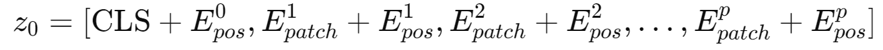
Step 4: Pass through Transformer – note the special extra input – classification token → How it works
How it Works:
  The [CLS] token is a learnable parameter, initialized randomly and optimized during training.
  It is prepended to the sequence of patch embeddings. So, if the image is divided into p patches, the input to the transformer becomes:
  The transformer applies self-attention across all tokens (including the [CLS] token) and passes information between the patches and the [CLS] token during each attention layer.
  After passing through all transformer layers, the final output corresponding to the [CLS] token (i.e., the transformed embedding of this token) is expected to hold a summary of the entire image, capturing the most important features needed for classification.
  Note: it is of dimension D to be the same dimension as the embedded patches and positional information.
Linear projection to C-dim vector of predicted class scores
Transformer
Special extra input: classification token (D dims, learned)
+ + + + + + + + +

Slide 67
Step 4: Pass through Transformer – note the special extra input – classification token → final output from CLS token is aggregate/holds summary of entire image
The transformer applies self-attention across all tokens (including the [CLS] token) and passes information s, the final output corresponding to the [CLS] token (i.e., the transformed embedding of this token) is expected to hold a summary of the entire image, capturing the most important features needed for classification.
As the [CLS] token interacts with the patch embeddings through multiple layers of attention, it accumulates relevant information from each patch. This process can be viewed as the model learning to extract and aggregate features that are important for the final clas
  The [CLS] token's representation evolves as it passes through the transformer layers. Each layer refines the representation by considering the relationships between all tokens.
  After each attention mechanism, the outputs undergo a feedforward transformation, further refining the features captured by the [CLS] token. This iterative process allows the [CLS] token to develop a rich and nuanced understanding of the image.sification task.
Example: if certain patches contain critical features (like the presence of a cat's ears or the outline of a car), the [CLS] token will learn to emphasize these features in its final representation through the self-attention mechanism.
Linear projection to C-dim vector of predicted class scores
Transformer
Special extra input: classification token (D dims, learned)
+ + + + + + + + +

Slide 68
Vision Transformer (ViT)
Computer vision model with no convolutions!
????
Linear projection to C-dim vector of predicted class scores
Output vectors
Exact same as NLP Transformer!
Transformer
Add positional embedding: learned D- dim vector per position
Linear projection to D-dimensional vector
N input patches, each of shape 3x16x16
Special extra input: classification token (D dims, learned)
+ + + + + + + + +
Dosovitskiy et al, “An Image is Worth 16x16 Words: Transformers for Image Recognition at Scale”, ICLR 2021

Slide 69

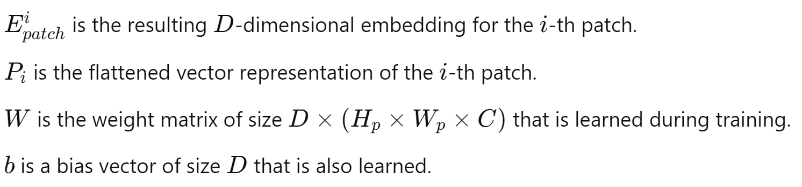
FIRST step is Convolution?
Computer vision model with no convolutions???
Linear Projection:
To convert the flattened patches into D-dimensional vectors, a learned linear projection is applied.
This is typically done using a dense (fully connected) layer:
Where
weight matrix W and the bias vector b are learned parameters.
Linear projection to D-dimensional vector
N input patches, each of shape 3x16x16

Slide 70
FIRST step is like Convolution
With patch size p, first layer is Conv2D(pxp, 3->D, stride=p)
Breakdown:
Image Patch Extraction:
  The input image is divided into fixed-size non-overlapping patches, each of size p×p. For instance, if the image is 224×224, and the patch size p=16, the image would be divided into 14×14 patches (since 224/16=14).
Patch Embedding Layer (Conv2D-like):
  The patches are flattened and linearly projected into a lower-dimensional embedding space. This projection can be thought of as similar to applying a Conv2D layer with:
    Kernel size: p×p (size of each patch). <<<< learned parameters
    Stride: p, to ensure that the patches are non-overlapping.
    Input channels: 3 (RGB channels).
    Output channels: D, the embedding dimension.
This can be formulated like a convolution operation with a filter size of p×p and a stride of p, where each patch is processed independently.
Linear projection to D-dimensional vector
N input patches, each of shape 3x16x16

Slide 71
FIRST step is like Convolution
There is convolution but, not as much as CNN - 1 layer
With patch size p, first layer is Conv2D(pxp, 3->D, stride=p)
performs a convolution-like operation using a patch embedding mechanism, which is functionally equivalent to a Conv2D operation with a kernel size of p×p (where p is the patch size), stride p, and input channels of 3 (for RGB images) that output a dimensional embedding D.
Linear projection to D-dimensional vector
N input patches, each of shape 3x16x16

Slide 72
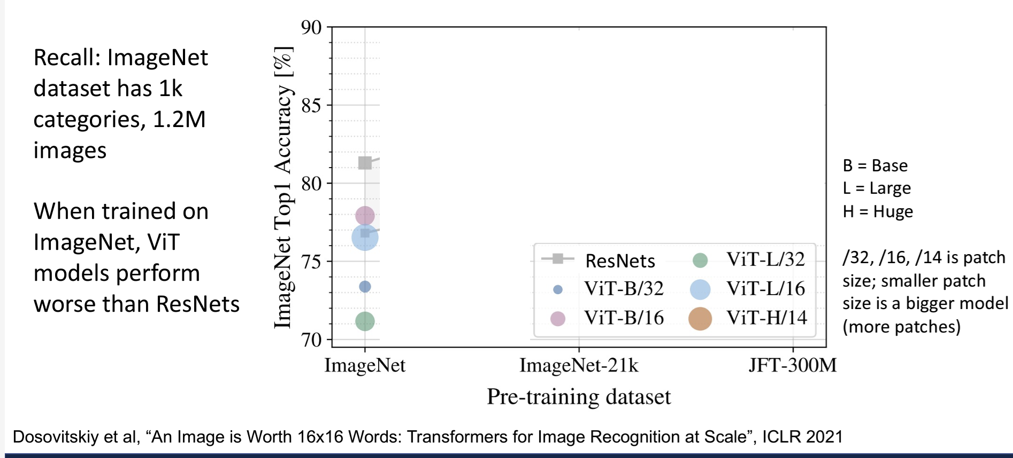
Comparison ViT with ResNet
Worse on baseline ImageNet (1.2M images)

Slide 73
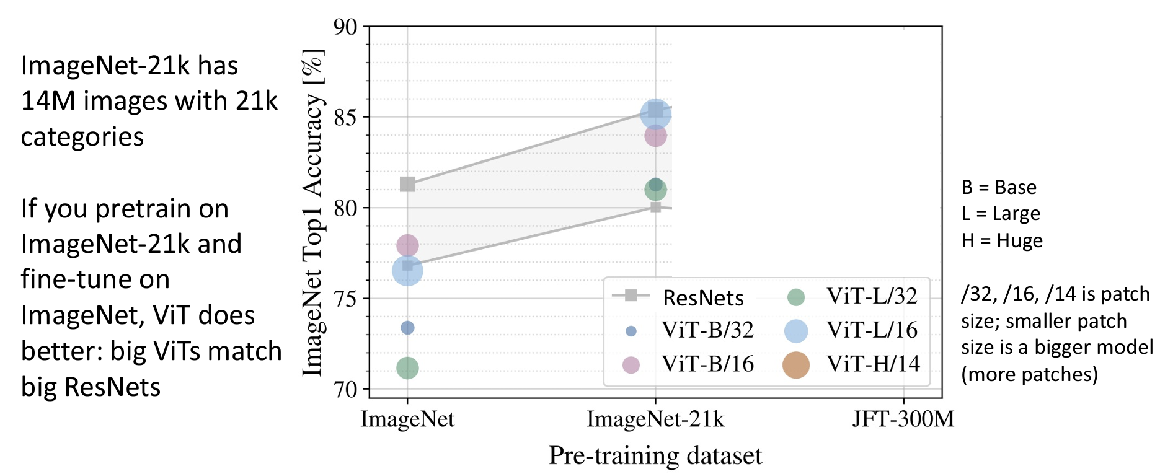
Comparison ViT with ResNet
Better on bigger ImageNet-21K (14M images)

Slide 74

Comparison ViT with ResNet
Best on EVEN larger dataset (300M).

Slide 75


Image/Vision Transformer w/ multiple convolutional layers in beginning
Original
First layer of p patches uses learned Convolution layer
pxp , 3→D, stride=p
MLPs in Transformer are stacks of 1x1 convolutions
Or can use CNN to get features that are fed into a Transformer
Carion et al, “End-to-End Object Detection with Transformers”, ECCV 2020

Slide 76

Object Detection with Transformers: DETR (Detection Transformer)
Carion et al, “End-to-End Object Detection with Transformers”, ECCV 2020

Slide 77
Object Detection with Transformers: DETR → Object Queries
DETR introduces the concept of object queries, which are learnable embeddings that correspond to potential object instances in the image. Query Slots Predict Object Instances, Not Specific Classes.
Number of Queries: The number of object queries is fixed (e.g., 100) and independent of the number of actual objects present in the image. This means that the model can predict a predetermined number of objects, regardless of how many objects are actually detected in the image <<< e.g. You can only predict up to 100 objects in the image.
How it works:
Embedding Process: After the input image is divided into patches and embedded into a feature map through the CNN backbone, each object query interacts with these features using self-attention mechanisms within the transformer architecture. This interaction allows each query to focus on different parts of the image and gather relevant information from the corresponding patches​ (learned)
Self-Attention Mechanism: The self-attention mechanism helps the model weigh the importance of various image features concerning the object queries. This allows the model to aggregate features from different parts of the image to form a comprehensive representation of each potential object. Each query can "attend" to the relevant image areas that contribute to its classification and bounding box prediction​
Carion et al, “End-to-End Object Detection with Transformers”, ECCV 2020

Slide 78
DETR: WAIT only 100 objects??
The 100 query slots in DETR are not meant to cover each possible class (like 1000 classes), but instead, they correspond to object instances in the image. Each query attempts to identify whether a particular object exists in the image, and if so, it predicts both the class and the bounding box for that object.
Each query slot can predict an object from any class—meaning one query could predict a “cat,” another a “dog,” and a third might predict a “person.” The output space of DETR includes the possibility of selecting from all 1000 object classes, but each query independently attempts to detect an object, regardless of class.
DETR frames object detection as a set prediction problem, where the 100 query slots predict a set of objects (of different or the same classes) in the image. It doesn't require more queries for additional classes but instead treats the problem of detecting objects in an image as predicting a fixed set of objects, regardless of the number of classes.

Slide 79
DETR: WAIT only 100 objects??
The use of **100 query slots** might seem limiting, especially when considering a large number of potential objects in various locations and the possibility of multiple instances of the same class, such as cats. How it works:
1. Object Queries as Hypotheses: Each of the 100 query slots acts as a hypothesis for the presence of an object in the image. Instead of needing a unique query for every possible object in the dataset, these slots can represent multiple instances of the same class. For example, if there are multiple cats in the image, the model can use the same query slot to identify different instances by focusing on different parts of the image through attention mechanisms.
2. Class and Localization Predictions: Each query slot outputs both a class label and a bounding box prediction. When the model processes an image, it generates a set of outputs corresponding to these query slots. If multiple cats are present, the slots will output predictions that indicate the presence of the class “cat” in different locations, each with its own bounding box.
3. Dynamic Attention Mechanism: The transformer’s self-attention mechanism allows each query to focus dynamically on different areas of the image. This means that even though there are only 100 query slots, the model can still effectively differentiate between multiple objects of the same class. The attention weights help the model learn where to “look” in the image for each query slot.
4. Non-Maximum Suppression (NMS): (nothing new) During post-processing, DETR applies techniques like non-maximum suppression to filter overlapping predictions and retain the most confident ones. This helps refine the output so that even if multiple query slots detect the same class, only the best bounding box for each instance is kept.
5. Flexible Architecture: While the original DETR paper uses 100 queries, this number can be adjusted based on the expected complexity of the images. The model’s architecture is flexible enough to accommodate varying numbers of queries to balance between performance and computational efficiency.

Slide 80
DETR: WAIT only 100 objects but, 1000 classes?? Example of query slots as hypothesizes
Query Slots: 100 learnable query slots, each acting as a hypothesis.
  Query 1 might predict a cat with a bounding box around Cat 1.
  Query 2 might predict a cat with a bounding box around Cat 2.
  Query 3 might predict a cat with a bounding box around Cat 3, each query focusing on different parts of the image for different cats.
  Query 4 might predict a dog with a bounding box around Dog 1.
  Query 5 might predict a dog with a bounding box around Dog 2, focusing on the location of the dogs.
  Query 6 might predict a car with a bounding box around the car.
  Other queries may predict background or "no object".
Through the self-attention mechanism, each query focuses on different regions of the image, allowing DETR to detect multiple instances of the same object class (cats, dogs) or different classes (cat, dog, car) efficiently. The output includes class labels and bounding boxes for each detected object instance.

Slide 81
DETR ---summary of main concept
The transformer processes both the image features (the encoded features of the image) and the queries (which are learnable embeddings that serve as object hypotheses) through a series of attention layers.
Importantly, self-attention is dynamic—each query slot doesn't have a fixed area of focus; instead, it can adapt and attend to any part of the image, depending on the input data.

Slide 82
FYI Training Data more or less the same
# JSON for DETR
{
"image_id": "img123",
"objects": [
{
"bbox": [x_min, y_min, x_max, y_max],
"category_id": 1 // Class label (e.g., "car")
},
{
"bbox": [x_min2, y_min2, x_max2, y_max2],
"category_id": 2 // Class label (e.g., "person")
}
]
}
# Pascal VOC for SSD MobileNet
<annotation>
<folder>images</folder>
<filename>img123.jpg</filename>
<object>
<name>car</name> <!-- Class label -->
<bndbox>
<xmin>x_min</xmin>
<ymin>y_min</ymin>
<xmax>x_max</xmax>
<ymax>y_max</ymax>
</bndbox>
</object>
<object>
<name>person</name>
<bndbox>
<xmin>x_min2</xmin>
<ymin>y_min2</ymin>
<xmax>x_max2</xmax>
<ymax>y_max2</ymax>
</bndbox>
</object>
</annotation>

Slide 83
Some Other Important Papers / Work in ViT
2017: "Attention is All You Need" – Vaswani et al.
Contribution: Introduced the Transformer architecture, originally designed for sequence-to-sequence tasks in natural language processing (NLP). The core concept is the self-attention mechanism, which captures global dependencies and relationships in data.
Significance: This paper laid the foundation for the transformer model, which would later be adapted for computer vision.
2020: "An Image is Worth 16x16 Words: Transformers for Image Recognition at Scale" – Dosovitskiy et al.
Contribution: Introduced the Vision Transformer (ViT), the first successful application of a transformer model for image classification. The key idea was to treat an image as a sequence of patches (16x16 pixels each) and apply a transformer model directly to these patches, just as transformers handle word sequences in NLP.
Significance: Achieved state-of-the-art performance on ImageNet when pre-trained on large datasets, marking a paradigm shift in computer vision models dominated by convolutional neural networks (CNNs).
2021: "Training Data-Efficient Image Transformers & Distillation through Attention" (DeiT) – Touvron et al.
Contribution: Introduced Data-efficient Image Transformer (DeiT), a more data-efficient variant of ViT, showing that transformers can be trained from scratch on ImageNet without the need for massive pre-training datasets. Also introduced knowledge distillation with a CNN-based teacher to improve the performance of ViTs.
Significance: Made ViTs more accessible by reducing the data and computational requirements for training, bringing transformers into the mainstream for vision tasks.
2021: "Multi-Scale Vision Transformers" (MViT) – Fan et al.
Contribution: Proposed Multi-Scale Vision Transformers, which introduce hierarchical attention at multiple scales, similar to how CNNs process information at different resolution levels.
Significance: Bridged the gap between the purely flat, single-scale attention in ViT and the hierarchical processing of CNNs, improving performance on various vision tasks.
2021: "Swin Transformer: Hierarchical Vision Transformer using Shifted Windows" – Liu et al.
Contribution: Proposed Swin Transformer, which uses a shifted window mechanism to compute local self-attention. The model has a hierarchical structure that computes attention at different scales, making it more efficient and scalable for high-resolution image tasks.
Significance: Outperformed previous vision transformers on multiple benchmarks, such as COCO object detection and ADE20K segmentation. Swin Transformers became popular in vision tasks beyond classification, such as object detection and segmentation.
2021: "TNT: Transformer in Transformer" – Han et al.
Contribution: Introduced the Transformer-in-Transformer (TNT), which models both patch-level and pixel-level information by using nested transformers. This architecture captures fine-grained details inside image patches, improving the model's representational capacity.
Significance: Enhanced the ability of transformers to model local pixel-level information, which was a weakness of early ViTs.

Slide 84
Some Other Important Papers / Work in ViT
2021: "Pyramid Vision Transformer: A Versatile Backbone for Dense Prediction without Convolutions" (PVT) – Wang et al.
Contribution: Introduced the Pyramid Vision Transformer (PVT), which builds a pyramid of feature maps (similar to CNNs) with progressive downsampling, enabling its application to dense prediction tasks like object detection and segmentation.
Significance: Made vision transformers more versatile for tasks that require multi-scale features and dense predictions, further competing with CNN-based models.
2021: "BEiT: BERT Pre-Training of Image Transformers" – Bao et al.
Contribution: Introduced BEiT (Bidirectional Encoder representation for Image Transformers), inspired by the BERT model in NLP. BEiT uses masked image modeling, where portions of the image are masked, and the model is trained to predict the missing patches, akin to masked language modeling.
Significance: Demonstrated that the self-supervised learning paradigm used in NLP (like BERT) can be applied effectively to vision transformers, improving their performance on various tasks after pre-training.
2021: "Visual Transformer Pruner: An End-to-End Pruning Framework for Vision Transformers" – Tang et al.
Contribution: Proposed a pruning method for ViTs that reduces the computational cost of transformers without significantly sacrificing performance.
Significance: Addressed the issue of ViTs being computationally expensive, making them more feasible for deployment in resource-constrained environments.
2022: "ConvFormer: Closing the Gap Between CNN and Vision Transformers" – Yu et al.
Contribution: Introduced ConvFormer, a hybrid model that uses convolutions within the transformer architecture. The model blends the strengths of CNNs (locality and inductive bias) with the global modeling capabilities of transformers.
Significance: Combines the best of CNNs and transformers, narrowing the gap between these two dominant architectures for vision tasks.
2022: "MAE: Masked Autoencoders Are Scalable Vision Learners" – He et al.
Contribution: Proposed Masked Autoencoders (MAE) for vision transformers, which mask a large portion of the image during training and then reconstruct the missing parts. This method scales well and learns strong visual representations.
Significance: MAE pushed the frontier of self-supervised learning for ViTs, showing that the "masked" learning concept from NLP could be leveraged in vision tasks to great effect.
2023: "Segment Anything Model" (SAM) – Kirillov et al.
Contribution: SAM proposes a transformer-based architecture that can perform image segmentation on any object in an image without being trained on specific object classes. It uses a combination of vision transformers and promptable segmentation.
Significance: Showed the flexibility of transformers in handling a variety of vision tasks, demonstrating their capacity for generalization and versatility in new areas such as zero-shot segmentation.

Slide 85
Summary
Vision Transformers have been a hot topic the past ~3-4 years!
Different architecture vs traditional CNNs
Applications to all tasks: classification, detection, segmentation, etc
Possible takeaway: Vison transformers are an evolution. Recent discussion of RNNs/CNNs with modifications achieving similar results.
A main benefit is probably speed: Matrix multiply is more hardware- friendly than convolution, so ViTs with same FLOPs as CNNs can train and run much faster

Slide 86
Remaining Lecture is Advanced material –on your own.
On YOUR OWN

Slide 87
Improving ViT
On YOUR OWN
Augmentation, Regularization + more
Steiner et al, “How to train your ViT? Data, Augmentation
, and Regularization in Vision Transformers”, arXiv 2021

Slide 88
Improving ViT: Augmentation & Regularization
FROM PAPER: Steiner et al, “How to train your ViT? Data, Augmentation, and Regularization in Vision Transformers”, arXiv 2021
Regularization for ViT models:
Weight Decay = technique that penalizes large weights in the model by adding an L2 regularization term to the loss function. It encourages smaller, more generalizable weights and helps reduce overfitting, which is especially important in large models like ViT.
Stochastic Depth = some layers in the transformer are randomly skipped during training. This helps reduce the depth of the model during training, effectively acting as an ensemble of shallower networks.
Dropout (in FFN layers of Transformer) = randomly sets a fraction of input units to zero at each forward pass during training, reducing reliance on specific neurons and encouraging more robust representations. Dropout is typically applied to the attention layers and fully connected layers in ViT, preventing co-adaptation between neurons.
Data Augmentation for ViT models:
MixUp = creation of synthetic data by “mixing”/combining data samples (see paper )
RandAugment = randomly selects augmentation operations and applies them to images during training CAN include rotation, shear, color jitter, brightness adjustments, contrast changes, solarization, and more

Slide 89

Improving ViT: Augmentation and Regularization
Hybrid models: ResNet blocks, then ViT blocks
ViT models: Ti = Tiny
S = Small
B = Base L = Large
Regularization for ViT models:
Weight Decay
Stochastic Depth
Dropout (in FFN layers of Transformer)
Data Augmentation for ViT models:
MixUp
RandAugment
More augmentation
FROM PAPER: Steiner et al, “How to train your ViT? Data, Augmentation, and Regularization in Vision Transformers”, arXiv 2021

Slide 90
Improving ViT: Augmentation and Regularization
Hybrid models: ResNet blocks, then ViT blocks
ViT models: Ti = Tiny
S = Small
B = Base L = Large
Regularization for ViT models:
Weight Decay
Stochastic Depth
Dropout (in FFN layers of Transformer)
Data Augmentation for ViT models:
MixUp
RandAugment
Original Paper:
77.9
76.53
More augmentation
FROM PAPER: Steiner et al, “How to train your ViT? Data, Augmentation, and Regularization in Vision Transformers”, arXiv 2021

Slide 91
Improving ViT: Augmentation and Regularization
Hybrid models: ResNet blocks, then ViT blocks
ViT models: Ti = Tiny
S = Small
B = Base L = Large
Regularization for ViT models:
Weight Decay
Stochastic Depth
Dropout (in FFN layers of Transformer)
Data Augmentation for ViT models:
- MixUp
Original Paper:
77.9
76.53
- RandAugment
Adding regularization is (almost) always helpful
More augmentation
FROM PAPER: Steiner et al, “How to train your ViT? Data, Augmentation, and Regularization in Vision Transformers”, arXiv 2021

Slide 92
Improving ViT: Augmentation and Regularization
Hybrid models: ResNet blocks, then ViT blocks
ViT models: Ti = Tiny
S = Small
B = Base L = Large
Regularization for ViT models:
Weight Decay
Stochastic Depth
Dropout (in FFN layers of Transformer)
Data Augmentation for ViT
Original Paper:
77.9
models:
MixUp
RandAugment
Regularization +
76.53
Augmentation gives big improvements
More augmentation
FROM PAPER: Steiner et al, “How to train your ViT? Data, Augmentation, and Regularization in Vision Transformers”, arXiv 2021

Slide 93
Improving ViT: Augmentation and Regularization
Hybrid models: ResNet blocks, then ViT blocks
ViT models: Ti = Tiny
S = Small
B = Base L = Large
Regularization for ViT models:
Weight Decay
Stochastic Depth
Dropout (in FFN layers of Transformer)
Data Augmentation for ViT models:
MixUp
RandAugment
Original Paper:
77.9
76.53
Lots of other patterns in full results
More augmentation
FROM PAPER: Steiner et al, “How to train your ViT? Data, Augmentation, and Regularization in Vision Transformers”, arXiv 2021

Slide 94
Improving ViT - Distillation
On YOUR OWN
Hinton et al, “Distilling the knowledge in a neural network”, NeurIPS Deep Learning and Representation Learning Workshop, 2015
For ViT : Touvrom et al, “Training data-efficient image transformers & distillation through attention”, ICML 2021

Slide 95

Improving ViT: Distillation
Step 1: Train a teacher model on images and ground-truth labels
Cross Entropy Loss
P(cat) = 0.9
P(dog) = 0.1
GT label: Cat
Refers to Knowledge Distillation, a technique used to transfer knowledge from a larger, pretrained model (referred to as the teacher model) to a smaller or less complex model (referred to as the student model). This process allows the smaller student model to achieve comparable performance to the larger teacher model, but with fewer parameters and reduced computational complexity.

Slide 96

Improving ViT: Distillation
Step 1: Train a teacher model on images and ground-truth labels
Cross Entropy Loss
P(cat) = 0.9
P(dog) = 0.1
GT label: Cat
Step 2: Train a student model to match predictions from the teacher
P(cat) = 0.1
P(dog) = 0.9
KL Divergence Loss
P(cat) = 0.2
P(dog) = 0.8

Slide 97
Improving ViT: Distillation
Step 1: Train a teacher model on images and ground-truth labels
Cross Entropy Loss
P(cat) = 0.9
P(dog) = 0.1
GT label: Cat
Step 2: Train a student model to match predictions from the teacher (sometimes also to match GT labels)
P(cat) = 0.1
P(dog) = 0.9
KL Divergence Loss
Cross Entropy Loss
P(cat) = 0.2
P(dog) = 0.8
GT label: Dog

Slide 98
Improving ViT: Distillation
Often works better than training student from scratch (especially if teacher is bigger than student)
Cross
Step 1: Train a teacher model on images and ground-truth labels
P(cat) = 0.9
P(dog) = 0.1
GT label: Cat
Entropy Loss
Step 2: Train a student model to match predictions from the teacher (sometimes also to match GT labels)
P(cat) = 0.1
P(dog) = 0.9
KL Divergence Loss
Cross Entropy Loss
P(cat) = 0.2
P(dog) = 0.8
GT label: Dog

Slide 99
Improving ViT: Distillation
Can also train student on unlabeled data! (Semi- supervised learning)
Step 1: Train a teacher model on images and ground-truth labels
Cross Entropy Loss
P(cat) = 0.9
P(dog) = 0.1
GT label: Cat
Step 2: Train a student model to match predictions from the teacher (sometimes also to match GT labels)
P(cat) = 0.1
P(dog) = 0.9
KL Divergence Loss
Cross Entropy Loss
P(cat) = 0.2
P(dog) = 0.8
GT label: Dog

Slide 100
Improving ViT: Distillation
Step 1: Train a teacher CNN on ImageNet
Cross Entropy Loss
P(cat) = 0.9
P(dog) = 0.1
GT label: Cat
Step 2: Train a student ViT to match ImageNet predictions from the teacher CNN (and match GT labels)
P(cat) = 0.1
P(dog) = 0.9
KL Divergence Loss
Cross Entropy Loss
P(cat) = 0.2
P(dog) = 0.8
GT label: Dog

Slide 101
Improving ViT: Distillation
Predicted class scores; should match
Predicted class scores; should match ground-truth
teacher
Touvrom et al, “Training data-efficient image transformers & distillation through attention”, ICML 2021
Output vectors
Transformer
Positional Embedding
+ + + + + + + + +
Classification token
Distillation
token
Linear projection
Input patches

Slide 102
Improving ViT: Distillation
ViT-B/16 on ImageNet
86
84
82
80
78
76
74
Top1 Accuracy
Original ViT-B/16
+Distillation
+Longer training +Higher resolution
(300 to 1000 epochs) (224x224 to 384x384)

Slide 103
Improving ViT: Distillation
ViT-B/16 on ImageNet
86
84
82
80
78
76
74
Top1 Accuracy
Original ViT-B/16
+Distillation
+Longer training (300 to 1000 epochs)
+Higher resolution (224x224 to 384x384)

Slide 104
Hierarchical ViT : Swin Transformer
Liu et al, “Swin Transformer: Hierarchical Vision Transformer using Shifted Windows”, CVPR 2021

Slide 105
ViT vs CNN
In most CNNs (including ResNets), decrease resolution and increase channels as you go deeper in the network (Hierarchical architecture)
3x3 conv, 512
Stage 3:
256 x 14 x 14
3x3 conv, 512
3x3 conv, 512
3x3 conv, 512
Useful since objects in images can occur at various scales
3x3 conv, 512
3x3 conv, 512, /2
3x3 conv, 128
3x3 conv, 128
Stage 2:
128 x 28 x 28
3x3 conv, 128
3x3 conv, 128
3x3 conv, 128
3x3 conv, 128, / 2
3x3 conv, 64
3x3 conv, 64
Stage 1:
64 x 56 x 56
3x3 conv, 64
3x3 conv, 64
3x3 conv, 64
3x3 conv, 64
Input:
Pool
3 x 224 x 224
7x7 conv, 64, / 2
Input

Slide 106

ViT vs CNN
In most CNNs (including ResNets), decrease resolution and increase channels as you go deeper in the network (Hierarchical architecture)
Layer Normalization
+
MLP MLP MLP MLP
Layer Normalization
+
Self-Attention
3rd block: 768 x 14 x 14
3x3 conv, 512
Stage 3:
256 x 14 x 14
3x3 conv, 512
3x3 conv, 512
3x3 conv, 512
Useful since objects in images can occur at various scales
Layer Normalization
+
MLP MLP MLP MLP
Layer Normalization
+
Self-Attention
3x3 conv, 512
3x3 conv, 512, /2
3x3 conv, 128
2nd block: 768 x 14 x 14
Stage 2:
128 x 28 x 28
3x3 conv, 128
3x3 conv, 128
In a ViT, all blocks have same resolution and number of channels (Isotropic architecture)
3x3 conv, 128
3x3 conv, 128
3x3 conv, 128, / 2
3x3 conv, 64
Layer Normalization
+
MLP MLP MLP MLP
Layer Normalization
+
Self-Attention
Stage 1:
64 x 56 x 56
3x3 conv, 64
3x3 conv, 64
1st block: 768 x 14 x 14
3x3 conv, 64
3x3 conv, 64
3x3 conv, 64
Input: 3 x 224 x 224
Pool
Input:
3 x 224 x 224
7x7 conv, 64, / 2
Input

Slide 107
ViT vs CNN
In most CNNs (including ResNets), decrease resolution and increase channels as you go deeper in the network (Hierarchical architecture)
Layer Normalization
+
MLP MLP MLP MLP
Layer Normalization
+
Self-Attention
3rd block: 768 x 14 x 14
3x3 conv, 512
Stage 3:
256 x 14 x 14
3x3 conv, 512
3x3 conv, 512
3x3 conv, 512
Useful since objects in images can occur at various scales
Layer Normalization
+
MLP MLP MLP MLP
Layer Normalization
+
Self-Attention
3x3 conv, 512
3x3 conv, 512, /2
3x3 conv, 128
2nd block: 768 x 14 x 14
Stage 2:
128 x 28 x 28
3x3 conv, 128
3x3 conv, 128
In a ViT, all blocks have same resolution and number of channels (Isotropic architecture)
3x3 conv, 128
3x3 conv, 128
3x3 conv, 128, / 2
3x3 conv, 64
Layer Normalization
+
MLP MLP MLP MLP
Layer Normalization
+
Self-Attention
Stage 1:
64 x 56 x 56
3x3 conv, 64
3x3 conv, 64
1st block: 768 x 14 x 14
3x3 conv, 64
3x3 conv, 64
3x3 conv, 64
Can we build a hierarchical ViT model?
Input: 3 x 224 x 224
Pool
Input:
3 x 224 x 224
7x7 conv, 64, / 2
Input

Slide 108

Hierarchical ViT: Swin Transformer
C × ^{𝐻} × ^{𝑊}
4 4
3 × 𝐻 × 𝑊
Divide image into 4x4 patches and project to C dimensions
Liu et al, “Swin Transformer: Hierarchical Vision Transformer using Shifted Windows”, CVPR 2021

Slide 109

Hierarchical ViT: Swin Transformer
C × ^{𝐻} × ^{𝑊}
4 4
2𝐶 × ^{𝐻} × ^{𝑊}
8 8
3 × 𝐻 × 𝑊
Divide image into 4x4 patches and project to C dimensions
Merge 2x2 neighborhoods; now patches are (effectively) 8x8
Liu et al, “Swin Transformer: Hierarchical Vision Transformer using Shifted Windows”, CVPR 2021

Slide 110
Hierarchical ViT: Swin Transformer
H/4
C × ^{𝐻 𝑊} 2𝐶 × ^{𝐻} × ^{𝑊}
4 × 4 8 8
C
W/4
3 × 𝐻 × 𝑊
Divide image into 4x4 patches and project to C dimensions
Merge 2x2 neighborhoods; now patches are (effectively) 8x8
Liu et al, “Swin Transformer: Hierarchical Vision Transformer using Shifted Windows”, CVPR 2021

Slide 111
Hierarchical ViT: Swin Transformer
H/4
C × ^{𝐻 𝑊} 2𝐶 × ^{𝐻} × ^{𝑊}
4 × 4 8 8
C
W/4
3 × 𝐻 × 𝑊
Concatenate groups of 2x2 features
H/8
4C
W/8
Divide image into 4x4 patches and project to C dimensions
Merge 2x2 neighborhoods; now patches are (effectively) 8x8
Liu et al, “Swin Transformer: Hierarchical Vision Transformer using Shifted Windows”, CVPR 2021

Slide 112
Hierarchical ViT: Swin Transformer
H/4
C × ^{𝐻 𝑊} 2𝐶 × ^{𝐻} × ^{𝑊}
4 × 4 8 8
C
W/4
3 × 𝐻 × 𝑊
Concatenate groups of 2x2 features
H/8
4C
W/8
Linear projection from 4C to 2C channels (1x1 conv)
Divide image into 4x4 patches and project to C dimensions
Merge 2x2 neighborhoods; now patches are (effectively) 8x8
H/8
2C
W/8
Liu et al, “Swin Transformer: Hierarchical Vision Transformer using Shifted Windows”, CVPR 2021

Slide 113

Hierarchical ViT: Swin Transformer
C × ^{𝐻} × ^{𝑊}
4 4
2𝐶 × ^{𝐻} × ^{𝑊}
8 8
4𝐶 × ^{𝐻} × ^{𝑊}
16 16
3 × 𝐻 × 𝑊
Divide image into 4x4 patches and project to C dimensions
Merge 2x2 neighborhoods; now patches are (effectively) 8x8
Merge 2x2 neighborhoods; now patches are (effectively) 16x16
Liu et al, “Swin Transformer: Hierarchical Vision Transformer using Shifted Windows”, CVPR 2021

Slide 114

Hierarchical ViT: Swin Transformer
C × ^{𝐻} × ^{𝑊}
4 4
2𝐶 × ^{𝐻} × ^{𝑊}
8 8
4𝐶 × ^{𝐻} × ^{𝑊}
16 16
8𝐶 × ^{𝐻} × ^{𝑊}
32 32
3 × 𝐻 × 𝑊
Divide image into 4x4 patches and project to C dimensions
Merge 2x2 neighborhoods; now patches are (effectively) 8x8
Merge 2x2 neighborhoods; now patches are (effectively) 16x16
Merge 2x2 neighborhoods; now patches are (effectively) 32x32
Liu et al, “Swin Transformer: Hierarchical Vision Transformer using Shifted Windows”, CVPR 2021

Slide 115
Hierarchical ViT: Swin Transformer
Problem: 224x224 image with 56x56 grid of 4x4
𝐻 | × | 𝑊 | 2𝐶 × | 𝐻 | × | 𝑊 | 4𝐶 × | 𝐻 |  | 𝑊 |  | 𝐻 |  | 𝑊
4 |  | 4 |  | 8 |  | 8 |  | 16 |  | 16 |  | 32 |  | 32
patches: attention matrix has 56⁴ = 9.8M entries
C ×
×
8𝐶 × ×
3 × 𝐻 × 𝑊
Divide image into 4x4 patches and project to C dimensions
Merge 2x2 neighborhoods; now patches are (effectively) 8x8
Merge 2x2 neighborhoods; now patches are (effectively) 16x16
Merge 2x2 neighborhoods; now patches are (effectively) 32x32
Liu et al, “Swin Transformer: Hierarchical Vision Transformer using Shifted Windows”, CVPR 2021

Slide 116
Hierarchical ViT: Swin Transformer
Problem: 224x224 image with 56x56 grid of 4x4
𝐻 | × | 𝑊 | 2𝐶 × | 𝐻 | × | 𝑊 | 4𝐶 × | 𝐻 |  | 𝑊 |  | 𝐻 |  | 𝑊
4 |  | 4 |  | 8 |  | 8 |  | 16 |  | 16 |  | 32 |  | 32
patches: attention matrix has 56⁴ = 9.8M entries
C ×
×
8𝐶 × ×
3 × 𝐻 × 𝑊
Divide image into 4x4 patches and project to C dimensions
Merge 2x2 neighborhoods; now patches are (effectively) 8x8
Merge 2x2 neighborhoods; now patches are (effectively) 16x16
Merge 2x2 neighborhoods; now patches are (effectively) 32x32
Solution: don’t use full attention, instead use attention over patches
Liu et al, “Swin Transformer: Hierarchical Vision Transformer using Shifted Windows”, CVPR 2021

Slide 117
Swin Transformer: Window Attention
With H x W grid of tokens, each attention matrix is H²W² – quadratic in image size
Liu et al, “Swin Transformer: Hierarchical Vision Transformer using Shifted Windows”, CVPR 2021

Slide 118

Swin Transformer: Window Attention
With H x W grid of tokens, each attention matrix is H²W² – quadratic in image size
Rather than allowing each token to attend to all other tokens, instead divide into windows of M x M tokens (here M=4); only compute attention within each window
Liu et al, “Swin Transformer: Hierarchical Vision Transformer using Shifted Windows”, CVPR 2021

Slide 119
Swin Transformer: Window Attention
With H x W grid of tokens, each attention matrix is H²W² – quadratic in image size
Rather than allowing each token to attend to all other tokens, instead divide into windows of M x M tokens (here M=4); only compute attention within each window
Total size of all attention matrices is now: M⁴(H/M)(W/M) = M²HW
Linear in image size for fixed M!
Swin uses M=7 throughout the network
Liu et al, “Swin Transformer: Hierarchical Vision Transformer using Shifted Windows”, CVPR 2021

Slide 120

Swin Transformer: Window Attention
Problem: tokens only interact with other tokens within the same window; no communication across windows
Liu et al, “Swin Transformer: Hierarchical Vision Transformer using Shifted Windows”, CVPR 2021

Slide 121

Swin Transformer: Shifted Window Attention
Solution: Alternate between normal windows and shifted windows in successive Transformer blocks
Ugly detail: Non-square windows at edges and corners
Block L: Normal windows
Block L+1: Shifted Windows
Liu et al, “Swin Transformer: Hierarchical Vision Transformer using Shifted Windows”, CVPR 2021

Slide 122
Swin Transformer: Shifted Window Attention
Solution: Alternate between normal windows and shifted windows in successive Transformer blocks
Detail: Relative Positional Bias
ViT adds positional embedding to input tokens, encodes absolute position of each token in the image
Block L: Normal windows
Block L+1: Shifted Windows
Liu et al, “Swin Transformer: Hierarchical Vision Transformer using Shifted Windows”, CVPR 2021

Slide 123
Swin Transformer: Shifted Window Attention
Solution: Alternate between normal windows and shifted windows in successive Transformer blocks
Detail: Relative Positional Bias
ViT adds positional embedding to input tokens, encodes absolute position of each token in the image
Swin does not use positional embeddings, instead encodes relative position between patches when computing attention:
Standard Attention:
𝐴 = 𝑆𝑜𝑓𝑡𝑚𝑎𝑥
𝑄𝐾"
𝑉
𝐷
𝑄, 𝐾, 𝑉: 𝑀# × 𝐷 (Query, Key, Value)
Block L: Normal windows
Block L+1: Shifted Windows
Liu et al, “Swin Transformer: Hierarchical Vision Transformer using Shifted Windows”, CVPR 2021

Slide 124
Swin Transformer: Shifted Window Attention
Solution: Alternate between normal windows and shifted windows in successive Transformer blocks
Detail: Relative Positional Bias
ViT adds positional embedding to input tokens, encodes absolute position of each token in the image
Swin does not use positional embeddings, instead encodes relative position between patches when computing attention:
Attention with relative bias:
𝑄𝐾"
𝐴 = 𝑆𝑜𝑓𝑡𝑚𝑎𝑥
+ 𝐵 𝑉
𝐷
𝑄, 𝐾, 𝑉: 𝑀# × 𝐷 (Query, Key, Value)
Block L: Normal windows
Block L+1: Shifted Windows
𝐵: 𝑀# × 𝑀# (learned biases)
Liu et al, “Swin Transformer: Hierarchical Vision Transformer using Shifted Windows”, CVPR 2021

Slide 125
Swin Transformer: Speed vs Accuracy
RegNetY EffNet ViT+Distillation (DeiT) Swin
85
84
83
82
81
80
Accuracy (ImageNet Top1)
79
0
2
4
6
8
10
12
14
16
18
20
Speed (ms/image on V100)
Liu et al, “Swin Transformer: Hierarchical Vision Transformer using Shifted Windows”, CVPR 2021

Slide 126
Swin Transformer: Speed vs Accuracy
RegNetY EffNet ViT+Distillation (DeiT) Swin
85
84
83
Accuracy (ImageNet Top1)
82
Bonus: Swin Transformer can also be used as a backbone for object
81
detection, instance segmentation,
80
and semantic segmentation!
79
0
2
4
6
8
10
12
14
16
18
20
Speed (ms/image on V100)
Liu et al, “Swin Transformer: Hierarchical Vision Transformer using Shifted Windows”, CVPR 2021

Slide 127



Other Hierarchical Vision Transformers
MViT Swin-V2
Improved MViT
Fan et al, “Multiscale Vision Transformers”, ICCV 2021
Liu et al, “Swin Transformer V2: Scaling up Capacity and Resolution”, CVPR 2022
Li et al, “Improved Multiscale Vision Transformers for Classification and Detection”, arXiv 2021

Slide 128
Can we simplify the attention in ViT

Slide 129
Vision Transformer: Another Look
Question: Can we use something simpler than self- attention to mix across tokens?
Apply (D->D) MLP to each of the N tokens
MLP MLP MLP MLP MLP MLP MLP MLP MLP
Mix tokens with self-attention
Input vectors N x D
Mix across tokens: Self-Attention
N input patches

Slide 130
MLP-Mixer: An All-MLP Architecture
Question: Can we use something simpler than self- attention to mix across tokens?
Apply (D->D) MLP to each of the N tokens
MLP MLP MLP MLP MLP MLP MLP MLP MLP
Apply (N->N) MLP to each of the D channels
Mix across tokens: MLP
Input vectors N x D
N input patches
Tolstikhin et al, “MLP-Mixer: An all-MLP architecture for vision”, NeurIPS 2021

Slide 131

MLP-Mixer: An All-MLP Architecture
Input: N x C
N patches with C channels each
MLP 1: C -> C,
apply to each of the N patches
MLP 2: N -> N,
apply to each of the C channels
Tolstikhin et al, “MLP-Mixer: An all-MLP architecture for vision”, NeurIPS 2021

Slide 132
MLP-Mixer: An All-MLP Architecture
MLP-Mixer is actually just a weird CNN???
Equivalent to Conv(1x1, C->C, stride=1)
Equivalent to Conv(N^{1/2} x N^{1/2}, C->C, groups=C)
Input: N x C
N patches with C channels each
MLP 1: C -> C,
apply to each of the N patches
MLP 2: N -> N,
apply to each of the C channels
Tolstikhin et al, “MLP-Mixer: An all-MLP architecture for vision”, NeurIPS 2021

Slide 133
MLP-Mixer: An All-MLP Architecture
Cool idea; but initial ImageNet results not very compelling (but
MLP-Mixer is actually just a weird CNN???
better with JFT pretraining)
Equivalent to
Equivalent to Conv(N^{1/2} x N^{1/2}, C->C, groups=C)
Conv(1x1, C->C, stride=1)
Input: N x C
N patches with C channels each
MLP 1: C -> C,
apply to each of the N patches
MLP 2: N -> N,
apply to each of the C channels
Tolstikhin et al, “MLP-Mixer: An all-MLP architecture for vision”, NeurIPS 2021

