Slide 1
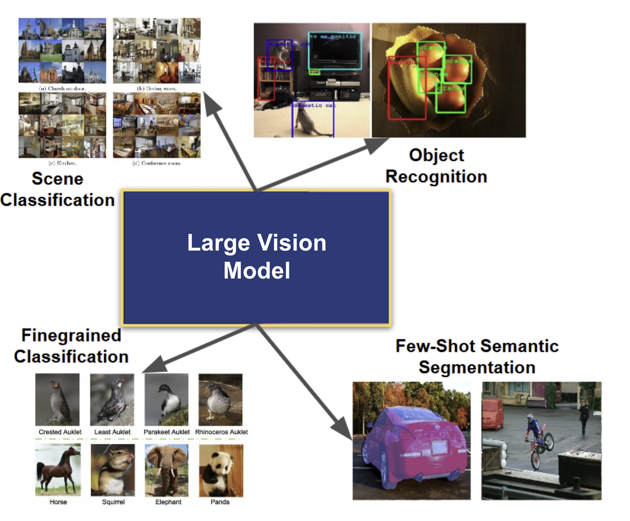
VLM – Vision Language Models
Large VLMs

Slide 2
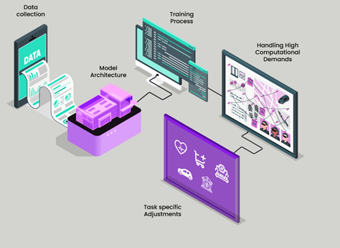

Large Vision Models Explained: Transforming AI
From healthcare to manufacturing, finance to entertainment, large vision models have/will become indispensable assets

Slide 3
Distinctive Features of Large Vision Models: Parameters and Scale
LARGE # Parameters: The Driving Force Behind Large Vision Models
  enabling it to capture intricate patterns and nuances within visual data.
Deep Architectures: deep network architectures, comprising multiple layers of interconnected nodes.
Transfer Learning Capabilities: excel in transfer learning, where a pre-trained model on a massive dataset can be fine-tuned for specific tasks with relatively smaller datasets.
  This adaptability makes them versatile across applications, from medical imaging to industrial quality control.
Massive Datasets: Large vision models thrive on extensive datasets encompassing vast arrays of visual information
Computational Intensity: The training process is computationally demanding, often requiring GPUs or TPUs.
Real-Time Inference Challenges: While training benefits from abundant computational resources, deploying models on edge devices necessitates optimizing for real-time inference in resource-constrained environments.

Slide 4
The Start Large Vision(only) Models
Google’s Vision Transformer (ViT): Referred to as ViT, Google’s Vision Transformer is tailored for image classification, employing a unique Transformer-like architecture that operates on patches of the image. ViT has garnered acclaim for achieving state-of-the-art results across various image classification benchmarks.
SWIN Transformer: The SWIN Transformer presents a hierarchical design for visual recognition tasks. With success in image classification and object detection, SWIN utilizes hierarchical representations, showcasing its versatility in handling complex visual information.
LandingLens™: A revolutionary platform crafted by LandingAI, LandingLens democratizes computer vision models by empowering users without prior coding experience. This intuitive platform offers a user-friendly interface for tasks such as image labeling, model training, and seamless deployment to both cloud and edge devices.
CLIP (Contrastive Language-Image Pretraining): Developed by OpenAI, CLIP represents a groundbreaking vision-language model meticulously trained to comprehend images in tandem with natural language. This sophisticated model finds applications in image captioning, visual question answering, and image retrieval.

Slide 5
Versions/parameters
Model & Variant | Launch Date / Year | Approx. Parameter Size
ViT–Base / ViT–Large / ViT–Huge | Fall 2020 (original ViT paper) (Wikipedia, THE DECODER) | ViT-Base: ~86MViT-Large: ~307MViT-Huge: ~632M (THE DECODER)
ViT-G/14 | Around mid-2021 | ~~2B parameters (THE DECODER)
ViT-22B | Early 2023 (Scaling paper) (THE DECODER, Google Research, OpenReview) | 22 billion parameters (THE DECODER, Google Research, OpenReview)
Swin Transformer (orig.) | Early 2021 (CVPR paper) (arXiv) | Not specified in sources (commonly ~50–100M in small/base configs)
Swin Transformer V2 | November 2021 (HF doc) (GitHub) | Up to ~3 billion parameters (GitHub, Hugging Face)
Model Family | Launch Date | Smallest Variant (params) | Largest Variant (params)
ViT (Vision Transformer, Google) | 2020 (ViT paper) | ViT-Base: ~86M | ViT-22B (2023): 22B
Swin Transformer (Microsoft) | 2021 (CVPR) / V2 in 2021 | Swin-Tiny: ~28M | SwinV2-G: ~3B

Slide 6
Variants & Dataset size for Large Vision Models
Model Family | Launch Date | Smallest Variant (params) | Largest Variant (params) | Dataset Size
ViT (Google) | 2020 | ViT-Base: ~86M | ViT-22B (2023): 22B | JFT-300M → JFT-3B (billions of images)
Swin (Microsoft) | 2021 / V2 in 2021 | Swin-Tiny: ~28M | SwinV2-G: ~3B | ImageNet-22K (~14M images) + curated large-scale datasets

Slide 7
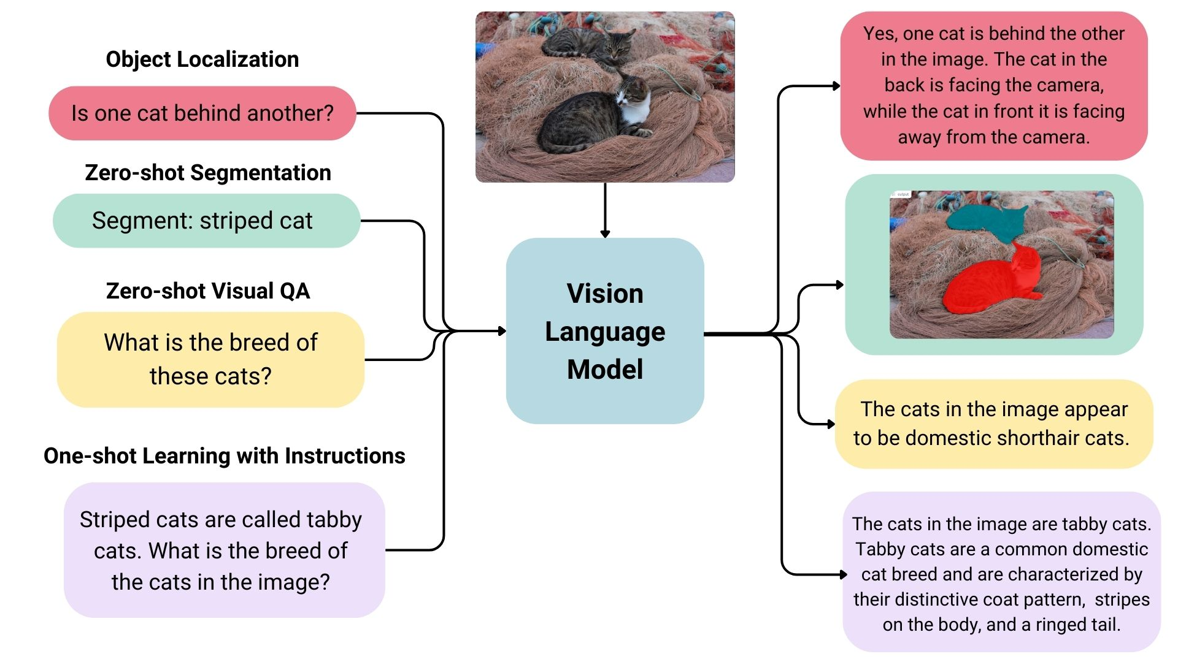
VLM - Vision Language Model –many applications
Multimodal LM: Span prediction with joint vision-language input/output. (detection, classification, description, more+)
Visual Question Answering (VQA):
Example — 'What is the man jumping over?' → 'Fire hydrant'.
Visual Grounding:
Example — 'Yellow fire hydrant' → associated region in the image.
Image-Text Matching:
Example — 'A cat is lying on a bed' → output True/False.
Key Notes:
- VLMs perform diverse tasks beyond traditional recognition.
- Additional intelligence emerges when integrating large language models with vision systems.

Slide 8
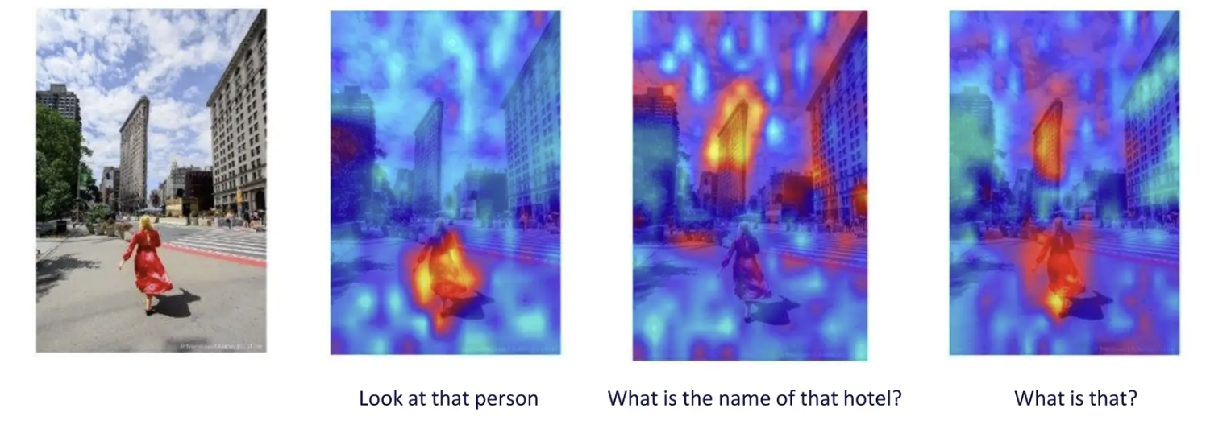
What Does the Vision Encoder See?
Visualization of vision encoder outputs using attention maps:
Example image: a person in a red dress walking in an urban environment.
Heatmaps illustrate focus areas for different queries:
- 'Look at that person': Strong attention on the person in red.
- 'What is the name of that hotel?': Attention shifts to the building in the background.
- 'What is that?': Broader attention across multiple regions, balancing object recognition with scene context.

Slide 9
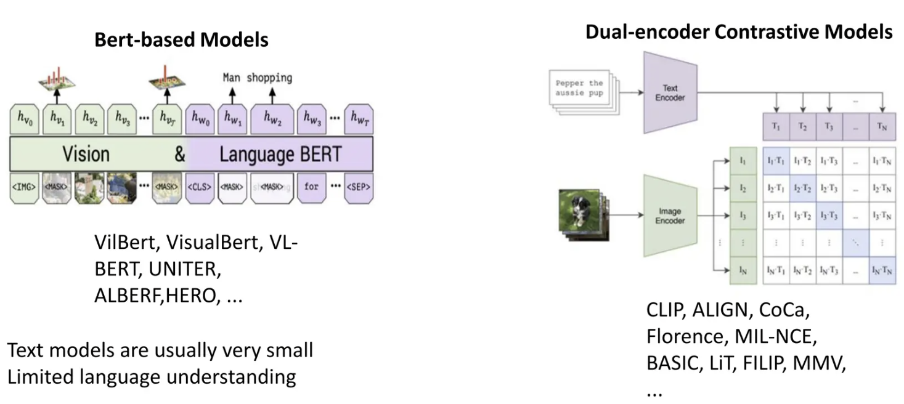
Vision Language Model (earliest)
Bert-based Models:
Examples: VilBERT (2019), VisualBERT (2019), VL-BERT (2020), UNITER (2019), ALBEF (2021), HERO (2020), etc.
combine visual inputs with a BERT-based language encoder.
  model share a single encoder (or joint transformer) where both image features (from an image embedding module like Faster R-CNN or ViT) and text tokens are fed together into one transformer (often adapted from BERT).
Text models were usually small with limited language understanding.
Dual-encoder Contrastive Models:
Examples: CLIP (2021), ALIGN (2021), CoCa (2022), Florence (2021), MIL-NCE (2020), BASIC (2021), LiT (2021), FILIP (2021), MMV (2021).
Employ separate text and image encoders.
  A vision encoder (e.g., ResNet, ViT) for images.A language encoder (e.g., Transformer) for text.
Enable joint embeddings for tasks like retrieval and classification.
  During training, the model sees matched pairs (e.g., an image and its caption) and non-matching pairs (e.g., an image with a wrong caption).
  The loss function (contrastive loss) pushes:
  Matched pairs → closer together in the embedding space.
  Mismatched pairs → farther apart in the embedding space.

Slide 10
Steps
Bert-based (earlier fusion of image+text info)
Image → Vision Pre-encoder → Image Tokens ┐
+→ Joint Transformer (cross-attention) → Cross-modal Embeddings
Text → Tokenizer → Text Tokens ─────────┘
Dual-Encoder based(later fusion of image+text info)
Image → Vision Transformer → Image Embedding ┐
├→ Shared Embedding Space → Similarity Score
Text → Text Transformer → Text Embedding ─┘

Slide 11
Vision Language Model (earliest)
Aspect | BERT-based Models (Joint Encoder) | Dual-encoder Models (Separate Encoders)
Architecture | Single joint transformer processes both image + text together. | Two separate encoders (vision + text), outputs aligned in a shared embedding space.
Fusion | Direct early fusion of modalities; cross-attention integrates vision + language. | Late fusion; image and text only interact after embedding alignment.
Training Objective | Masked language modeling + cross-modal prediction (e.g., matching captions, answering VQA). | Contrastive learning: matched pairs pulled together, mismatched pairs pushed apart.
Strengths / Advantages | - Rich cross-modal interactions.- Strong on fine-grained reasoning (e.g., VQA, visual grounding).- Better contextual understanding. | - Very scalable to internet-scale data.- Efficient at image-text retrieval.- Generalizes well to zero-shot classification.- Lighter inference (no cross-attention).
Weaknesses / Disadvantages | - Computationally heavier (joint attention across all tokens).- Harder to scale to billions of pairs.- Training requires aligned image-text pairs. | - Weaker at fine-grained reasoning (no deep fusion).- Limited contextual grounding (e.g., spatial relations).
Best Applications | - Visual Question Answering (VQA).- Image captioning.- Referring expression grounding.- Tasks requiring detailed multimodal reasoning. | - Large-scale image-text retrieval (e.g., Google Images, search engines).- Zero-shot classification (e.g., CLIP on ImageNet).- Robust multimodal pretraining at scale.
Why | Fusion inside a single transformer lets models learn subtle relationships between words and visual regions. | Separate encoders + contrastive learning make training efficient on web-scale data and embeddings reusable for retrieval.

Slide 12
Approach | Origin | Core Idea | How it Works | Encoder Training | Use in VLMs | Main Purpose | Fusion Style
BERT-based (ViLBERT, VisualBERT, VL-BERT, UNITER, ALBEF) | NLP (BERT, 2018 → multimodal 2019–2021) | Extend BERT’s transformer to handle both image + text | Extract visual features (Faster R-CNN, ViT patches) → concatenate with word embeddings → feed into one joint transformer encoder | Image + text fused together and trained jointly inside a single transformer | Deep cross-modal reasoning (VQA, captioning, grounding) | Learn joint contextual embeddings | Early Fusion (tokens interact inside same encoder)
CLIP-based (CLIP, ALIGN, Florence, LiT) | Contrastive learning (CLIP, 2021) | Align image + text embeddings in a shared space | Separate encoders: ViT/ResNet for image, Transformer for text → contrastive loss aligns paired embeddings | Encoders trained separately but jointly optimized with contrastive loss | Retrieval, classification, backbones for multimodal LLMs | Learn aligned embedding spaces | Late Fusion (separate encoders, fuse at embedding similarity)
VQ-VAE–based (VQ-VAE, VQGAN, DALL·E dVAE) | Generative modeling (2017+) | Convert images into discrete tokens (like a visual vocabulary) | VQ-VAE encoder → continuous features → quantization → discrete codebook tokens → feed alongside text tokens into a transformer | Image encoder trained separately (reconstruction loss); text tokens from normal LM tokenizer; fusion happens only later in the transformer | Turn images into “tokens” so LLMs can process them like text | Provide discrete, LLM-compatible visual tokens | Flexible Fusion (tokens unified at transformer input stage)

Slide 13
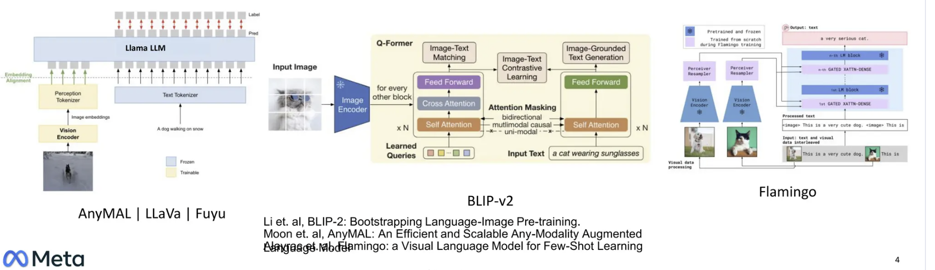
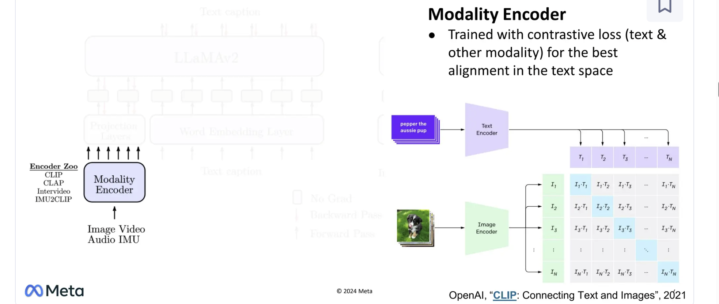
Earlier Vision + Text Language Model (OpenAI CLIP, AnyMAL, BLIP-v2,Flamingo)

Slide 14
Foundational Models
…bigger + more data

Slide 15
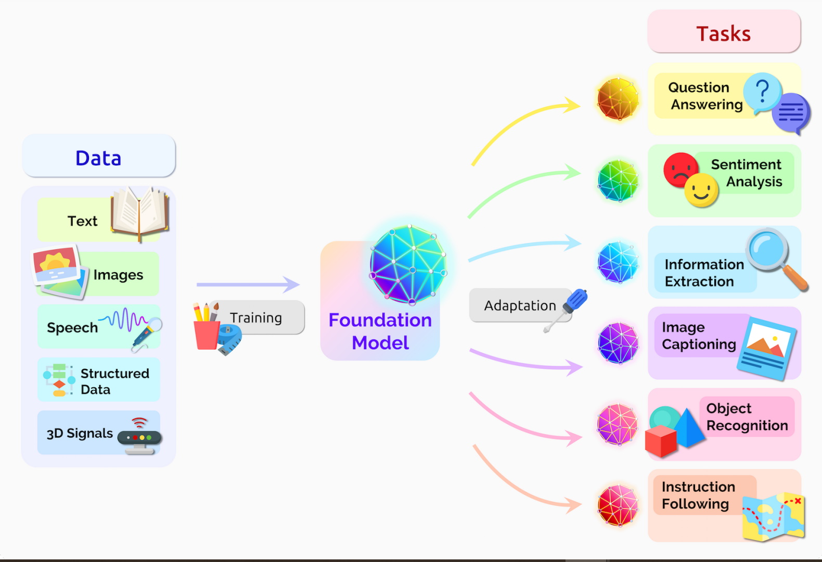
VLMs – vision + text (Foundational Models)
Some examples
Gemini: A family of multimodal models by Google DeepMind released in late 2023. The top-tier Ultra variant reaches around 540 billion parameters, with Pro around 280 billion.
Meta’s LLaMA 4: Announced in April 2025, with Scout and Maverick versions each at ~17B parameters. A super-sized Behemoth model (288B) is in development.
GPT-4V: The vision-enabled extension to GPT-4 launched around September 2023. Parameter counts remain undisclosed by OpenAI.
Qwen-VL Series: Alibaba's multimodal models—first Qwen-VL in 2023, upgraded to Qwen2.5-VL in early 2025. These come in multiple sizes including the largest 72B-parameter variant.
A foundation model is a large-scale model trained on broad, diverse datasets (text, images, speech, structured data, etc.) that can be adapted to many downstream tasks.

Slide 16
Examples VLMs (foundational)
Large Vision + Language(text) Models
Model / Variant | Launch Date | Approx. Parameter Size
Gemini (Google DeepMind) | Dec 6, 2023 (Gemini 1.0 launch) (Wikipedia) | Gemini Ultra: ~540BGemini Pro: ~280B (Toolnest)
LLaMA 4 (Meta) | April 5, 2025 (MLWires, Reuters, The Verge) | LLaMA 4 Scout / Maverick: 17B parameters (Hugging Face, The Verge)Behemoth: 288B active parameters (The Verge)
GPT-4V (Vision) | Sept 2023 (image support introduced) (capalearning.com) | Not publicly disclosed (Wikipedia)
Qwen-VL Series (Alibaba) | Qwen-VL: Sep 2023; Qwen2.5-VL: Jan 2025 (Qwen, openlaboratory.ai, Wikipedia) | Qwen2.5-VL variants: 3B, 7B, and 72B (Hugging Face)

Slide 17
Variants + Dataset size for VLMs
Model Family | Launch Date | Smallest Variant (params) | Largest Variant (params) | Dataset Size
Gemini (Google DeepMind) | Dec 2023 | Gemini Nano (~1.8B est.) | Gemini Ultra (~540B) | Multimodal (text+images+code+audio); trillions of tokens + billions of images (DeepMind not fully disclosed)
LLaMA 4 (Meta) | Apr 2025 | LLaMA-4 Scout/Maverick: 17B | LLaMA-4 Behemoth: 288B | Trained on ~15T tokens text + image-text pairs
GPT-4V (OpenAI) | Sept 2023 | Not disclosed - Generally believed to be in the range of hundreds of billions of parameters (speculation based on GPT-4 family) | Not disclosed - Generally believed to be in the range of hundreds of billions of parameters (speculation based on GPT-4 family) | Mixture of web-scale text + multimodal datasets; exact scale undisclosed
Qwen-VL (Alibaba) | 2023 → 2025 (Qwen2.5-VL) | Qwen2.5-VL-3B | Qwen2.5-VL-72B | Trillions of tokens + hundreds of millions of image-text pairs
Open Source
Open Source

Slide 18
Training Foundational models
Foundational models (LLMs, VLMs, diffusion models, etc.) are extremely powerful but also extremely data- and computation-hungry. The evolution of training strategies reflects attempts to overcome key bottlenecks:
Supervised Learning
Self-Supervised Learning
Student-Teacher Learning
Reinforcement Learning from Human Feedback (RLHF)
Reinforcement Learning from AI Feedback (RLAIF)
MORE

Slide 19
Training Concepts for Foundational Models → 1. Supervised Learning
Supervised Pretraining
  Uses large labeled datasets (e.g., ImageNet, COCO captions).
  Still useful for initializing vision encoders before multimodal pretraining.
  Limitation: labeled datasets are small compared to web-scale data.

Slide 20
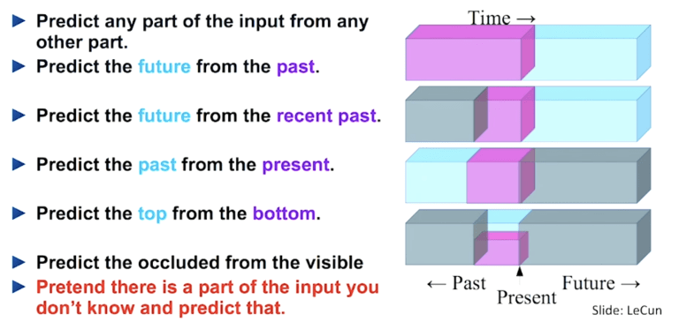
Training Concepts for Foundational Models → 2. Self-Supervised Learning

Slide 21
Training Concepts for Foundational Models → 2. Self-Supervised Learning
Use large unlabeled (or weakly labeled) data
Models learn broad representations without direct supervision
For vision or multimodal: masked region prediction, image–text contrastive loss, image caption prediction
CONCEPT:
During pretraining, you don’t explicitly teach the model how to do tasks. Instead, you expose it to massive text corpora, image collections, or paired image-text sets, and have the model predict missing parts (e.g. masked tokens or image patches) or align modalities. This gives the model a strong base of general knowledge.

Slide 22
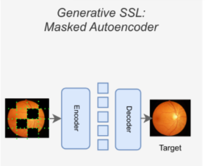
2. Self-Supervised Learning → Masked Region Prediction
Masked region prediction --- Similar to “masked language modeling” (where random words are hidden and the model must guess them), in images you can hide or mask parts of an image (patches, pixels, regions).
The model is trained to reconstruct or predict the missing content. This forces it to understand the overall structure of the image.

Slide 23
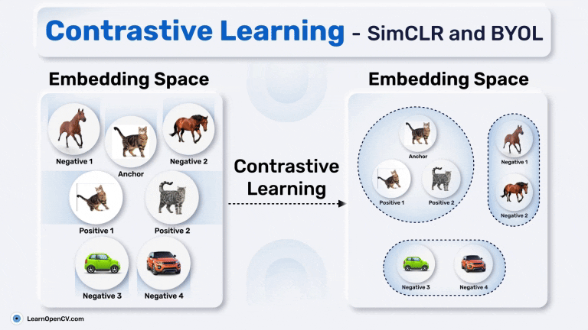
2. Self-Supervised Learning→ Contrastive Loss
Image–text contrastive loss
Given many image–text pairs, the model learns to bring the embedding of a matching image and caption closer together in representation space, while pushing apart non-matching pairs. This teaches alignment between visual and textual modalities.
Dual Encoders:
2 separate neural networks are typically used: an image encoder and a text encoder. These encoders process their respective modalities (image patches or text tokens) and project them into the same shared embedding space.
Positive and Negative Pairs:
Positive Pairs: An image and its associated text (e.g., a caption) form a positive pair, and their embeddings are encouraged to be similar.
Negative Pairs: An image and a different text from the same batch are treated as negative pairs, and their embeddings are pushed apart.
Contrastive Loss:
A loss function, such as InfoNCE loss, is used to optimize the encoders. This loss maximizes the similarity between positive pairs and minimizes the similarity between negative pairs within a batch.For each image in a batch, its similarity to its corresponding text is maximized, while its similarity to all other texts in the batch (negative samples) is minimized.
A symmetrical loss is also applied for each text, maximizing its similarity to its corresponding image and minimizing similarity to other images.
Shared Embedding Space:
Through this training process, the encoders learn to embed images and texts such that semantically related content is close in the embedding space, regardless of modality.
The central idea is to bring the representations of matching image-text pairs (e.g., an image and its corresponding caption) closer together in a high-dimensional embedding space, while simultaneously pushing apart the representations of non-matching pairs. This is achieved through a contrastive loss function

Slide 24
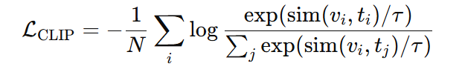
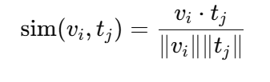
2. Self-Supervised Learning→ Contrastive Loss
Example CLIP:
Contrastive Language–Image Pretraining.
It’s a vision-language model (VLM) developed by OpenAI
N — number of image-text pairs in a batch.
vᵢ — visual embedding for the i-th image (from the vision encoder).
tᵢ — text embedding for the i-th text (from the text encoder).
τ: temperature scaling factor controlling sharpness (can be fixed or in CLIP learned)
controls how sharply the model distinguishes between positive and negative pairs.
sim() function defines how image and text embeddings are compared to measure how well they “match.”
bring the representations of matching image-text pairs (e.g., an image and its corresponding caption) closer together in a high-dimensional embedding space, while simultaneously pushing apart the representations of non-matching pairs.

Slide 25
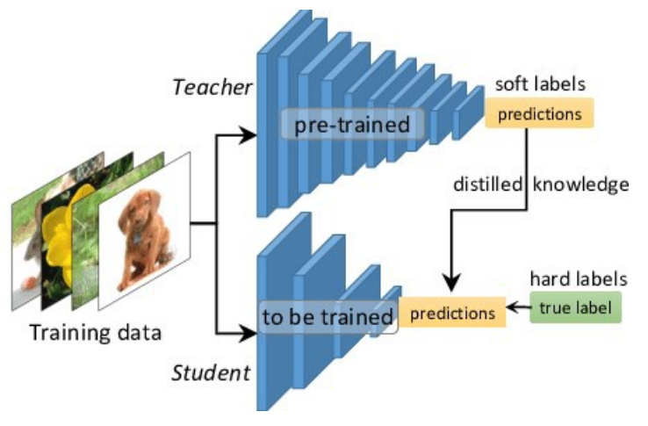
Training Concepts for Foundational Models → 3. Student-Teacher Training
Also called Knowledge Distillation or Teacher–Student Training.
  teacher is usually a larger, more accurate (but slower) model.
  student is a smaller, faster model trained to mimic the teacher’s predictions or representations.
Self-training on unlabeled data (pseudo-labeling).
Start with a competent teacher (maybe smaller). Use it to label huge unlabeled corpora, then train a larger student on the union of human-labeled + teacher-labeled data. The student can exceed the teacher (e.g., “Noisy Student” style for vision; analogous approaches in LLMs).

Slide 26
3. Student-Teacher Training
Distillation for real-world VLMs
Large generative or multimodal foundational models are too heavy for practical deployment.
Distillation — compressing the knowledge of a teacher into a smaller student
(e.g., MiniGPT-4 distilled from larger LLM + vision encoders).

Slide 27
Combo: SSL & Student-Teacher Training
SSL can produce the teacher model, which then supervises a lightweight student.
  In some designs, the student and teacher learn jointly (e.g., BYOL’s “online network” vs. “target network” — technically a student-teacher setup without explicit labels).
Modern large-scale models (like LLMs and vision transformers) often use both paradigms:
  SSL for pretraining on massive unlabeled corpora.
  Distillation to produce smaller versions for real-world deployment (e.g., DistilBERT, TinyBERT).

Slide 28
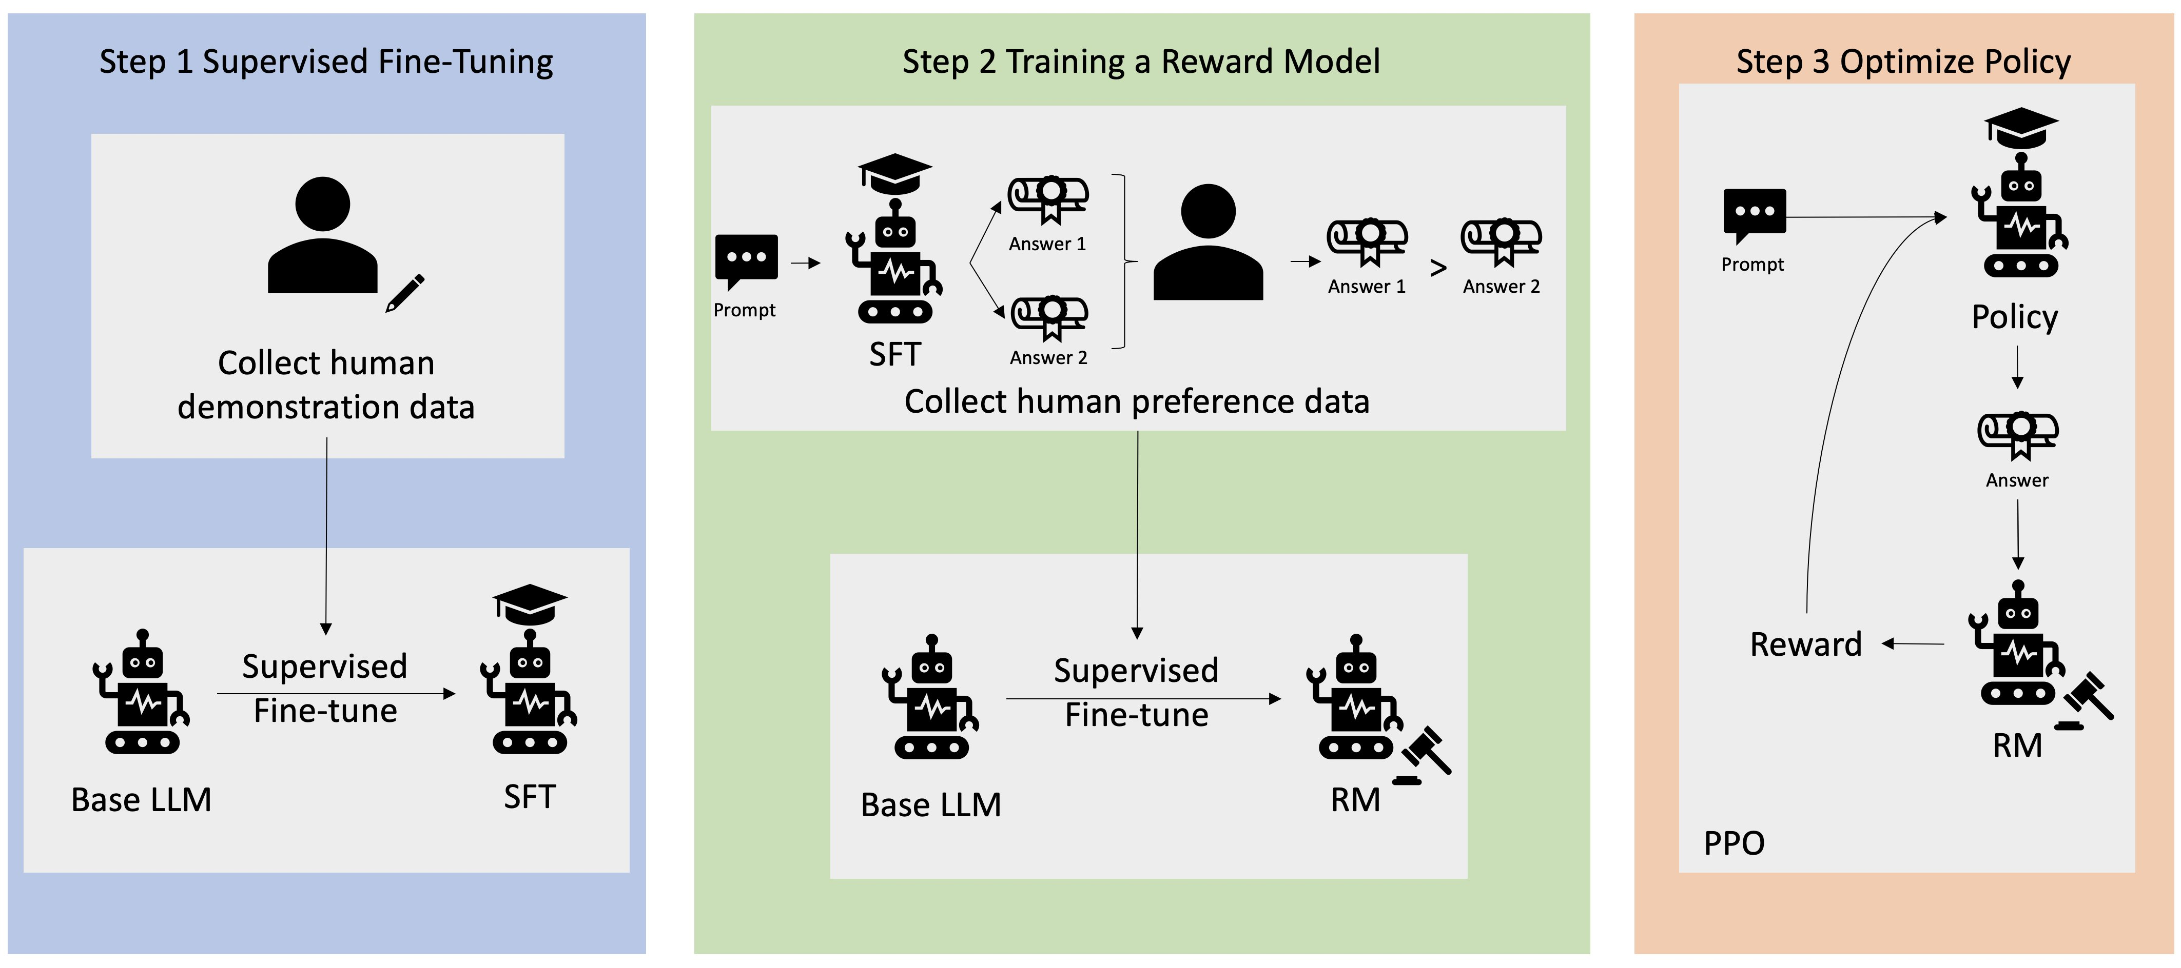
Training Concepts for Foundational Models → 4. Reinforcement Learning from Human Feedback (RLHF)
Aligns generative models with human values/preferences.
Pipeline: pretrain → fine-tune on labeled data → use reinforcement learning with human/AI preference signals.
Helps avoid toxic, irrelevant, or incoherent outputs.
SFT: Teach the model basic behavior with human-written examples.
Reward Model: Teach a smaller model to predict human preferences.
RL with PPO: Use that reward signal to fine-tune the main model so it consistently outputs responses people like.
This pipeline is how models like ChatGPT, InstructGPT, and many VLMs are aligned with human expectations after pretraining.
Next slides

Slide 29
4. Reinforcement Learning from Human Feedback (RLHF)
Step 1: Supervised Fine-Tuning (SFT)
Start with a base model (e.g., a pretrained language or vision-language model).
Collect human demonstration data — examples of prompts and the “ideal” answers written by humans.
Fine-tune the base model on this dataset so it learns to imitate high-quality, human-like responses.
Output is the SFT model (a teacher-like version, but still imperfect).

Slide 30
4. Reinforcement Learning from Human Feedback (RLHF)
SFT model output example
Input | Output
“Explain photosynthesis.” | “Photosynthesis is the process by which plants convert sunlight into energy.”

Slide 31
Reinforcement Learning from Human Feedback (RLHF)
Step 2: Train a Reward Model (RM)
Use the SFT model to generate multiple possible answers to the same prompt.
Humans compare these answers and say which one they prefer (e.g., “Answer 1 is better than Answer 2”).
These preferences become training data for a new model called the Reward Model.
  Input = prompt + candidate answer.
  Output = a score indicating how good that answer is, based on human preferences.
The Reward Model learns to approximate “what humans would prefer.”

Slide 32
Reinforcement Learning from Human Feedback (RLHF)
Step 2: Train a Reward Model (RM) –example prompting
Prompt | Response A | Response B | Human Prefers
“Explain gravity simply.” | “Gravity pulls objects toward each other.” | “Gravity is a quantum force field.” | A

Slide 33
Reinforcement Learning from Human Feedback (RLHF)
Step 3: Optimize Policy with PPO (Proximal Policy Optimization)
want to make the model itself align with human preferences.
Take the policy model (initialized from the SFT model).
For each prompt:
  The model generates an answer.
  The Reward Model scores that answer.
  That score acts as a reward signal.
Using PPO (a reinforcement learning algorithm), adjust policy model so it generates answers that maximize reward.
Result = aligned model: it responds in ways that humans prefer, balancing helpfulness, honesty, and safety.

Slide 34
Reinforcement Learning from Human Feedback (RLHF)
Step 3: Optimize Policy with PPO (Proximal Policy Optimization) – HOW IT WORKS>
3.1) the SFT model, (the “policy”) generates multiple responses to prompts.
3.2) The Reward Model (RM) scores them.
Using Reinforcement Learning (RL) — specifically Proximal Policy Optimization (PPO) — the SFT model’s parameters are adjusted to maximize the reward, i.e., to produce responses humans would rate highly.
PPO is a form of policy gradient optimization that prevents overly large, destabilizing updates (it keeps the policy close to its previous version).
A KL-divergence penalty is typically used to ensure the updated model doesn’t drift too far from the original SFT behavior.
This step balances between: Staying close to what the model already knows (so it doesn’t “forget”), and Optimizing toward outputs that people prefer.

Slide 35
Reinforcement Learning from Human Feedback (RLHF)
Step 3: Optimize Policy with PPO (Proximal Policy Optimization) – HOW IT WORKS>
3.1) the SFT model, (the “policy”) generates multiple responses to prompts.
Prompt:
“Explain why recycling is important.”
The SFT model might generate several candidate responses:
Response A:
“Recycling helps reduce waste, conserve resources, and minimize environmental pollution.”
Response B:
“Recycling is good because if you don’t do it, the planet will get worse.”
Response C:
“Recycling is important because it keeps the Earth healthy and saves materials for future use.”

Slide 36
Reinforcement Learning from Human Feedback (RLHF)
We want a function that
will choose the output
will higher reward
Step 3: Optimize Policy with PPO (Proximal Policy Optimization) – HOW IT WORKS>
3.2) The Reward Model (RM) scores them.
Response | Reward (Predicted Human Preference)
A | +0.92 (accurate, complete, polite)
B | +0.30 (too informal, less clear)
C | +0.80 (good, but slightly less detailed than A)
Response A:
“Recycling helps reduce waste, conserve resources, and minimize environmental pollution.”
Response B:
“Recycling is good because if you don’t do it, the planet will get worse.”
Response C:
“Recycling is important because it keeps the Earth healthy and saves materials for future use.”

Slide 37

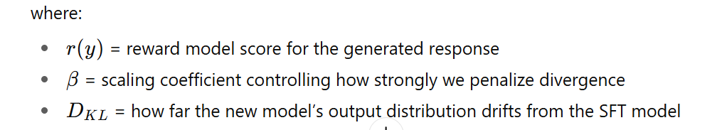
Reinforcement Learning from Human Feedback (RLHF)
STEP 3.2) The Reward Model (RM) scores them.
DKL = KL-divergence (Kullback–Leibler) penalty typically used to ensure updated model doesn’t drift too far from original SFT behavior.
  measures how different one probability distribution is from another — essentially, how much the new model’s behavior diverges from the old one.
want a function to choose the output with higher reward –but NOT too fast
x = prompt
y = model output
Loss function to minimize
πnew(y∣x): current policy model probability distribution (after an RL update) —how it now chooses responses.
πref(y∣x): reference model probabiity distribution (before RL update)
Next slide

Slide 38
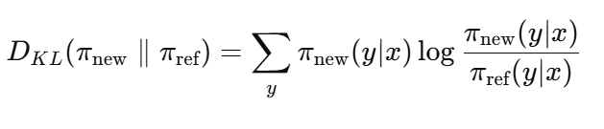
Reinforcement Learning from Human Feedback (RLHF)
STEP 3.2)
DKL = KL-divergence (Kullback–Leibler) = measures how different one probability distribution is from another — essentially, how much the new model’s behavior diverges from the old one.
x = prompt
y = model output
If both models assign similar probabilities to the same outputs → Dₖₗ is small (close to 0)
If the new model assigns very different probabilities → Dₖₗ is large
πnew(y∣x): current policy model probability distribution (after an RL update)
πref(y∣x): reference model probabiity distribution (before RL update)

Slide 39
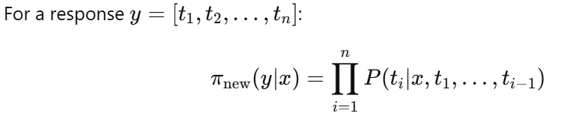
Reinforcement Learning from Human Feedback (RLHF)
Estimating Probability Distributions π(y∣x):
As SUM of token probabilities
x = prompt
y = model output
Prompt (x): “What color is the sky?”
Response (y): “The sky is blue.”
Token | Probability
“The” | 0.20
“sky” | 0.35
“is” | 0.40
“blue.” | 0.70
πnew​(y∣x)= 0.20×0.35×0.40×0.70 = 0.0196

Slide 40
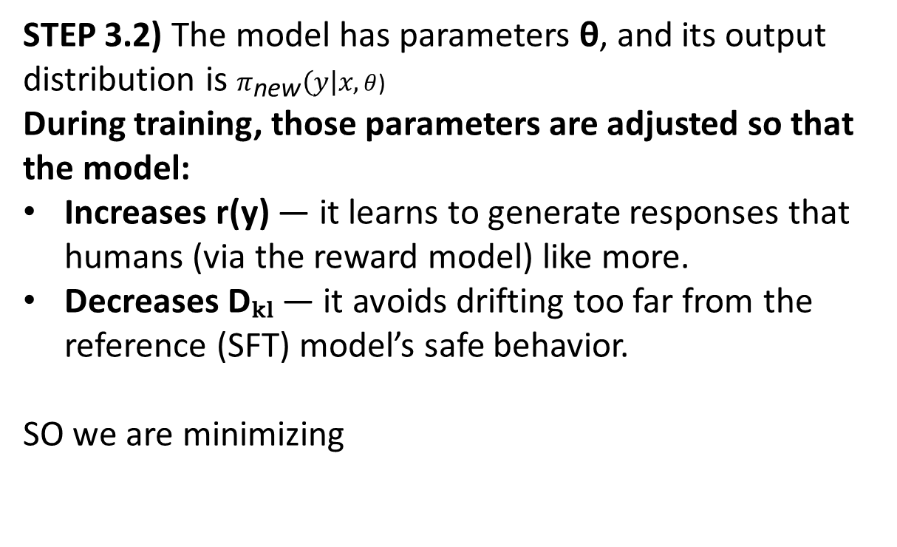
Reinforcement Learning from Human Feedback (RLHF)
STEP 3.2) The model has parameters θ, and its output distribution is $π_{\text{new}}\left(y\right|x,θ$)
During training, those parameters are adjusted so that the model:
Increases r(y) — it learns to generate responses that humans (via the reward model) like more.
Decreases Dₖₗ — it avoids drifting too far from the reference (SFT) model’s safe behavior.
SO we are minimizing
x = prompt
y = model output
πnew(y∣x): current policy model probability distribution (after an RL update) —how it now chooses responses.
πref(y∣x): reference model probabiity distribution (before RL update)

Slide 41
Reinforcement Learning from Human Feedback (RLHF)
AFTER ENOUGH TRAINING
If you ask again, “Explain why recycling is important,”
likely output:
“Recycling is important because it conserves natural resources, reduces energy consumption, and helps minimize pollution, contributing to a more sustainable environment.”
This output reflects SFT’s structure (grammatical, coherent) + RLHF alignment (polite, comprehensive, human-preferred tone).

Slide 42
Suggestions 2025 | CNNs | Vision Transformers (ViTs) | Foundation Models
Efficiency / Latency / Power | Very efficient; good for edge | Moderate efficiency | Least efficient; heavy compute
Accuracy (Typically) | High on small/ medium data | Higher with large data | Highest; state-of-the-art
Dataset Size | Works well with small/medium | Needs large datasets | Trained on web-scale data
Cost for Development | Low | Medium–High | Very high (train); API use easier
Tasks | Real-time, embedded, small-data vision, classification, segmentation, det. | Classification, detection, segmentation, captioning | Few/Zero-shot, multimodal, captioning, generative, various (weaker det., regression)

Slide 43
Future Trends and Conclusion
Ongoing Research and Development: Continuous innovation is pushing the boundaries of what foundational models can achieve. Efforts are focused on enhancing efficiency, interpretability, reducing computational demands, and broadening applicability through self-supervised learning methods.
Integration with Other AI Technologies: into VLA (vision + language + action)
Potential Impact on Various Industries: Large vision models will continue transforming industries. In healthcare, they support diagnostics and drug discovery. In manufacturing, they advance quality control and efficiency. In retail, they enhance customer experiences via recommendations and automation. In transportation, they power safer autonomous systems.
Conclusion: The trajectory of large vision models is remarkable. From classification to multimodal fusion, these models are now pivotal players in advancing AI. Their democratization and integration across sectors mark them as indispensable tools for shaping the future of technology and society.

Slide 44
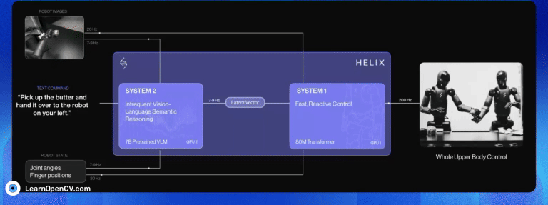
VLA – Vision Language Action models

Slide 45

What is Embodied AI?
- AI that interacts w/ the PHYSICAL world
- Can see, understand, and take actions.
Ex: A robot that follows the command "bring me a cup."
- Combines vision, language, and movement.
- Distinct from our existing VLM Foundation models ChatGPT or CLIP, which lack direct interaction with the physical world.

Slide 46
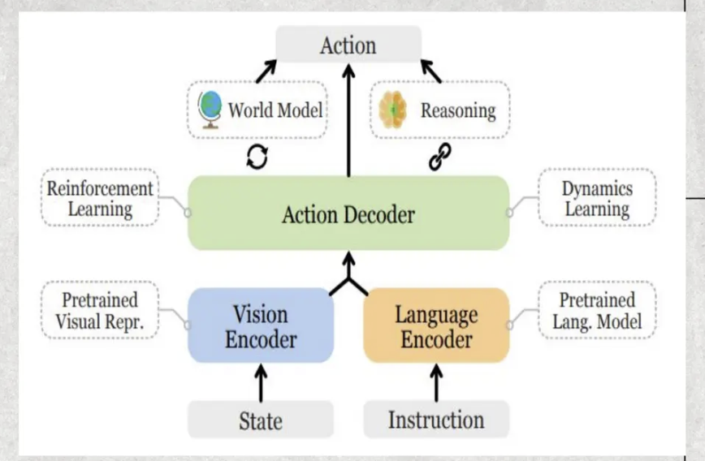
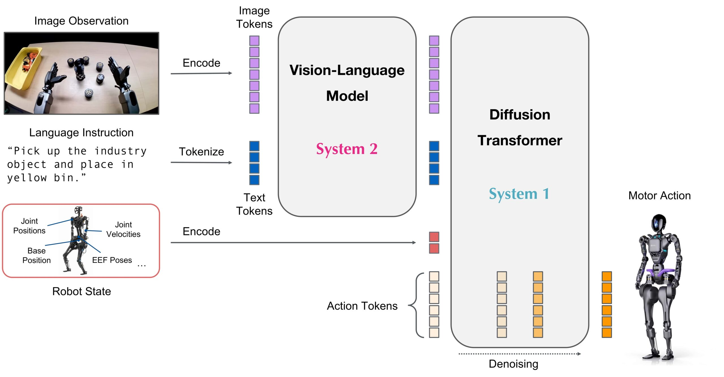
What are VLA Models?
- Vision Encoder processes visual state inputs.
- Language Encoder processes instructions.
- Action Decoder integrates both encoders with reinforcement learning and dynamics learning, guided by world models and reasoning modules.

Slide 47
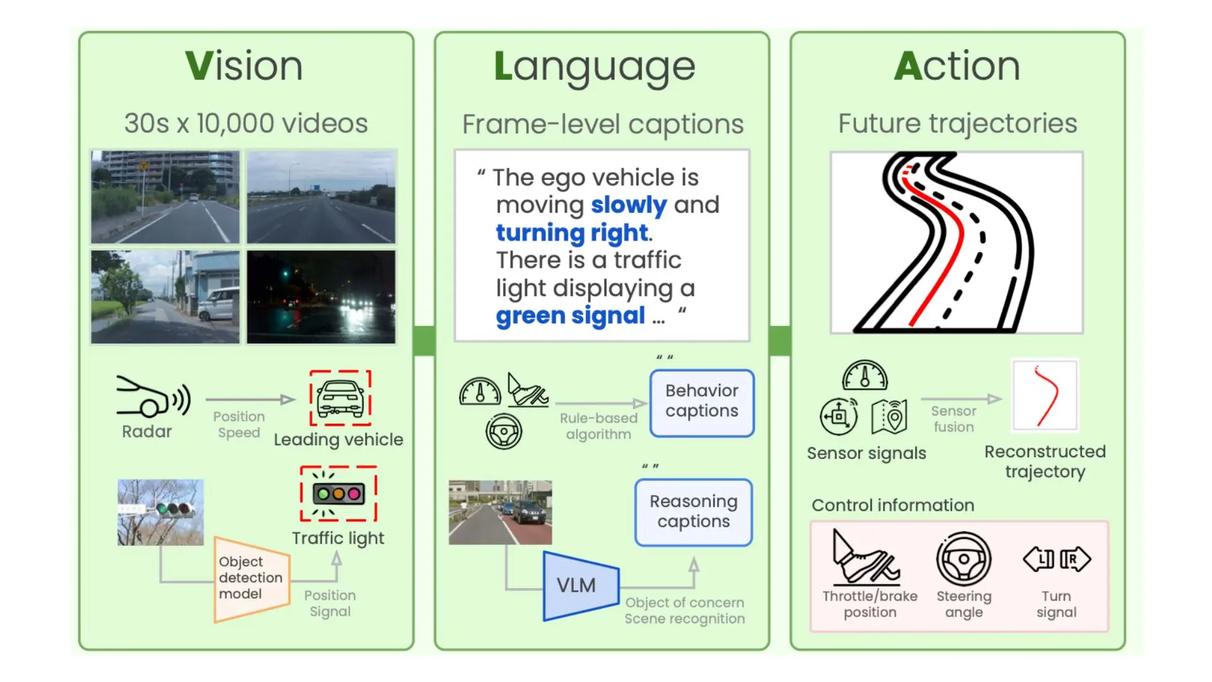
VLA -> for Self driving cars

Slide 48
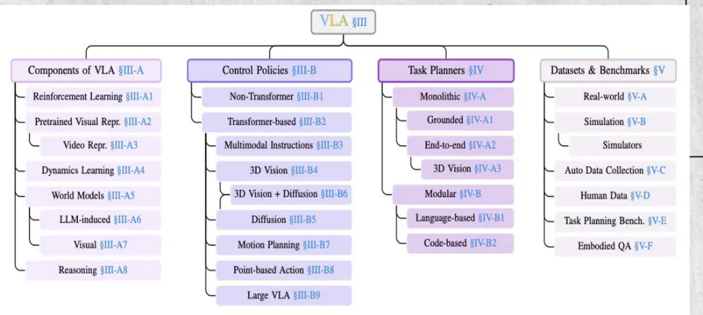
3 Main Parts of VLA Models
1. Components:
- Visual and language encoders
- World models
2. Low-Level Control:
- Executes small step actions (e.g., move, pick)
3. High-Level Planners:
- Break down large tasks into smaller steps
Benefits:
- Hierarchical design allows models to plan and act more effectively.
- Comparable to a team structure: the planner acts as the 'brain' while the controller serves as the 'hands.'
World Model
internal representation of the environment that helps an AI agent predict, plan, and act.
Instead of reacting purely to raw inputs (like camera frames), a world model builds a latent “mental map” of how the world works.
can simulate possible futures, predict the results of actions, and reason about unseen situations.
Inspired by how humans and animals form mental models of the world to plan their actions.

Slide 49
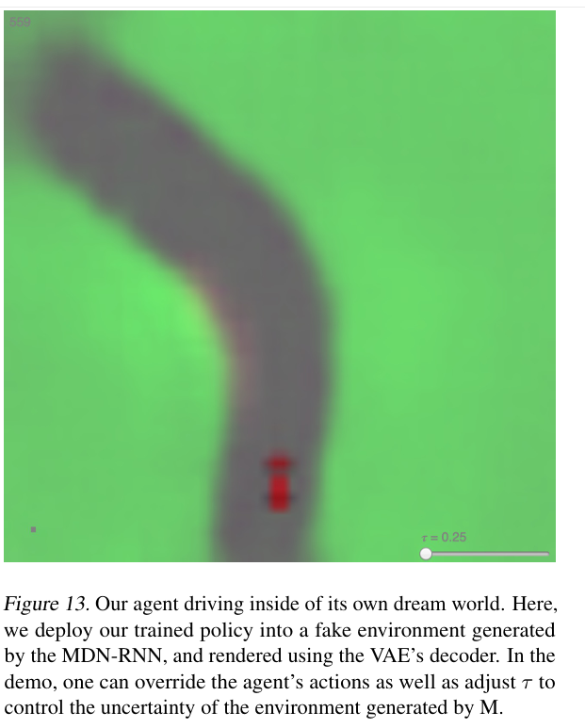
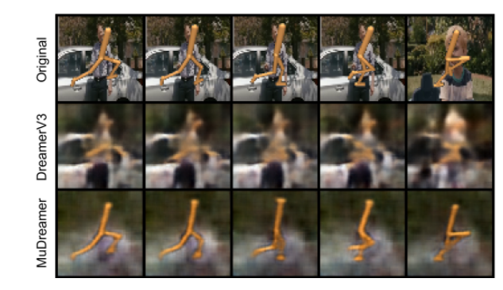
World model examples
Ha & Schmidhuber (2018) – World Models
Early work where a model learned a compressed latent representation of environments (like Atari or CarRacing) and used it to imagine trajectories.
DreamerV3 (DeepMind, 2023)
Learns a latent world model from pixels and rewards.
Can plan actions by “dreaming” about futures in latent space.
Mujoco / Robotics with VLMs
Open-source by DeepMind, is a physics engine designed for robotics, machine learning, and biomechanics
World models predict physics outcomes: if I push a cup, where will it go?
help integrate language commands (“place the cup on the table”) with predictions of how actions will affect the world.
Gato (DeepMind, 2022)
A multimodal agent (text, vision, actions) that implicitly contains a world model across different tasks and robots.

Slide 50
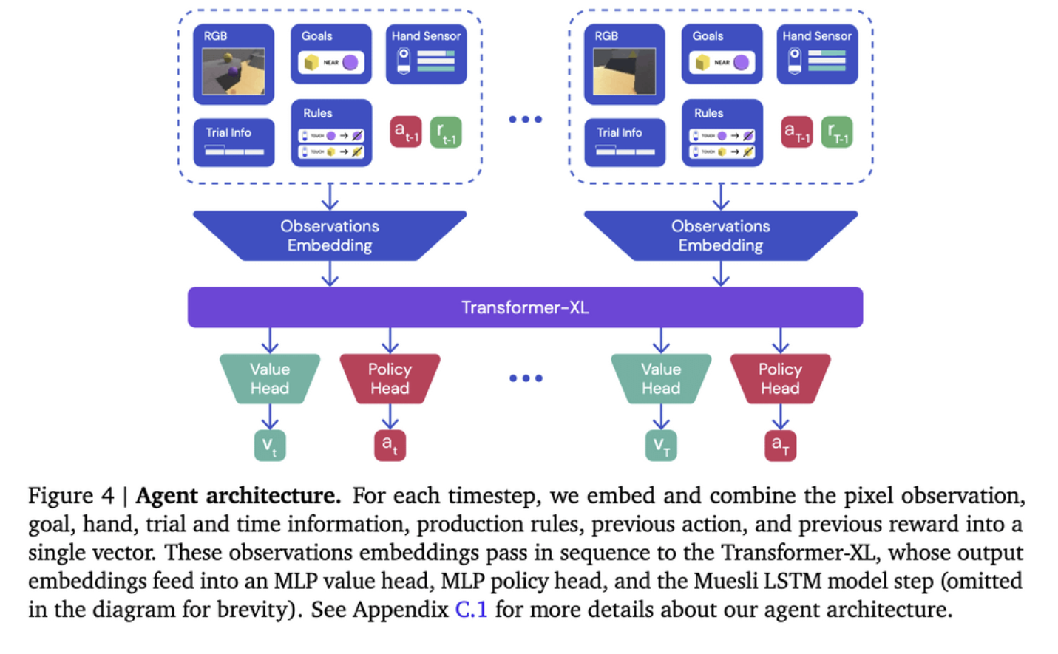
Dreamer V3 World Model –featuring Reinforcement Learning
Goal= playing
Minecraft
Game

Slide 51
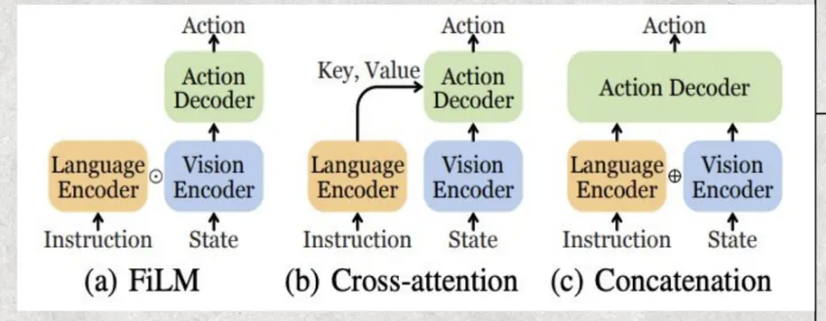
Low-Level Control
Definition:
- Low-level control involves executing small, fine-grained actions such as picking, moving, or turning.
- Uses real-time information from cameras combined with instructions.
Common Methods:
- FiLM: Adjusts vision using language.
- Cross-Attention: Deeply connects vision and language.
- Concatenation: Joins both inputs together for decision-making.
Representative Models:
- CLIPort
- BC-Z
- RT-1
- UniPi
Notes:
- Some models use transformers.
- Others even learn control behaviors directly from videos.

Slide 52
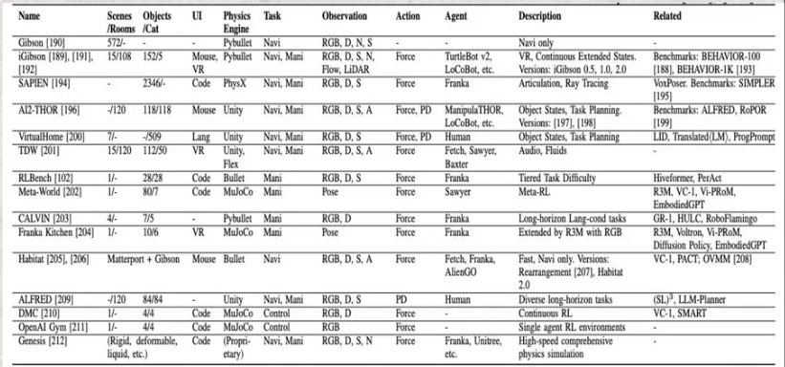
Training Data and Benchmarks
Challenges with Training Data:
- Real robot data is difficult and expensive to collect.
- Simulators (e.g., Habitat, AI2-THOR) are often used for faster and safer training.
- Some models learn from human videos or internet data.
Importance:
- Benchmarks are crucial for fair comparison across different VLA models.
Benchmarks for Testing Models:
- EmbodiedQA: tests asking and exploring capabilities.
- RLBench: evaluates robot manipulation.
- EgoPlan / PlanBench: assess planning skills.

Slide 53
Challenges
- Real data is hard to obtain; robot demonstrations are time-consuming.
- Models tend to be slow and need to act faster in real-world scenarios.
- Systems are complex, requiring many components to work together seamlessly.
- Difficulty generalizing to new tasks.
- Lack of standard benchmarks makes it hard to compare models fairly.
- Safety is critical; robots must earn human trust in real environments.

