Slide 1
Machine Learning – Training (how it learns)

Slide 2
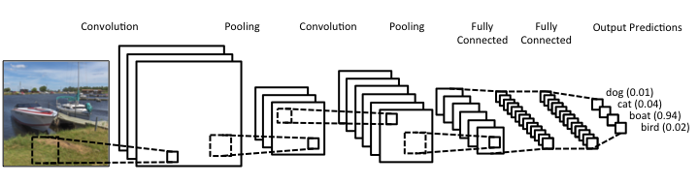
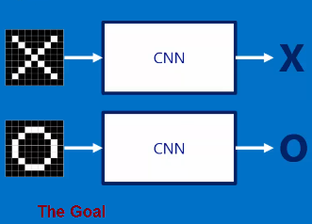
Remember our CNNs
Convolutional layers + FC layers

Slide 3
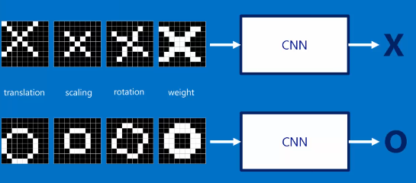
To learn we present our networks with Training data

Slide 4
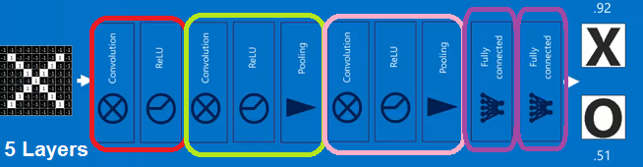
The output of presenting an Image
Output Vector , here [0.92 0.51]
IT is NOT CORRECT → NEED to modify our network parameters (weights) a LITTLE to get better results

Slide 5
How Do we LEARN
Some form of Backpropogation of the error to alter the weights a little to move towards the right answer
DIFFERENCE [1 0 ] - [0.92 0.51 ] = [0.08 0.49]

Slide 6

Altering the Weights: Training
Choose parameters to minimize error on training set
Stochastic gradient descent, computing gradient using trick (backpropagation, aka the chain rule)
Stop when error is low, and hasn’t changed much
E = ½ Σ_{i} (t_{i} – o_{i}) ²
^{where} o_{i} ^{is output node i &} t_{i} ^{is the correct value}

Slide 7
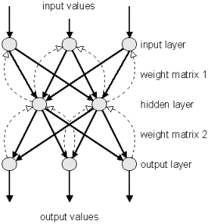
Backpropagation Learning of NN Weights for the Fully Connected Layers of our CNN.
Idea, feedback error signals to alter weights in attempt to reduce final error.
Keep doing until you get “good enough” results for you.
Lots of SW packages for NN out there.

Slide 8
Back propagation Algorithm
The back propagation learning algorithm can be divided into two phases:
Phase 1: Propagation
  Forward propagation of a training pattern's input through the neural network in order to generate the propagation's output activations.
  Backward propagation of the propagation's output activations through the neural network using the training pattern target in order to generate the deltas (the difference between the input and output values) of all output and hidden neurons.
Phase 2: Weight update
  Multiply its output delta and input activation to get the gradient of the weight.
  Subtract a ratio (percentage) of the gradient from the weight.

Slide 9
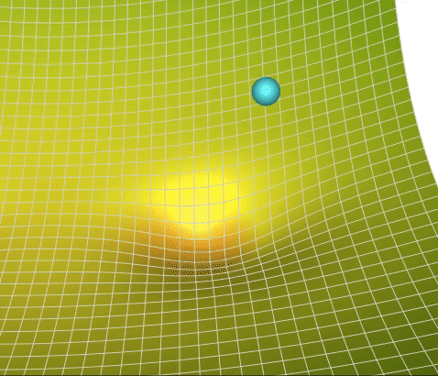
What is gradient descent algorithm??
Back propagation calculates the gradient of the error of the network regarding the network's modifiable weights.
This gradient can be calculated as a simple stochastic gradient descent algorithm to find weights that minimize the error.
delta = - learning_rate * gradient
theta += delta
E(W)
w₁
w₂

Slide 10
More….Delta Rule
The delta rule is used for calculating the gradient that is used for updating the weights.
We will try to minimize the following error:
E = ½ Σ_{i} (t_{i} – o_{i}) ²
For a new training example X = (x₁, x₂, …, x_{n}), update each weight according to this rule:
    w_{i} = w_{i} + Δw_{i}
  where, Δw_{i}= -n * E’(w)/w_{i}

Slide 11
To learn more about backprop
Go to our website to learn more about backprop & how it happens in the convolutional layers

Slide 12
Batch Size = How often do we update weights
Do you really want to update after showing each training image?
Results may be erratic –showing very little data (1 sample) before altering network

Slide 13
Batch Size
Number of examples from the training dataset used in the estimation of the error gradient for an update of the model weights.
For example, A batch size of 32 means that 32 samples from the training dataset will be used to estimate the error gradient before the model weights are updated.

Slide 14
Batch Size & Gradient Descent
Batch Gradient Descent . Batch size is set to the total number of examples in the training dataset.
Stochastic Gradient Descent . Batch size is set to one.
Minibatch Gradient Descent . Batch size is set to more than one and less than the total number of examples in the training dataset.

Slide 15
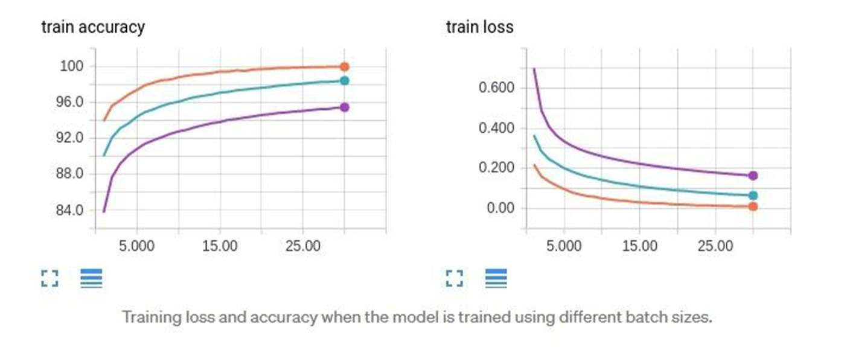
Batch Size
For this dataset all the tried batch sizes work however smaller than 64 this would possibly yield too much variation and make learning unstable.
In the below graph we will see the effect of batch size on training/testing accuracy and loss
64 batch size 256 batch size 1024 batch size

Slide 16
Batch size
Smaller Batch Size: Typically leads to slower convergence per epoch because fewer examples are processed at once. However, since the model's weights are updated more frequently, it might reach an optimal solution in fewer epochs.
Larger Batch Size: Utilizes hardware resources more efficiently (especially GPUs and TPUs), leading to faster per-epoch training times. However, due to less frequent weight updates, it might take more epochs to converge.

Slide 17
Batch Size TIPS
●Too large of a batch size can lead to poor generalization
●Using smaller batch sizes leads faster convergence to “good” solutions.
●Smaller batch sizes allow the model to “start learning before having to see all the data.”
●The downside of using a smaller batch size is that the model is not guaranteed to converge to the global optima.
●Smaller batch sizes make it easier to fit one batch worth of training data in memory (i.e. when using a GPU).

Slide 18
Learning Rates
Different learning rates affect the performance of a neural network significantly.
Learning rate relates to HOW much you change the weights ---recall
  Phase 2: Weight update
    Multiply its output delta and input activation to get the gradient of the weight.
    Subtract a ratio (percentage) of the gradient from the weight.
Update each network weight: (this is going from node i to node j)
W_{ji} = W_{ji} + Δw_{ji}
where Δw_{ji} = η δ_{j} X_{ji} (W_{ji} and X_{ji} are the input and
weight of node i to node j)

Slide 19
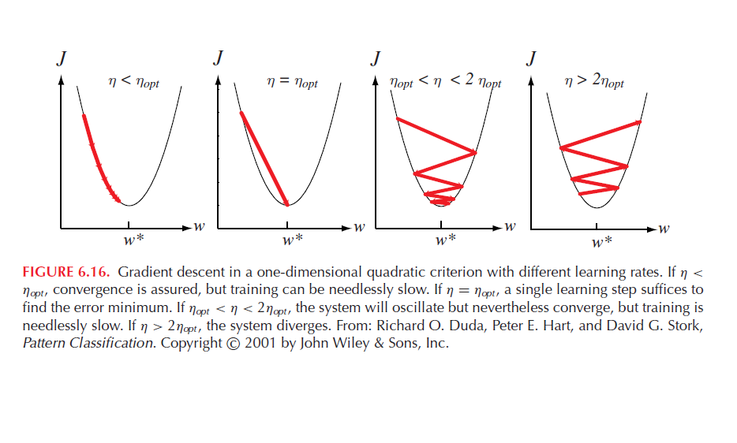
Learning Rates

Slide 20
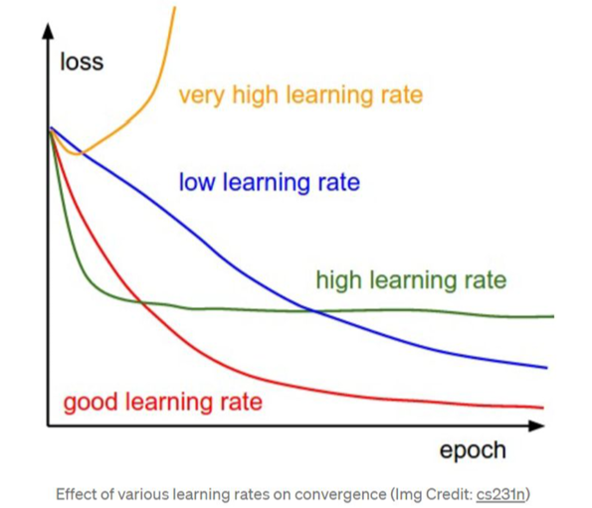
Learning Rates
Too high and will not converge

Slide 21
WARNING: learning rate too high
TIP: IF YOU ARE SEEING YOUR LOSS rising to infinity:
NOW this idea of going VERY HIGH in loss --there is a real problem there ---open possibility is divergence from a TOO large learning rate ..https://stackoverflow.com/questions/40050397/deep-learning-nan-loss-reasons
LOWER LEARNING RATE (how much?): Drop it by 1 to 3 orders of magnitude meaning multiple number by 0.1 to 0.001 to see if a lower learning rate will help
Lower the learning rate generally means you need to train more epochs (as it is learning more slowly)

Slide 22
Limitations of the back propagation algorithm
It is not guaranteed to find global minimum of the error function. It may get trapped in a local minima,
  Improvements,
    Add momentum.
    Use stochastic gradient descent.
    Use different networks with different initial values for the weights.
Back propagation learning does not require normalization of input vectors; however, normalization could improve performance.
  Standardize all features previous to training.

Slide 23
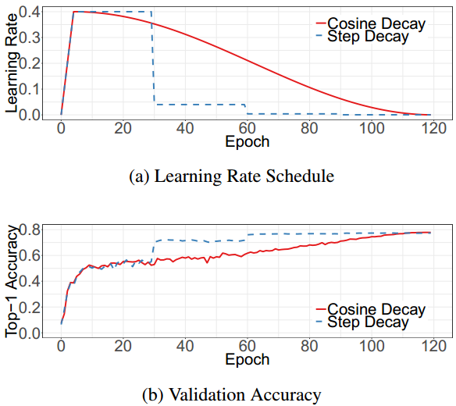
Learning Rate Functions
You can vary the rate.
You can have an initial “warm up” rate that is larger (to jump out of local minimums
Go to our website to learn about different Learning Rate Functions & Learning Rate Algorithms.

Slide 24
Learning Algorithms --not just gradient descent
Go to our website to learn about different Learning Rate Functions & Learning Rate Algorithms.

Slide 25
Remember Gradient Descent
. This works fine if your starting point is in the valley of the global minimum.
delta = - learning_rate * gradient
theta += delta

Slide 26
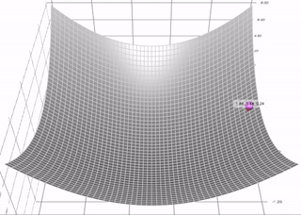
Momentum
) borrows the idea from physics. Imagine rolling down a ball inside of a frictionless bowl. Instead of stopping at the bottom, the momentum it has accumulated pushes it forward, and the ball keeps rolling back and forth. Here is an illustration of the idea

Slide 27
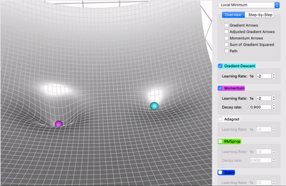
Momentum
In each step, in addition to the regular gradient, it also adds on the movement from the previous step. Mathematically, it is commonly expressed as:
  delta = - learning_rate * gradient + previous_delta * decay_rate (eq. 1)
  theta += delta (eq. 2)
This can be rewriten as :
  sum_of_gradient = gradient + previous_sum_of_gradient * decay_rate (eq. 3)
  delta = -learning_rate * sum_of_gradient (eq. 4)
  theta += delta (eq. 5, weight change)
  decay rate usually falls in
  range of 0.9 to 0.999
  Momentum and
  Gradient Descent>>>>

Slide 28
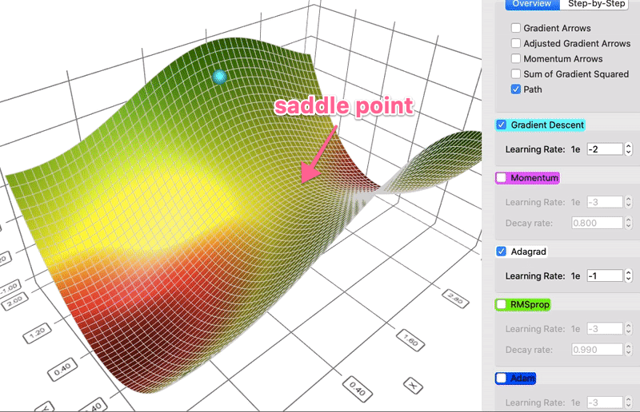
AdaGrad
Instead of keeping track of the sum of gradient like momentum, the Adaptive Gradient algorithm, or AdaGrad for short, keeps track of the sum of gradient squared and uses that to adapt the gradient in different directions. Often the equations are expressed in tensors. I will avoid tensors to simplify the language here. For each dimension:
  sum_of_gradient_squared = previous_sum_of_gradient_squared + gradient²
  delta = -learning_rate * gradient / sqrt(sum_of_gradient_squared)
  theta += delta
  AdaGrad and Gradient Descent>>

Slide 29
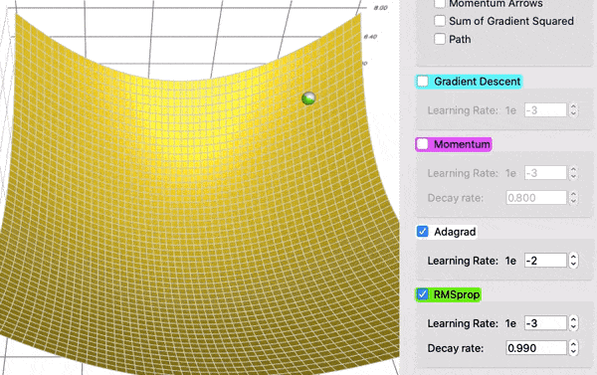
RMSProps
Root Mean Square Propagation, Instead of accumulating all past squared gradients, RMSProp uses an exponential decay that discards history from the extreme past so that it can converge rapidly after finding a convex bowl, as if it were an Adagrad with a fresh start.
  sum_of_gradient_squared = previous_sum_of_gradient_squared * β + gradient² * (1- β )
  delta = -learning_rate * gradient / sqrt(sum_of_gradient_squared + ɛ)
  theta += delta
  β = decay rate, Determines how quickly the
  moving average of squared gradients decays.
  A common default value is 0.9, which balances
  the contribution of recent and past gradients
  decay rate usually falls in range of 0.9 to 0.999
  ɛ = is a small constant to prevent divide by 0
  RMSProps & AdaGrad >>>>>>>

Slide 30
Adam
Adaptive Moment Estimation) takes the best of both worlds of Momentum and RMSProp. Adam empirically works well, and thus in recent years, it is commonly the go-to choice of deep learning problems.
Let’s take a look at how it works:
  [Momentum- where beta1= Momentum decay rate]
  sum_of_gradient = previous_sum_of_gradient * beta1 + gradient * (1 - beta1)
  [RMSProp, where beta2 = RMSProp decay rate]
  sum_of_gradient_squared = previous_sum_of_gradient_squared * beta2 + gradient² * (1- beta2)
  delta = -learning_rate * sum_of_gradient / sqrt(sum_of_gradient_squared + ɛ )
  theta += delta

Slide 31
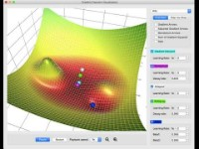
COMPARISONS

Slide 32
Which algorithm???
of the above I recommend Adam) ...more AMSGrad, NAdam,....
use framework implementations -e.g. Tensorflow optimizers
try different ones, experience, look to literature for examples, an active research area
Some TEnsorflow Options:
class Adadelta: Optimizer that implements the Adadelta algorithm.
class Adagrad: Optimizer that implements the Adagrad algorithm.
class Adam: Optimizer that implements the Adam algorithm.
class Adamax: Optimizer that implements the Adamax algorithm.
class Ftrl: Optimizer that implements the FTRL algorithm.
class Nadam: Optimizer that implements the NAdam algorithm.
class Optimizer: Base class for Keras optimizers.
class RMSprop: Optimizer that implements the RMSprop algorithm.
class SGD: Gradient descent (with momentum) optimizer

