Slide 1
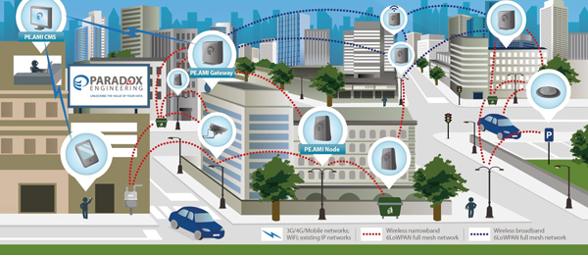
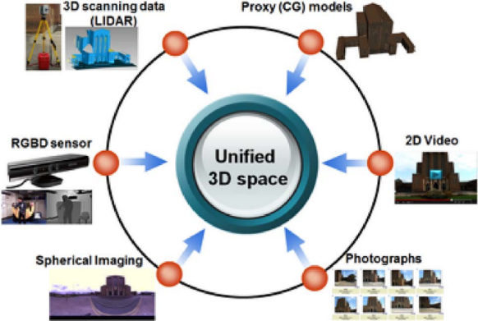
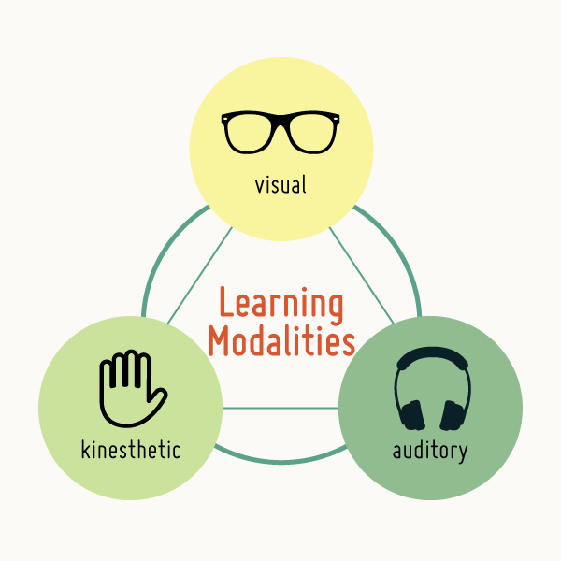
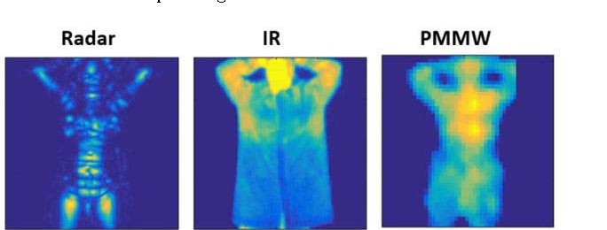
Multimodal Deep Learning: Issues and Solutions for Creating Well Performing Systems
Lynne Greweª
ªComputer Science, California State University East Bay, 25800 Carlos Bee Boulevard, Hayward, CA USA, 94542
Machine Learning in/with Information Fusion and Understanding Panel

Slide 2
Outline
Comparing Multimodal DL and conventional Multimodal ML
Multimodal Correlation / Alignment
The Fusion Stage & Multimodal Impacts– early, mid, late
Dealing with Multi-modal Data Issues (lack, missing)- Transfer Learning, Pretraining w/AutoEncoder, Perturbation, Generative Networks
Multi-modality Complexity & Performance – Attention Mechanisms.

Slide 3
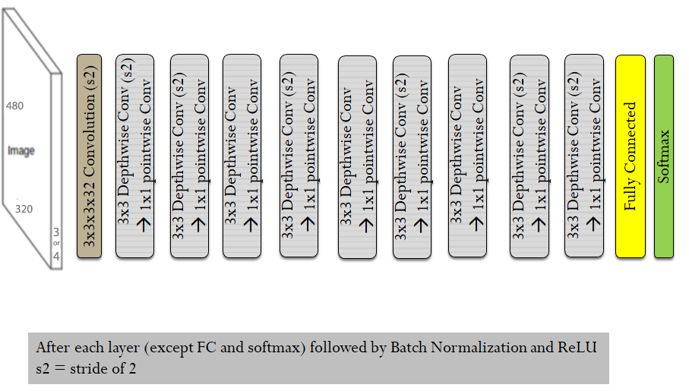
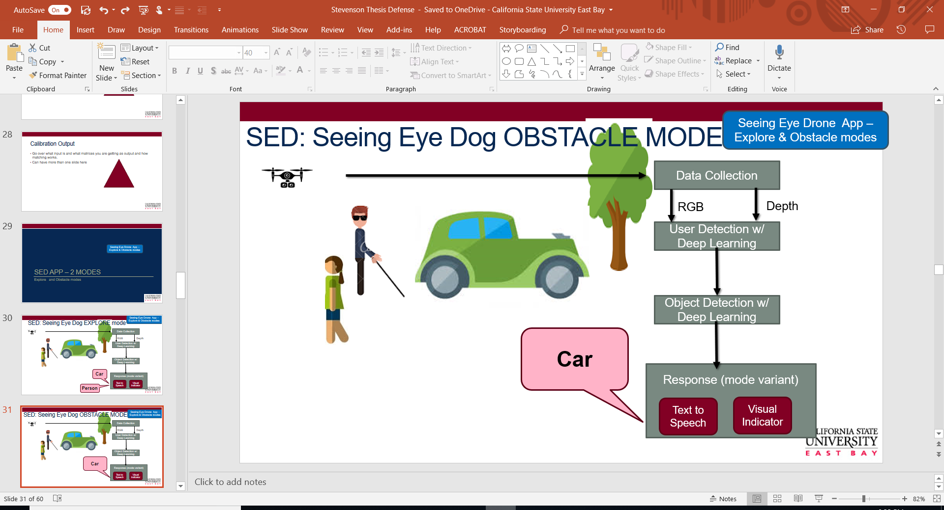
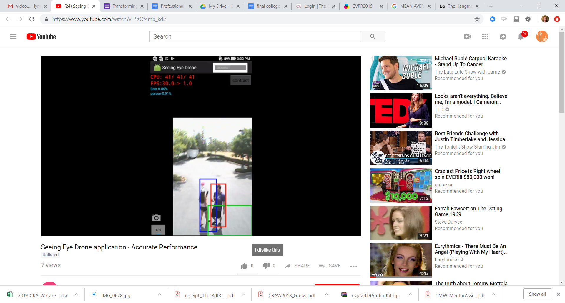
Seeing Eye Drone
RGB
Depth
Mobility for low vision

Slide 4
Comparing Multimodal DL and conventional Multimodal ML
Multimodal Deep Learning | Multimodal Conventional Learning
Both modality-wise representations (features) and shared (fused) representations are learned from data. | Features are manually designed and require prior knowledge about the underlying problem and data.
Requires little or no preprocessing of input data (end-to-end training). | Some techniques, like early fusion, may be sensitive to data preprocessing.
Supports early, late, or mid fusion. | Typically performs early or late fusion.
Fusion architecture can be learned during training | Rigid fusion architecture usually handcrafted.
Deeper, complex networks typically require large amounts of training data | May not require as much training data
Numerous hyperparameter tunings vital for state-of-art performance. | May not have as many hyperparameters as deep-learning architectures.
Compute intensive, requires powerful graphics processing units (GPUs) for reasonable training time. | GPUs may offer speed-up, but not critical.
May have faster run times | Run times may be slower

Slide 5
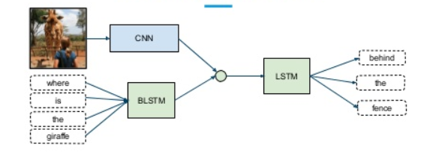
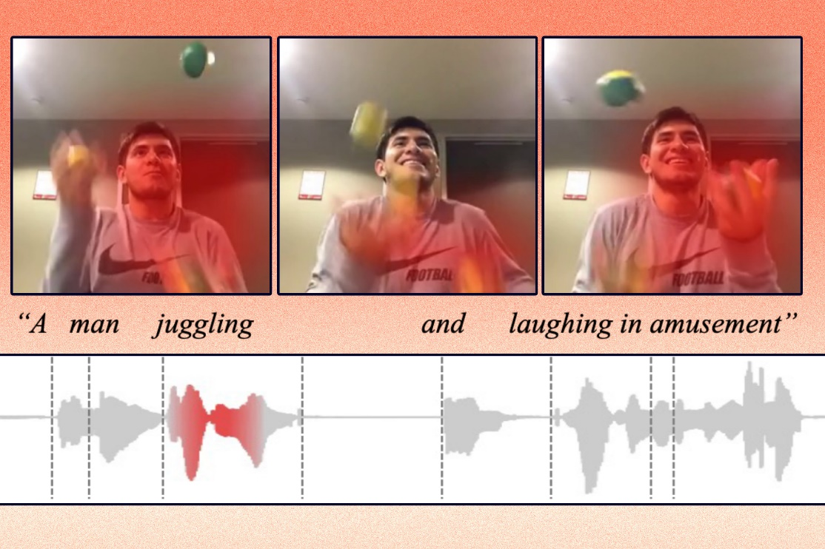
Multi-modal learning
Most common: Video/Images + Audio or Video/Images + Text or Video/Images + Audio + Text
Sometimes it means different kinds of images (IR, Photometric, 3D, etc.) coming from different sensors
Related Concept: Multi-Sensor (fusion)
from
https://news.mit.edu/2022/ai-video-audio-text-connections-0504

Slide 6
Multimodal data Alignment/Correlation

Slide 7
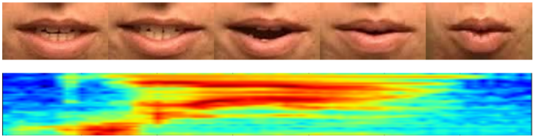
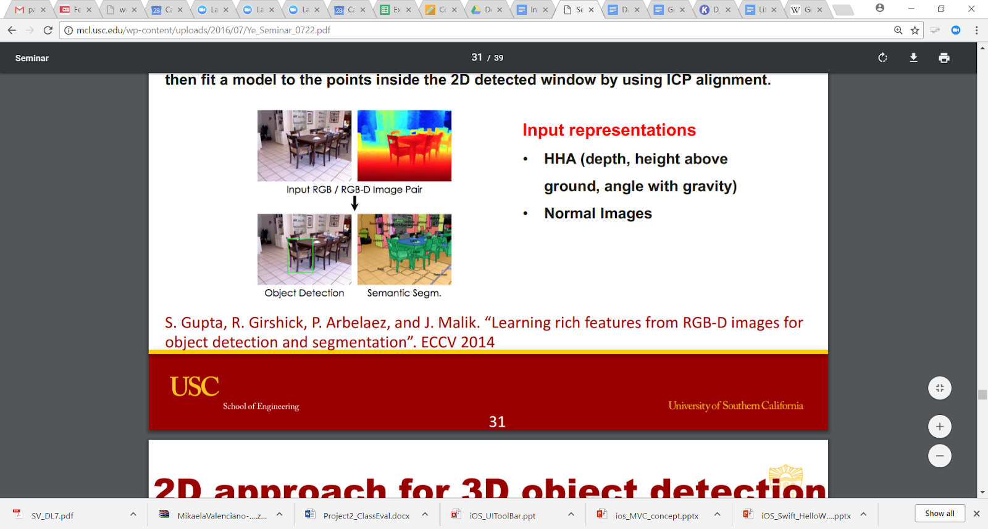
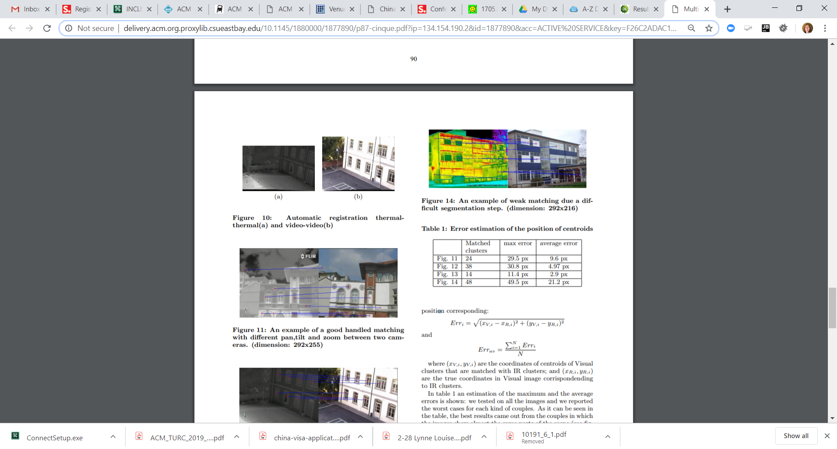
Modality Data Alignment/Correlation
Audio and Image Alignment
via Time Correlation
Time Correlation
Spatial Correlation
From L. Cinque, F. Di Renzo, et.al., “Multi-sensor registration for objects motion detection”, Proceedings of the first ACM international workshop on Analysis and retrieval of tracked events and motion in imagery streams, 2010.
From E. Patterson, S. Gurbuz, Z. Tufekci and J. Gowdy., “Moving-Talker, Speaker-Independent Feature Study and Baseline Results Using the CUAVE Multimodal Speech Corpus,” EURASIP Journal on Applied Signal Processing, vol. 2002, no. 11, pp. 1189-1201. (2002).

Slide 8
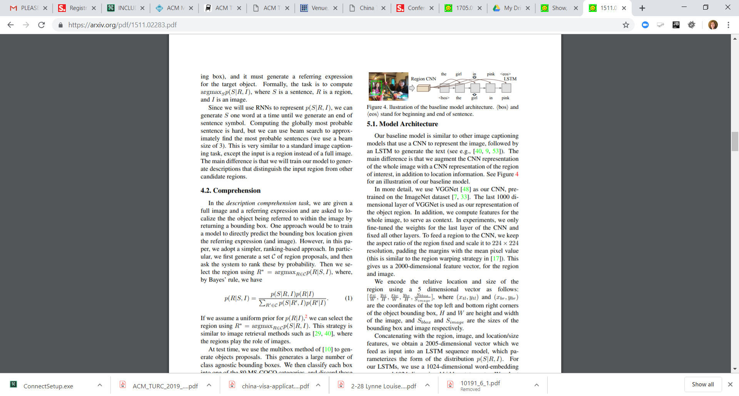
Modality Data Alignment/Correlation
Learning Correlation → applying DL to the task
Using a CNN followed by an LSTM to learn correlations for Text and Image
(note can be used for text generation/captioning) where a proposed region
is passed into the CNN.
From Mao, J. Huang, A. Toshev, O. Camburu, A. Yuille, and K. Murphy, “Generation and Comprehension of Unambiguous Object Descriptions,” in CVPR, 2016.

Slide 9
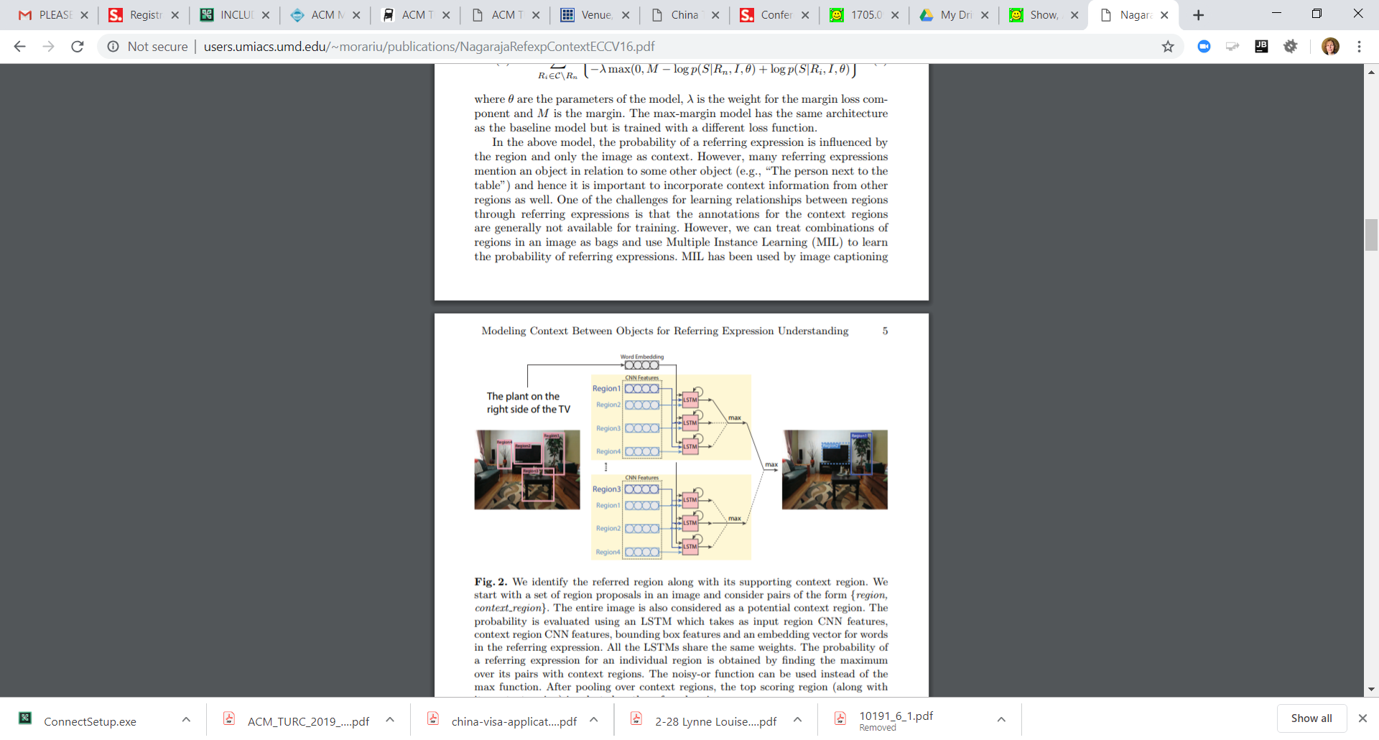
Modality Data Alignment/Correlation
Learning Correlation → applying DL to the task
Extension –here different keywords in sentence attributed to different regions
in the image
From L. Yu, P. Poirson, S. Yang, A. C. Berg, and T. L. Berg, “Modeling Context in Referring Expressions,” in ECCV, 2016.

Slide 10
Fusion Level and Multimodal

Slide 11
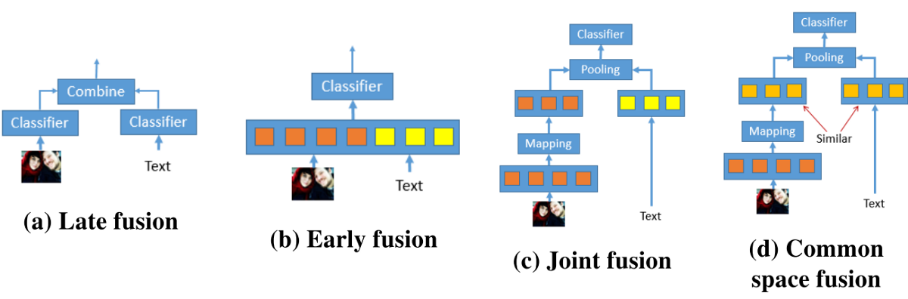



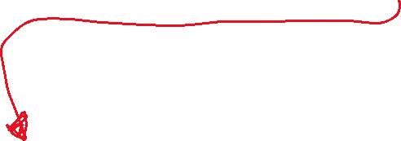
Multi-modal learning
Scope the problem in terms of “Multi-Sensor Fusion”.
Do you know the correlation between the data (timing alignment)?
Do you fuse or not?
  If you fuse is it early, mid or late
Do you convert from one modality to another?

Slide 12
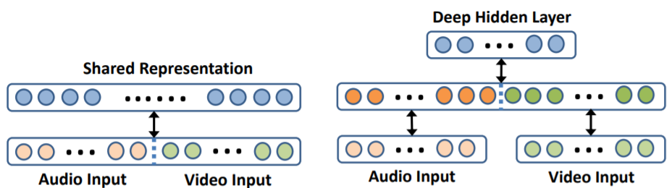
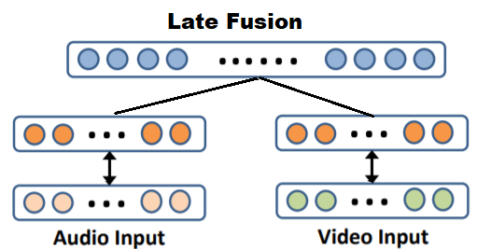
Another look – audio+video
EARLY Fusion
MID Fusion
LATE Fusion

Slide 13
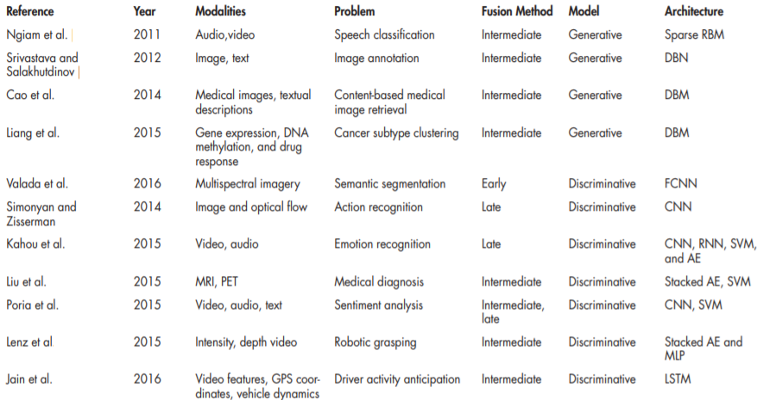
Different Systems –choosing different fusion levels
Mid
Mid
Mid
Mid
Mid
Early
Late
Late
Mid
Late
Mid &Late
Mid
Mid

Slide 14
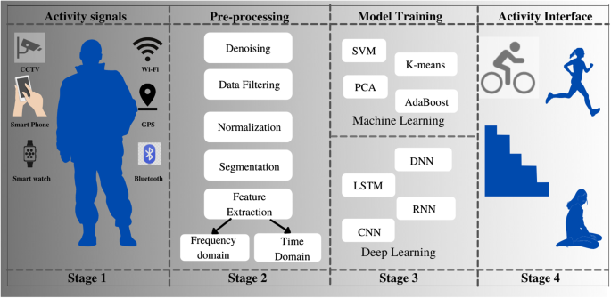
Multi-modal learning
Many options for techniques can be applied in different stages of the system of the recognition system

Slide 15
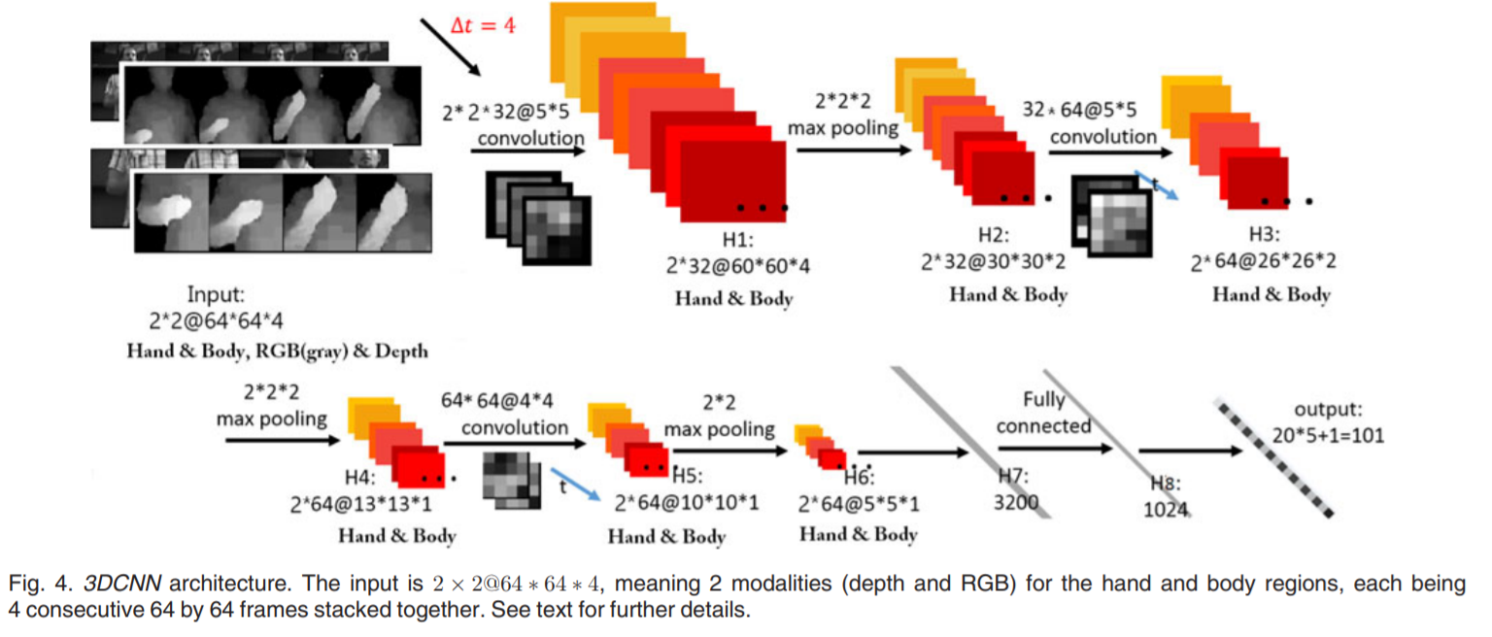
Early fusion example
3D and 2D image, here DL Network is a CNN
From D. Wu, L. Pigou, et. al, “Deep Dynamic Neural Networks for Multimodal Gesture
Segmentation and Recognition”, IEEE Transactions of Pattern Analysis and
Machine Intelligence, Vo. 38, No. 8, 2016

Slide 16
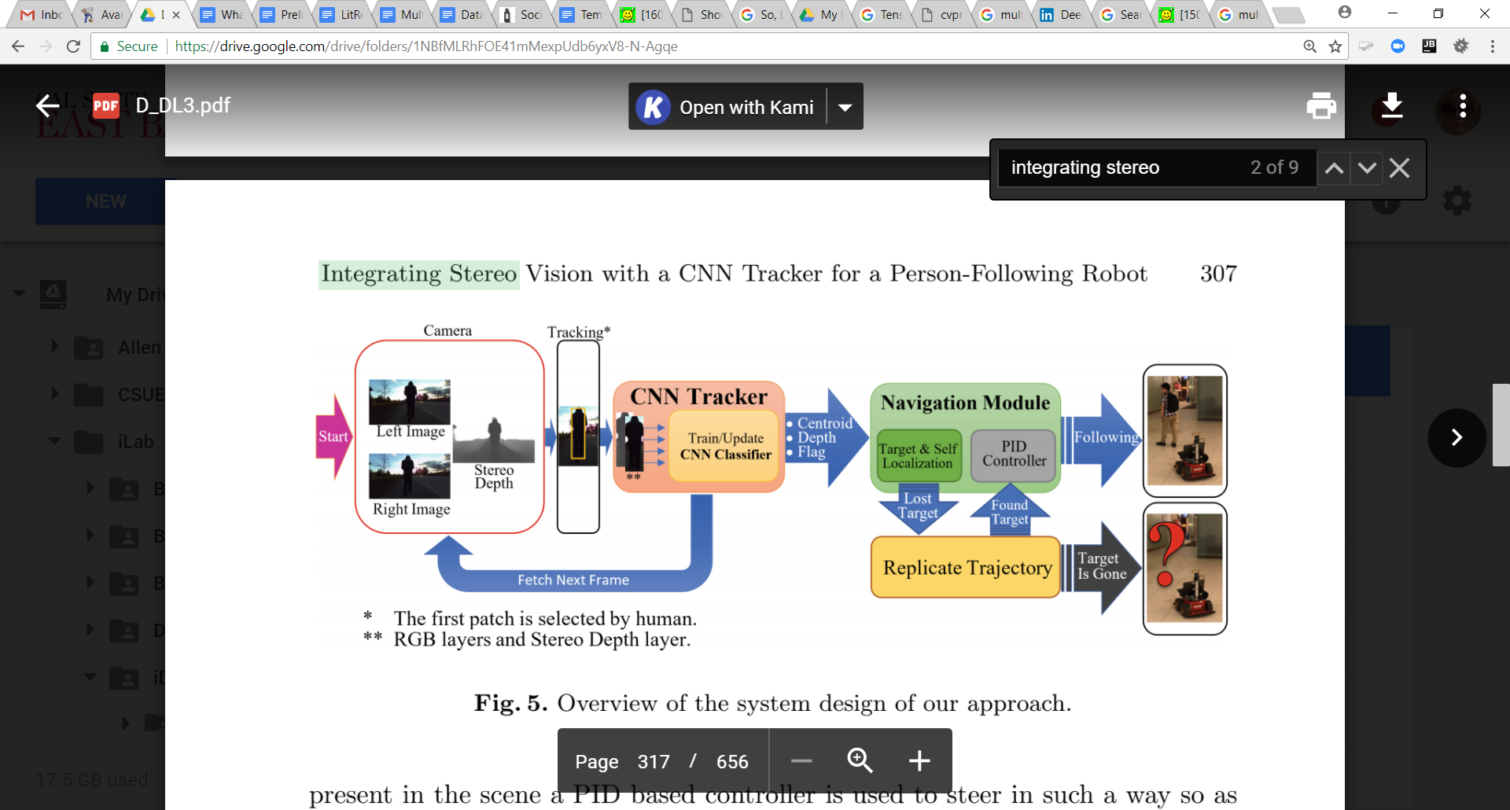
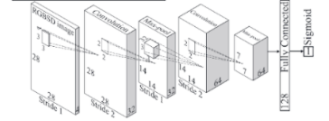
Another Early Fusion example
From B. Chen, R. Sahdev, J. Tsotsos, “Integrating stereo vision with a CNN tracker for a person-following Robot”, International Conference on Computer Vision Systems, 2017
4D =r,g,b,depth

Slide 17
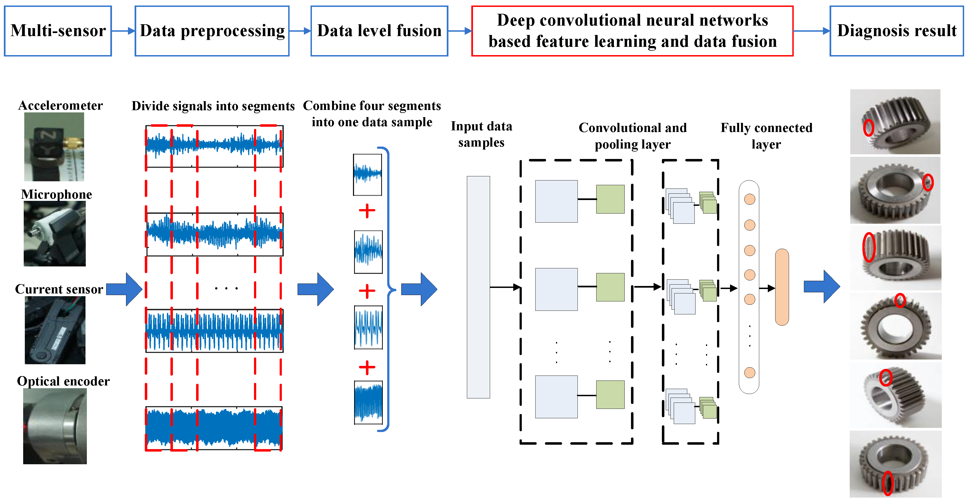
Another Early Fusion Example
Here is a NON visual (but, temporal data) sensor example
From L. Jing, T. Wang, M. Zhao, P. Wang, “An Adaptive Multi-Sensor Data fusion Method Based on Deep Convolutional Neural Networks for Fault Diagnosis of Planetary Gearbox”, Sensors 2017.

Slide 18
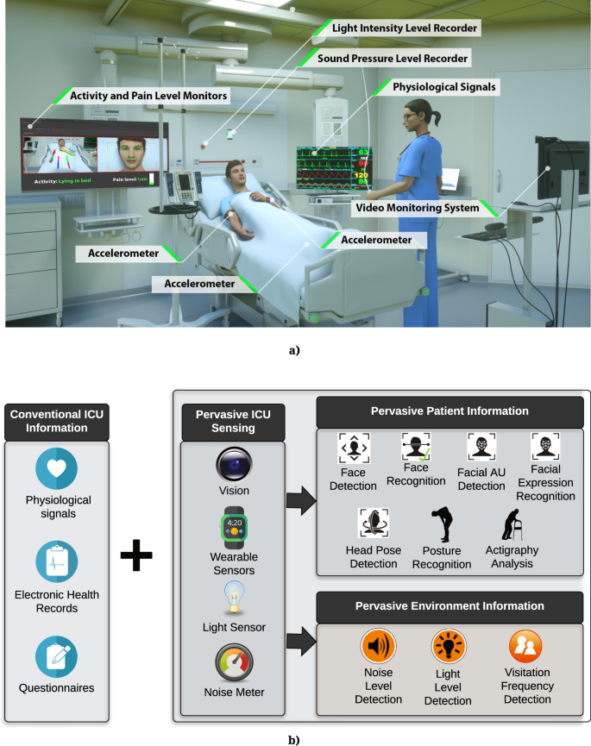
Late Fusion→ example activity recognition
Monitoring patients
From https://www.nature.com/articles/s41598-019-44004-w
LATE FUSION approach – process each sensor separately to create “events”/”activites” recognized

Slide 19
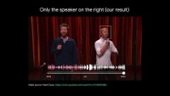
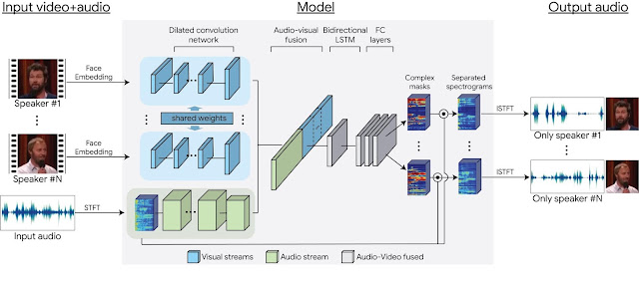

Mid level fusion→ example separation task
Separation If you have multiple speakers and sounds can you select a person/object and isolate or emphasize the sound coming from them.
Read more here from Google
And paper
MID Level fusion

Slide 20
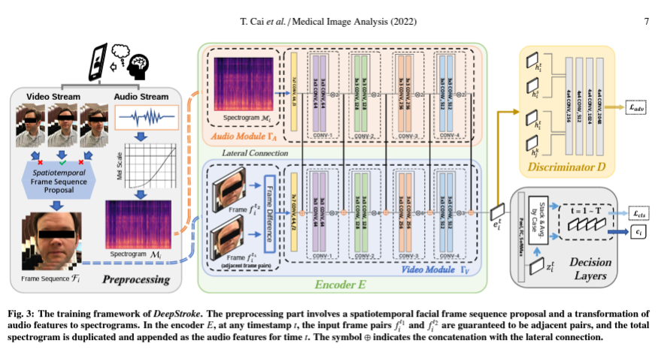
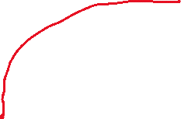






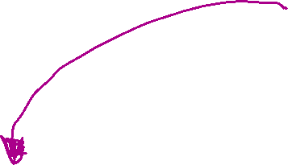
Multiple stage Fusion→ example activity recogn.
Read more here
CONVERT Modalities
Speech->Spectogram
MULTIPLE points of fusion
Stroke patients

Slide 21

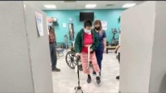
Multi-modal research idea → Project 3 → research @iLab
I want to work on a home
patient monitoring system
That looks for “changes”.
→Video + Audio
→Video alone: gait + face
Looking for research students
(potential capstone/thesis)

Slide 22
Guidelines
Can be broken

Slide 23
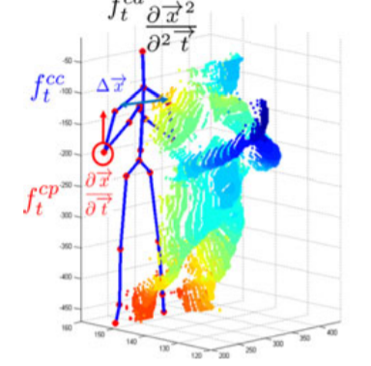
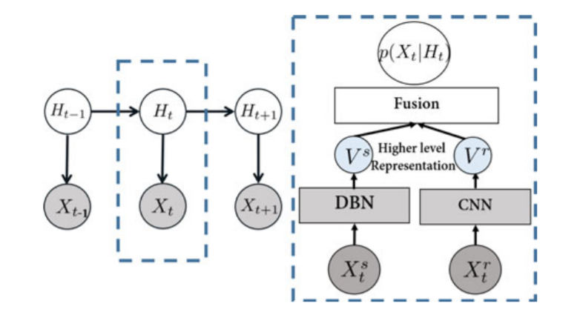
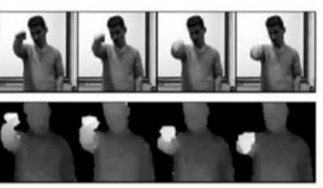
GUIDELINE 1: Nature of Data Can Effect Network choices and Fusion Level –Mid-level fusion
CNNs are type of DL network used for spatial data (images, etc) and not used for textual data. So, if you want a CNN and have both kids of data, early fusion is not possible.
From D. Wu, L. Pigou, et. al, “Deep Dynamic Neural Networks for Multimodal Gesture
Segmentation and Recognition”, IEEE Transactions of Pattern Analysis and
Machine Intelligence, Vo. 38, No. 8, 2016
skeleton
3D and 2D images
Mid-level fusion, where first similar image based (3D and 2D) multimodal
data is processed with a CNN and in parallel the skeleton data is processed
with a Gaussian-Bernoulli Restricted Boltzmann Machine (DBN-Deep Belief Network)
before being fused and the output used in a Hidden Markoff Model
for Gesture Recognition (a temporal event).

Slide 24
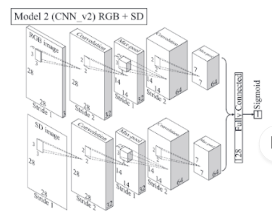
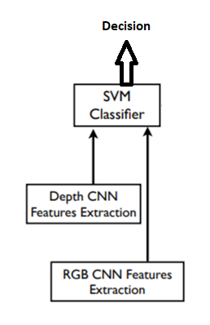
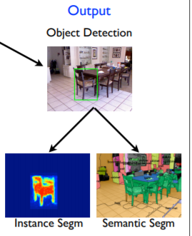
ANOTHER Mid-level example: separate CNN run in parallel for each sensor data
Must combine results of separate CNNs:
Fully connected layer
SVM
Rule-based / algorithmic combination
From B. Chen, R. Sahdev, J. Tsotsos, “Integrating stereo vision with a CNN tracker for a person-following Robot”, International Conference on Computer Vision Systems, 2017

Slide 25
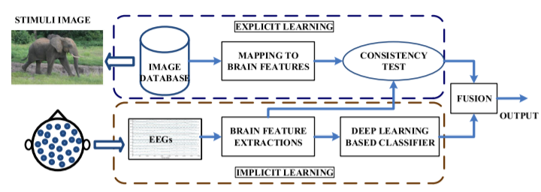
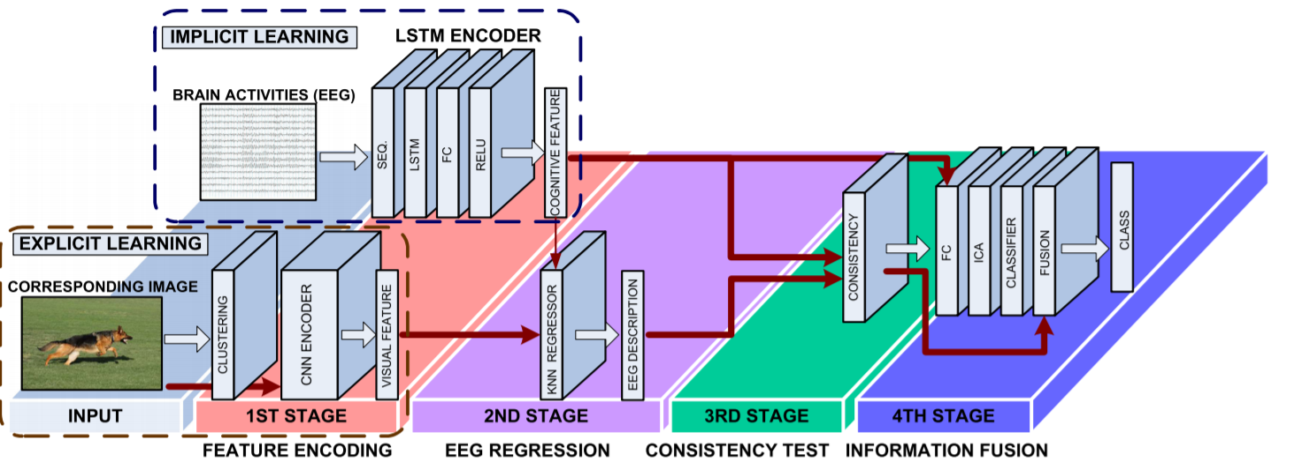
Late(r) Fusion example
Application = learn correlations between EEG response and Image stimuli
Multimodal data = 2D image processed with CNN and EGG (brain electroencephalogram) processed with LSTM
From J. Jiang, A. Fares, S. Zhong, “A Context=Supported Deep Learning Framework for Multimodal
Brain Imaging Classification”, IEE Transactions on Human-Machine Systems, 2019.

Slide 26
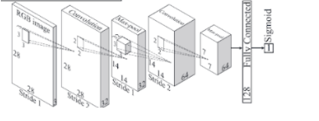
Another Late fusion example.
From B. Chen, R. Sahdev, J. Tsotsos, “Integrating stereo vision with a CNN tracker for a person-following Robot”, International Conference on Computer Vision Systems, 2017
Merge later = Rulebase, SVM, Another FC Network, Algorithmic
“Merge”

Slide 27
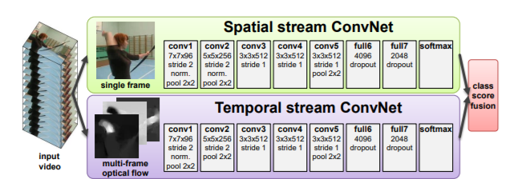
Another Late fusion example
From K. Simonyan and A. Zisserman, “Two-Stream Convolutional Networks for Action Recognition in Videos”, Neural Information Processing Systems Conference, 2014
2 CNNs: 1) for single RGB image 2) for optical flow between current and previous frame(s).

Slide 28
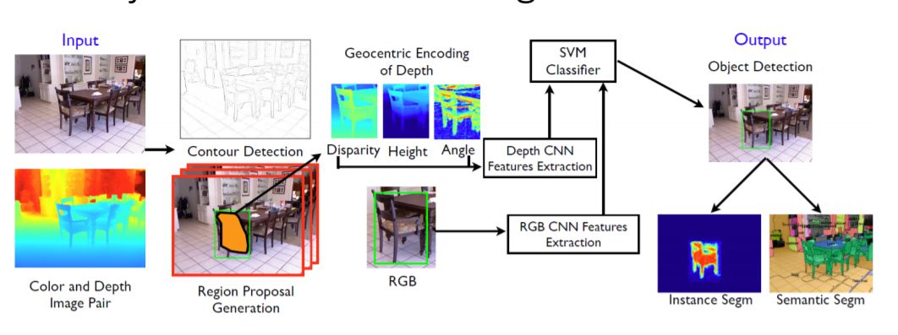
Late Fusion- separate CNNs & fuse in a SVM classifier
Gupta et al., “Learning Rich Features from RGB-D Images for Object Detection and Segmentation”, ECCV 2014.
Pre-trained on Image-Net using RGB images. Fine-tuned on NYUD2 (400 images) and synthetic data. SVM training on pool5, fc6 and fc7.
2 CNNs – 1 for depth, 1 for RGB.
Region Proposal ONLY in RGB

Slide 29
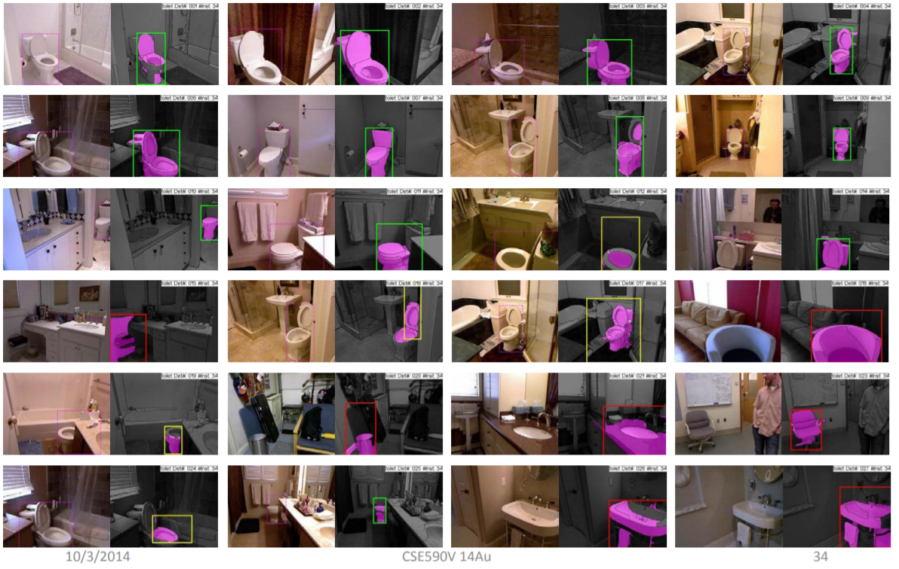
Continued…
Results Gupta et al., “Learning Rich Features from RGB-D Images for Object Detection and Segmentation”, ECCV 2014.

Slide 30
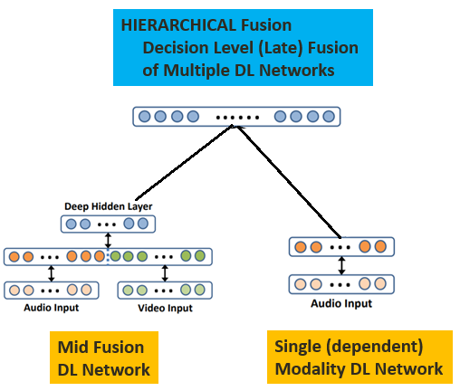
GUIDELINE 2: Strong Dependency on Modality X HIERARCHY of Network fusion
(modality X DL Network + Multiple Modality DL Network)
From – Speech Recognition: best to combine Audio DL network with Mid-level fused Multiple Modality DL Network
from J. Ngiam, A. Khosla, et.al., “Multimodal Deep Learning”, Proceedings of the 28th International Conference on Machine Learning, 2011.

Slide 31
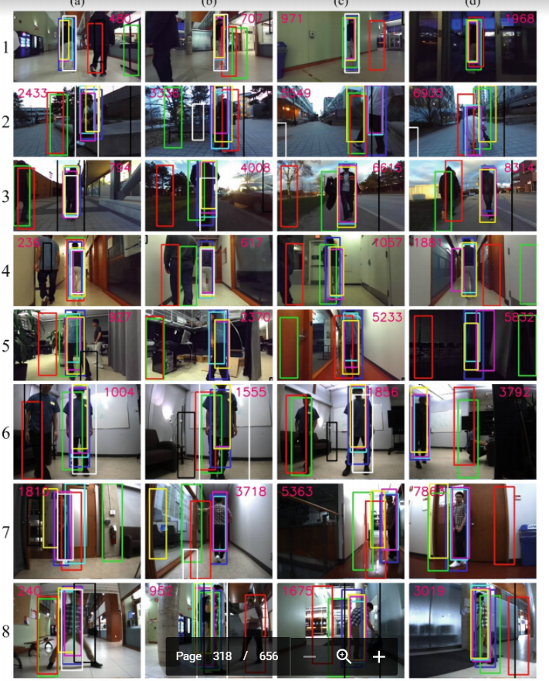
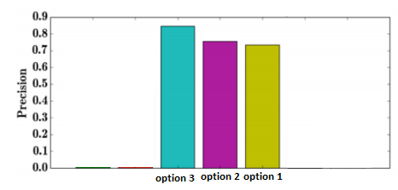
WHICH option is best?
No clear answer --test
From B. Chen, R. Sahdev, J. Tsotsos, “Integrating stereo vision with a CNN tracker for a person-following Robot”, International Conference on Computer Vision Systems, 2017
Compared early, mid and single sensor–
for Person Detection & Tracking with RGB + Depth
early: 1 CNN for all data
mid: 2 CNN in parallel
single sensor

Slide 32
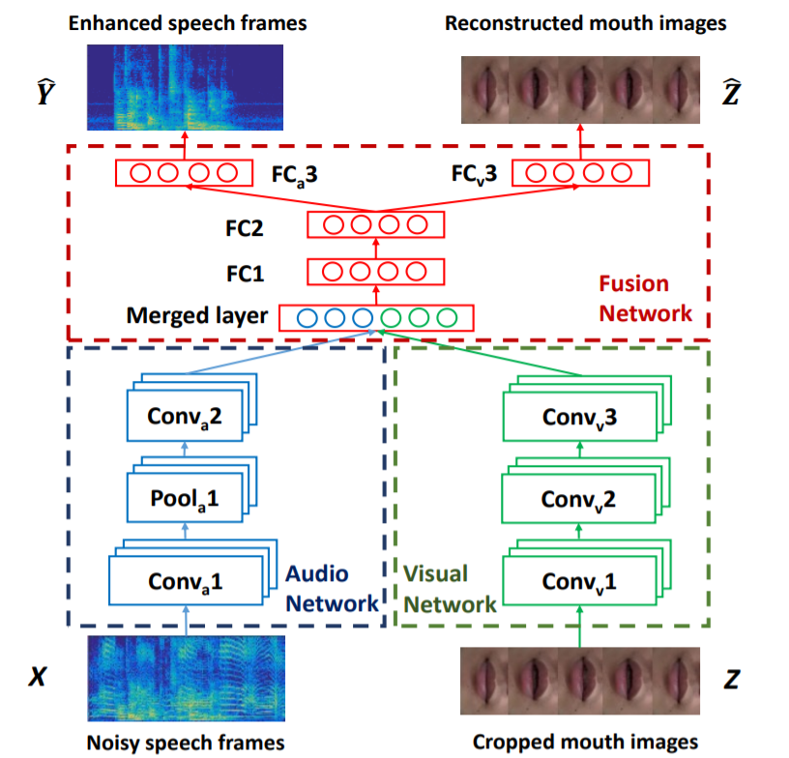
Case for Mid/late fusion- data does not “align” spatially
Example speech (not spatial, temporal only) and vision
Process in parallel with separate CNNs
    → this works because
    there is temporal alignment
J. Hou, S. Wnag, Y. Lai, Y. Tsao, “Audio-Visual Speech Enhancement Based on Multimodal Deep Convolutional Neural Networks”, 2017

Slide 33
Multimodal data + → more Complexity

Slide 34
Multimodal training sets emerging
KITTI Stereo gray- and color video, 3-D-LIDAR, inertial and GPS navigation data Autonomous driving , 2017
FCVID Video and audio Action recognition , 2017
MM-IMDb Video, images, and text metadata Movie genre prediction , 2017
Oxford RobotCar Six cameras, LIDAR, GPS, and inertial navigation data Autonomous driving , 2016
UTD-MHAD Depth and inertial sensor data Human action recognition, 2015
ChaLearn looking at people RGB-D, audio, skeletal pose Human activity recognition , 2014
Berkeley MHAD Multiviewpoint RGB-D and skeletal pose data Human activity recognition , 2013
MHRI data set Chest, top RGB-D, face, video, and audio Human–robot interaction , 2016
Multimodal BRATS T2-, FLAIR-, post-Gadolinium T1-MRI, perfusion, and diffusion MRI and MRSI Brain tumor segmentation , 2015
H-MOG Nine smartphone sensors and interaction data Continuous authentication in smartphones, 2016
Pinterest Multimodal Images and text (40M) Multimodal word embeddings, 2016
MHEALTH Accelerometer, electrocardiogram, magnetometer, and gyroscopes Health monitoring, 2015
KinectFaceDB RGB-D and facial landmarks Face recognition , 2014
RECOLA Audio, visual, and physiological Emotion recognition , 2013

Slide 35
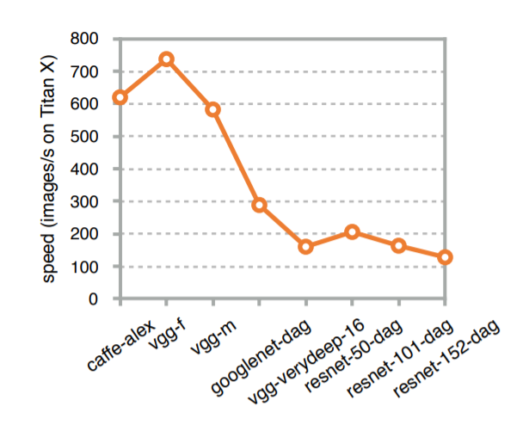
Problem –Deeper Network generally slower
Resnet -152 is 5 times slower than Alexnet

Slide 36
GUIDELINE 1: Reduce overall DL network depth via mid- or late –fusion → faster
Early fusion requires processing of all multimodal data at all layers → most increased complexity over single source data DL networks
Late fusion has only slightly increased depth of processing each modality in its own separate single modality DL network
Mid fusion is partway between early and late in required depth.

Slide 37
PROBLEM: Training data
Not enough data
Very few multimodal datasets (only audio/video, text/video and some 3D/2D).
SOLUTION -> Retraining (transfer learning)
Are there existing trained publicly available multimodal models?

Slide 38
GUIDELINE 2: Multimodal – Retraining* , will generally mean mid- late- fusion
Premise: you have an existing trained model for one of your modalities*
Create new “larger” network that reuses this model.
DL Network for Modality 2
Modality 1
DL Network for modality 1
DL Final Layers network (fusion)
Modality 2
DL Network for Modality 2
Modality n
DL Network for modality n

Slide 39
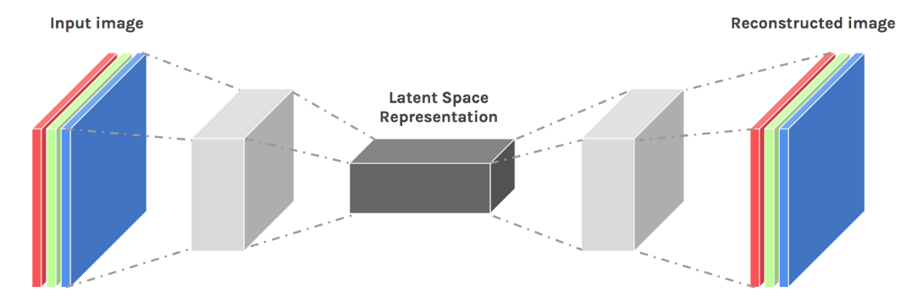
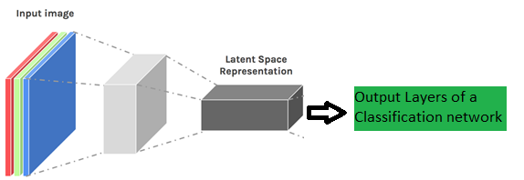
GUIDELINE 3: Lack of Training Data – Pre-training via AutoEncoder
Idea here is you use auto-encoder of a unsupervised trained auto-encoder/decoder network to be the pre-trained start of your DL network
STEP 1: train using
Unlabeled input data
an Autoencoder/decoder
STEP 2: use trained
Autoencoder as first stage
of your DL network and
train with your limited
labeled data

Slide 40

GUIDELINE 4: lack of one(+) Modality data → data perturbation
Image resizing, moving of regions, rotations, photometric changes
How do we do this for all different kinds of data → expert domain knowledge is minimally necessary
DANGER?: There are some perceived dangers as you are essentially introducing potentially
artificial changes

Slide 41

IDEA/GUIDELINE 5: lack of one(+) Modality data → Cross Modal Generative Network
If one modality is more limited, but, you still have some, you may be able to create a cross-modal generative network.
Question: How is the new resulting data here different than perturbation solution?
NOTE: Generative networks used in DL GAN (generative adversarial networks)

Slide 42

Example generative data using Multimodal training
Create CNN network based generation of EEG (output) from input Image.
CNN trained to estimate EEG features from images –can be used to generate
new (image, EEG) training data pairs
From C. Spampinato, et. al., “Deep Learning Human Mind for Automated Visual
Classification”, IEEE Conference CVPR, 2017.

Slide 43

Example 2 – different interpretation of cross-modal generation
Here you present the system with data from all modalities (here text and image) and the output is a newly generated (similar) data set
From Y. Peng, J. Qi, Y, Yuan, “CM-GANs: Cross-modal Generative Adversarial Networks for Common Representation Learning”, IEEE Transactions on Multimedia, 2018

Slide 44



Dangerous? Generative methods
Col 1-3 RGB 2D image
Col 4-6 corresponding Depth image
What do you think?
Missing Modality data
Generated Modality data

Slide 45
Multimodal DL: Dimensionality / Complexity of Network
Multimodal sources drives up complexity of network – too large to train efficiently and data needs so great to achieve good performing systems
GUIDELINE 6: a Solution – Attention Processing
  Concept from Human Visual System: as our eyes scan and focus on one portion of image at a time. Consider reading, you look at one word/character at a time and scan to next. Your focus or attention changes. This reduces the amount of data you need to process at one time
  In Images this has a counterpart in the concept of ROI and localization.

Slide 46
Multimodal Attention Mechanism
Mid-level DL network task, to determine focus on what “parts” of the currently processed mid-level features should be focused on.
Lots to explore – 1 mechanism for
attention or different for each modality
or some subsets? How can this be learned?
Modality 1
Early stage DL modality 1
Multimodal Attention
Mechanism
Final stage DL
Fused decision layers
Modality 2
Early stage DL modality 2
Modality n
Early stage DL modality n
NOTE: fusion can take place earlier or later as shown here

Slide 47

“General” Concept of Attention Processing
Mid-level in the DL network, after you have processed some features, it learns to “weight” some mid-level features more than others –which corresponds to only using portions of the original data that yielded those mid-level features
Here is an example of image captioning where parts of the image yielded mid-level features associated with a word in the resulting final DL output (see frisbee and corresponding attention area)
from “Show, Attend and Tell: Neural Image Caption
Generation with Visual Attention”, K. Xu, et.al. 2015

