Slide 1
"Deep Learning and Computer Vision - part 2"

Slide 2
Overview –part 2
Vision and (some) ML architectures – history
Localization – region based
Mobile (and reduce performance platforms)
Encoder-Decoder Network
Applications
Datasets
Special Issues –
not enough data
bounding box versus polygon
varying data size
OTHER Lectures:
RNN - LSTM & Temporal Networks
Multi-Modal issues for Vision- a case study
ADVANCED: on own Generative Adversarial Networks

Slide 3
ML CNN Architectures
-- some HISTORY

Slide 4
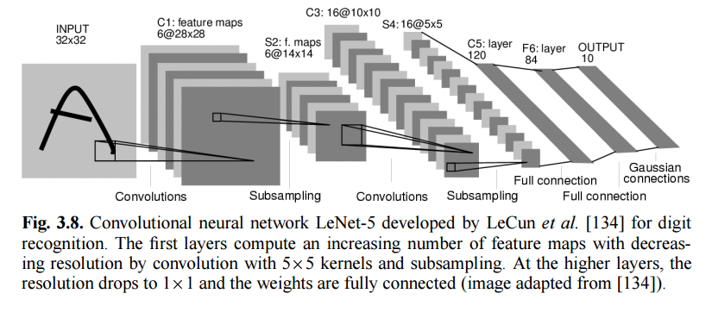
Some History to reflect on
The concept of learning Convolution mask and fully connected NN layers that make one network comes from 1998 paper by Y. LeCun

Slide 5

Some history
2012 was the first year that neural nets grew to prominence as Alex Krizhevsky w/ Hinton
used them to win that year’s ImageNet competition (basically, the annual Olympics of computer vision), dropping the classification error record from 26% to
15%, an astounding improvement at the time.Ever since then, a host of companies
have been using deep learning at the core of their services.
Facebook uses neural nets for their automatic tagging algorithms,
Google for their photo search, Amazon for their product recommendations,
Pinterest for their home feed personalization, and Instagram for their search
infrastructure. And MUCH MORE

Slide 6
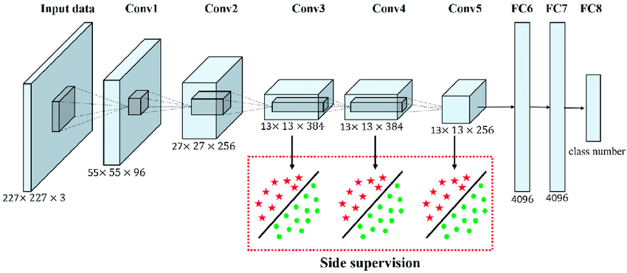
AlexNet
Deeper&Bigger
Trained ImageNet data, eventually 15 million annotated images from a total of over 22,000 categories.
Used ReLU for the nonlinearity functions (Found to decrease training time as ReLUs are several times faster than the conventional tanh function).
Used data augmentation techniques that consisted of image translations, horizontal reflections, and patch extractions.
Implemented dropout layers in order to combat the problem of overfitting to the training data.
Trained the model using batch stochastic gradient descent, with specific values for momentum and weight decay.
Trained on two GTX 580 GPUs for five to six days.
Alex Krizhevsky, and published with Ilya Sutskever and Krizhevsky's PhD advisor Geoffrey Hinton, Alex Krizhevsky, and published with Ilya Sutskever and Krizhevsky's PhD advisor Geoffrey Hinton,

Slide 7
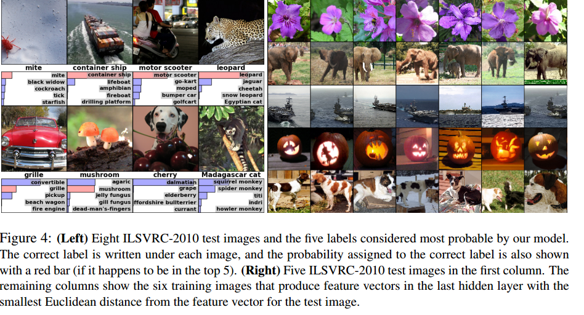
AlexNet
Results –hmmm On the test data, top-1 and top-5 error rates of 37.5% and 17.0% which is considerably better than the previous state-of-the-art at that time

Slide 8
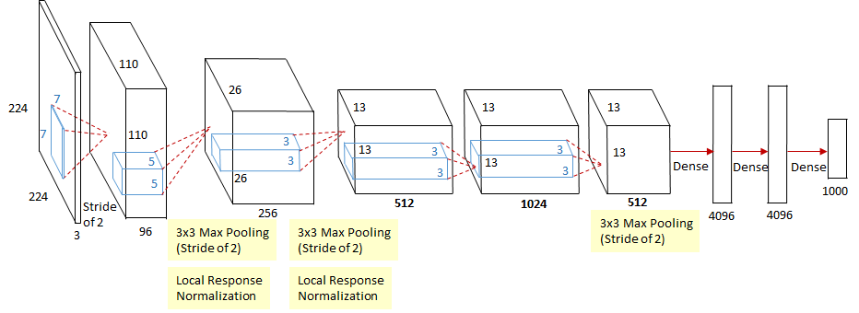
Next up- ZF Net
similar architecture to AlexNet, few minor modifications. trained on 1.3 million images.
11.2% error rate in its reduced domain
size 7x7 and a decreased stride value. REASON: smaller filter size in the first conv layer helps retain a lot of original pixel information in the input volume. Filter size 11x11 proved to be skipping a lot of relevant information, especially as this is the first conv layer.
As network grows, we also see a rise in the number of filters used.
Used ReLUs =activation func, cross-entropy =loss/error, trained w/batch stochastic gradient descent.
Trained on a GTX 580 GPU for twelve days.
Developed a visualization technique named Deconvolutional Network, which helps to examine different feature activations and their relation to the input space. Called “deconvnet” because it maps features to pixels (the opposite of what a convolutional layer does).

Slide 9
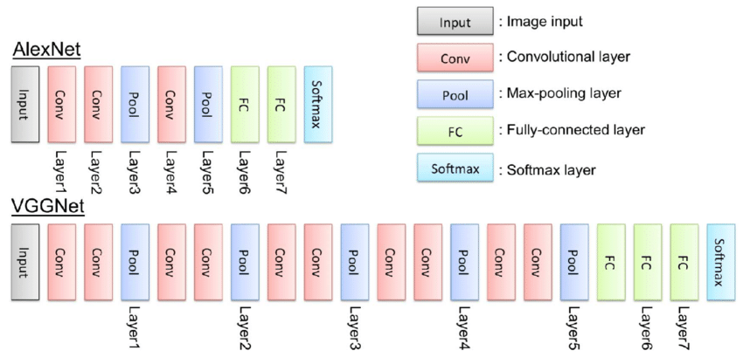
Next up-VGG Net
Simpler and smaller filters - 19 layer CNN that strictly used 3x3 filters with stride and pad of 1, along with 2x2 maxpooling layers with stride 2
Worked well- both image classification& localization
trained on 4 Nvidia Titan Black GPUs for 2-3weeks.
7.3% error rate

Slide 10
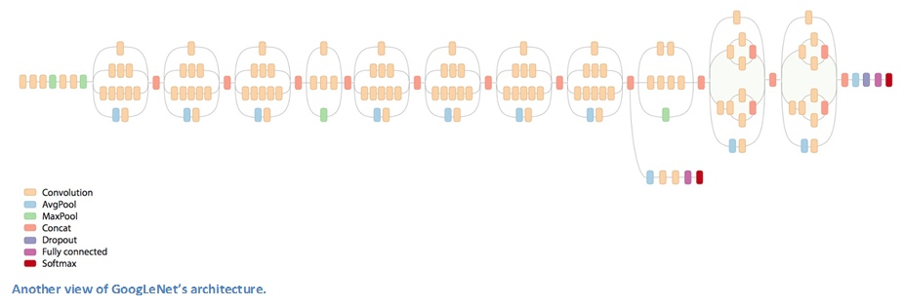


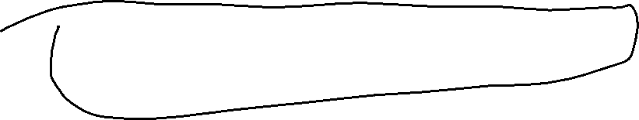

Next -- GoogLeNet
22 layer CNN (separating convoluting and pooling and activation/nonlinear)
a top 5 error rate of 6.7%
first CNN architectures that really strayed from the general approach of simply stacking conv and pooling layers on top of each other in a sequential structure
Next slide

Slide 11
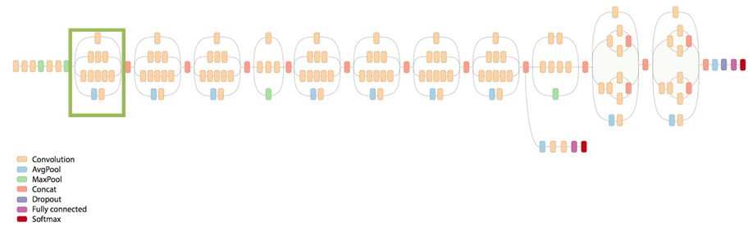
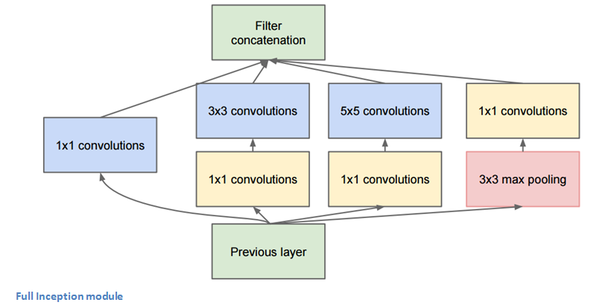





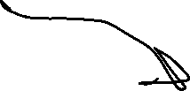



GoogLeNet -non sequential Inception model
strayed from the general approach of simply stacking conv and pooling layers on top of each other in a sequential structure
OUTPUT
NOT
Sequential
INPUT

Slide 12
GoogLeNet
Used 9 Inception modules in the whole architecture, with over 100 layers in total! Now that is deep…
No use of fully connected layers! They use an average pool instead, to go from a 7x7x1024 volume to a 1x1x1024 volume. This saves a huge number of parameters.
Uses 12x fewer parameters than AlexNet.
During testing, multiple crops of the same image were created, fed into the network, and the softmax probabilities were averaged to give us the final solution.
Trained on “a few high-end GPUs within a week”.

Slide 13
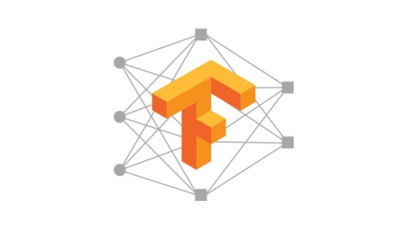
TensorFlow
Google released 2016 open source Machine Learning framework
Features GoogleNet CNN technology (can have different architectures of CNNs)
Languages: Python and C++ and now Java, Go (but, level of support unclear)
New Languages: new support for higher level front-end language like Keras (python based)
Other ML: Adding other Machine Learning algorithms: K-Means, Support Vector Machines, Random Forest, etc.
Train on your own machineS (gpus) or cloud
Run on any device (mobile/embedded, machines, special purpose GPUs) or run on service in cloud

Slide 14
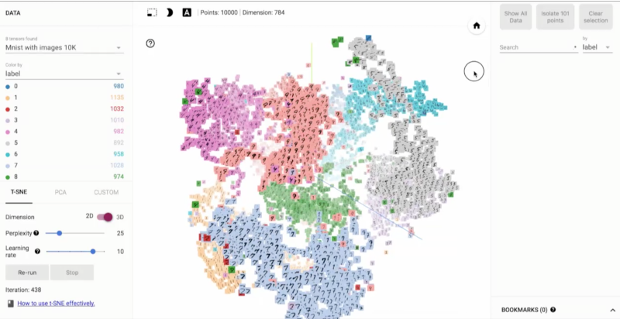
And much more since them….
Even tools like for TensorFlow there is TensorBoard:
Visualizer: visualize your TensorFlow graph
operates by reading TensorFlow events files, which contain summary data that you can generate when running TensorFlow
https://www.tensorflow.org/images/embedding-mnist.mp4
See your tensor flow graph

Slide 15
So why almost 20 years later?
High performance distributed computing / cloud makes it work with larger networks and LOTs of data → enter 2015 Google TensorFlow
Special hardware for deployment beyond cloud CPUs.
Still can take weeks to train one CNN for big problems
Good accuracies for constrained problems

Slide 16
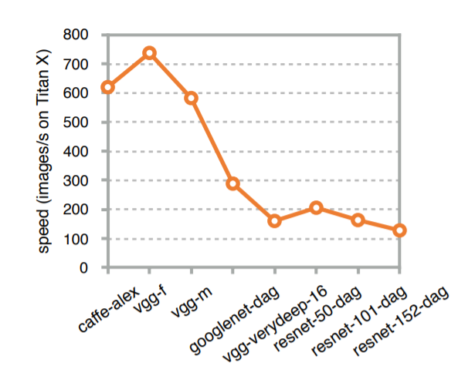
Problem –Deeper Network generally slower
Resnet -152 is 5 times slower than Alexnet

Slide 17
Localization --- finding the “region”/Bounding box
--- where is the object

Slide 18
Region Proposal
Proposal based: have region proposal stage first prior to CNN
Proposal-less: proposal built into network.

Slide 19
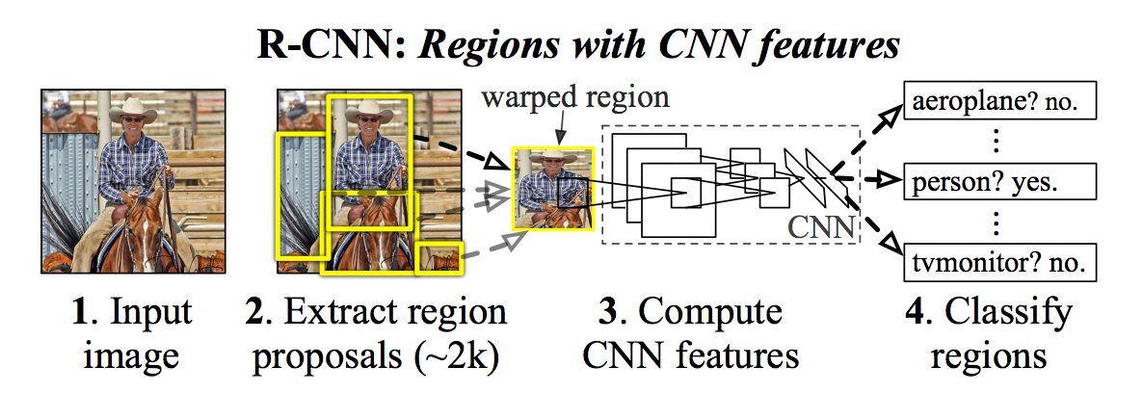
Regions with CNN
This is a PROPOSAL – based method –where by the
Region you are proposing a location of an object
Previous CNN did not localize but only identified the objects in the image.
Solution present sub-images = regions of original larger image for classification and by definition of the region localization

Slide 20
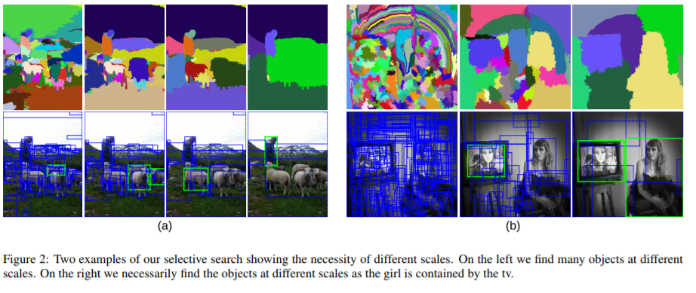
example
From https://www.koen.me/research/pub/uijlings-ijcv2013-draft.pdf

Slide 21
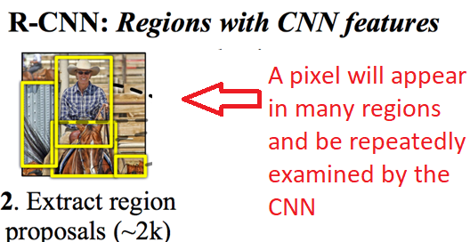
YOLO – You Only Look Once
This is a PROPOSAL-LESS – based method –where you do NOT propose a location/region
Don’t want the larger number of repetitive looks at parts of the image a R-CNN will give you
Solution YOLO

Slide 22
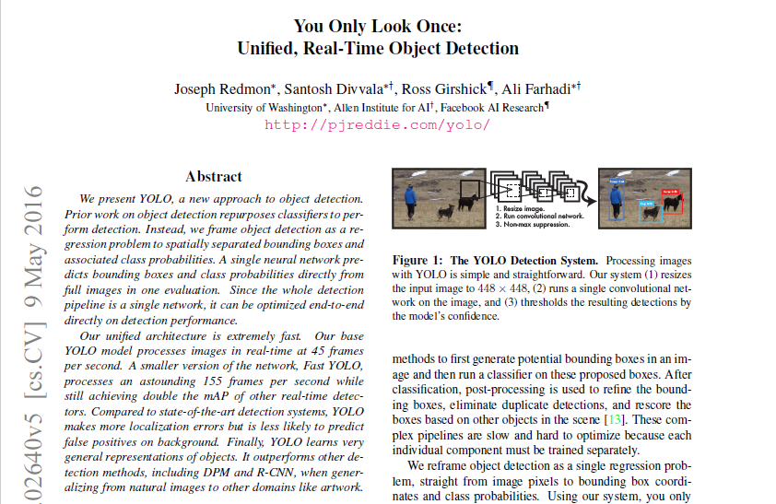
YOLO – You Only Look Once
This is a PROPOSAL-LESS – based method –where you do NOT propose a location/region

Slide 23
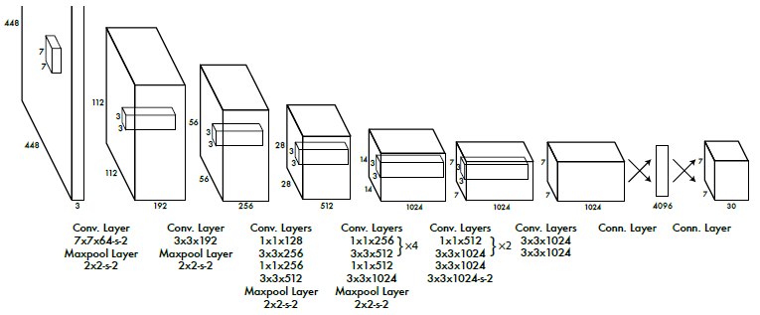
YOLO
For speed: Also! structure advantage!
No bounding box proposals and subsequent pixel or feature resampling stage
A neural network predicts bounding boxes and class probabilities directly from full images in one evaluation

Slide 24
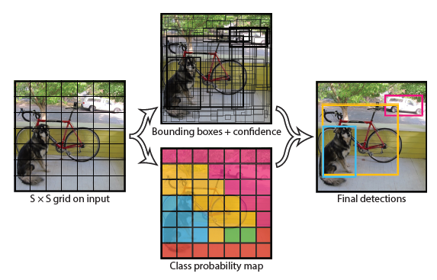
How (YOLO)unified detection works?
YOLO “frames object detection as a regression problem to spatially separated bounding boxes and associated class probabilities”
It divides the image into an even grid and simultaneously predicts bounding boxes, confidence in those boxes, and class probabilities.
Predictions encoded as an
S × S × (B ∗ 5 + C)
tensor
Each bounding box consists of 5 predictions: x, y, w, h, and confidence
uses features from the entire image to predict each bounding box
predicts all bounding boxes across all classes for an image simultaneously?
divides the input image into an S*S grid. If the center of an object falls into a grid cell, the cell is responsible for detecting that object.
each grid cell predicts B bounding boxes and confidence scores for those boxes
Each grid also predicts C conditional(conditioned on the grid cell containing an object) class probabilities

Slide 25

How it works?
confidence scores: reflect how confident is that {the box contains an object} + {how accurate the box is} .
conditional class probabilities: conditioned on the grid cell containing an object

Slide 26
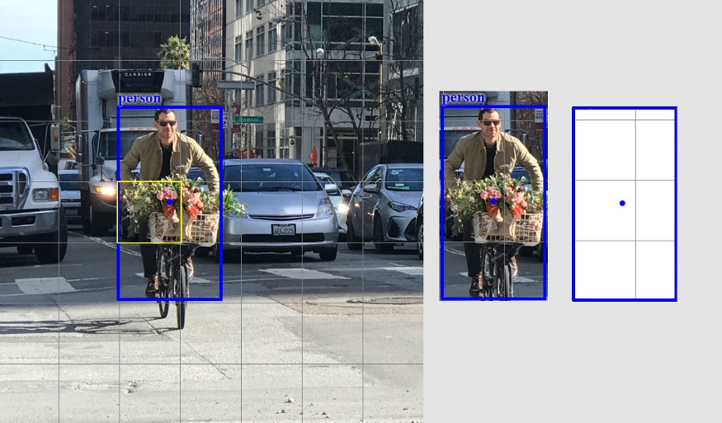
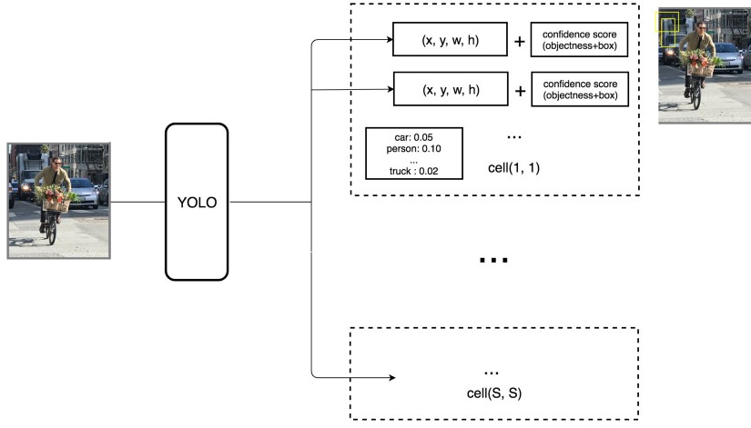
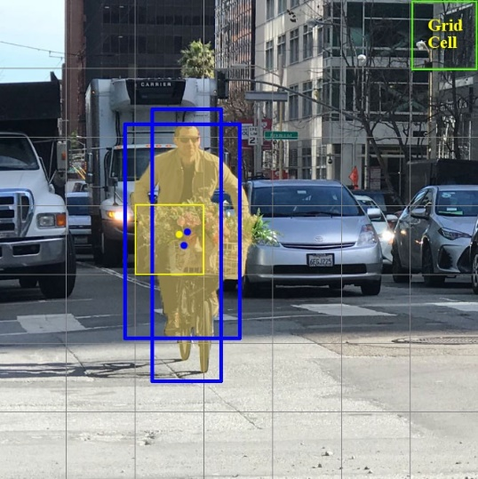
YOLO explained MORE
YOLO’s prediction has a shape of (S, S, B×5 + C) = (7, 7, 2×5 + 20) = (7, 7, 30)
Each grid in the SxS grid partition predicts one object
Then each grid can contribute to multiple bounding boxes for that object
predicts B boundary boxes & each box has one box confidence score,
it detects one object only regardless of the number of boxes B,
it predicts C conditional class probabilities (one per class for the likeliness of the object class). Example B= 2, C= 20 and SxS=7x7 grid
#output values = 5x2 + 20
Each bounding box has 5 output values =x.y,w,h,confidence
#output values = 5x2 + 20

Slide 27
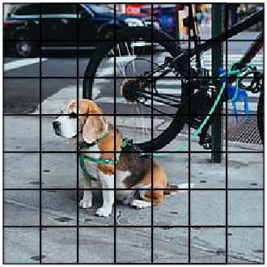
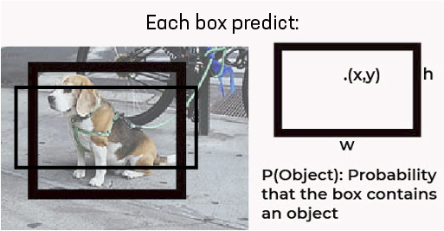
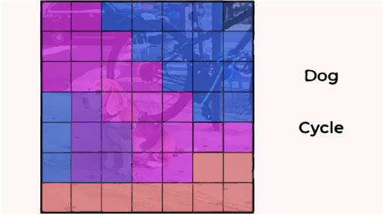
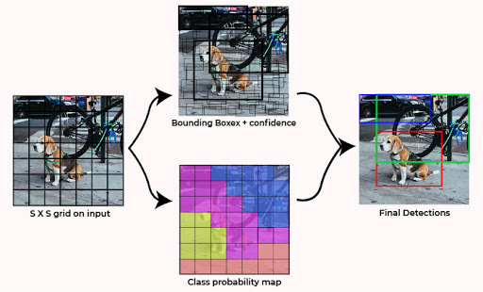
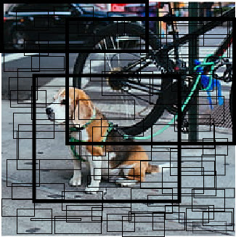
Just another example

Slide 28
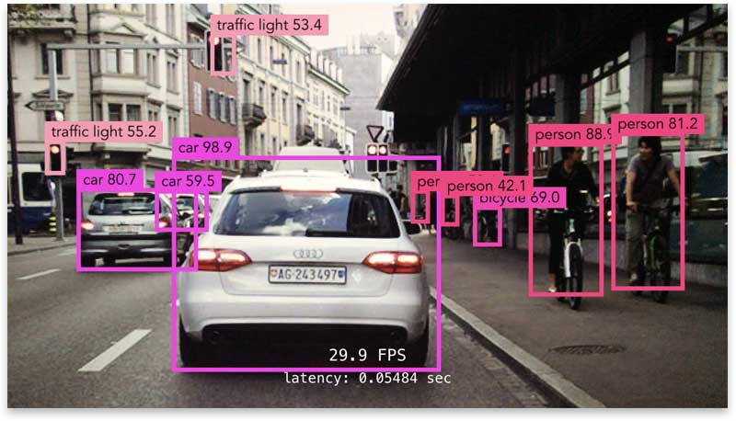
How good is a prediction? – first anytime you make a decision you must have a threshold on the confidence value to say the prediction is true or to reject it
If confidence > Threshold
prediction is good

Slide 29
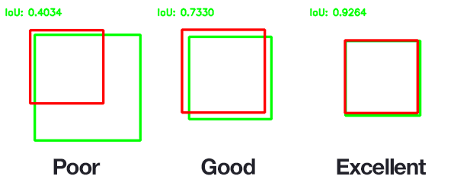
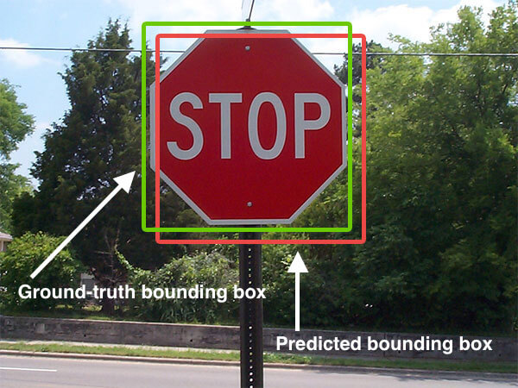
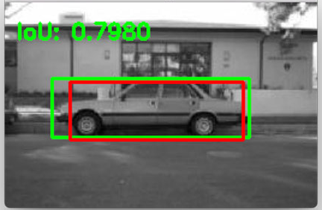
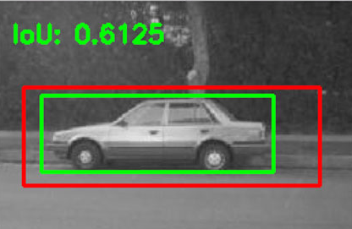
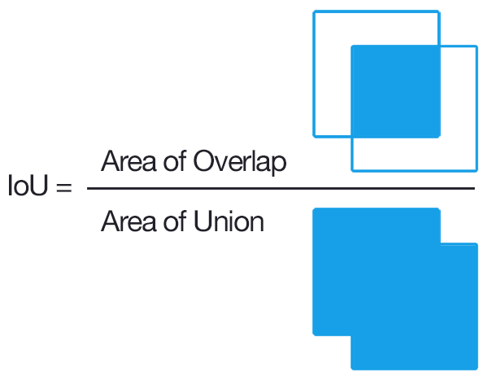
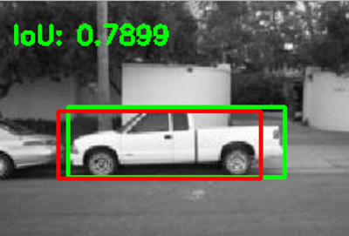
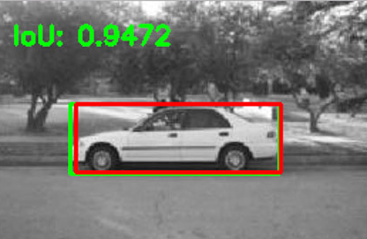
How good is a prediction? – IOU – Intersection over Union metric for how good localization is
You specify an IOU threshold
If IOU > IOU thresh
prediction is good

Slide 30
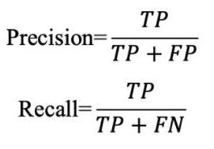
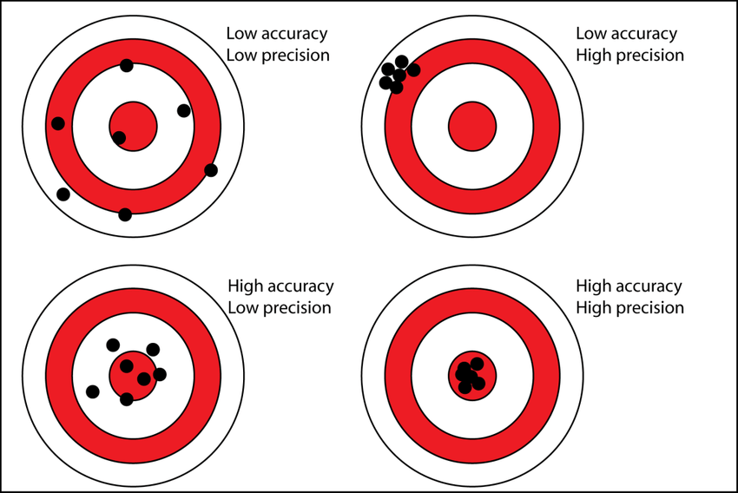
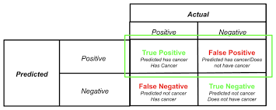
Overall, How good is a model? – remember Precision & Recall

Slide 31
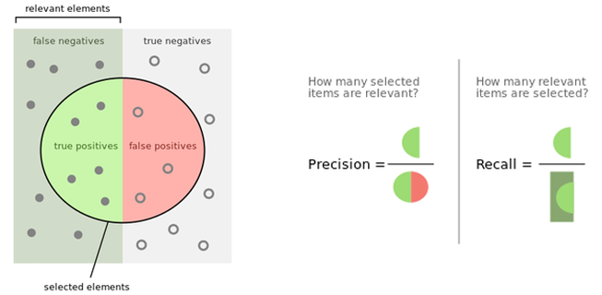
Overall, How good is a model? – remember Precision & Recall
Precision = % relevant results
Recall = % relevant results that are correctly classified by the model you’re running

Slide 32
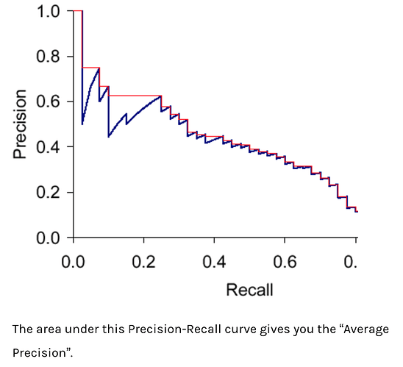
Overall, How good is a model – Precision-Recall curves
You can plot the change in values of Precision and Recall as your VARY the decision threshold (as go to right threshold goes down)
Average Precision =
Area under the Precision-Recall curve
>> higher the better

Slide 33
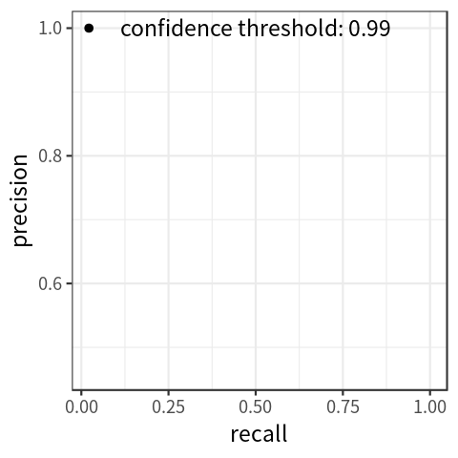
NOTE on : Precision-Recall curve
A tradeoff typically –recall goes up as precision goes down

Slide 34

Overall, How good is a model - mAP
mAP = mean Average Precision is the average of AP over each class.
where there are N classes
mAP is a common metric used to compare different MODELS trained on the same dataset

Slide 35
Yolo (v1) comparison to Fast R-CNN model
mAP of 63.4% when trained on Pascal VC 2007 (read paper)and voc 2012,
Fast YOLO which is almost 3x faster in result generation has mAP of 52%.
Fast R-CNN model achieved (71% mAP) and also the R-CNN achieved (66% mAP).

Slide 36
Yolo (v1) benefits/disadvantages
Benefits of YOLO:
Process frames at the rate of 45 fps (larger network) to 150 fps(smaller network) which is better than real-time.
The network is able to generalize the image better.
Disadvantages of YOLO (v1):
Comparatively low recall and more localization error compared to Faster R_CNN.
Struggles to detect close objects because each grid can propose only 2 bounding boxes.
Struggles to detect small objects.

Slide 37
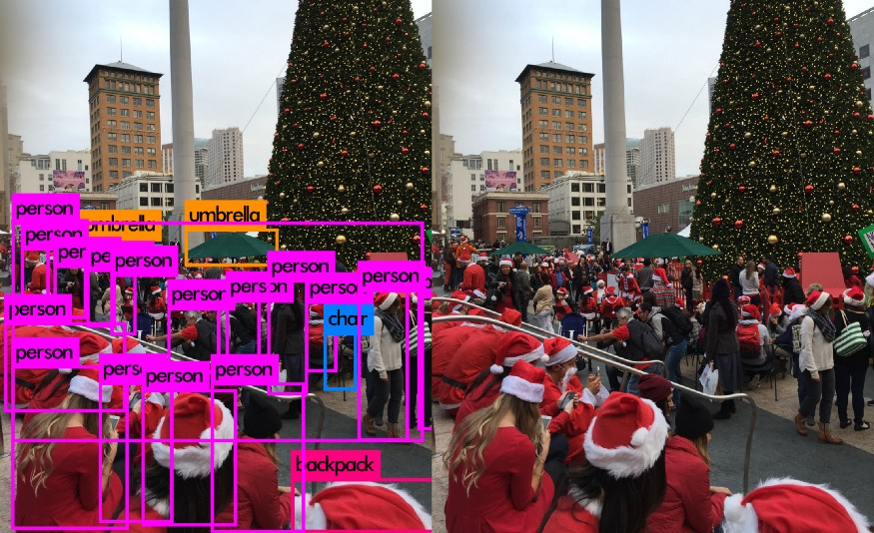

YOLO why issue with “small” objects
Each grid in the SxS grid partition predicts one object
Then each grid can contribute to multiple bounding boxes for that object
The one-object rule limits how close detected objects can be
Which is why Yolo(v1) has problems with detecting small objects
Why there are only 5 out of 9 santas detected below

Slide 38
YOLO – You Only Look Once v2
This is a PROPOSAL-LESS – based method –where you do NOT propose a location/region
Adds Batch Normalization (read paper)
is a technique for training very deep neural networks that standardizes the inputs to a layer for each mini-batch. This has the effect of stabilizing the learning process and dramatically reducing the number of training epochs required to train deep networks.
See Tensorflow
Implementation

Slide 39
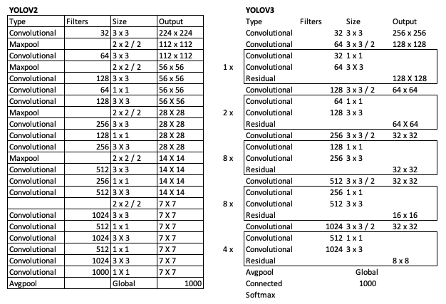
Yolo v2, v3, v4, and so on
Look to web for details

Slide 40
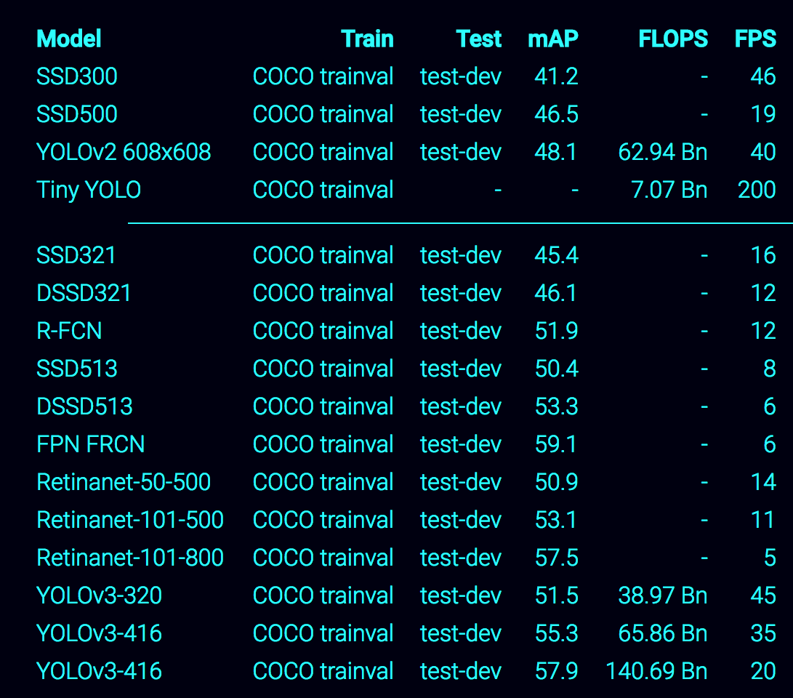
Yolo v2, v3, v4, so on
Look to web for details

Slide 41
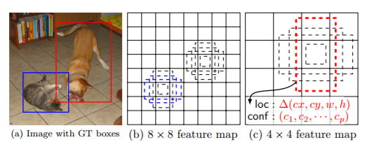
SSD- Single Shot Multi- box Detector
https://www.slideshare.net/xavigiro/object-detection-d2l4-2017-upc-deep-learning-for-computer-vision
See https://www.cs.unc.edu/~wliu/papers/ssd.pdf for original paper
(a) SSD only needs an input image and ground truth boxes for each object during training. In a convolutional fashion, we evaluate a small set (e.g. 4) of default boxes of different aspect ratios at each location in several feature maps with different scales (e.g. 8 × 8 and 4 × 4 in (b) and (c)). For each default box, we predict both the shape offsets and the confidences for all object categories ((c1, c2, · · · , cp)). At training time, we first match these default boxes to the ground truth boxes. For example, we have matched two default boxes with the cat and one with the dog, which are treated as positives and the rest as negatives. The model loss is a weighted sum between localization loss (e.g. Smooth L1 [6]) and confidence loss (e.g. Softmax).

Slide 42
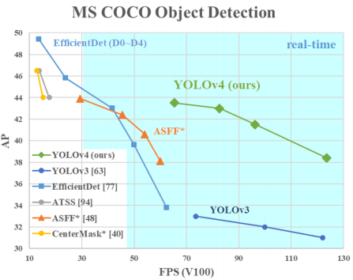
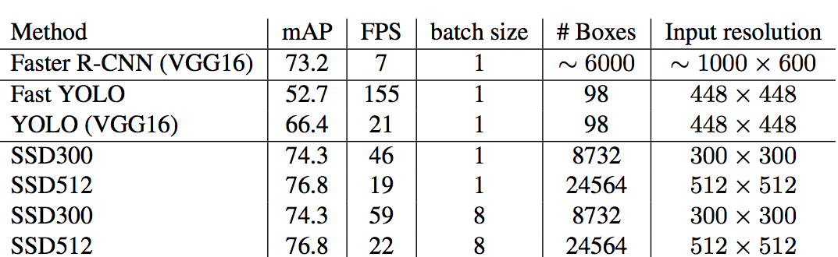
Comparison : different techniques for detection
mAP = mean Average Precision (higher is better)
FPS = frames per second (higher the better)
NOTE: you see different values as it can be over different datasets….so look at the comparison chart by chart.
NOTE = mAP then mean is over all the classes

Slide 43
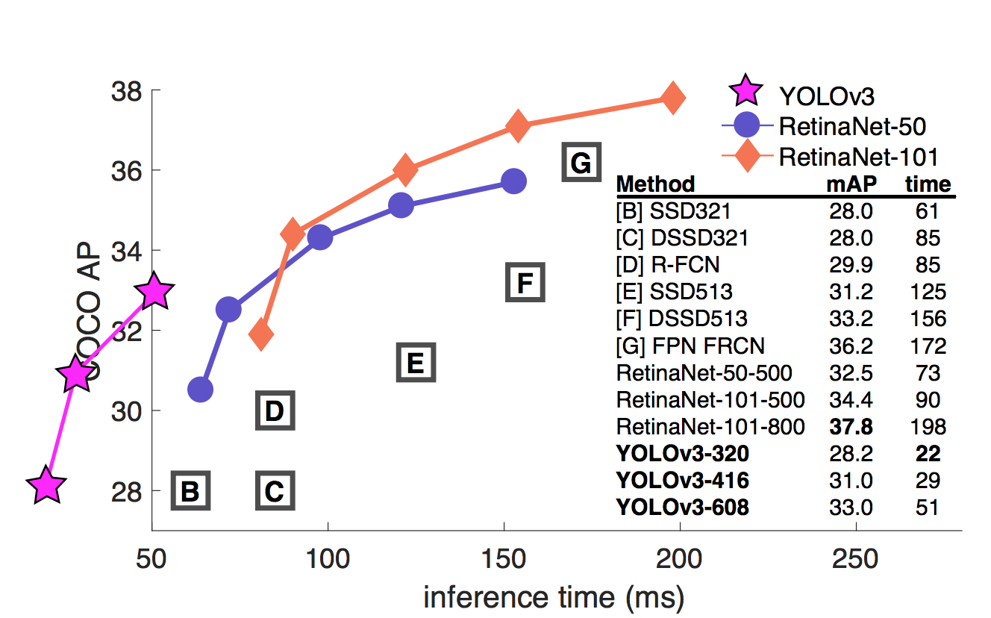
MORE –different versions
Check out This Link
mAP = mean Average Precision (higher is better)
Inference time (ms) = time it takes for running image through prediction/inference model (lower is better)

Slide 44
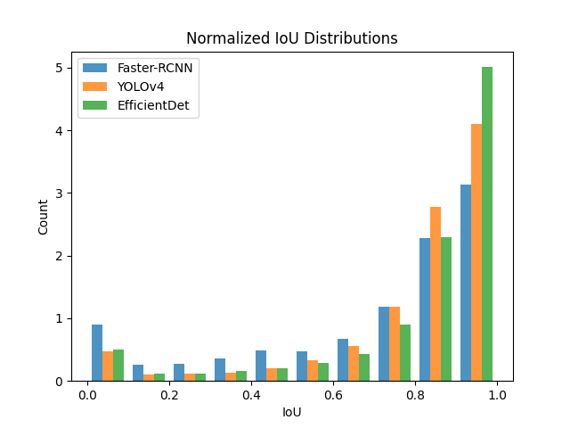
Comparison : instead of mAP look at IOU and localization
[4] M. Tan, et al, EfficientDet: Scalable and Efficient Object Detection (2020), Conference on Computer Vision and Pattern Recognition (CVPR
Below we see that EfficientDet has more models where IOU is near 1.0 than YOLOv4
EfficientDet may be better at localization. See blog

Slide 45
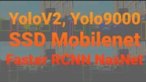
Models (and versions) can have different input resolutions effecting how good they may do at some tasks
One example: Look at differences in small object detection –watch people farther away

Slide 46

More comparisons –pointing out resolutions

Slide 47


Object size
What does small, medium and large mean ---this is COCO METRICS

Slide 48

More on Metrics: COCO Metrics
What does small, medium and large mean ---this is COCO METRICS
There are other metrics like Pascal VOC metric (defines the mAP metric using a single IoU threshold of 0.5)

Slide 49


More on COCO Metrics
mAR = mean Average Recall ---this is COCO METRICS
FOR different # of detections per image
FOR different size of objects being detected (both for mAR and mAP)

Slide 50

More Metrics: ROC curve
Another performance plot to consider –tradeoff higher TP means typically higher FP
Find “around” the bend in the curve
….. Depending on goal of the system

Slide 51

Some models better at small objects: R-CNN for smaller objects
https://link.springer.com/chapter/10.1007/978-3-319-54193-8_14

Slide 52
Parts –based R-CNN
Specifically have entire object and parts of an object in dataset
N. Zhang et al., “Part-based R-CNNs for Fine-grained Category Detection”, ECCV 2014
Caltech-UCSD bird dataset (CUB200-2011) with ~12,000 images of 200 bird species.
Strongly supervised setting in which ground truth bounding boxes of full objects (birds) and parts (head and body) are given.
Each part + full object are treated as independent object categories to train SVMs in original R-CNN pipeline.
Then geometric constraints (box + knn) are applied.

Slide 53

Parts-based R-CNN
See how it works below

Slide 54
What about Mobile (&iot)
---- reduce computational power devices

Slide 55

Mobile Frameworks
CoreML (apple) TensorFlow Light (Google)

Slide 56

Architecture is Critical –not just framework
Comparing different architectures using Core ML framework

Slide 57

We will use Tensorflow Lite
https://www.tensorflow.org/lite

Slide 58

Hardware comparison &TFlite
Same model from Alpha Labs , Hardware makes a difference –this is not running “real time”

Slide 59


MobileNet – a mobile architecture (designed for mobile)
Convolution = depthwise + pointwise
perform a spatial convolution while keeping the channels separate and then follow with a depthwise convolution.
Depthwise
pointwise
Why???? Saves on parameters ---LESS to learn, yet still effective

Slide 60
MobileNet –less parameters
For a depthwise separable convolution on the same example, we traverse the 16 channels with 1 3x3 kernel each, giving us 16 feature maps (called DepthWise Convolution). Now, before merging anything, we traverse these 16 feature maps with 32 1x1 convolutions each (called Pointwise convolution) and only then start to them add together. (this 1x1 is called a depthwise multiplier of 1)
Comparison of number of parameters --> SEPARATED IS LESS!!!
This results in 656 (16x3x3 + 16x32x1x1) parameters opposed to the 4608 (16x32x3x3) parameters from above.
SO its faster

Slide 61
MobileNet Archiecture
The full MobileNets network has 30 layers. The design of the network is quite straightforward:
Normal convolutional layer with stride 2
depthwise layer
pointwise layer that doubles the number of channels
depthwise layer with stride 2
pointwise layer that doubles the number of channels
depthwise layer
pointwise layer
depthwise layer with stride 2
pointwise layer that doubles the number of channels
and so on…
All. the convolutional layers are followed by a ReLU activation function
This goes on for a while until the original 224×224 image is shrunk down to 7×7 pixels but now has 1024 channels. After this there’s an average-pooling layer that works on the entire image so that we end up with a 1×1×1024 image, which is really just a vector of 1024 elements.
If we’re using MobileNets as a classifier, for example on ImageNet which has 1000 possible categories, then the final layer is a fully-connected layer with a softmax and 1000 outputs.

Slide 62

MobileNet
You can choose number of layers …example here with 9

Slide 63

EfficientDet – Another architecture towards mobile
[4] M. Tan, et al, EfficientDet: Scalable and Efficient Object Detection (2020), Conference on Computer Vision and Pattern Recognition (CVPR
NOTE = mAP then mean is over all the classes
ANOTHER chart,
AP50 is AP when IOU is >=0.5

Slide 64
Encoder-Decoder
--for use in “compression” or “feature extractor”

Slide 65

No Fully Connected Layers
Fully Convolutional Networks for Semantic Segmentation
Jonathan Long, Evan Shelhamer, Trevor Darrell, CVPR 2015

Slide 66
Applications in Vision
--showing CNN in practice

Slide 67



Application – Object Detection
Broad sets of Objects to Targeted sets

Slide 68



Application - Segmentation
One idea – encoder/decoder model

Slide 69
Segmentation Idea 1→ Fully Convolutional Networks (no fully connected layers) = FCN
FCN = Fully Convolutional Networks for Semantic Segmentation
Jonathan Long, Evan Shelhamer, Trevor Darrell, CVPR 2015

Slide 70


FCN
FCN =Fully Convolutional Networks for Semantic Segmentation
Jonathan Long, Evan Shelhamer, Trevor Darrell, CVPR 2015
Merge results at different “resolutions”/ layers
Convolutions not shown

Slide 71
FCN segmentation
Popularize the use of end to end convolutional networks for semantic segmentation
Re-purpose ImageNet pretrained networks for segmentation
Upsample using deconvolutional layers
Introduce skip connections to improve over the coarseness of upsampling

Slide 72

Segmentation Idea 2: SegNet
Vijay Badrinarayanan, Alex Kendall, Roberto Cipolla ‘SegNet: A Deep Convolutional Encoder-Decoder Architecture for Image Segmentation”, CVPR 2015
Convolutional Encoder + Decoder
Idea: decoder = upconvolutional layers
FCN = Fully Convolutional Networks
Still relatively coarse results

Slide 73

Segmentation Idea 3: DeepLab v1&2
Liang-Chieh Chen, George Papandreou, Iasonas Kokkinos, Kevin Murphy, Alan L. Yuille, “DeepLab: Semantic Image Segmentation with Deep Convolutional Nets, Atrous Convolution, and Fully Connected CRFs”, CVPR 2016
Use atrous/dilated convolutions ( increase the field of view without increasing the number of parameters) = DCNN
Multiscale processing is achieved either by passing multiple rescaled versions of original images to parallel CNN branches (Image pyramid) and/or by using multiple parallel atrous convolutional layers with different sampling rates (ASPP).
Use Fully connected CRF
Structured prediction is done by fully connected CRF. CRF is trained/tuned separately as a post processing step.

Slide 74


Many more segmentation +CNN → towards higher detail
Guosheng Lin, Anton Milan, Chunhua Shen, Ian Reid, ” RefineNet: Multi-Path Refinement Networks for High-Resolution Semantic Segmentation”, CVPR 2016
Liang-Chieh Chen, George Papandreou, Florian Schroff, Hartwig Adam, “Rethinking Atrous Convolution for Semantic Image Segmentation”, CVPR 2017

Slide 75


Application – Image & Video captioning AND related Action recognition
Oriol Vinyals, Alexander Toshev, Samy Bengio, Dumitru Erhan, “Show and Tell: A Neural Image Caption Generator”, CVPR 2014
416427136

Slide 76

Application – Image & Video captioning AND related Action recognition
https://arxiv.org/ftp/arxiv/papers/1706/1706.02430.pdf
Z. Yang, Y. Zhang, S. Rehman, Y. Huang, “Image Captioning with Object Detection and Localization”, CVPR 2017

Slide 77



Previous system results
416427136

Slide 78
Application – Depth calculations- stereo , optical flow
Oriol Vinyals, Alexander Toshev, Samy Bengio, Dumitru Erhan, “Show and Tell: A Neural Image Caption Generator”, CVPR 2014
416427136

Slide 79

Application – Image/Video Synthesis
Use Encoder /Decoder IDEA, GAN (Generative Adversarial Networks)

Slide 80

iLab efforts

Slide 81


iSight Goals
Helping low vision with Mobility by better understanding of their visual world

Slide 82





SSD based MobileNet
Object Identification & Localization
Mobile Device
Visualization & TTS

Slide 83
Seeing Eye Drone
Replace seeing eye dog
Computer vision -3D, deep learning
Obstacle detection and report
Using Multiple CNN for User Detection and Heading and Obstacle Detection and Selection for Avoidance

Slide 84
Data Sets
---sample of what is available

Slide 85

Datsets that have segmentation ground truth
http://host.robots.ox.ac.uk/pascal/VOC/voc2012/
http://cocodataset.org/#home
Example from COCO

Slide 86


RGB-D datasets
Image Net – 14 Million images, 21,841 sub-categories
http://image-net.org
COCO – 100 objects, images= 200K labeled, 330K total
http://cocodataset.org

Slide 87
Example –People datasets
Specialized Datasets

Slide 88


RGB-D People Dataset
http://www2.informatik.uni-freiburg.de/~spinello/RGBD-dataset.html
3000 images from 3 Vertically mounted Kinect

Slide 89


SLR Human attributes dataset
Person -rgb +depth (kinect) - 100 people, 100,000 images http://srl.informatik.uni-freiburg.de/human_attributes_dataset

Slide 90

Special Issue of Different Data Size
From http://slideplayer.com/slide/5277459/
If have model and for some reason the “new” input is a different size--- to resize or modify network→ like in retraining/transfer learning

Slide 91

Option 1 –resize data
problem of variable sized input propagates down to the first fully connected/inner product layer which requires a vector of fixed size.
Resize data to expected input size for Network
SPECIAL NOTE: if there are NO Fully connected layers, you do not need to do this. The output layer will be larger but, it does not represent classes but, feature vectors and can potentially be used in same way as before. One example Encoder-Decoder

Slide 92

Option 2 – “Spatial Pyramid Pooling”
"Spatial Pyramid Pooling in Deep Convolutional Networks for Visual Recognition" by He et al. proposes a Spatial Pyramid Pooling layer.
propose to add the Spatial Pyramid Pooling Layer just before the first fully-connected layer (details in the paper).
hierarchically partitions the feature maps of the last convolutional layer (or the subsequent pooling or response normalization layer) into a fixed number of bins.
Within these bins, responses are pooled as usually, creating a fixed-sized output

Slide 93
Special Issue: Not Enough Data (even with Manipulation)
---Generative Networks

Slide 94

Lack of Training Data → Transfer Learning
Use existing pre-trained model, change the later layers (1 or more) and retrain (all or only some of the later layers) using your model

Slide 95

Lack of Training Data → Transfer Learning : why
It will converge faster and maybe even yield a better model than training from scratch.
In essence you are keeping the “beginning” of the pretrained model which acts like a feature extractor (or feature extractor+ depending on how many FC layers you keep) already setup at the start of training.

Slide 96
TF Example
STEP 1: create base_model which is the pretrained model
instantiate a MobileNet V2 model pre-loaded with weights trained on ImageNet. By specifying the include_top=False argument, you load a network that doesn't include the classification layers at the top, which is ideal for feature extraction.
# Create the base model from the pre-trained model MobileNet V2 IMG_SHAPE = IMG_SIZE + (3,) base_model = tf.keras.applications.MobileNetV2(input_shape=IMG_SHAPE, include_top=False, weights='imagenet')
STEP 2: Specify the base_model as not trainable IF YOU WISH (this will freeze these layers) →see later a modification
base_model.trainable = False
STEP: 3 Add a classification head
To generate predictions from the block of features, average over the spatial 5x5 spatial locations, using a tf.keras.layers.GlobalAveragePooling2D layer to convert the features to a single 1280-element vector per image.
global_average_layer = tf.keras.layers.GlobalAveragePooling2D()

Slide 97
TF Example – cont.
STEP 4: Apply a tf.keras.layers.Dense layer to convert features into a single prediction per image. NOTE: there are n output classes, so the Dense layer has n units
prediction_layer = tf.keras.layers.Dense(n) prediction_batch = prediction_layer(feature_batch_average)
STEP 5: Put everything together into one model
inputs = tf.keras.Input(shape=(160, 160, 3)) x = data_augmentation(inputs) x = preprocess_input(x) x = base_model(x, training=False) x = global_average_layer(x) x = tf.keras.layers.Dropout(0.2)(x) outputs = prediction_layer(x) model = tf.keras.Model(inputs, outputs)

Slide 98
Lack of Training Data → Transfer Learning
Choose an architecture you like, and a model trained ideally with similar images (maybe have some of the classes already in the model, the images are similar – like natural versus man made scenes, indoor, outdoor, etc)
Sources for models (many—here are a few):
https://modelzoo.co/
https://paperswithcode.com/sota
https://tfhub.dev/
https://www.tensorflow.org/hub
Read on tensorflow about Transfer Learning: https://www.tensorflow.org/tutorials/images/transfer_learning

Slide 99
TF Example 2 → modify STEP2
HERE we are going to unfreeze some of the “feature extractor” pretrained model
STEP 2 –part 1: Specify the base_model as TRAINABLE
base_model.trainable = True
STEP 2 –part 2: specify which bottom layers(beginning) are frozen, the rest are retrained
# NOTE: this base_model has 154 layers # Fine-tune from this layer onwards fine_tune_at = 100 # Freeze all the layers before the `fine_tune_at` layer for layer in base_model.layers[:fine_tune_at]: layer.trainable = False
NOTE: you can print out the number of trainable layers if you wish using:
len(model.trainable_variables)
FOR the above code it will be 56 – the 54 layers of the base model + the global_average_layer + dense layer

Slide 100


TF Example 1 & 2 compared
See https://www.tensorflow.org/tutorials/images/transfer_learning for details
Example 1 – all of pretrained layers frozen
Example 2 – bottom 100 out of 156 layers frozen
Epoch 10 training accuracy :0.9045
Epoch 10 training accuracy : 0.984375

Slide 101
Lack of Training Data → Transfer Learning TIPS from Google
Using a pre-trained model for feature extraction: helps convergence and speed of training, can improve results especially when have less data
Fine-tuning a pre-trained model: To further improve performance, one might want to retrain the top-level layers of the pre-trained models to the new dataset via fine-tuning. Good when data set is adequate/large enough for retraining some of the feature extraction layers.

Slide 102


Lack of Training Data → Pre-training via AutoEncoder →GENERATIVE method
Idea here is you use auto-encoder of a unsupervised trained auto-encoder/decoder network to be the pre-trained start of your DL network
STEP 1: train using
Unlabeled input data
an Autoencoder/decoder
STEP 2: use trained Autoencoder as first stage
of your DL network and train with your limited
labeled data

Slide 103


Dangerous? Generative methods
What do you think?
May work best when only generating very similar data

Slide 104

Lack of Training Data →FEW Shot Learning
Few-shot training deals with the case when you have very little data
in contrast to traditional methods of training machine learning models, where a large amount of training data is typically used.
Area under research, https://paperswithcode.com/task/few-shot-object-detection
MetaYolo (meta learner model for few-shot object detection -blog)

Slide 105
SPECIAL ISSUE: Bounding Boxes or Polygons
Depends on needs of application

Slide 106


Example Boxes and polygons
Many annotation tools will
Let you create either, also other shapes
too (circle)

Slide 107

Bounding Box → used commonly in object detection
Simple shape, small parameters, adequate for many applications, generally faster than
Polygon

Slide 108

Polygon → used commonly in segmentation or free-formed detection → with Auto Encoder/Decoder
Here the Polygons are used to create masked image (segmented images) for training
Training with
Polygons means
Using polygons to
Create a masked image
Check out SegNet

Slide 109




Polygon → used commonly in segmentation, free-formed detection (instance detection) → Mask R-CNN
NOTE: input for training
Takes the polygons labeled
And creates mask images
IDEA:
add branch for predicting segmentation masks on each Region of Interest (RoI), in parallel with the existing branch for classification and bounding box regression
This “mask” branch is a small FCN (fully convolutional network –encoder/decoder) applied to each RoI, predicting a segmentation mask in a pixel-to pixel manner.

Slide 110



Polygon → used commonly in segmentation, free-formed detection (instance detection) → other options
Check out Poly-Yolo
Others like RetinaMask

Slide 111

Comparison of poly segment/detector: Mask R-CNN & Poly-Yolo
From Poly-Yolo paper does NOT fully explain the data below.
Note RetinaMask not compared

Slide 112

Polygons & Object Detection→ can use other techniques NOT DL
Fit polygons to contours (edges of segmented areas)

Slide 113

Overlapping polygons
Read this blog on how to create mask images from polygons

Slide 114









Mask R-CNN data input: image + (bounding box, class, polygon→mask)
Read this blog on details of input data for Mask R-CNN
Read this blog on how to create mask images from polygons
Input image
Bounding boxes [x y w h]).
Labels
Generated
Masks from
polygons
TF2 implementation (or search for latest)

Slide 115

Polygons & Object Detection→ training keypoints rather than masked regions
Uses CNN for keypoint training with images ---not exactly the same
See https://arxiv.org/pdf/1612.02699.pdf

Slide 116
Special Issue of Different Data Size
--- to resize or modify network
From http://slideplayer.com/slide/5277459/

Slide 117
Option 1 –resize data
problem of variable sized input propagates down to the first fully connected/inner product layer which requires a vector of fixed size.
Resize data to expected input size for Network
SPECIAL NOTE: if there are NO Fully connected layers, you do not need to do this. The output layer will be larger but, it does not represent classes but, feature vectors and can potentially be used in same way as before. One example Encoder-Decoder

Slide 118
Option 2 – “Spatial Pyramid Pooling”
"Spatial Pyramid Pooling in Deep Convolutional Networks for Visual Recognition" by He et al. proposes a Spatial Pyramid Pooling layer.
propose to add the Spatial Pyramid Pooling Layer just before the first fully-connected layer (details in the paper).
hierarchically partitions the feature maps of the last convolutional layer (or the subsequent pooling or response normalization layer) into a fixed number of bins.
Within these bins, responses are pooled as usually, creating a fixed-sized output

