Slide 1
Deep Learning & Computer Vision –part 1 (featuring CNN)

Slide 2
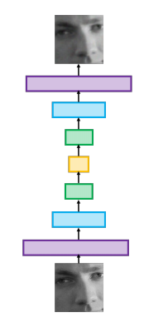
Deep Learning Architectures
feed-forward networks
auto-encoders (output want to recover input image, middle layer smaller - use results of middle layer for compression)
recurrent neural networks (RNNs) (backward feeding at run time as part of input into middle layer)
convolutional neural networks (CNNs)

Slide 3
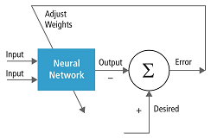
Deep Learning Topics
Neural Networks: perceptrons, activation functions, and basic neural networks. recall from discussion of NN - you train with input and desired outputs and use error to adjust weights in some kind of "learning algorithm".

Slide 4
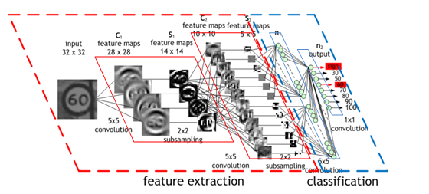
Deep Learning Topics
Logistic Classifier: this is a NN that the output layer has nodes that sum up to 1.0 --- meaning 100% probability. So each output node represents probability of that "thing it represents" occurring.

Slide 5
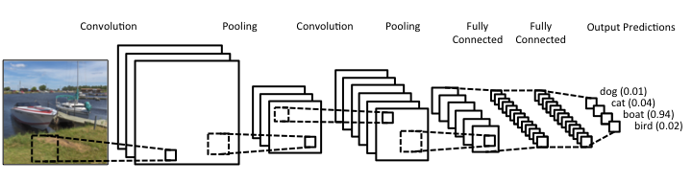
Deep Learning Topics
Convolutional Neural Networks:building blocks of convolutional neural networks, including filters, stride, and pooling. Capture local patterns →good for imaging applications

Slide 6
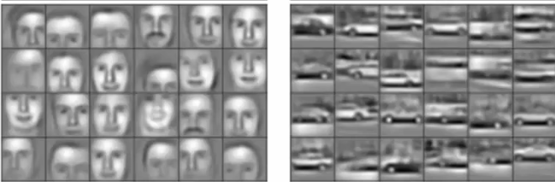
Characteristic of Deep Learning for Imaging
Input = raw pixels
CNN or regression (time feedback)

Slide 7
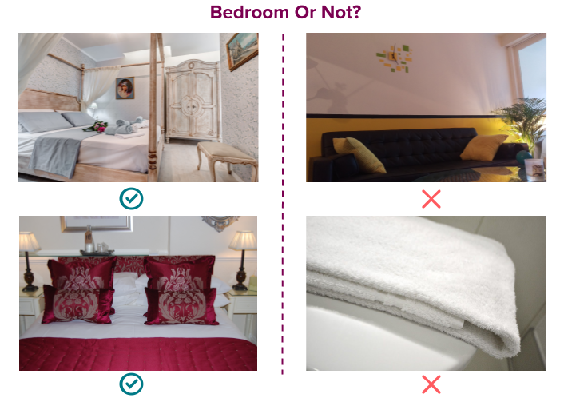
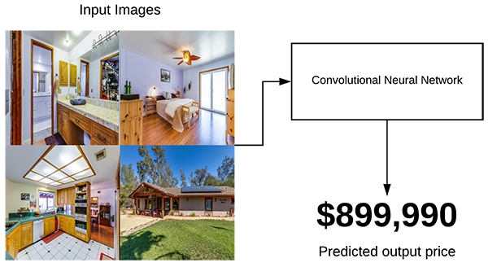
Classification/Detection Versus Regression
Classification = identify as 1 of a set of discrete classes.
Regression = prediction of a continuous value

Slide 8
Convolutional Neural Network
We will discuss the idea behind CNN

Slide 9
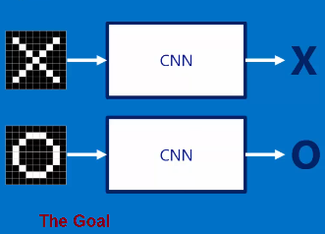
Motivation
SIMPLE example –want to detect X or O

Slide 10
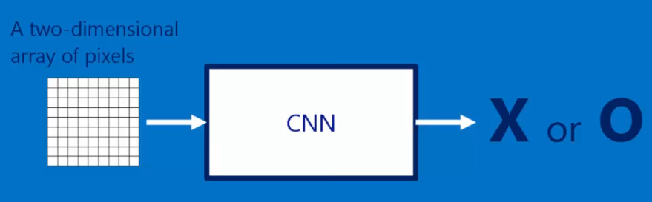
Input
Image (or part of image—somehow segmented)

Slide 11
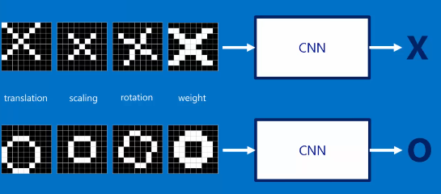
What we need –training data
Need LOTS, LOTS of data
How much training data --- examples for some forms of object recognition - could go into 1x00,000 samples or more. Sometimes like 10,000 or maybe for the really really simple example we show here we might get away with 200?
Google Open Image database – 9 million urls to labeled images

Slide 12
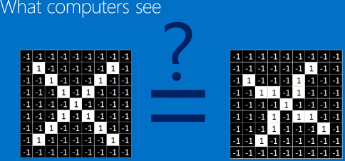
Understanding CNN
What a computer sees

Slide 13
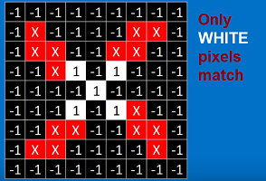
Understanding CNN

Slide 14
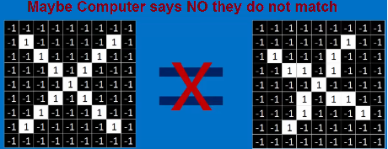
So a computer might say

Slide 15
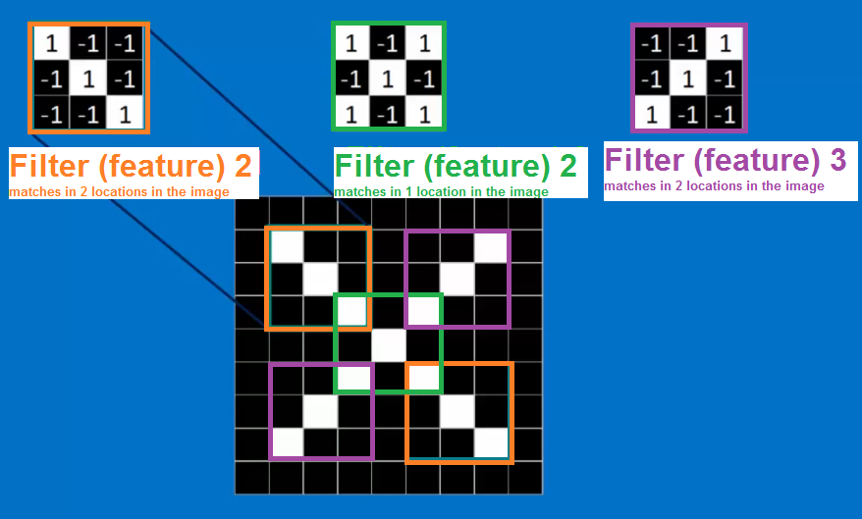
What if instead of matching everything at once ---we only try to match parts (local) of the X

Slide 16
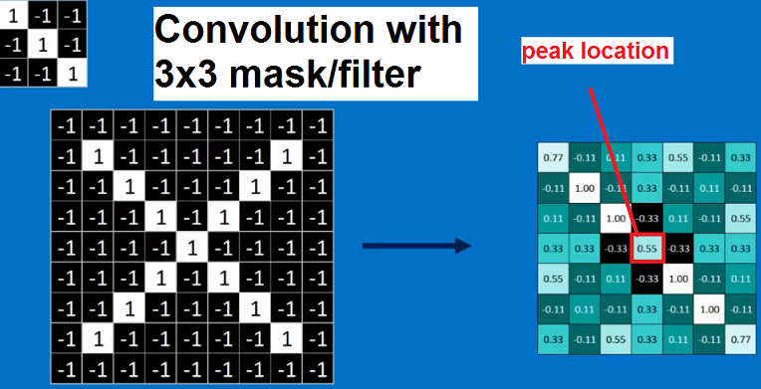
This idea of part = feature or results of a local filter
Here we have a filter looking for just diagonal part of the X

Slide 17
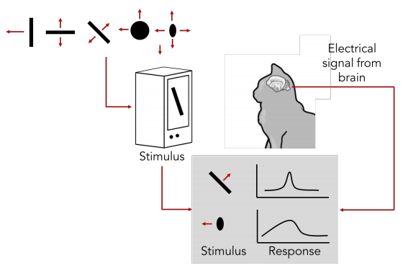
What should the filters be?
The CNN will LEARN THIS through training input = desired output
Interesting there is research showing the brain filters image data –this is not new and where edge detection etc. comes from

Slide 18
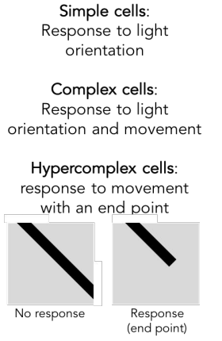
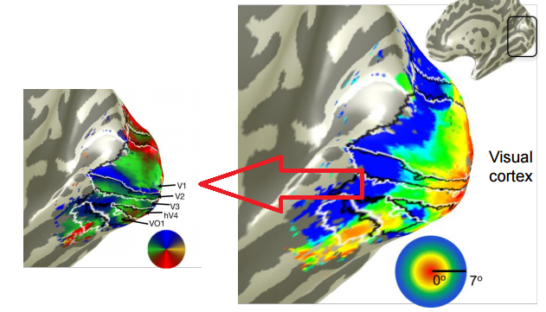
Again filters not new –evidence human brain
Here shows human brain and filtering in visual cortex V1 response

Slide 19
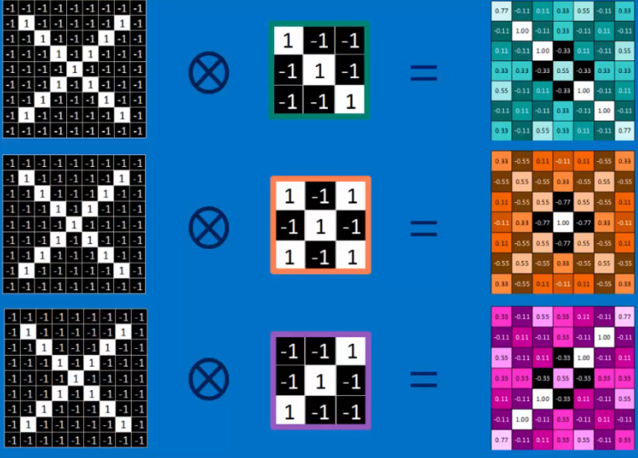
How many filters
Current implementations of CNN you must decide (for each layer) how many filters. Minimum 1

Slide 20
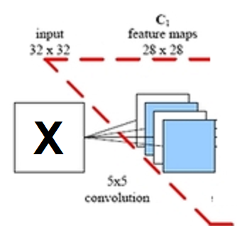
These are CONVOLUTION MxM filters
Example apply Three 5x5 filters to a 32x32 image
Output = Three 28x28 data values
NOTE: we loose 2 rows at top & bottom and 2 columns at left and right borders as can not process those with 5x5 mask → so output goes from 32x32 to 28x28

Slide 21
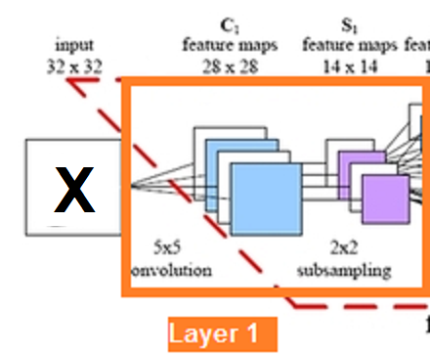
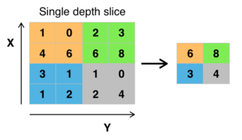
Yikes –we have MORE data if number filters > 1
Reduce data through Max Pooling
Space every 2x2 window and take max value
go from 28x28 → 14x14
Typically, 2x2 could be 3x3 windows –parameter you must choose

Slide 22
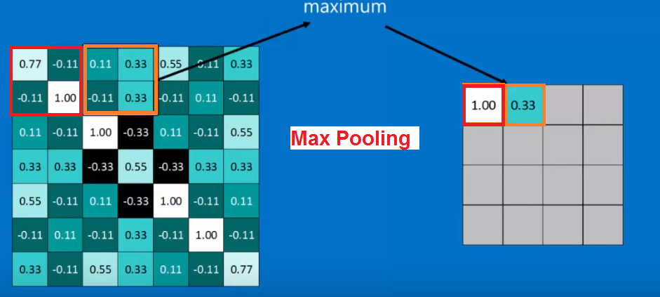
Max pooling illustrated

Slide 23
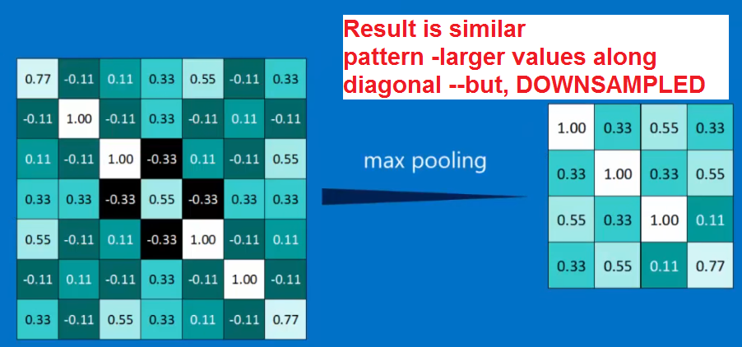
Max pooling illustrated

Slide 24
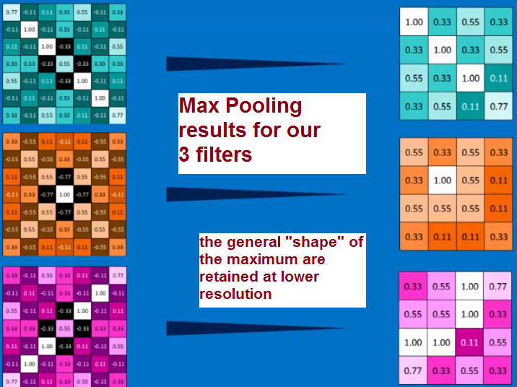
Max pooling illustrated

Slide 25
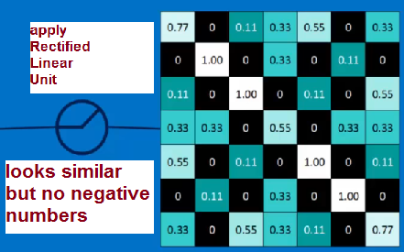

Not done yet with what a CNN does in a layer –NON-LINEARITY
--- we must introduce a non-linearity and do so for CNN at each data sample by applying Rectified Linear Units: set values < 0 to 0
This seems like magic –how did they come up with this? Why this?
Answer: in NN (came before) more elaborate functions like sigmas are used

Slide 26
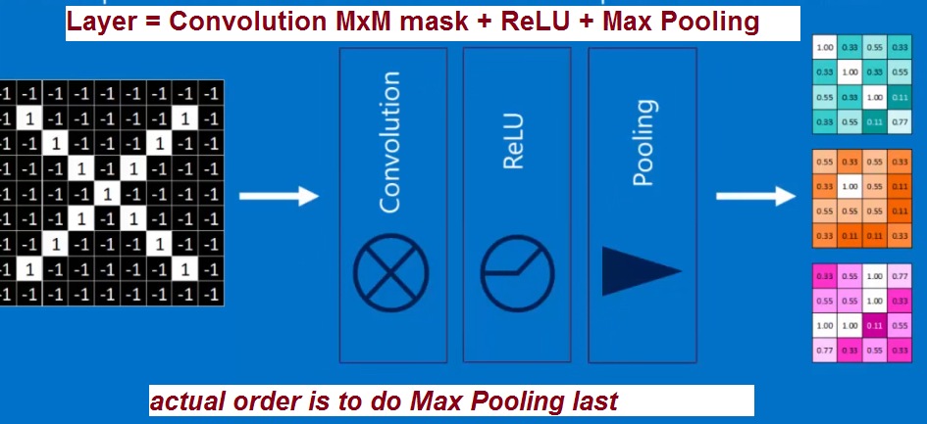
LAYER means…
= Convolution with set of (1-*) MxM filters + nonlinear + max pooling (downsample)

Slide 27
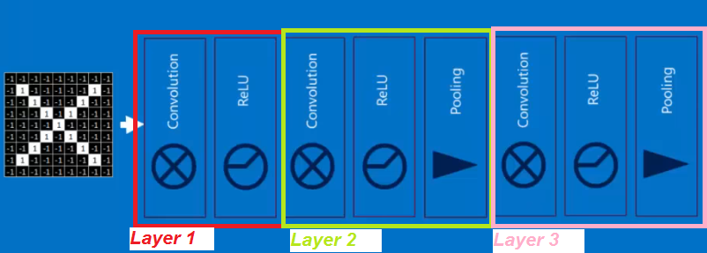
Example with 3 layers
Three Convolutional Layers

Slide 28
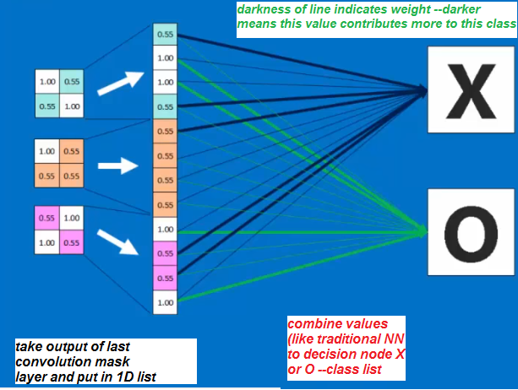
But the output does not say X or Y → Decision Layer (fully connected layer)
Last Layer -decision Layer (you can have more than one layer at the end that is fully connected like this --but, minimum is 1)
Weights will be learned through training

Slide 29
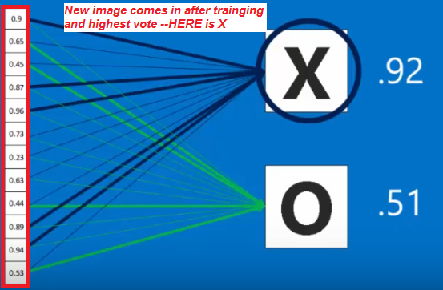
After training –using the CNN –what happens at last layer
Get a vote

Slide 30
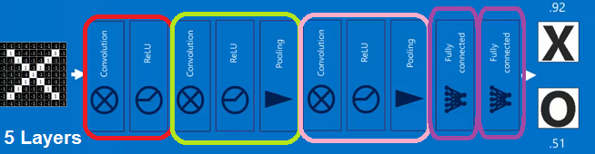
Final structure to our example CNN
5 layers – 3 convolutional and 2 fully connected

Slide 31
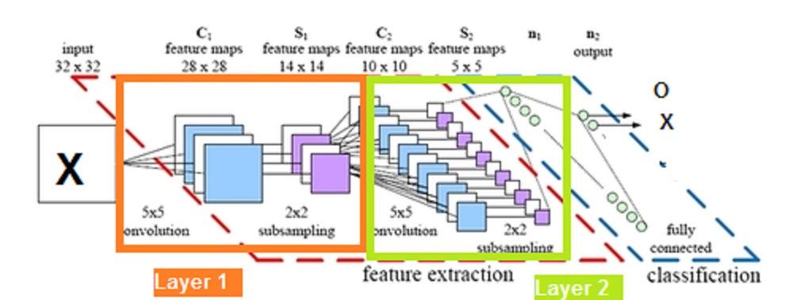
Smaller CNN possibility for our example
3 layers – 2convolutional, 1 fully connected
Layer 3

Slide 32
Lets look again in more detail
Convolution
Pooling/Strides
Fully Connected

Slide 33
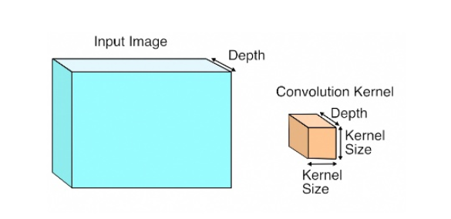
The first layer – Input & Convolution Kernel/Filter
Each layer of data in a convnet is a three-dimensional array of size h × w × d, where h and w are spatial dimensions, and d is the feature or channel dimension. The first layer is the image, with pixel size h × w, and d color channels (typically 3 for RGB)

Slide 34
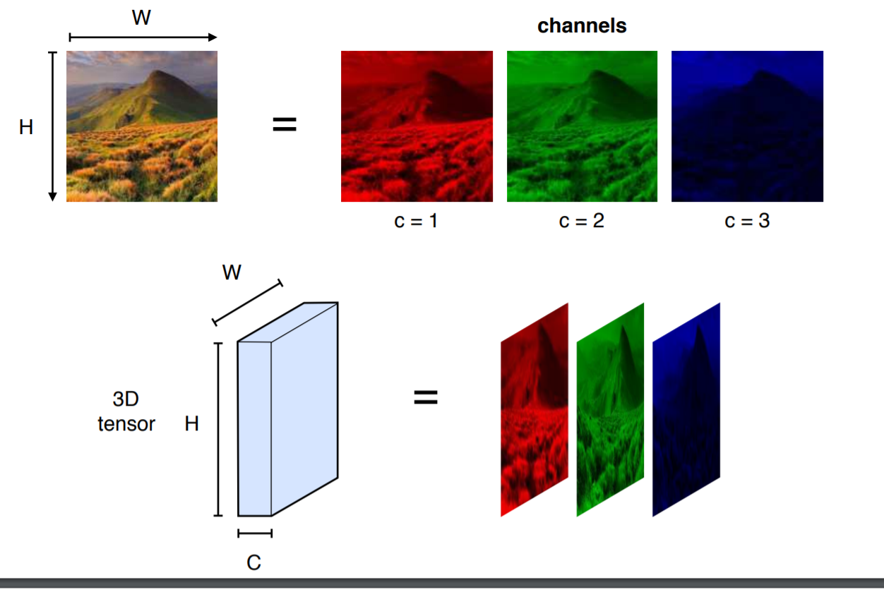
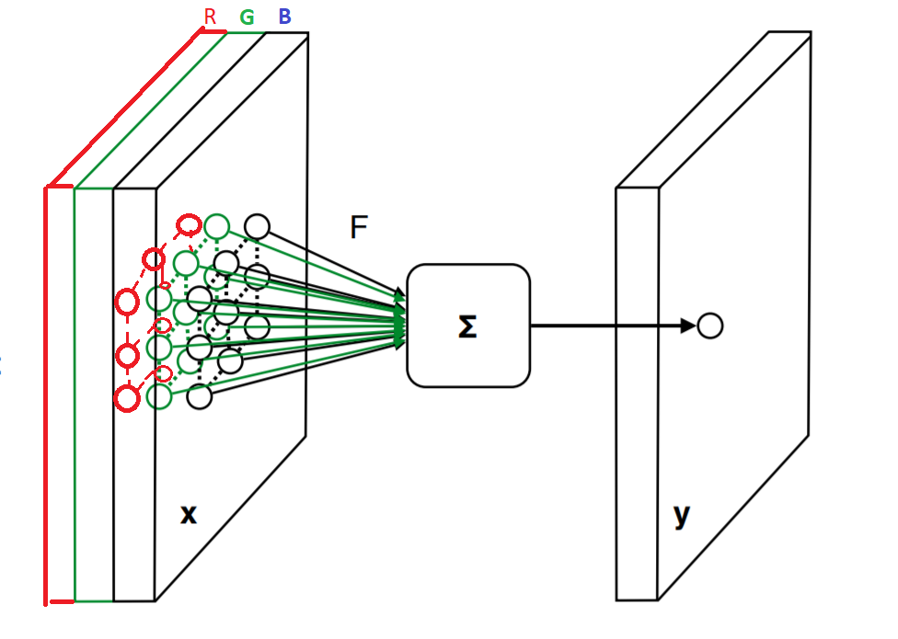
First layer – input and output of each Filter
Each filter works on all 3 channels R,G,B

Slide 35
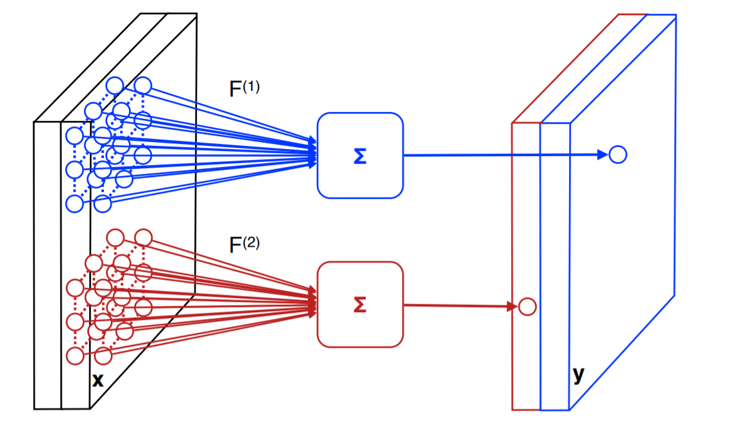
Output of Convolution Layer
If input =MxM and have K filters that are 3X3
OUTPUT = K channels of (M-2)x(M-2)
Example: 2 filters
→ 2 output channels

Slide 36
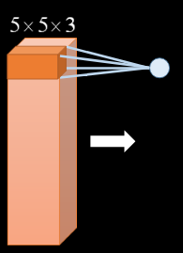
Special Note – Filters are 3D
You can apply your filter –say on the original input 64x64x3 (where 3 is red, green, blue) to be say a 5x5x3 filter (a spatial filter 5x5 in full depth 3 channels)
This can be true at ANY layer –can be 3D take in multiple results (depth)

Slide 37
Convolution layers - OUTCOME
CNN capture "local" spatial patterns at different scales (downsampling-max pooling) --- good for Image Applications

Slide 38
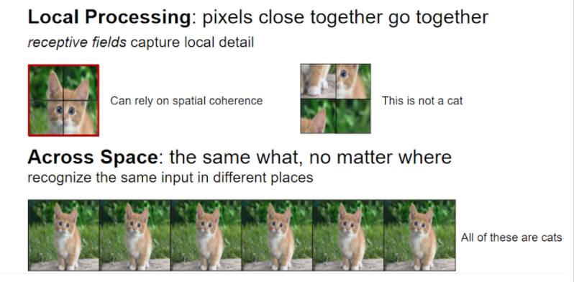
What convolution is capturing

Slide 39
Lets do a few calculations
---how much are we learning????

Slide 40
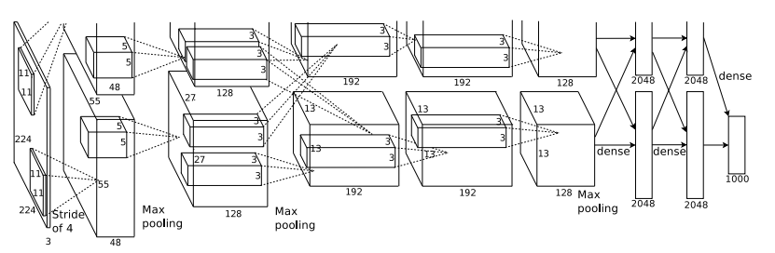
Some NUMBERS:
Layer 1 : 224×224×3 input image with 96 masks of size 11×11×3 with stride of 4 (skip window placement every 4) → output 55x55x 96
Output size = (Original_Size –Mask_size)/Stride + 1
= (224-11)/4 + 1 = 213/4 + 1 = 54 + 1 = 55
**apply max pooling in depth** → 55x55x48

Slide 41
Some NUMBERS: cont.
Layer 2: input = 55x55 x 48
convolution with 256 masks of size 5x5x48
→ output 51x51x256 (output length = (55-5)/1 + 1 =51 )
max pooled to output 27x27x128 and also applied nonlienar
(output length from max pooling = 51/2 +1 =26 +1 =27 output depth = 256/2 = 128)

Slide 42
Some NUMBERS: cont.
Layer 3 :384 kernels of size 3 × 3 × 256 connected to the (normalized, pooled)
output length = (27-3)/1 + 1 = 25
after max pooling output length = (25/2) = 13 output depth =384/2=192
→ output = 13x13x192

Slide 43
Stride
---making our data smaller

Slide 44
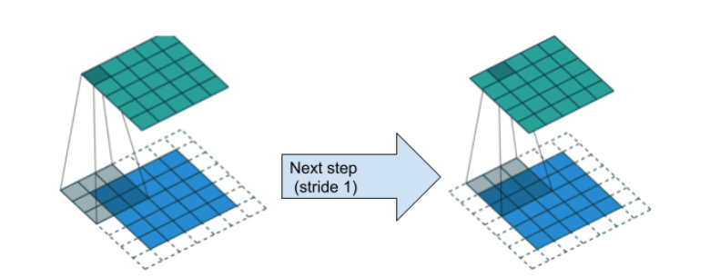
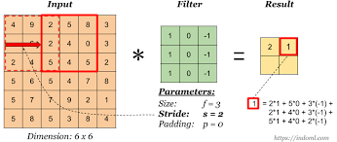
Apply filter using stride over entire data
Stride = 1
Stride = 2

Slide 45
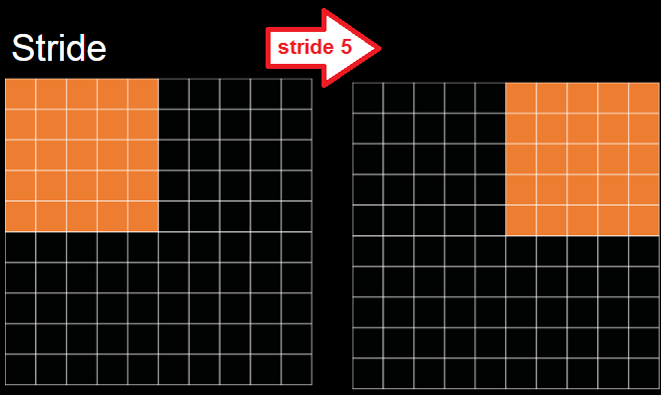

Stride of 5 - example
Stride of 5 (skip 5 pixels to apply filter next)
INPUT NxN, MASK MxM
Output length = (N-M)/stride + 1 = (10-5)/5 + 1 = 2 Output size = Output length x Output length = 2x2
OUTPUT
2x2

Slide 46
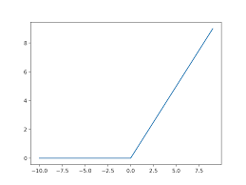
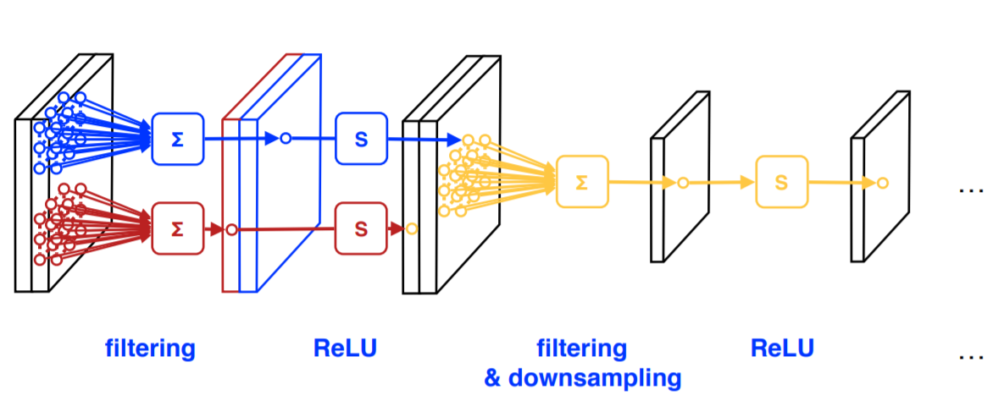
Apply nonlinearity – activation function
ReLU = rectified linear unit (“ray-loo”)
This function (ReLU in this example) placed directly behind every neuron, takes as input the linear neuron output and generates a nonlinear output based on it
ReLU is one of a number of nonlinearity functions that is popular

Slide 47
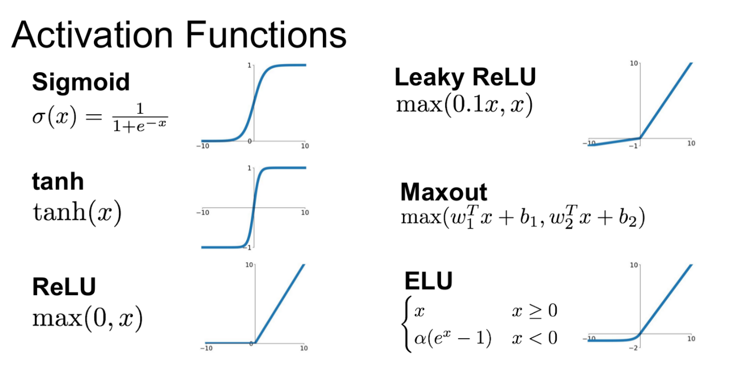
Applying nonlinearity – activation function
Which activation function??
In practice, ReLU converges six times faster than tanh and sigmoid activation functions.

Slide 48
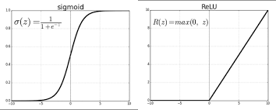
ReLU and Sigmoid
ReLu is used is because it is simple, fast, and empirically it seems to work well.
advantage is huge when dealing with big networks with many neurons, & can significantly reduce both training and evaluation times.
Early papers observed that training a deep network with ReLu tended to converge much more quickly and reliably than training a deep network with sigmoid activation.

Slide 49
ReLU versus Sigmoid
Advantage:
Relu : More computationally efficient to compute than Sigmoid like functions since Relu just needs to pick max(0, x) and not perform expensive exponential operations as in Sigmoids
Relu : In practice, networks with Relu tend to show better convergence performance than sigmoid. (Krizhevsky et al.)
Sigmoid: not blowing up activation
Relu : no vanishing gradient
Disadvantage:
Sigmoid: tend to vanish gradient (cause there is a mechanism to reduce the gradient as "a" increases, where "a" is the input of a sigmoid function. Gradient of Sigmoid: S′(a)=S(a)(1−S(a)). When "a" grows to infinite large, S′(a)=S(a)(1−S(a))=1×(1−1)=0.
Relu : tend to blow up activation (there is no mechanism to constrain the output of the neuron, as "a" itself is the output)
Relu : Dying Relu problem - if too many activations get below zero then most of the units(neurons) in network with Relu will simply output zero, in other words, die and thereby prohibiting learning.(This can be handled, to some extent, by using Leaky-Relu instead.)

Slide 50
The Vanishing Gradient Problem
REMEMBER: NN trained using stochastic gradient descent.
Calculate Error and use to estimate a GRADIENT to update each weight in the network (to reduce error).
This error gradient is propagated backward through the network from the output layer to the input layer.
As a NN adds MORE layers (deep NN) --PROBLEM is that the gradient diminishes dramatically as it is propagated backward through the network.
The error may be so small by the time it reaches layers close to the input of the model that it may have very little effect. → As such, this problem is referred to as the “vanishing gradients” problem.

Slide 51
The Vanishing Gradient Problem
creates unstable behavior that you may encounter when training a deep neural network.
Proposed solutions:
alternate weight initialization schemes, unsupervised pre-training, layer-wise training, and variations on gradient descent.
ONE SOLUTION is the use of rectified linear activation function

Slide 52
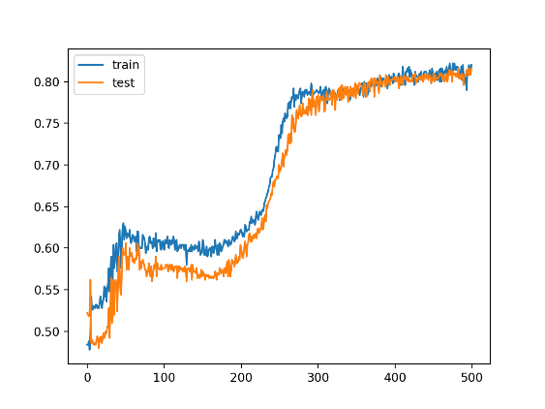
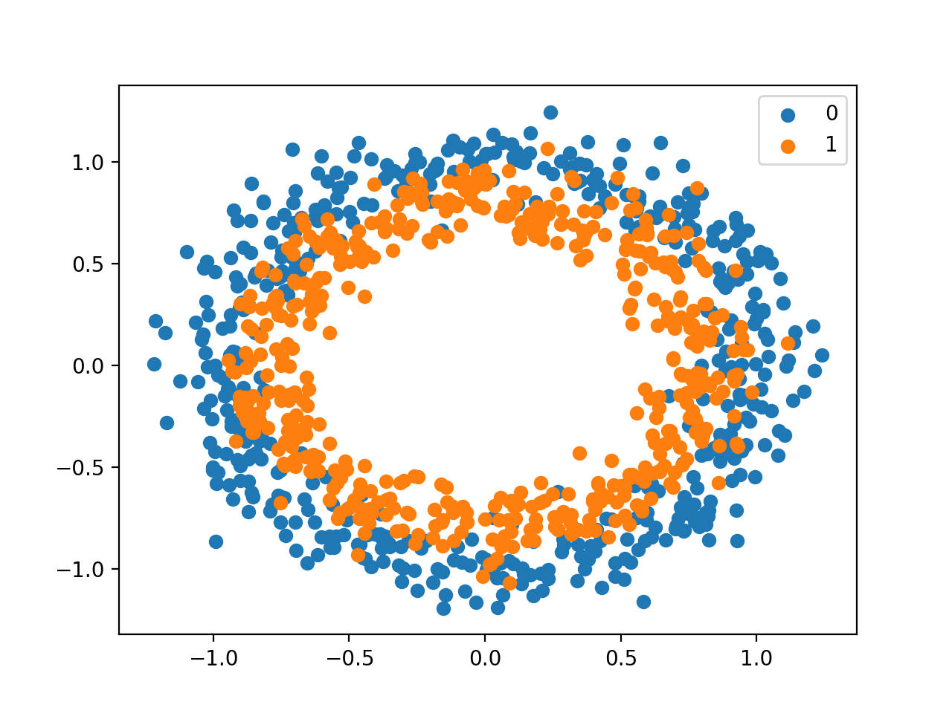
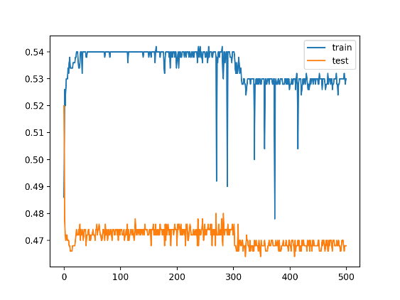
Example of Vanishing Gradients
See here over time the testing is getting significantly worse than earlier in the
Activation function = hyperbolic tangent
2 classes in example
3-Layer network training
Results-GOOD
8-Layer network training
VANISHING GRADIENT

Slide 53
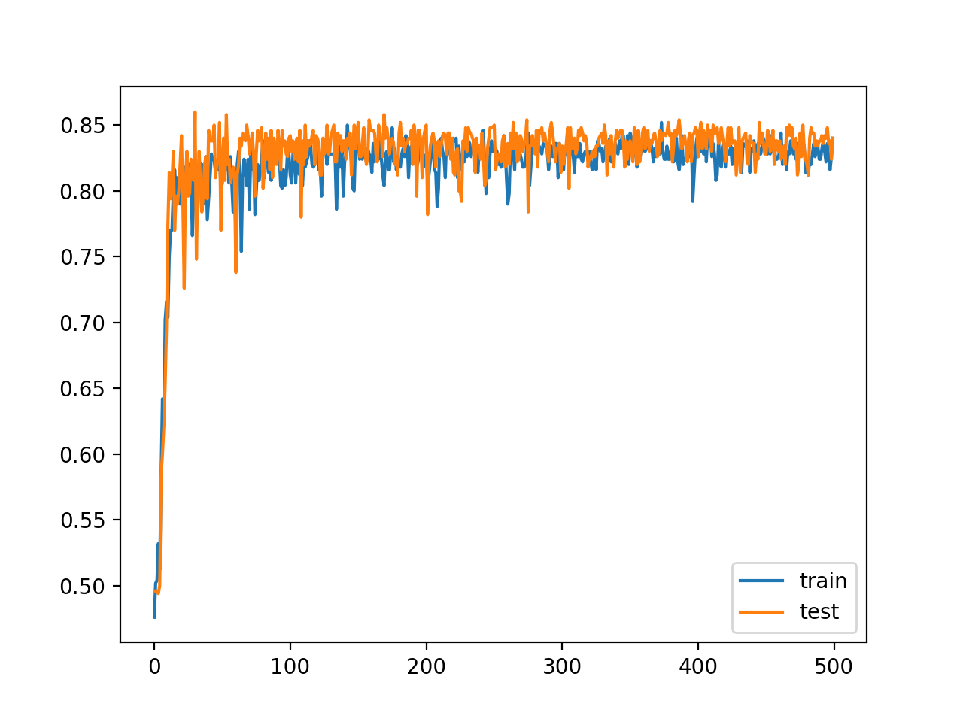
Example of Vanishing Gradients
LETS try Activation Function = ReLU for our 8-Lare network
FIXED
Remember the 8-Layer with hyperbolic tangent activation function
VANISHING GRADIENT

Slide 54

Yet—there are more options….ReLU versus Leaky ReLU
A negative of ReLU is that it is saturated at the negative region, meaning that the gradient at that region is zero.
With the gradient equal to zero, during backpropagation all the weights will not be updated, to fix this, we use Leaky ReLU.

Slide 55

In Max Pooling: can ALSO have concept of stride
This is the way we had before to reduce size

Slide 56


CNN – has multiple layers that usually end with fully connected and softmax layer
Deeper networks typically can distinguish greater number of objects/classes and/or handle harder discrimination tasks

Slide 57
Depth of network
---what it can mean

Slide 58

Shallow CNN for simpler problem of Digit recognition
4 convolutional layers + 1 fully connected layer

Slide 59

Going Deeper
ResNet 152 -- has 152 layers !!!!!!!!

Slide 60
Questions about architecture
----there are so many

Slide 61
Question 1: How many layers of each type (convolution and fully connected)?
hard to answer - minimum 3 largest maybe 6-15 (but, that is changing) . For sure the more layers, the longer to train and in general more data needed. More complex the problem more layers. Simpler the problem less layers needed. Minimum 1 fully connected layer. NOT LEARNED, you decide

Slide 62
Question 2: How many masks at each layer?
hard to answer - could learn this. Minimum obviously 1. Not too many or too many parameters. Can have more masks if they are small (3x3) than the number you would have if they were large (7x7)
Could have Three 3x3 masks OR One 7x7 mask?
Typically NOT LEARNED, you decide
This is one of the more difficult “parameters” to set—add more if results are bad

Slide 63
Question 3: what size is the mask?
Another hard question
minimum is 3x3 to 7x7??
Too big and too much to learn. Larger mask means larger scale pattern looking to match via convolution.
Typically NOT LEARNED, you decide

Slide 64
Question 4: What is content of MxM mask?
you learn this through training (backpropogation like traditional NN, use error between output and desired output to alter the parameters) LEARNED

Slide 65


Question 5: What are the weights in the fully connected layers?
you learn this through training (backpropogation like traditional NN, use error between output and desired output to alter the parameters) LEARNED

Slide 66
Number of Parameters for just One Layer you need to learn
Assume 10 filters at this layer
Each 5x5 and applied to Red, Green, Blue = 3 fields of input
Number paramenters for 1 filter = 5x5x3 =75
For 10 filters = 10x75 =750 parameters

Slide 67

Totally different example
Face detection

Slide 68

Yet another example
Note here only parts of image fed in

Slide 69
Cnn frameworks
There are many

Slide 70

CNN frameworks

Slide 71

TensorFlow by Google
is a library for CNN that is supported by Google
offers distributed computing.
tensorflow official site
tutorial site
install instructions

Slide 72
Frameworks on Frameworks
Keras
Front End Wrapper = library with backend of either TensorFlow or Theano
Google TensorFlow is offically supporting Keras
TFLite
More…

Slide 73
Keras – front end wrapper for CNN training
from keras.models import Sequential
from keras.layers import Dense, Activation
# Simple feed-forward architecture
model = Sequential()
model.add(Dense(output_dim=64, input_dim=100))
model.add(Activation("relu"))
model.add(Dense(output_dim=10))
model.add(Activation("softmax"))
# Optimize with SGD (learning process)
model.compile(loss='categorical_crossentropy', optimizer='sgd', metrics=['accuracy'])
# iterate training data in batches
model.fit(X_train, Y_train, nb_epoch=5, batch_size=32)
# alternatively feed in training data in one batch model.train_on_batch(x_batch, y_batch)
# Evaluate model
loss_and_metrics = model.evaluate(X_test, Y_test, batch_size=32)
# create predicitions on new data
classes = model.predicts(X_test, batch_size=32)
2017 – google
Announced support for Keras in TensorFlow to come

Slide 74

STAGES
Train w/Validation → Testing

Slide 75

Dataset Split
Starting point 80%/10%/10% (train, validation, test)
Make sure enough training data
Test data versus “Live Test” data

Slide 76
training
--options

Slide 77
TRAINING Options - WHERE
Train Locally
Train in a Colab
Train in Colab Pro
Train on the Cloud

Slide 78

TRAINING Options
Use on Google Cloud Machine Learning directly
OR Download and setup on your machine(S) –will take long time to train even in multi machine setup like days to week(s) when have large data sets. Even in cloud same time period. MUCH worse on single machine
Programming Interface – supports number of languages but, main is Python for training

Slide 79
History of Python as Machine Learning Language
NumPy package = numerical analysis like Matlab
matplotlib package= plotting functionality from Matlab was ported to Python
SciPy package = Libraries for scientific computing were built around NumPy and matplotlib
Python's support for Matlab-like array manipulation and plotting is a major reason to prefer it over Perl and Ruby.

Slide 80
Other popular ML languages
C/C++, Java
But, google seems to prefer Python for TensorFlow at base level (C++ also….some newer support for Java and Go)

Slide 81
TRAINING in Google Cloud ML
create a TensorFlow application that defines your computation graph and trains your model.
Cloud ML Engine has almost no specific requirements of your application during the training process, so you build it as you would to run locally in your development environment.
Get your training and verification data into a source that Cloud ML Engine can access.
usually means putting it in Google Cloud Storage, BigTable, or another Google Cloud Platform storage service associated with the same Google Cloud Platform project that you're using for Cloud ML Engine.

Slide 82
TRAINING in Google Cloud ML
3) application is ready to run
it must be packaged and transferred to a Google Cloud Storage bucket that your project can access. This is automated when you use the gcloud command-line tool to run a training job.
4) The Cloud ML Engine training service sets up resources for your job. Allocates one or more virtual machines (sometimes called training instances) based on your job configuration. Each training instance is set up by:
Applying the standard machine image for the version of Cloud ML Engine your job uses.
Loading your trainer package and installing it with pip.
Installing any additional packages that you specify as dependencies.

Slide 83
TRAINING in Google Cloud ML
5) Training service runs your trainer, passing the command-line arguments you specify when you create the training job.
6) You can get information about your running job in three ways:
On Stackdriver Logging
Requesting job details or running log streaming with the gcloud command-line tool.
Programmatically making status requests to the training service.

Slide 84
TRAINING in Google Cloud ML
7) When trainer succeeds or encounters an unrecoverable error, Cloud ML Engine halts all job processes and cleans up the resources.
This is an investment of time to learn and Money to run
--no real solution but, you can download package and “try” to run
Small amounts of data on your local machine –but, CNNs generally depend on large amounts of data to work
GPU versus CPU –running on GPU(s) on machines faster and they are primed to do image / graphics type operations like convolution

Slide 85


TRAINING in Google Cloud ML -Example
“SMALL” example
https://www.tensorflow.org/tutorials/deep_cnn small CNN takes hours to train on a GPU with 86% accuracy on 24x24 input training images:
CLASSES: airplane, automobile, bird, cat, deer, dog, frog, horse, ship, and truck.
4 layers: 2 convolutional + 2 fully connected
1,068,298 learnable parameters
requires about 19.5M multiply-add operations to compute inference on a single image.

Slide 86


TRAINING –fastest is in cloud (distributed computing)

Slide 87
runtime
--running your model

Slide 88
RUNTIME: Program to Use Trained CNN (TensorFlow)
Supports: Python, Java, Go, Android and more
Can use as a service from cloud or run inside client

Slide 89

Special Purpose Hardware - GPUs
Nvidia (chip manufacturer) has TESLA chip
Build your own special purpose on board RUNTIME hardware (embedded system)

Slide 90

GPUs faster at Matrix calculations (apply filter) than CPU

Slide 91

Intel wants to compete with Nvidia

Slide 92
Various special Notes/Ideas
---from data, to training and beyond

Slide 93


Special Note about “Artificially” increasing amount of training data
Can take random croppings or selections of original training data
Can alter image (example shown –alter contrast)

Slide 94

Special note- border and filtering
Option 1: don’t process boundaries
Option 2: Pad with 0s (size of output does not change –still function of input, filter and stride sizes)

Slide 95
Data – train, validation, test, and live test
Typically you take your labeled data and split it into : train, validation and test
80%(train)/ 10%(validation) / 10% (test) --- is a common split but, up to you
Train data= used in training the network
Validation data = sample of data used to provide an unbiased evaluation of a model fit on the training dataset while tuning model hyperparameters.
Test data = sample of data used to provide an unbiased evaluation of a final model fit on the training dataset.

Slide 96

TensorBoard --visualization
Specify your model to use TensorBoard & metrics to calcuate at checkpoints
https://www.tensorflow.org/tensorboard
Here we see “loss” (opposite of accuracy) of train and validation data at different “checkpoints” (points in training –can save model and statistics)

Slide 97
Special Note and Overfitting
Validation data can help you periodically assess you model to decide what check point is the best to use
Problem in all NN including CNN
Dropout = technique to help stop overfitting to training data
Set to zero the output of each hidden neuron with probability 0.5.
The neurons which are “dropped out” in this way do not contribute to the forward pass and do not participate in backpropagation.
This technique reduces complex co-adaptations of neurons, since a neuron cannot rely on the presence of particular other neurons.
You might choose to do this only on some of the convolution layers (maybe early on)

Slide 98
Transfer Learning
--- leveraging pre-trained models

Slide 99

Practical advice for ANY ML project
---- when little/no time, little/no money consider
-----when not “enough” data to train from scratch
-----when want to explore if transfer learning (re-training a pre-trained model) can help with accuracy results given any amount of time you will train.

Slide 100
Guidelines
---some suggestions

Slide 101

Guideline 1
Decrease size of data slowly
Bottom → Top
The spatial resolution H ⨉ W decreases
The number of channels C increases

Slide 102

Guideline 2 – Filters
Receptive field must be large enough to capture objects of interest
The image region influencing a neuron
Anything happening outside is invisible to the neuron
HOW TO INCREASE RECEPTIVE FIELD
Large filters
Chains of small filters

Slide 103

Guideline 3- Filters
User chain of smaller filters rather than large filter
Reduces number of parameters → faster
Get same receptive field as the larger filters
2 nonlinearities

Slide 104

Guideline 4- number of filters in layer (= # output channels)
Be conservative, don’t have too many filters (# filters K below)

Slide 105
Guideline 5 – when computation issue consider separable filters
Like MobileNet consider separable filters to reduce number of parameters and hence computations.
WE WILL DISCUSS Mobile in Part 2 of this lecture series

Slide 106
Overall Recommendations
ISSUE | RECOMMENDATION
More Complex Problems Large number of classes Large data set Greater confusion between classes | Increase depth of network Current trend – use larger number of layers of small sized filters
Future Looking Beyond classification of current state, looking to predict future | Consider Generative Adversarial Networks For temporal component use Long Term Short Term (LSTM) Networks or Recurrent Neural Networks
Mobile and Low Computational Devices (IoT) | For on device computation (otherwise consider cloud) Shallow Networks, minimize number of filters at each convolutional layer. Depthwise Separable Filters (reduce #parameters in mode) – MobileNet architecture [4] Optimize networks (elimination of low contribution nodes, etc.) Consider special purpose frameworks like TensorFlow Lite. [12]

Slide 107
Overall Recommendations
ISSUE | RECOMMENDATION
Multi-Modal Data | Tradeoff: potentially higher accuracy for increased computation of combined modality processing versus faster (and potentially lower accuracy) of having separate networks for each modality processing in parallel.
Data Size Variability | Pyramid approach [13] When size is different than trained network but, is fixed. Use only front (not FC layers) for feature extraction and then create new FC layers for your new size. Otherwise necessitates rescaling of data to input size of existing
Minimal Time and Resources Minimal time for training Minimal resources (computation, budget) | Perform Transfer Learning by finding a pre-trained network that has ideally similarity with your problem and replay the last layer(s) and retrain with your set of classes. Essentially use the pre-trained network’s beginning feature and potentially fully connected layers (minimally replace the end layer)

Slide 108
Overall Recommendations
ISSUE | RECOMMENDATION
Lack of Training Data Minimal data or none at all. Accommodate your sensor data to size Scale training data or sensor data to match | Numerous data sets mostly for 2D rgb images such as ImageNet [23], COCO [24] Emerging data sets in 3D [25-31] Specialized datasets -example: Person datasets: [32-35]

Slide 109
TESTING
----test data, metrics, live testing

Slide 110



ML Metrics
There are MANY Metrics you can apply →

Slide 111
Next Step
----start learning a ML Framework like Tensorflow, consider Cloud training

Slide 112
Get started????
Look at tutorials on Google TensorFlow site
Do small example they show on your own machine (could take hours to train)
Next – move to cloud (more time to learn and may cost $)

