Slide 1


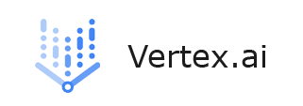
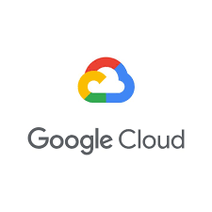
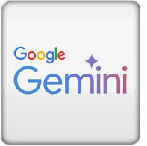
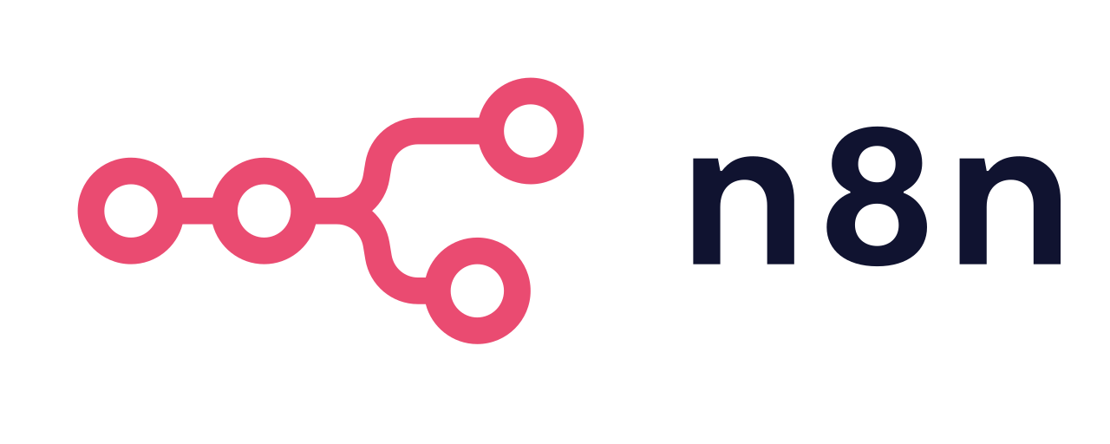
n8n AI Workflow with Custom Multi-Modal (image + text) Gemini Model to Base Model Spanish Translation
Worflow by Naman Rajani
CS graduate student, iLab, CSUEB

Slide 2
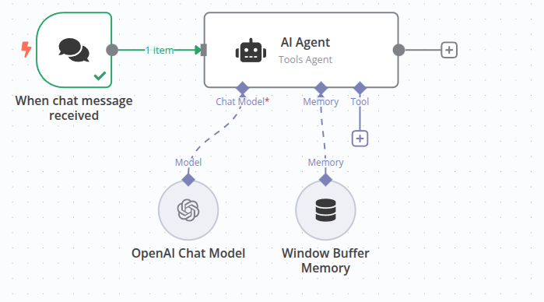
AI workflows and n8n
n8n you can chain together nodes such as:
Input/Trigger nodes: A new email arrives, a form is submitted, or a file is uploaded.
Processing nodes: Send the text to an LLM (OpenAI, Hugging Face, etc.) for summarization, classification, or generation.
Logic/Control nodes: Apply filters, conditions, or loops to handle different scenarios.
Output/Action nodes: Save results to a database, post to Slack, send an email, or update a CRM.

Slide 3
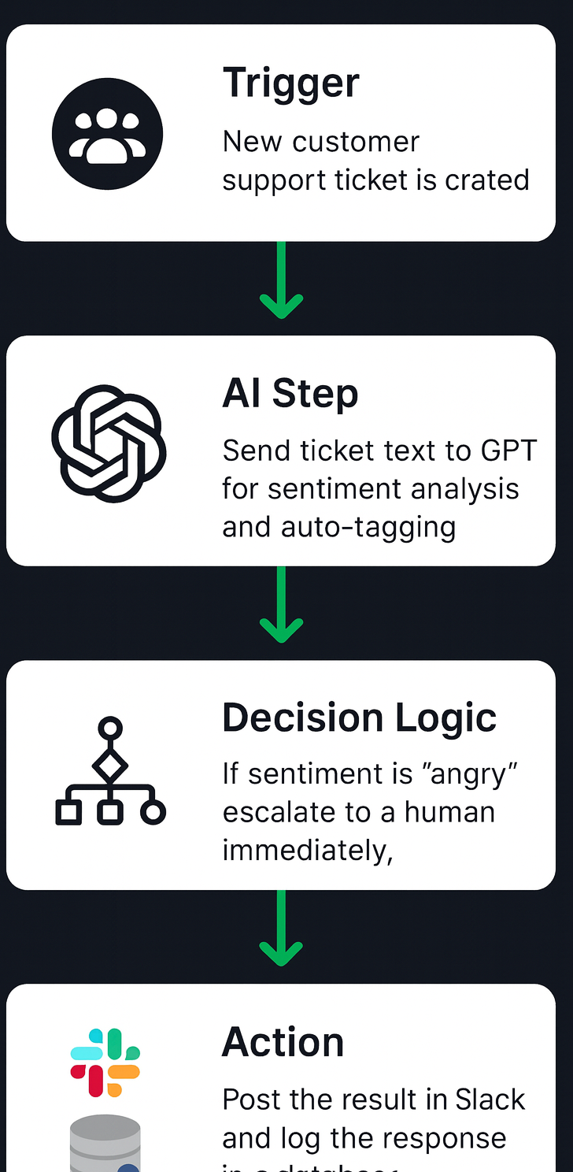
AI Workflow: smart processing of new customer support ticket
***** Example *******
Trigger: New customer support ticket is created.
AI Step: Send ticket text to GPT for sentiment analysis and auto-tagging.
Decision Logic: If sentiment is “angry,” escalate to a human immediately; otherwise, generate a draft response.
Action: Post the result in Slack and log the response in a database

Slide 4
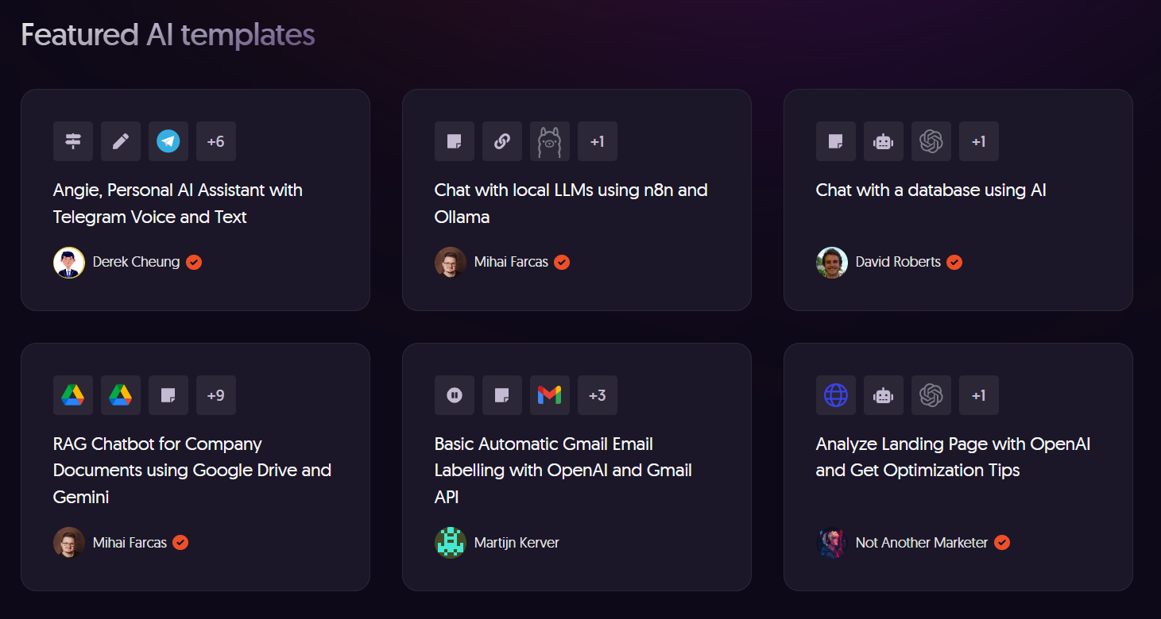
n8n has AI templates (free)
Top 3799 AI automation workflows

Slide 5
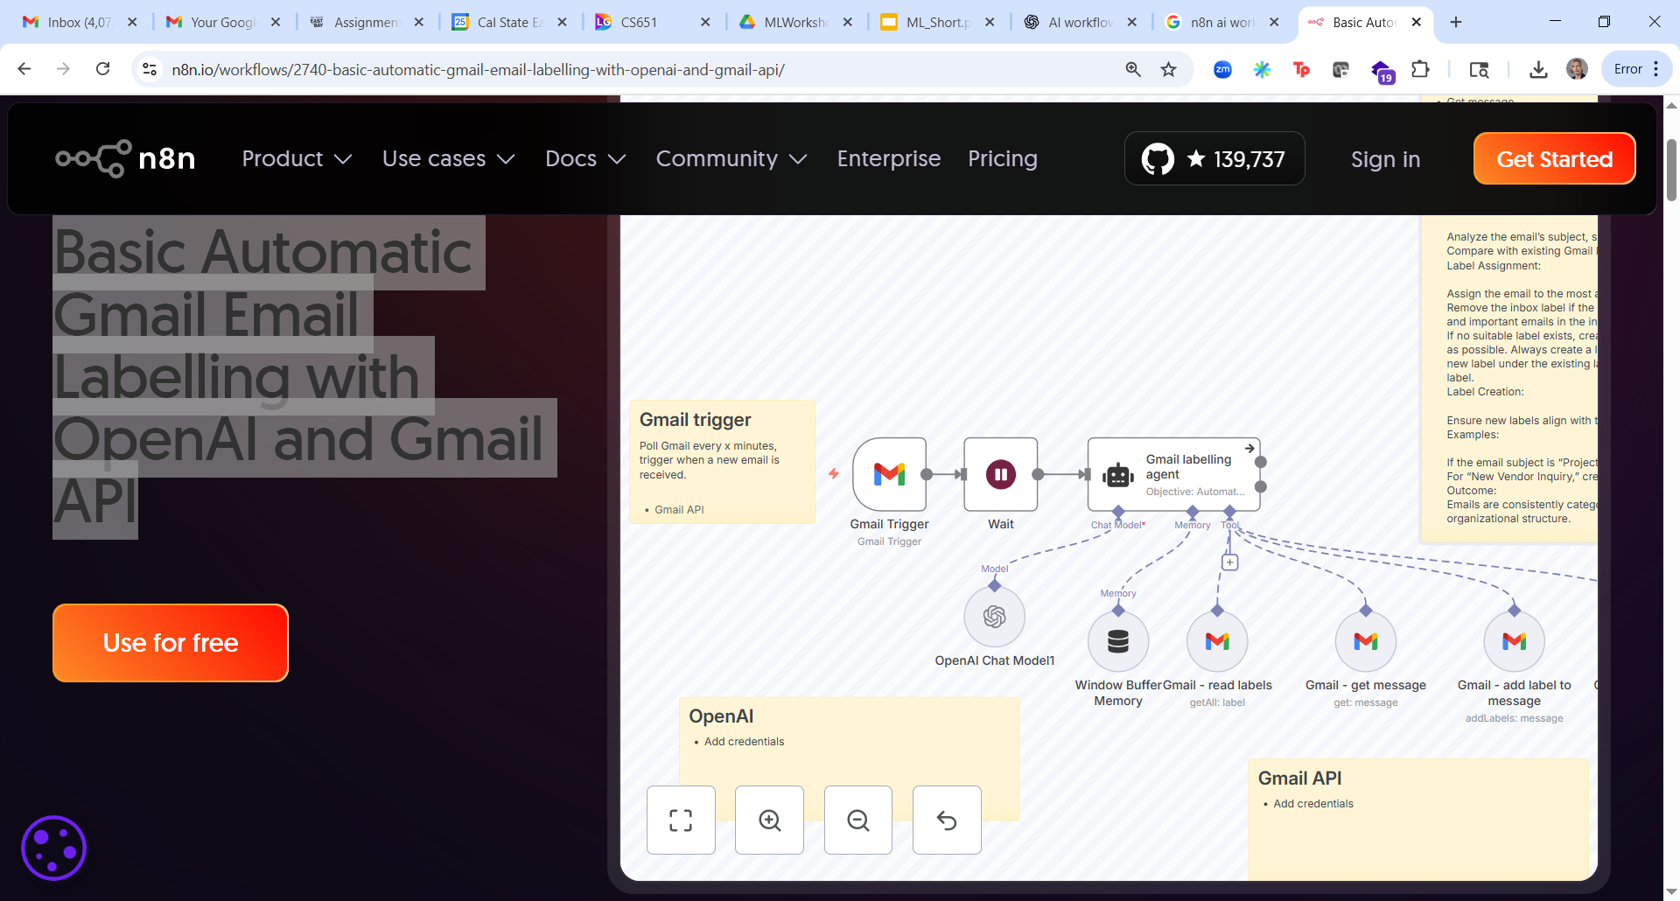
Template : Basic Automatic Gmail Email Labelling with OpenAI &Gmail API
***** Example *******

Slide 6
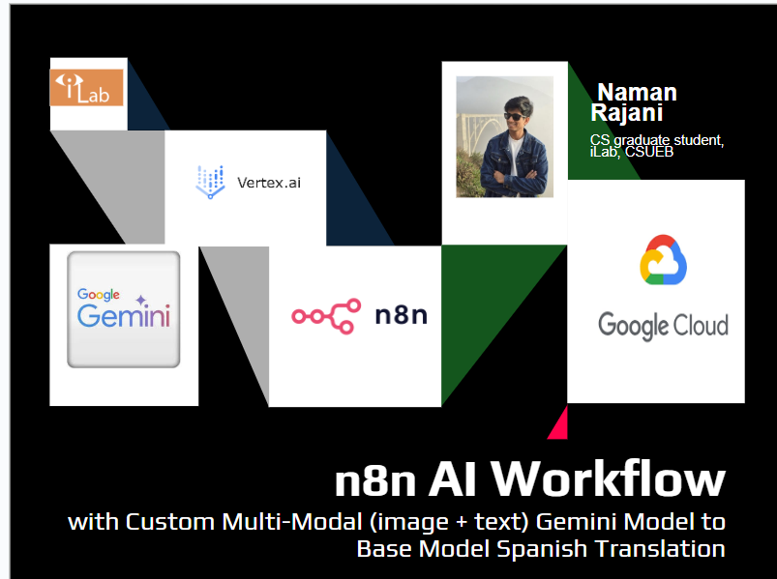
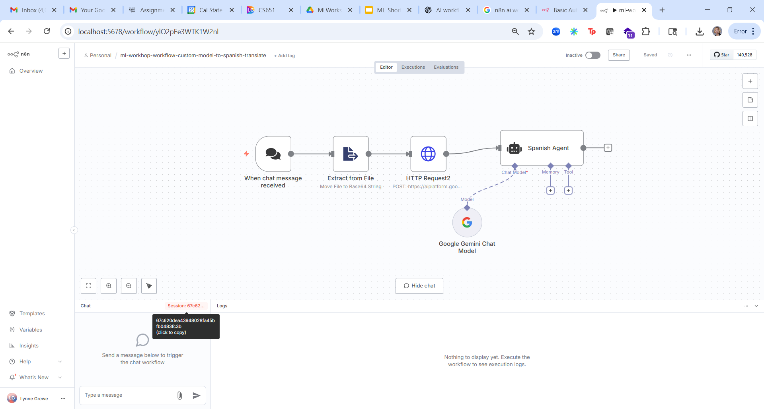
Multi-modal (vision + text) Chat input Processed by fine-tuned Gemini Model & Output Translated to Spanish
Trigger: User enters in image and Q (VQA task)
AI Step 1: send image+Q to fine-tuned Gemini model
Decision Logic: Understand this Question+data with our custom model & provide answer in English and Spanish
Action (AI step 2): Translate the answer to Spanish

Slide 7
n8n competitors
Tool / Platform | Origin / Launch Date | Popularity / Adoption / Reach | Special / Differentiating Features (vs generic workflow tools)
OpenAI Agents SDK / Agent tooling (Python / JS) | ~2024 / 2025 (recent) (GitHub) | Rapid adoption among developers building agentic systems; used to orchestrate multi-agent workflows. (GitHub) | Enables orchestration of multiple agents, “tool use” integration, handoffs, tracing / observability built in. (GitHub)
OpenAI Operator | Announced January 2025 (research preview) (Wikipedia) | Limited / experimental in early use (for ChatGPT Pro users) (Reuters) | Autonomously interact with web UIs (click buttons, fill forms, etc.) to perform tasks. (Reuters)
Google Workflows / Cloud Workflows + AI services | Google Cloud Workflows existing for some years; AI integration ongoing (Google Cloud) | Used within Google Cloud / enterprise settings | Allows orchestration of Google services / APIs, integrating AI models (e.g. Document AI) into automated pipelines. (Google Cloud)
Google AI Studio / Gemini tools | AI Studio launched late 2023 / 2024 timeframe (Wikipedia) | Growing among devs using Google’s AI / Gemini ecosystem | Web IDE / environment for prototyping apps with generative models. Serves more as development tooling rather than full orchestration platform. (Wikipedia)
Microsoft Agent Flows / Copilot / AI workflow tools | Agent flows introduced ~2025 in Copilot / Microsoft stack (Microsoft) | Enterprise / Microsoft ecosystem users (Office 365, Azure) | Tightly integrated with Microsoft’s workspace tools, and built for “AI-first workflows” that combine business logic with agent behavior. (Microsoft)

Slide 8
AI Agent and other Tools (OpenAI, Google, Microsoft)
Tool / Platform | Origin / Launch Date | Popularity / Adoption / Reach | Special / Differentiating Features (vs generic workflow tools)
OpenAI Agents SDK / Agent tooling (Python / JS) | ~2024 / 2025 (recent) (GitHub) | Rapid adoption among developers building agentic systems; used to orchestrate multi-agent workflows. (GitHub) | Enables orchestration of multiple agents, “tool use” integration, handoffs, tracing / observability built in. (GitHub)
OpenAI Operator | Announced January 2025 (research preview) (Wikipedia) | Limited / experimental in early use (for ChatGPT Pro users) (Reuters) | Autonomously interact with web UIs (click buttons, fill forms, etc.) to perform tasks. (Reuters)
Google Workflows / Cloud Workflows + AI services | Google Cloud Workflows existing for some years; AI integration ongoing (Google Cloud) | Used within Google Cloud / enterprise settings | Allows orchestration of Google services / APIs, integrating AI models (e.g. Document AI) into automated pipelines. (Google Cloud)
Google AI Studio / Gemini tools | AI Studio launched late 2023 / 2024 timeframe (Wikipedia) | Growing among devs using Google’s AI / Gemini ecosystem | Web IDE / environment for prototyping apps with generative models. Serves more as development tooling rather than full orchestration platform. (Wikipedia)
Microsoft Agent Flows / Copilot / AI workflow tools | Agent flows introduced ~2025 in Copilot / Microsoft stack (Microsoft) | Enterprise / Microsoft ecosystem users (Office 365, Azure) | Tightly integrated with Microsoft’s workspace tools, and built for “AI-first workflows” that combine business logic with agent behavior. (Microsoft)

Slide 9
Try it yourself

