Slide 1
Cloud Computing --- high level intro
“A model for enabling ubiquitous, convenient, on-demand network access to a shared pool of configurable computing resources (e.g., networks, servers, storage, applications, and services) that can be rapidly provisioned and released with minimal management effort or service provider interaction.”

Slide 2

What is Cloud
Cloud computing is the aggregation of various distributed services on disparate computing systems connected via a common network.
Anytime,
Anywhere,
With any device,
Accessing any services
Answers you might hear from people:
  Widely distributed,
  network based,
  storage,
  computation,
  utility computing,
  IaaS,
  PaaS,
  SaaS.

Slide 3
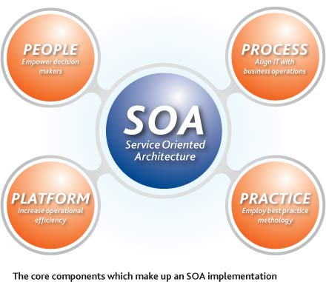
The timing
Software
  Standard Protocols
    IPv4, IPv6, IEEE_802.xx, TCP/IP, UDP, HTTP, HTTPS, ..etc
  Open Source Software
    Highly developed yet license free platforms and APIs
    Economics to spur innovation
  SOA mentality
Hardware
  Cheap Systems
    Commoditization of computers
    Virtualization of computers
  Network
    Bandwidth
    Constantly Connected
      WiFi
      Cellular / Mobile
SOA = structured collections of discrete software modules,
known as services, that collectively provide the
complete functionality of a large or complex software
application

Slide 4
Pros and Cons
Benefits
  Hardware efficiency
  Scalability
    Demand based computing
    Linear vs Tiered Growth rates
    Transactional Accounting
  Outsourcing of hardware level administration
  Reduced Costs
    Significantly lower barriers to entry
Concerns
  Security
    Increased focus on WebApp security
    Security without control/privacy
  Availability
    Increased network load
    SLE (service level expectations) of service provider
  Runaway costs
    Must scale business model to usage model
  Data ownership
    Who owns your data?
    Legality of intrusions.
    Private vs Public

Slide 5
Common cloud concepts
Universal Access
Scalable Services
Infrastructure managing the scaling, not applications
Elasticity: Expenses only incurred when they are needed
  New Application Service Models
  XaaS = X as a Service
  Pay-as-you-go

Slide 6
Examples
• Netflix spins up EC2 instances on-demand during peak traffic.
• Google Docs works seamlessly across devices.
• E-commerce auto-scales web servers on Black Friday.
• Startups share data center hardware via multi-tenancy.
• Runaway costs and quotas are real-world challenges.

Slide 7
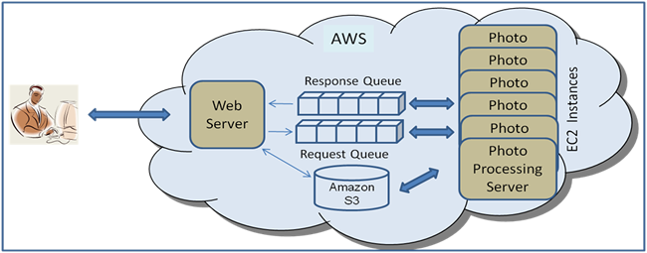
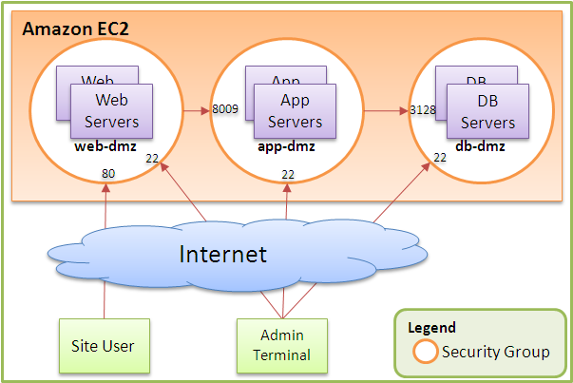
Amazon – the big start
Amazon EC2
  Elastic Cloud Computing
  virtual servers for rent, called Amazon Machine Images (AMIs)
priced on per hour
Amazon S3
  Simple Storage Service
  up to $0.XX per GB storage
  from $0.XX per GB transfer
via
    o REST
    o SOAP
    o BitTorrent

Slide 8
Amazon Instances-starting
M1 Small Instance – default*
  1.7 GiB memory
  1 EC2 Compute Unit (1 virtual core with 1 EC2 Compute Unit)
  160 GB instance storage
  32-bit or 64-bit platform
  I/O Performance: Moderate
  EBS-Optimized Available: No
M1 Medium Instance
  3.75 GiB memory
  2 EC2 Compute Unit (1 virtual core with 2 EC2 Compute Unit)
  410 GB instance storage
  32-bit or 64-bit platform
  I/O Performance: Moderate
  EBS-Optimized Available: No
M1 Large Instance
  7.5 GiB memory
  4 EC2 Compute Units (2 virtual cores with 2 EC2 Compute Units each)
  850 GB instance storage
  64-bit platform
  I/O Performance: Moderate
  EBS-Optimized Available: 500 Mbps
M1 Extra Large Instance
  15 GiB memory
  8 EC2 Compute Units (4 virtual cores with 2 EC2 Compute Units each)
  1,690 GB instance storage
  64-bit platform
  I/O Performance: High
  EBS-Optimized Available: 1000 Mbps

Slide 9
Amazon – current free teir
Free Tier*
One year only
750 hours of EC2 running Linux/Unix Micro instance usage
750 hours of EC2 running Microsoft Windows Server Micro instance usage
750 hours of Elastic Load Balancing plus 15 GB data processing
30 GB of Amazon EBS Standard volume storage plus 2 million IOs and 1 GB snapshot storage
15 GB of bandwidth out aggregated across all AWS services
1 GB of Regional Data Transfer

Slide 10
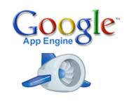
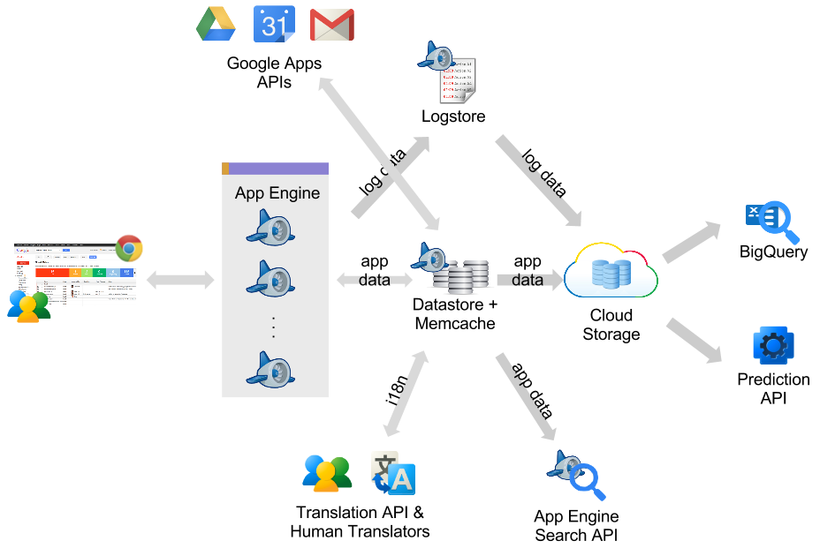
Another company- Google
A web application development framework and hosting solution rolled into one
uses the infrastructure available at Google
    Google servers + storage: BigTable
Python/JAVA/Go and GAE SDK
---We will look at this in more detail later-

Slide 11
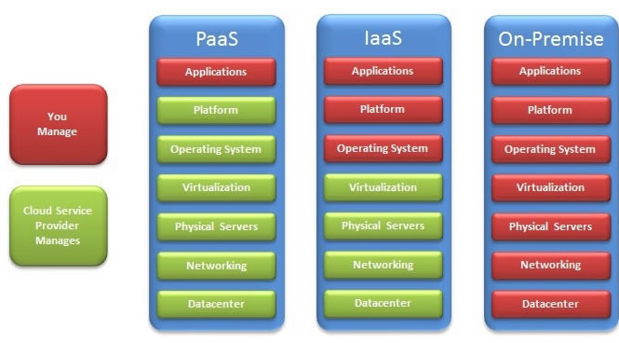
Cloud Layers and Companies

Slide 12
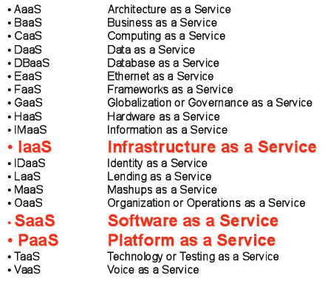
Terms
IaaS = Infrastructure as a Service
PaaS =Platform as a Service
SaaS = Software as a Service

Slide 13
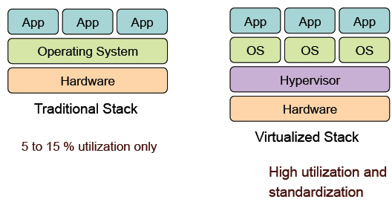
Virtualization Benefits --IaaS

Slide 14
Cloud Layers and Key technologies
Infrastructure as a Service (IaaS)
    rent cycles –don’t buy machines, equipment, don’t manage it
    Key Technology: Virtualization
Platform as a Service (PaaS)
    Get API and take care of the implementation
    No (not much) server setup,etc.
    Key Technology: New cloud programming paradigm, i.e. MapReduce, PIG, HIVE etc
Software as a Service (SaaS)
    Just run it for me!
    Key Technology: May use AJAX, other technologies.
Run multiple virtual computers on one physical box…..examples
" Xen
" VMWare
" Parallels
" Amazon AMI
" Microsoft Hype V

Slide 15
IaaS: Popular Providers & Scenarios
AWS EC2:
• Families: General, Compute, GPU, Memory.
• Example: Startups launching SaaS product scale with burstable instances.
Google Compute Engine:
• Custom machine types, preemptible VMs.
• Example: Video transcoding jobs with cheap preemptibles.
Azure Virtual Machines:
• Deep Microsoft AD integration.
• Example: Enterprises migrating legacy .NET apps.
When to choose IaaS:
• Custom OS or tuning required.
• Compliance requires full control.
• Lift & shift migrations.

Slide 16
PaaS: Offerings & Scenarios
AWS Elastic Beanstalk:
• Upload code, AWS handles infra.
• Example: Deploy Django app for university project.
Google App Engine:
• Fully managed serverless PaaS.
• Example: Mobile app backend with millions of requests.
Azure App Service:
• Deep Visual Studio integration.
• Example: Enterprise .NET Core business app migration.
Why PaaS:
• Focus on features, not infra.
• Built-in scaling/monitoring.
• Tradeoff: limited OS control.

Slide 17
Serverless: Event-Driven PaaS
Function-as-a-Service (FaaS):
• AWS Lambda, Google Cloud Functions, Azure Functions.
• Example: Resize images when uploaded to S3.
Serverless Containers:
• AWS Fargate, Google Cloud Run, Azure Container Apps.
• Example: Deploy microservice container without Kubernetes.
Characteristics:
• Scale-to-zero when idle.
• Pay-per-request billing.
• Cold start latency tradeoff.
When to use:
• Event-driven tasks, unpredictable load.
• Great for microservices, APIs.

Slide 18
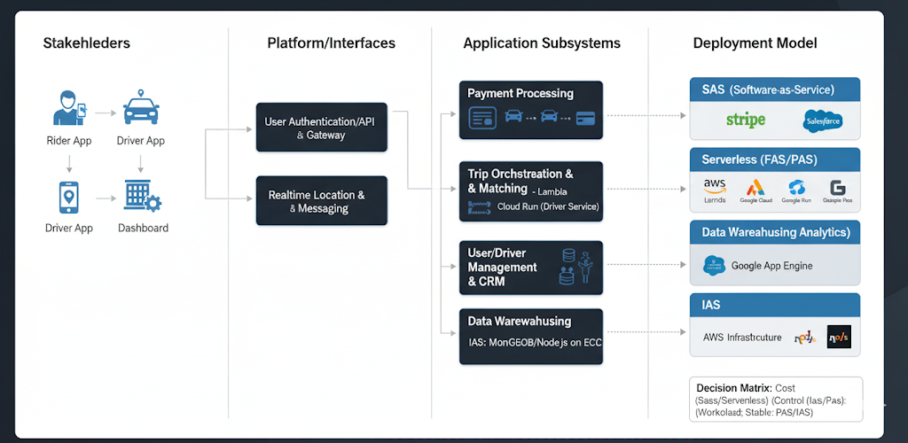
Case: Ride-Sharing Startup App
IaaS:
• Host MongoDB + Node.js on EC2; full control.
• Team manages scaling & patching.
PaaS:
• APIs on Google App Engine or AWS Beanstalk.
• Auto scaling with no server ops.
SaaS:
• Stripe for payments, Twilio for messaging,
Salesforce for CRM.
Decision Matrix:
• Need OS control → IaaS.
• Focus on code only → PaaS.
• Bursty workload → Serverless.
• Commodity tool → SaaS.
Serverless:
• Cloud Run for driver location service.
• Lambda for ride payment processing.

Slide 19
Cloud Layers and Companies
SaaS
  (AWS/Google/Microsoft)
  SalesForce.com
  Google Apps
  eBay
  Paypal
  Apple iTunes
  Big Belly
  Zynga
  DropCam
  Microsoft Live
  Facebook
  Twitter
  Zoho
  ANY WEBSITE!
PaaS
  (AWS/Google/Microsoft)
  SalesForce's Force.com
  Google App Engine
  Microsoft Azure
  Zoho Creator
  Amazon Beanstalk
IaaS
  (AWS/Google/Microsoft)
  Amazon AWS
  Joyent
  Rackspace
  Rightscale
  AT&T Synaptic Service
  Verizon
  Heroku

Slide 20
What kind of problems drive the cloud
Web (Internet) Scale applications
  data-intensive
  May be processing intensive
Examples
  Crawling, indexing, searching, mining the Web, AI

Slide 21
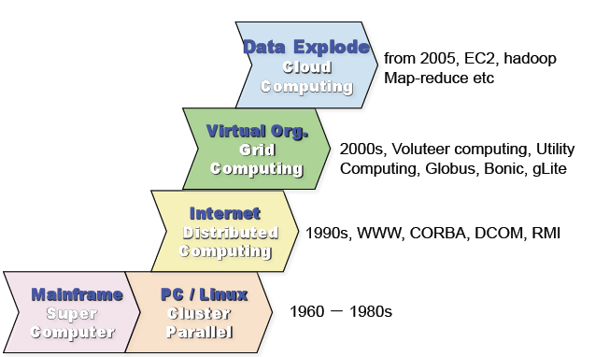
Historical Progression of computing

Slide 22
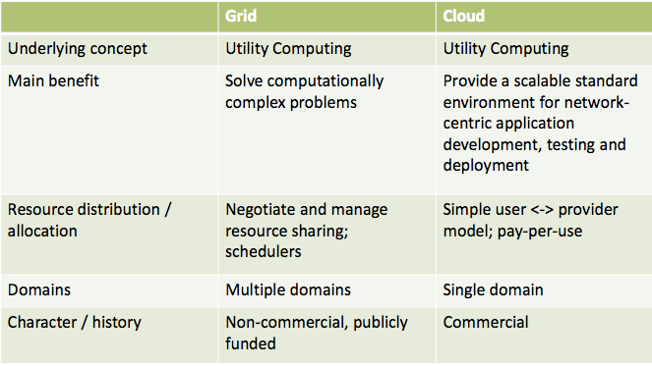
Cloud versus Grid
Sometimes not a difference…but, here are possible differences

Slide 23
Example of A question to solve with cloud
Given 100 computers, how do you compute the frequency of words in 1T text files?
you need a new paradigm for storing and processing large scale of data

Slide 24
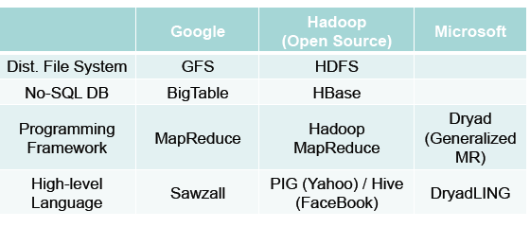
Some Solutions –driving the cloud –new models of large data
https://opencv.org/android/
2003, First MapReduce Lib developed in Google
2003, 2004, and 2006, Google published papers on GFS/MapReduce/BigTable.
2005- Now, Hadoop project (open source version of GFS/BigTable/MapReduce),
initiated by Doug Cutting, sponsored by Yahoo
2008/2009, Yahoo/Facebook contributed PIG/Hive on top of hadoop.

Slide 25
Some Solutions –computation & deployment
Hadoop
  MapReduce programs read input data from disk, map a function across the data, reduce the results of the map, and store reduction results on disk.
Spark
  Apache Spark is an open-source distributed general-purpose cluster-computing framework.
Docker - https://www.docker.com/
  Securely build & run applications anywhere, create containerized applications.
Kubernetes - https://kubernetes.io/
  is an open-source system for automating deployment, scaling, and management of containerized applications.
  It groups containers that make up an application into logical units for easy management and discovery.

Slide 26
Cloud Future
Trends in HW & SW...
  Increase in availability and performance of networks
  Decreased reliance on traditional OS and computing systems
  Increased consolidation of data, both public and private data.
  Decreased costs for hosted computational power.
  Increased prevalence of RFID and NFC chips.
Finding opportunities...
  Improve on things that bother you!
  Focus on the data.
  Break down large products into collections of smaller services.
  Evaluate how connecting various services could provide additional functionality.
  Get involved with Open Source Projects.

Slide 27
Pervasive Computing….
What is the Internet of Things?
A) An idea of all physical objects being universally addressable with most being digitally accessible or network connected.
What is so great about the Internet of Things?
A) Greater control and automation of daily processes. For example, greatly reducing inventories throughout a multi-layered supply chain through RFID inventory tags and interconnected inventory management systems.
What will enable the Internet of Things?
A) High bandwidth and ubiquitous wireless networks, extremely cheap RFID and NFC devices, enormous scaling of universal addresses for non-digital and inanimate objects

Slide 28
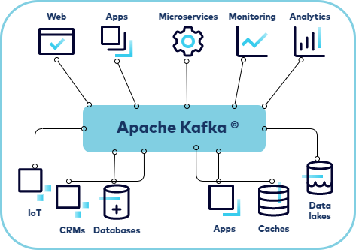
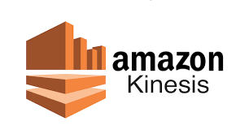
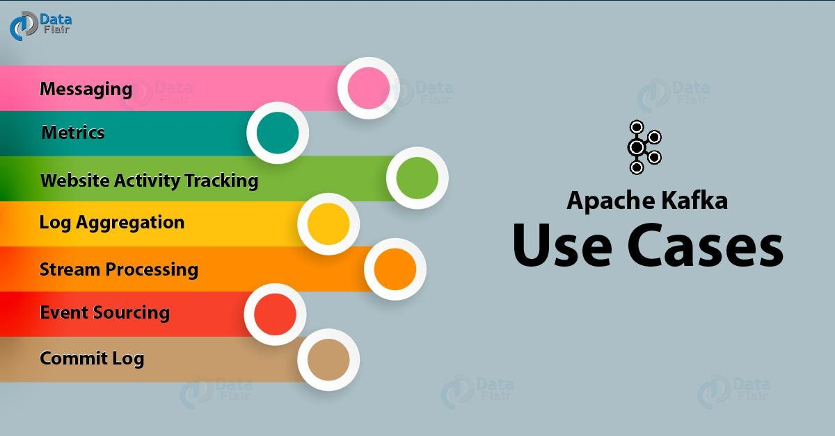
Streaming Data
Streaming data is the continuous, unbounded flow of events generated in real time. Instead of waiting for data batches, applications react instantly as data arrives.

Slide 29
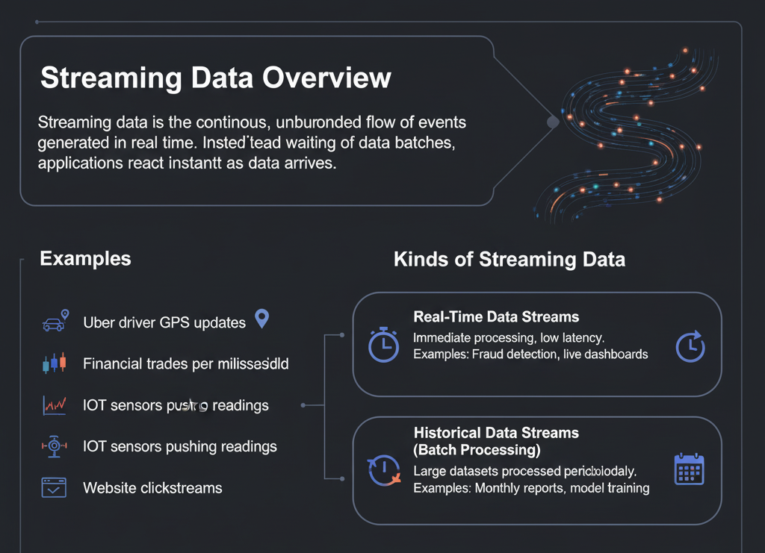
Examples
• Uber driver GPS updates
• Financial trades per millisecond
• IoT sensors pushing readings
• Website clickstreams
Advantages
• Enables real-time analytics (fraud detection, surge pricing)
• Multiple consumers can process the same stream simultaneously
• Supports event-driven microservice architectures
Disadvantages
• Complex system design and debugging
• High operational costs at scale
• Latency variability; must handle backlogs gracefully

Slide 30
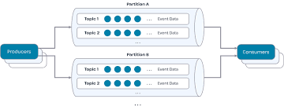
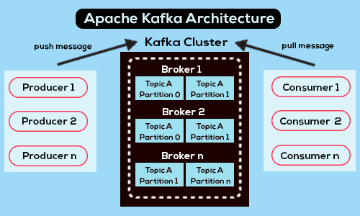
Apache Kafka
Distributed Event Log:
is a distributed append-only log across brokers.
Each event is recorded with an offset and replicated across
brokers for durability.
Applications can replay past events reliably, which makes
Kafka excellent for auditing and recovery.
Partitions:
Each topic is divided into partitions.
Partitions enable scalability by spreading data across brokers.
They allow multiple producers and consumers to work in parallel,
ensuring Kafka handles millions of events per second while
preserving order inside each partition.
Consumer Groups:
Consumers form groups to share work.
Each partition is consumed by only one consumer in the group, balancing load automatically.
Example: A ride-sharing platform has one consumer processing trip booking events while another consumer in the same group processes payment events.
Advantages:
• Extremely high throughput and low latency
• Strong ordering per partition
• Flexible replay of events
Disadvantages:
• Operational complexity of managing Kafka clusters and scaling partitions

Slide 31
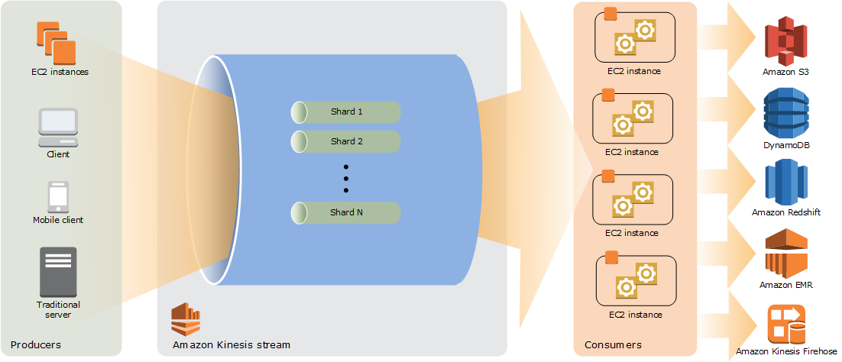
Amazon Kinesis
Amazon’s managed alternative to Kafka,
used for similar tasks like ingesting and
processing real-time data streams.
Shards:
Kinesis organizes streams into shards (like Kafka partitions)
Each shard provides fixed throughput (1 MB/s writes, 2 MB/s reads, 1000 records/s).
Partition keys decide which shard an event goes to, ensuring parallelism and scalability.
Throughput Units:
Consumers read data in parallel from shards. Developers must carefully design partition key strategies to avoid 'hot shards' that become bottlenecks.
Use Case (Netflix Watch Events):
Every play, pause, or skip is logged as an event to Kinesis. Lambda functions process events in real time to update recommendations and 'Continue Watching'. Data is also stored in S3/Redshift for historical analytics.

Slide 32
Amazon Kinesis
Redshift = cloud-scale data warehouse for fast SQL analytics on petabyte-scale data.
EMR = elastic map reduce
Kinesis Firehouse = A fully managed, serverless service in the Kinesis family.
Designed to capture, transform, and load streaming data into destinations like S3, Redshift, OpenSearch, or third-party services (Splunk, Datadog, etc.).
Unlike Kinesis Data Streams (which is like Kafka for building custom streaming apps), Firehose is focused on delivery pipelines with minimal setup.

Slide 33
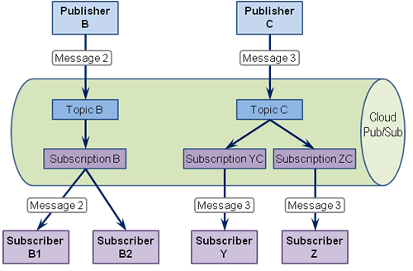
Google Pub/Sub
Publisher-Subscriber Pattern:
• Publishers send messages to a topic.
• Subscribers receive messages from that topic.
Multiple subscribers can receive the same message,
enabling one-to-many communication.
Differences from Kafka:
Kafka retains events in a distributed log with offsets, giving explicit replay control.
Pub/Sub automatically delivers messages and manages retention (7-day replay), making it simpler but with less fine-grained control.
Advantages:
• Fully managed and global service
• Push or pull subscriptions
• Great for broadcasting the same data to many consumers
Disadvantages:
• Less control over offsets than Kafka
• Ordering only guaranteed for regional keys
Use Case (Spotify Trending Analytics):
Every song play is published as a Pub/Sub event. One subscriber counts plays to update 'Top 50' charts, while another personalizes ads. Replay allows late subscribers to recompute results within the 7-day retention window.

Slide 34
More… Queues

Slide 35
Message Queues
is a communication mechanism that stores messages (units of work, tasks, or events) in a temporary buffer until they can be retrieved and processed by a consumer.
Key Characteristics:
•delivered async hronously (producer doesn’t wait for consumer).
• Each message is consumed once and then removed from the queue.
• Typically FIFO (First-In, First-Out), though priority/scheduling is possible.
• Decouples systems so producers and consumers work independently at different speeds.
Example:
An e-commerce site places a new order into a queue. A worker process consumes the message later to charge the customer, generate an invoice, and update inventory — without making the user wait.

Slide 36
Queues vs Streams
Message Queues:
• AWS SQS, Google Cloud Tasks, Azure Queue.
Use Case (E-commerce Orders): Each order enters a queue, workers process payment, invoice, and DB update. Once consumed, the message disappears — ensures exactly-once order handling.
Streams:
Use Case (Fraud Detection): Every credit card transaction streams into analytics. An ML model continuously evaluates risk scores in order, detecting fraud in real-time.
Key Difference:
• Queue = consumed once (work distribution).
• Stream = persists, multiple consumers, replay for analytics/audit.

Slide 37
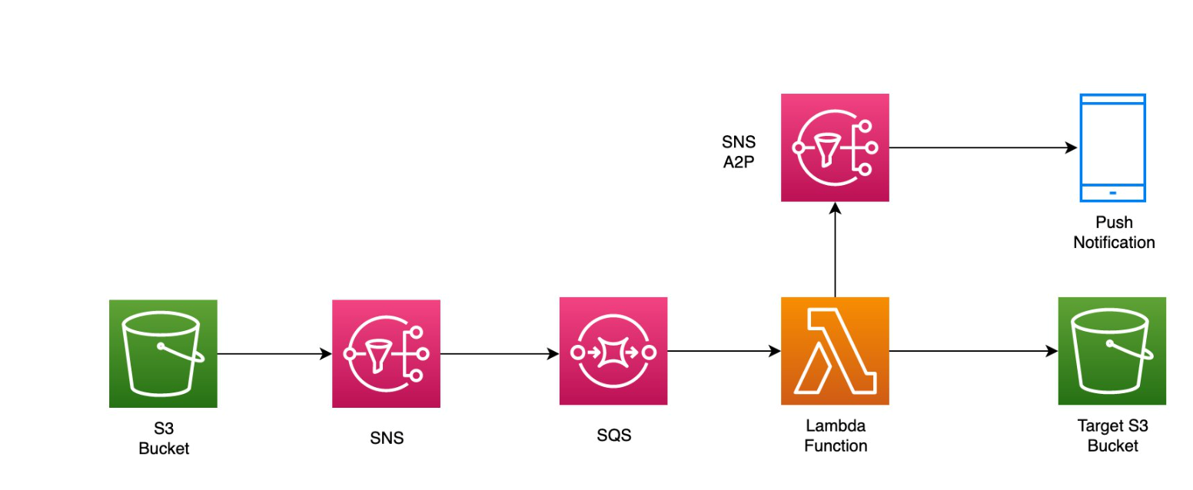
Amazon SQS (simple queue service)
Event driven design pattern for real-time notifications
Scenario: “SNS” sends messages to SQS and triggers code in Lambda that processes the message sending results to S3 and a subsequencet message tto a mobile device

Slide 38
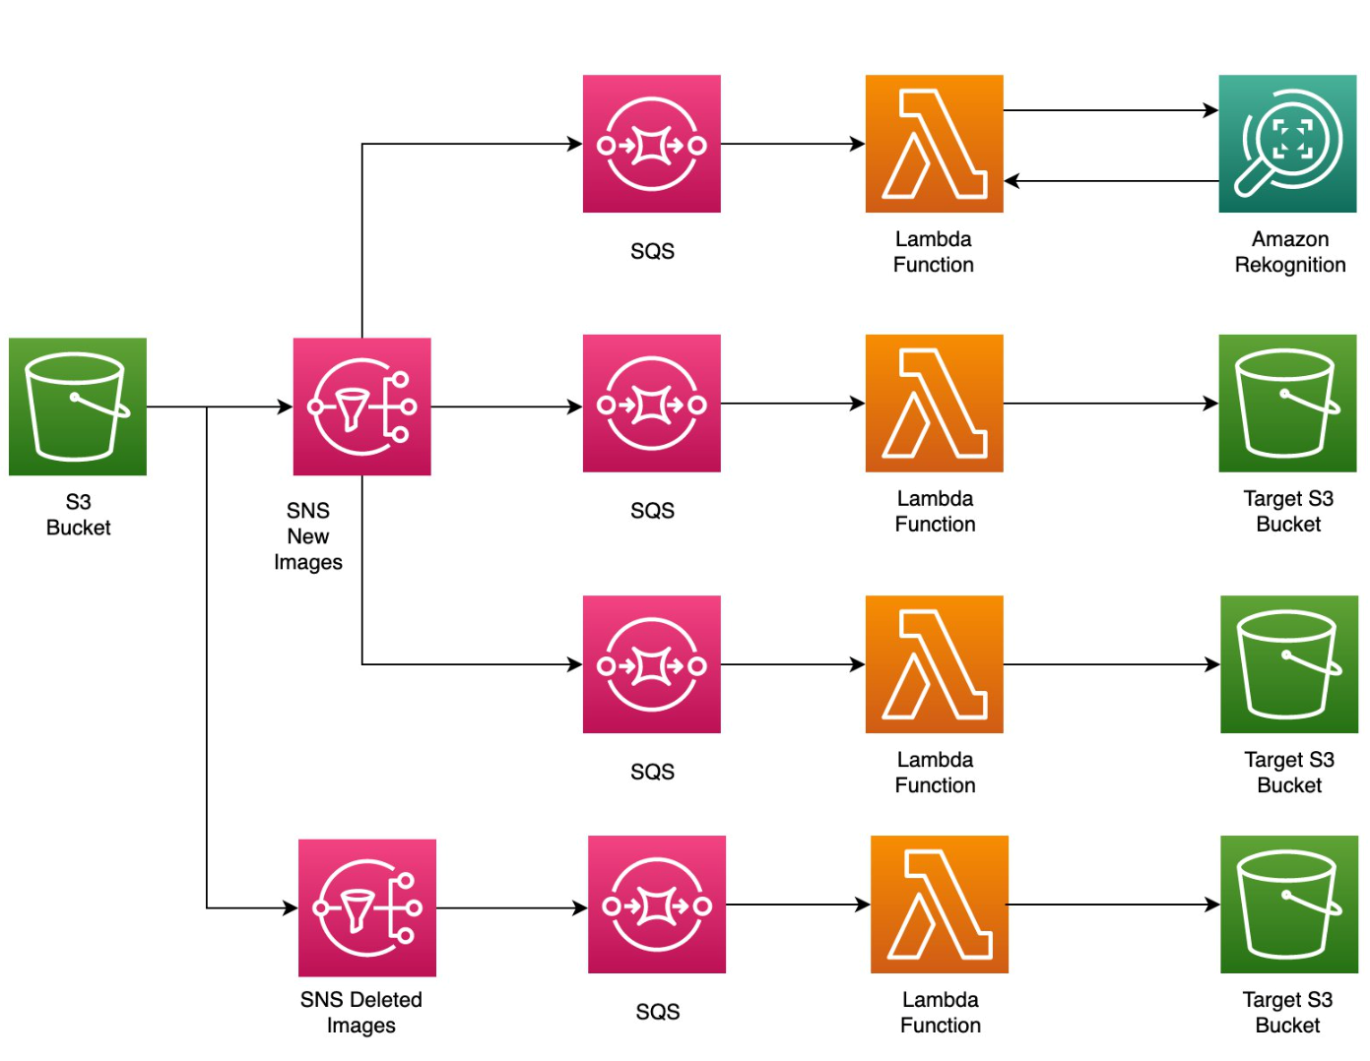
Multiple process path example from message queue
Fan out design pattern including secondary pipeline for deleting images
if you wanted to process a source image into multiple target resolutions, you could create a Lambda function for each.
The function will use the “fan-out” pattern to process all images at the same time, at each resolution.
You could then subscribe an SQS queue to your SNS topics.
This ensures that Event Notifications sent to SNS are verified as complete by SQS, once they’ve been processed by your Lambda function.

Slide 39
More… CRM (Customer relations management)

Slide 40
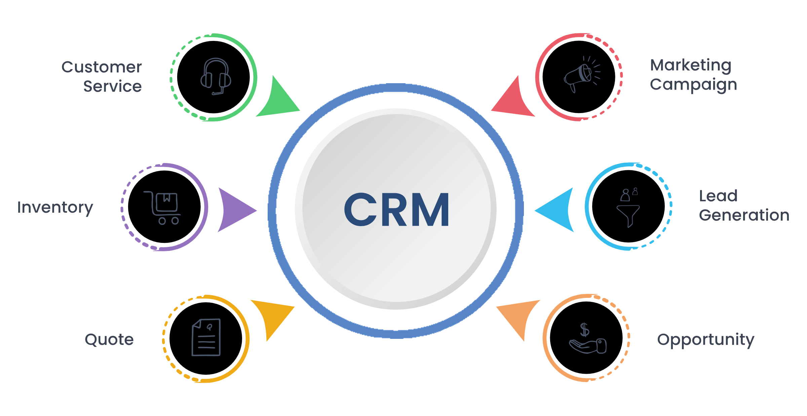
CRM
CRM = Customer Relationship Management
A strategy + set of tools for managing a company’s interactions with customers.
Focuses on collecting, storing, and analyzing customer information to improve service, retention, and sales.
Cloud-based CRMs integrate customer support, marketing, and sales into a single platform accessible anywhere.
Examples of Popular CRMs: Salesforce, Zendesk, HubSpot, Microsoft Dynamics 365.

Slide 41
Customer Contact & CRM
goes beyond storing contact info — it integrates real-time customer interaction data:
Call Center Integration: Cloud contact centers (AWS Connect, Google Contact Center AI) log calls, transcribe conversations, and push updates directly into CRM records.
Chatbots + Virtual Agents: Cloud AI services (Amazon Lex, Google Dialogflow) answer common questions, and automatically log the interaction into the CRM.
Sentiment Analysis: AI detects frustration or satisfaction during interactions and flags CRM entries for escalation or follow-up.
Unified View: Customer history, preferences, and prior support cases are instantly available to agents via CRM dashboards.

Slide 42
Some example services
AWS Connect:
• Cloud contact center with Lex (chatbots).
Use Case (Airline Support): Passenger calls airline → Lex IVR handles routine tasks → Connect routes to agent with CRM context.
Google Contact Center AI:
• Dialogflow bots, Agent Assist, sentiment analysis.
Use Case (Bank Chatbot): Virtual agent answers balance inquiries. If customer shows frustration, escalates to human agent.
Integration with SaaS CRMs:
• Salesforce, Zendesk.
Use Case (Retailer): AWS Connect logs automatically update Salesforce with call transcripts and customer data.

Slide 43
More… Analytics & Observability Services

Slide 44
What is Observability?
The ability to understand a system’s internal state by collecting, correlating, and analyzing telemetry data (logs, metrics, traces).
Goes beyond monitoring: focuses on why something is happening, not just what is happening.
Core Pillars:
  Metrics (numerical time-series data, e.g., CPU %, request latency).
  Logs (text records of events, e.g., errors, transactions).
  Traces (end-to-end record of a request across multiple services).

Slide 45
Analytics & Observability Services
AWS CloudWatch + X-Ray:
• Metrics, logs, alarms, distributed tracing.
Use Case (E-commerce): Monitor checkout latency. Alarm triggers rollback if latency >2s.
Google Cloud Monitoring/Logging:
• GCP-native observability.
Use Case (Gaming): Detects player traffic spikes, auto-scales servers.
Azure Monitor + App Insights:
• Deep integration with Microsoft stack.
Use Case (Enterprise): Tracks SQL DB deadlocks and .NET performance issues.
AIOps Advisors:
• AWS Trusted Advisor flags underutilized resources/security gaps.
Use Case (University Project): GPU instance left running, flagged before big costs accrue.

Slide 46
AWS Observability Services
• CloudWatch: Metrics, alarms, dashboards, logs
• X-Ray: Distributed tracing for microservices
• Trusted Advisor: Cost, performance, security recommendations
• AWS Shield: DDoS protection
Example:
Online store tracks checkout latency in CloudWatch. If p95 latency >2s, alarm triggers Lambda rollback.

Slide 47
Google Cloud Observability Services
• Cloud Monitoring (Stackdriver): Unified metrics dashboards
• Cloud Logging: Centralized log storage, export to BigQuery
• Cloud Trace & Profiler: Distributed tracing and code profiling
• Error Reporting: Aggregates and alerts on app errors
Example:
Gaming company monitors global latency. Spikes in Asia trigger autoscaling of instances in asia-east1 region.

Slide 48
Azure Observability Services
• Azure Monitor: Metrics and logs for apps and infra
• Application Insights: App telemetry, exceptions, dependency calls
• Azure Advisor: Optimization recommendations for cost, reliability
Example:
Financial app uses Application Insights to trace failed transactions, finding a bottleneck in SQL stored procedure.
telemetry is the automated collection and transmission of data from systems

Slide 49
Why Observability Matters
• Reliability: Detect issues before customers notice
• Cost Management: Identify idle/overprovisioned resources
• Security: Spot anomalies and intrusions
• Business Insight: Track KPIs alongside system health
Observability = essential for resilient, efficient, secure cloud systems.

Slide 50
More… Communication Services

Slide 51
Why Communication Services Matter
• Apps today need real-time voice, video, chat, SMS, push notifications.
• Cloud providers offer APIs/SDKs so developers don’t need to build telecom systems.
Benefits:
– Scalability: millions of concurrent users
– Security: encryption, compliance (HIPAA, GDPR)
– Global reach: SMS, video conferencing across regions

Slide 52
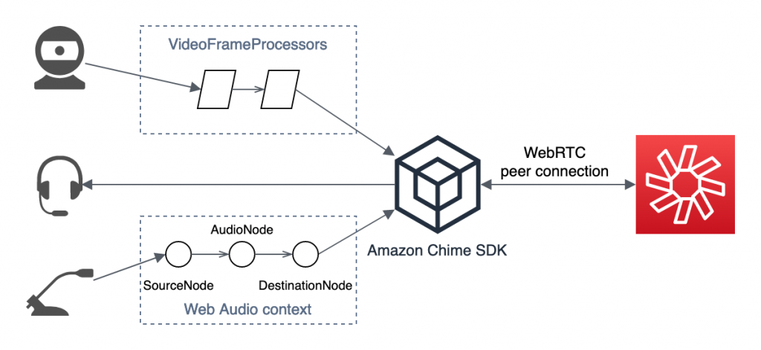
AWS Chime
API/SDK for
embedding real-time
voice, video, and chat
into applications.
Features:
• Secure, encrypted communication
• PSTN (phone) integration
• Recording & media pipelines
Use Case (Telemedicine):
Doctors and patients connect via secure in-app video calls. Sessions meet healthcare compliance (HIPAA). Metadata is logged for audits.

Slide 53
Google Meet APIs
APIs for integrating Google Meet meetings into apps and workflows.
Features:
• Auto-generate meeting links
• Embed Meet into scheduling systems
• Control participants, recordings
Use Case (HR System):
Candidate passes screening → Meet link created automatically. Invite sent via email/calendar. Interview recording stored for HR compliance.

Slide 54
Messaging APIs
APIs for SMS, push notifications, and email alerts.
Examples:
• AWS SNS (Simple Notification Service)
• AWS Pinpoint (engagement analytics)
• Firebase Cloud Messaging (push to iOS/Android)
Use Case (Ride-Sharing App):
SNS sends driver arrival SMS. FCM pushes app notification: 'Your driver is 2 minutes away.' Pinpoint tracks user engagement (open rates, segments).

Slide 55
MANY Other Communication Services
OTHER AWS/Google APIs & other providers offer communication SDKs:
  • Twilio – SMS, voice, video APIs widely used in startups & enterprises
  • Zoom SDK – Embed video meetings directly into custom apps
  • Slack/MS Teams APIs – Integrate app notifications into collaboration tools
These services extend communication capabilities and allow integration into existing workflows.

Slide 56
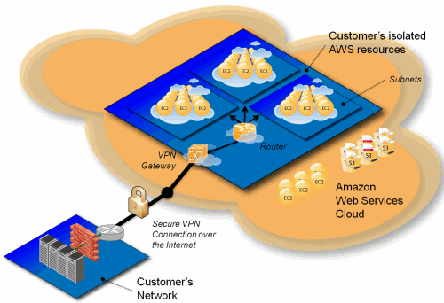
More… VPC – Virtual Private Cloud

Slide 57
Virtual Private Cloud (VPC) Fundamentals
A VPC is an isolated virtual network in the cloud where you deploy compute, storage, and services securely.
Core Features:
• Subnets: Public (internet-facing) vs Private (internal-only)
• Route Tables: Control traffic flow
• Gateways: Internet GW, NAT GW, VPN/DirectConnect
• Security: Security Groups (stateful), NACLs (stateless)
Example:
Healthcare startup VPC:
• Public subnet → API Gateway + Load Balancer
• Private subnet → App servers + HIPAA-compliant DB
• Benefit: Secure isolation + compliance

Slide 58
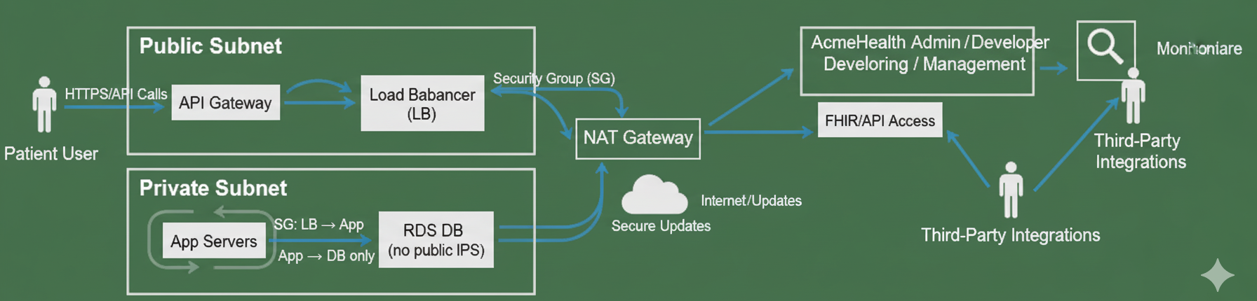
Scenario: AcmeHealth Patient Portal
Public Subnet: API Gateway + Load Balancer
  "front door" of the application. contain resources directly accessible from internet.
Private Subnet: App servers + RDS DB (no public IPs)
  protected part of the network. Not directly accessible from the internet.
  All traffic to & from the private subnet must be routed through a controlled gateway,
Security Groups: LB (load balancer) → App, App → DB (database)
NAT Gateway: App servers fetch updates securely
  allows instances in private subnet to connect to the internet or other external services while preventing external services from initiating a connection with them

Slide 59
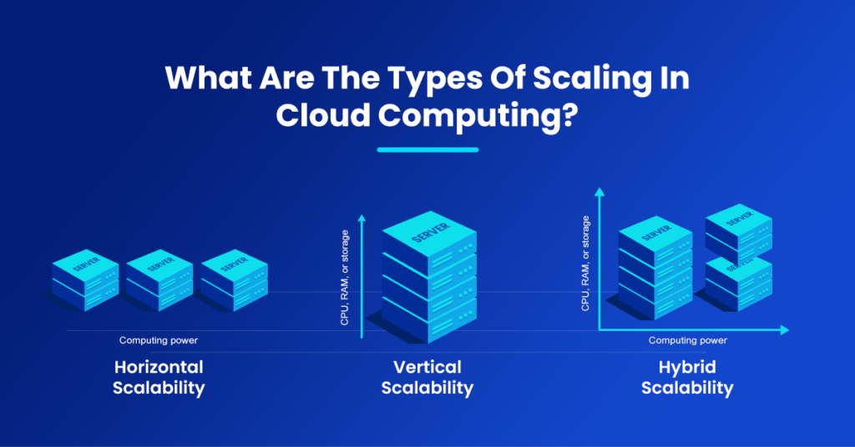
More… Scaling in the CLoud

Slide 60
Example - Scaling the MEAN Stack on IaaS
Architecture:
• MongoDB on Atlas / DocumentDB
• Node.js/Express app servers on EC2/GCE VMs
• Angular SPA via CDN (CloudFront, Cloud Storage + CDN)
Autoscaling:
• Auto Scaling Groups / Managed Instance Groups
• Policies: CPU %, requests/sec, queue depth
• Supports rolling + blue/green deployments
Example:
Shopping site adds 10 EC2 servers on Black Friday and scales back down after traffic drops.

Slide 61
Example - Scaling MEAN on PaaS & Serverless
PaaS Scaling:
• Platforms: Elastic Beanstalk, App Engine, Azure App Service
• Developer sets min/max instances, scaling rules
• Built-in health checks + rolling updates
Serverless Scaling:
• Platforms: Lambda + API Gateway, Cloud Run, Azure Container Apps
• Scale-to-zero when idle, scale up instantly
Example:
Payment microservice runs only when a transaction occurs. Cloud Run spins up containers per request.
Key Insight:
IaaS → control but heavy ops
PaaS → balance of simplicity + flexibility
Serverless → elasticity with minimal ops

Slide 62
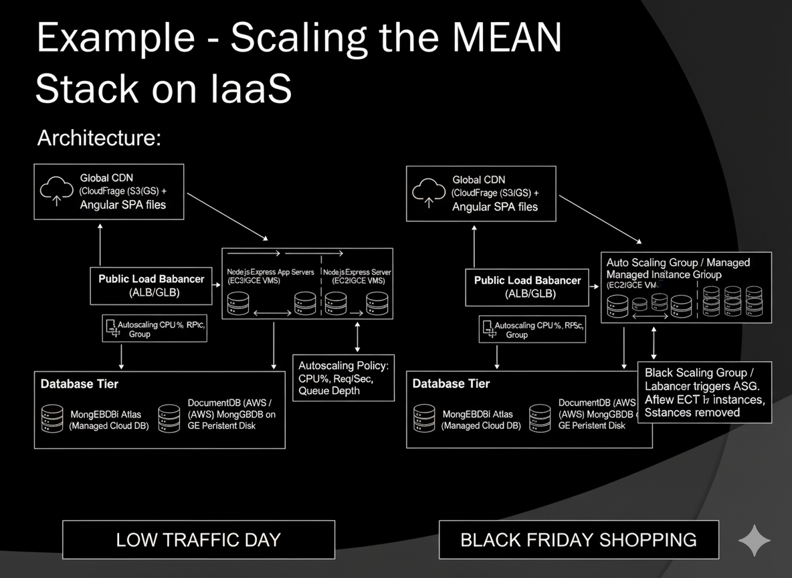
Example - Scaling MEAN on PaaS & Serverless

Slide 63
More… Access

Slide 64
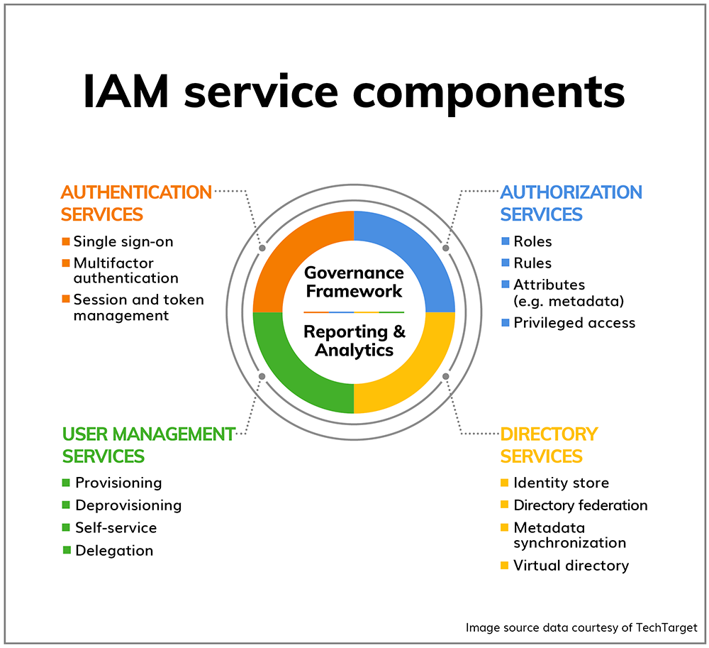
Identity & Access Management (IAM)
IAM defines who/what can access which resources, and how.
Core Components:
• Identities: users, groups, roles, service accounts
• Authentication (AuthN): Who you are
• Authorization (AuthZ): What you can do
• Principle of Least Privilege: Grant only minimal permissions
Example:
Data scientist can query S3 but cannot delete objects; Lambda role can read DynamoDB but not write.

Slide 65
IAM by Cloud Provider
AWS IAM:
• Users, roles, groups, JSON policies
• STS temporary credentials
Google Cloud IAM:
• Resource hierarchy: Org → Folder → Project
• Principals, roles (basic, predefined, custom)
Azure AD / RBAC:
• Entra ID for identities
• Managed identities for apps
• RBAC at subscription/resource levels
Example:
EC2 role for S3 access (AWS), service account with BigQuery read-only (GCP).

Slide 66
Secrets, Keys, and Program Access
Secrets Managers:
• AWS Secrets Manager
• Google Secret Manager
• Azure Key Vault
Encryption Keys:
• AWS KMS, Google KMS, Azure Key Vault HSM
• CMEK/CMK support for compliance
Program-to-Program Auth:
• OAuth2, OIDC, JWTs, mTLS
Example:
Microservice authenticates to DB using rotated credentials stored in Secrets Manager.

Slide 67
Security in Practice
Shared Responsibility:
• Provider responsible (infra, hardware, managed services)
•YOU secure (apps, data, configs, IAM)
Network Security:
• Security Groups, NACLs, WAF, private subnets
Data Security:
• Encryption at rest (KMS, CMEK)
• In transit (TLS, ACM)
Customer Authentication:
• AWS Cognito, Google Identity Platform, Firebase Auth
Example:
AWS patches EC2 hypervisor; customer configures IAM policies + app-level encryption.

Slide 68
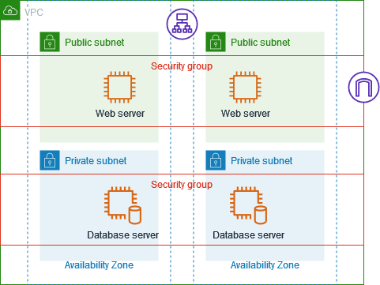
Network Security:
Security Groups
Security Groups → protect instances
Virtual firewalls that control inbound and outbound traffic at the instance level (e.g., an EC2 VM in AWS).
How they work:
  You attach them to servers/instances.
  Define rules: allow traffic from port 80 (HTTP) or 443 (HTTPS), but block everything else.
Example: A web server SG allows inbound HTTP/HTTPS from the internet, but only allows outbound traffic to the database subnet.

Slide 69
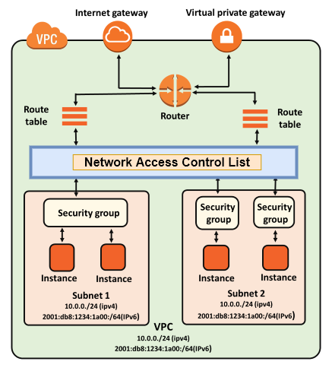
Network Security:
Network ACLs (access control list)
Firewalls that control traffic at the subnet level in a VPC.
How they work:
  Apply to all resources inside a subnet.
  Can allow or deny rules explicitly.
  Stateless (both inbound and outbound rules must be defined separately).
Example: A private subnet NACL blocks all inbound traffic from the internet, ensuring no accidental exposure of internal-only services.
NACLs → protect subnets.

Slide 70
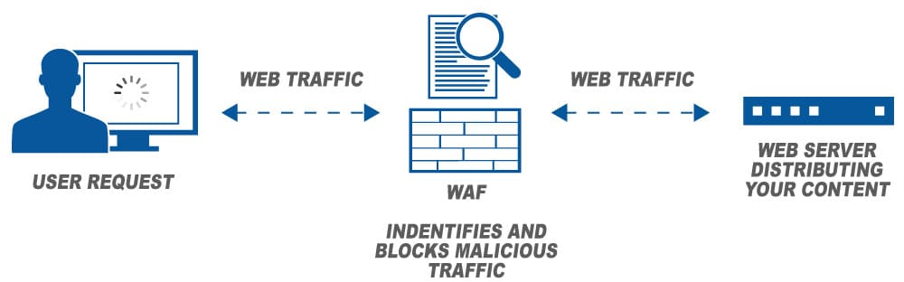
Network Security: WAF (Web Application Firewall)
A firewall that sits in front of your web applications to protect them from common exploits.
What it defends against:
  SQL Injection (bad queries).
  Cross-Site Scripting (XSS).
  DDoS attempts.
  Malicious bots.
Example: AWS WAF filters incoming requests before they reach your load balancer or API Gateway, blocking bad actors while allowing normal users.
WAF → protect applications from attacks.

Slide 71
Network Security: Private Subnets
Subnets in your VPC that have no direct internet access.
How they work:
  Resources in private subnets (like databases, internal APIs) are not assigned public IPs.
  They can connect to the internet indirectly via a NAT Gateway if needed.
Example: An RDS database runs in a private subnet so customers cannot connect to it directly from the internet; only app servers in a public subnet can.
Private Subnets → keep resources hidden from the internet.

Slide 72
More… Sample Architectures

Slide 73
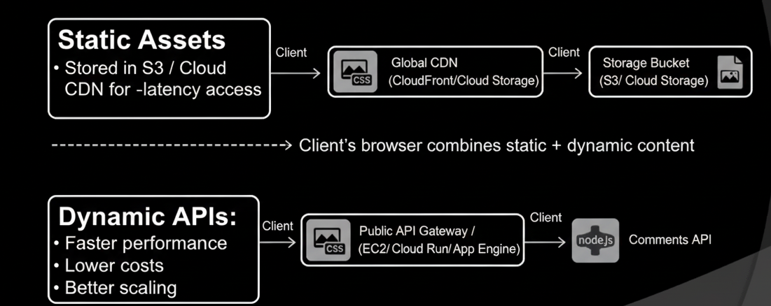
Reference Architecture: Static + Dynamic Split
Benefits:
• Faster performance
• Lower costs
• Better scaling
Example:
A blog stores images + CSS in S3/CloudFront, while
comments API is served by Node.js on App Engine.
Concept:
Separate static content delivery from dynamic APIs.
Static Assets:
• Stored in S3 / Cloud Storage
• Delivered via CDN for global low-latency access
Dynamic APIs:
• Served by app servers (EC2, Cloud Run, App Engine, etc.)

Slide 74
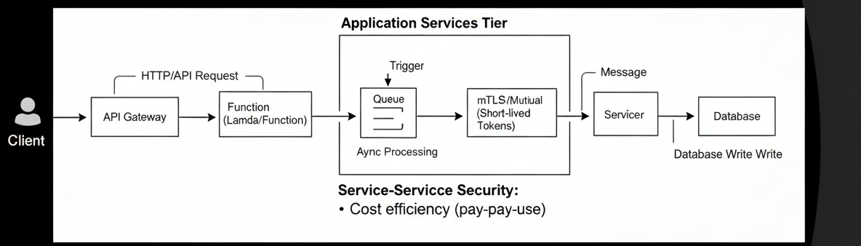
Reference Architecture: Event-Driven Microservices
Concept:
Applications broken into small, event-driven services.
Flow:
API Gateway → Function (Lambda/Cloud Function) → Queue (SQS/PubSub) → Worker → Database
Benefits:
• Decoupled services
• Elastic scaling
• Cost efficiency (pay-per-use)
Example:
E-commerce checkout: API Gateway receives order → Lambda validates → SQS queue → Worker charges card → DB updated.

Slide 75
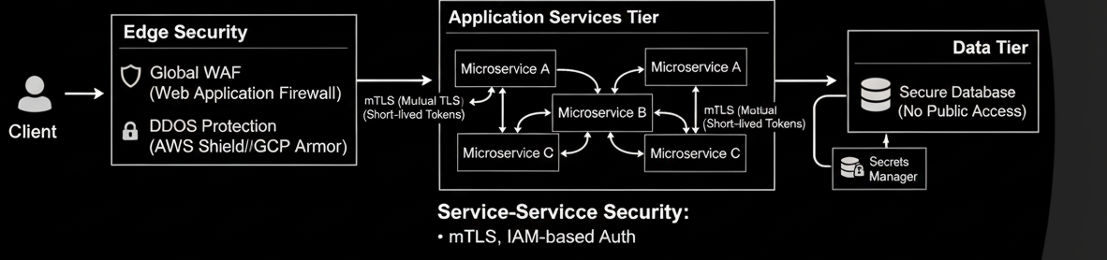
Reference Architecture: Zero-Trust Edge
Concept:
Assume no network is trusted, even internal.
Edge Security:
• WAF (Web Application Firewall)
• DDoS protection (AWS Shield, GCP Armor)
Service-to-Service Security:
• mTLS (mutual TLS)
• IAM-based authentication (short-lived tokens)
Benefits:
• Prevents lateral movement if attacker breaches one service
Example:
Banking app uses mTLS for service communication; WAF blocks SQL injection at the edge.

Slide 76
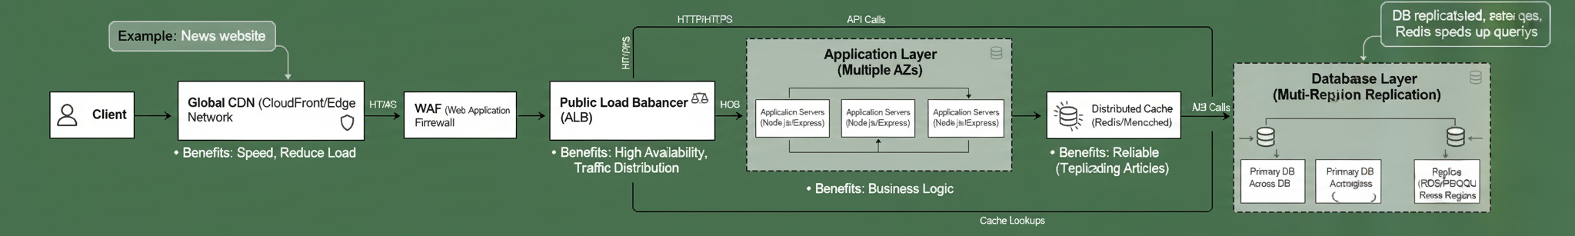
Reference Architecture: Multi-Tier Application
Architecture Layers:
• CDN (content delivery network) + WAF(web application firewall) → Load Balancer → Application Servers → Database → Cache
Benefits:
• CDN: Speed, reduce load
• LB: High availability, traffic distribution
• App Layer: Business logic
• DB Layer: Reliable, replicated storage
• Cache: Redis/Memcached for speed
Example:
News website: CDN serves content, app servers in multiple AZs, DB replicated across regions, Redis cache speeds up trending article queries.

