Slide 1
Spring + Spring Boot
A Java EE Framework

Slide 2

Spring Framework
5
Lead by pivotal
Open source application
Plugins and support for most web technologies
Utility API-s

Slide 3
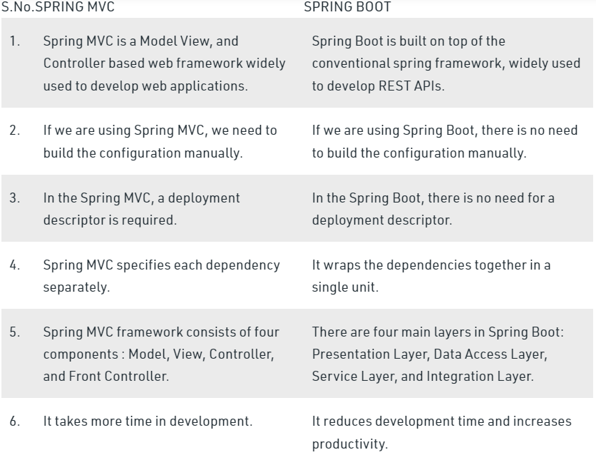
Should I bother?
6
Skipping OVER Spring & going straight to Spring Boot
Free
Easy to use
No XML anymore
Extremely popular
Java, Groovy and Kotlin support
Good for cloud and microservices

Slide 4
Learn by Example → Hello World
In Spring Boot, shown using IntelliJ IDE

Slide 5
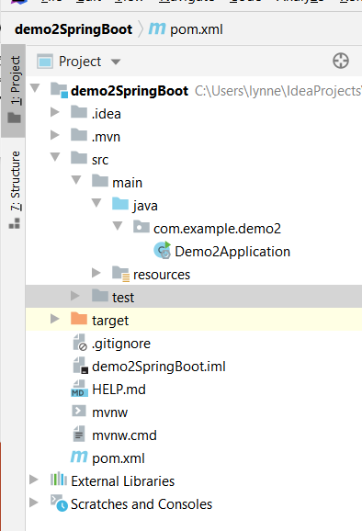
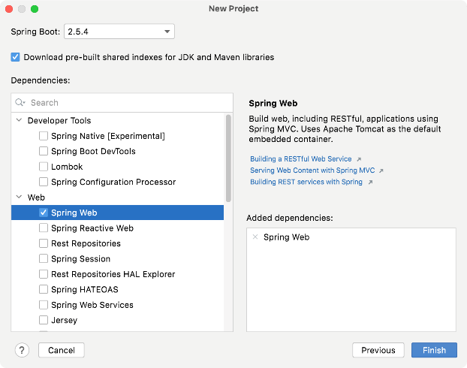
Spring Boot – hello word example
Project structure (note using IntelliJ IDE)
Called project demo2SpringBoot
Created as a Maven project
Make sure that you created the project with dependency of Spring Web

Slide 6
pom.xml - XML representation of a Maven project
Tells about project, dependencies, etc.
<?xml version="1.0" encoding="UTF-8"?> <project xmlns="http://maven.apache.org/POM/4.0.0" xmlns:xsi="http://www.w3.org/2001/XMLSchema-instance" xsi:schemaLocation="http://maven.apache.org/POM/4.0.0 https://maven.apache.org/xsd/maven-4.0.0.xsd"> <modelVersion>4.0.0</modelVersion> <parent> <groupId>org.springframework.boot</groupId> <artifactId>spring-boot-starter-parent</artifactId> <version>2.6.4</version> <relativePath/> <!-- lookup parent from repository --> </parent> <groupId>com.example</groupId> <artifactId>demo2</artifactId> <version>0.0.1-SNAPSHOT</version> <name>demo2</name> <description>Demo project for Spring Boot</description> <properties> <java.version>11</java.version> </properties> <dependencies> <dependency> <groupId>org.springframework.boot</groupId> <artifactId>spring-boot-starter-web</artifactId> </dependency>
<dependency> <groupId>org.springframework.boot</groupId> <artifactId>spring-boot-starter-test</artifactId> <scope>test</scope> </dependency> </dependencies> <build> <plugins> <plugin> <groupId>org.springframework.boot</groupId> <artifactId>spring-boot-maven-plugin</artifactId> </plugin> </plugins> </build> </project>
continued

Slide 7
Hello world code
method uses Spring Boot’s SpringApplication.run() method to launch an application. No XML , no web.xml file
package com.example.demo2; import org.springframework.boot.SpringApplication; import org.springframework.boot.autoconfigure.SpringBootApplication; import org.springframework.web.bind.annotation.GetMapping; import org.springframework.web.bind.annotation.RequestParam; import org.springframework.web.bind.annotation.RestController; @RestController @SpringBootApplication public class Demo2Application { public static void main(String[] args) { SpringApplication.run(Demo2Application.class, args); } @GetMapping("/hello") public String sayHello(@RequestParam(value = "myName", defaultValue = "World") String name) { return String.format("Hello %s!", name); } }
imports
A SpringBootApplication & will handle REST requests
main method will run instance of this class
this method invoked for the /hello URI
Reads parameter myName if given & returns custom String

Slide 8
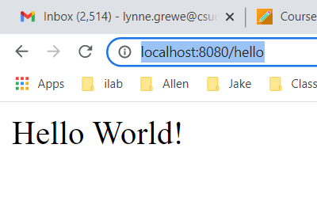
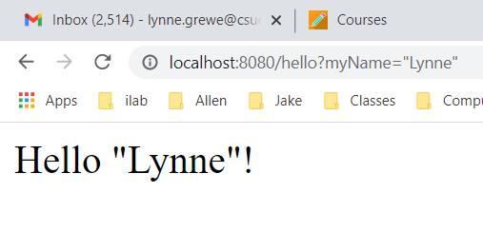
Run it locally –default base url is http://localhost:8080
With no parameter With parameter

Slide 9
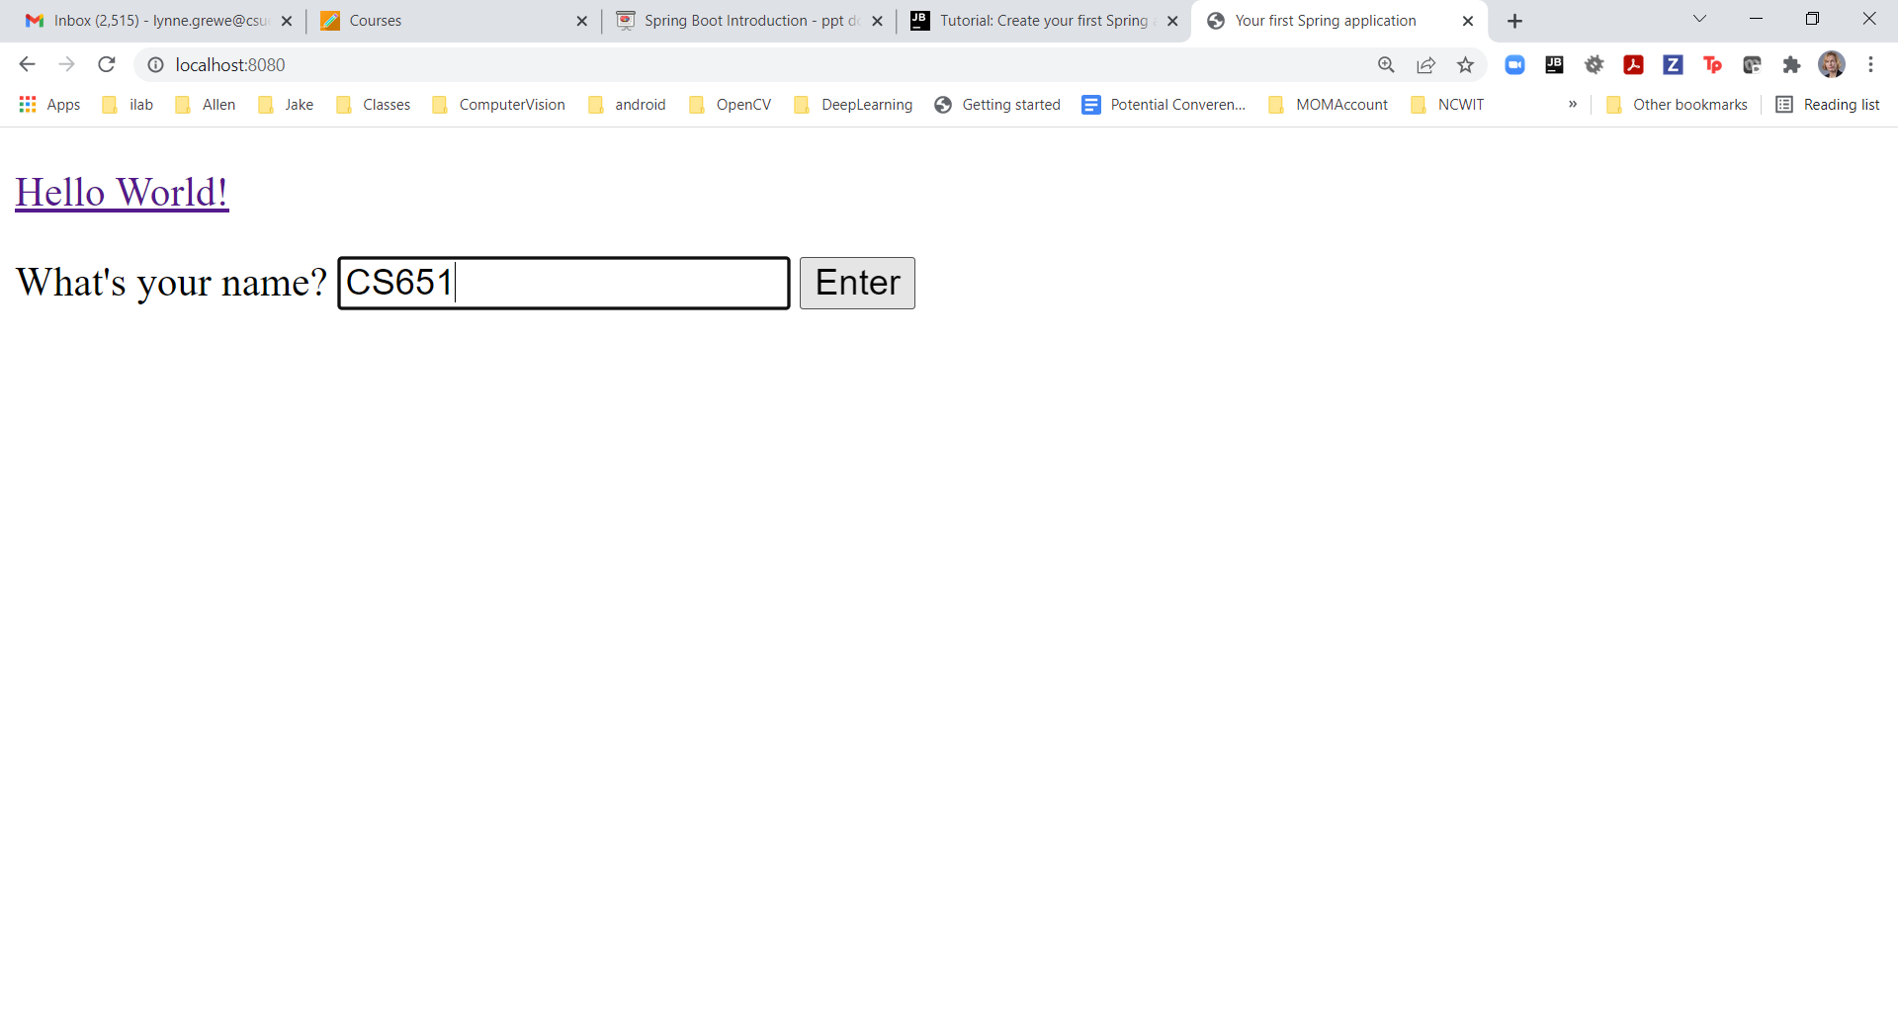
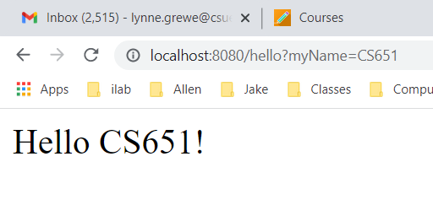
Adding static homepage (index.html)
Create the index.html file under /src/main/resources/static/
Created a simple form that has action pointing to /hello URI
<form action="/hello" method="GET" id="nameForm">

Slide 10
Spring Boot uses Annotations
13
@SpringBootApplication - placed above your main class, and it implicitly defines a base “search package
@RestController -it will handle REST requests
@Autowired - inject the **whatever** bean, which is implemented from the repository interface (see example soon)
@RequestMapping("/add") - before method you want to map request for /add to invoke (e.g. @GetMapping, @PostMapping, etc)
Learn more about Annotations + Official Spring Boot doc

Slide 11
Spring Boot Main Components
Spring Boot STARTERS – combine a group of common or related dependencies into single dependency
Spring Boot AutoConfiguration – reduce the Spring Configuration
Spring Boot CLI – run & test Spring Boot applications (but, you can get IDEs like JetBrain’s IntelliJ)
Spring Boot Actuator – provides Endpoints and Metrics
LET’S SEE SOME OF THIS IN ACTION IN AN EXAMPLE →

Slide 12
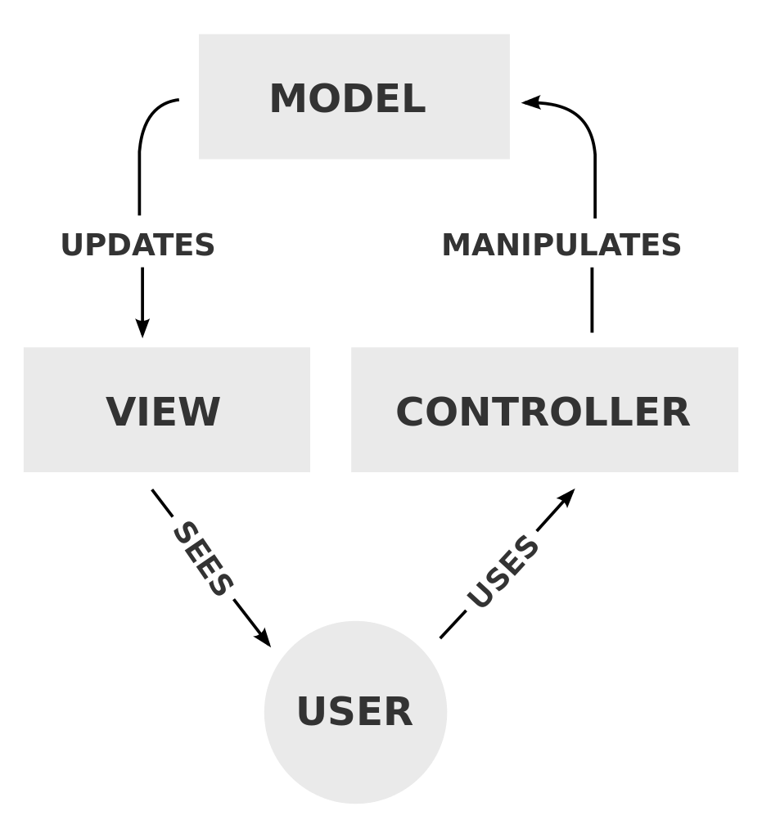
Spring Boot + MVC
Learning through extending our beginning project example

Slide 13
Application: Introducing Customers and related endpoints to our application and supported database with JPA +H2
H2 is an open-source in-memory SQL database written in Java.
H2 is similar to SQLite and is used primarily for local on device applications (small resources) like for mobile applications.
NOT for web applications in general –for local/device use, limited data
JPA facilitates database communications and sits on top of the base JDBC (java database connectivity) package.
STEP 1: Add dependencies for JPA and H2﻿
STEP 2: Add Customer.java to represent data object corresponding to an H2 table +JPA support
STEP 3: Create a Repository Interface
STEP 4: Create a Web Controller
STEP 5: Lets run it
STEP 6: Add a Spring Boot Actuator - adds a number of endpoints that help you monitor and manage your application

Slide 14
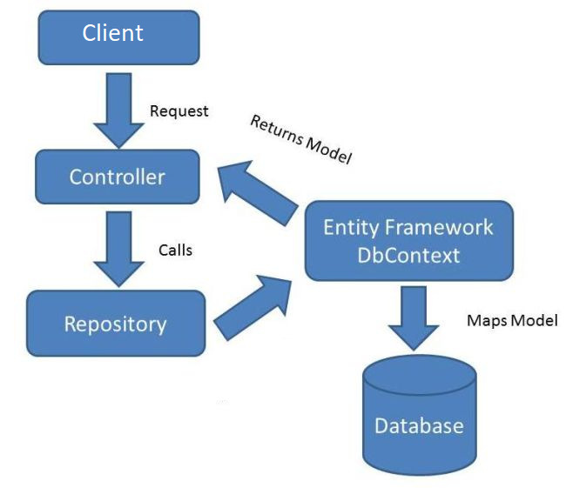
PART 1: Model of MVC
15
The CUSTOMER
STEP 1: Add dependencies for JPA and H2﻿
STEP 2: Add Customer.java to represent data object corresponding to an H2 table +JPA support
STEP 3: Create a Repository Interface
Extra: http://docs.spring.io/autorepo/docs/spring/4.1.x/spring- framework-reference/html/mvc.html

Slide 15
STEP 1: adding dependencies for JPA and H2 → edit your pom.xml file & add:
<dependency>
<groupId>org.springframework.boot</groupId>
<artifactId>spring-boot-starter-data-jpa</artifactId>
</dependency>
<dependency>
<groupId>com.h2database</groupId>
<artifactId>h2</artifactId>
</dependency>
Make sure you resolve the dependencies in your Project. Depends on IDE.
For example for ItelliJ: Click The Load Maven Changes button in the popup or press Ctrl+Shift+O to load the updated project structure.

Slide 16
What was that? Dependency
7
Your code depends on abstractions, Spring handles actual implementations

Slide 17
STEP 2&3: Uses Repository Pattern
The repository pattern is intended to create an abstraction layer between the data access layer and the business logic layer of an application.
It is a data access pattern that prompts a more loosely coupled approach to data access.
the data access logic is in a separate class, or set of classes, called a repository with the responsibility of persisting the application's business model.
The goal of Spring Data repository abstraction is to significantly reduce the amount of boilerplate code required to implement data access layers for various persistence stores.

Slide 18
STEP 2: Create a JPA entity that will be stored in the database﻿
public String getFirstName() { return firstName; } public void setFirstName(String firstName) { this.firstName = firstName; } public String getLastName() { return lastName; } public void setLastName(String lastName) { this.lastName = lastName; } }
Create and store Customer objects that have an ID, a first name, and a last name.
Create the Customer.java file under your main package src directory
@Entity annotation indicates that the Customer class is a JPA entity that should translate into the corresponding table in the database @Id annotation indicates that the id field is the object's ID. IntelliJ IDEA designates it with The ID icon in the gutter. @GeneratedValue tells JPA that the ID should be generated automatically.
package com.example.demo2; import javax.persistence.Entity; import javax.persistence.GeneratedValue; import javax.persistence.GenerationType; import javax.persistence.Id; @Entity public class Customer { @Id @GeneratedValue(strategy = GenerationType.AUTO) private Integer id; private String firstName; private String lastName; public Integer getId() { return id; }

Slide 19
STEP 3: Create a Repository Interface
main interface in Spring Data repository abstraction is Repository (CrudRepository is descendant). It takes the domain class to manage as well as the id type of the domain class as type arguments.
Create the CustomerRepository.java file under main package in src
package com.example.demo2; import org.springframework.data.repository.CrudRepository; public interface CustomerRepository extends CrudRepository<Customer, Integer> { Customer findCustomerById(Integer id); }
Repository works w/ Customer entities & Integer IDs.
Declares findCustomerById() method.
Spring Data JPA will derive a query based on this method's signature, which will select the Customer object for the specified ID.
Can add other methods to support CRUD statements on Customer
Goal of repository abstraction is to reduce the amount of boilerplate code required to implement data access layers for various persistence stores.

Slide 20

Question
11
Answer
10
How much code do I have to write in Java to do a simple DB query?
Interface + one line of code → another example UserRepository
public interface UserRepository extends CrudRepository<User, Long> {
}
Read Documentation AND more about Repository Interfaces
Because it inherits methods from CrudRepository as we will see in use later (e.g. findAll() ,etc)

Slide 21
PART 2: the Controller of MVC
15
STEP 4: Create the Web Controller using @RestController annotation
Extra: http://docs.spring.io/autorepo/docs/spring/4.1.x/spring- framework-reference/html/mvc.html

Slide 22
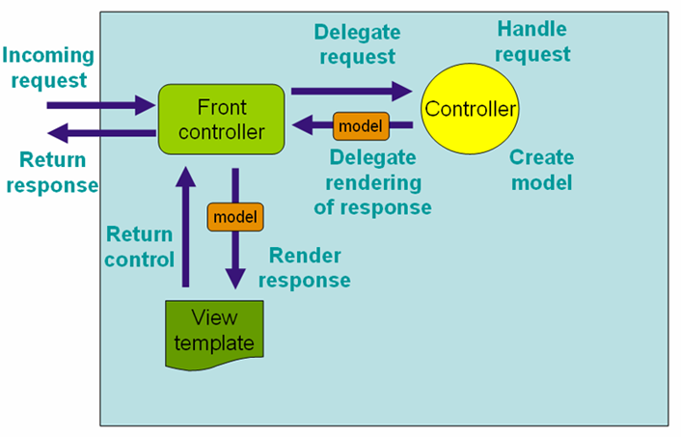
STEP 4: Create a Web Controller
handles HTTP requests for your Spring application.
Handles requests
Initialize and request mapping
Declare request parameters or path variables
@RequestParam/@PathVariable
Allows creation of RESTful sites and apps
Creates models
Delegates rendering requests

Slide 23
STEP 4: Create a Web Controller
package com.example.demo2; import org.springframework.beans.factory.annotation.Autowired; import org.springframework.web.bind.annotation.*; @RestController public class DemoController { @Autowired private CustomerRepository customerRepository; @PostMapping("/add") public String addCustomer(@RequestParam String first, @RequestParam String last) { Customer customer = new Customer(); customer.setFirstName(first); customer.setLastName(last); customerRepository.save(customer); return "Added new customer to repo!"; } @GetMapping("/list") public Iterable<Customer> getCustomers() { return customerRepository.findAll(); } @GetMapping("/find/{id}") public Customer findCustomerById(@PathVariable Integer id) { return customerRepository.findCustomerById(id); } }
handles HTTP requests for your Spring application.
/add endpoint to add Customer objects to the database,
/list endpoint to fetch all Customer objects from the database,
/find/{id} endpoint to find the customer with the specified ID.
Create the DemoController.java under src main package
It is a RestController –handle REST requests
@Autowired inject the customerRepository bean, which is implemented from the repository interface
map addCustomer() to POST requests for /add.
@RequestParam map the method parameters to the corresponding web request parameters.
Important annotations
@RestController = this makes it a REST controller
@Autowired = injects the CustomerRepository bean (see previous slide) – bean is simply a plain old object that is inside the Spring Boot container
map getCustomers() to GET requests for /list.
map findCustomerById() to GET request for /find/{id}
@PathVariable maps value in place of id variable from URL to corresponding method parameter.

Slide 24
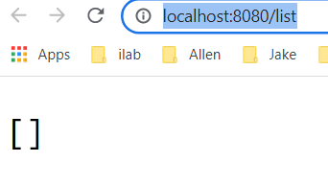
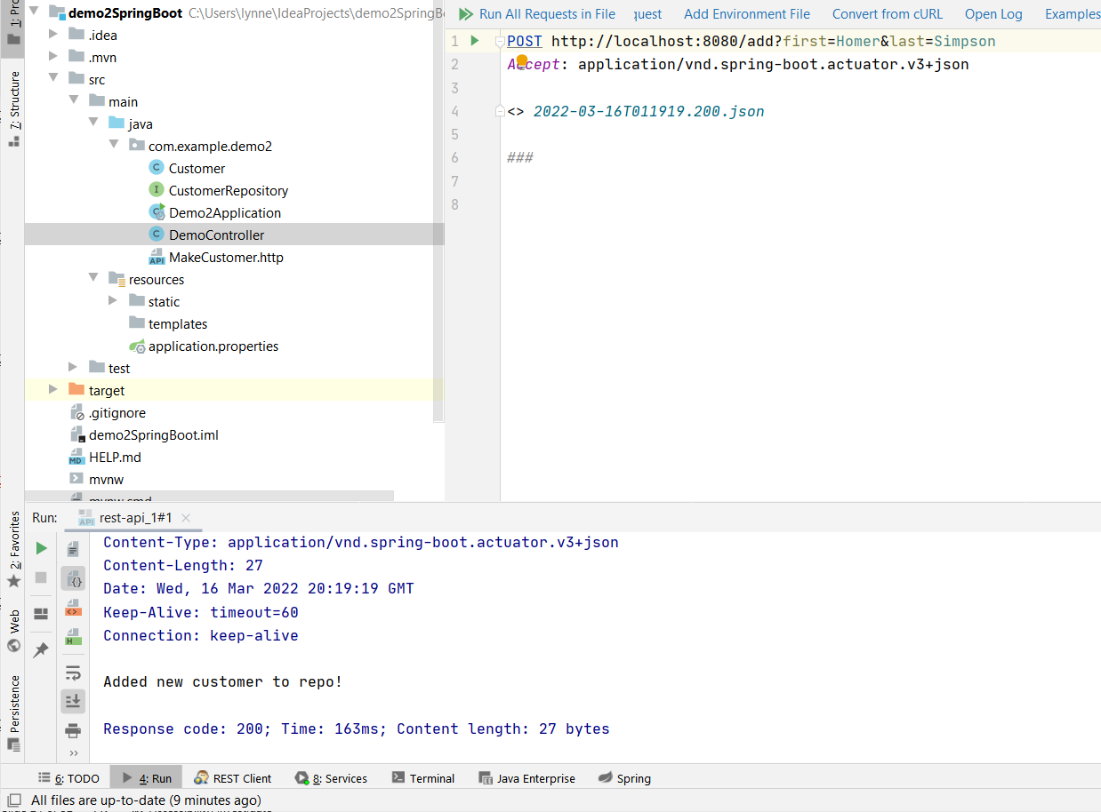
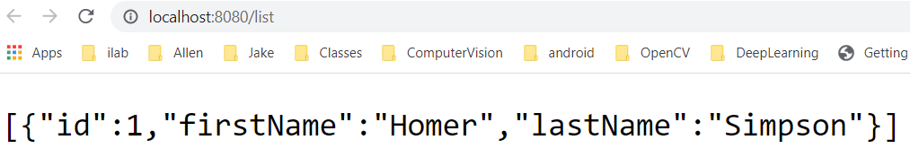
STEP 5: Lets Run It
First there are no customers so see []
To add Customer send POST request to /add with request parameters first & last name. IntelliJ IDE has an HTTP client built into the editor to compose and execute HTTP requests.
### POST http://localhost:8080/add?first=Homer&last=Simpson
TIP: IntelliJ has a plugin HTTPCLient that will let you do this

Slide 25
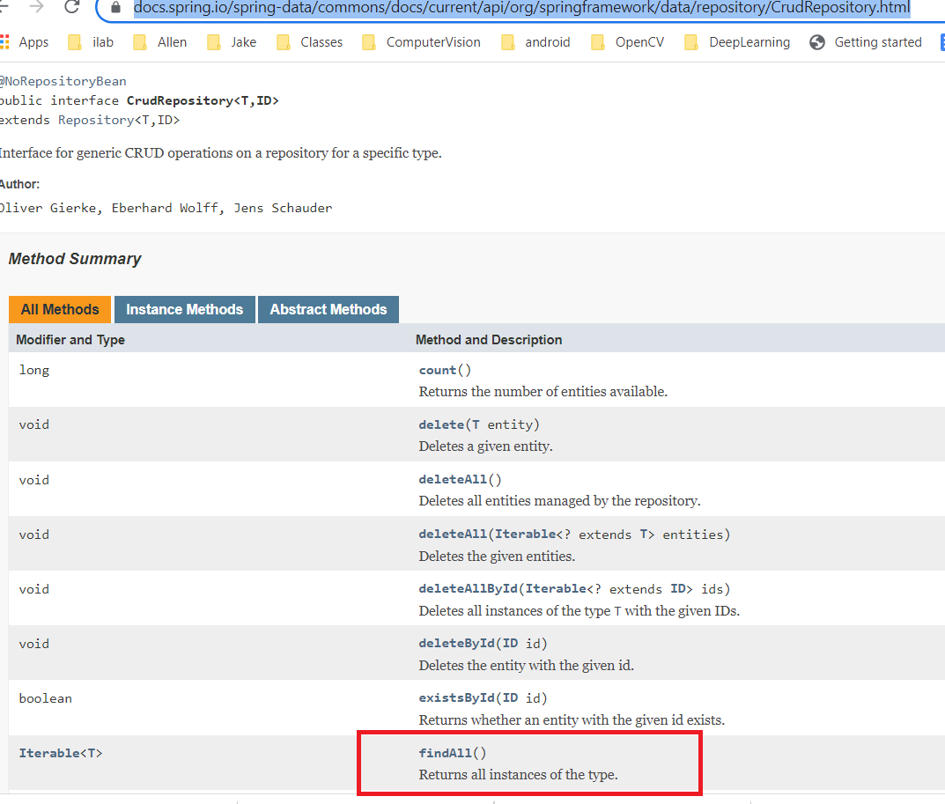
WOW –how did findAll() work
The code was inherited from the CrudResposity class
CustomerRepository extends CrudRepository
Goal of repository abstraction is to reduce the amount of boilerplate code required to implement data access layers for various persistence stores.

Slide 26
STEP 6: Add a Spring Boot Actuator
exposes information about the running of your application
adds a number of endpoints that help you monitor and manage your application.
Add the following dependency to your pom.xml file
<dependency>
<groupId>org.springframework.boot</groupId>
<artifactId>spring-boot-starter-actuator</artifactId>
</dependency>
Make sure you resolve the dependencies in your Project. Depends on IDE.
For example for ItelliJ: Click The Load Maven Changes button in the popup or press Ctrl+Shift+O to load the updated project structure.

Slide 27
More on Actuators
Actuator endpoints let you monitor and interact with your application.
Spring Boot includes a number of built-in endpoints and lets you add your own.
For example, the health endpoint provides basic application health information.

Slide 28
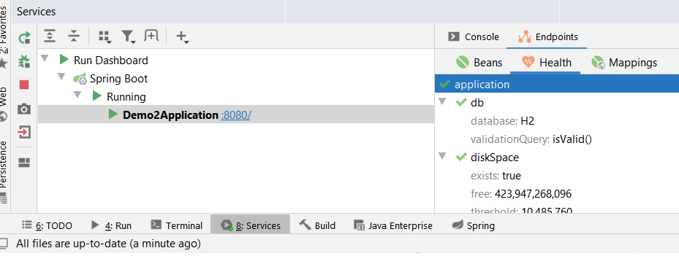
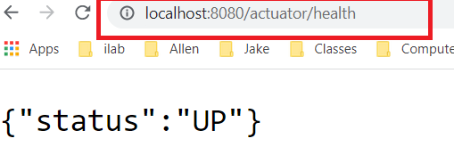
More step 6 -Actuator
Read more
About Actuators
Restart your Spring application and either type in the desired Actuator endpoint (see example below) Or in your IDE open the Actuator interface (e.g. in IntelliJ there ia an Actuator tab in the View->Tool Windows-> Services)
Example /actuator/health (or in your IDE the Health tab to monitor the status of your application) → [example here with IntelliJ ]

Slide 29
PART 3: the View of MVC
15
We have created simple views already –we are not going into details on View options like template engines ,etc.
<!DOCTYPE HTML>
<html xmlns:th="http://www.thymeleaf.org">
<head>
<title>Getting Started: Serving Web Content</title>
<meta http-equiv="Content-Type" content="text/html; charset=UTF-8" />
</head>
<body>
<p th:text="'Hello, ' + ${name} + '!'" />
</body>
</html>
Using Thymeleaf - Java template engine
Extra: http://docs.spring.io/autorepo/docs/spring/4.1.x/spring- framework-reference/html/mvc.html

Slide 30
Summary on Spring Boot
12
Don’t have to write XML anymore
Easier setup and ease of use
Annotation and Bean based configuration
Spring Boot MVC normally lets you do stuff according to the MVC pattern
But it doesn't prevent you from violating MVC if you really want to
MORE to learn:
Flexible designs, reusable
View+
Singe-page application
Integrating WebApp -JSP and Servlets for use in Spring Boot app

Slide 31
What’s next
25
You are going to learn some Spring Boot via an exercise with Google Cloud

Slide 32
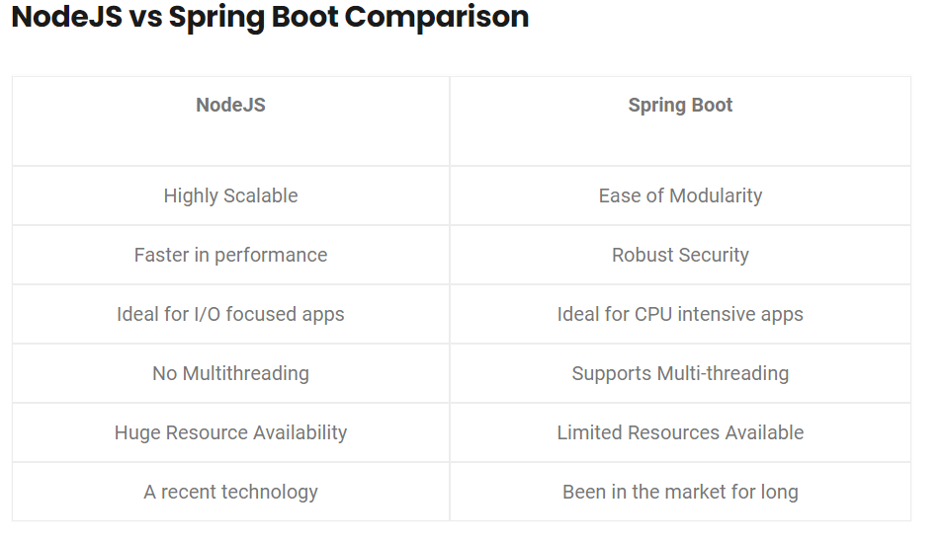
Comparison: NodeJS versus Spring Boot
NodeJS better for apps that have a lot of I/O
Spring Boot may be better for CPU intensive apps as it support multi-threading
BUT—there may be ways to partition functionality into microservices

