Slide 1
Securing Communications over Internet → TLS (Transport Layer Security)

Slide 2

Why Secure Communications
Protects User Data: Encryption prevents sensitive information—like passwords, credit card numbers, and personal data—from being intercepted by malicious actors during transmission.
Builds Trust and Credibility: A secure site (HTTPS with a valid certificate) signals to users that the website is trustworthy, which can improve customer confidence and conversion rates.
Prevents Data Tampering: Secure communication ensures that data sent between users and the website isn’t altered or corrupted during transfer, protecting both parties from manipulation or fraud.
Improves SEO and Browser Compatibility: Major search engines rank secure sites higher, and browsers increasingly flag or block insecure (HTTP-only) sites, potentially driving users away from unprotected pages.

Slide 3

TLS from SSL
TLS evolved from a previous encryption protocol called Secure Sockets Layer (SSL)
IETF TLS Working Group (Official Standards)URL: (Internet Engineering Task Force) defines TLS protocol. Includes RFCs for TLS 1.2, 1.3, etc.

Slide 4
HTTPS and TLS?
HTTPS is an implementation of TLS encryption on top of the HTTP protocol, which is used by all websites as well as some other web services.

Slide 5
Goal: enable secure communication over insecure channel
Secure Communications - Issues
Authentication
sender, receiver want to confirm identity of each other
use nonce to confirm liveness, Certificate Authority to confirm identity
Message integrity
sender, receiver want to ensure message not altered (in transit, or afterwards) without detection
Confidentiality
only sender, intended receiver understand message contents
sender encrypts message
receiver decrypts message
use cryptography: public/private key vs symmetric key

Slide 6
Security

Slide 7



Trudy poses as Alice (to Bob) and as Bob (to Alice)
Motivation: Man-in-the-middle Attack
-
attacker secretly intercepts and possibly alters the communication between two parties who believe they are directly communicating with each other.
K _{A = private key}
K _{A =public key}
+
I am Alice
1
I am Alice Nonce
2
4
3
Nonce
Nonce = “number used once”
random value generated for each session to ensure uniqueness and prevent replay attacks.
-
-
4
K _{A}(Nonce)
Send me your public key
3
K _{T}(Nonce)
Send me your public key
6
5
6
+
5
+
K Trudy sends her public key
K _{A}
T
+
7
-
+
+
8
-
+
K (m)
m=K (K (m))
K (m)
m = K (K (m))
m=message
A
T
A
A
T T
Bob sends m to "Alice" encrypted with Trudy’s public key
Notes:
What’s happening step-by-step:
Trudy impersonates Alice to Bob, and Bob to Alice.
Trudy sits in the middle and pretends to be Alice when talking to Bob, and pretends to be Bob when talking to Alice.
This allows Trudy to intercept all messages between them.
Alice says “I am Alice.”
She initiates communication with what she thinks is Bob (but is actually Trudy).
Trudy (posing as Alice) sends message to Bob “I am Alice”
Nonce exchange (random value):
3) Bob (actually Trudy) sends back a Nonce, which Alice encrypts and returns.
4) Bob sends Nonce to “Alice” (Trudy) , which Trudy encrypts and returns
Public key exchange:
5) Alice asks for Bob’s public key & Trudy intercepts and sends her own public key instead.
6) Bob asks for Alice’s. & Trudy sends hers
This means that both Alice and Bob are actually encrypting messages using Trudy’s key — giving Trudy the ability to decrypt and re-encrypt messages invisibly.
Message transmission:
7) When Alice sends a message encrypted with what she believes is Bob’s public key, Trudy decrypts it (using her private key), reads/modifies it if she wants,
8) then re-encrypts it with Bob’s actual public key before sending it along. Bob thus receives what appears to be a legitimate message from Alice.

Slide 8
Trudy poses as Alice (to Bob) and as Bob (to Alice)
Motivation: Man-in-the-middle Attack
-
attacker secretly intercepts and possibly alters the communication between two parties who believe they are directly communicating with each other.
K _{A = private key}
K _{A =public key}
+
I am Alice
1
I am Alice Nonce
2
4
3
What’s happening step-by-step:
Trudy impersonates Alice to Bob, and Bob to Alice.
Trudy sits in the middle and pretends to be Alice when talking to Bob, and pretends to be Bob when talking to Alice.
This allows Trudy to intercept all messages between them.
Alice says “I am Alice.”
She initiates communication with what she thinks is Bob (but is actually Trudy).
Trudy (posing as Alice) sends message to Bob “I am Alice”
Nonce
Nonce = “number used once”
random value generated for each session to ensure uniqueness and prevent replay attacks.
-
-
4
K _{A}(Nonce)
Send me your public key
3
K _{T}(Nonce)
Send me your public key
6
5
6
+
5
+
K Trudy sends her public key
K _{A}
T
+
7
-
+
+
8
-
+
K (m)
m=K (K (m))
K (m)
m = K (K (m))
m=message
A
T
A
A
T T
sends m to Alice encrypted with Alice’s public key

Slide 9
Trudy poses as Alice (to Bob) and as Bob (to Alice)
Motivation: Man-in-the-middle Attack
-
attacker secretly intercepts and possibly alters the communication between two parties who believe they are directly communicating with each other.
K _{A = private key}
K _{A =public key}
+
I am Alice
1
I am Alice Nonce
2
4
3
Nonce
Nonce = “number used once”
random value generated for each session to ensure uniqueness and prevent replay attacks.
-
-
4
K _{A}(Nonce)
Send me your public key
3
K _{T}(Nonce)
Send me your public key
Nonce exchange (random value):
3) Bob (actually Trudy) sends back a Nonce, which Alice encrypts and returns.
4) Bob sends Nonce to “Alice” (Trudy) , which Trudy encrypts and returns
6
5
6
+
5
+
K Trudy sends her public key
K _{A}
T
+
7
-
+
+
8
-
+
K (m)
m=K (K (m))
K (m)
m = K (K (m))
m=message
A
T
A
A
T T
sends m to Alice encrypted with Alice’s public key
Notes:
What’s happening step-by-step:
Trudy impersonates Alice to Bob, and Bob to Alice.
Trudy sits in the middle and pretends to be Alice when talking to Bob, and pretends to be Bob when talking to Alice.
This allows Trudy to intercept all messages between them.
Alice says “I am Alice.”
Trudy (posing as Alice) sends message to Bob “I She initiates communication with what she thinks is Bob (but is actually Trudy).
am Alice”
Nonce exchange (random value):
3) Bob (actually Trudy) sends back a Nonce, which Alice encrypts and returns.
4) Bob sends Nonce to “Alice” (Trudy) , which Trudy encrypts and returns
Public key exchange:
5) Alice asks for Bob’s public key & Trudy intercepts and sends her own public key instead.
6) Bob asks for Alice’s. & Trudy sends hers
This means that both Alice and Bob are actually encrypting messages using Trudy’s key — giving Trudy the ability to decrypt and re-encrypt messages invisibly.
Message transmission:
7) When Alice sends a message encrypted with what she believes is Bob’s public key, Trudy decrypts it (using her private key), reads/modifies it if she wants,
8) then re-encrypts it with Bob’s actual public key before sending it along. Bob thus receives what appears to be a legitimate message from Alice.

Slide 10
Trudy poses as Alice (to Bob) and as Bob (to Alice)
Motivation: Man-in-the-middle Attack
-
attacker secretly intercepts and possibly alters the communication between two parties who believe they are directly communicating with each other.
K _{A = private key}
K _{A =public key}
+
I am Alice
1
I am Alice Nonce
2
4
3
Nonce
Nonce = “number used once”
random value generated for each session to ensure uniqueness and prevent replay attacks.
-
-
4
K _{A}(Nonce)
Send me your public key
3
K _{T}(Nonce)
Send me your public key
6
5
6
+
5
+
K Trudy sends her public key
K _{A}
T
Public key exchange:
5) Alice asks for Bob’s public key & Trudy intercepts and sends her own public key instead.
6) Bob asks for Alice’s. & Trudy sends hers
This means that both Alice and Bob are actually encrypting messages using Trudy’s key — giving Trudy the ability to decrypt and re-encrypt messages invisibly.
+
7
-
+
+
8
-
+
K (m)
m=K (K (m))
K (m)
m = K (K (m))
m=message
A
T
A
A
T T
sends m to Alice encrypted with Alice’s public key
Notes:
What’s happening step-by-step:
Trudy impersonates Alice to Bob, and Bob to Alice.
Trudy sits in the middle and pretends to be Alice when talking to Bob, and pretends to be Bob when talking to Alice.
This allows Trudy to intercept all messages between them.
Alice says “I am Alice.”
Trudy (posing as Alice) sends message to Bob “I She initiates communication with what she thinks is Bob (but is actually Trudy).
am Alice”
Nonce exchange (random value):
3) Bob (actually Trudy) sends back a Nonce, which Alice encrypts and returns.
4) Bob sends Nonce to “Alice” (Trudy) , which Trudy encrypts and returns
Public key exchange:
5) Alice asks for Bob’s public key & Trudy intercepts and sends her own public key instead.
6) Bob asks for Alice’s. & Trudy sends hers
This means that both Alice and Bob are actually encrypting messages using Trudy’s key — giving Trudy the ability to decrypt and re-encrypt messages invisibly.
Message transmission:
7) When Alice sends a message encrypted with what she believes is Bob’s public key, Trudy decrypts it (using her private key), reads/modifies it if she wants,
8) then re-encrypts it with Bob’s actual public key before sending it along. Bob thus receives what appears to be a legitimate message from Alice.

Slide 11
Trudy poses as Alice (to Bob) and as Bob (to Alice)
Motivation: Man-in-the-middle Attack
-
attacker secretly intercepts and possibly alters the communication between two parties who believe they are directly communicating with each other.
K _{A = private key}
K _{A =public key}
+
I am Alice
1
I am Alice Nonce
2
4
3
Message transmission:
7) When Bob sends a message encrypted with what he believes is Alice’s public key, Trudy decrypts it (using her private key), reads/modifies it if she wants,
8) then re-encrypts it with Alice’s actual public key before sending it along. Alice thus receives what appears to be a legitimate message from Bob.
Messages from Alice to Bob can similarly be read and altered by Trudy
Nonce
Nonce = “number used once”
random value generated for each session to ensure uniqueness and prevent replay attacks.
-
-
4
K _{A}(Nonce)
Send me your public key
3
K _{T}(Nonce)
Send me your public key
6
5
6
+
5
+
K Trudy sends her public key
K _{A}
T
+
7
-
+
+
8
-
+
K (m)
m=K (K (m))
K (m)
m = K (K (m))
m=message
A
T
A
A
T T
Bob sends m to "Alice" encrypted with Trudies’s public key
Notes:
What’s happening step-by-step:
Trudy impersonates Alice to Bob, and Bob to Alice.
Trudy sits in the middle and pretends to be Alice when talking to Bob, and pretends to be Bob when talking to Alice.
This allows Trudy to intercept all messages between them.
Alice says “I am Alice.”
Trudy (posing as Alice) sends message to Bob “I She initiates communication with what she thinks is Bob (but is actually Trudy).
am Alice”
Nonce exchange (random value):
3) Bob (actually Trudy) sends back a Nonce, which Alice encrypts and returns.
4) Bob sends Nonce to “Alice” (Trudy) , which Trudy encrypts and returns
Public key exchange:
5) Alice asks for Bob’s public key & Trudy intercepts and sends her own public key instead.
6) Bob asks for Alice’s. & Trudy sends hers
This means that both Alice and Bob are actually encrypting messages using Trudy’s key — giving Trudy the ability to decrypt and re-encrypt messages invisibly.
Message transmission:
7) When Alice sends a message encrypted with what she believes is Bob’s public key, Trudy decrypts it (using her private key), reads/modifies it if she wants,
8) then re-encrypts it with Bob’s actual public key before sending it along. Bob thus receives what appears to be a legitimate message from Alice.

Slide 12
Use certification authority (CA)
A SOLUTION
binds public key to particular entity
e.g., Alice, Bob, website, …
100s of certification authorities
BUT….
CAs are critical but potentially weak link …
If a CA makes a mistake or is compromised, any certificate it issued can be used to impersonate trusted websites — even banks, governments, or email providers.
The DigiNotar breach was a significant cybersecurity incident in 2011 where a Dutch certificate authority (CA), DigiNotar, was compromised, leading to the issuance of over 500 fraudulent digital certificates. These certificates allowed attackers to impersonate major websites, including Google, Yahoo, and Microsoft, facilitating man-in-the-middle (MITM) attacks, particularly targeting Iranian internet users. The breach undermined trust in DigiNotar's certificates, leading to its bankruptcy and highlighting vulnerabilities in the public key infrastructure (PKI) system.​

Slide 13




Alice registers her public key with CA
Alice provides proof of identity to CA
CA creates certificate binding Alice to its public key
certificate digitally signed by CA
Alice’s public
key K
Digital signature (encrypt)
+
+ A
K_{A}
CA
Certificate for Alice’s public key, signed by CA
private _{K} -
Alice’s identifying information
key CA

Slide 14




When Bob wants Alice’s public key
gets Alice’s certificate from Alice or elsewhere
applies CA’s public key to Alice’s certificate
gets Alice’s public key
+
Digital signature (decrypt)
Alice’s public key
K_{A}
+
K _{A}
CA
public
key
_{K} +
CA

Slide 15
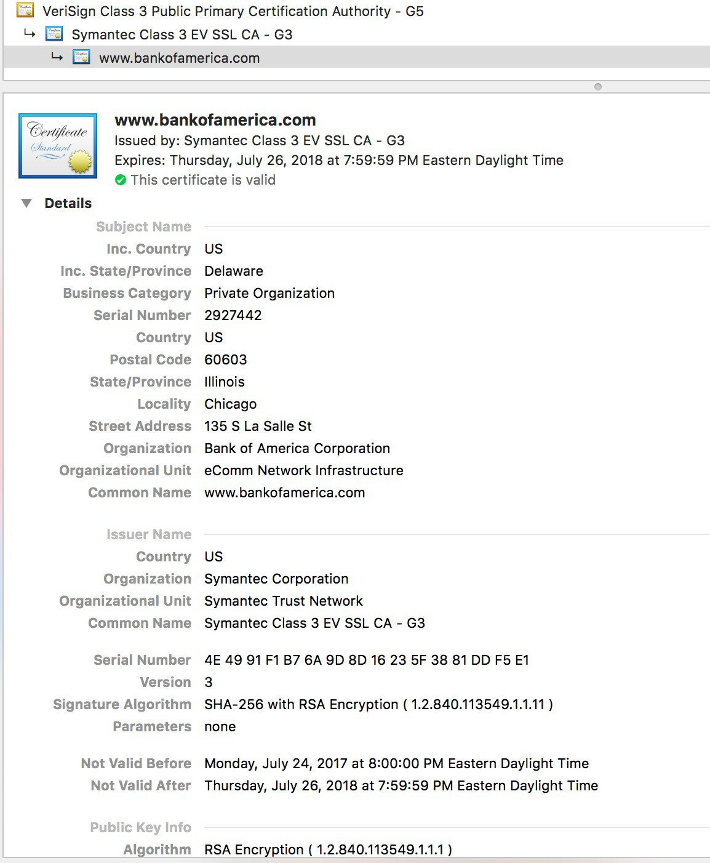
certificate details view typically shown in a web browser when a user clicks the lock icon in the address bar of an HTTPS website.

Slide 16
Security

Slide 17

Alice and Bob must be able to detect whether msg changed
verify msg originated from Alice
verify msg not tampered with on way to Bob
Solution
– digital signatures: cryptographic technique like hand-written signature
Channel
Data, control messages
Secure sender
Secure receiver
Data
Data
Alice
Bob
Trudy

Slide 18

Recipient (Bob)
Sender (Alice)
– encrypts msg m with her private key K_{A} to create
– applies Alice’s public key K⁺ to
A
-
K⁻ (m)
A
-
signed message, K ⁻(m)
– if K⁺(K (m)) = m whoever
A
– proves she is owner/creator
A A
signed m was Alice or has
Alice’s private key
Alice’s private key
Alice’s msg, m
_{K} -
A
⁻ (m)
m, K
Dear Bob
The secret meeting takes place at midnight under the old oak tree
Alice
A
Alice’s msg, m, signed (encrypted) with her private key
Public key encryption algorithm
Bob
Alice

Slide 19
Public key cryptography is expensive
more expensive the longer the message is
Public key cryptography is expensive because it involves mathematically complex operations like exponentiation over very large prime numbers (for RSA) or elliptic curves (for ECC).
Public key cryptography (e.g., RSA, ECDSA) isn't optimized for encrypting large amounts of data.
Solution
sign digital ``fingerprint” of msg rather than msg itself
Message digest
Instead of signing the whole message, you sign its digital "fingerprint".
fingerprint is called a message digest, and it's produced by a cryptographic hash function (e.g., SHA-256).
A hash function takes a message of any length and produces a fixed-size output (the digest).
You then sign the digest using the sender’s private key.

Slide 20
TLS: Signing + Encryption
1. Encrypt the Message (Confidentiality)
Use a symmetric key algorithm (like AES) to encrypt the full message. They use asymmetric key exchange algorithms during the TLS handshake to derive a shared symmetric key
This keeps it secret from anyone but the intended recipient.
2. Sign the Message (Integrity + Authentication)
Use a private key to sign the hash of the original (or encrypted) message.
This ensures it’s not tampered with and proves who sent it.

Slide 21
What happens
SENDER:
Create the Message Digest:
The sender computes a hash (digest) of the full message using a cryptographic hash function (like SHA-256).
Sign the Digest:
The sender encrypts the digest with their private key — this is the digital signature.
Send Both:
The original message (in plaintext or encrypted (symmetric key), depending on the context).
The digital signature (i.e., the signed digest).
RECIEVER:
Hash the Message Again:
The receiver computes their own digest of the received message using the same hash function.
Verify the Signature:
The receiver decrypts the digital signature using the sender’s public key to recover the original digest.
If this matches the digest they computed from the message, the signature is valid.
Read message (decrypt)

Slide 22
More- Symmetric Key generation for data encryption
ECDHE (Diffie-Hellman Key Exchange — Secure & Modern)
- Used in TLS 1.2 and TLS 1.3 (default)
Steps:
Server sends its public ECDHE key in the handshake.
Client generates its own ECDHE public key and sends it.
Both sides now use Elliptic Curve math to compute the same shared secret:
sharedSecret = ECDHE(client_private, server_public) = ECDHE(server_private, client_public)
That secret is then hashed and turned into the symmetric session key using a Key Derivation Function (KDF).
✅ key was never transmitted, only calculated independently on both sides.
even though each side uses different inputs, the math guarantees that the result — the shared secret — is identical.
After client and server both compute the same shared secret using ECDHE,they still can’t use that value directly to encrypt data. Why? Because:
The raw shared secret isn’t random enough for encryption, and
It needs to be transformed into one or more strong, usable symmetric keys for actual data encryption and integrity checks.
That’s where the Key Derivation Function (KDF) comes in.

Slide 23
Desired features are what hash function gives
More on Message Digest
fixed-length
easy-to-compute
2 msgs unlikely to have same digest
Apply hash function H to m
Large msg, m
H: Hash Function
H(m) = msg digest
Hash function properties
many-to-1 function
produces fixed-size msg digest, H(m)
given message digest H(m), computationally infeasible to find m’ such that H(m) = H(m’)

Slide 24
MD5 hash function (RFC 1321)
computes 128-bit message digest in 4-step process.
“cryptographically broken and unsuitable for further use”
CMU Software engineering Institute
SHA-1
160-bit message digest
many vulnerabilities, browsers will no longer use/accept
SHA-2, SHA-3

Slide 25


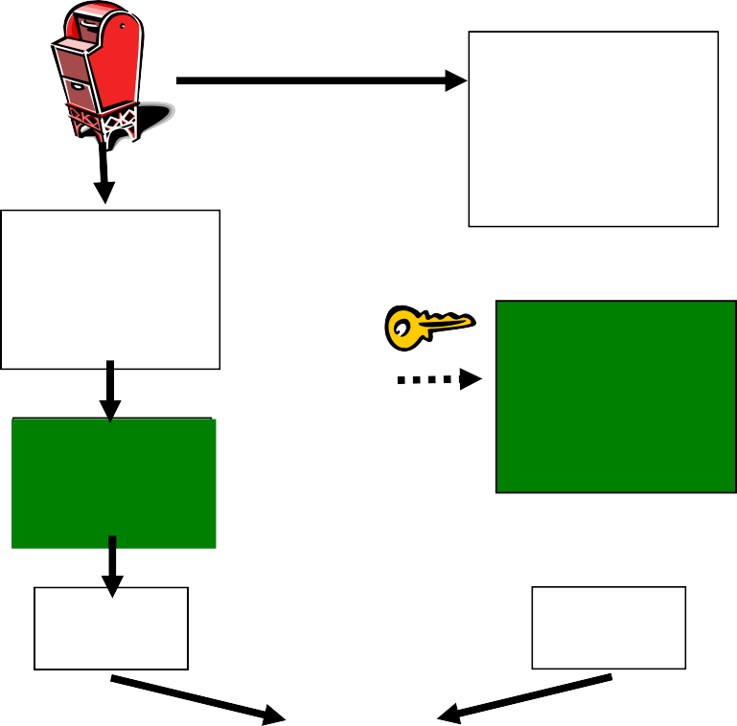


Bob verifies signature, integrity of digitally signed msg
Alice sends digitally signed message
Large msg,m
H: Hash function
H(m)
Encrypted
msg digest
-
K_{A}(H(m))
Alice’s private
key
Digital signature (encrypt)
Large msg, m
-
Alice’s public
key
Digital signature (decrypt)
K_{A}
_{K}+
Encrypted
H: Hash function
A
msg digest
+
K⁻ (H(m))
A
H(m)
H(m)
equal
?

Slide 26
Transport Layer Security → More

Slide 27
TLS provides application programming interface to apps
Application
TCP
IP
Application
TLS
TCP
IP
Normal application
Application with TLS

Slide 28

Send byte streams & interactive data
why? → modern web and network applications (like HTTPS, email, messaging, etc.) need to securely transmit continuous, bidirectional data — such as a video stream
Want set of secret keys for entire connection
why?→ A shared set of session keys (symmetric keys) ensures that all data sent after the handshake is encrypted and authenticated efficiently. Symmetric encryption is fast and scalable,
Want certificate exchange as part of protocol handshake phase
why? → client can verify it's talking to the correct server (and not a malicious actor) before any keys are shared or data is transmitted. This is critical for preventing man-in-the-middle attacks.

Slide 29
Handshake
– Alice and Bob use their certificates, private keys to authenticate each other and exchange shared secret
Key derivation
Alice and Bob use shared secret to derive set of keys
Data transfer
data to be transferred is broken up into series of records
Connection closure
special messages to securely close connection

Slide 30

hello
public key certificate
K
_{B}+
(MasterSecret) = EncryptedMS
Derive keys from master secret
use key derivation function (KDF)
takes master secret and additional random data and creates keys

Slide 31

Don’t use same key for more than one cryptographic operation
keys for message authentication code (MAC): like hash
keys for encryption
Encryption keys
K_{c} = encryption key for data sent from client to server
K_{s} = encryption key for data sent from server to client
MAC keys
M_{c} = MAC key for data sent from client to server
M_{s} = MAC key for data sent from server to client
Used to Encrypt actual data (like website content) (e.g. AES-GCM).
Message Authentication Code. Ensures message integrity — checks that data hasn't been altered. (e.g. SHA)
A MAC (Message Authentication Code) is calculated over each TLS record (i.e., chunk of data). Includes message digest. MAC is verified by receiver to confirm data was not tampered with.

Slide 32

Why not encrypt data in constant stream as we write it to TCP?
where to put MAC?
if at end, no message integrity until all data processed
e.g., instant messaging
how can we do integrity check over all bytes sent before displaying?
Solution: break stream in series of records
each record carries MAC
receiver can act on each record as it arrives
Length | Data | MAC
A MAC is like a cryptographic “checksum.” It’s computed over each chunk of data (TLS record) using a hash function (like SHA). The receiver recalculates the MAC and compares — if it matches, the data is authentic.

Slide 33

What if attacker replays or re-orders records?
Solution: put sequence # into MAC (no seq # field)
MAC = MAC(M_{x}, sequence || data)
What if attacker replays all records?
Solution: use nonce (input into encryption)
What if attacker forges TCP connection close?
Solution: have record types, with one type for closure
type 0 for data
type 1 for closure
MAC = MAC(M_{x}, sequence || type || data)
seq# starts at 1 and increase by 1 for each record
Mx is Mc or Ms
Mc = MAC key for client → server
Ms = MAC key for server → client
Length | Type | Data | MAC

Slide 34

bob.com
hello
certificate, nonce
K
_{B}+
(MasterSecret) = EncryptedMS
type 0, seq 1, data
type 0, seq 2, data
Encrypted
type 0, seq 1, data
type 0, seq 3, data
Nonce = “number used once” It is a random value generated for each session to ensure uniqueness and prevent replay attacks.
type 1, seq 4, close
type 1, seq 2, close

Slide 35
Transport Layer Security

Slide 36
How long are fields? Which encryption protocols? How do client and server negotiate encryption algorithms?
TLS more to learn
TLS Handshake
confidentiality
client and server negotiate encryption algorithms before data transfer
– i.e., negotiate ciphersuite
derive keys used in data exchange
integrity
check if handshake tampered with based on hash of handshake msgs
authentication
using public key and server’s certificate
optional client authentication

Slide 37

Negotiation: client, server agree on cipher suite
During the TLS handshake, the client and server agree on a cipher suite from a list of supported options.
– client offers choice server picks one TLS_RSA_WITH_3DES_EDE_CBC_SHA
Key exchange algorithm: public- key
Symmetric encryption algorithm: block cipher to encrypt msg stream
MAC
algorithm
Used to securely exchange a symmetric key. (e.g. RSA) – used during Handshake
Used to Encrypt actual data (like website content) (e.g. AES-GCM).
Message Authentication Code. Ensures message integrity — checks that data hasn't been altered. (e.g. SHA)
Which ciphersuites are supported depends on TLS version
TLS 1.2 supports many cipher suites
TLS 1.3 supports many fewer cipher suites
A MAC (Message Authentication Code) is calculated over each TLS record (i.e., chunk of data). Includes message digest. MAC is verified by receiver to confirm data was not tampered with.

Slide 38

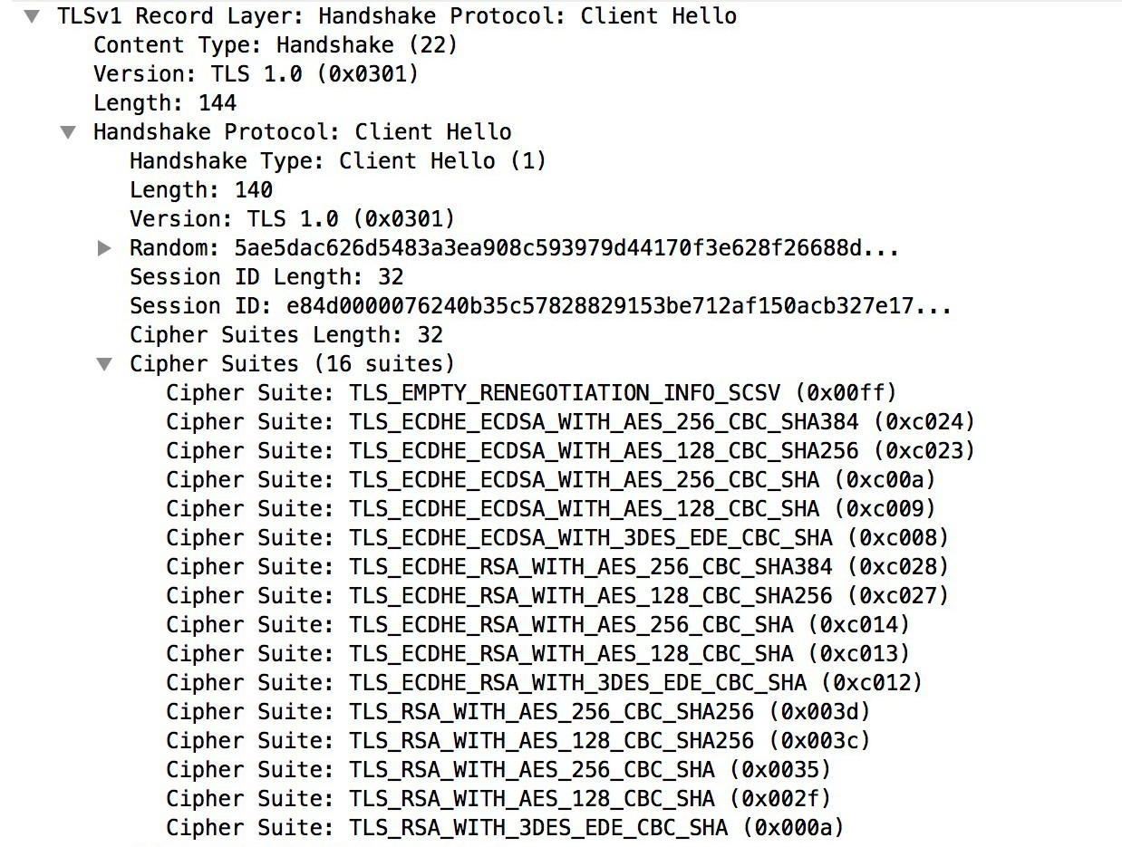
client starts the handshake by sending a Client Hello message, which includes info on cipher suites
Client (e.g., a web browser) initiates a secure connection with a server.

Slide 39

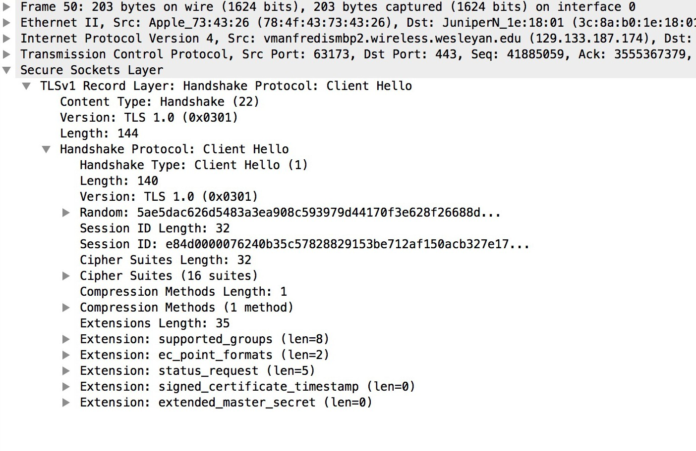
shows exactly how that message looks “on the wire” — the actual fields and structure captured in a real TLS handshake.

Slide 40


Alice
Integrity: If any handshake message was tampered with, digest won’t match, & connection will be terminated.
Bob
1. Client hello ➔
client nonce, ciphersuites
2. Server hello
server nonce, chosen ciphersuite, RSA certificate
3. Verifies certificate
generates premaster secret
4. Premaster secret ➔ encrypted with Bob’s public key from certificate
5. Generate symmetric keys client nonce, server nonce, premaster, ciphersuite
6. Generate symmetric keys client nonce, server nonce, premaster, ciphersuite
7. Server hello done
MAC of all handshake msgs encrypted with server session keys
8. Client hello done ➔
MAC of all handshake msgs
encrypted with client symmetric key
Protect handshake from tampering
7. Encrypted data ➔
8. Encrypted data

Slide 41


Alice
Bob
1. Client hello ➔
client nonce, ciphersuites
2. Server hello
server nonce, chosen ciphersuite, RSA certificate
Suppose Trudy sniffs all messages between Alice & Bob
next day, Trudy sets up TCP connection with Bob
replays sequence of records
Bob (Amazon) thinks Alice made two separate orders for same thing
Solution
Bob sends different random nonce for each connection
causes encryption keys to be different on the 2 days
Trudy’s messages will fail Bob’s integrity check

Slide 42
Look at TLS traffic and openssl s_client traffic
NEXT shows the output of the command-line tool openssl s_client, which is being used to connect to the HTTPS server and inspect its TLS certificate and connection info.

Slide 43


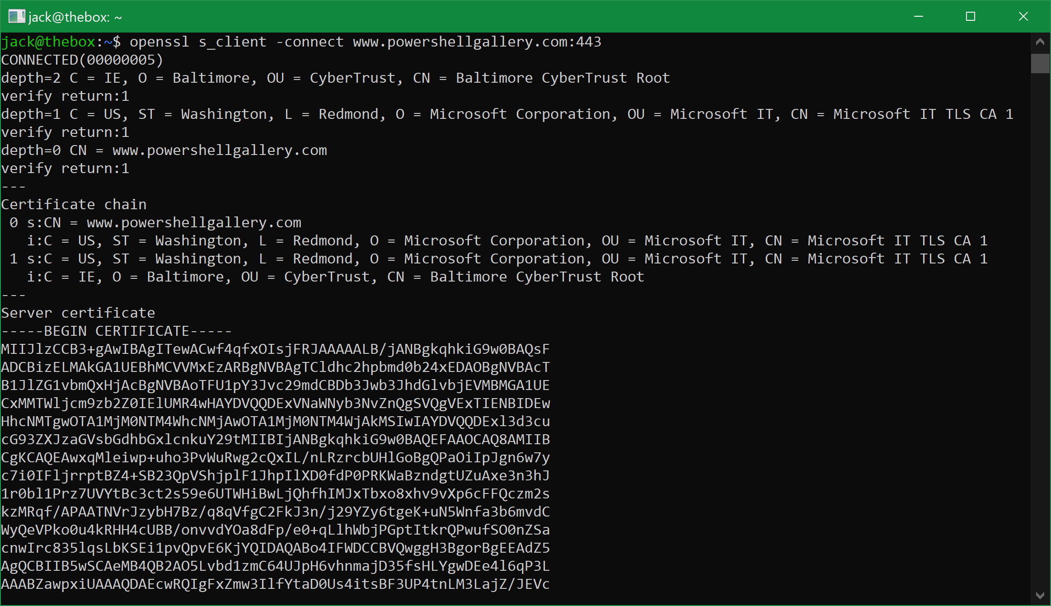
You can see that it verified that the issuer of the top-level certificate in the issuance chain (the CN=Baltimore CyberTrust Root CA) is trusted ("verified", against my local ca files), and each trust relationship all the way down to the peer (or endpoint) certificate for www.powershellgallery.com. From: https://blog.iisreset.me/openssl-s_client-but-in-powershell/

Slide 44
GAE (& most PaaS) handles TLS for you automatically
You don’t need to manually configure TLS certificates or HTTPS listeners in your Node.js app.
TLS and Cloud

Slide 45
TLS and Cloud
Google Compute Engine (& most/all IaaS)
You must set this up.
Option 1: Use HTTPS via Google Cloud Load Balancer (Recommended)
Let Google handle TLS termination for you using a Global HTTP(S) Load Balancer in front of your VM. How It Works:
Your VM (GCE instance) runs your Node.js app on HTTP (port 80 or 8080).
You configure a Google Cloud Load Balancer in front of it.
The load balancer:
Terminates TLS/HTTPS.
Forwards traffic as plain HTTP to your Node.js app.
Can use Google-managed SSL certificates (free & auto-renewed).
Setup Steps:
Go to Cloud Console > Network Services > Load balancing.
Create a Global HTTP(S) load balancer.
Add:
Backend: your GCE instance group
Frontend: enable HTTPS (port 443)
Attach Google-managed certificate or upload your own
Point your domain's DNS A record to the load balancer's IP.
TLS termination means ending (or “stopping”) the TLS encryption at a specific point in the network — usually at a load balancer or proxy server — where the data is decrypted before being sent to your backend servers.

Slide 46
TLS and Cloud → configure on GCE
🛠️ Option 2: Handle TLS Yourself (on the VM)
You can configure HTTPS directly in your Node.js app, typically using Express + HTTPS module.
🛠️ Basic Setup:
Obtain a certificate:
Use Let’s Encrypt (via Certbot or acme.sh)
Or purchase and install a cert manually
Add this to your Node.js app:
Open ports 443 and optionally 80 in your GCP firewall rules:
gcloud compute firewall-rules create allow-https --allow tcp:443 --target-tags your-instance-tag
Node.js includes a bundled OpenSSL binary → it will support a version of TSL by default
Protocol | Default Port | Description
HTTP | 80 | Unencrypted web traffic (plain text)
HTTPS | 443 | Secure, encrypted web traffic (uses TLS/SSL)
const https = require('https');
const fs = require('fs');
const express = require('express');
const app = express();
app.get('/', (req, res) => res.send('Hello HTTPS!'));
const options = {// Load certificate files
key: fs.readFileSync('/etc/letsencrypt/live/yourdomain.com/privkey.pem'),
cert: fs.readFileSync('/etc/letsencrypt/live/yourdomain.com/fullchain.pem')
};
https.createServer(options, app).listen(443, () => {// Start HTTPS server with certificates specified
console.log('Secure server running on port 443');
});
⚖️

