Slide 1


Ruby on Rails
View of MVC

Slide 2
Model-View-Controller Paradigm
A way of organizing a software system
Benefits:
  Isolation of business logic from the user interface
  Code Reusability
  Making it clear where different types of code belong for easier maintenance

Slide 3
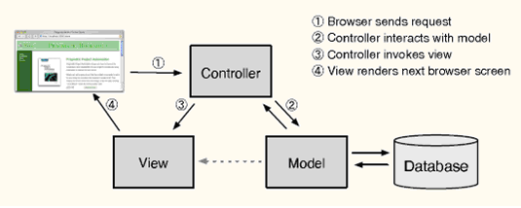
MVC
Model - the information (data) of the application and the rules to manipulate that data. Business logic
View – (potentially) takes data and displays it
Controller – the glue between the model and controller. In Rails, they’re responsible for processing the incoming requests from the web browser, interrogating the models for data, and passing that data on to the views for presentation.

Slide 4
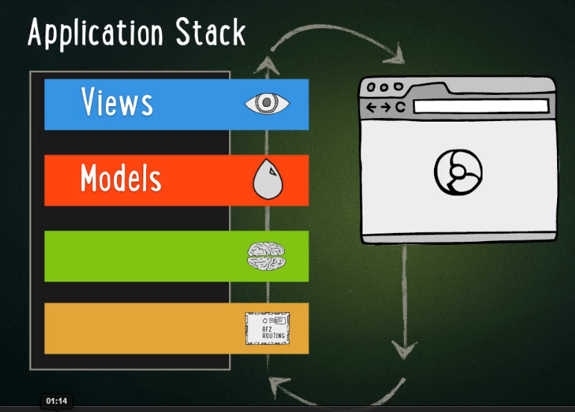
View – The interface (here a web-app interface)

Slide 5
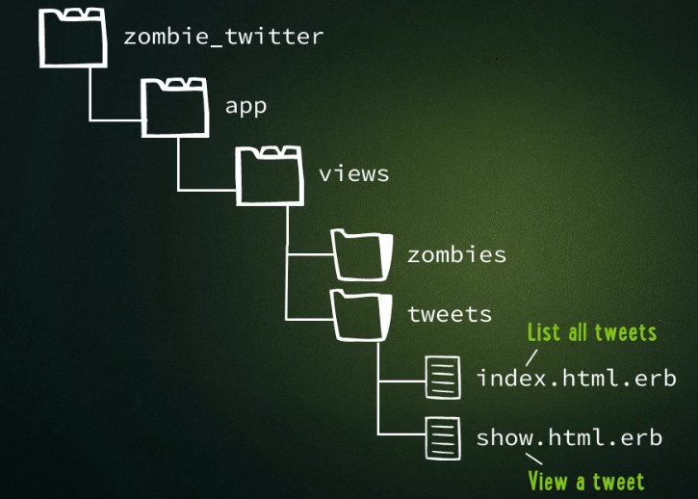
Continuing with the Zombie tutorial
We have the following file structure now
NOTE:
erb = Embeddable Ruby
This means (like jsp) these
files have HTML and Ruby
in them

Slide 6
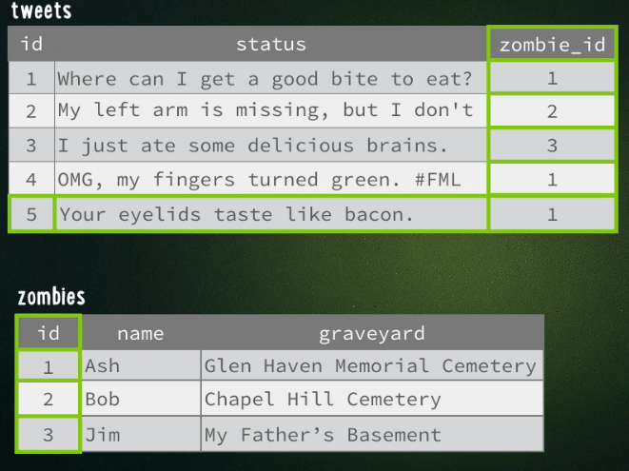
Remember the Zombie example
Databases zombies and tweets

Slide 7
View to show a single Tweet
In app/views/tweets/show.html.erb
Looks a bit like jsp
<html>
<head> …</head>
<body>
…..
<% tweet= Tweet.find(1) %>
<h1> <%= tweet.status %> </h1>
Posted by <%= tweet.name %>
</body>
</html>
NOTE:
Show the 1st Tweet in the database tweets
<% -> evaluate contents
<%= -> evaluate & print
Results
Where can I get a bite to eat?
Posted by Ash

Slide 8
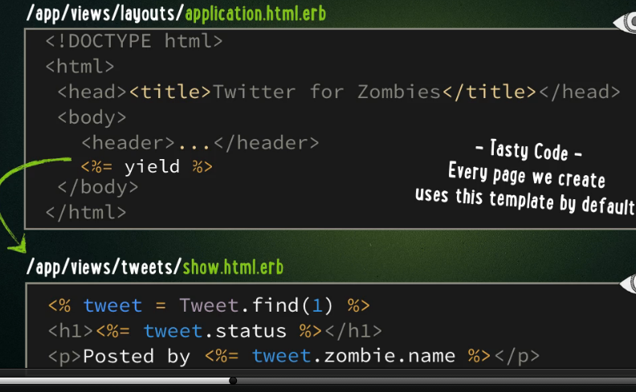
ALTERNATIVE: View to show a single Tweet --- put static in separate file
NOTE: every page loads application.html.erb that has static code THEN --- <%= yield %> brings in the specific ruby code you called like show.html.erb

Slide 9
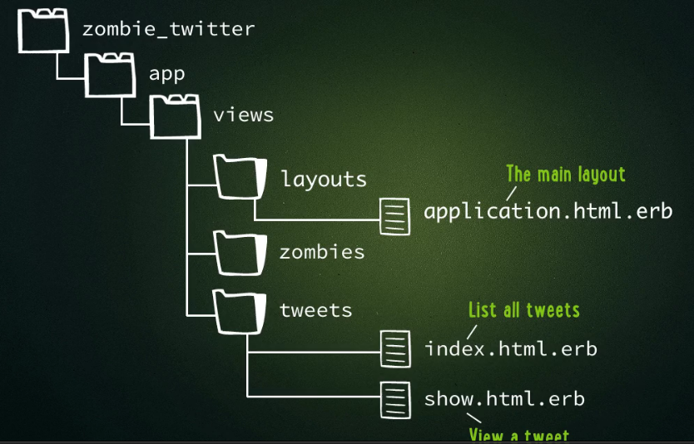
Now we have the following file structure

Slide 10
Various view code snippets
….some useful examples

Slide 11
Web link_to –ruby on rails – link to pull in data
<% tweet= Tweet.find(1) %>
Where can I get a bite to eat? <br>
Posted by <% link_to tweet.zombie.name, tweet.zombie%>
GENERAL:
<% link_to Text_to_Show , Model Instance %>
Results FROM BLUE
Where can I get a bite to eat?
Posted by Ash

Slide 12
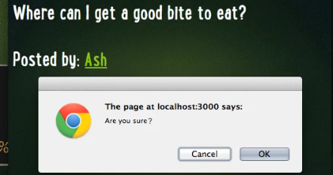
Web – link_to, confirmation option
You can also ask user with confirm attribute if they really want to perform the link operation
<% tweet= Tweet.find(1) %>
<% link_to tweet.zombie.name, tweet.zombie,
confirm: “Are you sure?”%>

Slide 13
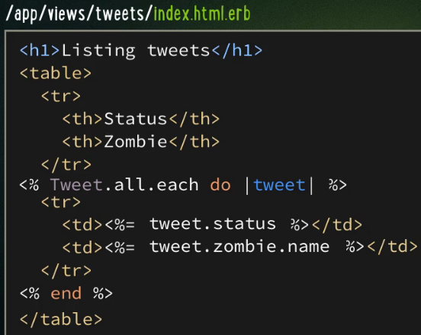
Lets create index.html.erb to list ALL tweets in the Zombie example
This line cycles through all the entries in tweets database, creating a Tweet Model instance named tweet in a loop.

Slide 14
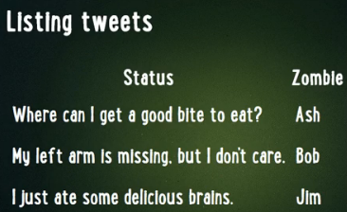
Results of index.html.erb

Slide 15
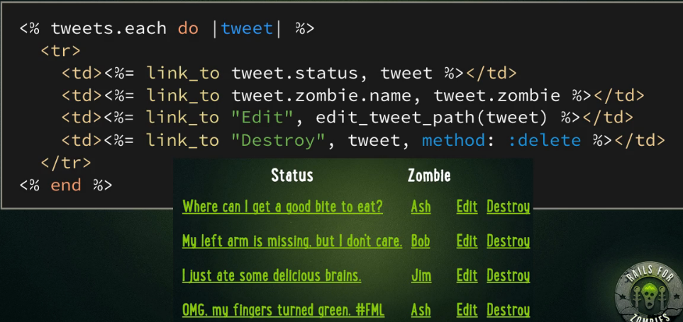
Add some more links, link_to and have special links to delete or modify
First 2 link_to look similar.
edit_tweet_path(tweet) will bring up option to edit the corresponding tweet
delete will call the delete method on the corresponding tweet

Slide 16
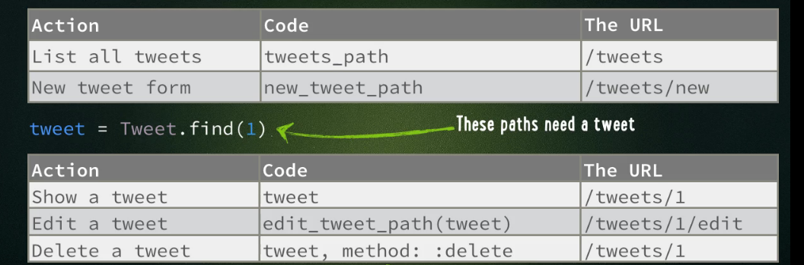
What is going on ---there are predefined URL generator methods in RoR
HOW TO USE GENERALLY:
<%= link_to Text_to_Show, code %>
Example
<%= link_to “Delete it” , tweet, method: :delete %>
<%= link_to “Delete it”, {:action =>”delete”, :controller=>”tweet’, :id=>tweet.id } %>
<%= link_to "Nonsense search", searches_path(foo: "bar", baz: "quux")
# => <a href="/searches?foo=bar&amp;baz=quux">Nonsense search</a>

Slide 17
View to read in parameters passed to URL
How to read in parameters (URI?p1=v1&p2=v2)
In your view_file.html.erb have the following.
  NOTE: params is reserved hash object in Rails
<p>
The <code>params</code> hash
contains the following values:
</p>
<% params.each do |key, value| %>
<p><%= key %>: <%= value %></p>
<% end %>
<code> is an html styling tag
REQUEST:
http://localhost:3000/controller_name/methodURI?ids[]=1&ids[]=2&ids[]=3
MEANS:
params[:ids] will now be ["1", "2", "3"].

Slide 18
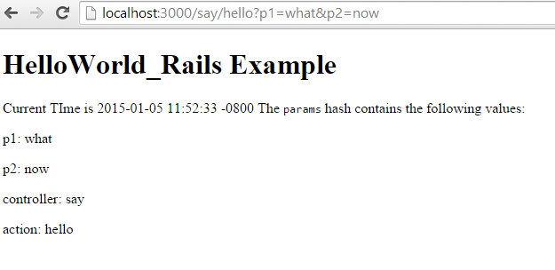
OUTPUT View to read in parameters passed to URL
REQUEST:
http://localhost:3000/say/hello?p1=what&p2=now
say.html.erb file
<h1> HelloWorld_Rails Example</h1>
Current TIme is <%= Time.now() %>
The <code>params</code> hash contains the following values:
</p>
<% params.each do |key, value| %>
<p><%= key %>: <%= value %></p>
<% end %>

Slide 19
Remember the assets directory in your project
---let's look at putting some image(s) in the assets/images directory and using in our view

Slide 20
Using image in the assets folder
you can access images in the public/assets/images directory like this: (here the file rails.png is stored)
In your view whatever.html.erb:
If instead it was in the sub-directory icons:
<%= image_tag "rails.png" %>
<%= image_tag "icons/rails.png" %>

