Slide 1


Ruby on Rails
Routes

Slide 2
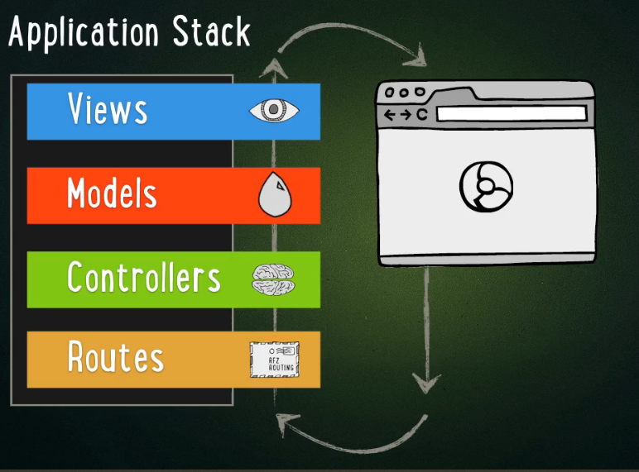
Routes
How we map URIs like /tweets/1 to calling the show method of the Controller
Notes:
The expectation is that you have

Slide 3
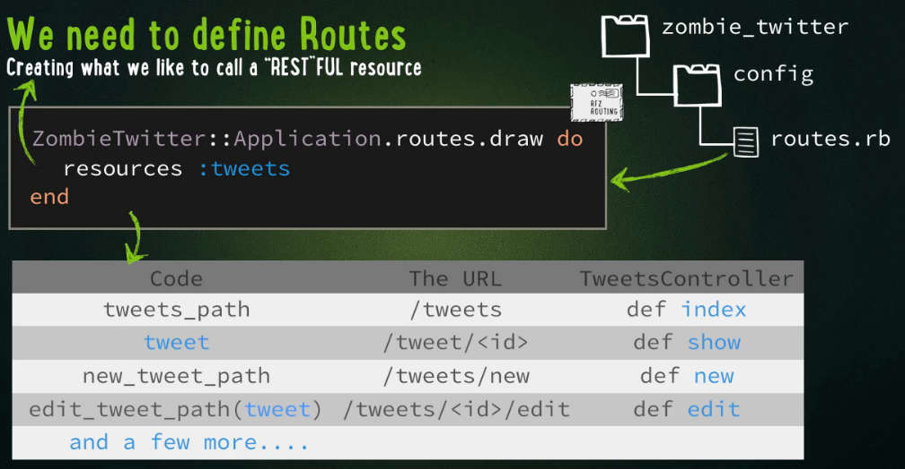
Routes defined in routes.rb file
NOTE: resources :tweets → means map routes of standard URIs to standard Controller method names (as shown below) so /tweets → index AND /tweet/1 → show

Slide 4
resources :tweets
This is a great short cut rather than making mappings for each of the default RESTFUL request on next slide

Slide 5
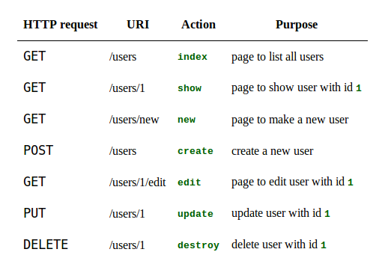
RESTful controller actions possible and the methods they invoke for users (zombie example)
Notes:
Here it is again

Slide 6
resources :users
If you add to routes.rb file the following line
resources :users
it will setup the following mappings (see http://guides.rubyonrails.org/routing.html)
HTTP request | URI Path | Controller#Action | Used for
GET | /users | user#index | display a list of all users
GET | /users/new | user#new | return an HTML form for creating a new user
POST | /users | user#create | create a new user
GET | /users/:id | user#show | display a specific user
GET | /users/:id/edit | user#edit | return an HTML form for editing a user
PATCH/PUT | /users/:id | users#update | update a specific user
DELETE | /users/:id | users#destroy | delete a specific user
resources :photos

Slide 7
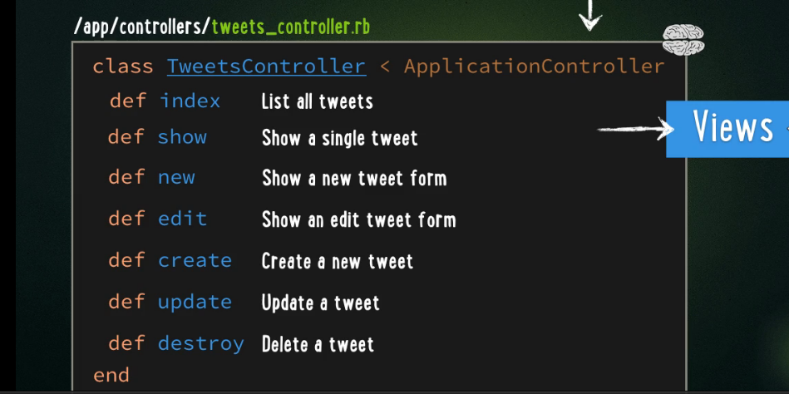
How about for tweets: Different URI invoked methods in our Controller class
Each URI type will invoke a different predefined method in the Controller class. YOU HAVE to write the code in your Controller class for each method.
Example URI /tweets/2/edit will invoke edit method
Remember add
resources :tweets
to routes.rb to quickly add all the maps related to these methods

Slide 8
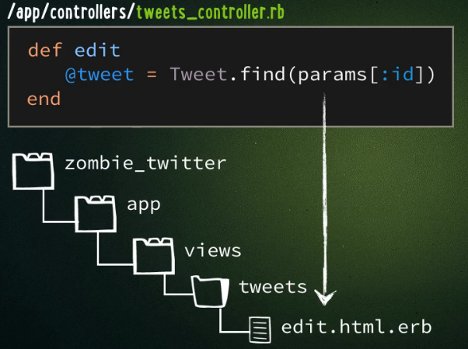
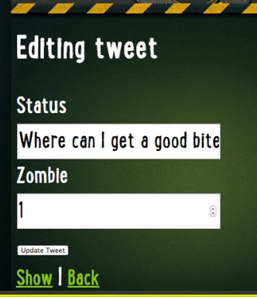
Let’s add the edit method to Controller
URI /tweets/2/edit
edit method inside controller
View edit.html.erb
Fill in form fields with values
@tweet.status
@tweet.zombie_id
By DEFAULT the edit method at end will call the edit view edit.html.erb

Slide 9
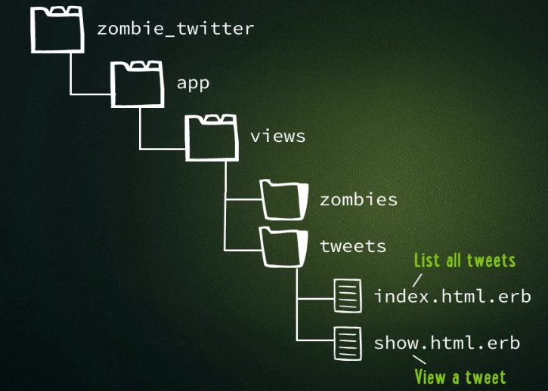
Continuing with the Zombie tutorial
Rememver following file structure now

Slide 10
Remember our show.html.erb View
In app/views/tweets/show.html.erb
<html>
<head> …</head>
<body>
…..
<% tweet= Tweet.find(1) %>
<h1> <%= tweet.status %> </h1>
Posted by <%= tweet.name %>
</body>
</html>
NOTE:
A View here is calling directly a Model (Tweet).
While this can work, it is not the intention of MVC.
FIX: we need to replace this with Controller code.

Slide 11
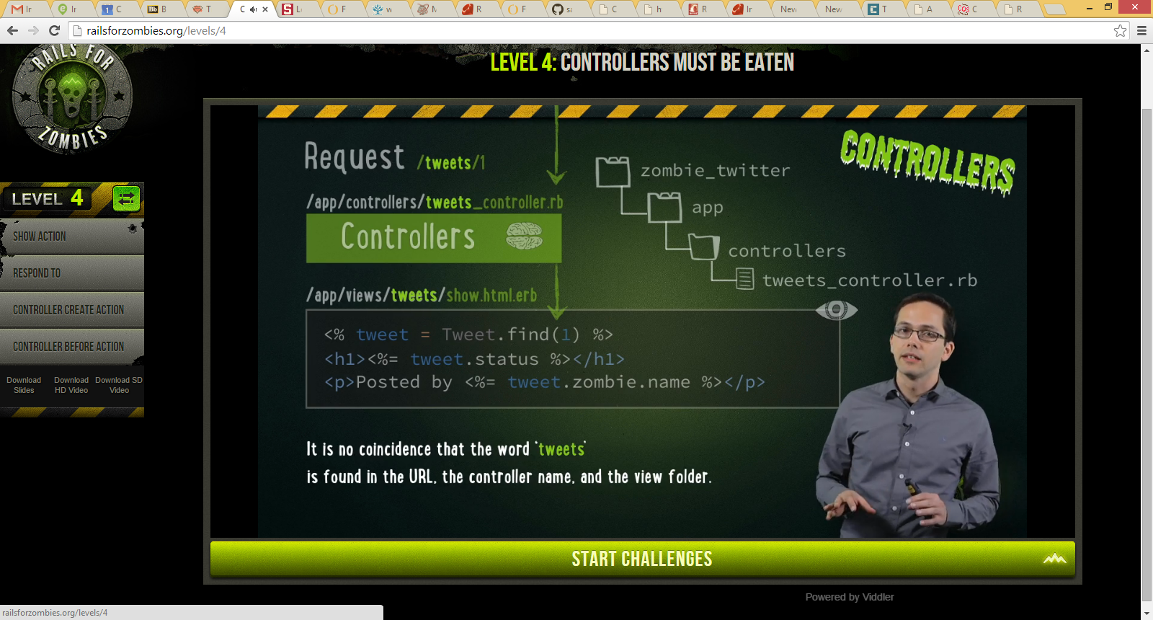
What we want instead…. Is a Controller that has a SHOW method
1: request /tweets/1
3: the controller then invokes the view show.html.erb

Slide 12
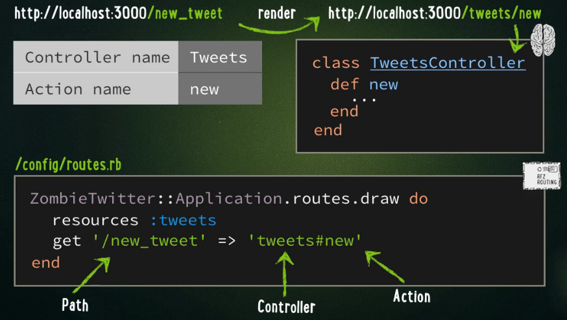
But what about CUSTOM Routes
Example want URI /new_tweet → Tweet Controller’s new method

Slide 13
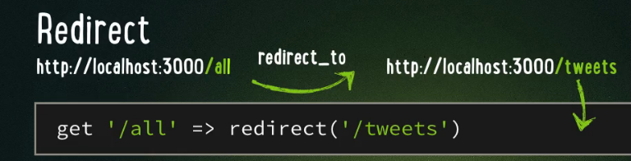
Using Routes to redirect a URI
Suppose you want /all to redirect to the URI /tweets
ADD the following code in our routes.rb
ZombieTwitter::Application.routes.draw do

Slide 14
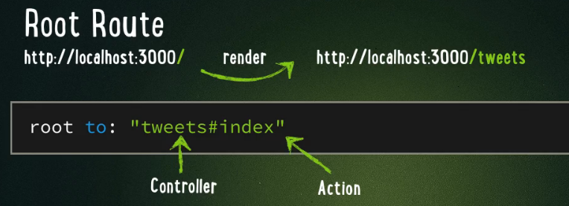
Root Route → what users sees when types in URL with no path http://server
ADD the following code in our routes.rb
ZombieTwitter::Application.routes.draw do

Slide 15
Do you finally see how through Rails structure you create a website???

