Slide 1


Ruby on Rails: Databases

Slide 2
Rails Database
Familiar Table Concept
Naming convention – lower case, plural (i.e. tweets)
How to Access (find), Update, Delete (destroy) , Add (create)

Slide 3
Rails –connection to a database
By default uses SQLite3 (a file based solution)
You can modify to connect to other databases (Oracle, MySQL) --- usually you edit the config/database.yml file to point to correct database and connection properties
# config/database.yml
# SQLite version 3.x
#
# Ensure the SQLite 3 gem is defined in your Gemfile
# gem 'sqlite3'
#
default: &default
adapter: sqlite3
pool: 5
timeout: 5000
development:
<<: *default
database: db/development.sqlite3
# Warning: The database defined as "test" will be erased and
# re-generated from your development database when you run "rake".
# Do not set this db to the same as development or production.
test:
<<: *default
database: db/test.sqlite3
production:
<<: *default
database: db/production.sqlite3

Slide 4
This lecture and our class…..
Concentrates not on setting up a database and connecting to it via rails. But, rather once you have done that how to use it (to find entries, to add, delete and update…sometimes called CRUD = create ,read, update, delete).
NOTE: we will use default SQLite3 (filebased) that you can simply install as a gem (via > gem install sqlite3) on the command line
AGAIN: to connect to a different database you edit the config/database.yml file to point to your database.

Slide 5
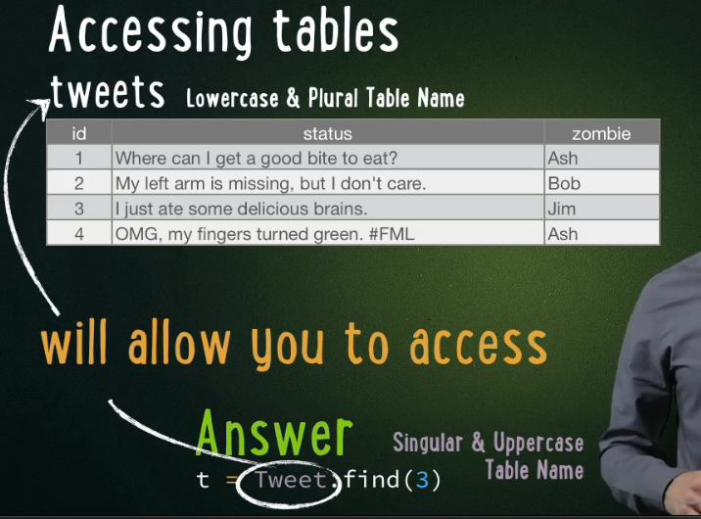
Rails Database – Read Access (find)
Name tables = lowercase, plural (tweets)
Access table via Models (discussed in other lecture) = uppercase, singular (Tweet.find(*) )

Slide 6
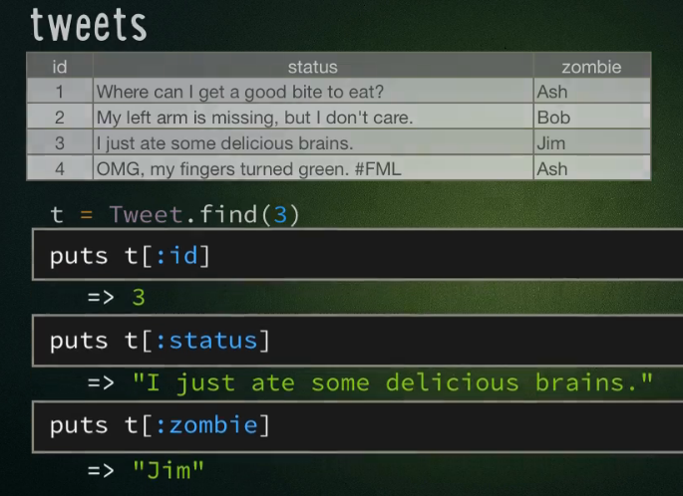
Accessing database
Retrieve item using find(*) method
t = Tweet.find(3) #get the entry with id 3
NOW t = hash {id: 3, status: “I just ate…” , zombie:“Jim” }

Slide 7
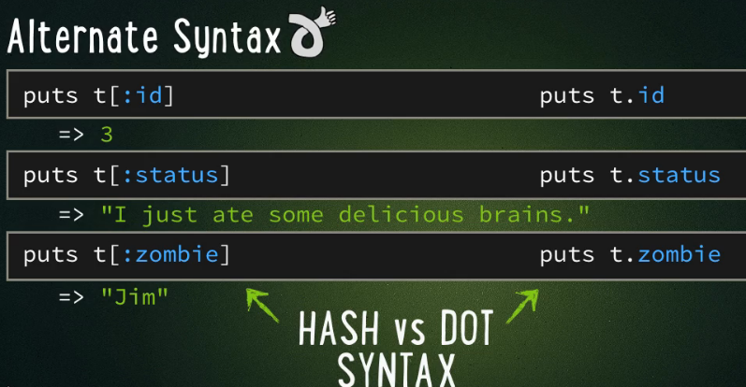
Accessing database with “.” syntax - preferred
Have t = Tweet.find(3)
Can treat as saw before like a Hash, or use “.” syntax (more common) as in database entry
t.status VERSUS t[:status]

Slide 8
Database Access -more
Tweet.find(2) => gets entry with id=2
Tweet.find(3,4,5) => gets ENTRIES with ids =3,4,5
Tweet.first Tweet.last => gets First and last entry
Tweet.all => gets all the entries
Tweet.count =>number of entries
Tweet.order(:zombie) => returns ORDER BY alphanumeric data in zombie column
Tweet.limit(90) => limits to 90 entries returned
Tweet.where(zombie: “ash”) => WHERE zombie = “ash”

Slide 9
Database Access –Where conditional clause and ordering results
Tweet.where(zombie: “ash”).order(:status).limit(10)
    MEANS IN SQL WHERE zombie = “ash” AND ORDERBY status AND limit =10

Slide 10
Rails Database: Create New Entry
t = Tweet.new
t.status = “I < 3 brains.”
t.save
GENERALLY,
T= TableName.new
t.key = value
t.save
NOTE: you do not have to specify the id that is automatically determined by Rails

Slide 11
Rails Database: Create New Entry –ALTERNATIVE 1
t = Tweet.new(
status : “I < 3 brains.”
zombie: “Jim”)
t.save
GENERALLY,
t= TableName.new(
key1: value1,
key2: value2)
t.save
NOTE: you do not have to specify the id that is automatically determined by Rails

Slide 12
Rails Database: Create New Entry –ALTERNATIVE 2
t = Tweet.create(
status : “I < 3 brains.”,
zombie: “Jim”)
GENERALLY,
t= TableName.create(
key1: value1,
key2: value2)
NOTE: you do not have to specify the id that is automatically determined by Rails
ALSO: you do not have to execute a save

Slide 13
Rails Database: Update Entry
First, retrieve it, then update values
t = Tweet.find(3)
t.zombie = “EyeEater”
t.save
GENERALLY,
t = TableName.find(x)
t.key = “new value”
t.save

Slide 14
Rails Database: Update Entry – ALTERNATIVE 1
First, retrieve it, then update values using attributes and passing a hash to set all of them
t = Tweet.find(3)
t.attributes = {
status : “Can I eat your Eyes?”,
zombie : “EyeEater” }
t.save
GENERALLY,
t = TableName.find(x)
t.attributes = {
key1: “value 1”,
key2: “value 2” }
t.save

Slide 15
Rails Database: Update Entry – ALTERNATIVE 2
First, retrieve it, then use update method
t = Tweet.find(3)
t.update(status : “Can I eat your Eyes?”,
zombie : “EyeEater” )
GENERALLY,
t = TableName.find(x)
t.update(key1: “value 1”, key2: “value 2”)
NOTE: you do not have to execute a save
NOTE: you do not have to execute a save

Slide 16
Rails Database: Delete an entry
Find Entry, then call destroy method
t = Tweet.find(2)
t.destroy

Slide 17
Migration: Create New Table
SUPPOSE you have created a model called Student it will create the following file for you containing the class CreateStudents. Edit it as shown in red to add code to create the corresponding database table.
db/migrate/20090215220309_create_students.rb:
class CreateStudents < ActiveRecord::Migration
def change
create_table :students do |t|
t.column :name, :string
t.column :birth, :date
t.column :gpa, :float
t.column :grad, :integer
end
end
end
id | name | birth | gpa | grad
Primary key | string | date | float | int

Slide 18
Migration: Add Column to students table
db/migrate/20101013224357_add_advisor.rb:
class AddAdvisor < ActiveRecord::Migration
def change
add_column :students, :advisor_id, :integer
end
end

Slide 19
Migration Utilities
rails generate model students
(NOTE: on RubyMine IDE is : Tools-> Run Rails Generator -> model and then give the name students as the Model name)
rails generate migration load_data
=> db/migrate/load_data.rb
rake db:migrate
rake db:migrate VERSION=20090130180755
rake db:reset
rake db:migrate:reset

