Slide 1


Ruby on Rails
Controller of MVC

Slide 2
Model-View-Controller Paradigm
A way of organizing a software system
Benefits:
  Isolation of business logic from the user interface
  Code Reusability
  Making it clear where different types of code belong for easier maintenance

Slide 3
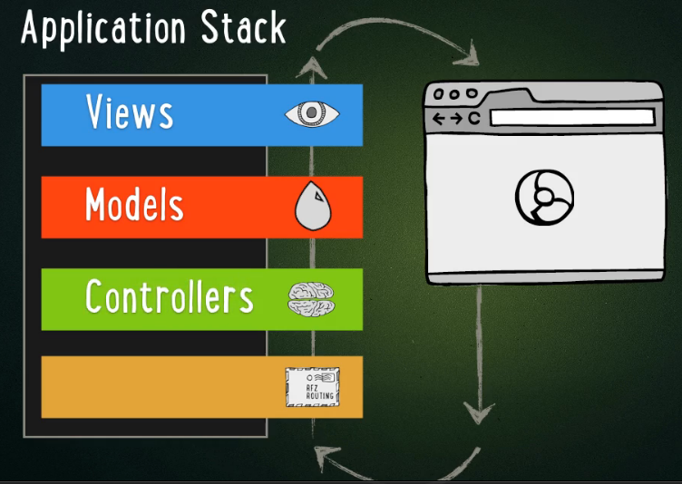
Controllers
Interaction between Models and Views
conform to REST
  The expectation is that each controller corresponds to a resource and each controller action corresponds to a RESTful action.
Notes:
The expectation is that you have

Slide 4
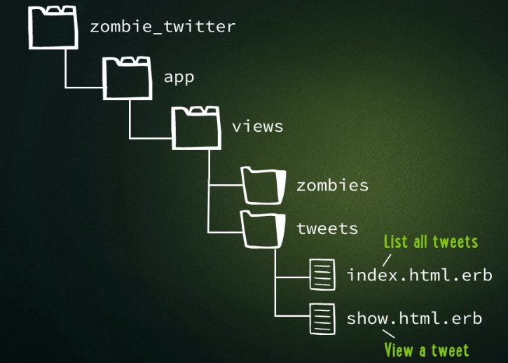
Continuing with the Zombie tutorial
Remember following file structure now

Slide 5
Remember our show.html.erb View
In app/views/tweets/show.html.erb
<html>
<head> …</head>
<body>
…..
<% tweet= Tweet.find(1) %>
<h1> <%= tweet.status %> </h1>
Posted by <%= tweet.name %>
</body>
</html>
NOTE:
A View here is calling directly a Model (Tweet).
While this can work, it is not the intention of MVC.
FIX: we need to replace this with Controller code.

Slide 6
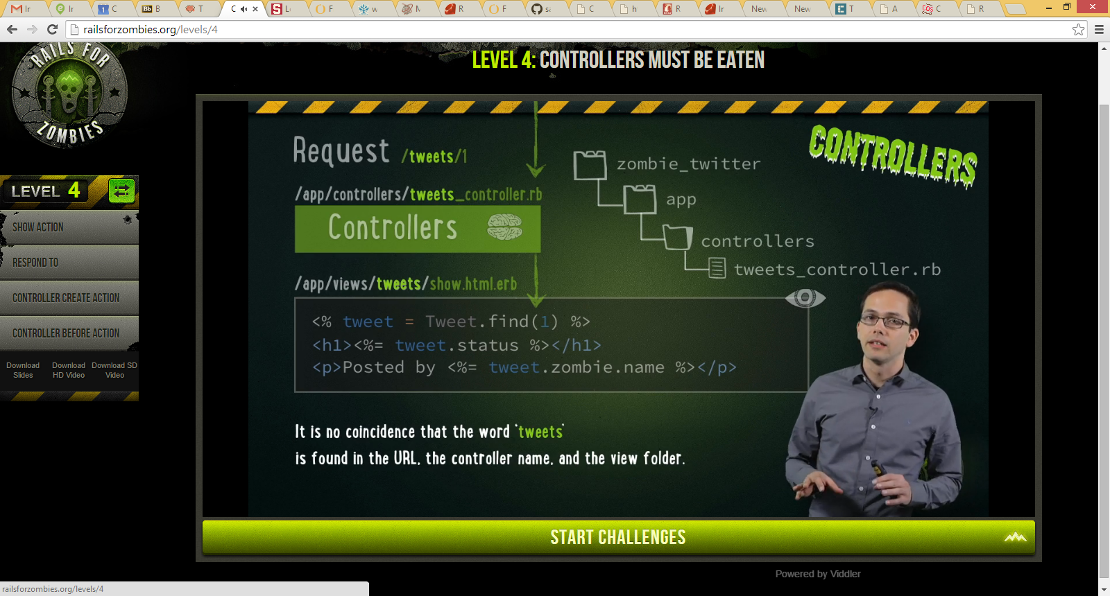
What we want instead…. Is a Controller that has a SHOW method
1: request /tweets/1
2: this invokes Controller tweets_controller.rb and calls its show method
3: the controller then invokes the view show.html.erb

Slide 7
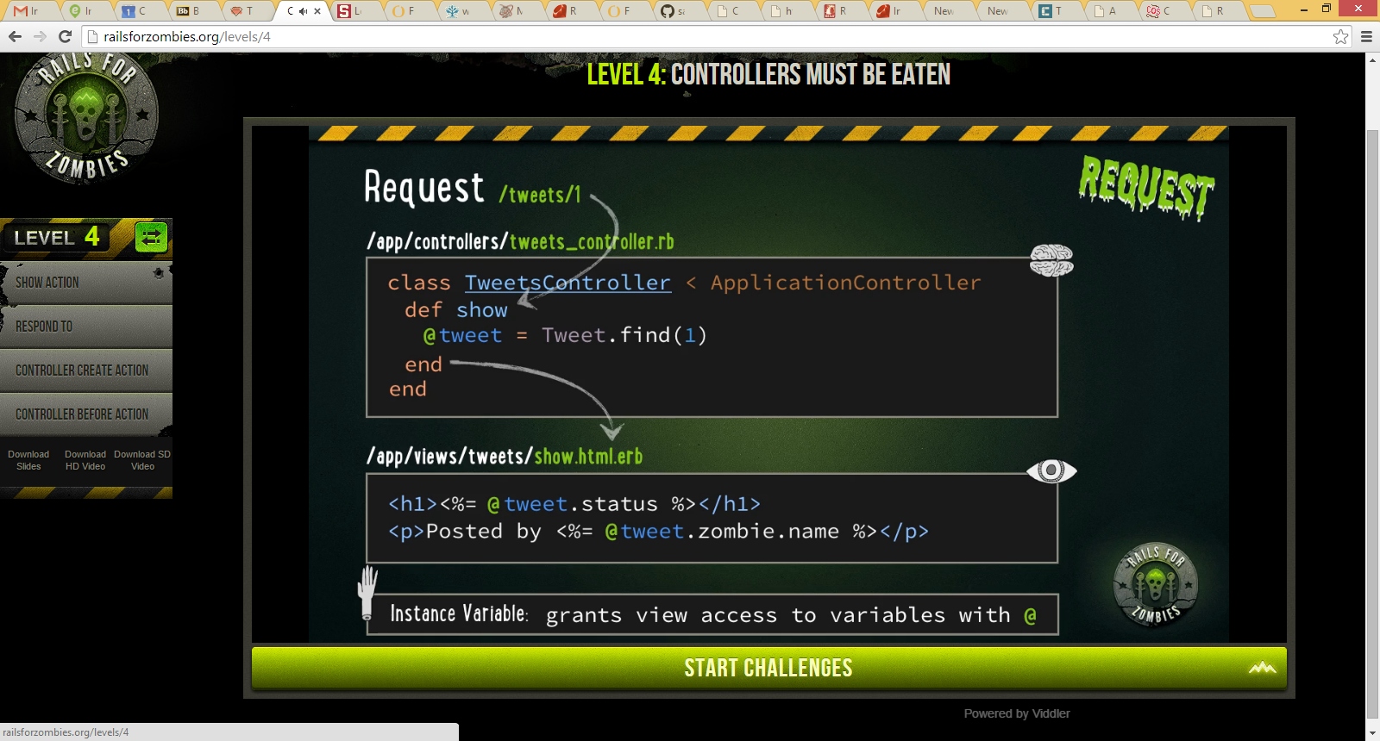
What we want instead….continued
1: request /tweets/1
2: this invokes Controller tweets_controller.rb
AND call’s its show method
3: FIX, the controller creates the instance of the Model, then as the method is called “show” it automatically calls the view
“show”.html.erb

Slide 8
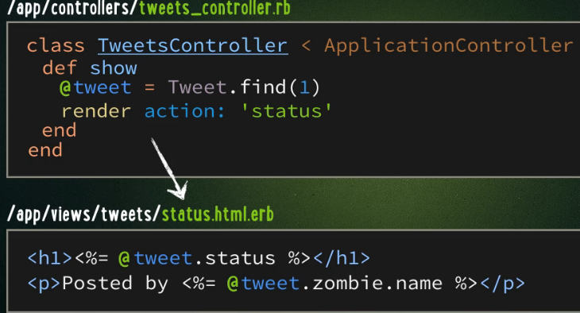
What if want to invoke a different view….say one called status.html.erb

Slide 9
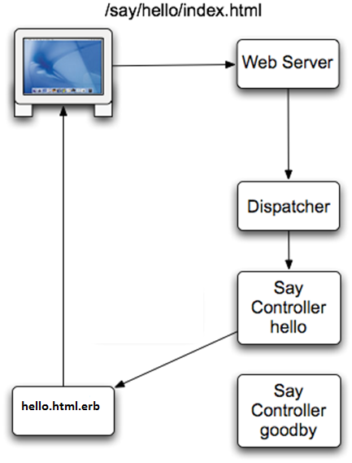
Another example Controller
class SayController < ApplicationController
def hello
@time = Time.now
render :action => ‘hello’
end
def goodbye
end
end
2: Controller method (hello) does some business logic then calls the VIEW hello.html.erb
1: go to routes listing & figure out which controller and what method to invoke

Slide 10
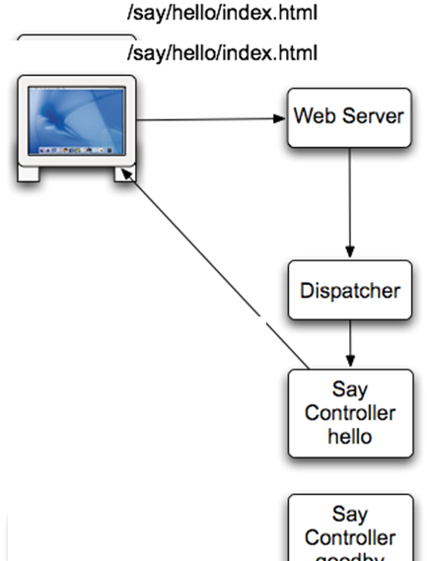
Another Example Controller –here don’t call view but directly render text
class SayController < ApplicationController
def hello
@time = Time.now
render :text => "Hello There"
end
def goodbye
end
end

Slide 11
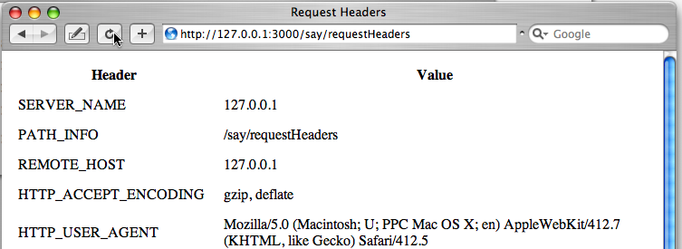
Controller and View to print out HTTP request headers
requestHeaders.html.erb
<html>
<head>
<title>Request Headers</title>
</head>
<body>
<table border="0" cellspacing="5" cellpadding="5">
<tr><th>Header</th><th>Value</th></tr>
<% request.env.each_pair do | key, value| %></p>
<tr><td><%= key %></td><td><%= value %></td></tr>
<% end %>
</table>
</body>
</html>
class SayController < ApplicationController
def requestHeaders
remote_host = request.env['REMOTE_HOST']
end
def requestHeaders
end
end
request is a predefined object

Slide 12
Let’s fix the hardcoded id value for show
….. Instead pass as a parameter in the url. For example to see the tweet with id 3 the url is
http://host***/tweets/show/3

Slide 13

Passing Parameters in Request to Controller
Example request: tweets/3 # means get tweet 3
Read in parameter (default parameter above is always id) in Controller via: params[:id]
At the end of the above show method will call status.html.erb view passing the instance variable @tweet

Slide 14
Another example for passing parameters
….example to create a new tweet passing the “status of the tweet”

Slide 15
Another example Passing Parameter
Say have request: /tweets?status=I’m hungry
Lets say we want this to mean, create a new Tweet with the status of “I’m hungry”
Here is the controller code:
@tweet = Tweet.create(status: params[:status] )
/tweets?status=I’m hungry
YIELDS the following hash for params
params = {status: “I’m hungry” }

Slide 16
IF we reformat how we send the parameter….
….we can make our controller code even simpler

Slide 17
Another example
Passing Parameter
Passing the status as a hash array element
Say have request: /tweets?tweet[status]=I’m hungry
Lets say we want this to mean, create a new Tweet with the status of “I’m hungry”
Here is the controller code:
@tweet = Tweet.create(params[:tweet])
/tweets?tweet[status]=I’m hungry
YIELDS the following hash for params
params = {tweet: {status: “I’m hungry” }}
Note: params[:tweet] = {status: “I’m hungry}
AND that hash can be used directly as input into
create method
This is WHY you commonly see the above request format

Slide 18
Another example reading in the params hash object in the Controller
class RailsIntroController < ApplicationController
def show_primes
if params[:count] != nil then
count = params[:count].to_i()
else
count = 10
end
@primes = []
candidate = 2
while @primes.length < count
is_prime = true
@primes.each do |prime|
if (candidate % prime) == 0 then
is_prime = false
break
end
end
if is_prime then
@primes << candidate
end
candidate += 1
end
end
end
Query value determines
# primes to compute
Fill in @primes array
with prime numbers
REQUEST:
http://localhost:3000/railsintro/show_primes/count=20

Slide 19
A word of caution about passing parameters

Slide 20
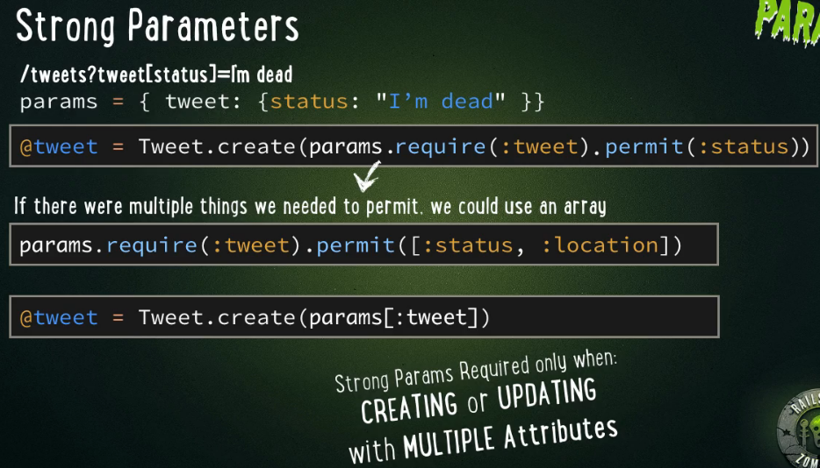
In the last code, a person could have set any values in the request ---that could be dangerous …SQL injection attacks …. SOLUTION→ Strong Parameters
This means you require :tweet
and you allow :status attribute of params[:tweet]

Slide 21
You can create modelclass_params method in the Controller class to define the required and permitted parameters → and pass this method to create method or update methods for the Model class → a way of centralizing these strong parameters
…example the UserController class has a user_params method that you can pass to User.create(user_params) or User.update(user_params)
You can keep the code like the previous example writing inside of every time you call a User.create or User.update → but, better to have a method you call that has the code

Slide 22
Typical way you define in Controller a method ***_params (where ***=name of model class) to set required and permitted (strong parameters)
class UsersController < ApplicationController
def create
@user = User.new(user_params)
if @user.save
sign_in @user
flash[:success] = "Welcome to Sample App!"
redirect_to @user
else
render 'new'
end
end
def edit
end
def update
if @user.update_attributes(user_params)
flash[:success] = "Profile updated"
sign_in @user
redirect_to @user
else
render 'edit'
end
end
private
def user_params
params.require(:user).permit(:name, :email, :password,
:password_confirmation)
end
end
sign_in & redirect_to are built in methods in Rails

Slide 23
What was redirect_to in previous page
redirect_to sends an HTTP 302 redirect message to the user's browser, telling it to go to a different URL, thus stopping your current execution.
redirect_to @user will send to the http://currenthost:3000/@user_value

Slide 24
A few redirect_to examples

Slide 25
Example using auto-calling render to *.html.erb, using render and using redirect_to
class Book
  #renders the 'new' view automatically
  def new
  @book = Book.new
  end
  def create
  @book = Book.new params[:book]
  if @book.save #try to save the book to database table
  redirect_to :action => :show #if the book is successfully created,
  #redirect to its show action
  else
  render :new #else render the new action again but with error messages available
  #from @book.errors and with the fields the user filled in available
  end
  end
end
If RoR fails saving @book to database then will have errors saved in @book.errors

Slide 26
Another render and redirect_to example
class MicropostsController < ApplicationController
  #other stuff including defining root_url
  def create
  @micropost = current_user.microposts.build(micropost_params)
  if @micropost.save
  flash[:success] = "Micropost created!"
  redirect_to root_url
  else
  render 'static_pages/home'
  end
  end
  private
  def micropost_params
  params.require(:micropost).permit(:content)
  end
end

Slide 27
More on specifying redirect_to
redirect_to action: "show", id: 5
redirect_to post
redirect_to "http://www.rubyonrails.org"
redirect_to "/images/screenshot.jpg"
redirect_to articles_url
redirect_to :back
redirect_to proc { edit_post_url(@post) }
The redirection happens as a “302 Found” header unless otherwise specified using the :status option:
redirect_to post_url(@post), status: :found
redirect_to action: 'atom', status: :moved_permanently
redirect_to post_url(@post), status: 301
redirect_to action: 'atom', status: 302

Slide 28
redirect_to with message
flash provides a way to pass temporary primitive-types (String, Array, Hash) between actions.
  Anything you place in the flash will be exposed to the very next action and then cleared out.
class PostsController < ApplicationController
def create
@post = Post.create params[:post]
flash[:notice] = "Post successfully created"
redirect_to @post
end
def show
# doesn't need to assign the flash notice to the template, that's done automatically
end
end
show.html.erb
<% if flash[:notice] %>
<div class="notice"><%= flash[:notice] %></div>
<% end %>

Slide 29
redirect_to with a message
flash names alert and notice as well as a general purpose flash
redirect_to post_url(@post), alert: "Watch it, mister!"
redirect_to post_url(@post), status: :found, notice: "Pay attention to the road"
redirect_to post_url(@post), status: 301, flash: { updated_post_id: @post.id }
redirect_to({ action: 'atom' }, alert: "Something serious happened")

Slide 30
Using Rails to create XML or JSON
This is one feature that is easy to do in Rails compared to other languages

Slide 31
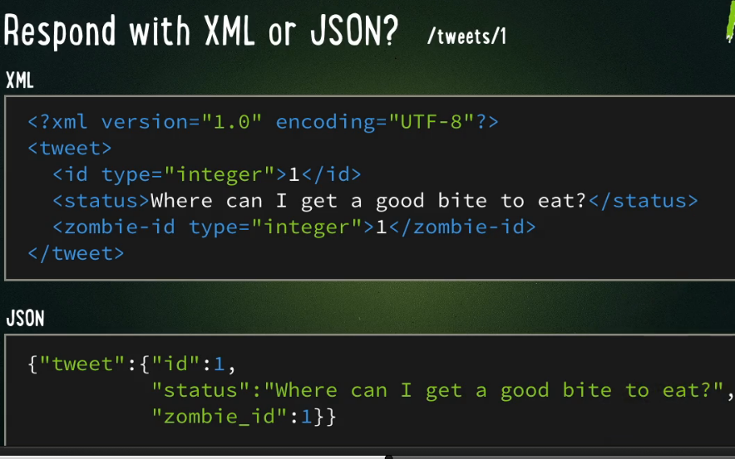
Suppose we wanted to take data from our Zombie example and create XML or JSON
IDEA: /tweets/1 returns results as XML or JSON
SOLUTION: have controller return it…XML not too different than the HTML views the previous controller returned AND our Model returns data as hashs that LOOK like JSON

Slide 32
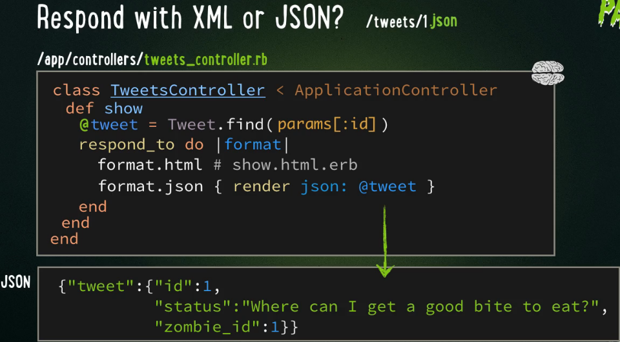
Lets modify our previous controller.. to get JSON request now is /tweets/1.json
respond_to do |format| → means look at the format on of the request (above is .json)
  If .html → then will render the standard show.html.erb
  If .json → then will render the json format of the tweet hash

Slide 33

Lets modify our previous controller.. to get JSON request now is /tweets/1.xml
respond_to do |format| → means look at the format on of the request (above is .xml)
  If .html → then will render the standard show.html.erb
  If .json → then will render the json format of the tweet hash
  If .xml → then will render the xml format of the tween hash

Slide 34
What did you forget to ask???
WHY the show method of the controller when we have request
tweets/1 OR tweets/1.json
ANSWER: this is the method you are mapping to (in the routes.rb ---see lecture on routes)……WHAT ARE THE OTHER COMMON CONVENTIONS OF MAPPINGS and HOW DO THEY GET INVOKED BY REQUESTS

Slide 35
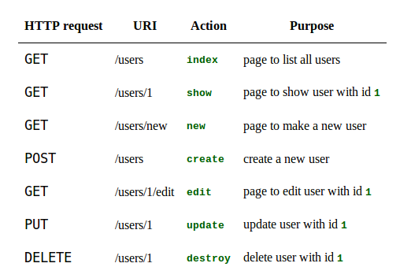
RESTful controller actions possible and the methods they invoke for users (zombie example)
Notes:
Here it is again

Slide 36
Special Note:
If you add to routes.rb file the following line
resources :users
it will setup the following mappings (see http://guides.rubyonrails.org/routing.html)
HTTP request | URI Path | Controller#Action | Used for
GET | /users | user#index | display a list of all users
GET | /users/new | user#new | return an HTML form for creating a new user
POST | /users | user#create | create a new user
GET | /users/:id | user#show | display a specific user
GET | /users/:id/edit | user#edit | return an HTML form for editing a user
PATCH/PUT | /users/:id | users#update | update a specific user
DELETE | /users/:id | users#destroy | delete a specific user
resources :photos

Slide 37
Post/Get actions in a controller
class ClientsController < ApplicationController
# This action uses query string parameters because it gets run
# by an HTTP GET request, but this does not make any difference
# to the way in which the parameters are accessed. The URL for
# this action would look like this in order to list activated
# clients: /clients?status=activated
def index
if params[:status] == "activated"
@clients = Client.activated
else
@clients = Client.inactivated
end
end
# This action uses POST parameters. They are most likely coming
# from an HTML form which the user has submitted. The URL for
# this RESTful request will be "/clients", and the data will be
# sent as part of the request body.
def create
@client = Client.new(params[:client])
if @client.save
redirect_to @client
else
# This line overrides the default rendering behavior, which
# would have been to render the "create" view.
render "new"
end
end
end

Slide 38
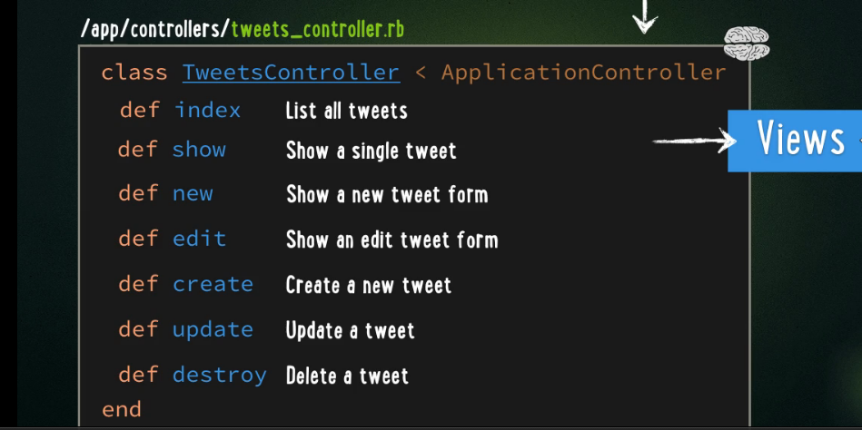
How about for tweets: Different URI invoked methods in our Controller class
Each URI type will invoke a different predefined method in the Controller class. YOU HAVE to write the code in your Controller class for each method.
Example URI /tweets/2/edit will invoke edit method
Remember add
resources :tweets
to routes.rb to quickly add all the maps related to these methods

Slide 39
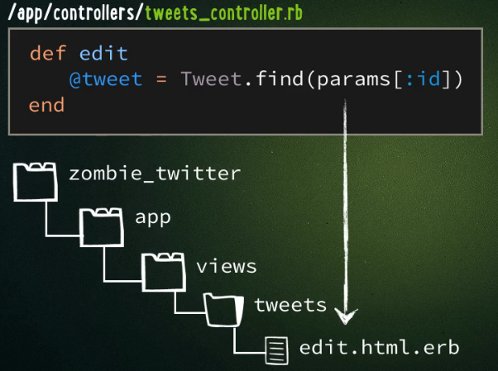
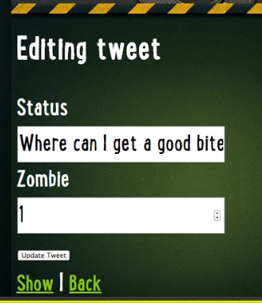
Let’s add the edit method to Controller
URI /tweets/2/edit
edit method inside controller
View edit.html.erb
Fill in form fields with values
@tweet.status
@tweet.zombie_id
By DEFAULT the edit method at end will call the edit view edit.html.erb

Slide 40
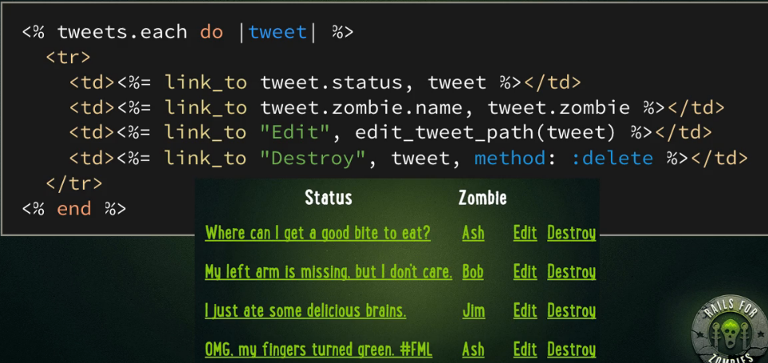
Can bring up edit method with tweets/1/edit OR the case where hit the Edit link in the following view we created before edit_tweet_path(tweet)
part of app/views/tweets/index.html.erb Which was View to list out all of the Tweets

Slide 41
Adding in Authentication
Sometimes you need to restrict who can invoke which methods in a Controller.
Example – you don’t want just ANY user to edit someone else’s Tweet.
SOLUTION: Simple Authentication --- which is built into Rails

Slide 42
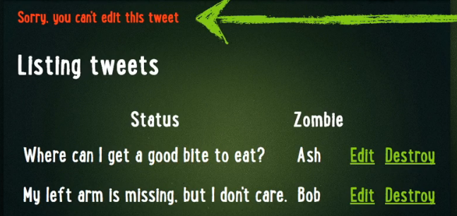
THE PROBLEM –AN EXAMPLE
Going back to our Zombie case---if user wants to try to edit someone else’s tweet THIS IS WRONG….we want response like

Slide 43
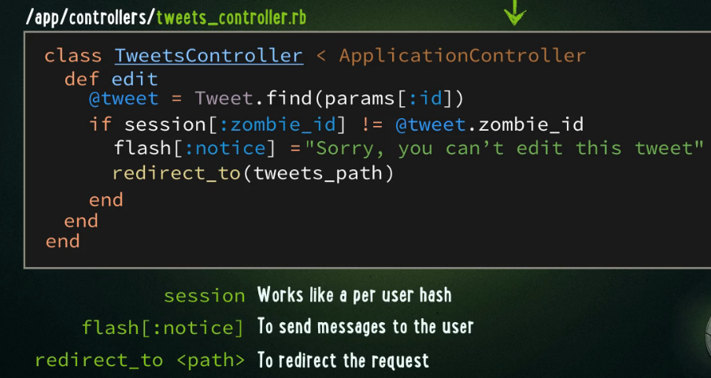
SOLUTION: Rails --- session[]
session is a per user hash array
Example, in our Zombie case
    session[:zombie_id] = id associated in THIS session with a user
How can we use this to change our Controller
Note: tweets_path = /tweets url
which invokes index method of TweetsController to display ALL the tweets

Slide 44
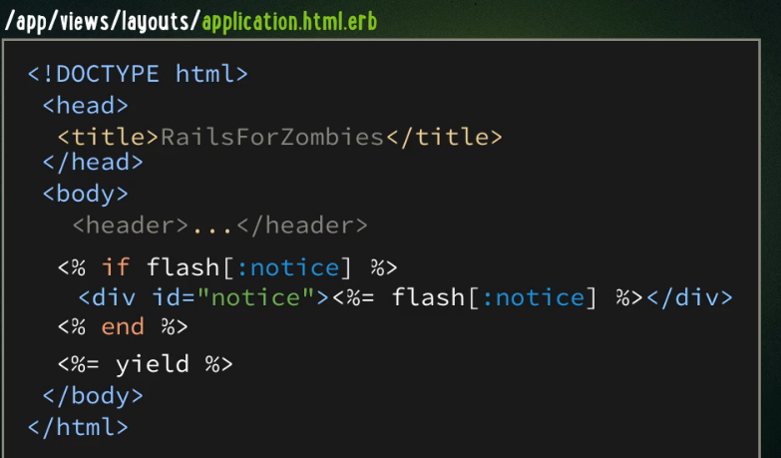
flash – setting messages – one way to display the previous flash
Note: tweets_path = /tweets url
They are NOT automatically displayed.
NOTE: previous code calls TweetController index method which will display all the tweets (invoking the index.html.erb) and remember it is wrapped by application.html.erb
We add code there to say that we display any flash message in a special <div> tag

Slide 45
What about other methods ---destroy, update, etc.
WELL YOU HAVE TO IMPLEMENT THEM.
GUESS WHAT --- some of the code may be the same. For example, edit, update and destroy all require you first lookup the tweet and then authenticate you are the correct user to perform this action on THAT tweet.
SOLUTION --- use Rails before_action command to group repeated code

Slide 46
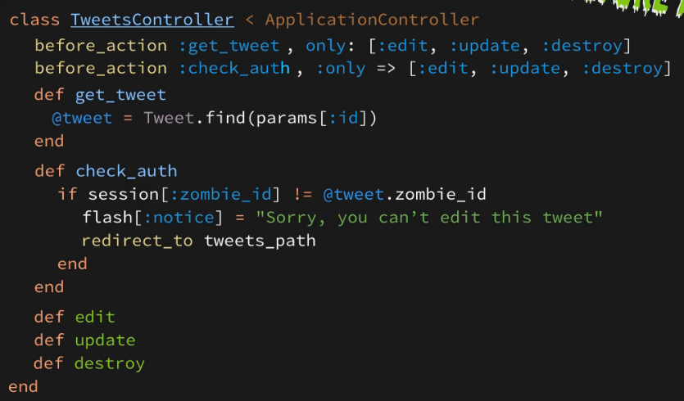
Reusing code and before_action
Here we create methods of code we want to use and then trigger which default methods (like edit, update, etc) might use them and invoke it prior to executing
Do this ONLY before the methods
edit, update, destroy

