Slide 1
MEAN/MERN stack
L. Grewe

Slide 2

What is ME(A/R)N
M = MongoDB → DATA solution
E = Express JS (for use with nodeJS) → Routing and ease of transactions (above simple NodeJS) , session management, server side
  A = AngularJS → Presentation layer ease (above simple NodeJS)
  R= ReactJS → Presentation layer ease (above simple NodeJS)
N = NodeJS → main language that Express and Angular built on and used for server-side programs, server side

Slide 3
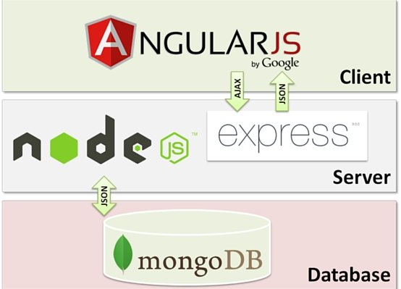

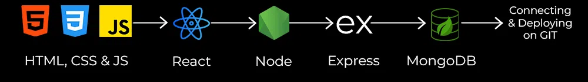
Another View
You can have MEAN/MERN applications or just MEN applications

Slide 4
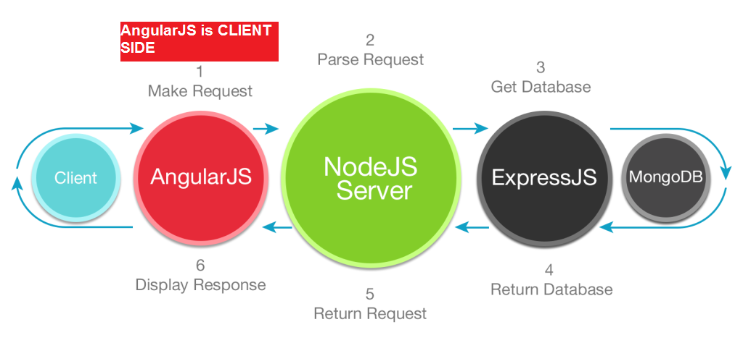
Another view
Here we can see how a user/client request is processed and response returned

Slide 5
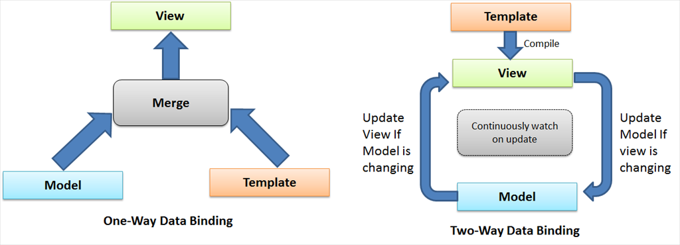
MEAN – ME(A/R)N or MEN??? when do you include AngularJS/ReactJS
Without Angular/React - MEN - on server the HTML, CSS, embedded client JS is created and delivered to the Client based on data on server --> Called 1 way data binding.
With AngularJS/React – MEA/RN- : Puts HTML together on CLIENT side based on data provided AND updates HTML if data changes (subscribes) and can also update the data if HTML changes (a push) --> Called 2 way data binding

Slide 6
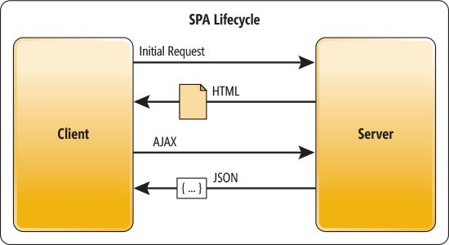
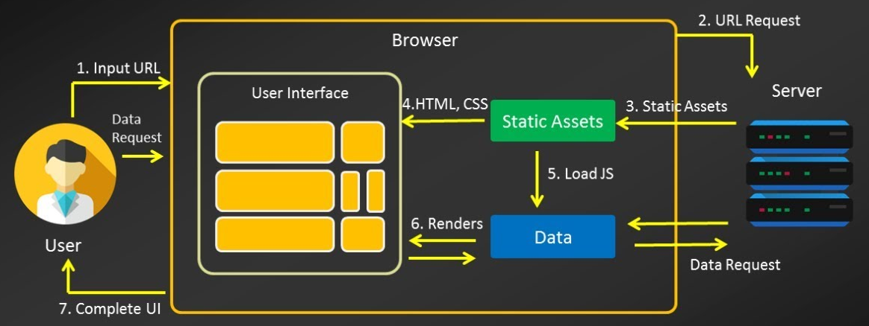
SPA: using AngularJS/React
What is a single page application?
SPA = Think of Yahoo! or Google Mail as examples.
  runs inside single page load, just updates part of the page as you need it.
  Positives: once you load it, it has fast response, moves some of computation to client side (in AngularJS/React)
  Negatives: longer to load then regular full responses from server apps, not indexed because crawlers typically don't execute the client side javascript (AngularJS/React) that build the page on client dynamically

Slide 7
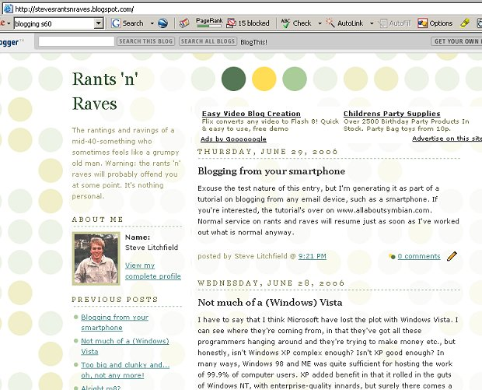
When MEN
need fast load time, want pages to be found by search engines, want to use analytics
  So any kind of backend processing would be good for MEN for sure
Example – a blog where you are serving different blog entries all the time

Slide 8
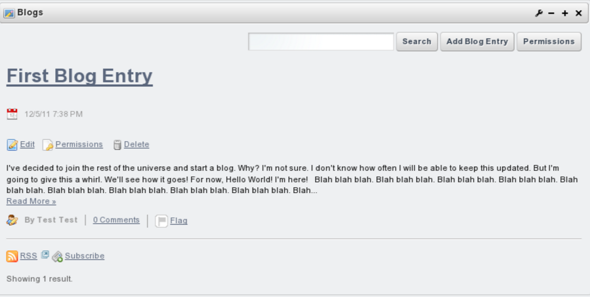
When MEA/RN
don't care about longer initial load time, but, want faster interactive use
Example: Admin interface of Blog where blogger creates new entries and manages old blog posts.

Slide 9
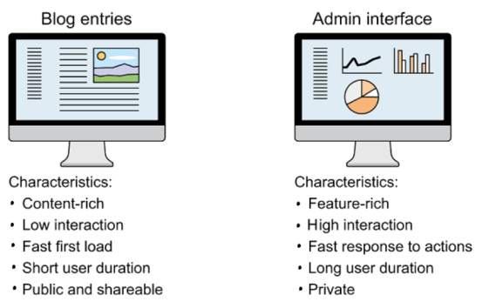
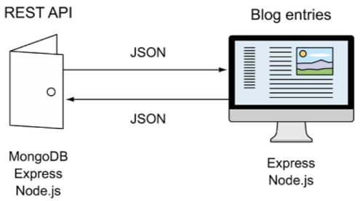
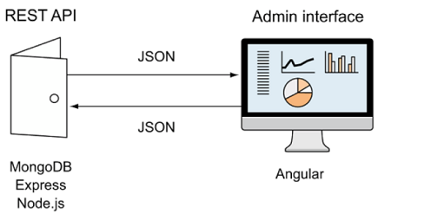
blog site
MEN
MEA/RN

Slide 10
A note React + Angular can be used for non-SPA front ends
Not to complicate the matter but, they are also used for non-SPA front-ends.
More discussion later

Slide 11
Solution???
Use MEN for part of your system and MEA/RN for other part(s).

