Slide 1
Express with Node
L. Grewe

Slide 2
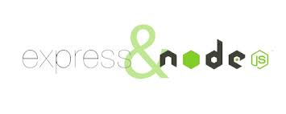
What does Express add to NodeJS
minimal and flexible Node.js web application framework that provides a robust set of features for web and mobile applications. Provides EASIER WAY (than just nodeJS).
What does the this mean?
Note: sometimes Express is thought of as minimalistic (there are other frameworks like Meteor that are more complex)

Slide 3
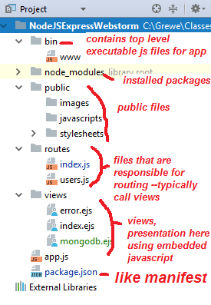
Feature 1
Project structure

Slide 4
FEATURE 1: It adds the project structure we saw before for NodeJS + Express
This kind of multi-folder architecture is sometimes called a “scaffolded app”
Note: even if you do not use an IDE but,
Create a NodeJS project using command line
npm tool you get a similar directory structure
This partitioning (towards MVC pattern) is a good one and helps with breaking up of code
Components which allows for more reuse, easier code, better growth/extensions –and is easier when working with a group.

Slide 5
Getting Express + NodeJS project
OPTION 1: create new NodeJS + Express project in WebStorm
        WATCH VIDEO
OPTION 2: (do 1 instead use Webstorm) if not using WebStorm IDE can create new NodeJS + Express project on command line by going to desired directory and typing
      npm install express-generator -g express nameOfApp
NOTE: you can’t easily add Express to an existing NodeJS directory ---as it completely changes
the filestructure

Slide 6
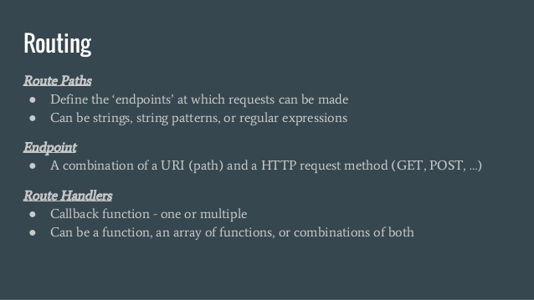
Feature 2
ROUTING

Slide 7
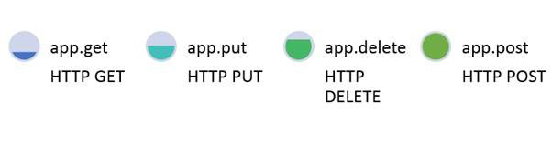
FEATURE 2: Express also basic routing
Routing is mapping URIs + Request Type -> code/static page
    Here are some method calls on the express instance that are related to HTTP request type
how application responds to client request to a particular endpoint, which is a URI (or path) and a specific HTTP request method (GET, POST, and so on).
Example: request for /getAllRoutes might map to the controller code located in controller/getAllRoutes.js

Slide 8
Where is the code for routing located
In a javascript file in the routes directory
In the following project →
there are 2 files index.js and
users.js that contain routing code

Slide 9
Routing Code-- what is this app object
In your code
after requiring
the express
module, you
declare an
instance of
express object
called app
simple index.js file
//require the Express module and call express
var express = require('express')
var app = express()
//Following declares URI path / will cause the message Hello World to be sent
app.get('/', function (req, res) {
res.send('Hello World!')
})
//application will listen for requests on port number 300
app.listen(3000, function () {
console.log('Example app listening on port 3000!')
})
Remember this inside
a routing file in routes directory

Slide 10
Examining the simple routing code
simple index.js file
//require the Express module and call express
var express = require('express')
var app = express()
//Following declares URI path / will cause the message Hello World to be sent
app.get('/', function (req, res) {
res.send('Hello World!')
})
//application will listen for requests on port number 300
app.listen(3000, function () {
console.log('Example app listening on port 3000!')
})
Remember this inside
a routing file in routes directory
Require express module→
declare app = express instance→
When request for ‘/’ comes in →
with request type = get then
send response text ‘Hello World!’

Slide 11

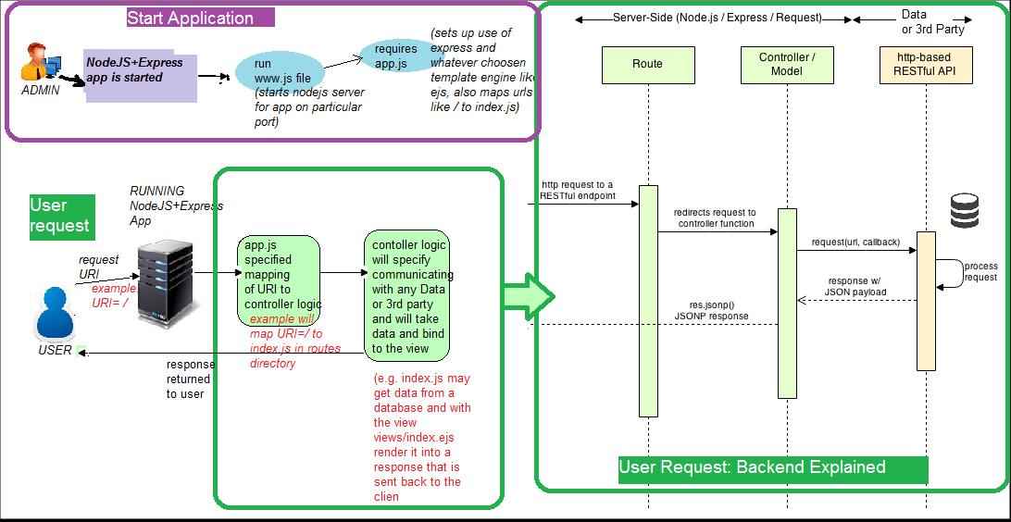
RUNNING: The basic flow of a Node+Express app
1) START APPLICATION: launch app and listens for requests at the specified port in www.js AND sets up routing maps as specified in the required app.js file (which in turn can call in different routing files in routes directory)
2) USER REQUEST COMES IN: using routing information invokes the appropriate controller logic found in routes and this can involve calling other js programs that communicate with Database/Data servers or 3rd party (like ups etc). Then the data (if any) is bound to a template (a view found in views directory) and rendered and the response is delivered to the user.

Slide 12
Here is example of a www.js file
#!/usr/bin/env node
/**
* Module dependencies.
*/
var app = require('../app'); //THIS will load the app.js file that sets up routing
var debug = require('debug')('nodejsexpresswebstorm:server');
var http = require('http');
/**
* Get port from environment and store in Express.
*/
var port = normalizePort(process.env.PORT || '3000');
app.set('port', port);
/**
* Create HTTP server.
*/
var server = http.createServer(app);

Slide 13
www.js file continued
/**
* Listen on provided port, on all network interfaces.
*/
server.listen(port);
server.on('error', onError);
server.on('listening', onListening);
/**
* Normalize a port into a number, string, or false.
*/
function normalizePort(val) {
var port = parseInt(val, 10);
if (isNaN(port)) {
// named pipe
return val;
}
if (port >= 0) {
// port number
return port;
}
return false;
}

Slide 14
www.js file continued
/**
* Event listener for HTTP server "error" event.
*/
function onError(error) {
if (error.syscall !== 'listen') {
throw error;
}
var bind = typeof port === 'string'
? 'Pipe ' + port
: 'Port ' + port;
// handle specific listen errors with friendly messages
switch (error.code) {
case 'EACCES':
console.error(bind + ' requires elevated privileges');
process.exit(1);
break;
case 'EADDRINUSE':
console.error(bind + ' is already in use');
process.exit(1);
break;
default:
throw error;
}
}
/**
* Event listener for HTTP server "listening" event.
*/
function onListening() {
var addr = server.address();
var bind = typeof addr === 'string'
? 'pipe ' + addr
: 'port ' + addr.port;
debug('Listening on ' + bind);
}

Slide 15
app.js file: Routing example
var cool = require('cool-ascii-faces');
var express = require('express');
var app = express();
var pg = require('pg');
//map URI /nodeMongoDBTest to nodeMongoDBTest.ejs in the sub-directory pages
app.get('/', function(request, response) { response.render('pages/index'); });
//map URI /nodeMongoDBText to the page pages/nodeMongoDBTest
app.get('/nodeMongoDBTest', function(request, response) { response.render('pages/nodeMongoDBTest'); });
//when URI /cool requested call the cool function from the cool module required at top
app.get('/cool', function(request, response) { response.send(cool()); });
//when URI /times requested call the inline function which increments #times run
app.get('/times', function(request, response) {
var result = ''
var times = process.env.TIMES || 5
for (i=0; i < times; i++)
result += i + ' ';
response.send(result);
});

Slide 16
Some routing code examples
NOTE: for each request type (GET, POST, PUT, DELETE, etc) there is a method call on our express object app
generic example for POST request:
app.post(‘URI’, function(req, res) {
res.send('Hello World!')
});
Remember this inside
a routing file in routes directory

Slide 17
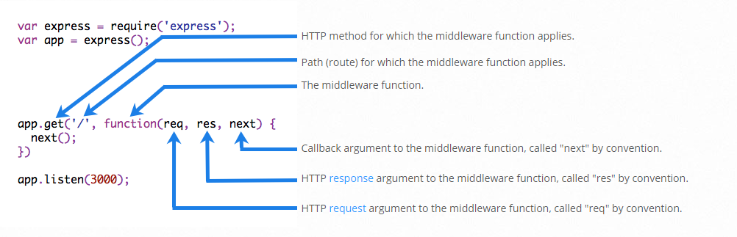
Decomposing the app.get call
Remember this inside
a routing file in routes directory

Slide 18
What is the request and response objects in our app.get(‘uri’, function(request, response, next) method
The req object represents the HTTP request and has properties for the request query string,
parameters, body, HTTP headers, and so on.
Request Object req.params.name_of_param For example: app.get('/user/:id', function(req, res) { res.send('user ' + req.params.id); }); But you could just as well have: app.get('/user/:id', function(request, response) { response.send('user ' + request.params.id); }); req.baseUrl, req.body, req.cookies (req.cookies.name_of_cookie), req.hostname, req.path, etc see documentation
var express = require(‘express’);
var app = express();
Remember this inside
a routing file in routes directory

Slide 19

More on the request object
var express = require(‘express’);
var app = express();
app.get('/', function(req, res) { ***
Remember this inside
a routing file in routes directory
Body of Request = if you want to see the body of the request for printing it out do the following console.log(JSON.stringify(req.body)); EXAMPLE (handler code): var body = JSON.stringify(req.body); var params = JSON.stringify(req.params); res.send("recieved your request!</br>" + "parameters: " + params + "</br>URL:" + req.url + "body: " + body); will produce
req.body
Contains key-value pairs of data submitted
in the request body.
HTML Form say: to: | Response
hi
Express forms

Slide 20
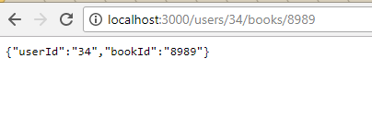
Example passing parameters in URL
var express = require(‘express’);
var app = express();
Suppose you want to send parameters in URL such as
http://localhost:3000/users/34/books/8989
Where 34 is the id of the user and the book is 8989
    app.get('/users/:userId/books/:bookId', function (req, res) {
    res.send(req.params) } );
Result is
Remember this inside
a routing file in routes directory

Slide 21
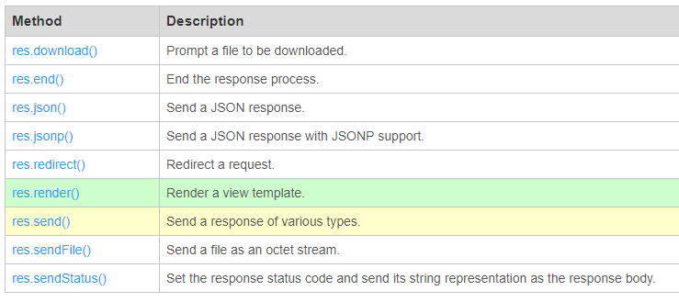
The response object
var express = require(‘express’);
var app = express();
app.get('/', function(req, res) { ***
Has a series of the expected useful methods in building a response like:
res.render, res.send, res.cookie, res.redirect, and many more

Slide 22
What if you want all request types to respond the same way
var express = require(‘express’);
var app = express();
app.all('/secret', function (req, res) {
console.log('Accessing the secret section ...');
});
Remember this inside
a routing file in routes directory
the following handler is executed for requests to the route “/secret”
whether using GET, POST, PUT, DELETE, or any other
HTTP request method supported in the http module.

Slide 23
Multiple handler functions –a chain of them defined to execute in response to a request
var express = require(‘express’);
var app = express();
var cb0 = function (req, res, next) {
console.log('CB0');
next(); }
var cb1 = function (req, res, next) {
console.log('CB1');
next(); }
var cb2 = function (req, res) {
res.send('Hello from C!'); }
// DEFINE MULTIPLE handler functions for the URI /example/c app.get('/example/c', [cb0, cb1, cb2]);
Remember this inside
a routing file in routes directory

Slide 24
Routing Patterns
var express = require(‘express’);
var app = express();
/acd and /abcd.
    app.get('/ab?cd', function (req, res) { res.send('ab?cd') })
/abcd, abbcd, abbbcd, and so on.
    app.get('/ab+cd', function (req, res) { res.send('ab+cd') })
/abcd, abxcd, abRANDOMcd, ab123cd, and so on.
    app.get('/ab*cd', function (req, res) { res.send('ab*cd') })
/abe and /abcde.
    app.get('/ab(cd)?e', function (req, res) { res.send('ab(cd)?e') })
Remember this inside
a routing file in routes directory

Slide 25
more Routing Patterns
var express = require(‘express’);
var app = express();
match anything with an “a” in the route name.
    app.get(/a/, function (req, res) { res.send('/a/') })
Remember this inside
a routing file in routes directory

Slide 26
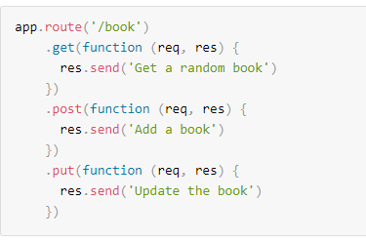
app.route()
var express = require(‘express’);
var app = express();
You can create chainable route handlers for a route path for different request types
Remember this inside
a routing file in routes directory

Slide 27
Multiple Routing files
Modularizing your routes for better organization

Slide 28
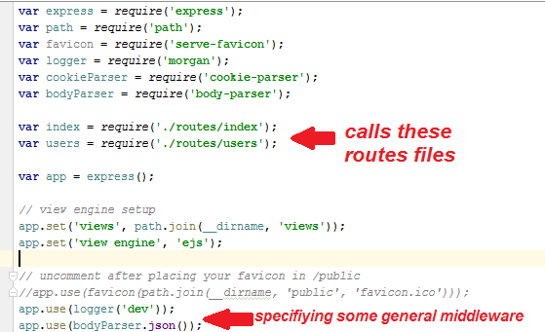
Here is example of app.js file that instead of mapping paths to controller codes loads specific routing files index .js and users.js
Notice it loads
(requires) a number
of routes files
And later it
Specifies some
“middleware”
functions it will
execute

Slide 29
Contents of these “sub” routing files uses a class called Router to do the mapping
Example inside say dogs.js routing file
var express = require('express');
var router = express.Router();
router.get('/', function(req, res) {
res.send('GET handler for /dogs route.');
});
This looks the same as the previous routing mapping code in our app.js main routing file examples

Slide 30
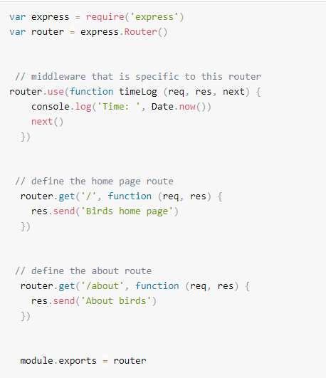
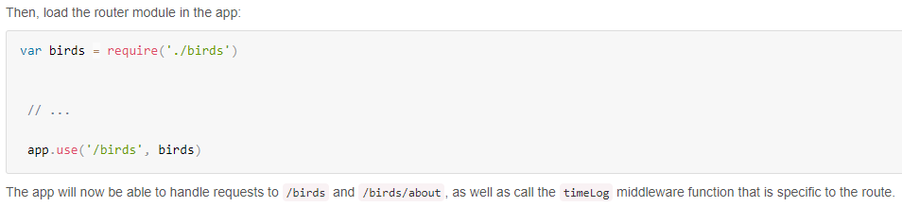
express.Router --another example
birds.js routing file
sub routing uses express.Router() object
_{Main apps.js routing file}
first loads up the sub routing file birds.js
then says it will use that FILE and its mappings with any URL path starting with /birds

Slide 31
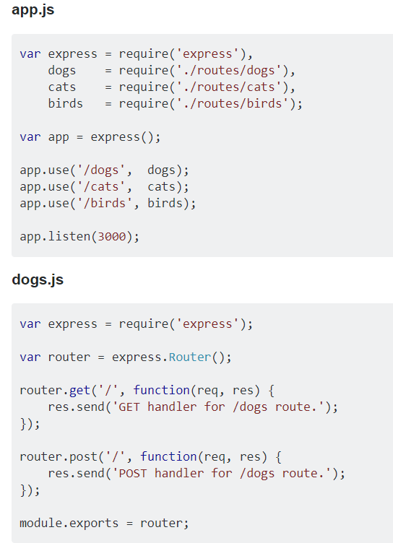
Another multi-routing file example
_{Main apps.js routing file}
first loads up the sub routing file dogs, cats, birds
then says it will use that FILE and its mappings with any URL path starting with /dogs uses dogs.js file
_{/birds uses birds.js file}
_{/cats uses cats.js file}
dogs.js routing file
sub routing uses
express.Router() object

Slide 32
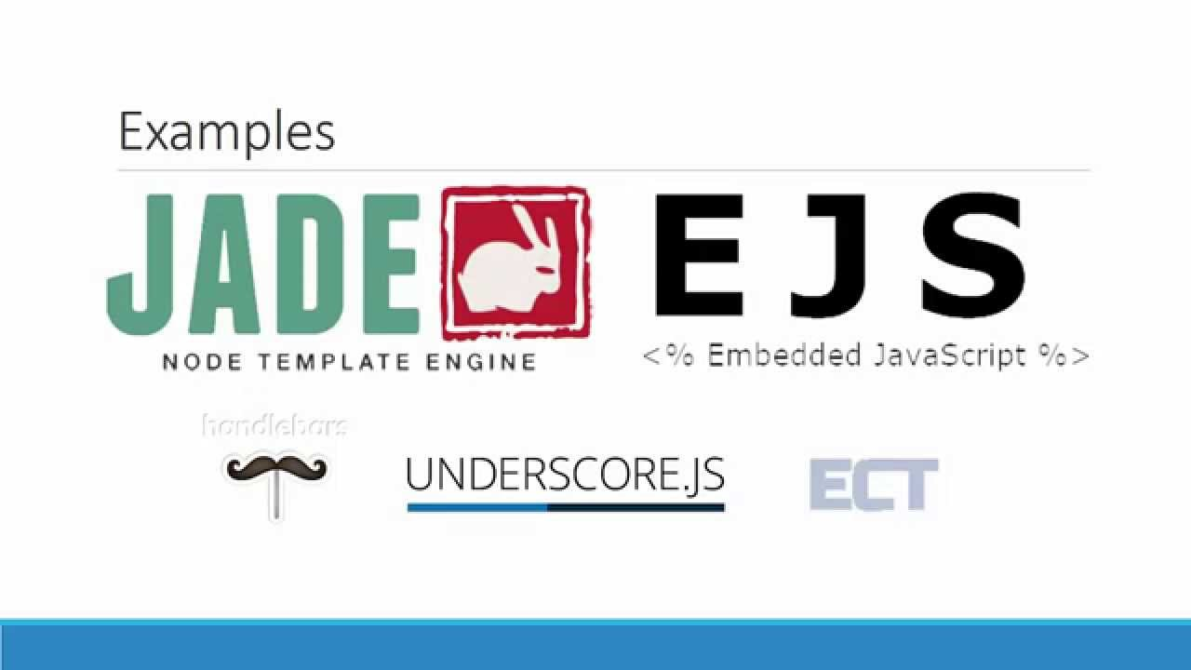
Feature 3
TEMPLATE ENGINE

Slide 33
FEATURE 3: Supports Template Engines
templates let you embed backend variables into a file and when requested it renders the file with the variables set to their actual values
uses EJS or Jade/Pug (template engine) and others are supported.
WE WILL HAVE A FUTURE lecture on this

Slide 34
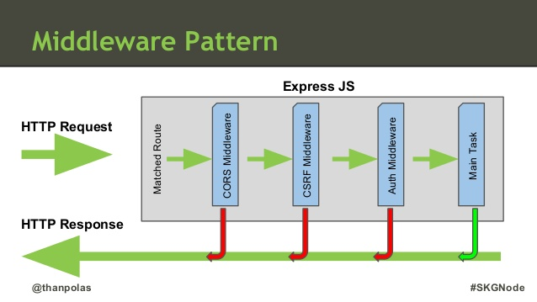
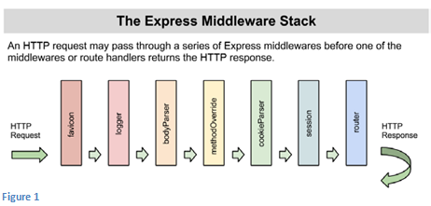
Feature 4
MIDDLEWARE

Slide 35
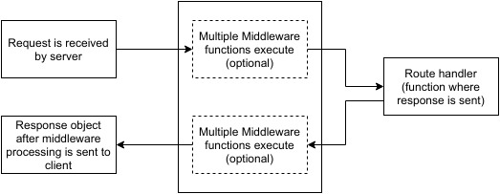
FEATURE 4: Middleware
A number of functions executed PRIOR to the handler
or at the end of handler code.

Slide 36
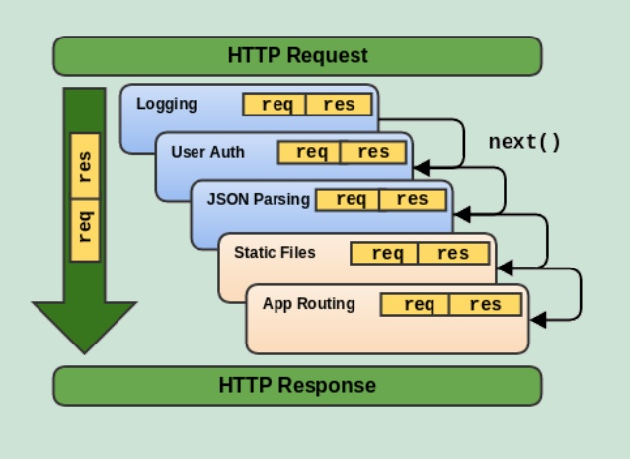
Middleware
function which takes as parameters: req, res and next function

Slide 37
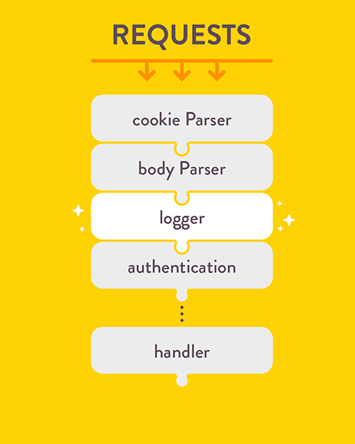
Middleware examples
Has code to process requests &
perform other middleware operations:
    Cookies
    Body parsing
    Logging
    Authentication
Your code must declare their use
var app = express();
app.use(cookieParser());
app.use(bodyParser());
app.use(logger());
app.use(authentication());
app.get('/', function (req, res) { // ...});
app.listen(3000);

Slide 38
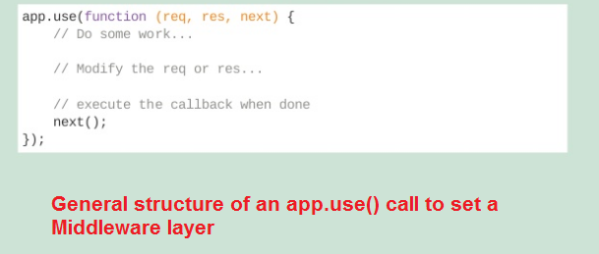
What is app.use() ????
app.use() =
specify middleware
to execute (can call
multiple times)
EXAMPLE 1: middleware that is called ALWAYS regardless of URI request
var express = require('express');
var app = express();
//Simple request time logger
app.use(function(req, res, next){
console.log("A new request received at " + Date.now());
//This function call is very important. It tells that more processing is
//required for the current request and is in the next middleware function/route handler. next(); });
Remember this inside
a routing file in routes directory

Slide 39
app.use() example 2
if have a get request for / will first execute myLogger then go to app.get handler function that sends
‘Hello World1’
var express = require('express');
var app = express();
var myLogger = function (req, res, next) { console.log('LOGGED');
next(); }
app.use(myLogger);
app.get('/', function (req, res) { res.send('Hello World!') });
app.listen(3000)

Slide 40
app.use() example 3
var express = require('express');
var app = express();
//Middleware function to log request protocol
app.use('/things', function(req, res, next){
console.log("A request for things received at " + Date.now());
next(); });
//Route handler that sends the response
app.get('/things', function(req, res){ res.send('Things'); });
app.listen(3000);
where you call middleware only if URI is /things
then will go next to app.get handler code which
sends ‘Things’ string

Slide 41
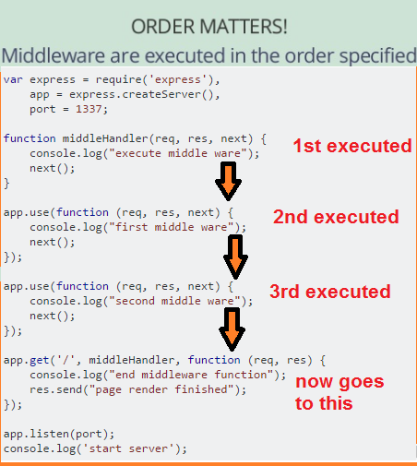
Order in app.use() is important
In order of
appearance
of code in
route file

Slide 42
A specific middle ware example
FORM PROCESSING

Slide 43
Middleware – Form Processing
NEW package.json
{
"name": "nodejsexpresswebstorm",
"version": "0.0.0",
"private": true,
"scripts": {
"start": "node ./bin/www"
},
"dependencies": {
"body-parser": "^1.17.2",
"cookie-parser": "~1.4.3",
"debug": "~2.6.3",
"ejs": "~2.5.6",
"express": "~4.15.2",
"mongodb": "^2.2.31",
"morgan": "~1.8.1",
"multer": "^1.3.0",
"serve-favicon": "~2.4.2"
}
}
STEP 1: install body-parsers and multer packages
  *** assumming you have already created a basic express applicaiton project *****
  install the body-parser(for parsing JSON and url-encoded data) and multer(for parsing multipart/form data) middleware.
  GO to your terminal window in application and type
    npm install --save body-parser multer

Slide 44
Form Processing – Body parser
STEP 2: Load the middleware
This is used to parse the body of requests which have payloads attached to them. To mount body parser, we need to install it using npm install --save body-parser and to mount it, include the following lines in your index.js:
To view all available
options for body-parser,
visit its github page.
NOTE: URL Encoding has
to do with enoding strings so can be sent as part of URL (like encoding blank space) –so you need to receive & “decode” URL encoded strings
var bodyParser = require('body-parser');
//To parse URL encoded data
app.use(bodyParser.urlencoded({ extended: false }));
//To parse json data
app.use(bodyParser.json());
First parses for url encoding
THEN parses for JSON

Slide 45
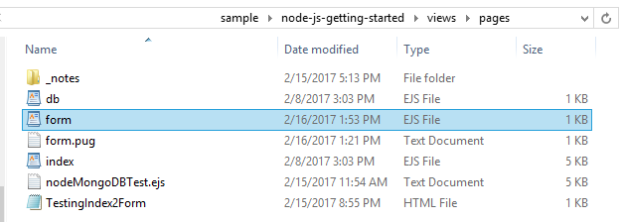
From processing – example
<!DOCTYPE html>
<html>
<head> Testing Form data</head>
<body>
hello <br><br>
<form action="/processForm", method="POST“>
<div>
<label> Say</label>
<input type="text" name="say" value="hi"> <br/>
<label> TO:</label>
<input type="text" name="to" value="express forms">
<input type="submit" value="send greetings">
</div>
</form> </body> </html>
This is the form

Slide 46
FEATURE 5
Specification of static files location (for potentially faster and direct serving)

Slide 47
FEATURE 5: separates static files & serves them directly through URIs
below indicates the public subdirectory in main application directory contains the static files
    app.use(express.static('public'))
Now, you can load the files that are in the public directory: (assuming listing at port 3000)
    http://YOURSERVER:3000/images/kitten.jpg
    http://YOURSERVER:3000/css/style.css
    http://YOURSERVER:3000/js/app.js
    http://YOURSERVER:3000/images/bg.png
    http://YOURSERVER:3000/hello.html
This code is in the www.js
file –the main app executable code
Express looks up the files relative to the static directory, so the name of the static directory is not part of the URL.

Slide 48
More static files
To use multiple static assets directories, call the express.static middleware function multiple times:
    app.use(express.static('public'));
    app.use(express.static('files'));
Virtual URI:
  To create a virtual path prefix (where the path does not actually exist in the file system) for files that are served by the express.static function, specify a mount path for the static directory, as shown below:
      app.use('/static', express.static('public'))
      Now you can execute URIs
      http://localhost:3000/static/images/kitten.jpg
This code is in the www.js
file –the main app executable code

Slide 49
There are more features
That’s for your future reading or reading as you need.

