Slide 1
Data Today
L. Grewe

Slide 2
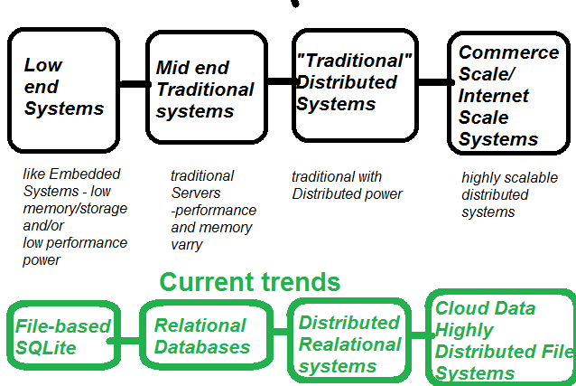
Whole range of solutions

Slide 3
This class
Focus on learning Mid-end Traditional Data Systems = Relational Database Systems
Note: if we do an mobile project you will have the option of learning “low-end systems” data.

Slide 4
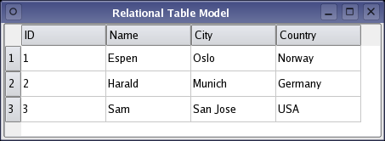
What are Relational Databases?
Uses construct of a “Table”
Uses Relational Math to manipulate tables.

Slide 5
Relational Table
Here we have a CUSTOMER Table
With 4 keys/columns
ID
Name
City
Country
EACH row in the table is a DATABASE ENTRY
Example: Entry = (ID=1,Name=Espen, City = Olso, Country = Norway)
Each Column is represented by a Key name.
One or more Keys can serve as a unique identifier (called a primary key)
Above ID is the primary key (no 2 entries can have the same ID value)

Slide 6
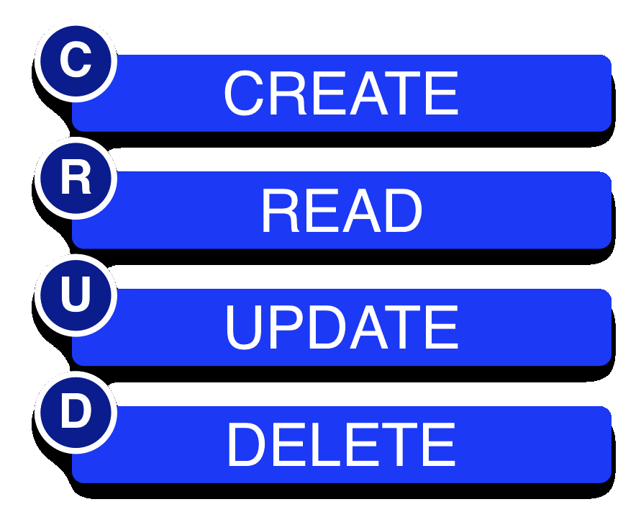
CRUD – the essence of what we want to do in a Relational Database Management System
Create
Read
Update
Delete

Slide 7
Output of a CRUD operation is another TABLE
The output of a CRUD operation is either the original table (select * from TABLENAME) or some sub-set of the table (select * form TABLENAME where ….)
CRUD operation

Slide 8
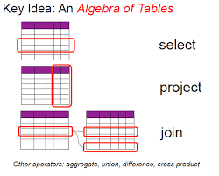
Some of the CRUD operations in Relational Databases done w/Relational Math
We are not going to worry about HOW Relational Databases accomplish the CRUD operations but, it is based on concepts form Relational math---set theory
Select is like Read operation.

Slide 9
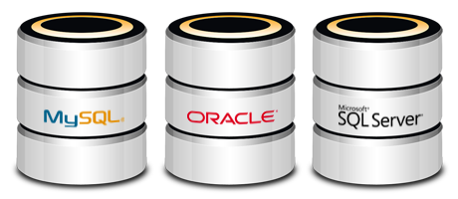
There are many Relational Databases
….here are a few

Slide 10
Most Relational Databases use SQL
SQL - structured query language is a language of commands that implement CRUD operations
We will have a separate lecture on SQL

Slide 11
More….
So there is much more to understanding todays “Data Solutions”…..
To learn more consider taking a class like Web Systems featuring cloud, or distributed systems or…
But, here are a few more slides & things to think about.

Slide 12
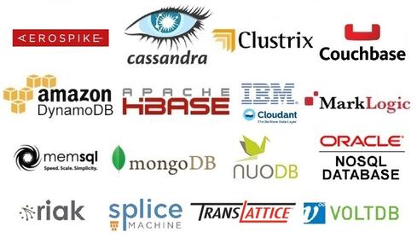
NO SQL Database –a trend
There is a movement to avoid some of the “Heaviness” of Relational SQL based databases --- that has lead to the creation of NO SQL databases
Example MongoDB (and others)

Slide 13
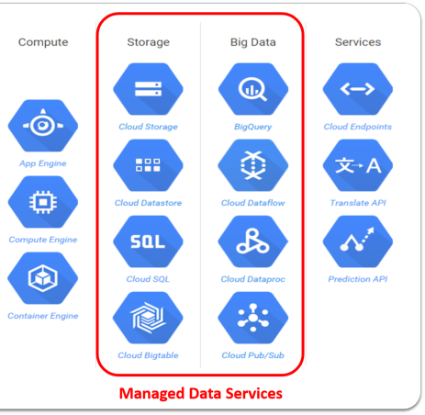
Differentiate solutions not based on performance /system level –but on kind of data
Some other differences between data solutions –are their intent –or rather the kind of data they store and serve

Slide 14
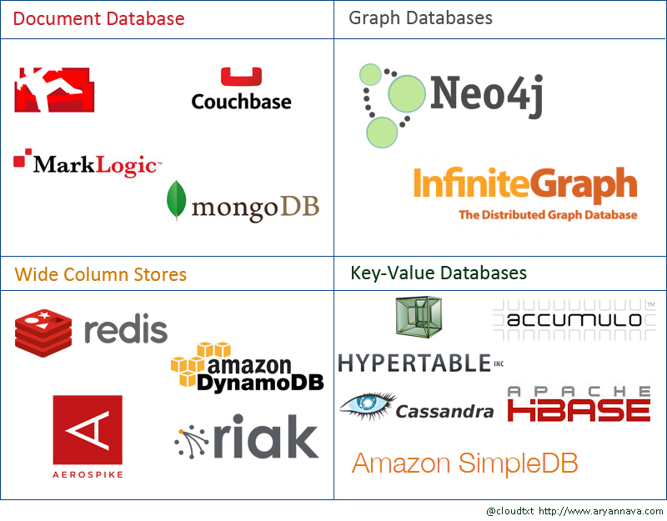
Differentiate based on technologies used

Slide 15
Cloud Data Solutions.....many
Cloud Databases: AWS RDS, Google Cloud SQL, Azure SQL
Serverless Databases: AWS DynamoDB, GoogleFirebase, FaunaDB
Hybrid Approaches: Combining SQL & NoSQL in cloud-based ecosystems

Slide 16
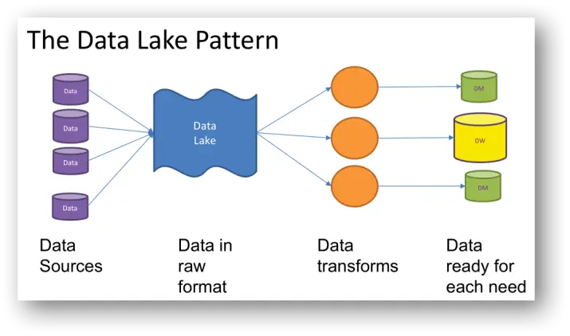
Data Lakes
What is a Data Lake?
A centralized repository that allows you to store all structured and unstructured data at any scale.
Data is stored in its raw format, without the need for predefined schemas.
AWS Lake Formation
Azure Data Lake Storage
Google Cloud Storage
AWS S3 + Glue*
Cost-effective: Data lakes can be cost-effective because they are built on inexpensive object storage.
Flexible: Data lakes can be used for any type of data, including operational, time-series, and near-real-time data.
*data catalog and ETL (Extract, Transform, Load) engine, enabling schema discovery, metadata management, and data transformation.
Feature | Data Warehouse | Data Lake
Data Type | Structured (SQL-based) | Structured & Unstructured
Schema Enforced | Before Data Storage | After Data Storage (Schema-on-read)
Cost | Expensive (Compute-Intensive) | Cost-effective (Storage-based)
Performance | Optimized for analytics | Optimized for large-scale storage
Use Cases | BI, Reporting | Machine Learning, AI, IoT

Slide 17
Real-Time Data Processing Technologies
Apache Kafka – Event streaming
Apache Flink – Real-time processing
AWS Kinesis – Serverless real-time ingestion
Use Cases
Stock Market Transactions
Financial Fraud Detection
IoT Sensor Data Processing
Feature | Streaming Data | Batch Processing
Processing Time | Real-time (ms) | Delayed (mins/hours)
Data Size | Continuous | Large chunks
Use Cases | Fraud detection, IoT | Reports, backups

Slide 18
Data + Security on Cloud
AWS Key Management Service (KMS) – Encrypts data at rest and in transit.
AWS Identity and Access Management (IAM) – Controls user permissions and access.
AWS Shield – Protects against DDoS attacks.
AWS Macie – Uses AI to detect sensitive data (e.g., PII, financial data).
AWS Audit Manager – Automates security audits and compliance tracking.
AWS Security Hub – Centralized security monitoring across AWS services.
🔗 More AWS Security Solutions: https://aws.amazon.com/security/
Google Cloud Key Management (KMS) – Encrypt and manage cryptographic keys securely.
Google Cloud IAM – Manage user permissions and enforce least privilege access.
Google Cloud Armor – Protects applications from DDoS attacks and provides web application firewall (WAF) capabilities.
Google Security Command Center – Centralized threat detection and security posture management.
Google Cloud Data Loss Prevention (DLP) – Detect and protect sensitive data across structured and unstructured sources.
Google Chronicle – AI-powered security analytics for cyber threat detection and real-time threat hunting.
🔗 More Google Cloud Security Solutions: Google Cloud Security

