Slide 1

Internet Scale Systems
L. Grewe

Slide 2
What do I mean?
Examples include
Web, Email, Search, content delivery networks (e.g., Akamai, and Limelight), IPTV, P2P content distributions (e.g., BitTorrent, Limewire, PPLive), multimedia/social networks (e.g., skype, facebook, myspace), and cloud computing (e.g., Amazon EC, Google App Engine, and Microsoft Azure cloud services).
Applications that have such a scale that a single application will use as many as hundreds of thousands of servers.

Slide 3
Some issues
Server scaling
adaptive, open clients
Scalability and reliability
service-oriented software design
cloud computing paradigms
protocol specification
performance modeling
debugging and diagnosis
deployment and licensing.

Slide 4
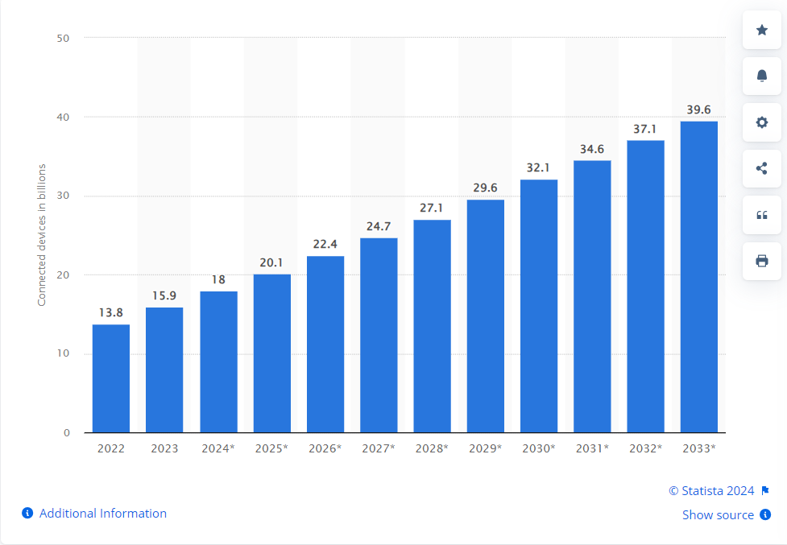
Growth of the Internet in Terms of Number of IoT devices

Slide 5
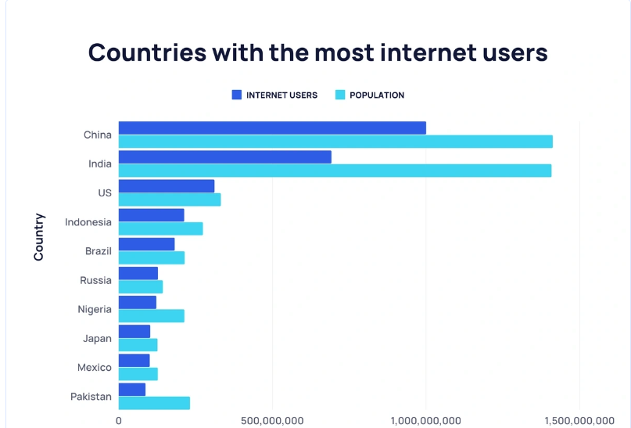
Users –some global info
From https://explodingtopics.com/blog/countries-internet-users

Slide 6
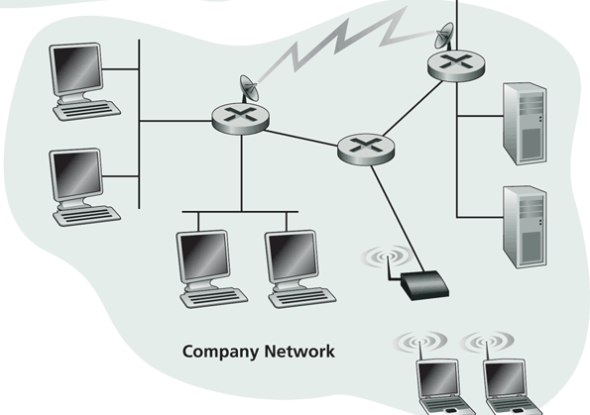
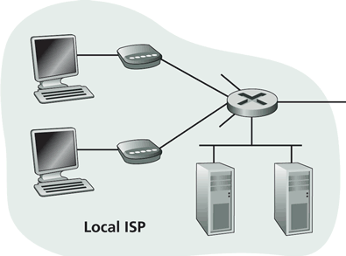
Internet Physical Infrastructure
Residential access
Cable
Fiber
DSL
Wireless
ISP
Backbone ISP
ISP
The Internet is a network of heterogeneous networks
Each individually administrated network is called an Autonomous System (AS)
Campus access, e.g.,
Ethernet
Wireless

Slide 7
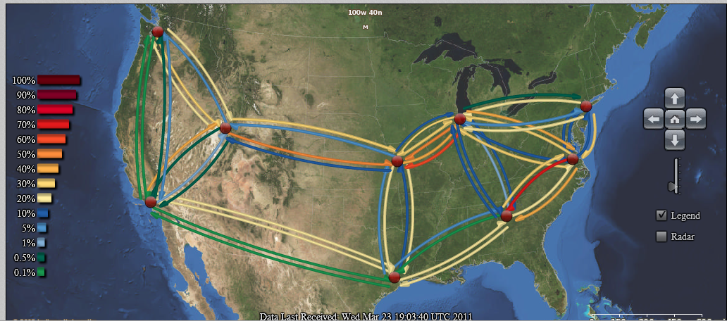
Us Traffic
http://atlas.grnoc.iu.edu/atlas.cgi?map_name=Internet2%20IP%20Layer

Slide 8
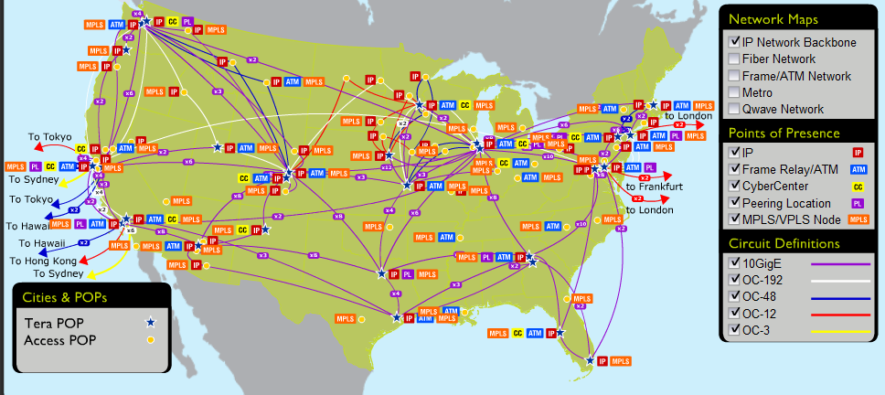
Qwest Backbone Map
Old example

Slide 9
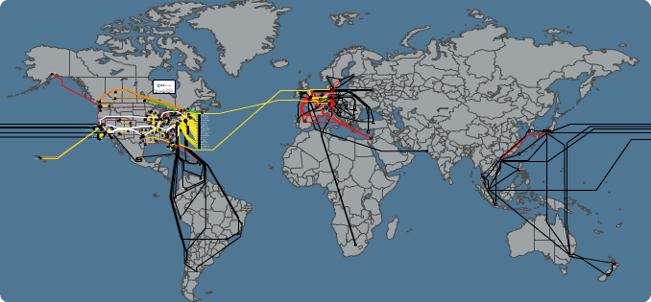
ATT Global Backbone IP Network
From http://www.business.att.com --- OLD

Slide 10
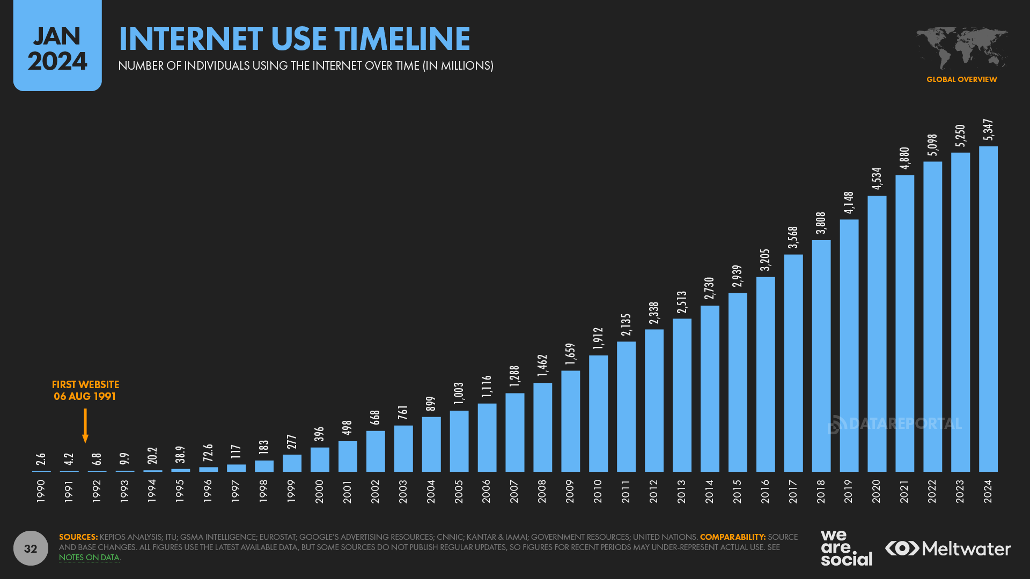
Traffic
Source:https://datareportal.com/reports/digital-2024-deep-dive-the-state-of-internet-adoption

Slide 11
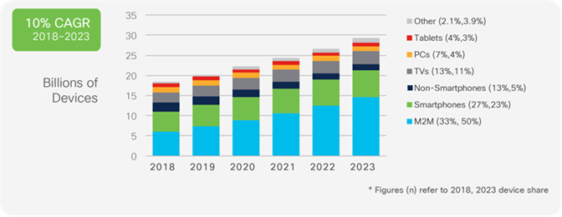
Where from?
Cisco -2023
report

Slide 12
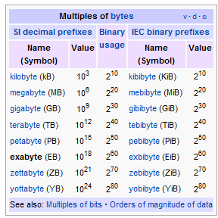
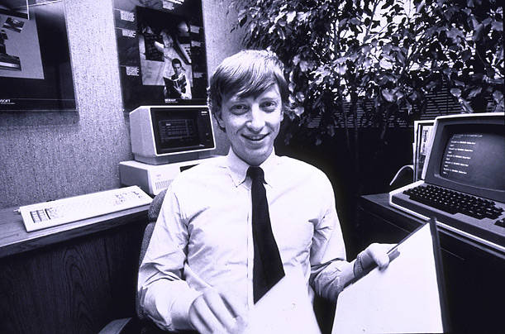
How Much Data?
2023 – Google handles 40,000 Petabytes Of Data On A Daily Basis
640K ought to be enough for anybody.
1 PB = 1000 TB
1EB = 1000 PB

Slide 13
Processing Examples
Crawling, indexing, searching, mining the Web
Ecommerce transactions
Software as service
…

Slide 14
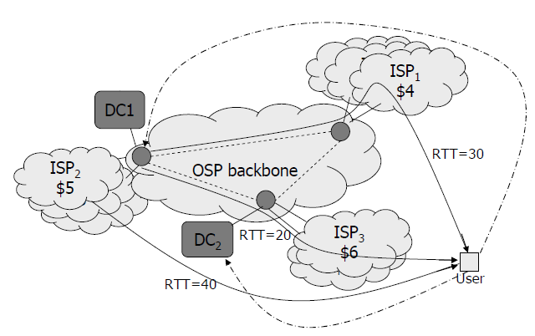
Large Data Centers
One idea/ trend: centralization of computing resources in large data centers
Necessary ingredients: space +?
What do Oregon, Iceland, and abandoned mines have in common?
Major design point: scale out, not scale up

Slide 15
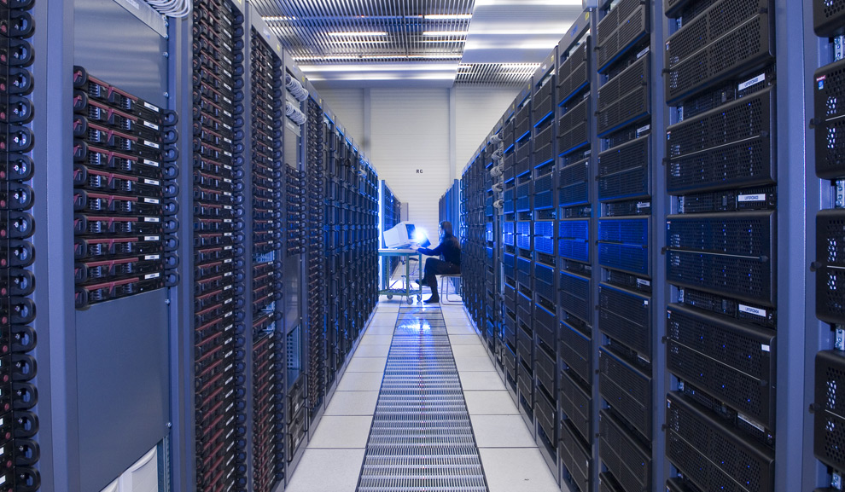
Maximilien Brice, © CERN

Slide 16
Evolving Computing Models
Do it yourself (build your own data centers)
Utility computing → IaaS
Why buy machines when you can rent cycles?
Examples: Amazon’s EC2, GoGrid, AppNexus
Platform as a Service (PaaS)
Give me nice API and take care of the implementation
Example: Google App Engine
Software as a Service (SaaS)
Just run it for me!
Example: Gmail; MS Exchange; MS Office Online

Slide 17
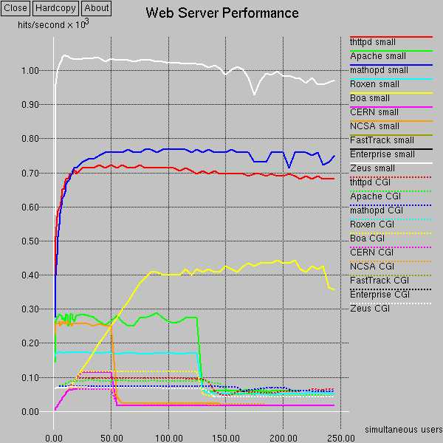
Programming Architecture Matters
Performance vs. software extensibility
<old numbers

Slide 18
Software Architecture Matters
It all boils down to…
Divide-and-conquer (to the grid?)
Throwing more hardware at the problem as the problem grows bigger

Slide 19
Divide and Conquer
“Work”
Partition
w₁
w₂
w₃
“worker”
“worker”
“worker”
r₁
r₂
r₃
Combine
“Result”
It is simple to state, hard to master…

Slide 20
Different Workers
Where are the workers?
Different threads in the same core
Different cores in the same CPU
Different CPUs in a multi-processor system
Different machines in a distributed system (grid)
Many design issues
Which worker does what?
How do the workers communicate/coordinate?
What if some workers die or are separated from others?

Slide 21
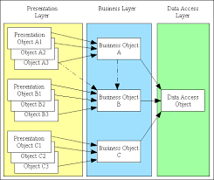
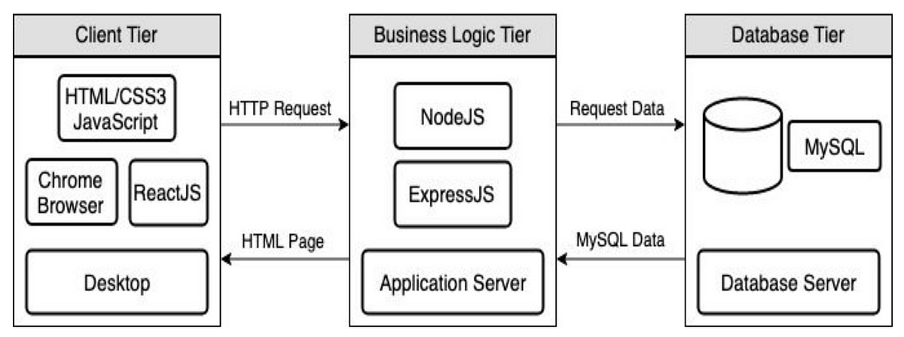
Example Architecture: 3 Tier Architecture
Stateless frontend
Soft state middle tier containing application logic and common services
Backend persistent storage

Slide 22
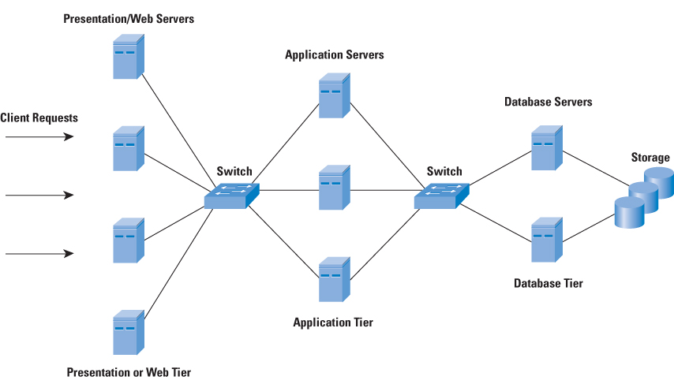
More 3 tier ideas/images
Traditional –from Cisco

Slide 23
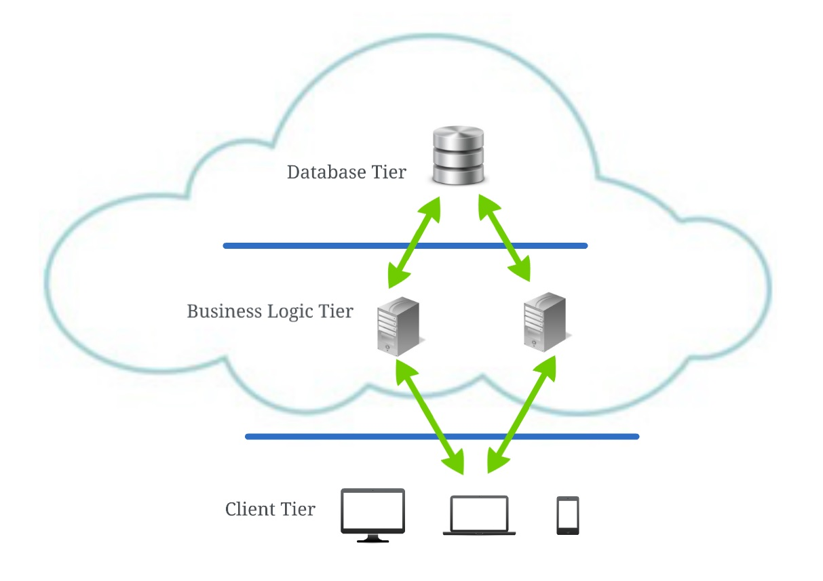
More 3 tier ideas/images
Moving into cloud

Slide 24
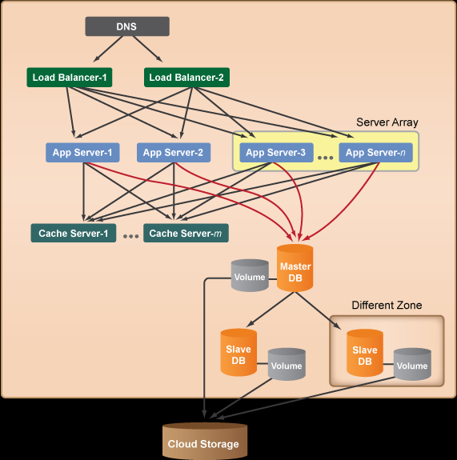
More 3 tier ideas/images
Thinking Cloud Storage

Slide 25
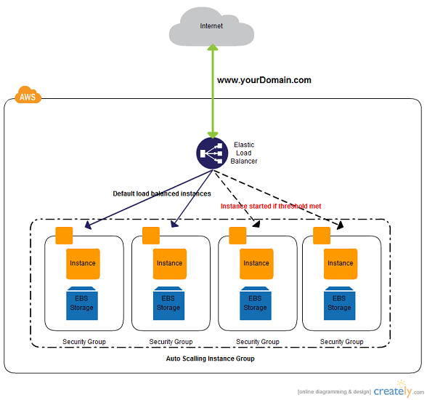
More 3 tier ideas/images
Moving into cloud
IaaS

Slide 26
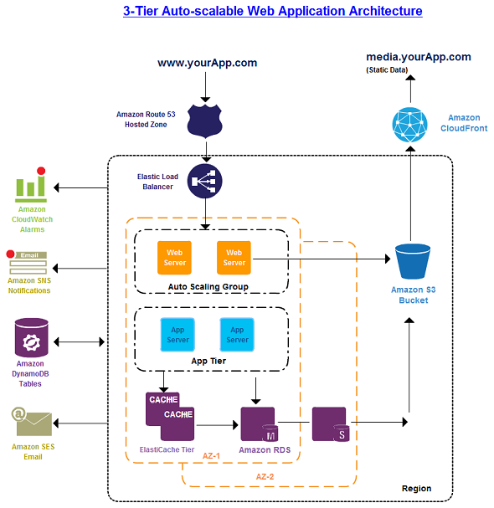
More 3 tier ideas/images
Moving into cloud
IaaS – here feature Amazon

Slide 27
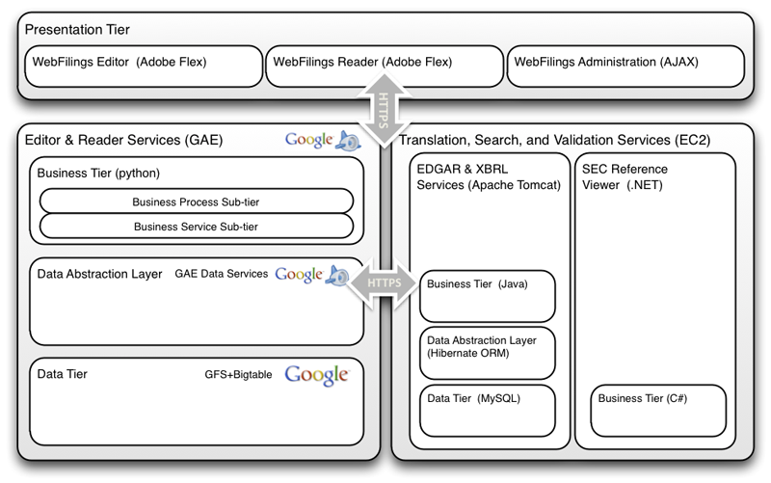
3 Tier GAE and Amazon mix
For WebFilings.com (see http://googleappengine.blogspot.com/2010/08/webfilings-streamlines-sec-reporting.html)

Slide 28
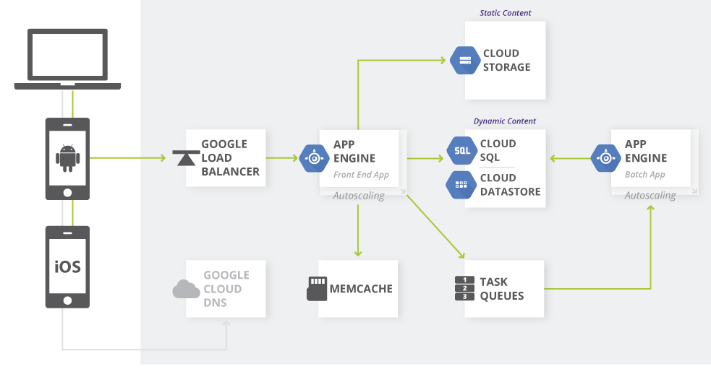
3 Tier with GAE and Google Cloud
See https://cloud.google.com/solutions/architecture/webapp
Autoscaling compute power of App Engine,distributed in-memory cache, task queues and datastore, to create robust applications quickly and easily.

Slide 29
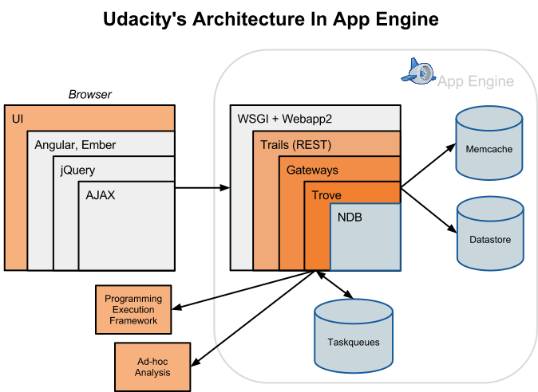
3 Tier GAE for Udacity
See http://googleappengine.blogspot.com/2012_10_01_archive.html

Slide 30
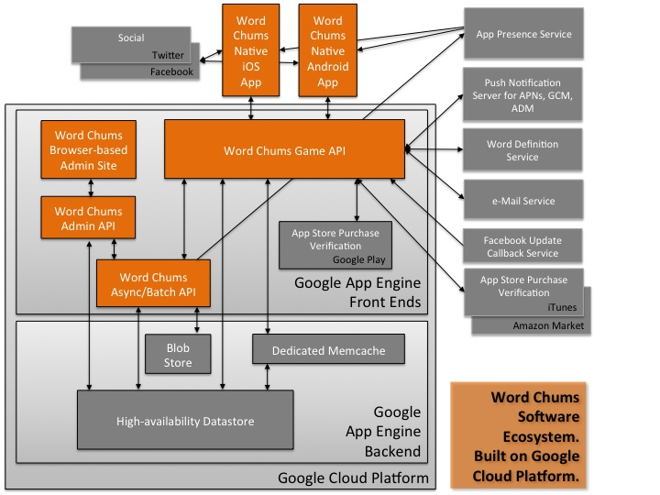
3 Tier GAE for WordChums Game
See http://googlecloudplatform.blogspot.com/2014_03_01_archive.html

Slide 31
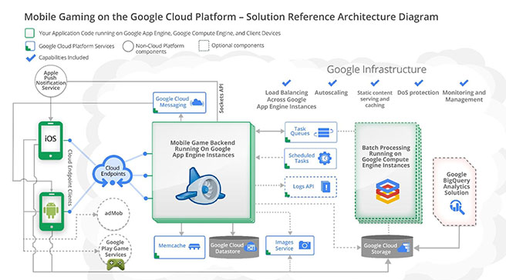
Mobile on GAE
See https://cloud.google.com/developers/articles/developing-mobile-games-on-google-app-engine-compute-engine/

Slide 32
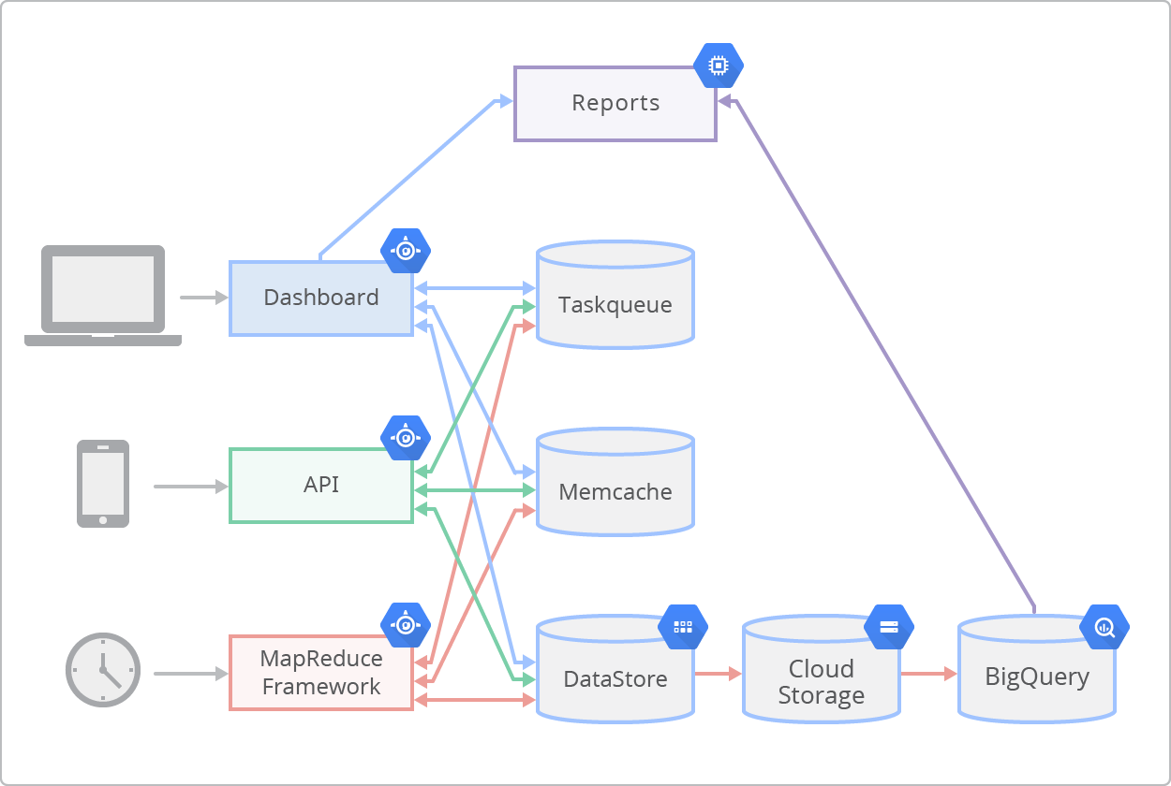
Adding Google Cloud onto GAE for Lean Plum.com
Addition of cloud storage and Big Query
BigQuery lets us run arbitrary queries on arbitrary data sets
It has improved our customer response time by allowing us to query over our logs in seconds whenever we receive a support call.
Cloud Datastore lets us store vast amounts of structured data
Cloud Storage provides secure, scalable storage. Like Amazon S3
Compute Engine to take advantage of more powerful cores for processing large amounts of data when generating reports. (like Amazon EC2)
See http://googlecloudplatform.blogspot.com/2014/03/google-cloud-platform-and-leanplum-help-app-developers-conduct-on-the-fly-ab-tests.html

Slide 33
Platform Matters
“Developers who have worked at the small scale might be asking themselves why we need to bother with “platform design” when we could just use some kind of out-of the-box solution. For small-scale applications, this can be a great idea. We save time and money up front and get a working and serviceable application. The problem comes at larger scales—there are no off-the-shelf kits that will allow you to build something like Amazon or Friendster. While building similar functionality might be fairly trivial, making that functionality work for millions of products, millions of users, and without spending far too much on hardware requires us to build something highly customized and optimized for our exact needs. There’s a good reason why the largest applications on the Internet are all bespoke creations: no other approach can create massively scalable applications within a reasonable budget.”
http://www.evontech.com/symbian/55.html

