Slide 1
Concurrent Client server
L. Grewe

Slide 2
Reveiw: Client/server socket interaction: TCP
Welcome Socket Queue
Server (running on host)
Client
create socket,
port=x, for
incoming request:
welcomeSocket =
ServerSocket(x)
TCP
connection setup
create socket,
connect to serv host, port=x
wait for incoming
connection request
connectionSocket =
welcomeSocket.accept()
clientSocket =
Socket()
send request using
clientSocket
read request from
connectionSocket
write reply to
connectionSocket
read reply from
clientSocket
close
connectionSocket
close
clientSocket

Slide 3
Recap: Data Representation
Always pay attention to the data that you transfer: the client and server may interpret the byte stream differently
String/Char
Int/short
Byte

Slide 4
Recap: State of Basic C/S
Welcome Socket Queue
system state: # of requests queued at the welcome socket of the server
0
1
k
k+1
N
p0
p1
pk
pk+1
pN
Strategy: if we know the fraction of time the server spends at each state, we can get answers to some basic questions: How long is the queue at the welcome socket? What is the response time of a request?

Slide 5
Events of Basic C/S
We are not interested in extremely precise modeling, but want intuition
System state changes upon events. Let’s focus on equilibrium
Consider a simple arrival pattern
client requests arrive at a rate of λ (lambda/second)
each request takes 1/mu seconds
Assume memory less
During a small interval Δt, the number of new arrival is: λΔt
During a small interval Δt, the probability of a current request finishes is: μΔt

Slide 6
What is a Character of Equilibrium?
Time Reversibility: state trend neither growing nor shrinking
state
k+1
k
time

Slide 7
What Does Time Reversibility Imply?
Cannot distinguish
state
k+1
k
time

Slide 8
Analysis of Queue Length for C/S
system state: # of requests queued at the welcome socket of the server
λ
0
1
k
k+1
N
μ
p0
p1
pk
pk+1
pN
at equilibrium (time reversibility) in one unit time: #(transitions k → k+1) = #(transitions k+1 → k)

Slide 9
Example
Assume requests come in at a rate of one request per 20 seconds
Each request takes on average 10 seconds
What is the fraction of time that the welcome queue has a backlog of 3 requests?

Slide 10
Server Flow
Create ServerSocket(6789)
connSocket = accept()
Welcome Socket Queue
read request from connSocket
Processing request
close connSocket

Slide 11
Writing High Performance Servers: Major Issues
Many socket/IO operations can cause a process to block, e.g.,
accept: waiting for new connection;
read a socket waiting for data or close;
write a socket waiting for buffer space;
I/O read/write for disk to finish
Thus a crucial perspective of network server design is the concurrency design (non-blocking)
for high performance
to avoid denial of service
Concurrency is also important for clients!

Slide 12
Outline
Recap
Basic client/server request/reply
Intro
Basic socket programming
Basic modeling
Supporting concurrency

Slide 13
Multiplexing/Demultiplexing Issue
The server needs the capability to extract multiple requests from the welcome socket, instead of one at a time
Problem: mutltiplexing since all clients to server use the same dest port
Welcome Socket Queue

Slide 14
TCP Connection-Oriented Demux
TCP socket identified by 4-tuple:
source IP address
source port number
dest IP address
dest port number
recv host uses all four values to direct segment to appropriate socket
server can easily support many simultaneous TCP sockets: different connections/sessions are automatically separated into different sockets

Slide 15
Connection-Oriented Demux
P1
P4
P5
P6
P2
P1
P3
SP: x
DP: 25
S-IP: B
D-IP: S
SP: x
SP: y
client
IP: A
DP: 25
server
IP: S
DP: 25
Client
IP:B
S-IP: A
S-IP: B
D-IP: S
D-IP: S
SP= source port number
DP= dest. port number
S-IP=source IP address
D-IP = dest IP address

Slide 16
Under the Hood: TCP Multiplexing
server
client
128.36.232.5 128.36.230.2
198.69.10.10
TCP socket space
TCP socket space
state: listening
address: {*:6789, *:*}
completed connection queue:
sendbuf:
recvbuf:
state: starting
address: {198.69.10.10:1500, *:*}
sendbuf:
recvbuf:
local port
local addr
remote port
remote addr
state: listening
address: {*:25, *:*}
completed connection queue:
sendbuf:
recvbuf:
state: listening
address: {*:25, *:*}
completed connection queue:
sendbuf:
recvbuf:
%netstat -P tcp

Slide 17
puzzle>> netstat -anv -P tcp
TCP: IPv4
Local/Remote Address Swind Snext Suna Rwind Rnext Rack Rto Mss State
-------------------- ----- -------- -------- ----- -------- -------- ----- ----- -----------
*.* *.* 0 00000000 00000000 49152 00000000 00000000 3375 1220 IDLE
134.154.14.51.22 66.123.67.238.61635 16304 00000030 00000000 49368 00000000 00000000 588 1452 ESTABLISHED
>>>>more >>>>>

Slide 18
Example: Client Initiates Connection
server
client
128.36.232.5 128.36.230.2
198.69.10.10
TCP socket space
TCP socket space
state: listening
address: {*:6789, *.*}
completed connection queue:
sendbuf:
recvbuf:
state: connecting
address: {198.69.10.10:1500, 128.36.232.5:6789}
sendbuf:
recvbuf:
state: listening
address: {*.25, *.*}
completed connection queue:
sendbuf:
recvbuf:
state: listening
address: {*.25, *.*}
completed connection queue:
sendbuf:
recvbuf:

Slide 19
Example: TCP Handshake Done
server
client
128.36.232.5 128.36.230.2
198.69.10.10
TCP socket space
TCP socket space
state: listening
address: {*:6789, *:*}
completed connection queue: {128.36.232.5.6789, 198.69.10.10.1500}
sendbuf:
recvbuf:
state: connected
address: {198.69.10.10:1500, 128.36.232.5:6789}
sendbuf:
recvbuf:
state: listening
address: {*:25, *:*}
completed connection queue:
sendbuf:
recvbuf:
state: listening
address: {*:25, *:*}
completed connection queue:
sendbuf:
recvbuf:

Slide 20
Example: Server accept()
server
client
128.36.232.5 128.36.230.2
198.69.10.10
TCP socket space
TCP socket space
state: listening
address: {*.6789, *:*}
completed connection queue: sendbuf:
recvbuf:
state: connected
address: {198.69.10.10.1500, 128.36.232.5:6789}
sendbuf:
recvbuf:
state: established
address: {128.36.232.5:6789, 198.69.10.10.1500}
sendbuf:
recvbuf:
state: listening
address: {*.25, *:*}
completed connection queue:
sendbuf:
recvbuf:
state: listening
address: {*.25, *:*}
completed connection queue:
sendbuf:
recvbuf:
Packet demutiplexing is based on (dst addr, dst port, src addr, src port)
Packet sent to the socket with the best match!

Slide 21
Outline
Recap
Basic client/server request/reply
Intro
Basic socket programming
Basic modeling
Supporting concurrency
Multiplexing and demultiplexing
Multi-threads

Slide 22
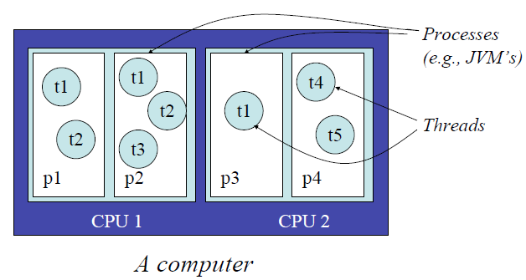
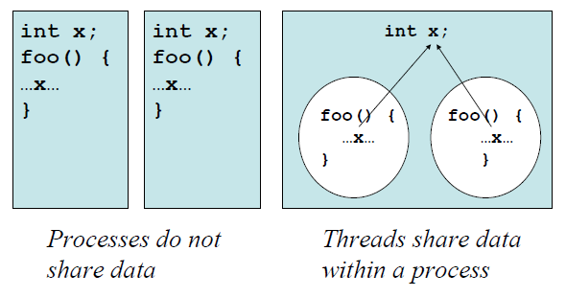
Thread vs Process

Slide 23
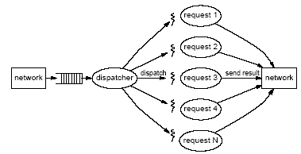
Using Multi-Threads for Servers
A thread is a sequence of instructions which may execute in parallel with other threads
We can have one thread for each client connection
Thus, only the flow (thread) processing a particular request is blocked

Slide 24
Java Thread Model
The Java virtual machine (JVM) creates the initial Java thread which executes the main method of the class passed to the JVM
Most JVM’s use POSIX threads to implement Java threads
Threads in a Java program can be created
Explicitly, or
Implicitly by libraries such as AWT/Swing, Applets, Servlets, web services, RMI, and image loading

Slide 25
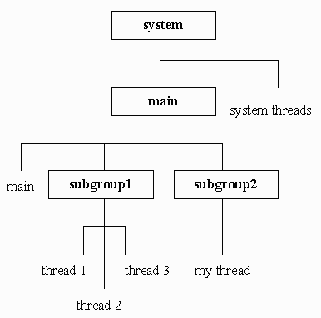
Java Thread Class
Concurrency is introduced through objects of the class Thread
Provides a ‘handle’ to an underlying thread of control
Threads are organized into thread group
A thread group represents a set of threads activeGroupCount ();
A thread group can also include other thread groups to form a tree
Why thread group?
http://java.sun.com/javase/6/docs/api/java/lang/ThreadGroup.html

Slide 26
Some Main Java Thread Methods
Thread(Runnable target) Allocates a new Thread object.
Thread(String name) Allocates a new Thread object.
Thread(ThreadGroup group, Runnable target) Allocates a new Thread object.
start() Start the processing of a thread; JVM calls the run method

Slide 27
Creating Java Thread
Two ways to implement Java thread
Extend the Thread class
Overwrite the run() method of the Thread class
Create a class C implementing the Runnable interface, and create an object of type C, then use a Thread object to wrap up C
A thread starts execution after its start() method is called, which will start executing the thread’s (or the Runnable object’s) run() method
A thread terminates when the run() method returns
http://java.sun.com/javase/6/docs/api/java/lang/Thread.html

Slide 28
Option 1: Extending Java Thread
class PrimeThread extends Thread { long minPrime; PrimeThread(long minPrime) { this.minPrime = minPrime; } public void run() { // compute primes larger than minPrime . . . } }
PrimeThread p = new PrimeThread(143);
p.start();

Slide 29
Option 1: Extending Java Thread
class RequestHandler extends Thread { RequestHandler(Socket connSocket) { // … }
public void run() { // process request } …
}
Thread t = new RequestHandler(connSocket); t.start();

Slide 30
Option 2: Implement the Runnable Interface
class PrimeRun implements Runnable { long minPrime; PrimeRun(long minPrime) { this.minPrime = minPrime; } public void run() { // compute primes larger than minPrime . . . } }
PrimeRun p = new PrimeRun(143);
new Thread(p).start();

Slide 31
Option 2: Implement the Runnable Interface
class RequestHandler implements Runnable { RequestHandler(Socket connSocket) { … }
public void run() {
//
} …
}
RequestHandler rh = new RequestHandler(connSocket); Thread t = new Thread(rh); t.start();

Slide 32
Example: a Multi-threaded TCPServer
The program creates a thread for each request

Slide 33
Multi-Thread Server
main thread
main() { ServerSocket s = new ServerSocket(port); while (true) {
Socket conSocket = s.accept();
Thread t = new RequestHandler(conSocket); t.start(); }
thread starts
thread starts
thread ends
thread
ends
TCPServerMT.java

Slide 34
Modeling Multi-thread Server So Far
0
1
k
k+1
N
p0
p1
pk
pk+1
pN
Welcome Socket Queue

Slide 35
Problems of Multi-Thread Server
Too many threads → resource overuse → throughput meltdown → response time explosion
One solution
bound or pre-spawn a fixed number of threads

Slide 36
Question: Using a Fixed Number of Threads
What are some design possibilities?

Slide 37
Design 1: Threads Share Access to the welcomeSocket
WorkerThread { void run { while (true) { Socket myConnSock = welcomeSocket.accept(); // process myConnSock myConnSock.close(); } // end of while }
sketch; not working code
welcome socket
Thread 1
Thread 2
Thread K

Slide 38
Design 2: Producer/Consumer
main { void run { while (true) { Socket con = welcomeSocket.accept(); Q.add(con); } // end of while }
welcome socket
Main thread
WorkerThread { void run { while (true) { Socket myConnSock = Q.remove(); // process myConnSock myConnSock.close(); } // end of while }
Q: Dispatch queue
sketch; not working code
Thread K
Thread 1
Thread 2

Slide 39
Common Issues Facing Design 1 and 2
Both designs involve multiple threads modify the same data concurrently
Design 1:
Design 2:
welcomeSocket
Q

Slide 40
Outline
Recap
Basic client/server request/reply
Intro
Basic socket programming
Basic modeling
Supporting concurrency
Multiplexing and demultiplexing
Multi-threads basic
Thread concurrency and shared data

Slide 41
Concurrency and Shared Data
Concurrency is easy if threads don’t interact
Each thread does its own thing, ignoring other threads
Typically, however, threads need to communicate with each other
Communication/coordination can be done by shared data
In Java, different threads may access static and heap simultaneously, causing problem

Slide 42
Simple Example
public class Example extends Thread {
private static int cnt = 0; // shared state
public void run() {
int y = cnt;
cnt = y + 1;
}
public static void main(String args[]) {
Thread t1 = new Example();
Thread t2 = new Example();
t1.start();
t2.start(); Thread.sleep(1000); System.out.println(“cnt = “ + cnt);
}
}
What is potential result?

Slide 43
Simple Example
What if we add a println: int y = cnt; System.out.println(“Calculating…”);
cnt = y + 1;

Slide 44
What Happened?
A thread was preempted in the middle of an operation
Reading and writing cnt was supposed to be atomic to happen with no interference from other threads
But the scheduler interleaves threads and caused a race condition
Such bugs can be extremely hard to reproduce, and so hard to debug
We will cover some later in the course

Slide 45
Question
If instead of
int y = cnt;
cnt = y+1;
We had written
cnt++;
Would this avoid race condition?
Answer: NO!
Don’t depend on your intuition about atomicity

Slide 46
Synchronization
Refers to mechanisms allowing a programmer to control the execution order of some operations across different threads in a concurrent program.
We use Java as an example to see synchronization mechanisms
We'll look at locks first.

Slide 47
Java Lock (1.5)
interface Lock {
void lock();
void unlock();
... /* Some more stuff, also */
} class ReentrantLock implements Lock { ... }
Only one thread can hold the lock at once
Other threads that try to acquire it block (or become suspended) until the lock becomes available
Reentrant lock can be reacquired by same thread
As many times as desired
No other thread may acquire a lock until has been released same number of times it has been acquired
Do not worry about the reentrant perspective for now, consider it a lock

Slide 48
Java Lock
Fixing the Example.java problem
import java.util.concurrent.locks.*;
public class Example extends Thread {
private static int cnt = 0;
static Lock lock = new ReentrantLock();
public void run() {
lock.lock();
int y = cnt;
cnt = y + 1;
lock.unlock();
}
…
}

Slide 49
Java Lock
It is recommended to use the following pattern
…
lock.lock();
try {
// processing body } finally {
lock.unlock(); }

Slide 50
Java Synchronized
This pattern is really common
Acquire lock, do something, release lock after we are done, under any circumstances, even if exception was raised etc.
Java has a language construct for this
synchronized (obj) { body }
Every Java object has an implicit associated lock
Obtains the lock associated with obj
Executes body
Release lock when scope is exited
Even in cases of exception or method return

Slide 51
Java synchronized
static Object o = new Object();
void f() throws Exception {
synchronized (o) {
FileInputStream f =
new FileInputStream("file.txt");
// Do something with f
f.close();
} // end of sync
} // end of f
Lock associated with o acquired before body executed
Released even if exception thrown

Slide 52
Discussion
object o
o’s lock
An object and its associated lock are different !
Holding the lock on an object does not affect what you can do with that object in any way
Examples:
synchronized(o) { ... } // acquires lock named o
o.f (); // someone else can call o’s methods
o.x = 3; // someone else can read and write o’s fields

Slide 53
Synchronization on this
class C {
int cnt;
void inc() {
synchronized (this) {
cnt++;
} // end of sync
} // end of inc
}
C c = new C();
Thread 1
c.inc();
Thread 2
c.inc();
A program can often use this as the object to lock
Does the program above have a data race?
No, both threads acquire locks on the same object before they access shared data

Slide 54
Synchronization on this
class C {
int cnt;
void inc() {
synchronized (this) {
cnt++;
} // end of sync
} // end of inc void dec() {
synchronized (this) {
cnt--;
} // end of sync
} // end of dec
}
C c = new C();
Thread 1
c.inc();
Thread 2
c.dec();
Does the program above have a data race?
No, both threads acquire locks on the same object before they access shared data

Slide 55
Synchronization on this
class C {
int cnt;
void inc() {
synchronized (this) {
cnt++;
} // end of sync
} // end of inc
}
C c1 = new C(); C c2 = new C();
Thread 1
c1.inc();
Thread 2
c2.inc();
Does this program have a data race?

Slide 56
Synchronized Method
Marking method as synchronized is the same as synchronizing on this in body of the method
The following two programs are the same
class C {
int cnt;
void inc() {
synchronized (this) {
cnt++;
} // end of sync
} // end of inc
}
class C {
int cnt;
void synchronized inc() {
cnt++;
} // end of inc
}

Slide 57
Synchronization on this
class C {
int cnt;
void inc() {
synchronized (this) {
cnt++;
} // end of sync
} // end of inc void synchronized dec() {
cnt--;
} // end of dec
}
C c = new C();
Thread 1
c.inc();
Thread 2
c.dec();
Does this program have a data race?
No, both threads acquire locks on the same object before they access shared data

Slide 58
Summary of Key Ideas
Multiple threads can run simultaneously
Either truly in parallel on a multiprocessor
Or can be scheduled on a single processor
A running thread can be pre-empted at any time
Threads can share data
In Java, only fields can be shared
Need to prevent interference
Rule of thumb 1: You must hold a lock when accessing shared data
Rule of thumb 2: You must not release a lock until shared data is in a valid state
Caution: Overuse use of synchronization can create deadlock

Slide 59
Example
Implement a server with a fixed number of threads

