Slide 1

Website Caching and Memcached in Node.js
Enhancing Web Application Performance

Slide 2
What is Caching?
Definition: Caching temporarily stores data to reduce retrieval times.
Importance:
- Improves speed and efficiency.
- Reduces load on backend services.
Forms of Caching:
- Client-Side Caching
- Server-Side Caching

Slide 3
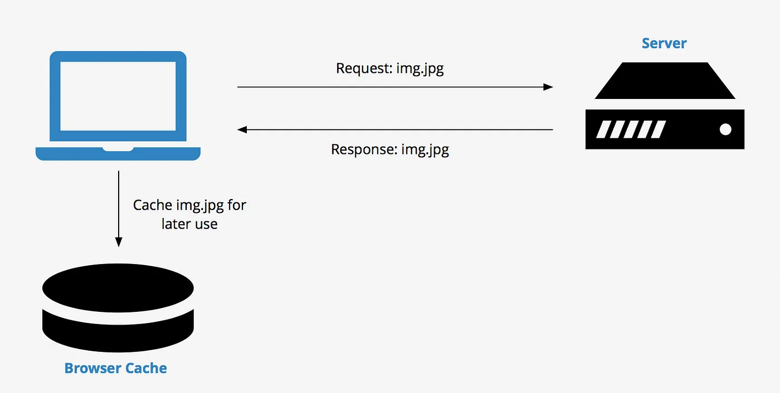
Client-Side Caching Overview
Definition: Storing web resources (HTML, CSS, JS, images) on the user's device.
Examples:
- Browser caching.
- Manual caching -Storage APIs (localStorage -, sessionStorage).
Controlled By:
- HTTP Headers: Cache-Control, Expires.
Benefits:
- Faster page load times.
- Reduced bandwidth usage.

Slide 4
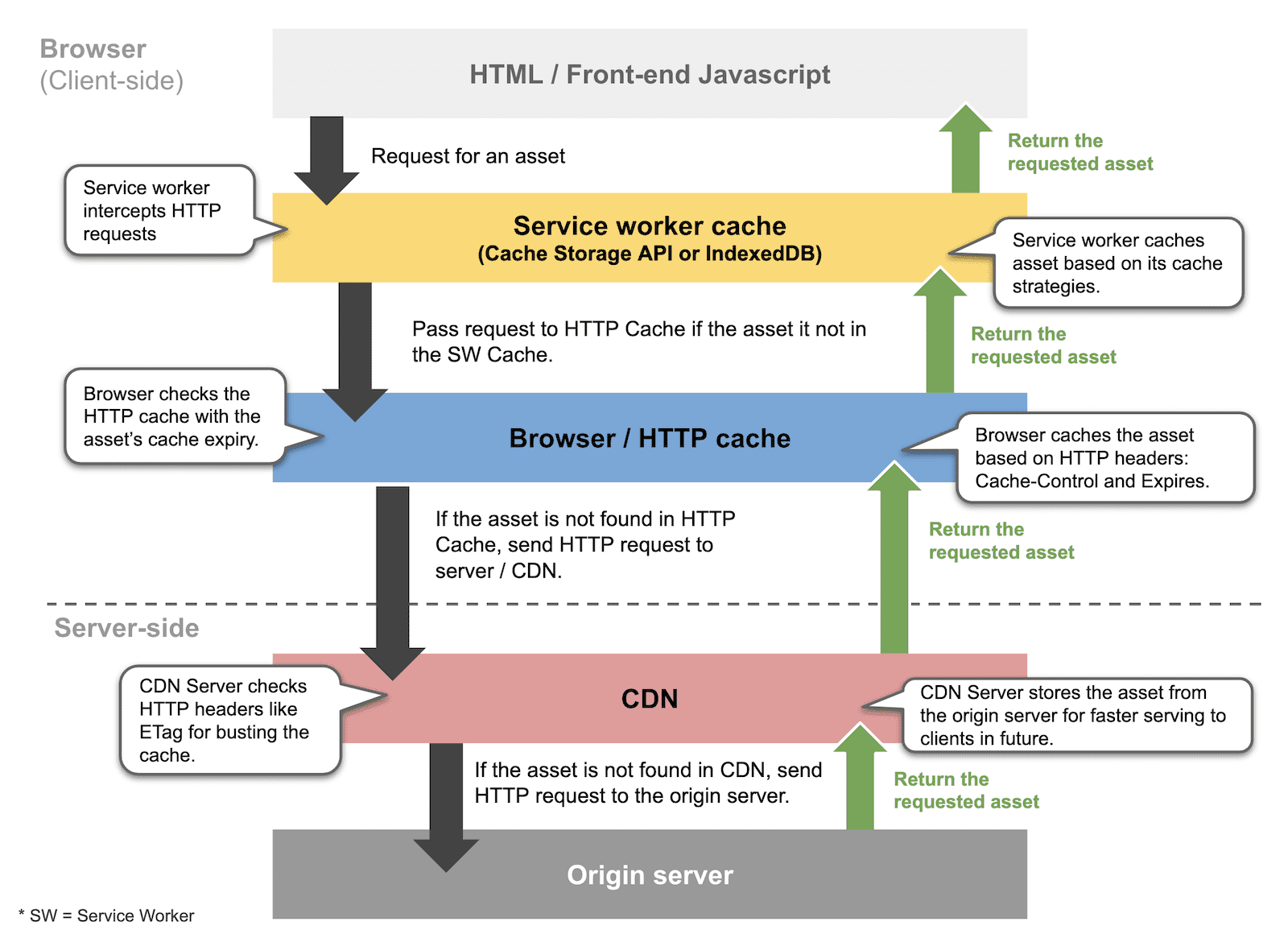

Slide 5
Browser (default) Client-Side Caching with HTTP Headers
How HTTP Headers Influence Caching:
- Cache-Control: Specifies caching policies (e.g., max-age, no-cache).
- Expires: Sets an expiration date/time for cached content.
- ETag: Allows validation of cached content with the server.
Flow of Operation:
1. User requests a resource.
2. Browser checks cache for the resource.
3. If found and valid (based on headers), the resource is served from cache.
4. If not found or invalid, the resource is fetched from the server.
Example HTTP Response Header:
Cache-Control: max-age=3600
Expires: Wed, 18 Nov 2024 12:00:00 GMT

Slide 6
Using JavaScript for Manual Client-Side Caching
How Manual Caching Differs from Automatic Browser Caching:
Manual caching (e.g. localStorage) gives developers complete control over what to cache and when to invalidate it.
Automatic browser caching relies on HTTP headers like Cache-Control or Expires to decide how long to cache content.
Manual caching requires custom logic for cache invalidation and updating.
Manual Caching in Local Storage:
const key = 'userData';
const cachedData = localStorage.getItem(key);
if (cachedData) {
console.log('Serving from cache:', JSON.parse(cachedData));
} else {
fetch('/api/user')
.then(response => response.json())
.then(data => {
localStorage.setItem(key, JSON.stringify(data));
console.log('Fetched and cached:', data);
});
}
Documentation Links:
LocalStorage API: https://www.w3schools.com/jsref/prop_win_localstorage.asp
Cache Storage Compatibility: https://developer.mozilla.org/en-US/docs/Web/API/CacheStorage#browser_compatibility

Slide 8
Service Workers
What is a Service Worker?
- A service worker is a background script that acts as a proxy between the browser(client) and network. It runs independently of a web page and enables offline capabilities, background synchronization, and push notifications.
Real-World Scenario:
- A news website uses a service worker to pre-cache the latest articles. Users can view cached articles offline.
Key Features of Service Workers:
Asynchronous: Service workers rely on promises for operations, ensuring non-blocking behavior.
Life Cycle Events: Includes install, activate, and fetch for controlling caching and request handling.
Independent Execution: Runs even when no web page is open, making it ideal for background tasks like syncing data or delivering notifications.

Slide 9
Service Workers for Advanced Caching
- Service workers are client-side scripts that run in the browser, not on the server.
- They operate in a separate thread, independent of the main browser thread, ensuring they do not block user interface rendering. The code example provided is registered by the browser as a service worker. It is typically written in JavaScript and saved in a file (e.g., service-worker.js).Example of service worker registration in a web application:
if ('serviceWorker' in navigator) {
navigator.serviceWorker.register('/service-worker.js').then(() => {
console.log('Service worker registered successfully');
}).catch((error) => {
console.error('Service worker registration failed:', error);
});
}
Code Example (from service-worker.js):
self.addEventListener('install', event => {
event.waitUntil(
caches.open('v1').then(cache => {
return cache.addAll(['/index.html', '/style.css', '/script.js']);
})
);
});
This code ensures the service worker file (/service-worker.js) is loaded and registered by the browser.
self.addEventListener('fetch', event => {
event.respondWith(
caches.match(event.request).then(response => {
return response || fetch(event.request);
})
);
});
The caches object is part of the Cache Storage API.URL: https://developer.mozilla.org/en-US/docs/Web/API/CacheStorage

Slide 10
When to Use Client-Side Caching
Best Scenarios:
- Static resources: Images, scripts, stylesheets.
- API responses that don’t change frequently.
How This Differs from Automatic Browser Caching:
- Automatic browser caching is passive and follows HTTP headers.
- Manual caching allows precise control over cache storage, updates, and invalidation.
Defining a Service Worker:
- A script that runs in the background, independently of web pages, to enable offline functionality and enhance caching mechanisms
Benefits:
- Reduces load on the server.
- Improves user experience with faster response times.
Challenges:
-Managing cache invalidation.
- Ensuring up-to-date content when required.

Slide 11
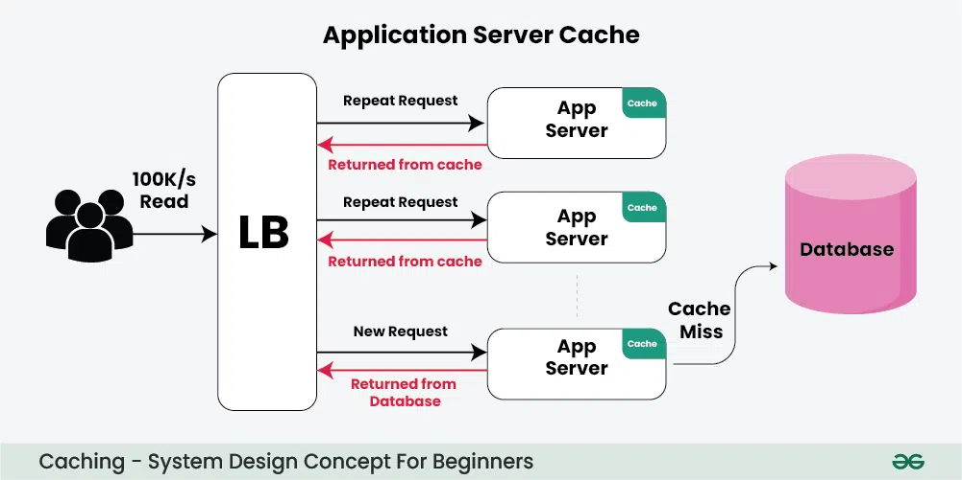
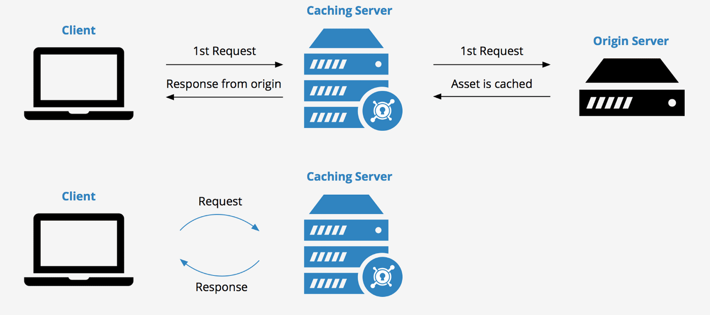
Server Side Caching

Slide 12
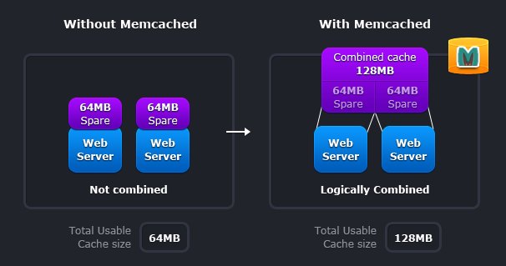
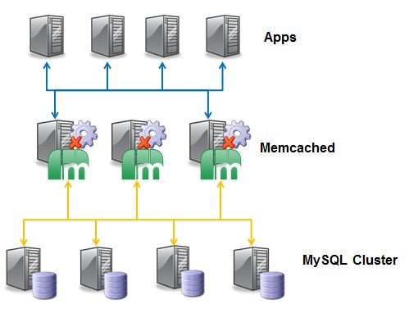
How Memcached Works
Architecture:
Memcached follows a distributed architecture, storing data across multiple servers.
This design allows horizontal scaling, where new servers can be added to handle increased traffic or data
It uses a hash function to determine which server should store a specific key-value pair.
Memcached servers store data in RAM, making data retrieval extremely fast.
the simplicity of key-value storage ensures high performance and low latency.
Memcached can store small chunks of arbitrary data, such as strings, objects, or even serialized data structures.
It is not ideal for large binary data like images or videos.
Use Cases:
Caching session information, user preferences, or API results.
Integration with Node.js: https://www.npmjs.com/package/memcached

Slide 13
Installing Memcached in Node.js
Installation Command:
npm install memcached
Setup Example:
1. Start the Memcached Server:
Command: memcached -vv -p 11211
`-vv`: Enables verbose logging for debugging.
`-p`: Specifies the port number (default: 11211).
2. Connect to Memcached in Node.js:
Local server: const memcached = new Memcached('localhost:11211');
Remote server:
const memcached = new Memcached('remote-server.example.com:11211');
Memcached Server Management:
Regular restarts prevent memory fragmentation and ensure optimal performance, especially in high-traffic scenarios.
Suggested restart frequency: Weekly or bi-weekly, depending on traffic volume.
On server restart, all cached data is cleared, requiring cache warm-up to repopulate.

Slide 14
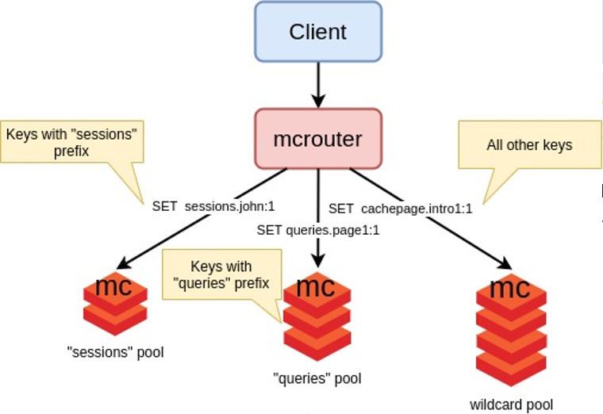
Benefits of Memcached
Performance Improvement:
- Data retrieval from memory instead of the database.
Scalability:
- Distributed architecture with consistent hashing.
When a new server is added, the hash function rebalances the keys across the servers.
Client libraries automatically route requests to the appropriate server, ensuring seamless scalability.
Example: A load balancer might distribute traffic across three Memcached servers, each handling specific segments of the data.
- New servers can be added to balance the load.
Ease of Use:
- Simple API for seamless integration.

Slide 15
Comparison
Feature | Client-Side Caching | Server-Side Caching
Location | User's device | Server
Data Stored | Static assets | Dynamic data, DB results
Usage | Faster load times | Reduce backend processing

Slide 16
References
1. Memcached Official Website: https://memcached.org
2. Node.js Memcached Package: https://www.npmjs.com/package/memcached
3. HTTP Caching Documentation: https://developer.mozilla.org/en-US/docs/Web/HTTP/Caching
4. Cache Storage API Documentation: https://developer.mozilla.org/en-US/docs/Web/API/CacheStorage
5. LocalStorage API Documentation: https://developer.mozilla.org/en-US/docs/Web/API/Window/localStorage

Slide 17
Try it out
Google Cloud Memcached (Memorystore for Memcached)
NodeJS client api https://cloud.google.com/nodejs/docs/reference/memcache/latest

