Slide 1

AngularJS intro
L. Grewe

Slide 2
AngularJS
Is a client side JavaScript framework typically used in a MEAN (MongoDB- Express-Angular –NodeJS) project/application/site
Angular is front end
It sits in the client (web browser)
It can be used to improve front-end
But, it is especially designed to create Single Page Applications( SPAs)
    Note a website may have traditional multi-page functionality but, for some part of it (say the admin interface or email or the front page) you might make a SPA
    SPAs = load once in browser (client) and then for parts of its page it needs to alter/update it makes calls only for that content. (hence can be faster/more responsive after the initial load)

Slide 3
How to “get it”
It is client side so will be downloaded to client
When create an Angular project in WebSphere (our choice of IDE) it has setup the Angular software already
Otherwise you can get it from https://angularjs.org/

Slide 4
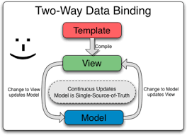
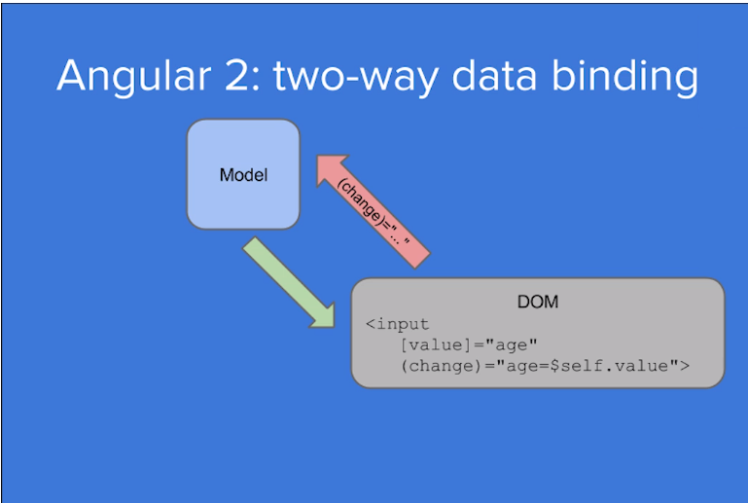
2way Data binding (→ how SPA can be created)
data model and the view are bound together
Both are live.
changes to the view update the model
AND changes to the model update the view

Slide 5
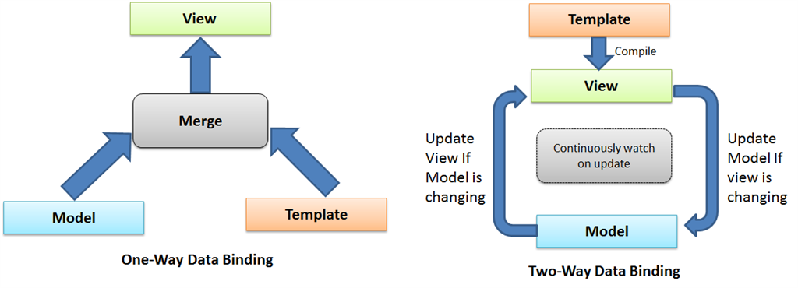
Curious: 1-way data binding versus 2-way
Data bind is the connection bridge between view and business logic (view model) of the application.
2-way = automatic updates both ways
MEN ( &angular can also support) does 1-way :
merge model component & template into a view = the model data is bound to the view.
NEW model changes ARE NOT automatically reflected to the view, same as any changes done by the user on view are not reflected to the model.
AngularJs is the automatic synchronization between the model and view

Slide 6
Angular more MVC
More MVC oriented than Express (which is server side web framework –dealing with traditional multi-page websites/or portions of web sites)
        Has Models, Views, Controller

Slide 7
AngularJS and Angular
Feature | AngularJS | Angular
Architecture | Based on MVC (Model-View-Controller) | Uses a component-based architecture
Language | Written in JavaScript | Written in TypeScript
Performance | Two-way data binding, but can be slow for large applications | Faster with improved change detection and rendering
Dependency Injection | Limited and built-in | Powerful and hierarchical DI system
Mobile Support | Not optimized for mobile | Designed with mobile support in mind
DOM Manipulation | Direct manipulation using $scope and directives | Virtual DOM, improved rendering performance
Routing | $routeProvider in ngRoute module | Uses @angular/router with a powerful routing mechanism
Modularity | Less modular, difficult to manage large applications | Highly modular with better scalability
Tooling | Basic CLI support | Robust CLI (Angular CLI) for project scaffolding and development
Updates & Support | Last update in 2018; officially deprecated in 2022 | Actively maintained with new versions released regularly

Slide 8
Why Did AngularJS End in 2022?
Performance Issues: AngularJS struggled with performance in complex applications due to its heavy reliance on two-way data binding and digest cycles.
Scalability Concerns: Managing large-scale applications with AngularJS was challenging, as its architecture was not optimized for modularity and maintainability.
Modern Development Needs: AngularJS lacked support for TypeScript, reactive programming, and mobile-first design, which modern frameworks like React and Vue offered.
Security & Maintenance: Google decided to end support to encourage developers to migrate to a more secure, well-supported, and efficient framework.
Industry Trends: The industry shifted toward component-based architectures and reactive programming, which Angular (2+) adopted.
Official Announcement: Google provided long-term support until December 31, 2021, and completely discontinued AngularJS on January 1, 2022.
Migration Path: Developers were encouraged to migrate to Angular (2+), React, or Vue.js for modern application development.

Slide 9
Optional --AngularJS
---for historical purposes –this class will use ReactJS

Slide 10
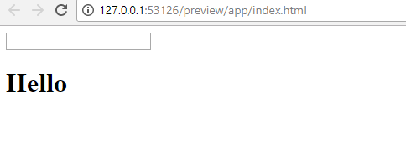
An example to understand from Getting MEAN
Have code:
  <!DOCTYPE html>
  <html>
    <head>
      <meta charset="utf-8">
      <title>Angular binding test</title>
    </head>
    <body>
      <input />
      <h1>Hello </h1>
    </body>
  </html>
GOAL:
we want to take whatever text is entered into the input box
and immediately display it after the Hello in the h1
(you could do this with normal Javascript even listener but,
lets see how to do with AngularJS without WRITING ANY
CODE—that’s the point)

Slide 11
Step 1: add reference to AngularJS
Add in head <script src="angular.min.js"></script>
****or for remote loading
<script src="//ajax.googleapis.com/ajax/libs/angularjs/1.8.2/angular.min.js"></script>
AND add ng-app option to html tag
  <!DOCTYPE html>
  <html ng-app>
    <head>
      <meta charset="utf-8">
      <title>Angular binding test</title>
      <script src="angular.min.js"></script>
      OR <script src="//ajax.googleapis.com/ajax/libs/angularjs/1.2.19/angular.min.js"></script>
    </head>
    <body>
      <input />
      <h1>Hello </h1>
    </body>
  </html>
ng-app tells Angular that anything nested inside
the tag can be considered part of the application
SPECIAL NOTE: you need to have downloaded the angularjs code to your system.
Otherwise you might look at using a remote uri
<script src="//ajax.googleapis.com/ajax/libs/angularjs/1.2.19/angular.min.js"></script>

Slide 12
Step 2: bind view input to a model
Here we are specifically going to:
giving it a name—for example, myInput— like this:
<input ng-model="myInput" />
<!DOCTYPE html>
<html ng-app>
<head>
  <meta charset="utf-8">
  <title>Angular binding test</title>
  <script src="//ajax.googleapis.com/ajax/libs/angularjs/1.2.19/angular.min.js"></script>
</head>
<body>
  <input ng-model="myInput" />
  <h1>Hello </h1>
</body>
</html>
This means that the input form tag –any value
someone types in will be associated with the Angular JS
model called myInput

Slide 13
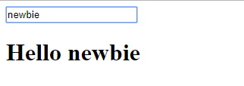
Step 3: take the model data and display in view
Specifically, we are going to alter : Hello {{ myInput }}
NOTE the {{ }} means take the value of the named Model
<!DOCTYPE html>
<html ng-app>
<head>
  <meta charset="utf-8">
  <title>Angular binding test</title>
  <script src="//ajax.googleapis.com/ajax/libs/angularjs/1.2.19/angular.min.js"></script>
</head>
<body>
  <input ng-model="myInput“ />
  <h1> Hello {{ myInput }} </h1>
</body>
</html>
TRY IT
C
C
Now you can type and the Model data associated with the input View is updated
when you type in the input View ---and you can see this displayed after Hello

Slide 14
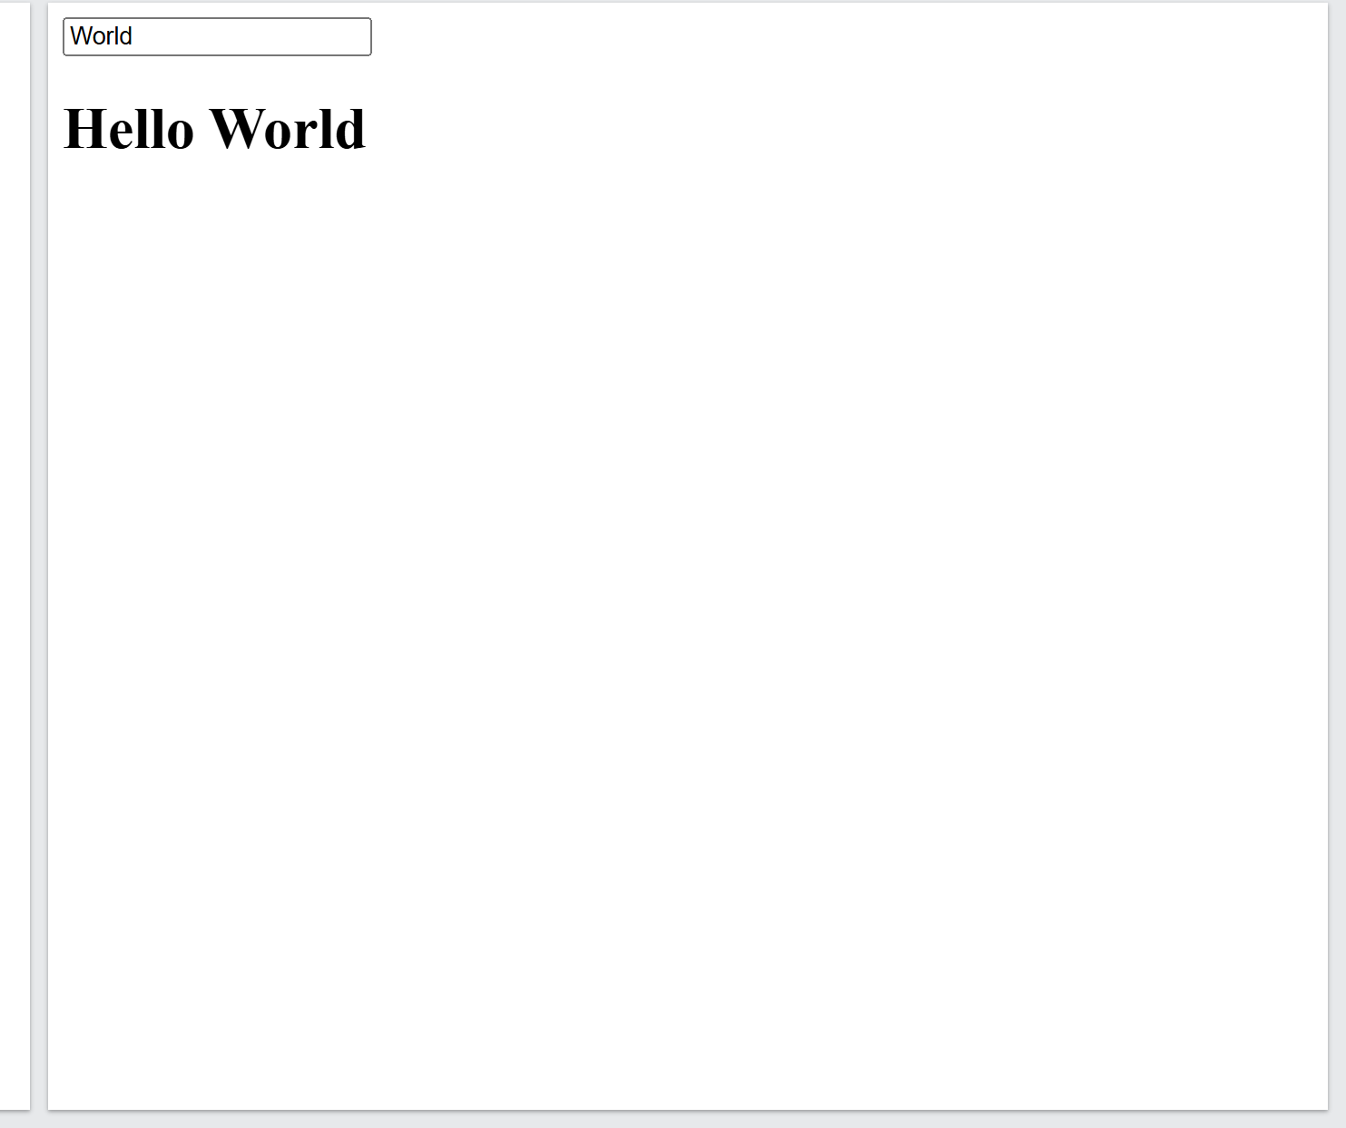
Small changes
<!DOCTYPE html>
<html ng-app="myApp">
<head>
<meta charset="utf-8">
<title>Angular Binding Test</title>
<script src="//ajax.googleapis.com/ajax/libs/angularjs/1.8.2/angular.min.js"></script>
</head>
<body>
<div ng-controller="MyController">
<input type="text" ng-model="name" placeholder="Enter your name" />
<h1>Hello {{ name }}</h1>
</div>
<script>
angular.module('myApp', []).controller('MyController', function($scope) {
$scope.name = "World";
});
</script>
</body>
</html>
defining a module explicitly

Slide 15
What are these special ng-tags??
Directives
  Many embedded directives for the visual control
    ng-bind, ng-model
    ng-if, ng-switch, ng-repeat,
    ng-show, ng-hide

Slide 16
The code we just saw –that’s not usually how we create AngularJS code
But, it’s a great way to begin to understand AngularJS and in this case data binding.
Lets go a little more –following example in Getting MEAN book
……before we learn about the proper MVC way of using AngularJS

Slide 17
Next Example – modifying previous to add a default value for model data → requires:
STEP 1: define our Angular application as a module
STEP 2: create a controller to manage the scope.

Slide 18
Step 1.1: Defining angular application as a module
Module name is the value assigned to the ng-app attribute
<html ng-app="myApp">
Make a reference to some new javascript code you will create in step 2
<!DOCTYPE html>
<html ng-app=“myApp”>
<head>
  <meta charset="utf-8">
  <title>Angular binding test</title>
  <script src="//ajax.googleapis.com/ajax/libs/angularjs/1.2.19/angular.min.js"></script>
</head>
<body>
  <input ng-model="myInput" />
  <h1> Hello {{ myInput }} </h1>
  <script src=“app.js”> </script>
</body>
</html>
Here we are declaring the module name of app = myApp
Here is some code we will use

Slide 19
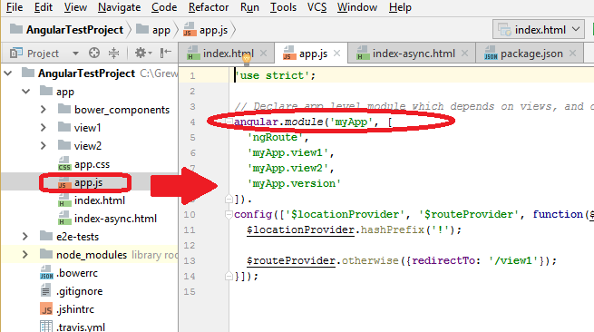
Step 1.2: create app.js file and add the following code which defines the module
angular.module('myApp', []);
app.js file is located in the
same directory of our
previous html file
NOTE: if using an IDE like WebSphere
to make an AngularJS project –it will automatically
create the index.html file for you (like the previous code
+ more) and an app.js file with this content (and more in it)

Slide 20
Step 1.2: MORE about app.js
'use strict';
// Declare app level module which depends on views, and components – have 2 views view1 and veiw2 currently
angular.module('myApp', [
'ngRoute',
'myApp.view1',
'myApp.view2',
'myApp.version'
]).
config(['$locationProvider', '$routeProvider', function($locationProvider, $routeProvider) {
$locationProvider.hashPrefix('!');
$routeProvider.otherwise({redirectTo: '/view1'});
}]);
Default View to bring up is /view1

Slide 21
Step 2: Add some controller javascript code to the app.js file
In html file add the
attribute to body tag of the controller
<body ng-controller="myController">
<!DOCTYPE html>
<html ng-app=“myApp”>
<head>
  <meta charset="utf-8">
  <title>Angular binding test</title>
  <script src="//ajax.googleapis.com/ajax/libs/angularjs/1.2.19/angular.min.js"></script>
</head>
<body ng-controller=“myController”>
  <input ng-model="myInput" />
  <h1> Hello {{ myInput }} </h1>
  <script src=“app.js”> </script>
</body>
</html>
In the app.js file add the following CONTROLLER CODE
var myController = function() {
// controller code here };
angular .module('myApp') .controller('myController', myController);
Here we the name of the Controller function code
myController that will be in the app.js file we included

Slide 22
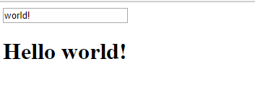
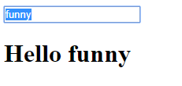
Step 2: modify controller function to set default value for our model
Alter the code as follows to your app.js file
var myController = function($scope) {
$scope.myInput = "world!"; };
TRY IT
$scope = represents the scope the controller has access to
which in our html file is the <body> tag marked with the
attribute ng-controller
VIEW, MODEL, CONTROLLER –share the same scope
// the app.js file
//define the module
angular.module("myApp", []);
//setup the controller
var myController = function($scope) {
$scope.myInput = "world!"; };
angular
.module('myApp')
.controller('myController', myController);
Shows the default
Now user types in “funny”

Slide 23
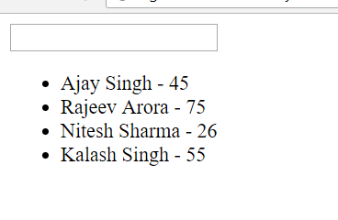
Another similar example
// the html file<!doctype html>
<html>
<head>
<meta charset="utf-8">
<title>Untitled Document</title>
<script src="http://ajax.googleapis.com/ajax/libs/angularjs/1.2.26/angular.min.js"></script>
</head>
<body data-ng-app="myApp">
<div data-ng-controller="myController">
<input data-ng-model="typename" type="text" /> {{ typename }}
<ul>
<li data-ng-repeat="view in Listing">{{view.name}} - {{view.age}} </li>
</ul>
</div>
<script src="app2.js"></script>
</body>
</html>
// the app.js file
var app = angular.module("myApp",[]);
app.controller('myController', function($scope){
$scope.Listing = [
{name:'Ajay Singh', age:'45'},
{name:'Rajeev Arora', age:'75'},
{name:'Nitesh Sharma', age:'26'},
{name:'Kalash Singh', age:'55'}
];
})
TRY IT
NEW directive = ng-repeat this is like a FOR EACH loop and will cycle through the array called Listing
and the loop variable is called view

Slide 24
STOP – what is data-ng-* and why not just ng-* ???
NO difference between the two, except that certain HTML5 validators will throw an error on a property like ng-app, but they don't throw an error for anything prefixed with data-, like data-ng-app.
So using data- prefix with our angular directives is good

Slide 25
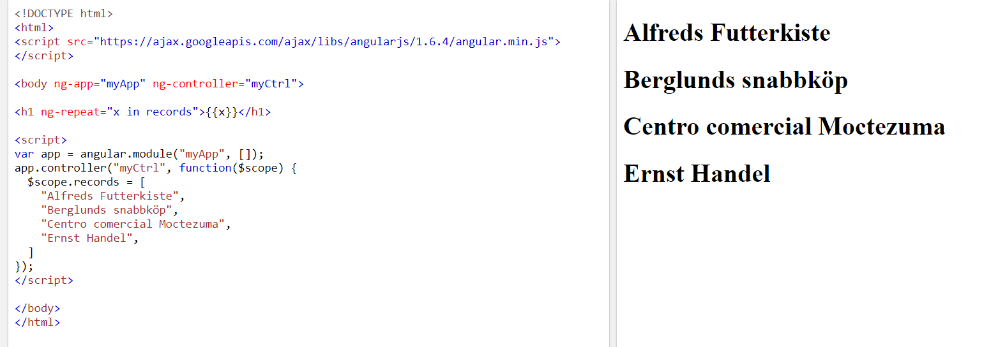
Different example with ng-repeat
NEW directive = ng-repeat this is like a FOR EACH loop and will cycle through the array called records
and the loop variable is called x

Slide 26
Another example – “Angular lists”
A MORE elaborate example using WebStorm
Initially create a NodeJS + Express project
Add AngularJS code and directory to it

Slide 27
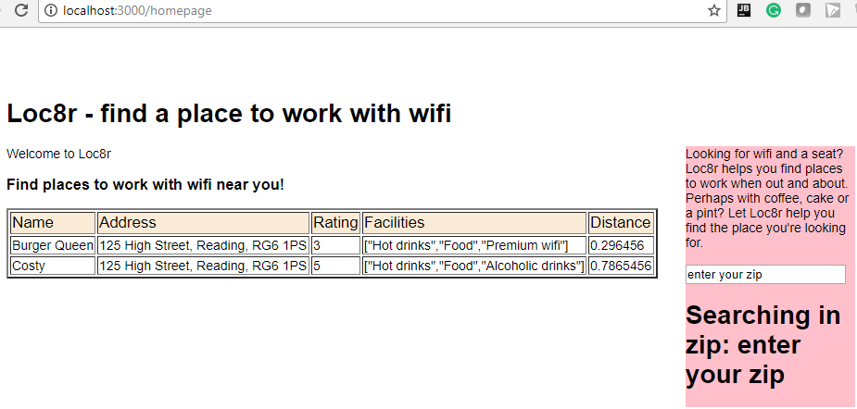
Loc8rApp from Getting MEAN
The “homepage” we are going to display a list of locations
TO make this easy we are going to hardcode the data –but, you would really pull from a database –but, that is another subject

Slide 28
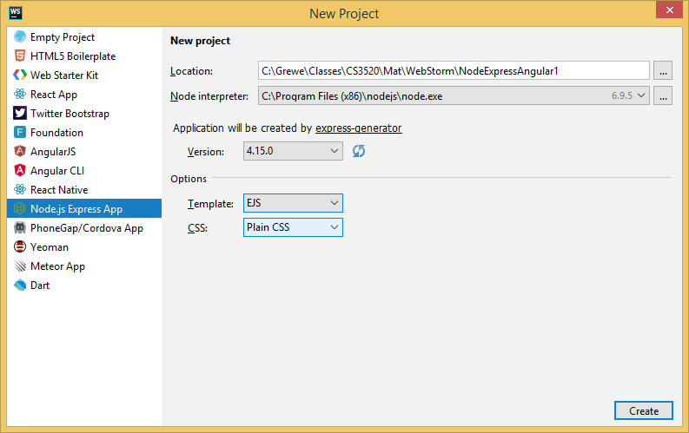
STEP 1: create a NodeJS+Express project (or use an existing one)
I like EJS but, you
can use Jade or
whatever web framework
you have and like

Slide 29
Step1.1: setup URI mapping of /homepage to a NodeJ+Express Controller
NodeJS +
Express Part

Slide 30
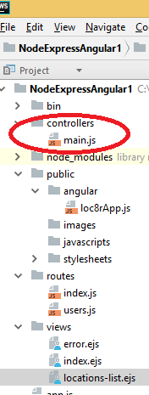
In routes/index.js maps a get request /homepage URI → controllers/main.js and the function homelist
THIS IS THE routes/index.js file
var express = require('express');
var router = express.Router();
var controllerMain = require('../controllers/main'); //this will load the main controller file
/* GET home page. */
//calls the controller code main.js, the function homelist
router.get('/homepage’, controllerMain.homelist );
module.exports = router;
This will only make sense if you know NodeJS+Express --REVISIT
NodeJS +
Express Part

Slide 31
Step 1.2: set up the corresponding NodeJS+Express controller homelist
… we will hard code some data
that is sent to the NodeJS+Express
view called views/location-list.ejs
CREATE controllers directory in NodeJS+Expres
app and create a JS file there called main.js
NodeJS +
Express Part

Slide 32
main.js Controller file for NodeJS+Express
This will only make sense if you know NodeJS+Express --REVISIT
NodeJS +
Express Part
/* GET home page Controller. */
//export function homelist that will display list for homepage
module.exports.homelist = function(req, res){
renderHomepage(req, res);
};
//creates title, pageheader adn sidebar information for use in rendering Homepage
var renderHomepage = function(req, res){
res.render('locations-list', {
title: 'Loc8r - find a place to work with wifi',
pageHeader: {
title: 'Loc8r',
strapline: 'Find places to work with wifi near you!'
},
sidebar: "Looking for wifi and a seat? Loc8r helps you find places to work when out and about. " +
"Perhaps with coffee, cake or a pint? Let Loc8r help you find the place you're looking for."
});
};
This HARD CODES some of the data we want to display in our home page which uses the
location-list.ejs view file

Slide 33
parts of NodeJS+Express Controller map to its EJS view locations-list.ejs
This will only make sense if you know NodeJS+Express --REVISIT
var renderHomepage = function(req, res){
res.render('locations-list', {
title: 'Loc8r - find a place to work with wifi',
pageHeader: {
title: 'Loc8r',
strapline: 'Find places to work with wifi near you!'
},
sidebar: "Looking for wifi and a seat? Loc8r helps you find places to work when out and about. " +
"Perhaps with coffee, cake or a pint? Let Loc8r help you find the place you're looking for."
});
};

Slide 34
SO where is the AngularJS going to work???
Notice in the output the location-list.ejs has an area where it
displays data –we will use data binding of Angular to achieve this

Slide 35
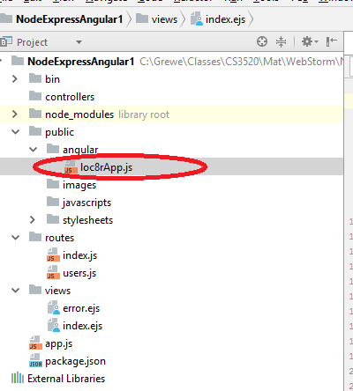
Step 2: setup the AngularJS code
Create folder angular under public
And create a new javascript
file called loc8rApp.js which will be
our Angular code there.
This code will be responsible for
the databinding within our output

Slide 36
STEP 2: create your loc8rApp.js (or if you like app.js) javascript file that will define the angular app and its angular controllers
NOTE: I created an angular folder and this is where I put my loc8rApp.js file

Slide 37
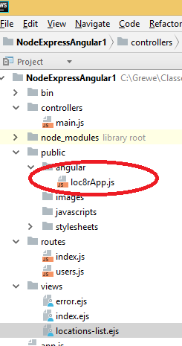
The loc8rApp.js file- a start
Just defines the app module loc8rApp and sets 2 controllers – one for zip code and one that hard codes data for locations
// the loc8rApp.js file// JavaScript
//define the module
angular.module("loc8rApp", []);
//setup controller for zip that sets the value for the model myInput to default
// value of enter your zip.
var myZipController = function($scope) {
$scope.myInput = "enter your zip"; };
//associate the myZipController with the above function myZipController
angular.module('loc8rApp').controller(‘myZipController', myZipController);
CONTINUE NEXT PAGE →

Slide 38
The loc8rApp.js file- continued
Just defines the app module loc8rApp and sets 2 controllers – one for zip code and one that hard codes data for locations
//Stupidly for this demo hard coding data via a locationListCrtl Controller function
var locationListCtrl = function ($scope) {
$scope.data = {
locations: [{
name: 'Burger Queen',
address: '125 High Street, Reading, RG6 1PS',
rating: 3,
facilities: ['Hot drinks', 'Food', 'Premium wifi'],
distance: '0.296456',
_id: '5370a35f2536f6785f8dfb6a'
},{
name: 'Costy',
address: '125 High Street, Reading, RG6 1PS',
rating: 5,
facilities: ['Hot drinks', 'Food', 'Alcoholic drinks'],
distance: '0.7865456',
_id: '5370a35f2536f6785f8dfb6a'
}]};
};
angular.module('loc8rApp').controller(‘locationListCrtl',locationListCrtl);
NOTE: the name of the
model data we are hard
coding is called “data”
In part 2 we will discuss database retrieval

Slide 39
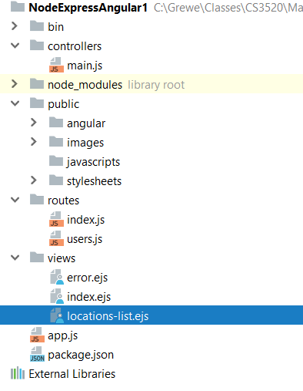
STEP 3: Edit your View (EJS in our case called views/location-list.ejs)
PART A: Have it load AngularJS files
PART B: Have it Have it point to the listLocationCrtl controller at the appropriate place where you want to use the data
PART C: Have it load the “hardcoded” data setup in the listLocationCrtl into the view
NOTE: I also have a separate myZipController that is associated with the zip code a user in the future (not doing here) may want to use the data to make a request to Server for the real data from a database

Slide 40
Beginning location-list.ejs file
<!DOCTYPE html>
<html ng-app="loc8rApp" >
<head >
<title><%= pageHeader.title %></title>
<link rel='stylesheet' href='/stylesheets/style.css' />
<script src="http://ajax.googleapis.com/ajax/libs/angularjs/1.2.26/angular.min.js"></script>
</head>
<body ng-controller="myZipController">
<script src="http://ajax.googleapis.com/ajax/libs/angularjs/1.2.26/angular.min.js"></script>
<script src="/angular/loc8rApp.js"></script>
<h1><%= title %></h1>
<div style="float: right;background-color: pink; width: 20%; border-width: 10px; clear: right" >
<%= sidebar%> <br/><br />
<input ng-model="myInput" />
<h1>Searching in zip: {{ myInput }} </h1>
</div>
<p>Welcome to <%= pageHeader.title %></p>
<h3> <%= pageHeader.strapline%></h3>
PART A: Have it load AngularJS files

Slide 41
Beginning location-list.ejs file
<table ng-controller="locationListCtrl" border="2">
<tr style="background-color: antiquewhite; font-size: larger">
<td >Name </td> <td>Address</td> <td>Rating</td> <td>Facilities</td> <td>Distance</td>
</tr>
<tr ng-repeat="x in data.locations">
<td>{{x.name}}</td>
<td>{{x.address}}</td>
<td>{{x.rating}}</td>
<td>{{x.facilities}}</td>
<td>{{x.distance}}</td>
</tr>
</table>
</body>
</html>
PART B: Have it point to the listLocationCrtl controller at the appropriate place where you want to use the data
PART C: Have it load the “hardcoded” data setup in the listLocationCrtl into the view
NOTE: I also have a separate myZipController that is associated with the zip code a user in the future (not doing here) may want to use the data to make a request to Server for the real data from a database

Slide 42
Generics of ng-repeat x in List
var myController = function($scope) {
$scope.items = ["one", "two", "three"]; };
You can output the items in the array using the ng-repeat directive like this:
  <body ng-controller="myController">
  <ul>
  <li ng-repeat=“x in items">{{ item }}</li>
  </ul>
  </body>
The resulting output, omitting the attributes that Angular will add to the HTML elements,
is this:
  <ul>
  <li>one</li>
  <li>two</li>
  <li>three</li>
  </ul>

Slide 43
So we just did your first NodeJS+Express + Angular application
Here Angular is used to data-bind with only PART (the table displaying the locations of wifi)
This seems
silly as the
data is hardcoded
but if it was
associated with
a database you
Could have it pull
dynamically from
the database

Slide 44
Using Angular Filters to FORMAT Data
Formatting text, currency, date and more

Slide 45
Generic: applying filter (format) to data
{{ data | filter }}
Example:
  <div>{{ 123.2345 | currency }}</div>
  Output: $123.23
Another Example: THIS ONE SHOWS AN OPTION –symbol of currency
  <div>{{ 123.2345 + 321.321 | currency:“$" }}</div>
  Output: $444.56

Slide 46
Example of Date Filter
<div>{{ "Let's shout" | uppercase }}</div>
Output: LET’S SHOUT
{{ timestamp | date:"d MMM yyyy" }}
Output: 21 Aug 2014

Slide 47
Creating a Custom Filter
Taking example from Getting MEAN
Add the following javascript functions to our loc8rApp.js Angular file
//Some functions dealing with data manipulation/formatting for locations
/**
* tests if numeric or not
* @param n
* @returns {boolean}
* @private
*/
var _isNumeric = function (n) {
return !isNaN(parseFloat(n)) && isFinite(n);
};
/**
* function to determing if should list units as km or m
* @returns {Function}
*/
var formatDistance = function () {
return function (distance) {
var numDistance, unit;
if (distance && _isNumeric(distance)) {
if (distance > 1) {
numDistance = parseFloat(distance).toFixed(1);
unit = 'km';
} else {
numDistance = parseInt(distance * 1000,10);
unit = 'm';
}
return numDistance + unit;
} else {
return "?";
}
};
};
A custom filter is
Basically a javascript
Function that returns
Data formatting in
an AngularJS file

Slide 48
Creating custom filter ---adding code to activate its use
At bottom of loc8rApp.js add the following
angular
.module('loc8rApp')
.controller('locationListCtrl', locationListCtrl)
.filter('formatDistance', formatDistance);
Now in location-list.ejs (the view) add the filter
<tr ng-repeat="x in data.locations">
<td>{{x.name}}</td>
<td>{{x.address}}</td>
<td>{{x.rating}}</td>
<td>{{x.facilities}}</td>
<td>{{x.distance | formatDistance}}</td>
</tr>

Slide 49
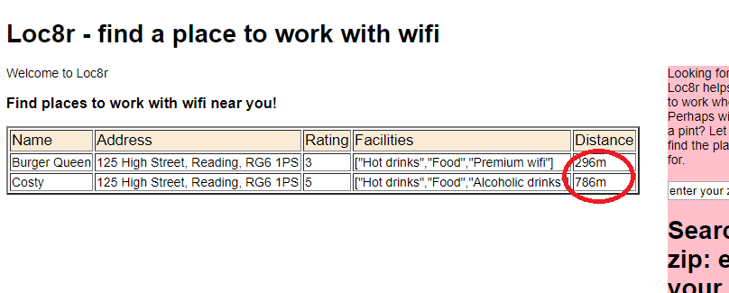
Results adding custom filter for distance
See the units of “m” added to the end.

Slide 50
Using Directive in Angular →generate HTML “snippets”

Slide 51
Angular directives
Can be reused by different Angular controllers or views.
Browsers can/may cache the resulting html snippets for reuse

Slide 52
STEP 1: create directive in Angular Controller code file
Here we are adding to our loc8rApp.js
//directive is a function that generates output of the rating of the location data
var ratingStars = function () {
  return {
  template : "{{ location.rating }} stars"
  };
};
//REGISTER the above directive function to the controller locationListCrtl
angular
.module('loc8rApp')
.controller('locationListCtrl', locationListCtrl)
.filter('formatDistance', formatDistance)
.directive('ratingStars', ratingStars);
Remember
our hard
coded data
//Stupidly for this demo hard coding data
var locationListCtrl = function ($scope) {
$scope.data = {
locations: [{
name: 'Burger Queen',
address: '125 High Street, Reading, RG6 1PS',
rating: 3,
facilities: ['Hot drinks', 'Food', 'Premium wifi'],
distance: '0.296456',
_id: '5370a35f2536f6785f8dfb6a'
},{
name: 'Costy',
address: '125 High Street, Reading, RG6 1PS',
rating: 5,
facilities: ['Hot drinks', 'Food', 'Alcoholic drinks'],
distance: '0.7865456',
_id: '5370a35f2536f6785f8dfb6a'
}]};
};

Slide 53
STEP2 – apply to view (in our case location-list.ejs)
<table ng-controller="locationListCtrl" border="2">
<tr style="background-color: antiquewhite; font-size: larger">
<td >Name </td> <td>Address</td> <td>Rating</td>
<td>Facilities</td> <td>Distance</td>
</tr>
<tr ng-repeat="x in data.locations">
<td>{{x.name}}</td>
<td>{{x.address}}</td>
<td> <div rating-stars="x"></div> </td>
<td>{{x.facilities}}</td>
<td>{{x.distance | formatDistance}}</td>
</tr>
</table>
NOTE: you
pass the data x
to the directive function
You can add your
directive as an attribute
to many html tags like
links (<a>), spans, divs
WEIRD BUT TRUE --- note in the view you take a directive name
like doIt and it is refered to as do-it
So our directive of ratingStars in our ejs is called rating-stars

Slide 54
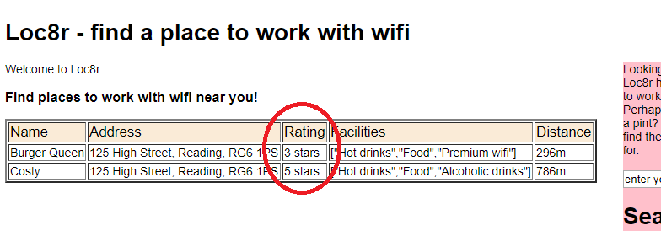
Results
Doesn’t really look different than before but, it works and you can repeat use it.
Your directive can do more elaborate work than ours here –but, you get the idea.

Slide 55
Directive with external template for further styling
The new directive function refers to a template URL that is a html file located in angular directory called rating-stars.html
/** directive to create rating Html snippet to do rating with external template */
var ratingStars = function () {
return {
scope: {
thisRating : '=x.rating'
},
templateUrl: '/angular/rating-stars.html'
};
};
NOTE: we define the name of the rating data passed to this function as thisRating which can be used anywhere in this function but, also the referenced templateURL

Slide 56


Our rating-stars.hml
This says if the variable thisRating is < each number print a star and if not print empty
<span class="glyphicon glyphicon-star{{ thisRating<1 ? '-empty' : ''}}"></span>
<span class="glyphicon glyphicon-star{{ thisRating<2 ? '-empty' : ''}}"></span>
<span class="glyphicon glyphicon-star{{ thisRating<3 ? '-empty' : ''}}"></span>
<span class="glyphicon glyphicon-star{{ thisRating<4 ? '-empty' : ''}}"></span>
<span class="glyphicon glyphicon-star{{ thisRating<5 ? '-empty' : ''}}"></span>
So if the value of thisRating is 3 it means it will look like:

Slide 57
Filtering results

Slide 58
For every data field there are predefined filters to transform data:
currency Format a number to a currency format.
date Format a date to a specified format.
filter Select a subset of items from an array.
json Format an object to a JSON string.
limitTo Limits an array/string, into a specified
number of elements/characters.
lowercase Format a string to lower case.
number Format a number to a string.
orderBy Orders an array by an expression.
uppercase Format a string to upper case.

Slide 59
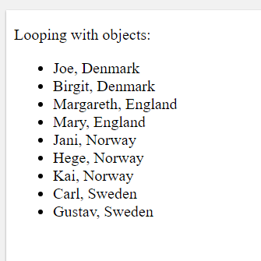
Another example –predefined orderBy filter
<div ng-app="myApp" ng-controller="namesCtrl">
<p>Looping with objects:</p>
<ul>
    <li ng-repeat="x in names | orderBy:'country'">
    {{ x.name + ', ' + x.country }}
    </li>
</ul>
</div>
<script>
angular.module('myApp', []).controller('namesCtrl', function($scope) {
$scope.names = [
{name:'Jani',country:'Norway'},
{name:'Carl',country:'Sweden'},
{name:'Margareth',country:'England'},
{name:'Hege',country:'Norway'},
{name:'Joe',country:'Denmark'},
{name:'Gustav',country:'Sweden'},
{name:'Birgit',country:'Denmark'},
{name:'Mary',country:'England'},
{name:'Kai',country:'Norway'}
];
});
</script>
</body>

Slide 60
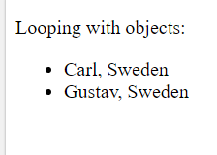
Another example –predefined filter filter
<div ng-app="myApp" ng-controller="namesCtrl">
<p>Looping with objects:</p>
<ul>
    <li ng-repeat="x in names | filter :{'country': 'Sweden'} ">
    {{ x.name + ', ' + x.country }}
    </li>
</ul>
</div>
<script>
angular.module('myApp', []).controller('namesCtrl', function($scope) {
$scope.names = [
{name:'Jani',country:'Norway'},
{name:'Carl',country:'Sweden'},
{name:'Margareth',country:'England'},
{name:'Hege',country:'Norway'},
{name:'Joe',country:'Denmark'},
{name:'Gustav',country:'Sweden'},
{name:'Birgit',country:'Denmark'},
{name:'Mary',country:'England'},
{name:'Kai',country:'Norway'}
];
});
</script>
</body>
The filter filter looks to make sure data’s
property country contains Sweden in it

Slide 61
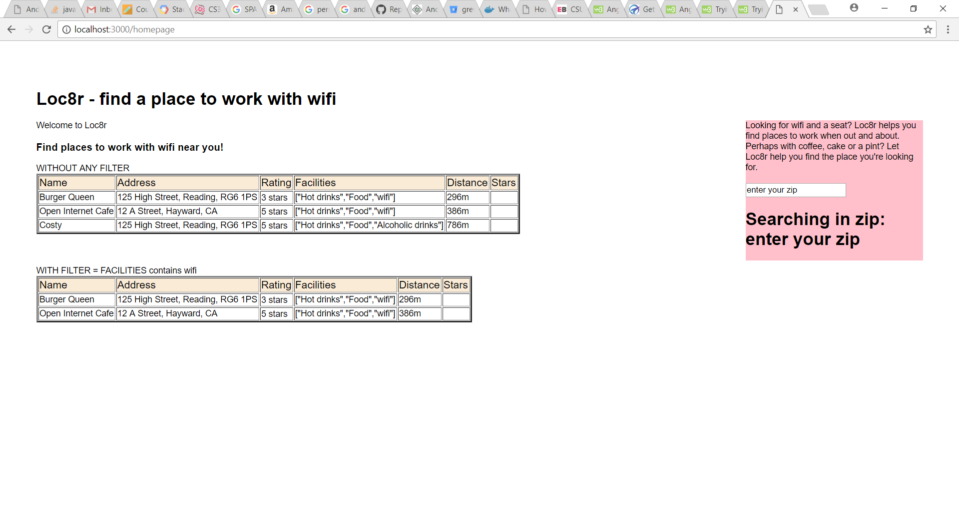
Lets add a filter to our loc8r example so that looks for wifi in the facilities

Slide 62
code in views/location-list.ejs that cycling through data with ng-repeat
WITHOUT ANY FILTER
<table ng-controller="locationListCtrl" border="2">
<tr style="background-color: antiquewhite; font-size: larger">
<td >Name </td> <td>Address</td> <td>Rating</td> <td>Facilities</td> <td>Distance</td><td>Stars</td>
</tr>
<tr ng-repeat="x in data.locations ">
<td>{{x.name}}</td>
<td>{{x.address}}</td>
<td> <div rating-stars="x"></div> </td>
<td>{{x.facilities}}</td>
<td>{{x.distance | formatDistance}}</td>
<td> <div rating-stars2="x"></div> </td>
</tr>
</table>

Slide 63
New code in views/location-list.ejs that adds the filter when cycling through data with ng-repeat
WITH FILTER = FACILITIES contains wifi
<table ng-controller="locationListCtrl" border="2">
<tr style="background-color: antiquewhite; font-size: larger">
<td >Name </td> <td>Address</td> <td>Rating</td> <td>Facilities</td>
<td>Distance</td><td>Stars</td>
</tr>
<tr ng-repeat="x in data.locations | filter:{'facilities':'wifi'}:true">
<td>{{x.name}}</td>
<td>{{x.address}}</td>
<td> <div rating-stars="x"></div> </td>
<td>{{x.facilities}}</td>
<td>{{x.distance | formatDistance}}</td>
<td> <div rating-stars2="x"></div> </td>
</tr>
</table>

Slide 64
NEXT Lecture on services
Tying the service to retrieval of data from database

