Slide 1
Internationalization (i18n) of Websites
Adapting Websites for Global Audiences

Slide 2
What is internationalization
Definition: Internationalization (i18n) is the process of designing a website to be adaptable for multiple languages, regions, and cultures.
Goal: To make a website easily translatable and usable in different locales without requiring significant redevelopment.
Expand Reach: Access a broader audience by accommodating various languages and cultures.
Improved User Experience: Tailor content to resonate with regional audiences, improving usability.
Competitive Advantage: Stand out by demonstrating inclusivity and accessibility in diverse markets.
SEO Benefits: Optimize for region-specific search engines and increase visibility in multiple languages.
Key Concept: i18n prepares a site for localization (l10n), which tailors the website’s content to specific regions.

Slide 3
Considerations
Plan for Multilingual Support: Ensure the website design and code can support multiple languages from the beginning.
Separate Content from Code: Use resource files (e.g., JSON, XML) to store text and images separately, making translations easier.
Implement Locale-Aware Formatting: Adapt date, time, currency, and number formats for different regions.
Use Unicode (UTF-8) Encoding: Ensure character encoding supports all languages, including those with special characters.

Slide 4
Handling text
Use Resource Files: Store text in external files for each language (e.g., en.json for English, fr.json for French).
Language Keys: Assign keys to each text element (e.g., header.title), so translations can be applied dynamically.
Dynamic Language Switching: Implement a language selection feature allowing users to switch between languages seamlessly.

Slide 5


URL Structure
Best practices for displaying multilingual content suggest your localized website should be situated within the same URL, and categorized under language-specific subdirectories or subdomains.
Example of sub-directories https://thecompany.com/es or https://thecomany.com/fs
Example sub-domains https://fr.thecompany.com or https://es.thecompany.com
That way, search engines like Google will recognize these websites as separate from each other, preventing duplicate content penalties.
Look at this for fun : https://www.zara.com/es/ (Spanish site) AND https://www.zara.com/es/en/ (for Spanish people who want to see the site in English)

Slide 6
CMS – Content Management System
Can help with language
If you’re using a CMS for your website, you’ll need one that easily accommodates different languages. Most popular technologies, like WordPress, Squarespace, Shopify, and Webflow fit the bill. Each offer their own way of adding languages to your site.

Slide 7
Text Expansion and Contraction with different languages
Things will not retain their visual harmony across different languages unless you specifically configure them to be, making this a vital aspect of internationalization.
When translated text is visually longer or shorter than the source text, this is what’s called text expansion and contraction.
A website that isn’t optimized for this will look awkward and unwieldy across different languages, leaving strange-looking gaps between content blocks or spillovers into the background.

Slide 8
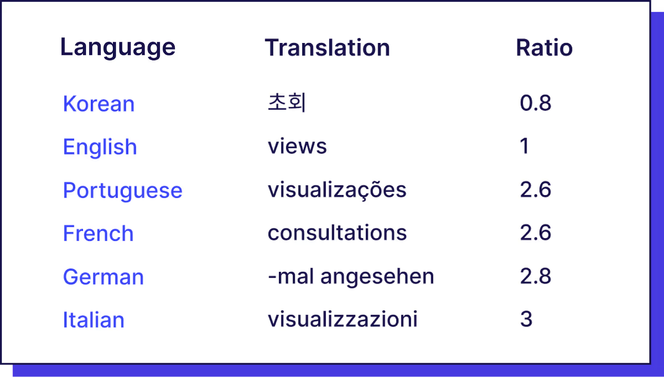
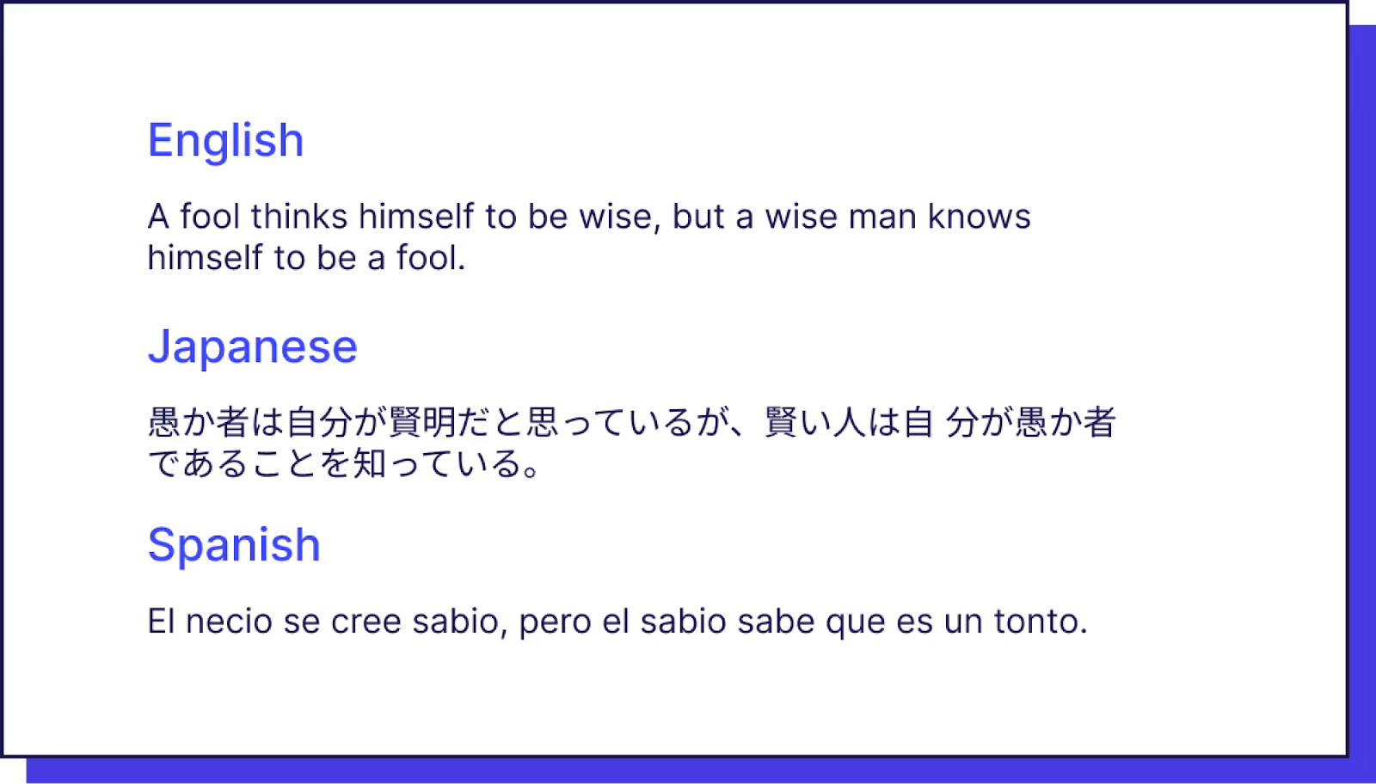
Text Expansion and Contraction with different languages

Slide 9
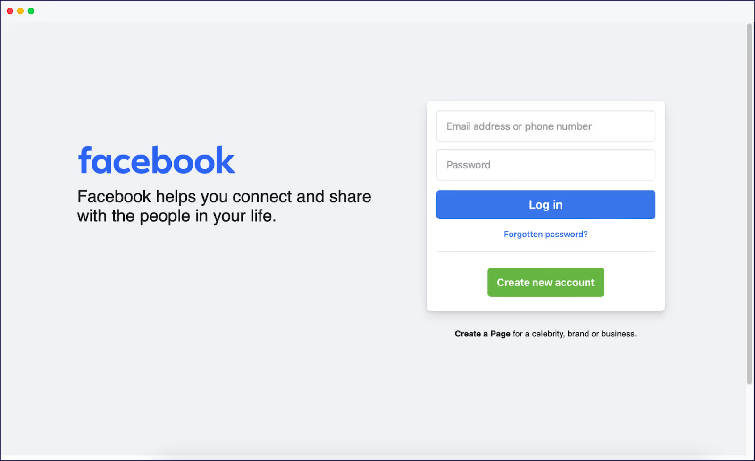
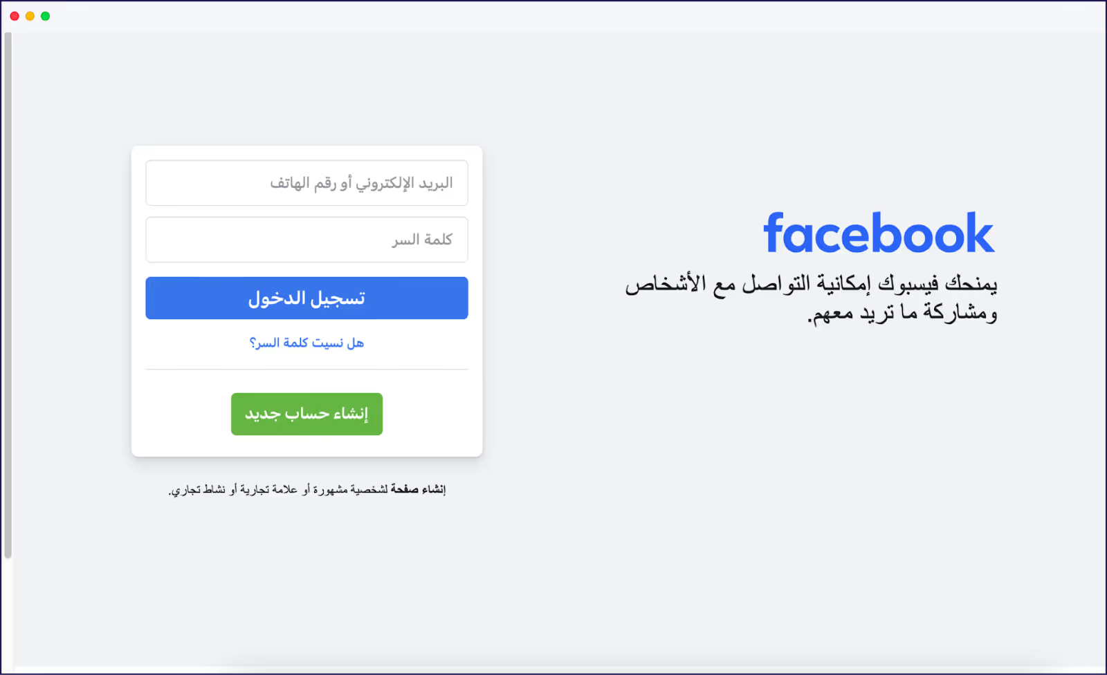
Right to Left Text
Right-to-left languages like Arabic and Hebrew are formatted differently. Your layout and user interface will look clunky and inelegant when it isn’t optimized for languages in both directions.
Some websites have flipped the interface to provide a better viewing experience for speakers of RTL languages. Take Facebook for example.

Slide 10
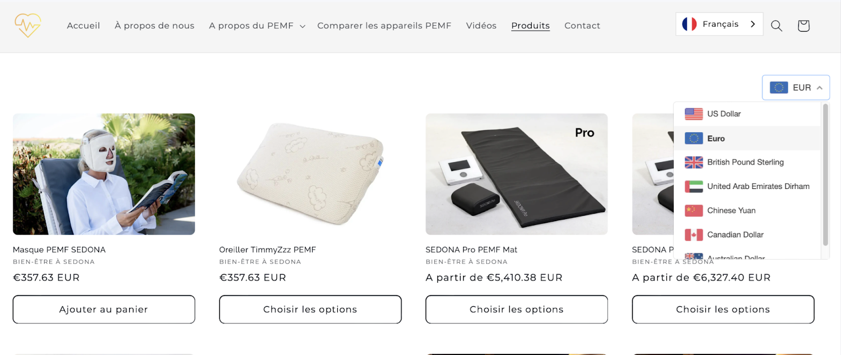
Website Localization (beyond internationalization)
adapting your multilingual site to offer a relevant user experience to your new foreign audience. This includes nuances in language and cultural references to customize it to fit your target market’s needs.
Example: a localized website consists of content that contains specific references that your particular target audience resonates with.
It’s also adapted so that the naming conventions and numeric formats like the time, date, currency, and even units of measurement are what’s standard to them.

Slide 11
Date, Time + Currency
Use Locale-Specific Formats: Display dates, times, and currency symbols according to local conventions.
Automate Conversions: Use libraries like moment.js or native APIs to automatically format these elements based on locale.
Consider Time Zones: Adjust for time zones when displaying time-sensitive information (e.g., order deadlines, event times).

Slide 12
Tools for Internationalization
i18n Libraries: Popular libraries include i18next for JavaScript
Content Management Systems (CMS): Many CMS platforms, like WordPress and Drupal, offer built-in i18n tools or plugins.
Automated Translation Services: Services like Google Translate API, but consider manual review for quality.

Slide 13
General Tips
Consider cultural differences: Accommodate cultural differences and nuances, such as naming conventions and date formats.
Use Unicode: Use Unicode character encoding for content and databases.
Avoid hard-coded text: Avoid hard-coded text and leave enough space for text expansion. \
Support local formats: Support local formats for names, addresses, times, and dates.
Use style sheets: Use style sheets for presentational information.
Check for cultural bias: Check images, animations, and examples for translatability and inappropriate cultural bias.
Conduct market research to identify international buyer personas.
Use analytics tools to collect and report data on traffic, conversions, engagement, retention, and satisfaction.
Use feedback tools to gather input and opinions from users.
Perform A/B testing to compare and evaluate different versions and variations of content.
Implement a banner when you recognize users are in the wrong location.
Avoid automatic redirects.

Slide 14
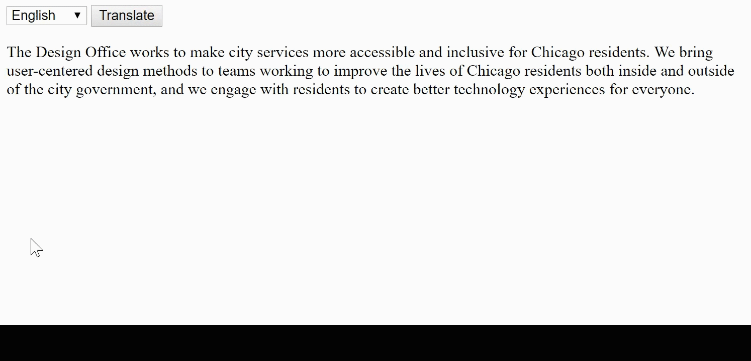
Try it
Google Translate API in a codelab
See case study City of Chicago

