Slide 1


Ruby on Rails
Model of MVC

Slide 2
Model-View-Controller Paradigm
A way of organizing a software system
Benefits:
  Isolation of business logic from the user interface
  Code Reusability
  Making it clear where different types of code belong for easier maintenance

Slide 3
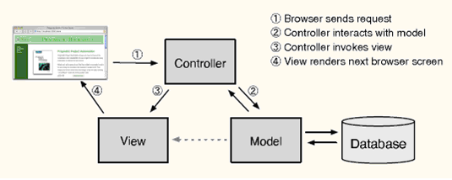
MVC
Model - the information (data) of the application and the rules to manipulate that data. Business logic
View – takes data and displays it
Controller – the glue between the model and controller. In Rails, they’re responsible for processing the incoming requests from the web browser, interrogating the models for data, and passing that data on to the views for presentation.

Slide 4
Models
the information (data) of the application and the rules to manipulate that data. Business logic should be concentrated here.
Models are usually related to tables in a database.
  Model’s attributes are “columns”.
  But not always.
  Models that are not related to database tables are transient.
EXAMPLE: If a model is related to a table, the table’s name will be “line_items” for model LineItem, for example.
Demo: app/model/user.rb
Notes:
If a model is related to a table, the table’s name will be “line_items” for model LineItem, for example.

Slide 5
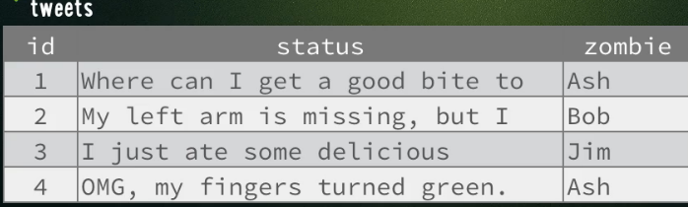
Model Class – representing a database table
Database table example:
Name of table = tweets
    Has keys of id, status and zombie where id is unique, primary key

Slide 6
Model Class – representing a database table
Now, lets create a Model class associated with our database table tweets. GIVE IT NAME Uppercase, singual = Tweet
Stored in app/models/tweet.rb
class Tweet < ActiveRecord::Base
end
NOTE: ActiveRecord::Base
is part of an SQL based
database module ActiveRecord
that lets you map Model to
its object-relational representation
--an instance will map to an
entry/row in the SQL table & perform
operations on it

Slide 7
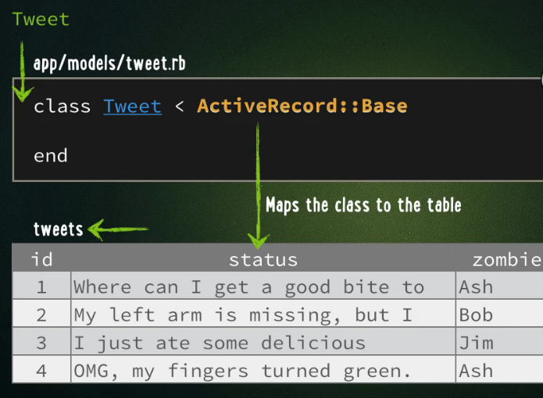
Model Class – representing a database table entry
Our Class Tweet is mapped to database tweets automatically by naming convention

Slide 8
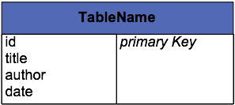
What is Activation Record
3
An Object that
wraps a row in a database table or view,
encapsulates the database access,
adds domain logic on that data
"Martin Fowler"
require "rubygems"
require_gem "activerecord"
#Connect
ActiveRecord::Base.establish_connection(
:adapter => "mysql",
:host => "localhost",
:database => "cs683BookStore_development",
:username => "whitney")
class Book < ActiveRecord::Base
end
1
You would replace this with YOUR database’s info
2
Suppose you have the following database table –maybe in mysql (could be others)
books
MODEL class for books table
General Code using Model Book
#Add to database
ruby = Book.new
ruby.title = 'Programming Ruby'
ruby.author = 'Thomas, Dave'
ruby.date = Time.now
ruby.save
from_database = Book.find_by_title('Programming Ruby')
puts from_database.author
4
CREATE TABLE `books` (
`id` int(11) NOT NULL auto_increment,
`title` varchar(100) NOT NULL default '',
`author` varchar(50) NOT NULL default '',
`date` date default '0000-00-00',
PRIMARY KEY (`id`)
)

Slide 9
More Examples (now with Book Model) to find database entries
a = Book.find_by_title('Programming Ruby')
a = Book.find_by_author('Thomas, Dave')
a = Book.find_all_by_author('Thomas, Dave')
a = Book.find_by_sql("select * from Books where author = 'Thomas, Dave' ")
a = Book.find(:first,
:conditions => "author = 'Thomas, Dave'")
a = Book.find(:first,
:conditions => [ "author = 'Thomas, Dave' and title = 'Programming Ruby'"])
a = Book.find(:all,
:conditions => [ "author = 'Thomas, Dave'"])
name = 'Thomas, Dave'
a = Book.find(:first,
:conditions => [ "author = ?", name])

Slide 10
More Examples (now with Book Model) to create database entry
ruby = Book.new
ruby.title = 'Programming Ruby'
ruby.author = 'Thomas, Dave'
ruby.date = Time.now
ruby.save
aBook = Book.new(
:title => 'Programming Ruby',
:author => 'Thomas, Dave',
:date => Time.now )
aBook.save
aBook = Book.create(
:title => 'Programming Ruby',
:author => 'Thomas, Dave',
:date => Time.now )
params = { :title => 'Programming Ruby',
:author => 'Thomas, Dave',
:date => Time.now}
aBook = Book.create(params)

Slide 11
Well… how do you actually create a new Model class in Rails
You use a generation tool…….lets look

Slide 12
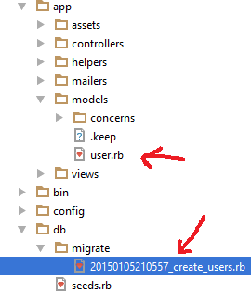
How do you create a Model class in Rails
Command Line
rails generate model name_model_class
RubyMine IDE
Tools-> Run Rails Generator -> model
>>> give it the name of the model class (like
user or students or book)
  What is generated 2 files:
  1) app/models/name.rb
  this is the model class file
  2) db/migrate/*_create_nameS.rb
this is a database file you can use to create
corresponding table (see lecture on database on how to
edit this to create a
NOTE: this assumes we have setup
the Ruby on Rails project to use
a SQL based database
If you instead wanted to use
a MongDB database you would need to install mongoid gem

Slide 13
Using the db/migrations/*_create_modelnameS.rb file to create the underlying database table
Using our previous User example edit the file
db/migrations/*_create_users.rb
class CreateUsers < ActiveRecord::Migration
def change
create_table :users do |t|
t.column :first_name, :string
t.column :last_name, :string
t.timestamps null: false
end
end
end
“users” database table
id | first_name | last_name
Primary key | string | string

Slide 14
Validating
Being Careful when you create a new database entry ---you don’t want blank entries after all or worse?

Slide 15
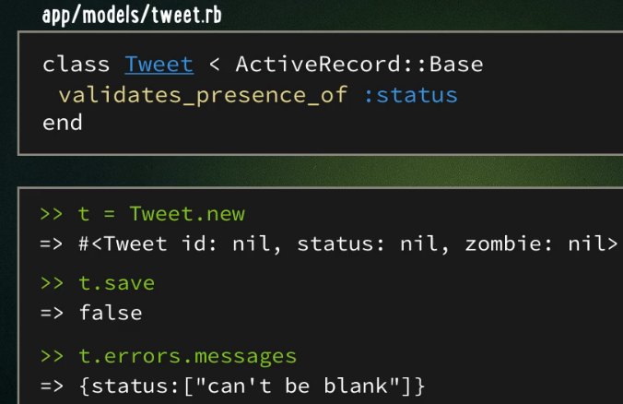
Model Class -- validating
Make sure you don’t want to create a new database entry using our Model class that has certain keys empty.
You do this by setting validates_presence_of :key in the Model class

Slide 16
Model Class – other validations
validates_presence_of :key if key value is specified
validates_numericality_of :key if key value is numerical
validates_uniqueness_of :key if key value is unique
validates_length_of :key, minimum: 3 if key value has length at least 3
validates_inclusion_of :key, in: 9..31 if key value is between 9 to 31

Slide 17
Relationship between Models
Database tables can have relationships between them. Think of Tweet and Zombie. A Zombie can have many Tweets and a Tweet has only one Zombie

Slide 18
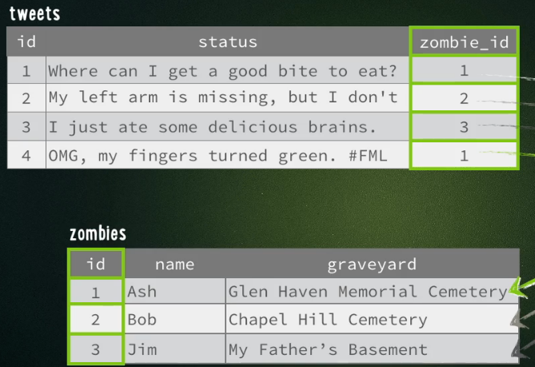
2 tables with Relationships – yields 2 Model classes
First say we have 2 tables

Slide 19
Zombie Class
First, each Zombie class instance (database entry) can have 0 to many Tweet entries
In apps/models/Zombie.rb
class Zombie < ActiveRecord::Base
has_many: tweets
end
Note: you say has_many: tablename
not the corresponding Class name

Slide 20
Zombie Class
First, each Tweet class instance (database entry) can have only 1 corresponding Zombie
In apps/models/Tweet.rb
class Tweet < ActiveRecord::Base
belongs_to: zombie
end
Note: you say SINGULAR
zombie

Slide 21
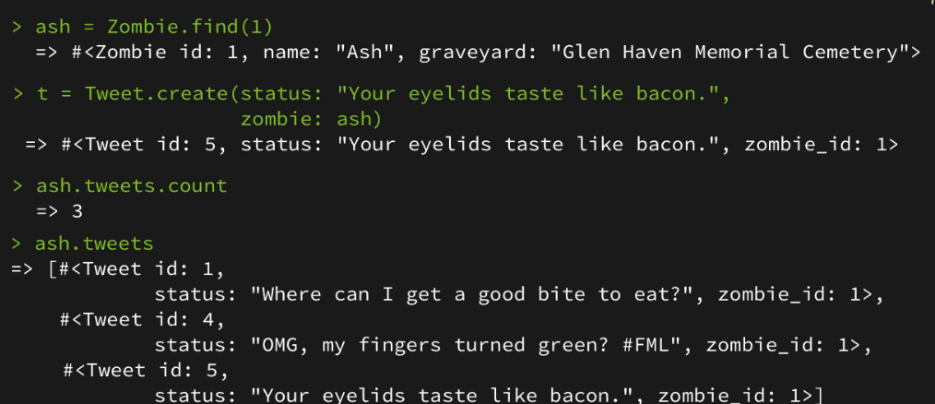
Creating New Tweet for the Zombie with name Ash
First get Zombie Ash, Then create Tweet passing it the Zombie Ash ---it will setup the zombie_id field for you
Start: Ash has 2 tweets

Slide 22
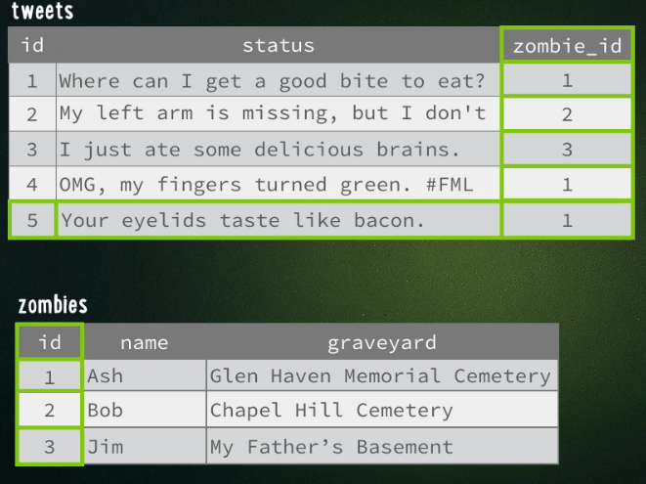
The new Tweet in database tweets

Slide 23
Model Class – other validations
ALTERNATIVE
validates :key, type: value
EXAMPLE
validates :status, presence: true if they status’s value is not nill
EXAMPLE 2
validates :status, length: {minimum: 3} if they status’s value has minimum length of 3

Slide 24
One more example for the road
The Student Model and corresponding students table

Slide 25
Model for Student Table
SELECT * FROM students;
+----+-----------+------------+------+------+
| id | name | birth | gpa | grad |
+----+-----------+------------+------+------+
| 1 | Anderson | 1987-10-22 | 3.9 | 2009 |
| 2 | Jones | 1990-04-16 | 2.4 | 2012 |
| 3 | Hernandez | 1989-08-12 | 3.1 | 2011 |
| 4 | Chen | 1990-02-04 | 3.2 | 2011 |
+----+-----------+------------+------+------+
Rails model class (app/models/student.rb):
class Student < ActiveRecord::Base
end
Command to create this class:
rails generate model student

Slide 26
How you can Create New Record--- maybe inside a Controller class’s method somewhere (we will discuss Controllers later)
student = Student.new
student.name = "Williams"
student.birth = "1989-11-16"
student.gpa = 2.8
student.grad = 2012
student.save()

Slide 27
Well here is a peak (you don’t understand yet) at some controller code That asks to get All students in the database table
app/controllers/students_controller.rb:
class StudentsController < ApplicationController
...
def index
@students = Student.all
end
end
REQUEST:
http://localhost:3000/students/index
This will call the StudentsController.index method

Slide 28
Here is a View that will be invoked by previous Controller’s index method
app/views/students/index.html.erb:
<%@title = "All Students"%>
<h1>Current Students</h1>
<table class="oddEven">
<tr class="header">
<td>Name</td>
<td>Date of Birth</td>
<td>GPA</td>
<td>Graduation Year</td>
</tr>
<% for student in @students %>
<tr class="<%= cycle('even', 'odd') %>">
<td><%= link_to(student.name, :action => :edit,
:id => student.id) %></td>
<td><%= student.birth %></td>
<td><%= student.gpa %></td>
<td><%= student.grad %></td>
</tr>
<% end %>
</table>
NOTE:
The hash @students was defined in Controller on previous slide. It contains instances of Student Model class –each one representing a different entry in the students database table

Slide 29
Student Model: Read, Update, Delete
students = Student.all()
student = Student.find(187)
student = Student.find_by(name: "Hernandez")
student = Student.find_by_name("Hernandez")
smarties = Student.where("gpa >= 3.0")
smarties = Student.order("gpa DESC").limit(10)
student = Student.find(187)
student.gpa = 4.0
student.save()
Student.find(187).destroy()
AGAIN:
This code would be in a Controller class’s method(s)

