Slide 1
iPhone App Development
Basic ideas ---see developer.apple.com for latest in tools and techniques

Slide 2
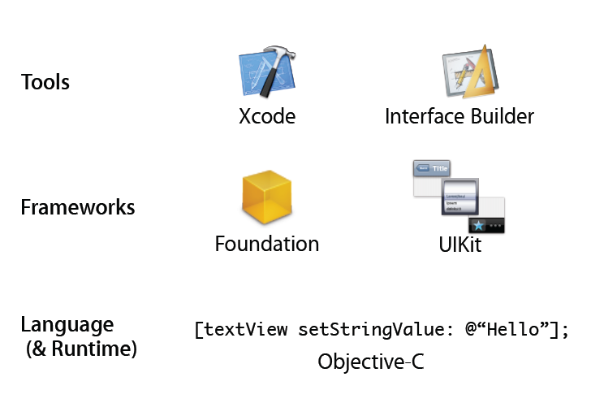
The components

Slide 3
Swift
End 2014 invented for iOS Development
Created to replace Objective-C
“simpler”?
Object Oriented

Slide 4
Objective C
Exposure to other languages is always good
ObjectiveC is a language focused on simplicity and the elegance of OO design
Based on ANSI C
Brings many object oriented principles, but with a minimal amount of syntax
A data point to compare with designs of C, C++ and Java

Slide 5
Core OS
OS X Kernel Power Mgmt
Mach 3.0 Keychain
BSD Certificates
Sockets File System
Security Bonjour

Slide 6
Core Services
Collections Core
Location
Address Book
Net Services
Networking
Threading
File Access
Preferences
SQLite
URL utilities

Slide 7
Media
Core Audio
JPG, PNG, TIFF
OpenAL
PDF
Audio Mixing
Quartz (2D)
Audio Recording
Core Animation
Video Playback
OpenGL ES

Slide 8
Cocoa Touch
Multi-Touch Events
Alerts
Multi-Touch Controls
Web View
Accelerometer
People Picker
View Hierarchy
Image Picker
Localization
Camera

Slide 9
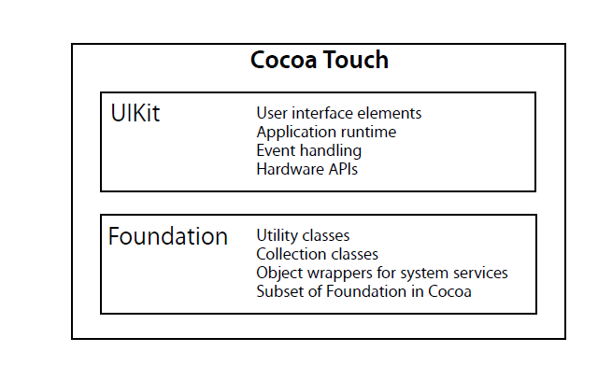
Cocoa Touch Architecture

Slide 10
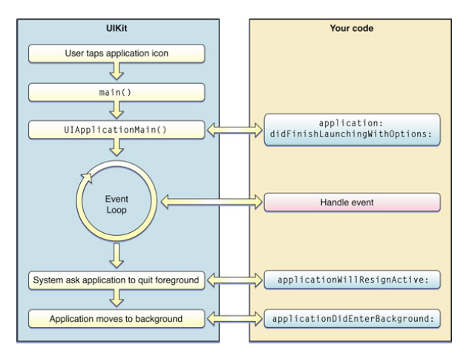
Application Lifecycle

Slide 11
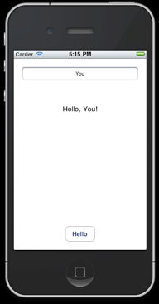
Learning through Example

Slide 12
Concepts to Master
Application & Delegation
Model View Controller
Events

Slide 13
What we will learn
UIKit
Classes, methods
How it works

Slide 14
Tools we will use
Xcode
Interface builder
StoryBoard Interface Builder, xib files
resources etc

Slide 15
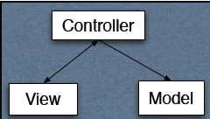
iPhone development based on MVC
Model
App data & functionality
View
user interface
Controller
Intermediary between Model & View
When model changes updates view
When user interacts with view updates model
App logic lives here

Slide 16
UIApplication
All iOS apps are instances of UIApplication class
Handles lifecycle of the application
Handles events from OS
Manages status bar
Contains all application windows

Slide 17
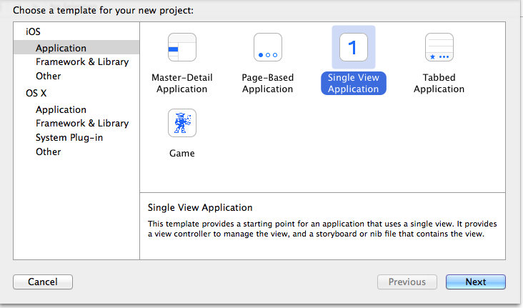
The HelloWorld iOS App
Launch Xcode.
By default it’s in Developer/Applications.
Create a new project by choosing File > New Project.
You should see a new window similar to this:

Slide 18
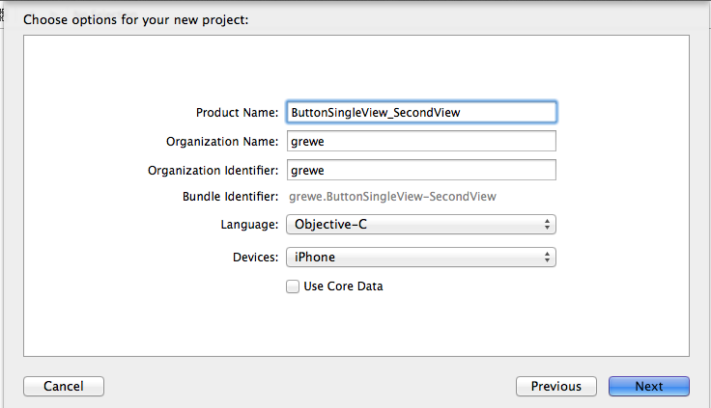
Creation of Project continued
In the left pane, choose iOS ->application.
Select whatever you want like Single View Application then click Next.
In the project options menu, make sure iPhone is selected if you want iPhone app, otherwise iPad or Universal (for both).
Do not select the option to use Core Data. This code does not use Core Data.
Choose Language, Project name, organization.

Slide 19
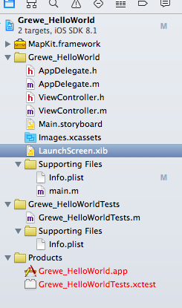
Creation of Project continued
Click Next.
A sheet appears to allow you to select where your project will be saved.
Select a suitable location for your project (such as the Desktop or a custom Projects directory), then click Save.
You do not need to create a version control repository for this project, although in general you are encouraged to do so.
Here we created a Project called Grewe_HelloWorld
>> see above for the created files.

Slide 20
Project Files Explained-Single View Example
AppDelegate.h,.m = delegate class
ViewController.h,.m = main (single) ViewController created
Main.storyboard = storyboard containing Single View Interface (tied to ViewController)
main.m = Main function launches AppDelegate UIApplicaiton
Info.plist = property list for application
Here we created a Project called Grewe_HelloWorld
>> see above for the created files.

Slide 21
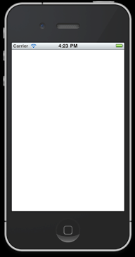
Running your Project in Simulator
Product > Run (or click the Run button in the toolbar).
At this point what you see is blank:
Simulator > Quit stops it

Slide 22
Lets examine what is going on
This project creates an application object, connects to the window server, establishes the run loop, and so on. Most of the work is done by the UIApplicationMain function.
The main function in main.m calls the UIApplicationMain function:
int retVal = UIApplicationMain(argc, argv, nil, nil);
This creates an instance of UIApplication.
It also scans the application’s Info.plist property list file.

Slide 23
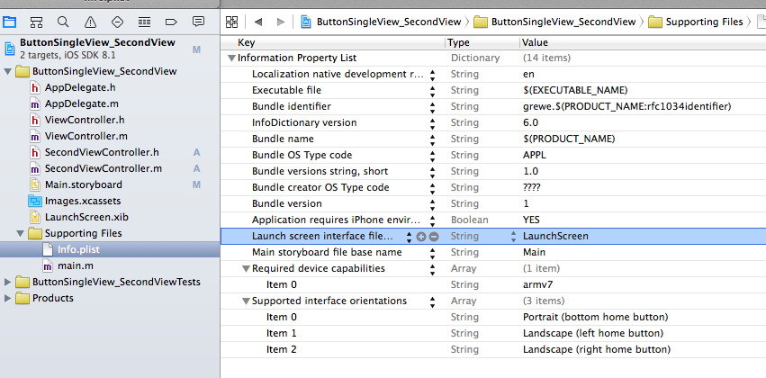
Info.plist
is a dictionary that contains information about the application such as its name and icon.
Says LaunchScreen = file LaunchScreen.xib
Says Main Storyboard = Main.storyboard

Slide 24
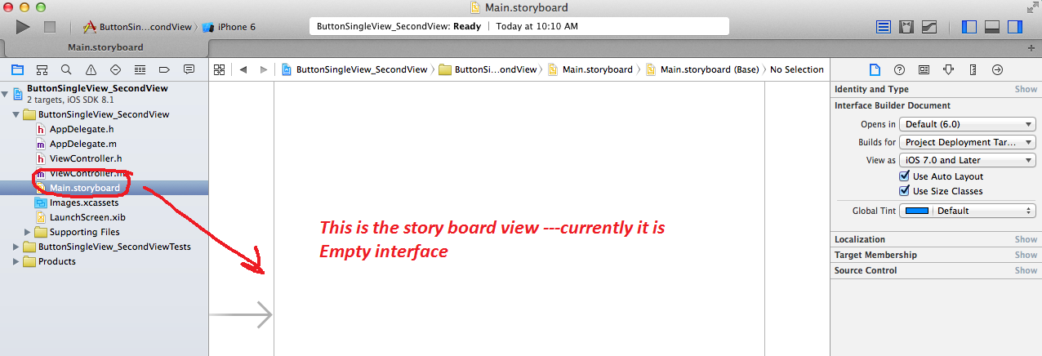
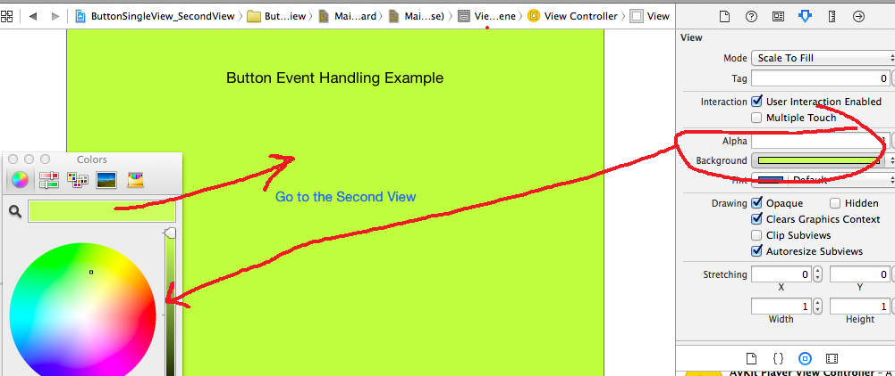
The interface --- uses StoryBoards
Here I created an Interface with Label and Button and Green background

Slide 25
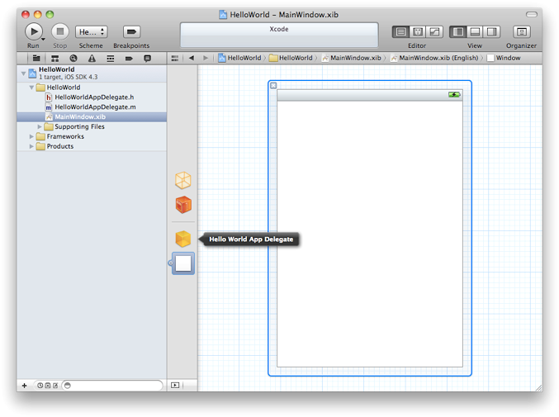
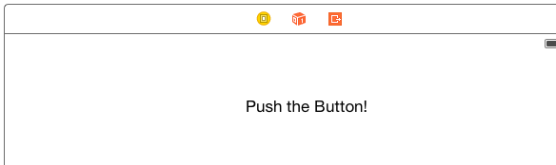
What are the Xcode icons – see top of each View in Storyboard
ViewController
When select this you can drag and drop Widgets from Object Library
First Responder
Deals with The Event-Handling System
Exit
Advanced- A way to Unwind a previous View when you exit this view

Slide 26
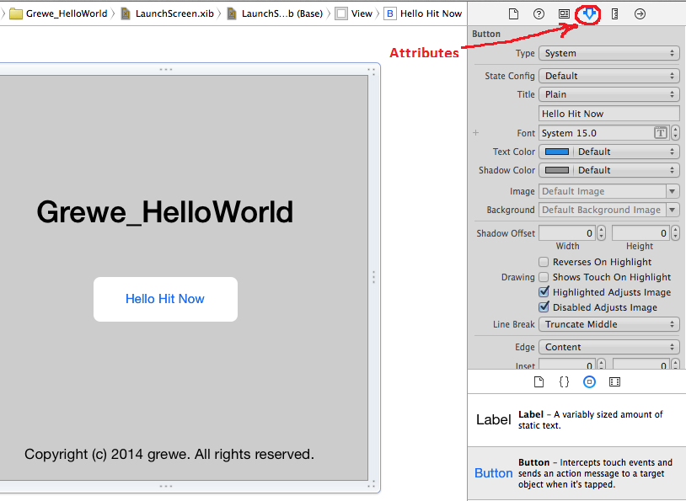
Altering the interface---make the “Hello App”
Select View in StoryBoard
Select on bottom Right window the Object Library
Drag and Drop Widgets to View

Slide 27
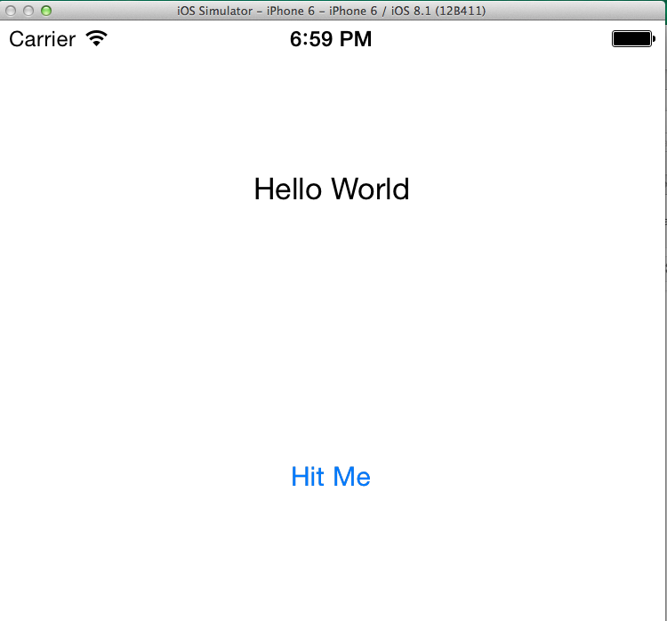
Hello Application - events
When user hits button things will happen → See example on website

Slide 28
Delegation
Delegation is a pattern in which one object sends messages to another object specified as its delegate to ask for input or to notify the delegate that an event is occurring.
The Hello application object tells its delegate that the main start-up routines have finished and that the custom configuration can begin.
Application’s Delegate should create an instance of a controller to set up and manage the view.
Also text field will tell its delegate (which in this case will be the same controller) when the user has tapped the Return key.

Slide 29
Hello Application: Event Handling
The target-action mechanism enables a view object that presents a control—that is, an object such as a button or slider—in response to a user event (such as a click or a tap) to send a message (the action) to another object (the target) that can interpret the message and handle it as an application-specific instruction.
Hello Application: button tells the controller to update its model and view based on the user’s input.

Slide 30
OS Events & Your App
App started
App moving to background
App terminating
App received memory warning
App received notification

