Slide 1
The Controller in MVC of iOS
CS4521

Slide 2
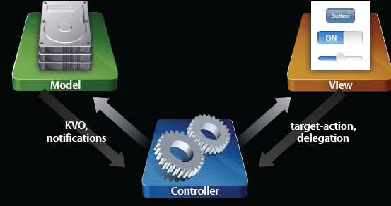
The controller in the MVC
Controller
Knows about model and view objects
The brains of the operation
Manages relationships and data flow
Typically app-specific,
so rarely reusable

Slide 3
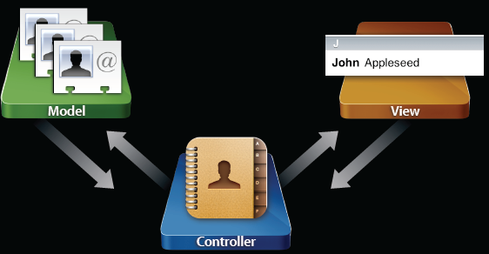
Visualization of the MVC for the “Contacts” App

Slide 4
Typical Application Flow
Some application flows are very common
  Navigation-based
  Tab bar-based
  Combine the two
Don’t reinvent the wheel
Plug individual screens together to build an app

Slide 5
UIViewController
You will create as needed subclass of UIViewController
#import <UIKit/UIKit.h>
@interface MyViewController : UIViewController {
    // A view controller will usually
    // manage views and data
    NSMutableArray *myData;
    UILabel *myLabel;
}
//Expose data-content to users of this class
@property (readonly) NSArray *myData;
// And respond to actions
- (void)doSomeAction:(id)sender;

Slide 6
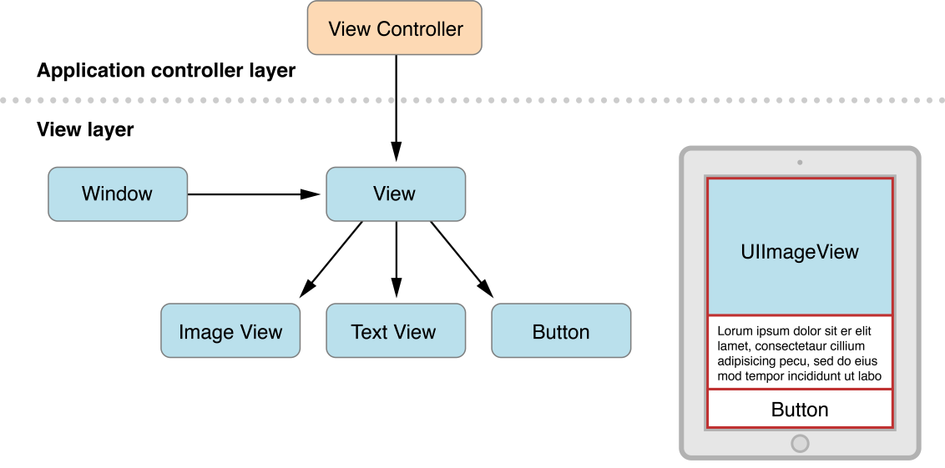
What does a UIViewController do?
Where necessary, a view controller:
  resizes and lays out its views
  adjusts the contents of the views
  acts on behalf of the views when the user interacts with them
NOTE: this is MORE than handling user interaction
A View Controller Controls a single “scene” (GUI if you will) and that means making it display as well as hooking up any user interaction code (event handling).
A single scene has a root UIView that can contain a hierarchy of views

Slide 7
Where is the View in a UIViewController
UIViewController superclass has a view property
@property (retain) UIView *view;
Loads lazily
On demand when requested
Can be son demand as well (low memory)
NOTE: The view stored in this property represents the root view for the view controller’s view hierarchy

Slide 8
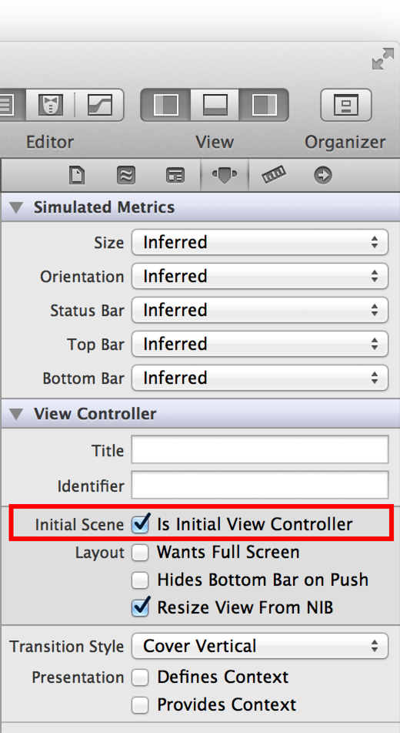
With Storyboarding on in your project –you can select which UIViewController displayed at launch
Select the UIViewController
In properties you can
select it as the initial “scene”

Slide 9
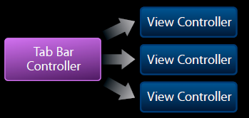
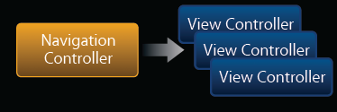
Creating your own UIViewController subcalsses
Create your own UIViewController subclass for each screenful or View as needed
    Plug them together using existing composite view controllers

Slide 10
UIViewController loading the View using nib file → initWithNibName method
INSIDE your UIViewController class
// The designated initializer. Override to perform setup that is required before the view is loaded.
- (id)initWithNibName:(NSString *)nibNameOrNil bundle:(NSBundle *)nibBundleOrNil {
if ((self = [super initWithNibName:nibNameOrNil bundle:nibBundleOrNil])) {
// Perform initialization --- NOTHING View related
******code here- don’t override method if nothing here
}
return self;
}

Slide 11
Now we are not meant to edit our nib (.xib) files in raw XML (unlike other mobile platforms---android and .xml layout files)
BUT….. Here is a peak at PART of a simple “hello world” application with a UIView and a UILabel in it
<object class="IBUIView" id="774585933">
<reference key="NSNextResponder"/>
<int key="NSvFlags">274</int>
<object class="NSMutableArray" key="NSSubviews">
<bool key="EncodedWithXMLCoder">YES</bool>
<object class="IBUILabel" id="965650967">
<reference key="NSNextResponder" ref="774585933"/>
<int key="NSvFlags">292</int>
<string key="NSFrame">{{114, 74}, {89, 21}}</string>
<reference key="NSSuperview" ref="774585933"/>
<bool key="IBUIOpaque">NO</bool>
<bool key="IBUIClipsSubviews">YES</bool>
<int key="IBUIContentMode">7</int>
<bool key="IBUIUserInteractionEnabled">NO</bool>
<string key="targetRuntimeIdentifier">IBCocoaTouchFramework</string>
<string key="IBUIText">Hello World</string>
<object class="NSColor" key="IBUITextColor">
<int key="NSColorSpace">1</int>
<bytes key="NSRGB">MCAwIDAAA</bytes>
</object>
<nil key="IBUIHighlightedColor"/>
<int key="IBUIBaselineAdjustment">1</int>
<float key="IBUIMinimumFontSize">10</float>
</object>

Slide 12
UIViewController loading the View programmatically in loadView method
// Implement loadView to create a view hierarchy programmatically, without using a nib.
- (void)loadView
{
  //create View object in code
  MyView *myView = [[MyView alloc] initWithFrame:frame];
  //associate view object with this UIViewController’s view
  self.view = myView; // The view controller now owns the view
  [myView release];
}

Slide 13
View Lifecycle –what you must do in UIViewController
STEP 1: Create view using nib or programmatically
STEP 2: Implement viewDidLoad when you want to customize the view after it has been loaded in STEP 1
    - (void)viewDidLoad
    {
      // Your view has been loaded
      // Customize it here if needed
      view.someWeirdProperty = YES;
    }
STEP 3: View about to appear –override if desired
    - (void)viewWillAppear:(BOOL)animated
    {
      [super viewWillAppear:animated];
      // Your view is about to show on the screen
      [self beginLoadingDataFromTheWeb];
      [self startShowingLoadingProgress];
    }

Slide 14
View Lifecycle –what you must do in UIViewController
STEP 4: View about to DISAPPEAR –override if desired
  - (void)viewWillDisappear:(BOOL)animated
  {
    [super viewWillDisappear:animated];
    // Your view is about to leave the screen
    [self rememberScrollPosition];
    [self saveDataToDisk];
  }

