Slide 1
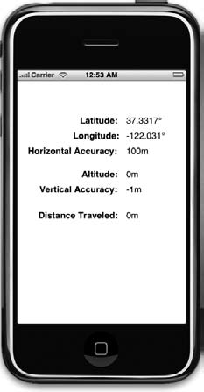
iOS and Location Services
CS4521

Slide 2
Core Location
Framework to determine the current latitude and longitude of a device
Core Location uses a type of streaming notification so that your application receives updates as the GPS ascertains a more accurate fix.
CAREFUL: can be expensive for battery

Slide 3
There are three technologies that core
location uses :
  GPS
  Reads microwave signals from multiple satellites to determine the current location
  Cell Tower Triangulation
  Determine the current location by calculation based on location of cell towers in iPhone’s range.
  Wi-Fi positioning Service (WPS)
  Uses IP address from iPhone’s Wi-Fi connection by referencing database of service providers and areas they service

Slide 4
Location Manager
(CLLocationManager)
create an instance of Location Manager.
CLLocationManager *locationManager=[[CLLocationManager alloc]init];
Assign a delegate object to it, and configure the
desired accuracy you want.

Slide 5
Location Object
(CLLocation)
Represents the location data generated by a CLLocationManager object.
Lat, Long, accuracy and when taken

Slide 6
CLLocationAccuracy - Setting Desired Accuracy
CONSTANTS declared in CoreLocation/CoreLocation.h (in degrading accuracy)
  kCLLocationAccuracyBest
  kCLLocationAccuracyNearestTenMeters
  kCLLocationAccuracyHundredMetres
  kCLLocationAccuracyKilometers
  kCLLocationAccuracyThreeKilometers
Setting Delegate and Accuracy:
locationManager.delegate=self;
locationManager.desiredAccuracy= kCLLocationAccuracyBest

Slide 7
Setting Distance Filter
you can tell Location manager not to notify for every change in location but to only notify you when location changes by certain amount.
Setting up a distance filter reduced the amount of polling that your application does.
Specifying a distance filter of 1000 tells location manager not to notify the delegate until the iPhone has moved at least 1000 meters from previously reported position

Slide 8
Setting Distance Filter Example
For example:
locationManager.distanceFilter=1000.0f;
To return location manager to return to default setting with no filter then:
locationManager.distanceFilter= kCLDistanceFilternone;

Slide 9
Starting the Location Manager
It will continue to call your delegate method whenever it senses a change that exceeds the current distance filter
[locationManager startUpdatingLocation];

Slide 10
Location Manager Delegate
CLLocationManagerDelegate
defines the methods used to receive location and heading updates from a CLLocationManager object.
YOU WILL create your OWN Location Manager Delegate class and implement methods of your need.

Slide 11
CLLocationManagerDelegate
Getting Location Updates
When the location manager wants to inform its delegate of the current location, it calls:
[LocationMangerDelegate locationManger:lm didUpdateToLocation:tLoc fromLocation:fLoc]
locationManager:didUpdateToLocation:fromLocation
  locationManager= First parameter is location Manager that called the delegate.
  didUpdateToLocation= Second is CLLocation object that defines current location of iPhone
  didUpdateToLocation=Third parameter is CLLocation object that defines previous location from last update (will be nil if method is called first time.)

Slide 12
Implement the method
-(void)locationManager:(CLLocationManager *)manager didUpdateToLocation:(CLLocation *)newLocation fromLocation:(CLLocation *)oldLocation
{ //save location in class variable currentLocation
self.currentLocation = newLocation;
if(newLocation.horizontalAccuracy <= 100.0f)
{ [locationManager stopUpdatingLocation]; }
}

Slide 13
Getting Latitude and Longitude using CLLocation
CLLocation object has some properties that might be interest to your application
The latitude and longitude are stored in property called coordinate.
CLLocationDegrees latitude=theLocation.coordinate.latitude;
CLLocationDegrees longitude=theLocation.coordinate.longitude;
CLLocation object also tell you how confident the location manager is in latitude and longitude calculations by the property horizontalAccuracy which describes the radius a circle with coordinates as its center.

Slide 14
Getting Latitude and Longitude using CLLocation
The CLLocation object also has a property called altitude that tell you how many metres above the sea level you are:
CLLocationDistance altiude=theLocation.altitude
Each CLLocation object maintains a property called verticalAccuracy that indicate how confident core location is in its altitude determination.
If verticalAccuracy is negative core location is telling you that it cannot determine the altitude.

Slide 15
Getting Latitude and Longitude using CLLocation
has timestamp
getDistanceFrom: method calculates distance etween 2 CLLocation objects
CLLocationDistance dist;
dist =[fromLocation getDistanceFrom:toLocation];
Note: ignores the altitude as if both locations are at sea level

Slide 16
Error Notification
locationManager:didFailWithError:.
  Method called when can not get location of device will call second delegate method named
KCLErrorDenied:
  first time your application goes to determine location an alert will popup on screen asking user if its OK for the current program to access your location.
  If user clicks the Don’t Allow button,your delegate will be notified with an error code kCLErrorDenied.
kCLErrorLocationUnnown
  which indicate core location unable to determine location but will keep trying.

Slide 17
Another CCLocationManagerDelegate method –handling errors
(void)locationManager:(CLLocationManager *)manager didFailWithError:(NSError *)error
{
  if(error.code == kCLErrorDenied)
  { [locationManager stopUpdatingLocation]; }
  else if(error.code == kCLErrorLocationUnknown)
  { // retry }
  else
  { UIAlertView *alert = [[UIAlertView alloc] initWithTitle:@"Error retrieving location"
  message:[error description]
  delegate:nil
  cancelButtonTitle:@"OK"
  otherButtonTitles:nil];
  [alert show]; }
}

Slide 18
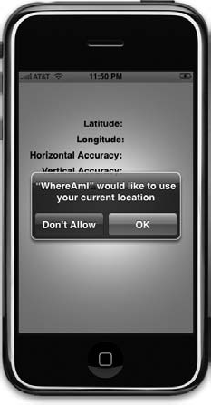

Slide 19
Trying Out Core Location
>>>app get current location and total distance travelled while program has been running.

Slide 20
Step 1- create the project
In Xcode, create a new project using view-based application template and call the project WhereAmI..
Expand the classes and resources folders and single-click WhereAmIViewContoller..h and make following changes

Slide 21
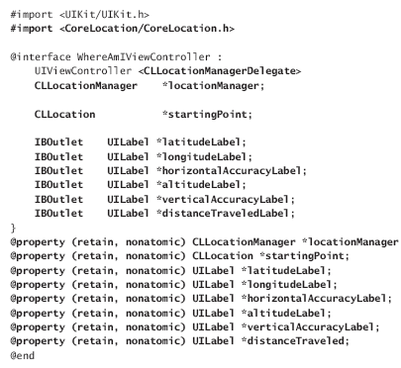
Step 2- WhereAmIViewContoller..h
NOTE: your app’s ViewController IS the
CLLocationMangerDelegate
NOTE: ViewController contains class variables of the CLLocationManger and
Current CLLocation

Slide 22
Step 2- Create XIB using Interface Builder
Open WhereAmIViewController.xib in IB. Drag 6 UILabel labels from library to the view window.
Connect to proper outlets

Slide 23
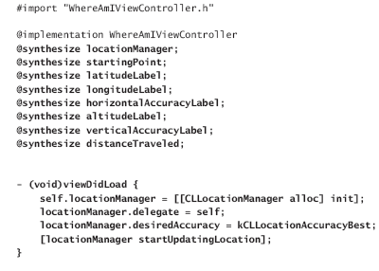
Step 3- WhereAmIViewController.m
Create this code
Get CLLocationManger and start it

Slide 24
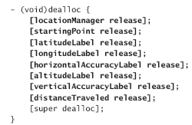
Release locationManger ---save Battery!!!!

Slide 25
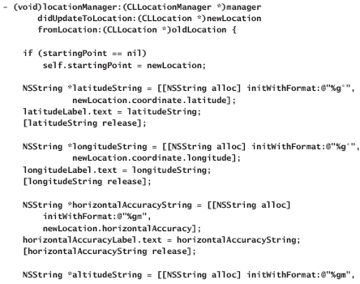
Step4: To WhereAmIViewController.h add the CLLocationManager Delegate Method to get Update
Gets Lat and Long
and saves it in UILabel’s of the View

Slide 26
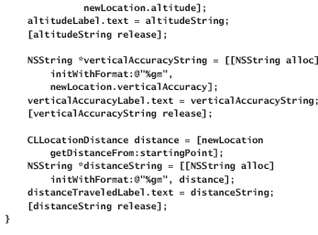

Slide 27
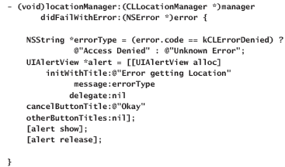
Step5: To WhereAmIViewController.h add the CLLocationManager Delegate Method to handle Errors

Slide 28
Application

