Slide 1
iOS and AddressBook
CS4521

Slide 2

Address Book UI Framework Exploring Contacts

Slide 3
Address Book UI
The Address Book UI framework provides controllers that facilitate displaying, editing, selecting, and creating records in the Address Book database.
On the iPhone, contact data resides in the home Library folder. On the Macintosh simulator, you can freely access these files in ~/Library/Application Support/iPhone Simulator/User/Library.

Slide 4
Address Book UI
The two files, AddressBook/AddressBook.sqlitedb and AddressBook/AddressBookImages.sqlitedb use standard SQLite3 to store contact information and optional contact images.
On the iPhone, you cannot access these directly.
The files live in /var/mobile/Library/AddressBook
The Address Book UI framework provides two key user interfaces: a people "picker" navigation controller to choose contacts, and a view controller to display a single contact.

Slide 5
Working with Address Book Objects
There are four basic objects that you need to understand in order to interact fully with the Address Book database: address books, records, single-value properties, and multivalue properties

Slide 6
Address Book
Address books let you interact with the Address Book database and save changes to it. To use an address book, declare an instance of ABAddressBookRef and set it to the value returned from the function ABAddressBookCreate.
After you have created an address book reference, your application can read data from it and save changes to it. To save the changes, use the function ABAddressBookSave; to abandon them, use the function ABAddressBookRevert. To check whether there are unsaved changes, use the function ABAddressBookHasUnsavedChanges.

Slide 7
Person Records
Person records are made up of both single-value and multi-value properties. Properties that a person can have only one of, such as first name and last name, are stored as single-value properties. Other properties that a person can have more that one of, such as street address and phone number, are multi-value properties.

Slide 8
Group Records
Users may organize their contacts into groups for a variety of reasons. For example, a user may create a group containing coworkers involved in a project, or members of a sports team they play on. Your application can use groups to allow the user to perform an action for several contacts in their address book at the same time.
Group records have only one property, kABGroupNameProperty, which is the name of the group. To get all the people in a group, use the function ABGroupCopyArrayOfAllMembersWithSortOrdering or ABGroupCopyArrayOfAllMembers, which return a CFArray of ABRecordRef objects with and without sorting.

Slide 9
Interacting Using UI Controllers
The Address Book UI framework provides one view controller and three navigation controllers for common tasks related to working with the Address Book database and contact information.
ABPeoplePickerNavigationController prompts the user to select a person record from their address book.
ABPersonViewController displays a person record to the user and optionally allows editing.

Slide 10
ABNewPersonViewController prompts the user create a new person record.
ABUnknownPersonViewController prompts the user to complete a partial person record, optionally allows them to add it to the address book.
To use these controllers, you must set a delegate for them which implements the appropriate delegate protocol.

Slide 11
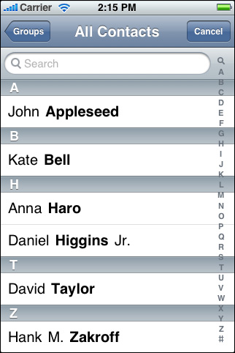
ABPeoplePickerNavigationController
Allows users to browse their list of contacts and select a person and, at your option, one of that person’s properties.
Notes:
ABPeoplePickerNavigationController

Slide 12
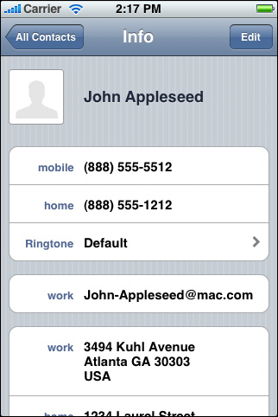
ABPersonViewController
Displays a record to the user.
Person view controller—displaying with editing allowed
Notes:
ABPeoplePickerNavigationController

Slide 13
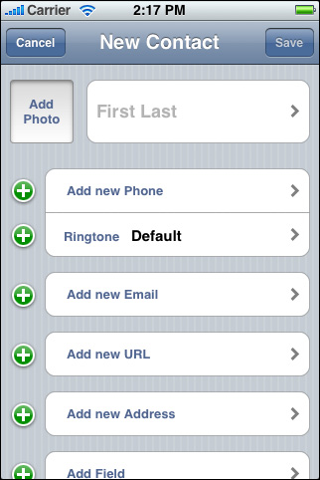
ABNewPersonViewController
Allows users to create a new person
Notes:
ABPeoplePickerNavigationController

Slide 14
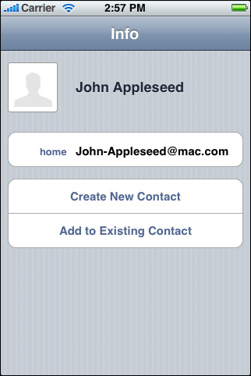
ABUnknownPersonViewController
Allows the user to add data to an existing person record or to create a new person record for the data.
Notes:
ABPeoplePickerNavigationController

Slide 15
Create the Project
In Xcode, create a new project from the View Based Application template. Save the project as QuickStart. The next step is to add the frameworks you will need. First, go to your project window and find the target named QuickStart in the Targets group. Open its info panel (File > Get Info) and, in the General tab, you see a list of linked libraries. Add the Address Book and Address Book UI frameworks by clicking the plus button and selecting them from the list.
Notes:
ABPeoplePickerNavigationController

Slide 16
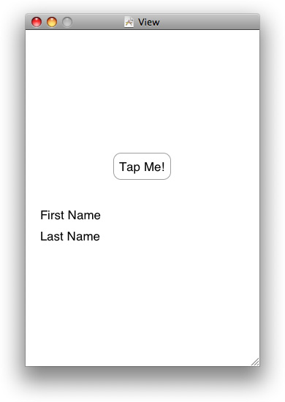
QuickStartViewController.xib.
Notes:
ABPeoplePickerNavigationController

Slide 17
QuickStartViewController.h
@interface QuickStartViewController : UIViewController <ABPeoplePickerNavigationControllerDelegate>
{
IBOutlet UILabel *firstName;
IBOutlet UILabel *lastName;
}
@property (nonatomic, retain) UILabel *firstName;
@property (nonatomic, retain) UILabel *lastName;
- (IBAction)showPicker:(id)sender;
@end
Notes:
ABPeoplePickerNavigationController

Slide 18
QuickStartViewController.m
#import "QuickStartViewController.h“
@implementation QuickStartViewController
@synthesize firstName;
@synthesize lastName;
-(IBAction)showPicker:(id)sender
{
ABPeoplePickerNavigationController *picker = [[ABPeoplePickerNavigationController alloc] init]; picker.peoplePickerDelegate = self; [self presentModalViewController:picker animated:YES];
[picker release];
}
Notes:
ABPeoplePickerNavigationController

Slide 19
you will now begin implementing the delegate protocol, by adding two more methods.
If the user cancels, the first method is called to dismiss the people picker.
If the user selects a person, the second method is called to copy the first and last name of the person into the labels and dismiss the people picker.
Notes:
ABPeoplePickerNavigationController

Slide 20
(void)peoplePickerNavigationControllerDidCancel: (ABPeoplePickerNavigationController*) peoplePicker
{
[self dismissModalViewControllerAnimated:YES];
}
Notes:
ABPeoplePickerNavigationController

Slide 21
- (BOOL)peoplePickerNavigationController: (ABPeoplePickerNavigationController *)peoplePicker shouldContinueAfterSelectingPerson:(ABRecordRef)person
{
NSString* name = (NSString *)ABRecordCopyValue(person, kABPersonFirstNameProperty);
self.firstName.text = name;
[name release];
name = (NSString *)ABRecordCopyValue(person, kABPersonLastNameProperty);
self.lastName.text = name; [name release];
[self dismissModalViewControllerAnimated:YES];
return NO;
}
Notes:
ABPeoplePickerNavigationController

Slide 22
To fully implement the delegate protocol, you must also add one more following function. The people picker calls this third function when the user taps on a property of the selected person in the picker. In this application, the people picker is dismissed when the user selects a person, so there is no way for the user to select a property of that person. This means that the third method can never be called. However if it were left out, the implementation of the protocol would be incomplete.
Notes:
ABPeoplePickerNavigationController

Slide 23
(BOOL)peoplePickerNavigationController: (ABPeoplePickerNavigationController *)peoplePicker shouldContinueAfterSelectingPerson: (ABRecordRef)person property:(ABPropertyID)property identifier:(ABMultiValueIdentifier)identifier
{
return NO;
}
(void)dealloc
{
[firstName release];
[lastName release];
[super dealloc];
}
@end
Notes:
ABPeoplePickerNavigationController

Slide 24
Make Connections
In the Identity inspector (Tools > Identity Inspector), verify that the class identity of File’s Owner is QuickStartViewController—it should already be set correctly for you by the template. Connect the outlets for firstName and lastName from File’s Owner to the first name and last name labels. Finally, connect the Touch Up Inside outlet from the button to File’s Owner and select the showPicker method.
Notes:
ABPeoplePickerNavigationController

