Slide 1
MVC in iOS
Conceptual ideas

Slide 2
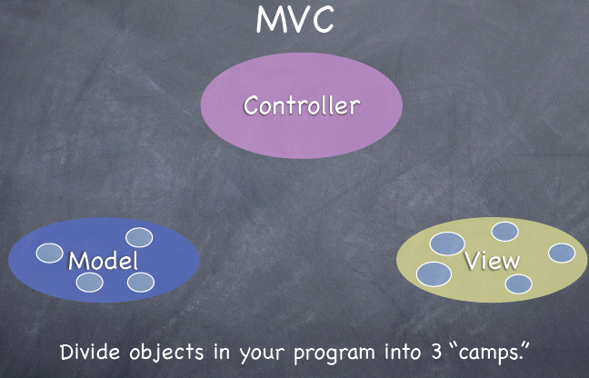
MVC – Model View Controller
Some images borrowed from Stanford Utunes iOS lectures

Slide 3
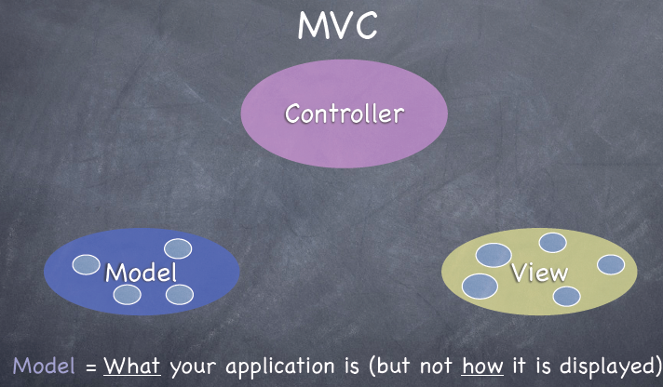
Model
Represents “state/ data/ information” in our app

Slide 4

Controller
Used to update our Model and trigger our Views

Slide 5
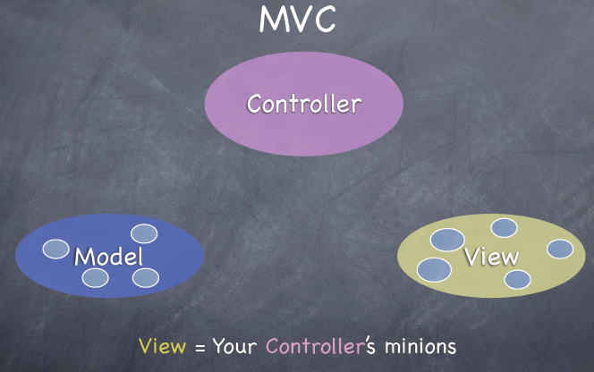
View
Represents the “presentation” layer of our app

Slide 6
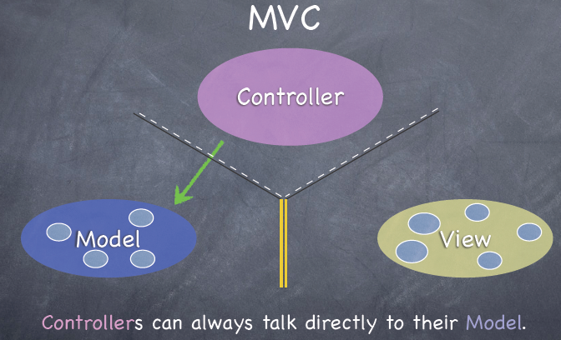
MVC --- how do they interact
Controller → updates the Model

Slide 7
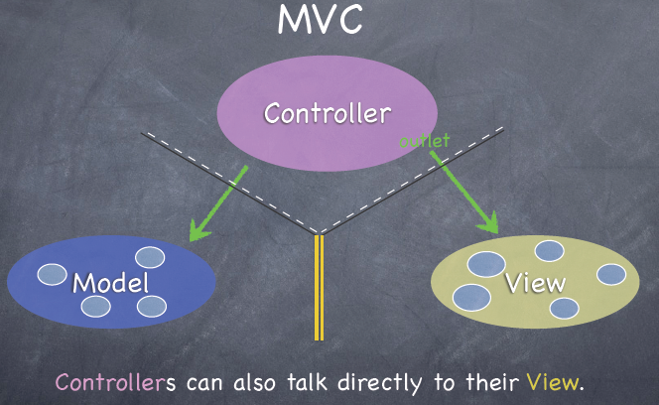
MVC --- how do they interact
Controller → tells View to update or xxx

Slide 8
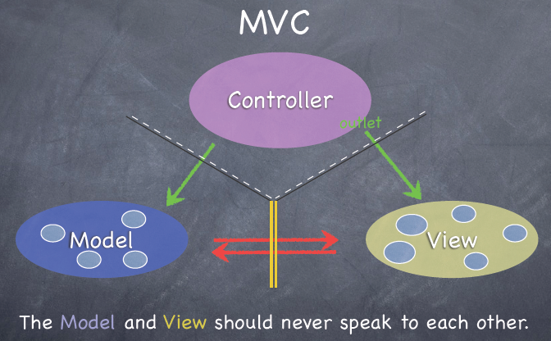
MVC --- how do they interact
Model and View NEVER COMMUNICATE DIRECTLY

Slide 9



MVC – can the View communicate to Controller when an Event?
In an “indirect” way yes for iOS
STEP 1: Controller drops a target on itself called an “outlet”
STEP2: Give the View an “action” that can be triggered to communicate to the “outlet” of the Controller
STEP 3: View when altered (say by user doing something in it—i.e. typing text) through the “action” notifies the “outlet” of changes

