Slide 1
Android – Gestures
L. Grewe

Slide 2
What and why
a great way to interact with applications on mobile devices.
With a touch screen, users can easily tap, drag, fling, or slide to quickly perform actions in their favorite applications.
Android framework makes it's easy to recognize simple actions, like a swipe,
new gestures API in Android 1.6. lets developer recognize more complicated gestures.
package android.gesture, : store, load, draw, and recognize gestures.

Slide 3
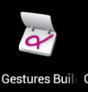
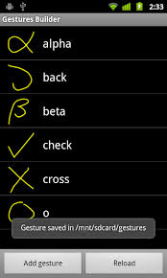
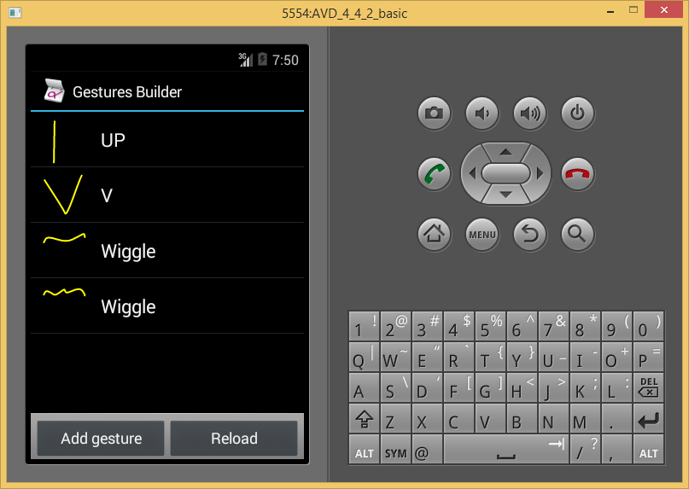
Creating a gestures library
Gestures Builder
  application pre-installed on the emulator,
  create a set of pre-defined gestures for your own application (rather than the standard set)
  Here is example with a few gestures already created
Because store files in SD card:
make sure to create an AVD with an SD card image to use Gestures Builder.

Slide 4
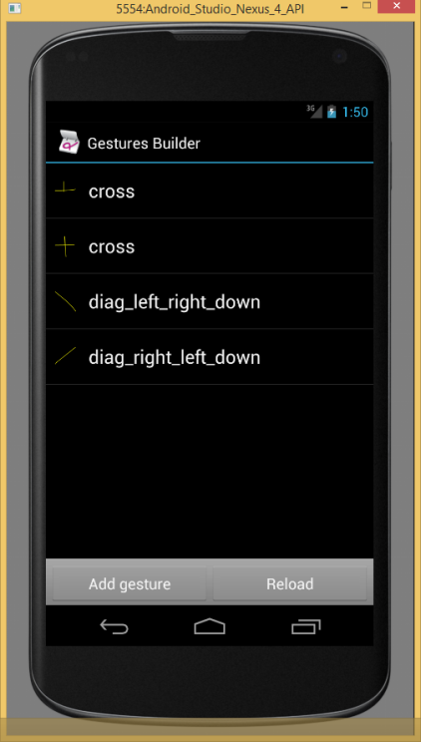
Defining your own Gestures
Gesture associated with a name
names do not have to be unique.
  scan be very useful to have several gestures with the same name to increase the precision of the recognition.

Slide 5
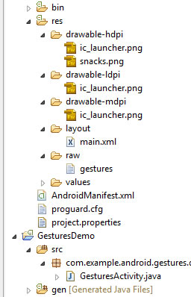
Defining your own Gestures
Android Studio (create raw directory)
locate and right-click on the res folder (located under app) and select New -> Directory
GestureBuilder:
Every time you add or edit a gesture in the Gestures Builder, a file is generated on the emulator's SD card, /sdcard/gestures.
  file contains the description of all the gestures
  you will need to package it inside your
  application inside the resources directory,
  in /res/raw.
move the generated /sdcard/gestures file
to your /rese/raw folder in your project

Slide 6
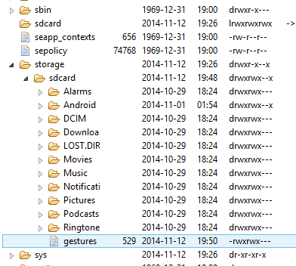
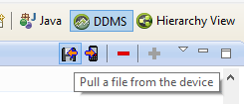
How to move file
Go to Android Device Manager to get to FileExporer
See outline for web page
FileExplorer tab (either Android Device Manager or DDMS in ecluspe view)
Go to /sdcard directory and copy the gesture file to your computer, for example on your desktop.
To copy the gesture file from the emulator,
select it and click the “Pull a file from the device” button, marked with red in the screenshot below:
Don’t forget to create a new folder called raw in the res directory of your project and copy there the gesture file.

Slide 7
How to move file
Can do the following for command line
For emulator called “emulator-5554” and puts it in the current directory of cmd prompt window
  adb -s emulator-5554 pull /sdcard/gestures .
For a device and puts it in the current directory of cmd prompt window
  adb -d pull /sdcard/gestures .

Slide 8
Loading the gestures library
load it inside your application.
Assuming the name of the file is R.raw.spells (res/raw/spells.xml)
    mLibrary = GestureLibraries.fromRawResource(this,R.raw.spells);
    if (!mLibrary.load()) {
    finish();
    }
NOTE: here the gestures file is called
spells.xml

Slide 9
Recognizing gestures
add a GestureOverlayView to your XML layout:
    A simple drawing board on which user can draw gestures.
    can alter properties:
      color,
      width of the stroke used to draw gestures,
i.e. res/layout/main.xml contains
    <android.gesture.GestureOverlayView
    android:id="@+id/gestures"
    android:layout_width="fill_parent"
    android:layout_height=“fill_parent"
    android:layout_weight="1.0" />
NOTE: you must use android.gesture.GestureOverlayView --- its fully qualified name.

Slide 10
Register Listener for User Drawing on GestureOverlayView
Commonly used listener is GestureOverlayView.OnGesturePerformedListener
Typically do in onCreate of Activity, here the Activity is the listener
  GestureOverlayView gestures = (GestureOverlayView) findViewById(R.id.gestures);
  gestures.addOnGesturePerformedListener(this);

Slide 11
Listener Code -- class implementing GestureOverlayView.OnGesturePerformedListener RECOGNIZE
get sent gesture in the onGesturePerformed method:
call GestureLibrary.recognize(gesture) to get a list of Prediction instances,
  each with a name - the same name you entered in the Gestures Builder –
  each with a score.
  list is sorted by descending scores;
  higher the score more likely the associated gesture is the one the user intended to draw

Slide 12
Listener Code -- class implementing GestureOverlayView.OnGesturePerformedListener RECOGNIZE
public void onGesturePerformed(GestureOverlayView overlay, Gesture gesture) {
//this call asks to recognize the gesture against loaded gesture library
ArrayList<prediction> predictions = mLibrary.recognize(gesture);
// We want at least one prediction
if (predictions.size() > 0) {
Prediction prediction = predictions.get(0); //get the 1st prediction auto generated for you by Android
// We want at least some confidence in the result
if (prediction.score > 1.0) {
// Show the spell
Toast.makeText(this, prediction.name, Toast.LENGTH_SHORT).show();
}
}
}
NOTE: 1st prediction is taken into account only if it's score > 1.0
NOE: Scores < 1.0 are typically poor matches.

Slide 13
Gestures overlay
  GestureOverlayView was used as a normal view
  OR it can also be used as an overlay on top of other views.
    This can be useful to recognize gestures in a game or just anywhere in the UI of an application.
  Example: GesturesListDemo, we'll create an overlay on top of a list of contacts. XML Layout
<android.gesture.GestureOverlayView ---GestureOverlayView is on top of a ListView---
xmlns:android="http://schemas.android.com/apk/res/android"
android:id="@+id/gestures"
android:layout_width="fill_parent"
android:layout_height="fill_parent"
android:gestureStrokeType="multiple" -- this allows multiple strokes in gesture
android:eventsInterceptionEnabled="true" -- this means get events from child(ListView) once knows user drawing
android:orientation="vertical"> -- scroll orientation of view underneath is vertical thus,
any horizontal drawing know right away gesture
<ListView
android:id="@android:id/list"
android:layout_width="fill_parent"
android:layout_height="fill_parent" />
</android.gesture.GestureOverlayView>

Slide 14
GestureListDemo
gestures view is an overlay on top of a regular ListView.
PROPERTIES
gestureStrokeType: indicates whether we want to recognize gestures made of a single stroke or multiple strokes. Since one of our gestures is the "+" symbol, we need multiple strokes
eventsInterceptionEnabled: when set to true, this property tells the overlay to steal the events from its children as soon as it knows the user is really drawing a gesture. This is useful when there's a scrollable view under the overlay, to avoid scrolling the underlying child as the user draws his gesture
orientation: indicates the scroll orientation of the views underneath. In this case the list scrolls vertically, which means that any horizontal gestures (like action_delete) can immediately be recognized as a gesture. Gestures that start with a vertical stroke must contain at least one horizontal component to be recognized. In other words, a simple vertical line cannot be recognized as a gesture since it would conflict with the list's scrolling.

Slide 15
GestureListDemo
Names of Gestures:
“action_add”
“action_delete”
“action_refresh”
The code used to load and set up the gestures library and overlay is exactly the same as before
public void onGesturePerformed(GestureOverlayView overlay, Gesture gesture) {
ArrayList<Prediction> predictions = mLibrary.recognize(gesture);
if (predictions.size() > 0 && predictions.get(0).score > 1.0) {
String action = predictions.get(0).name; //get the name of the predicted gesture
if ("action_add".equals(action)) {
Toast.makeText(this, "Adding a contact", Toast.LENGTH_SHORT).show();
} else if ("action_delete".equals(action)) {
Toast.makeText(this, "Removing a contact", Toast.LENGTH_SHORT).show();
} else if ("action_refresh".equals(action)) {
Toast.makeText(this, "Reloading contacts", Toast.LENGTH_SHORT).show();
}
}
}

Slide 16
You can Also recognize standard Gestures without setting them up
Example, screen shot where did a swipe from left to right ---- called a "Fling“
public class Gesture_SwipeCoded2 extends Activity implements OnGestureListener {
private LinearLayout main;
private TextView viewA;
private GestureDetector gestureScanner;
@Override
public void onCreate(Bundle savedInstanceState) {
super.onCreate(savedInstanceState);
gestureScanner = new GestureDetector(this);
main = new LinearLayout(this);
main.setBackgroundColor(Color.GRAY);
main.setLayoutParams(new LinearLayout.LayoutParams(320,480));
viewA = new TextView(this);
viewA.setBackgroundColor(Color.YELLOW);
viewA.setTextColor(Color.BLACK);
viewA.setTextSize(16);
viewA.setLayoutParams(new LinearLayout.LayoutParams(320,80));
main.addView(viewA);
setContentView(main);
}

Slide 17
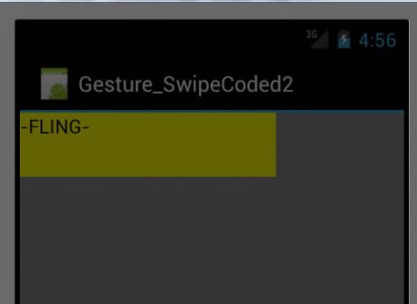
More….
@Override
public boolean onTouchEvent(MotionEvent me) {
return gestureScanner.onTouchEvent(me);
}
@Override
public boolean onDown(MotionEvent e) {
viewA.setText("-" + "DOWN" + "-");
return true;
}
@Override
public boolean onFling(MotionEvent e1, MotionEvent e2, float velocityX, float velocityY) {
viewA.setText("-" + "FLING" + "-");
return true;
}

Slide 18
More….
@Override
public void onLongPress(MotionEvent e) {
viewA.setText("-" + "LONG PRESS" + "-");
}
@Override
public boolean onScroll(MotionEvent e1, MotionEvent e2, float distanceX, float distanceY) {
viewA.setText("-" + "SCROLL" + "-");
return true;
}
@Override
public void onShowPress(MotionEvent e) {
viewA.setText("-" + "SHOW PRESS" + "-");
}
@Override
public boolean onSingleTapUp(MotionEvent e) {
viewA.setText("-" + "SINGLE TAP UP" + "-");
return true;
}
}

