Slide 1
Android and Asynchronously requesting Web (HTTP) data
Using AsynCTask class

Slide 2
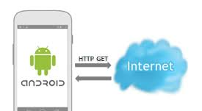
The idea --- you don’t want to wait
If you have your App and you need to make a request via the web for some data (possibly from a 3rd party like facebook or twitter) you don’t won’t to have your application waiting around for it idly
SOULTION: Asynchronously ask for the data

Slide 3
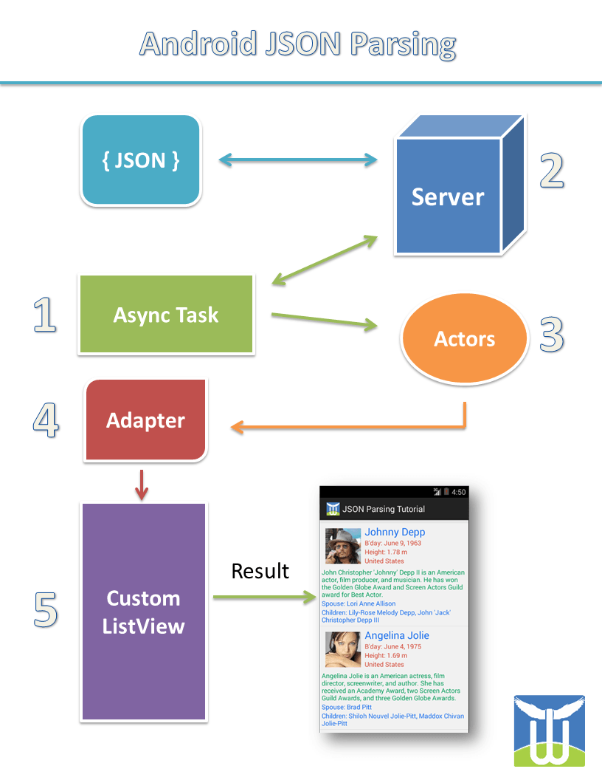
More Motivation – JSON retrieval
App ask’s its private AsyncTask class to get the data myAsycnTaskObj.execute(params)
AsyncTask call’s its own doInBackground(params) method
doInBackground(params) makes HTTPURLConnection to “Server” asking for data
Server gets requests, processes it and returns results (here JSON but, could be any kind of data)
AsyncTask gets called back with data from #4 in onPostExecute(results)
onPostExecute() will make calls to its OUTER class parent (the fragment or Activity that it is inside) and invoke that Activity’s Adapter and ListView in the GUI to populate the results. BUT, what you do is up to you with the results
1 (myAsynceTaskObj.execute)
3 (Http request)
4&5 (onPostExecute)
2 (doInBackground)
6 (onPostExecute-
calls to OUTER Activity
class)

Slide 4
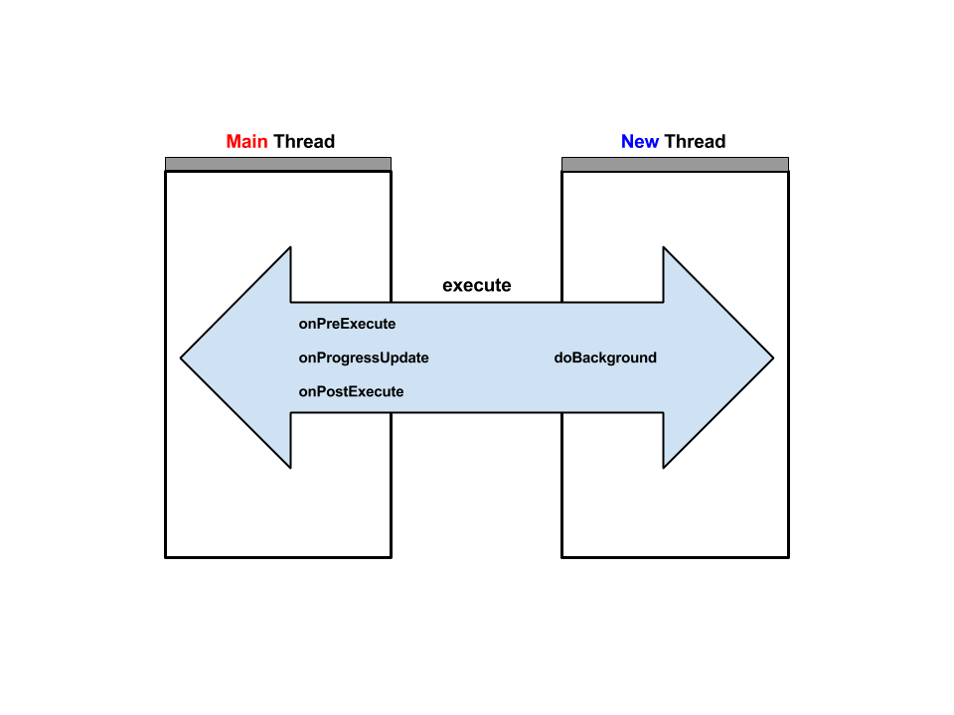
Notice the Asynchronous calls

Slide 5
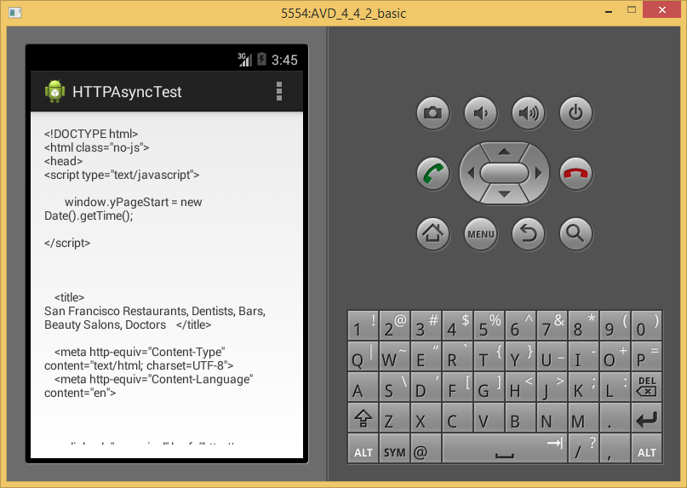
Lets to an Example
Make a request to get data from (http://yelp.com) –this will actually be the homepage –for yelp api calls you need to do Authentication and register to be a developer (we are not discussing this) –what we are doing is just grabbing the html/css/javascript code that makes up yelp’s front page.
What it looks like>>>

Slide 6
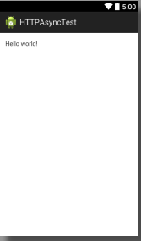
We have a single view Activity --simple
<RelativeLayout xmlns:android="http://schemas.android.com/apk/res/android"
xmlns:tools="http://schemas.android.com/tools"
android:layout_width="match_parent"
android:layout_height="match_parent"
android:paddingBottom="@dimen/activity_vertical_margin"
android:paddingLeft="@dimen/activity_horizontal_margin"
android:paddingRight="@dimen/activity_horizontal_margin"
android:paddingTop="@dimen/activity_vertical_margin"
tools:context="com.example.httpasynctest.MainActivity" >
<TextView
android:id="@+id/textDump"
android:layout_width="wrap_content"
android:layout_height="wrap_content"
android:text="@string/hello_world" />
</RelativeLayout>

Slide 7
The Manifest –we are using Internet
<?xml version="1.0" encoding="utf-8"?>
<manifest xmlns:android="http://schemas.android.com/apk/res/android"
package="com.example.httpasynctest" android:versionCode="1" android:versionName="1.0" >
<uses-sdk
android:minSdkVersion="19" android:targetSdkVersion="19" />
<uses-permission android:name="android.permission.INTERNET"/>
<uses-permission android:name="android.permission.ACCESS_NETWORK_STATE"/>
<application
android:allowBackup="true"
android:icon="@drawable/ic_launcher"
android:label="@string/app_name"
android:theme="@style/AppTheme" >
<activity
android:name=".MainActivity"
android:label="@string/app_name" >
<intent-filter>
<action android:name="android.intent.action.MAIN" />
<category android:name="android.intent.category.LAUNCHER" />
</intent-filter>
</activity>
</application>
</manifest>

Slide 8
Activity Class – part 1
public class MainActivity extends Activity {
TextView dumpText; //variable that refers to the TextView in associated GUI
@Override
protected void onCreate(Bundle savedInstanceState) {
super.onCreate(savedInstanceState);
setContentView(R.layout.activity_main);
//grab TextView
dumpText = (TextView) findViewById(R.id.textDump);
//grab data from Yelp only if we have connectivity
ConnectivityManager connMgr = (ConnectivityManager) getSystemService(Context.CONNECTIVITY_SERVICE);
NetworkInfo networkInfo = connMgr.getActiveNetworkInfo();
if (networkInfo != null && networkInfo.isConnected()) {
getYelpdata(); // fetch data
} else {
dumpText.setText("No Connection"); // display error
}
}

Slide 9
Activity Class – part 2 (continued)
//go to yelp URL and grab data –just its front page
// calls static method execute of OUR AsycnTask inner class defined in a bit called DownloadWebpageTask
protected void getYelpdata() {
//call ASync Task class to process getting data
String stringUrl = "http://yelp.com";
new DownloadWebpageTask().execute(stringUrl);
}

Slide 10
Activity INNER class DownloadWebpageTask- part 1
//private class to do ASYNC getting of yelp data
// Uses AsyncTask to create a task away from the main UI thread. This task takes a
// URL string and uses it to create an HttpUrlConnection. Once the connection
// has been established, the AsyncTask downloads the contents of the webpage as
// an InputStream. Finally, the InputStream is converted into a string, which is
// displayed in the UI by the AsyncTask's onPostExecute method.
private class DownloadWebpageTask extends AsyncTask<String, Void, String> {
@Override
protected String doInBackground(String... urls) {
// params comes from the execute() call: params[0] is the url.
try {
return downloadUrl(urls[0]);
} catch (IOException e) {
return "Unable to retrieve web page. URL may be invalid.";
}
}
// onPostExecute displays the results of the AsyncTask. ASYNCHRONOUS CALL BACK
@Override
protected void onPostExecute(String result) {
dumpText.setText(result);
}

Slide 11
Activity INNER class DownloadWebpageTask- part 1
//this is the workhorse method that does the HTTPRequest Given a URL, establishes an HttpUrlConnection
// and retrieves the web page content as a InputStream, which it returns as a string.
private String downloadUrl(String myurl) throws IOException {
InputStream is = null;
// Only display the first 500 characters of the retrieved web page content.
int len = 500;
try {
URL url = new URL(myurl);
HttpURLConnection conn = (HttpURLConnection) url.openConnection();
conn.setReadTimeout(10000 /* milliseconds */);
conn.setConnectTimeout(15000 /* milliseconds */);
conn.setRequestMethod("GET");
conn.setDoInput(true);
// Starts the query
conn.connect();
int response = conn.getResponseCode();
Log.d("ASyncTask", "The response is: " + response);
is = conn.getInputStream();
// Convert the InputStream into a string
String contentAsString = readIt(is, len);
return contentAsString;
// Makes sure that the InputStream is closed after the app is
// finished using it.
} finally {
if (is != null) {
is.close();
}
}
}

Slide 12
Activity INNER class DownlaodWebPageTask – part 3
// Reads an InputStream and converts it to a String.
public String readIt(InputStream stream, int len) throws IOException, UnsupportedEncodingException {
Reader reader = null;
reader = new InputStreamReader(stream, "UTF-8");
char[] buffer = new char[len];
reader.read(buffer);
return new String(buffer);
}

Slide 13
Lets Run it
What it looks like>>>

Slide 14
What you learned
You created an class that extends AsyncTask to handle processing on a different Thread than the main Application
It calls back Asynchronously when done executing to onPostExecute
We used it to get data from
a web request.
Made it an INNER class
so results could be dumped in
OUTER classes GUI widgets
(NOTE: Inner classes have
access to Outer classes variables
& methods)

