Slide 1
Scrum
An introduction

Slide 2
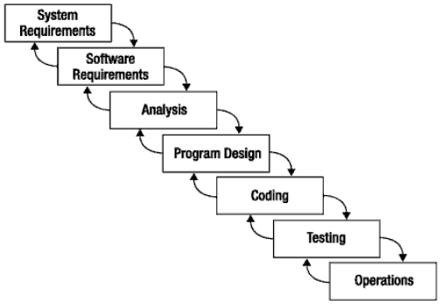
What is Scrum?
Scrum:
  Is an agile, lightweight process
  Can manage and control software and product development
  Uses iterative, incremental practices
  Has a simple implementation
  Increases productivity
  Reduces time to benefits
  Embraces adaptive, empirical systems development
  Is not restricted to software development projects
  Embraces the opposite of the waterfall approach…

Slide 3

Scrum Origins
Jeff Sutherland
  Initial scrums at Easel Corp in 1993
  IDX and 500+ people doing Scrum
Ken Schwaber
  ADM
  Scrum presented at OOPSLA 96 with Sutherland
  Author of three books on Scrum
Mike Beedle
  Scrum patterns in PLOPD4
Ken Schwaber and Mike Cohn
  Co-founded Scrum Alliance in 2002, initially within Agile Alliance

Slide 4


Agile Manifesto
Individuals and interactions
Process and tools
over
Working software
Comprehensive documentation
over
Customer collaboration
Contract negotiation
over
Responding to change
Following a plan
over
Source: www.agilemanifesto.org

Slide 5
Scrum at a Glance
How many lines of code on
average do you think a Google
SW Engineer produces?
24 hours
Daily Scrum
Meeting
Backlog tasks
expanded
by team
30 days
Sprint Backlog
Potentially Shippable
Product Increment
Product Backlog
As prioritized by Product Owner
Source: Adapted from Agile Software Development with Scrum by Ken Schwaber and Mike Beedle.
There are variations of scrum –some companies do weekly or every X day meetings

Slide 6
Sequential vs. Overlap
Requirements
Design
Code
Test
Rather than doing all of one thing at a time...
...Scrum teams do a little of everything all the time

Slide 7
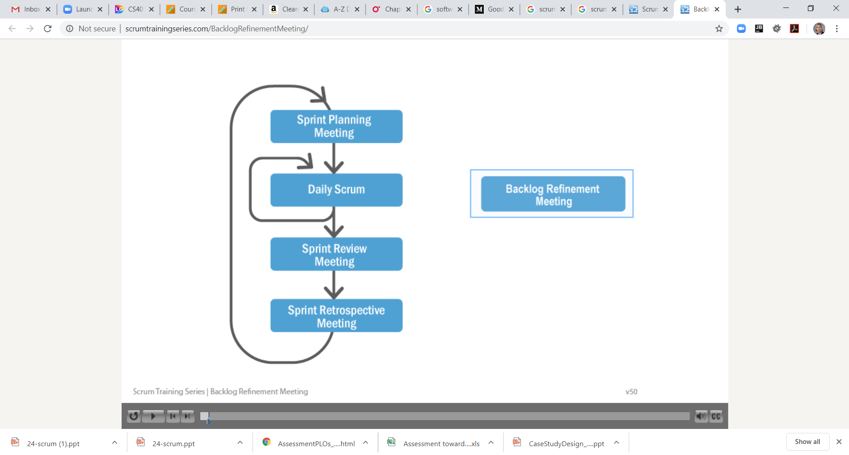
Scrum Framework
Roles
Product owner
Scrum Master
Team
Ceremonies
Sprint planning
Sprint review
Sprint retrospective
Daily scrum meeting
Artifacts
Product backlog
Sprint backlog
Burndown charts

Slide 8







Scrum Roles
  Product Owner
    Possibly a Product Manager or Project Sponsor
    Decides features, release date, prioritization, $$$
  Scrum Master
    Typically a Project Manager or Team Leader
    Responsible for enacting Scrum values and practices
    Remove impediments / politics, keeps everyone productive
  Project Team
    5-10 members; Teams are self-organizing
    Cross-functional: QA, Programmers, UI Designers, etc.
    Membership should change only between sprints

Slide 9
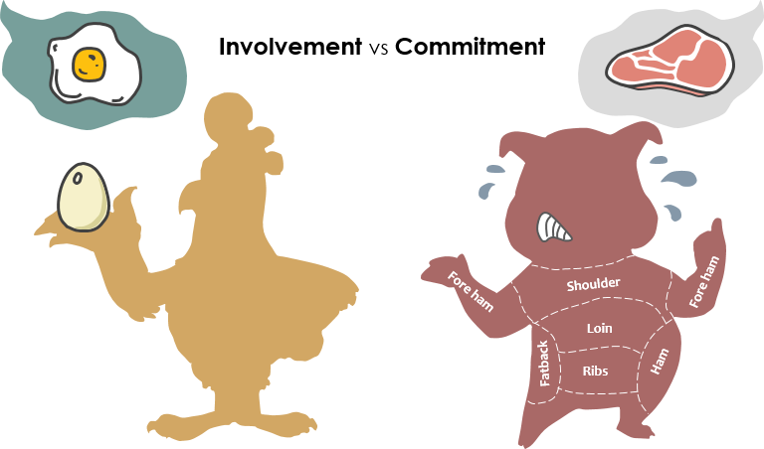
Importance of different team members →"Pigs" and "Chickens"
Pig: Team member committed to success
of project
Chicken: Not a pig; interested but not committed
A pig and a chicken are walking down a road. The chicken looks at the pig and says, "Hey, why don't we open a restaurant?" The pig looks back at the chicken and says, "Good idea, what do you want to call it?" The chicken thinks about it and says, "Why don't we call it 'Ham and Eggs'?" "I don't think so," says the pig, "I'd be committed but you'd only be involved."
SCRUM: chickens have input on the product that will be developed, but pigs decide how it’s going to be done and the rate at which it can be accomplished.
PIG = development team members, product owner who represents the chickens, and the Scrum Master, responsible for organizing a sort of Scrum events especially during Scrum stand-ups.
CHICKENS = customer, vendor, executives and other important people with vision

Slide 10
What is a Scrum Sprint
24 hours
Daily Scrum
Meeting
30 days
ToDo tasks
Sprint Backlog
Potentially Shippable
Product Increment
Product Backlog
As prioritized by Product Owner
Source: Adapted from Agile Software Development with Scrum by Ken Schwaber and Mike Beedle.
Scrum Sprint is a repeatable fixed time-box during which a "Done" product of the highest possible value is created.

Slide 11
What Happens in a Scrum Sprint
Scrum Sprint is a repeatable fixed time-box during which a "Done" product of the highest possible value is created.

Slide 12


Sprint Planning Meeting
Team capacity
Sprint planning meeting
Sprint prioritization
Product backlog
Analyze/evaluate product backlog
Select sprint goal (and issues to work on)
Sprint
goal
Business conditions
Sprint planning
Decide how to achieve sprint goal (design)
Create sprint tasks/issues (sometimes called sprint backlog) from product backlog items (user stories / features)
Estimate sprint backlog in hours
Current product
Sprint
Backlog
Technology

Slide 13
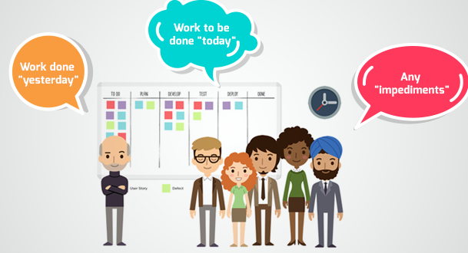
Daily Scrum Meeting
Parameters
  Daily, ~15 minutes, Stand-up
  Anyone late pays a $1 fee
Not for problem solving
  Whole world is invited
  Only team members, Scrum Master, product owner, can talk
  Helps avoid other unnecessary meetings
3 questions answered by each team member:
  What did you do yesterday?
  What will you do today?
  What obstacles are in your way?
it’s the perfect occasion to share an issue or ask for help. But don’t you try resolving it then.
→You do technical discussions/solution brainstorming AFTER the meeting
Notes:
13

Slide 14
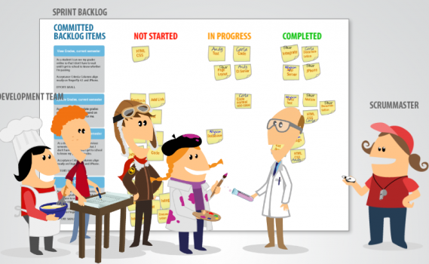
What is that chart in the background at the daily scrum standup?
Like our Kanban Board (we using Trello.com)
So have meeting in same place each day.

Slide 15
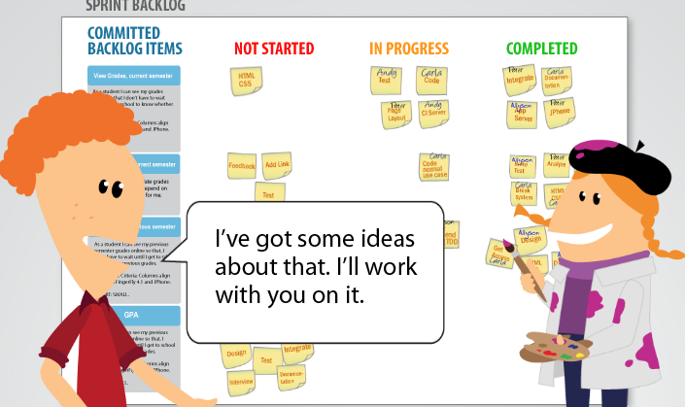
Don’t solve the problem in the Daily Scrum → but people volunteer to assist

Slide 16
Scrum “Documents” include
Scrum has remarkably few documents
  Kanban type Board / Issues
  Backlog
  Burndown Charts
  Velocity Chart
Can be managed using just an Excel spreadsheet OR Professional Software
24 hours
Daily Scrum
Meeting
30 days
ToDo
Sprint Backlog
Potentially Shippable
Product Increment
Product Backlog
As prioritized by Product Owner

Slide 17
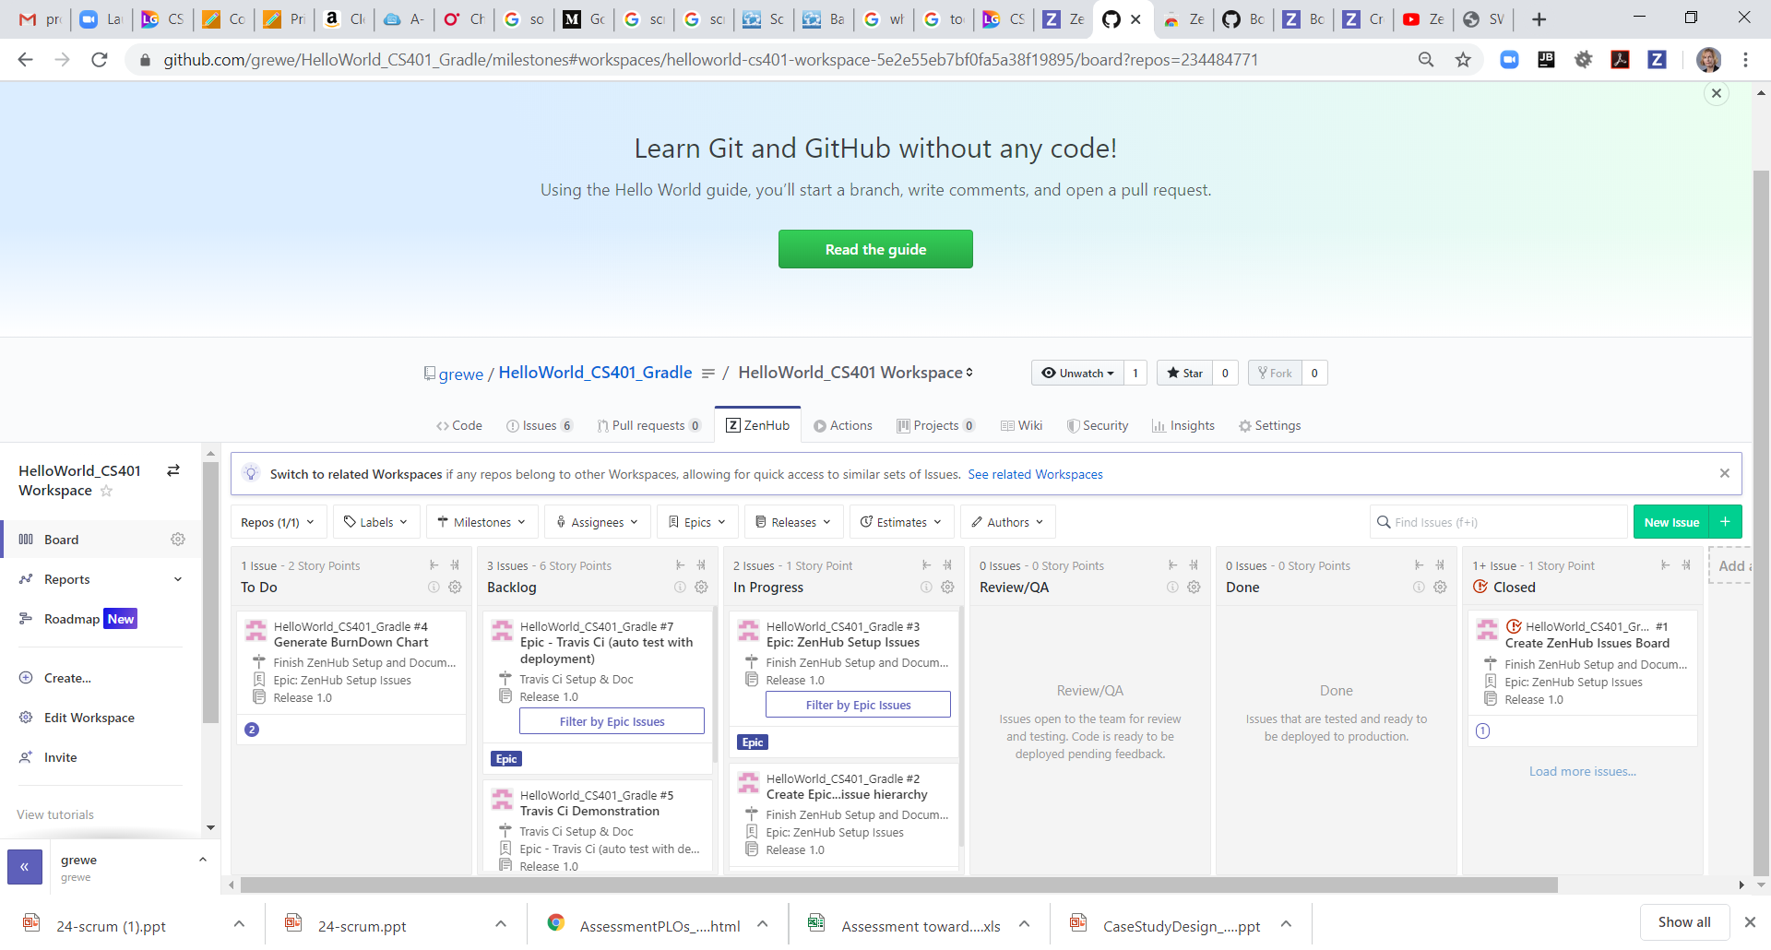
Issues Board
Can create Milestones, Assign issues to team members, associate dependencies, associate with releases and more
Below is example of using ZenHub a plugin to GitHub (free for basic use)

Slide 18

To Do/In Progress (lists in board)
The CURRENT (scrum cycle) requirements → in the To Do / In Progress Lists
A list of all desired work on project for current cycle (or possibly listed for release)
Possibly prioritized
CURRENT issues
ZenHub
Milestone = has 1 or usually multiple issues and
theoretically in ZenHub is like a Sprint

Slide 19
Product Backlog (list in board)
The FUTURE / NEXT set of (scrum cycle) requirements
A list of all desired work on project
Reprioritized at start of each sprint →and moved into In Progress list
product backlog

Slide 20
“User Stories” – concept
“Issues,Epics” – in practice
Instead of Use Cases, Agile project owners do "user stories"
  Who (user role) – Is this a customer, employee, admin, etc.?
  What (goal) – What functionality must be achieved/developed?
  Why (reason) – Why does user want to accomplish this goal?
As a [user role], I want to [goal], so I can [reason].
Example:
  "As a user, I want to log in, so I can access subscriber content."
story points: Rating of effort needed to implement this story
  common scales: 1-10, shirt sizes (XS, S, M, L, XL), etc.
  ZenHub: IN PRACTICE these become tasks/ISSUES on our board

Slide 21
A different Sample Product Backlog
Backlog item | Estimate
Allow a guest to make a reservation | 4 (days)
As a guest, I want to cancel a reservation. | 5
As a guest, I want to change the dates of a reservation. | 3
As a hotel employee, I can run RevPAR reports (revenue-per-available-room) | 8
Improve exception handling | 8
... | 30
... | 50
Notes:
21

Slide 22
Backlog
Individuals sign up for work of their own choosing
  Work is never assigned
Estimated work remaining is updated daily
Any team member can add, delete change sprint backlog
Work for the sprint emerges
If work is unclear, define a sprint backlog item with a larger amount of time and break it down later
Update work remaining as more becomes known

Slide 23
Sample Sprint backlog ESTIMATES→ evolution over time…..
Tasks
Mon
Tue
Wed
Thu
Fri
Code the user interface
8
4
8
Code the middle tier
16
12
10
4
Test the middle tier
8
16
16
11
8
Write online help
12
Write the Foo class
8
8
8
8
8
Add error logging
8
4
The units are typically days but, you can decide as a team what to make them
Notes:
23

Slide 24
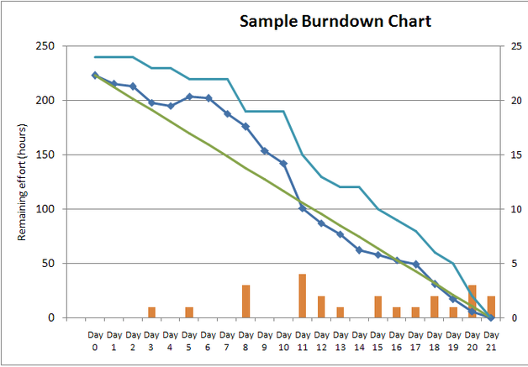
Sprint Burndown Chart
A display of what work has been completed
and what is left to complete
  one for each developer or work item
  updated every day
  (make best guess about hours/points completed each day)
variation: Release burndown chart
  shows overall progress
  updated at end of each sprint
  (called a Milestone in ZenHub)

Slide 25
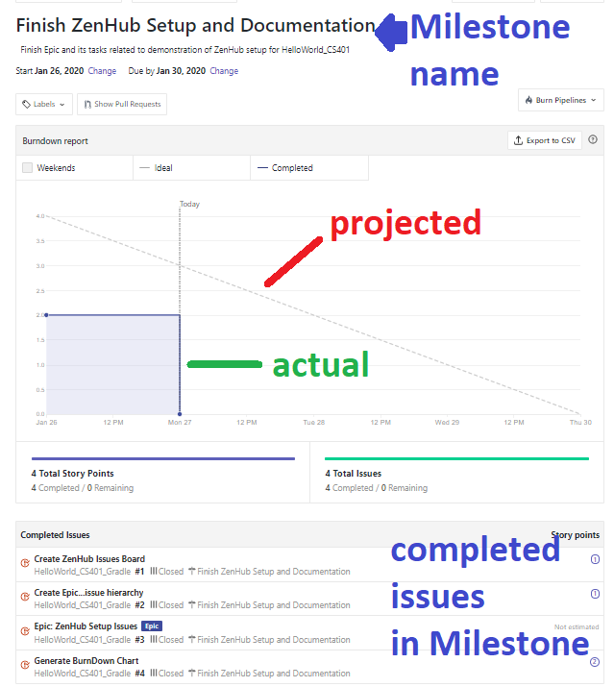
Example
ZenHub
BurnDown chart
Associated with COMPLETED (CLOSED) Milestone
Milestone has start and end date and one or more issues associated with it
For a Milestone to be closed ALL issues associated with it must be closed
A Milestone in
ZenHub = 1 Sprint

Slide 26
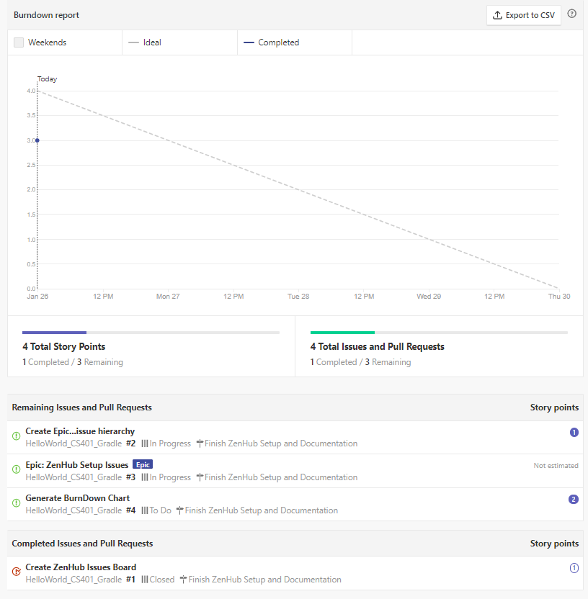
ZenHub → FYI what you see for BurnDown chart BEFORE milestone closed
Just projected date
of completion and
current issues related
to it

Slide 27

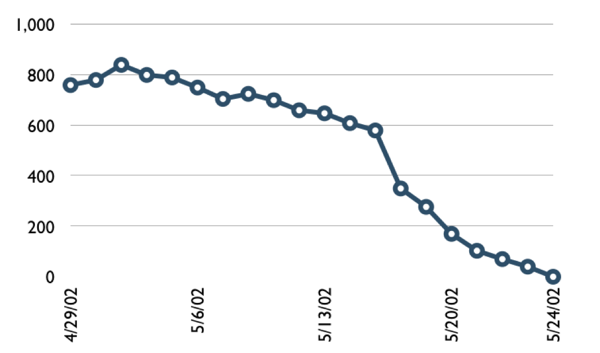
A different Sample Burndown Chart
Hours
Notes:
27

Slide 28
Tasks
Mon
Tue
Wed
Thu
Fri
Code the user interface
8
4
8
Code the middle tier
16
12
10
7
Test the middle tier
8
16
16
11
8
Write online help
12
50
40
30
Hours
20
10
0
Mon
Tue
Wed
Thu
Fri
Notes:
28

Slide 29
Burndown Example 1 --interpretation
No work being performed

Slide 30
Burndown Example 2 -- interpretation
Work being performed, but not fast enough

Slide 31
Burndown Example 3-- interpretation
Work being performed, but too fast!

Slide 32
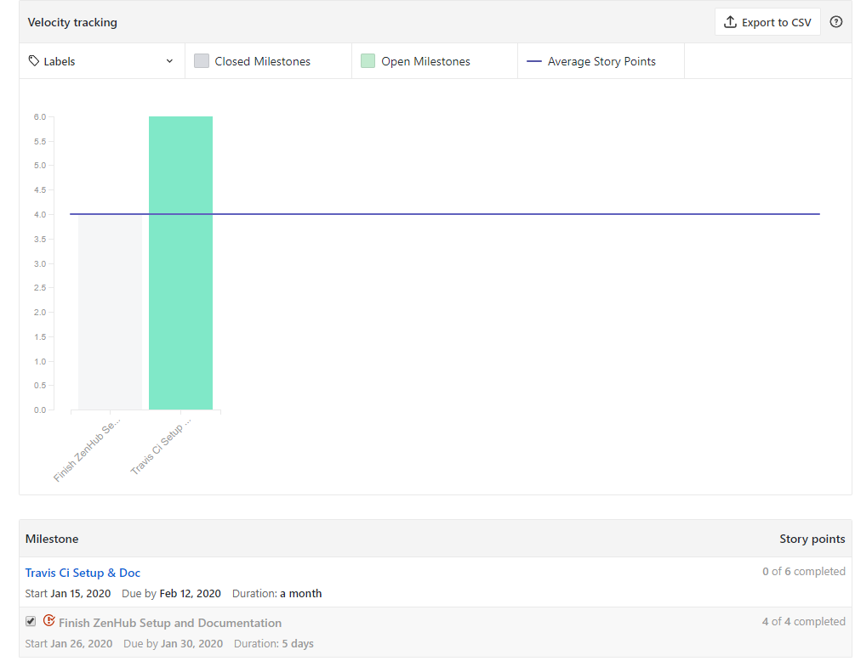
Sprint Velocity Chart
Calculate the average speed of work across previously completed Milestones to make accurate commitments each sprint.
ZenHub example for our toy HelloWorld_CS401_Gradle project (and github repository and workspace)

Slide 33
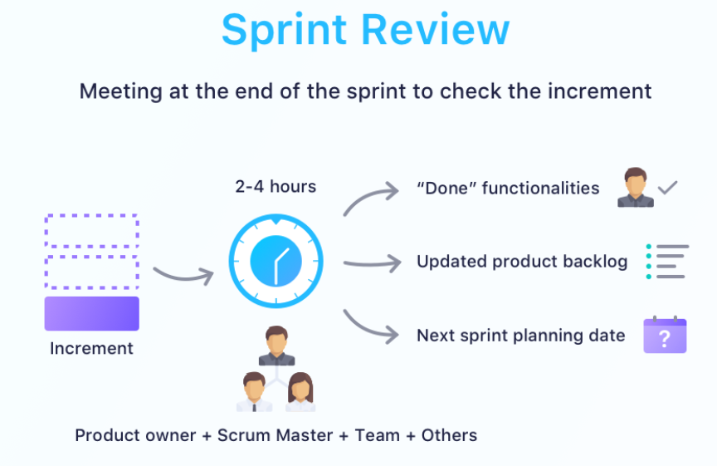
The Sprint Review
Team presents what it accomplished during the sprint
Typically takes the form of a demo of new features or underlying architecture
Informal
  2-hour prep time rule
  No slides
Whole team participates
Invite the world

Slide 34
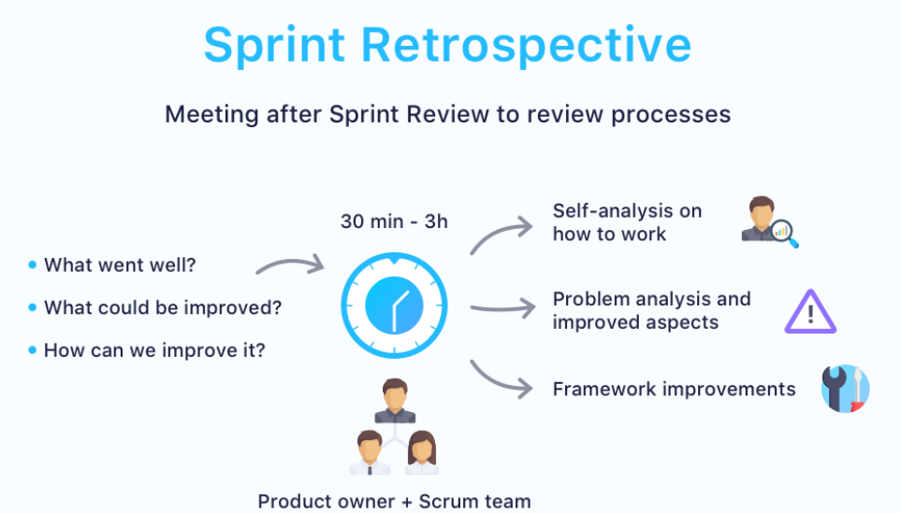
The Sprint Retrospective Meeting
done at the end of a sprint.
reflect on what went well and what didn't go well in the previous sprint and determine how it can be improved in the next sprint.
HUH? Sprint Review is focused on the product and maximizing the business value of the results of the work of the previous sprint and the Sprint Retrospective is focused on the process and continuous process improvement.

Slide 35
Scalability
Typical individual team is 7 ± 2 people
  Scalability comes from teams of teams
Factors in scaling
  Type of application
  Team size
  Team dispersion
  Project duration
Scrum has been used on multiple 500+ person projects

Slide 36






Scaling: Scrum of Scrums

