Slide 1

Intro to Java
L. Grewe

Slide 2
Java history
James Gosling and others at Sun, 1990 - 95
Internet application
simple language for writing programs that can be transmitted over network
Now owned by Oracle

Slide 3
Some Goals
Portability
Internet-wide distribution: PC, Unix, Mac
Reliability
Avoid program crashes and error messages
Safety
Programmer may be malicious
Simplicity and familiarity
Appeal to average programmer; less complex than C++
Efficiency
Important but secondary

Slide 4
Characteristics
Simplicity
Everything an object
All objects on heap, accessed through pointers
no functions
no multiple inheritance,
no operator overloading
Portability
Bytecode interpreter on many platforms
Reliability and Safety
Run-time type and bounds checks
Garbage collection

Slide 5
Java System
The Java programming language
Compiler and run-time system
Programmer compiles code
Compiled code transmitted on network
Receiver executes on interpreter (JVM)
Safety checks made before/during execution
Library, including graphics, security, etc.
Large library
Interoperability
Provision for “native” methods

Slide 6
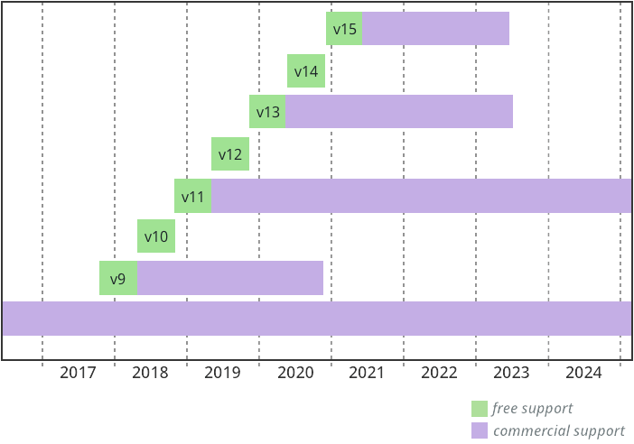
Java Release History
1995 (1.0) – First public release
1997 (1.1) – Inner classes
2001 (1.4) – Assertions
Verify programmers understanding of code
2004 (1.5) – Tiger
Generics, foreach, Autoboxing/Unboxing,
Typesafe Enums, Varargs, Static Import,
Annotations, concurrency utility library
2006 (1.6) – SE 6
2007 – SE 7
2014- SE8
2017 – SE9
2018- SE10,11
2019 – SE12,13
2020- SE14
2020- SE15
Work on SE16
Faster Release times→

Slide 7
Language Terminology
Class, object
Field – data member
Method - member function
Static members - class fields and methods
this - self
Package - set of classes in shared namespace
Native method - method written in another language, often C

Slide 8
Java Classes and Objects
Syntax similar to C++
Object
has fields and methods
is allocated on heap, not run-time stack
accessible through reference (only ptr assignment)
garbage collected
Dynamic lookup
Similar in behavior to other languages
Static typing => more efficient than Smalltalk
Dynamic linking, interfaces => slower than C++

Slide 9
Template for Class Definition
Import Statements
Class Comment
class
{
Class Name
Fields/Variables
Methods
(incl. Constructor)
}
Notes:
This is the template we use when creating programmer-defined classes.

Slide 10
Point Class
class Point {
private int x;
protected void setX (int y) {x = y;}
public int getX() {return x;}
Point(int xval) {x = xval;} // constructor
};

Slide 11
Object initialization
Java guarantees constructor call for each object
Memory allocated
Constructor called to initialize memory
Some interesting issues related to inheritance

Slide 12
Garbage Collection and Finalize
Objects are garbage collected
No explicit free
Avoids dangling pointers and resulting type errors
Problem
What if object has opened file or?
Solution
finalize method, called by the garbage collector
Before space is reclaimed, or when virtual machine exits

Slide 13
Encapsulation and packages
Every field, method belongs to a class
Every class is part of some package
Can be unnamed default package
File declares which package code belongs to
package
class
field
method
package
class
field
method

Slide 14
Access
Four access distinctions
public, private, protected, package
Method can refer to
private members of class it belongs to
non-private members of all classes in same package
protected members of superclasses (in diff package)
public members of classes in visible packages
Visibility determined by files system, etc. (outside language)
Qualified names (or use import)
java.lang.String.substring()
package
class
method

Slide 15
Inheritance
Similar to Smalltalk, C++
Subclass inherits from superclass
Single inheritance only (but Java has interfaces)

Slide 16
Example subclass
class ColorPoint extends Point {
// Additional fields and methods
private Color c;
protected void setC (Color d) {c = d;}
public Color getC() {return c;}
// Define constructor
ColorPoint(int xval, Color cval) {
super(xval); // call Point constructor
c = cval; } // initialize ColorPoint field
};

Slide 17
Class Object
Every class extends another class
Superclass is Object if no other class named
Methods of class Object
GetClass – return the Class object representing class of the object
ToString – returns string representation of object
equals – default object equality (not ptr equality)
hashCode
Clone – makes a duplicate of an object
wait, notify, notifyAll – used with concurrency
finalize

Slide 18
Constructors and Super
Java guarantees constructor call for each object
Different conventions for finalize and super
Compiler does not force call to super finalize

Slide 19
Final classes and methods
Restrict inheritance
Final classes and methods cannot be redefined
Example
java.lang.String
Reasons for this feature
Important for security
Programmer controls behavior of all subclasses
Critical because subclasses produce subtypes
Compare to C++ virtual/non-virtual
Method is “virtual” until it becomes final

Slide 20
Call-by-Value Parameter Passing
When a method is called,
value of argument is passed to the matching parameter, separate memory space is allocated to store this value.
This way of passing the value of arguments is called a pass-by-value
Since separate memory space is allocated for each parameter during the execution of the method,
the parameter is local to the method,
changes made to the parameter will not affect the value of the corresponding argument.

Slide 21
Java Types
Two general kinds of types
Primitive types – not objects
int, float, double, ….
Reference types
Classes, interfaces, arrays
No syntax distinguishing Object * from Object
Data Classes: Integer, Float, Boolean, …

Slide 22
Classification of Java types
Reference Types
Object
Object[ ]
Throwable
Shape
Shape[ ]
Exception types
Circle
Square
Circle[ ]
Square[ ]
user-defined
arrays
Primitive Types
boolean
int
byte
…
float
long

Slide 23
Primitive Data Types
Primitive Types
byte | Example: byte word; Size = 8 bits.
short | Example: short num; Size = 16 bits.
int | Example: int Year; Size = 32 bits.
long | Example: long word; Size = 64 bits.
float | Example: float time; Size = 32 bits.
double | Example: double time; Size = 64 bits.
char | Example: char symbol; Size = 16 bits.
boolean | Example: boolean answer; value= true or false (not a number as in C++).

Slide 24
Class “data” types
Class Types (see book or documentation for details)
Variables can be declared with a protection type or status that restricts who can access them
String Example of Declarations:String Name; Name = "Lynne Grewe"; OR String Name = new String("Lynne Grewe"); OR String Name = "Lynne Grewe";
Boolean
Double
Float
Short
Byte
Long

Slide 25
Static Variables
If a variable is declared static it means that the value of this variable will be the same for any object instatiated from its class. For example,
class Document
{ static int version=10;
..... }
Any object instantiated from Document will have the same value of version. When any Document object changes the value of version it is changed for ALL instances of this object. This is somewhat like the concept of a global variable. You can access a static variable through the class name or an instance of the class:
Document.version++;
Document d = new Document(); d.version = 7;

Slide 26
Final keyword
This is akin to a constant in that it is set once and can never be changed. The value is set at declaration time as shown in the example below.
class Document
{ final int year 1997;
..... }

Slide 27
Arrays
Automatically defined
Can have for primitive types and objects.
Multi-dimensional arrays T[ ] [ ]
Treated as reference type
An array variable is a pointer to an array, can be null
Example: Circle[] x = new Circle[array_size]
Every array type is a subtype of Object[ ], Object
Length of array is not part of its static type

Slide 28
Arrays - initializing
3 ways to initialize an array depending on data:
Arrays of Objects (exception Strings), first declare the array and for each element call the class's constructor as shown in example 1.
String Arrays and primitive type Arrays (e.g. arrays or int or float), can either initialize the array at the same time you create it or afterwards. Examples 2 and 3 show these later methods.
Example 1 | Example 2(only Strings and primitive types) | Example 3 (only Strings and primitive types)
Button[] B = new Button[3];B[0] = new Button();B[1] = new Button();B[2] = new Button(); | String Names[] = { "Lynne", "Doug", "Butch", "Rosie" }; | String Names[] = new Names[4]; Names[0] = "Lynne"; Names[1] = "Doug"; Names[2] = "Butch"; Names[3] = "Rosie";

Slide 29
Methods
General structure:
protection_type return_type method_name( type1 var1, type2 var2, ...)
{ .... }
Local Variables
Any variable defined inside of a method has a scope local to that method.
Return Type
A method can return nothing (void) or can retrun any kind of class, variable or an array.
Passing Arguments
The variables are passed by reference
Thus changes are retained after the method is done executing.

Slide 30
Methods Example
class Person {
String name;
int age;
//CONSTRUCTOR which sets the name and age
Person(String n, int a) {
this.name = n; //could have written name = n;
this.age = a; // similarly could have age = a;
}
void printPerson() {
System.out.print("Hi, my name is " + name);
System.out.println(". I am " + age + " years old.");
}
public static void main (String arguments[]) {
Person p;
p = new Person("Luke", 50); //call constructor
p.printPerson();
}
}
A class Person has a method
printPerson

Slide 31
Constructor (the creation method)
optional method(s), a default exists that does nothing.
Method called when creating an instance of a class
Same name as the class.
Can have multiple constructors (overloaded) that take different inputs
Has NO return type.
If you write a class with a constructor with parameters and you intend to possibly use it as a Parent class you need to make sure you also write a constructor with NO parameters. This is needed because: If the child class is defined with no constructors, it will automatically call super() which is the Parent's constructor with no arguments.
Inside of a constructor, if you need to call the parents constructor, you can do so by simply adding the following line inside of your constructor:
super(arg1, ....);

Slide 32
Constructor Example
class Person {
String name;
int age;
//CONSTRUCTOR which sets the name and age
Person(String n, int a) {
this.name = n; //could have written name = n;
this.age = a; // similarly could have age = a;
}
void printPerson() {
System.out.print("Hi, my name is " + name);
System.out.println(". I am " + age + " years old.");
}
public static void main (String arguments[]) {
Person p;
p = new Person("Luke", 50); //call constructor
p.printPerson();
}
}

Slide 33
finalizer Method
Called just before the object is garbage-collected and its memory reclaimed. Must be defined as follows:
protected void finalize() throws Throwable { ...}
NOTE: the throws Throwable refers to errors/exceptions that could occur....we will discuss this later when we talk about exceptions!!!
The default finalize() does nothing.
You can call a parent's finalize() using:
super.finalize();
You can call finalize() yourself...it will not call the garbage collector.

Slide 34
Overloading Methods
has multiple methods of the same name but have different parameters either in number or type.

Slide 35
Overloading example
import java.awt.Point;
class MyRect {
int x1 = 0;
int y1 = 0;
int x2 = 0;
int y2 = 0;
MyRect buildRect(int x1, int y1, int x2, int y2) {
this.x1 = x1;
this.y1 = y1;
this.x2 = x2;
this.y2 = y2;
return this;
}
MyRect buildRect(Point topLeft, Point bottomRight) {
x1 = topLeft.x;
y1 = topLeft.y;
x2 = bottomRight.x;
y2 = bottomRight.y;
return this;
}
MyRect buildRect(Point topLeft, int w, int h) {
x1 = topLeft.x;
y1 = topLeft.y;
x2 = (x1 + w);
y2 = (y1 + h);
return this;
}
void printRect(){
System.out.print("MyRect: <" + x1 + ", " + y1);
System.out.println(", " + x2 + ", " + y2 + ">");
}
public static void main(String arguments[]) {
MyRect rect = new MyRect();
System.out.println("Calling buildRect with coordinates 25,25, 50,50:");
rect.buildRect(25, 25, 50, 50);
rect.printRect();
System.out.println("***");
System.out.println("Calling buildRect with points (10,10), (20,20):");
rect.buildRect(new Point(10,10), new Point(20,20));
rect.printRect();
System.out.println("***");
System.out.print("Calling buildRect with 1 point (10,10),");
System.out.println(" width (50) and height (50):");
rect.buildRect(new Point(10,10), 50, 50);
rect.printRect();
System.out.println("***");
}
}

Slide 36
Overriding Methods
how methods that are inherited from a classes ancestors in the inheirantence chain are replaced or over-ridden by new methods.
Even if you have created a method that overrides a superclass's method, you can still call this superclasses method by using the following:
super.method();

Slide 37
Overriding example
class PrintClass {
int x = 0;
int y = 1;
void printMe() {
System.out.println("x is " + x + ", y is " + y);
System.out.println("I am an instance of the class " +
this.getClass().getName());
}
}
class PrintSubClass2 extends PrintClass {
int z = 3;
void printMe() {
System.out.println("x is " + x + ", y is " + y +
", z is " + z);
System.out.println("I am an instance of the class " +
this.getClass().getName());
}
}

Slide 38
static methods
can accessed without creating an instance of this class. Every static method is implicitly final (see below) and hence can not be overwritten. There is a Math class in Java and a static method called sqrt() that can be called as follows:
float value = Math.sqrt(200.0);
Note that an instance of the class Math is not needed to invoke the static method sqrt.
if a method is declared static it means that it cannot access any instance variables of the class that are not also declared static. For example,
class Document {
static int version=10;
int Num_Chapters;
static void modify_version(int ver) {
version = ver;
/*can not access Num_Chapters*/
}
void update_info(int ver, int num) {
version = ver;
Num_Chapters = num;
}
}

Slide 39
final methods
Final Methods
If a method is declared as final then it can not be overridden.

Slide 40
Conditionals - if
The statement inside of an if must return a boolean value meaning true or false. (Note: C/C++ can return an integer). Otherwise, it is the same as in C/C++ (if, then, else if, else) Example:
if(count < 0)
{ System.out.println("Error!"); }
else if (count > 10)
{ System.out.println("Stop being a hog!");
count = 0; /*take that*/ }
else
{ System.out.println("Great Running!");
count++; }

Slide 41
Switch statement
switch (option) {
case 0:
System.out.println("You choose Thresholding");
Threshold(); /*call the treshold method of this class*/
break;
case 1:
System.out.println("You choose Bit-Slicing");
BitSlice(); /*call the Bit-slice method of this class*/
break;
default:
System.out.println("Invalid Choice!");
break;
}
//Threshold() and BitSlice() methods defined elsewhere....

Slide 42
for loop
Same as C++
class ArrayTest {
String[] firstNames = { "Dennis", "Grace", "Bjarne", "James" };
String[] lastNames = new String[firstNames.length];
void printNames() {
for(i=0; i <firstNames.length; i++)
System.out.println(firstNames[i] + );
}
public static void main (String arguments[]) {
ArrayTest a = new ArrayTest();
a.printNames();
System.out.println("-----");
a.lastNames[0] = "Ritchie";
a.lastNames[1] = "Hopper";
a.lastNames[2] = "Stroustrup";
a.lastNames[3] = "Gosling";
a.printNames();
}
}

Slide 43
While + Do loops
Same as in C/C++ except must have boolean test. Can break out of loops with break; statement and skip a loop with the continue; statements.
while (boolean test)
{ statements... }

Slide 44
Interface example
interface Shape {
public float center();
public void rotate(float degrees);
}
interface Drawable {
public void setColor(Color c);
public void draw();
}
class Circle implements Shape, Drawable {
// does not inherit any implementation
// but must define Shape, Drawable methods
}

Slide 45
Interfaces
Flexibility
Black box design….specify input/output but, not internals.

Slide 46
Java Exceptions
Similar basic functionality to C++
Constructs to throw and catch exceptions
Dynamic scoping of handler
Some differences
An exception is an object from an exception class
Subtyping between exception classes
Use subtyping to match type of exception or pass it on …
Type of method includes exceptions it can throw

Slide 47
Exception Classes
Throwable
Exception
Runtime
Exception
Error
checked
exceptions
User-defined
exception classes
Unchecked exceptions
If a method may throw a checked exception, then this must be in the type of the method

Slide 48
Try/finally blocks
Exceptions are caught in try blocks
try {
statements
} catch (ex-type1 identifier1) {
statements
} catch (ex-type2 identifier2) {
statements
} finally {
statements
}

Slide 49
Keyword “this"
Object can use to refer to itself.
Can use to refer to its variables…see example.
class Person {
int age;
public void setAge(int val) {
this.age = val;
}
. . .
}

Slide 50
Overloaded Methods
Methods can share the same name as long as
different number of parameters (Rule 1) or
their parameters are of different types when the number of parameters is the same (Rule 2)
public void myMethod(int x, int y) { ... }
public void myMethod(int x) { ... }
Rule 1
public void myMethod(double x) { ... }
public void myMethod(int x) { ... }
Rule 2
Notes:
Notice that the difference in the return type alone is not enough to overload the methods. For example, the following declaration is invalid
public double convert(int num) { . . . }
public float convert(int num) { . . . }

Slide 51
Simple Console Application
Lets create Hello World in Java
Single class
Contains VERY special method with signature: public static void main(String args) { //your code here }

Slide 52
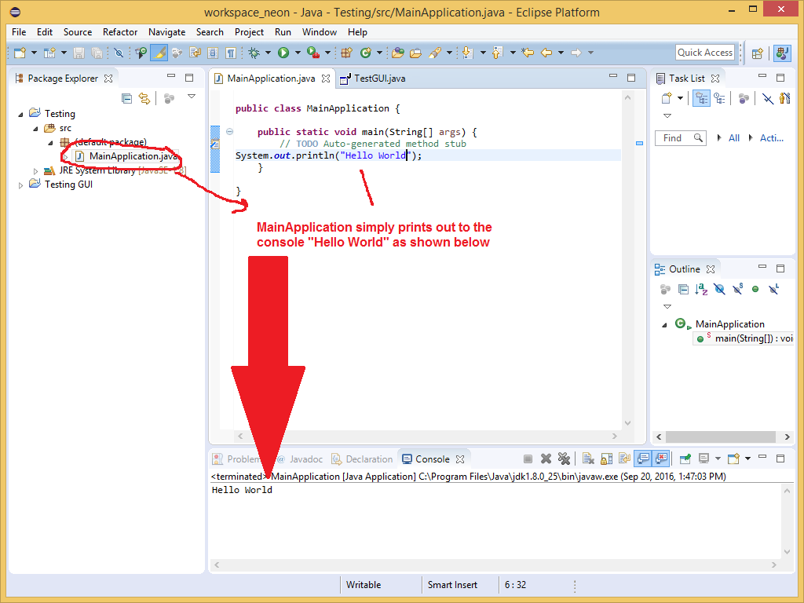
Simple Console Application
Here we see it in the Eclipse IDE

