Slide 1
Git – versioning and managing your software
L. Grewe

Slide 2
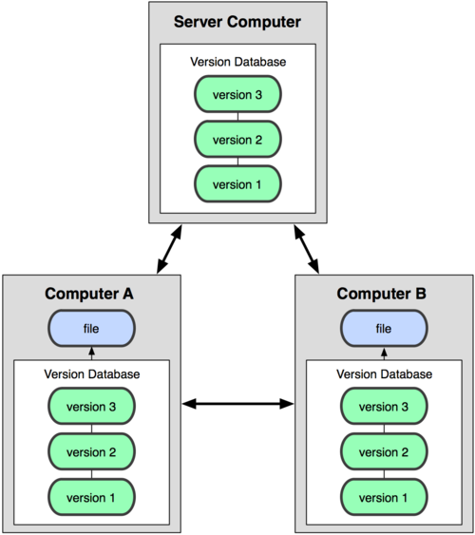
What is Git?
GIT = is a distributed revision control system for software.
there are a number of free resources to use GIT and host remotely your code - GitHub and Bitbucket are popular
you can also buy commercial versions
Created by Linus Torvalds for work on the Linux kernel ~2005
Actually implements a replicated versioned file system

Slide 3
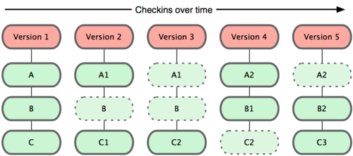
The concept
Git maintains versions of software over time

Slide 4
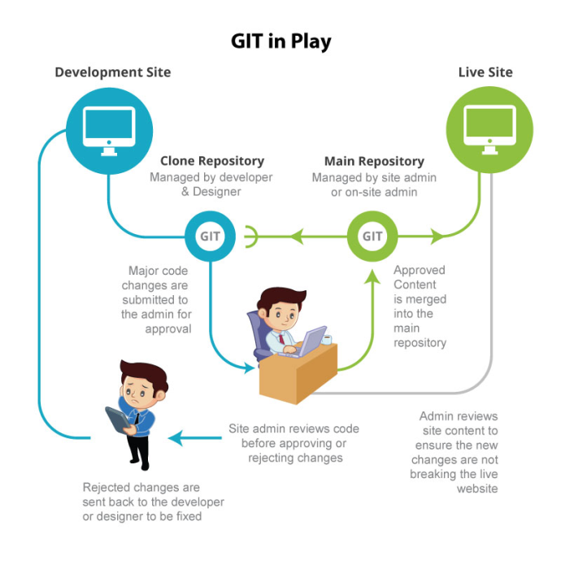
The concept
you have code on your local development machine (local git repository) that you can create versions of and commit to a remote Git repository.
repository = a location storing and mantaining versioned code

Slide 5
The concept

Slide 6
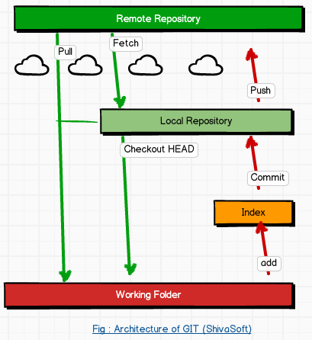
Another view

Slide 7
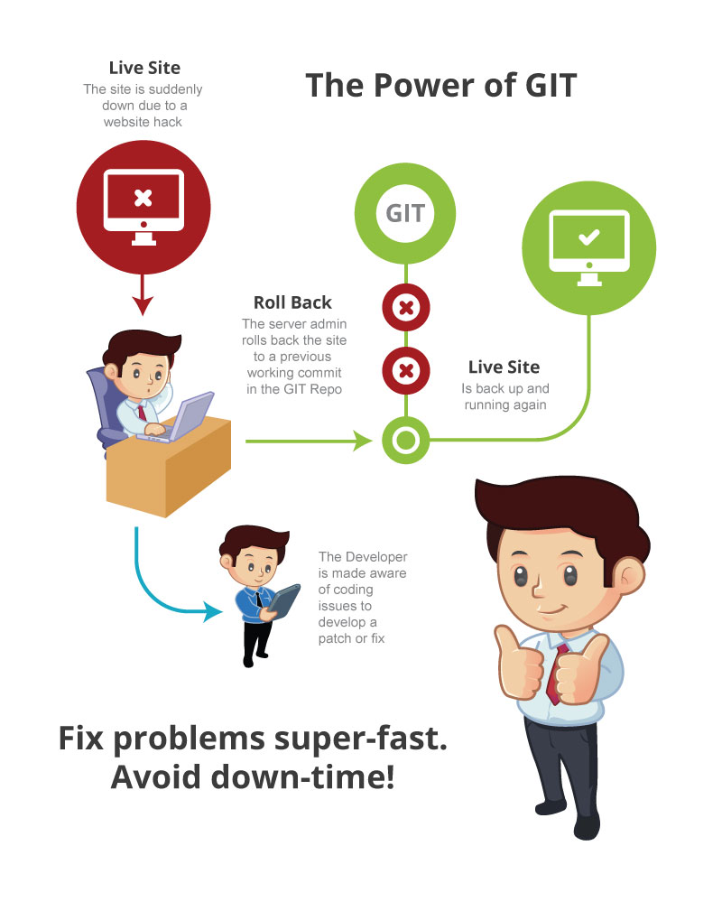
Another powerful use --rollback
Scenario: there is a bug in the code that was committed ---you need to QUICKLY go back

Slide 8
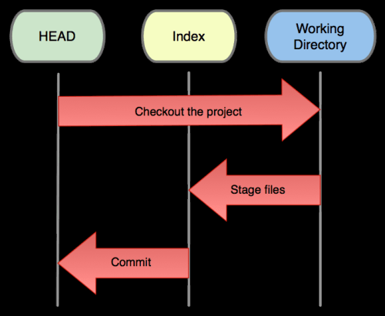
3 roles of Git
The HEAD (master) =
last commit snapshot, pointer to the current branch
The Index =
proposed next commit snapshot
The Working Directory = sandbox (local machine)

Slide 9
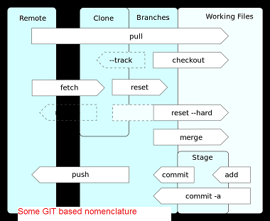
Common operations/ nominclature
Operations to submit/get code
Operations to revert code

Slide 10
Operations to submit/get code
commit = the code is read to submit to repository
push = pushes it to remote repository
pull = gets current code from remote repository
merge = if you are trying to push code that has been pushed more recently than you pulled it by another person -- the Git system will ask you to merge the files and clean up any descrepencies.
  scenario - you and Jill pull down the current code and you are both working on a file called doit.java. Jill pushes her changed code first. Then you try to push your code??? you could have changed the code in the same place --what is the system to do. You need to go through the process of merging the code and figuring out what conflicts might exist

Slide 11
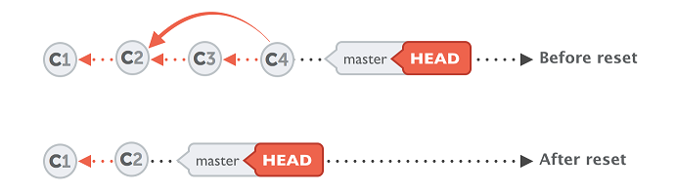
Operations to revert/undo to previous
checkout = if you want to revert to a
previous version BEFORE you have
committed any changes
revert = if you want to undo a certain commit
  Sometimes you'll want to undo a certain commit. E.g. when you notice that your changes were wrong, when you introduced a bug, or simply when the customer has decided he doesn't want this anymore
reset = if you want to go to a previous version but, not remove the commits ---basically it resets the HEAD(master) to an older branch

Slide 12
Groups of Git commands
Setup and branch management
  init, checkout, branch
Modify
  add, delete, rename, commit
Get information
  status, diff, log
Create reference points
  tag, branch

Slide 13
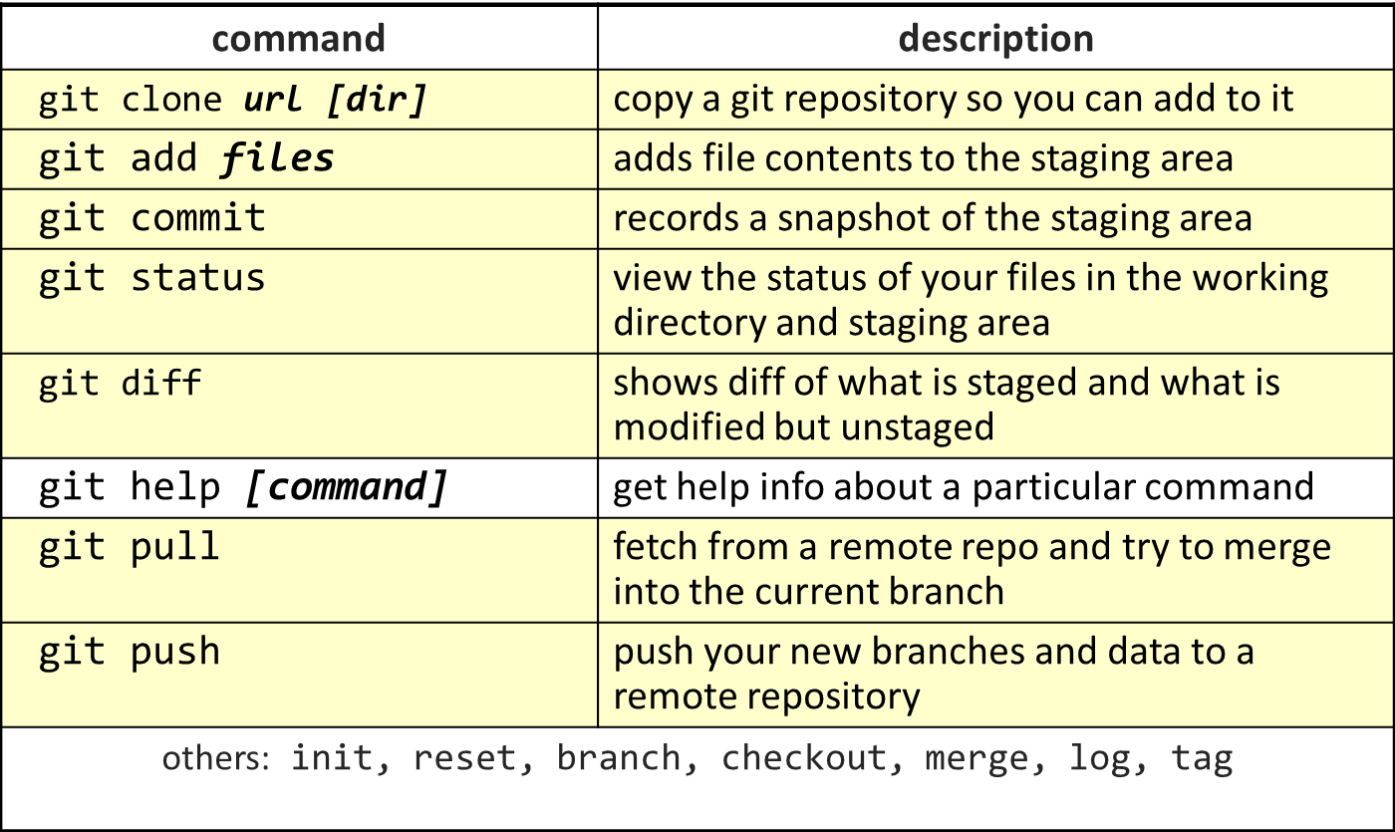
Some of the operations

Slide 14
Branching
The next step

Slide 15
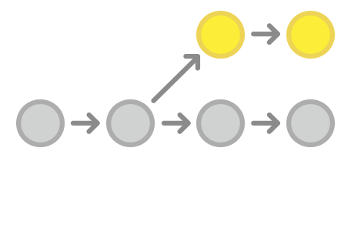
Branching the concept
Sometimes you want to have two different paths the development of your software can go.
Example: maybe you want to have a version for your corporate customers and a different version for your military customers
It lets you create isolated development environments within a single repository.

Slide 16
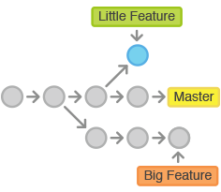
Another use of branches
Want to add a new feature or fix a
you can spawn a new branch to encapsulate your changes.
  makes sure unstable code is never committed to the main code base, and it gives you the chance to clean up your feature’s history before merging it into the main branch.

Slide 17
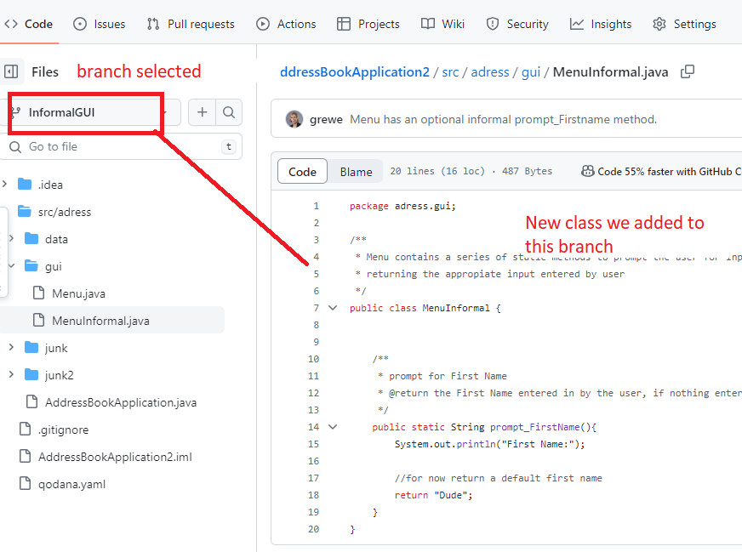
“Developer” Branches
Developer wants to add some new code, consider adding a branch for themselves to represent new code they are creating
Isolates the new code from the master branch
Tell other developers when done with this code in your branch via a pull request (we will show later)
You create your branch (name it meaningfully)
Create some code and corresponding unit test code – submitting to your branch as you code
Run your tests, try your code
Now you want say others to review so you can
Merge with the master branch SO ASK FOR CODE REVIEW by Creating a pull requests ---this serves as a mechanism for a developer to notify team members that they have completed a feature.

Slide 18
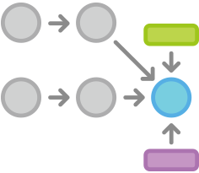
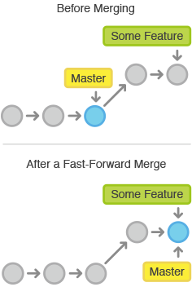
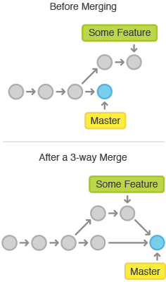
You can merge a branch into the master
Using the merge command you can merge a branch back into the master
Different kinds of merging

Slide 19
Lets look at some operations
IntelliJ Managing Branches in the IDE
https://www.jetbrains.com/help/idea/manage-branches.html

Slide 20
Branches – the master is your first branch
NOTE: we are showing you the command
line interface for git.. Note you can use
GUI GIT tools for local repositories like
SourceTree or others.
master
A
> git commit –m ‘my first commit’
Notes:
Now lets see what this visually looks like.
On my first commit I have A.
The default branch that gets created with git is a branch names Master.
This is just a default name. As I mentioned before, most everything in git is done by convention. Master does not mean anything special to git.

Slide 21
Adding commits to master
master
A
B
C
NOTE: we are showing you the command line interface for git.. Note you can use GUI GIT tools for local repositories like SourceTree or others.
> git commit *****
Notes:
We make a set of commits, moving master and our current pointer (*) along

Slide 22
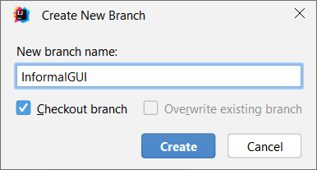
Creating a New Branch and having master point to it
NOTE: we are showing you the command line interface for git.. Note you can use GUI GIT tools for local repositories like SourceTree or others.
master
A
B
C
At end of checkout master (start) points to bug123 branch
bug123
IntelliJ Git->New Branch
> git branch bug123
> git checkout bug123
OR short cut
> git checkout –b bug123
Notes:
Suppose we want to work on a bug. We start by creating a local “story branch” for this work.
Notice that the new branch is really just a pointer to the same commit (C) but our current pointer (*) is moved.

Slide 23
Continuing commits –will be where the head is pointing to –which is our bug123 branch
master
The commits are going to bug123
A
B
C
D
E
bug123
> git commit ******
Notes:
Now we make commits and they move along, with the branch and current pointer following along.

Slide 24
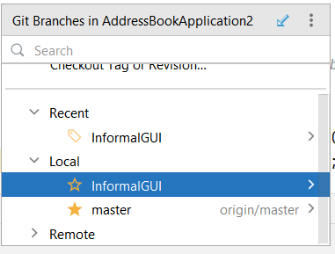
IntelliJ –view branches
Viewing branches Git-> Branches

Slide 25
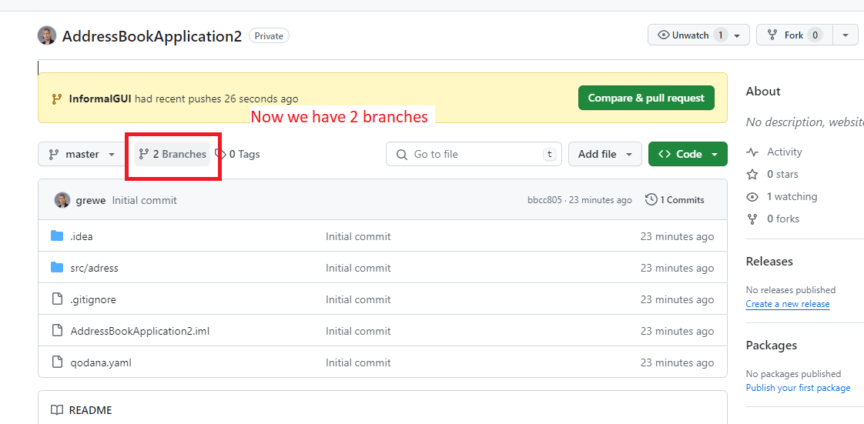
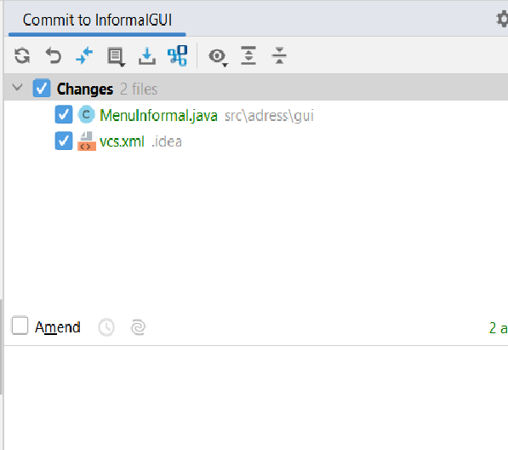
IntelliJ –commit to a branch
Git-> Commit&Push
Will show the current files to commit in the current selected branch

Slide 26
Lets point back to master
master
A
B
C
D
E
bug123
> git checkout master
Notes:
We can “checkout” to go back to the master branch.
This is where I was freaked out the first time I did this. My IDE removed the changes I just made. It can be pretty startling, but don’t worry you didn’t lose anything.

Slide 27
Now we want to merge bug123 into our head (current pointing to master)
master
A
B
C
D
E
bug123
> git merge bug123
Notes:
And then merge from the story branch, bringing those change histories together.

Slide 28
The results of merging
master
A
B
C
D
E
Now lets delete our branch bug123
> git branch -d bug123
Notes:
And since we’re done with the story branch, we can delete it. This all happened locally, without affecting anyone upstream.

Slide 29
IntelliJ merging
Commit your changes to the desired branch,
switch to master,
Then Git->Merge to merge changes from desired branch into master

Slide 30
Another use scenario
Let’s consider another scenario. Here we created our bug story branch back off of (C). But some changes have happened in master (bug 123 which we just merged) since then.
And we made a couple of commits in bug 456.

Slide 31
Our starting place
master
A
B
C
D
E
F
G
bug456
Notes:
Let’s consider another scenario. Here we created our bug story branch back off of (C). But some changes have happened in master (bug 123 which we just merged) since then.
And we made a couple of commits in bug 456.

Slide 32
Check out master so we can merge next
master
A
B
C
D
E
F
G
bug456
> git checkout master
Notes:
Again, to merge, we checkout back to master which moves our (*) pointer.

Slide 33
Merge bug456 branch into head (master)
master
A
B
C
D
E
H
And now we merge, connecting the new (H) to both (E) and (G). Note that this merge, especially if there are conflicts, can be unpleasant to perform.
F
G
bug456
> git merge bug456
Notes:
And now we merge, connecting the new (H) to both (E) and (G). Note that this merge, especially if there are conflicts, can be unpleasant to perform.

Slide 34
The results
master
A
B
C
D
E
H
F
G
Cleanup- delete branch bug456
> git branch -d bug456
Notes:
Now we delete the branch pointer.
But notice the structure we have now. This is very non-linear. That will make it challenging to see the changes independently. And it can get very messy over time.

Slide 35
Working in teams with Git
How it can help you….

Slide 36
Working as a team
Tom’s Repo
Matt’s Repo
A
B
C
A
B
C
Everyone has initially the same
code on their local machines –checked out from remote master repository
My Local Repo
Tracey’s Repo
A
B
C
A
B
C
Notes:
Since everyone on the team has a complete copy of the repository you can do things like this.
But no one wants to keep track of changes this way.

Slide 37
Here we are working and we are sharing the remote repository
Tom’s Repo
Matt’s Repo
A
B
C
D
A
B
C
D
Remote Repo
A
B
C
D
My Local Repo
Tracey’s Repo
A
B
C
D
A
B
C
D
Notes:
There really is nothing special about the remote server. You can have more than one. But it enables a nice integration location, just like you are used to in the centralized version control

Slide 38
Some more
Beyond the very basics

Slide 39
A Fork
Most commonly, forks are used to either propose changes to someone else's project or to use someone else's project as a starting point for your own idea.
A fork (on github) is a new project that is based on a previous project.
  it is a copy of a repository. Forking a repository allows you to freely experiment with changes without affecting the original project.
WAIT → How is this
different than a branch
  branch is a light weight thing that is
  often temporary and may be deleted.

Slide 40
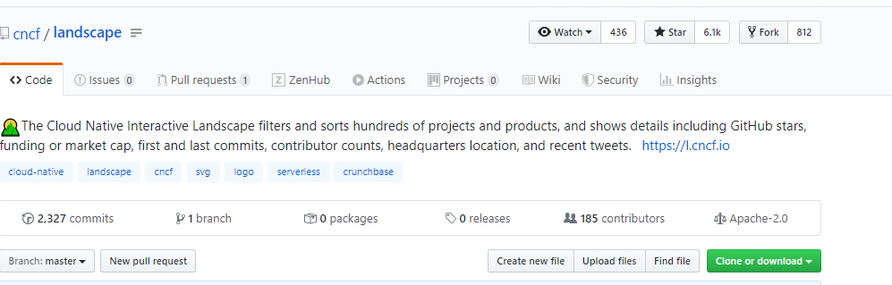
Creating a Fork- your own copy of someone else’s repository
Create Fork (this means you are not the OWNER of the repository—then you can use this code base and change it possibly making pull requests to it)
Create a fork﻿
Open the project that you want to fork on GitHub and click
A copy of the original project will be created under your account. To make changes to this project, you need to clone it to create a local repository.

Slide 41
Fork –to change someone else’s repository
Propose changes to someone else's project
For example, you can use forks to propose changes related to fixing a bug. Rather than logging an issue for a bug you've found, you can:
  Fork the repository.
  Make the fix.
  Submit a pull request to the project owner.

Slide 42
Fork – to use as a starting point for a new project
Open source is based on the idea that by sharing code, we can make better, more reliable software.
When creating your public repository from a fork of someone's project, make sure to include a license file that determines how you want your project to be shared with others. For more information, see “Choose an open source license" at choose a license.
See GitHub’s Open Source Guides
See GitHub Learning Lab course on maintaining open source communities.

Slide 43
What was this thing you mentioned a “pull request”?

Slide 44
Pull Request
NOT the same as a git pull (which is pulling down code from a repository)
https://help.github.com/en/github/collaborating-with-issues-and-pull-requests/about-pull-requests
Pull requests let you tell others (and owner) about changes you've pushed to a branch (or for a fork) in a repository on GitHub.
Once a pull request is opened, you can discuss and review the potential changes with collaborators and add follow-up commits
Then owner can merge your changes into the base branch.
You are NOT the owner of the repository in this case
IDEA = the owner receives pull requests from others which is basically asking them
to merge in/accept the code changes made by someone else.

Slide 45
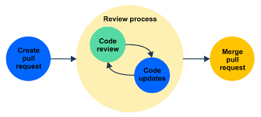
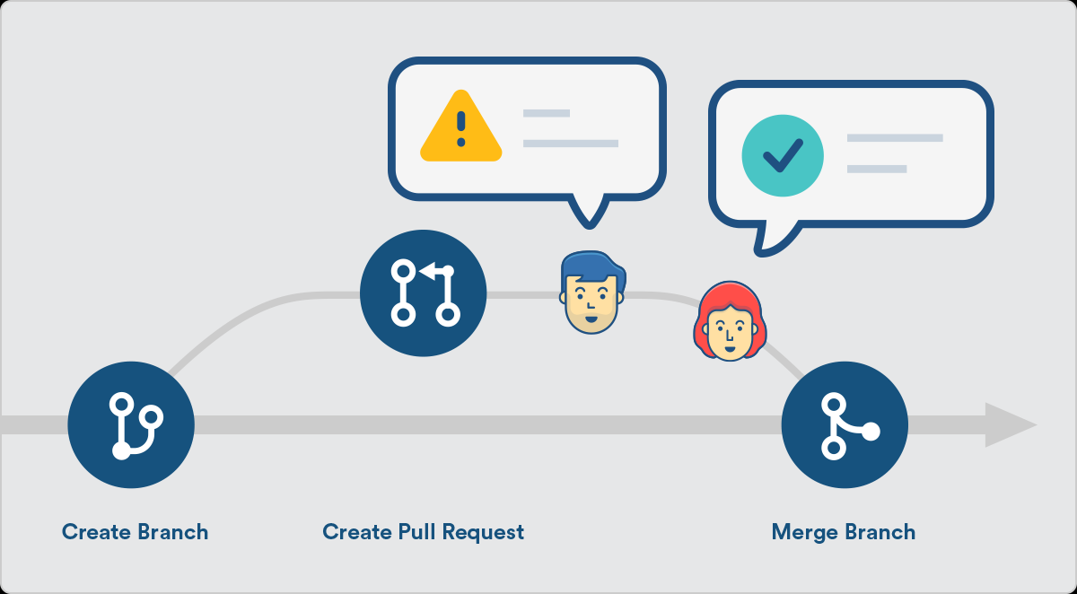
Pull Request
Once a pull request is opened, you can discuss and review the potential changes with collaborators and add follow-up commits
Then owner can merge your changes into the base branch.

Slide 46
Git Pull Request
Command Line:
IntelliJ: VCS | Git | Create Pull Request.
git request-pull [-p] <start> <url> [<end>]

Slide 47
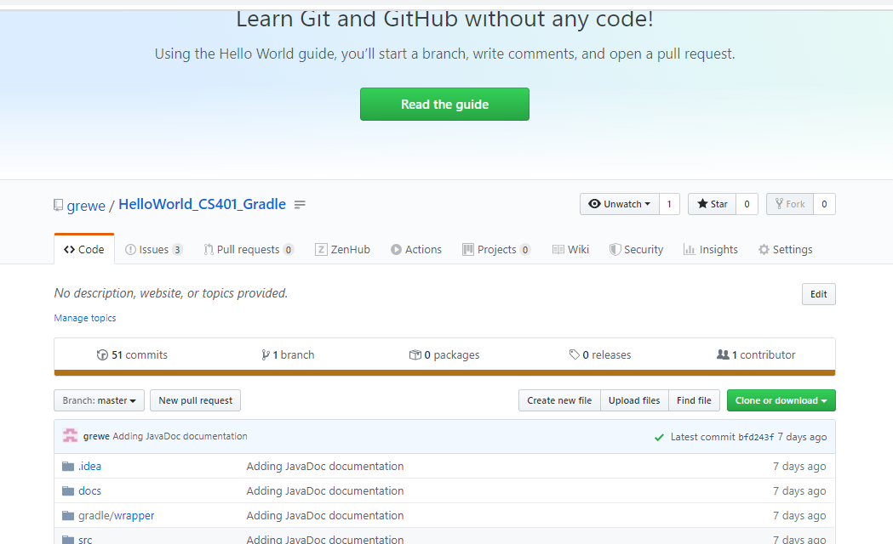
GitHub Pull Request

Slide 48
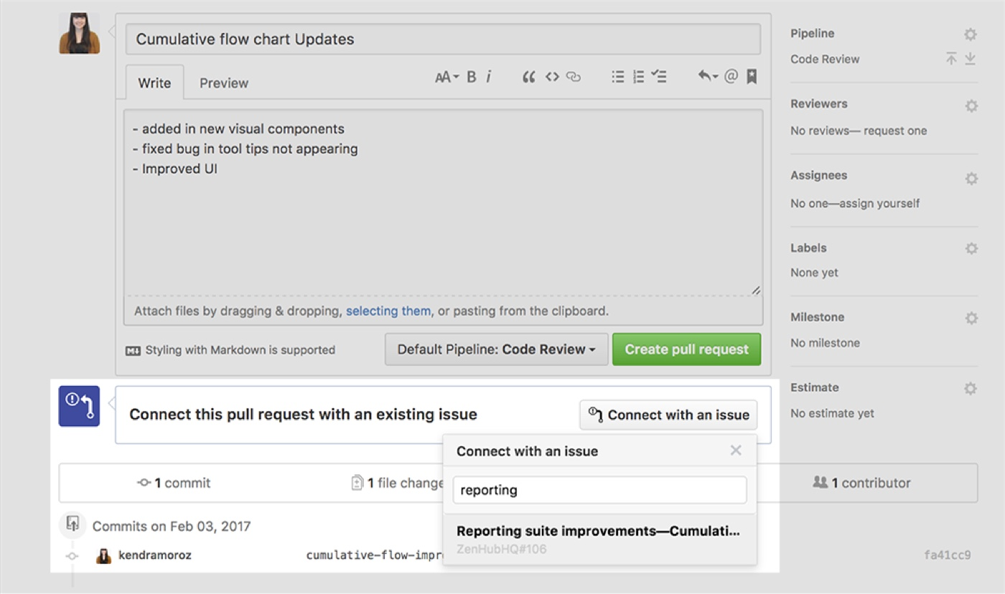
Some use Pull Requests to represent Issues
From GitHub
Associate issues with pull requests so that your issue automatically closes when you merge a pull request. For more information, see "Closing issues using keywords.“
From ZenHub (SW Engineering management plug in for GitHub)
https://www.zenhub.com/blog/github-issue-pull-request-linking/

Slide 49
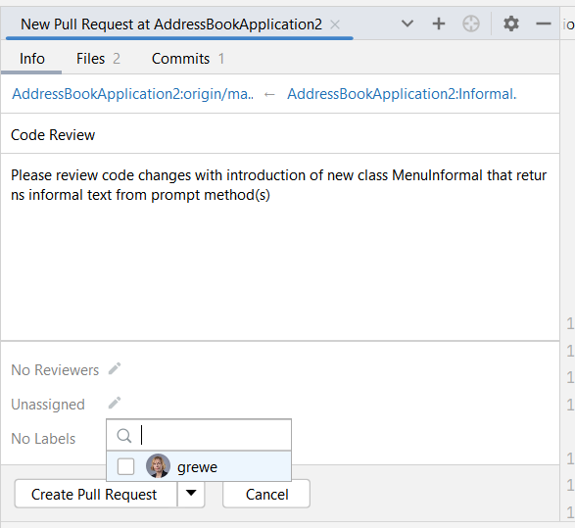
IntelliJ Pull Request
GO to https://www.jetbrains.com/help/idea/contribute-to-projects.html
Git->Git Pull Request
In the Info tab, the repository
on the left is the base repository
that will receive the updates.
The repository on the right
is the head repository with the
changes that will be added to
the base repository.
Add title, description, make labels,
assign reviewers, etc.
Remember pull request requires you have 2 branches
And you have submitted some changes in one
branch & you want say others to review so you can
Merge----pull requests are a mechanism for a developer to
notify team members that they have completed a feature.

Slide 50
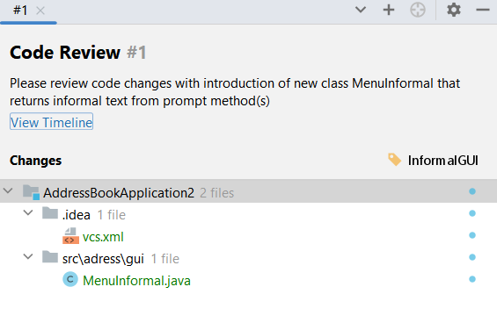
IntelliJ viewing pull requests
Git->Github->View Pull Requests
You can see the description, code involves, branch location of changes
You can request reviews of anyone on the remote repository

Slide 51
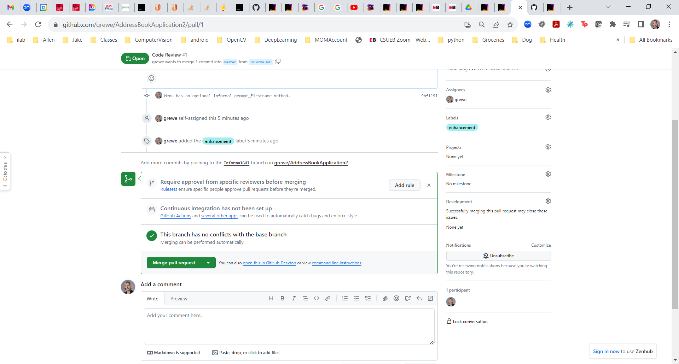
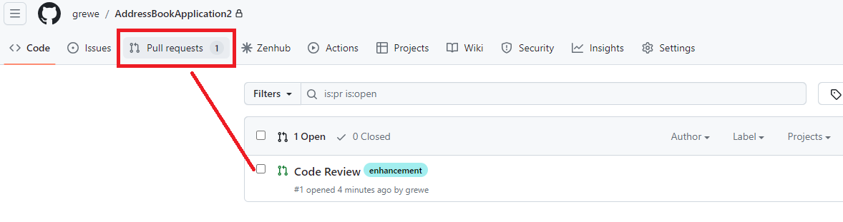
GitHub viewing pull request
Go to github repository and select pull requests
You can place comments on pull request and Merge branches (to say master)

Slide 52
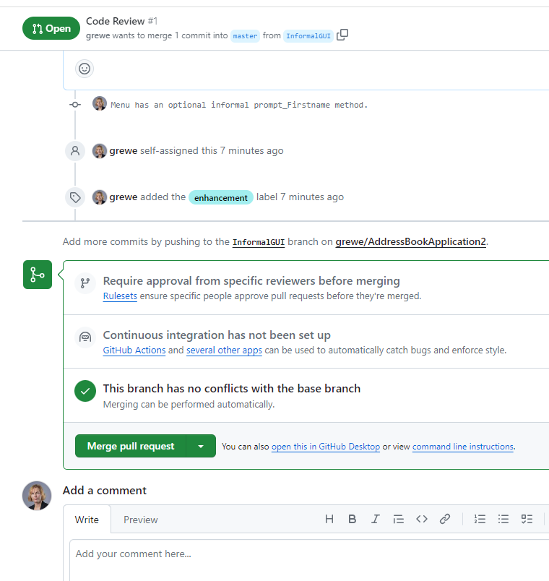
GitHub managing pull request
You can place comments on pull request
and Merge branches
(to say master)

Slide 53
One Workflow….
The next step

Slide 54
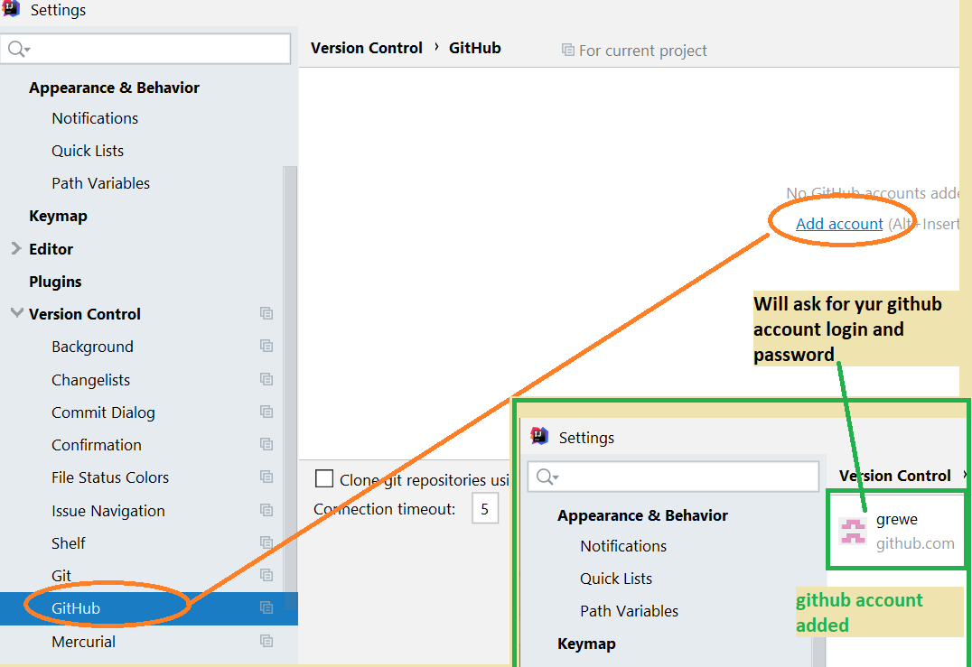
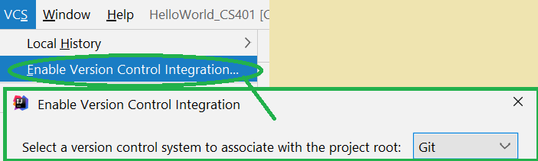
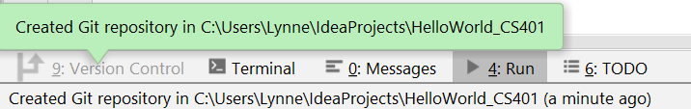
What we will use: GitHub for remote GIT, git for local w/IntelliJ
THIS is what we will do!!!!!

Slide 55
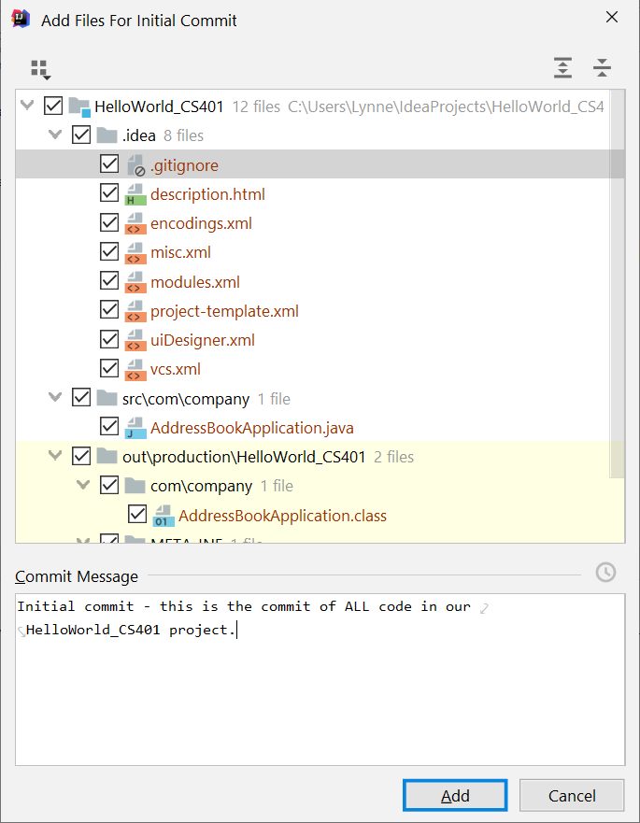
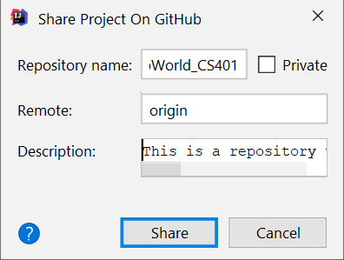
Setting up remote GitHub associated with IntelliJ Project

Slide 56
Another Workflow….
The next step

Slide 57
What we will use: BitBucket for remote GIT, eGit for support in Eclipse, local client SourceTree
https://bitbucket.org/ for details (try setting up the tutorial example and download SourceTree as part of it). SourceTree can be found directly at http://sourcetreeapp.com/
See class website for tips on how to setup and of course the websites for each product.

Slide 58
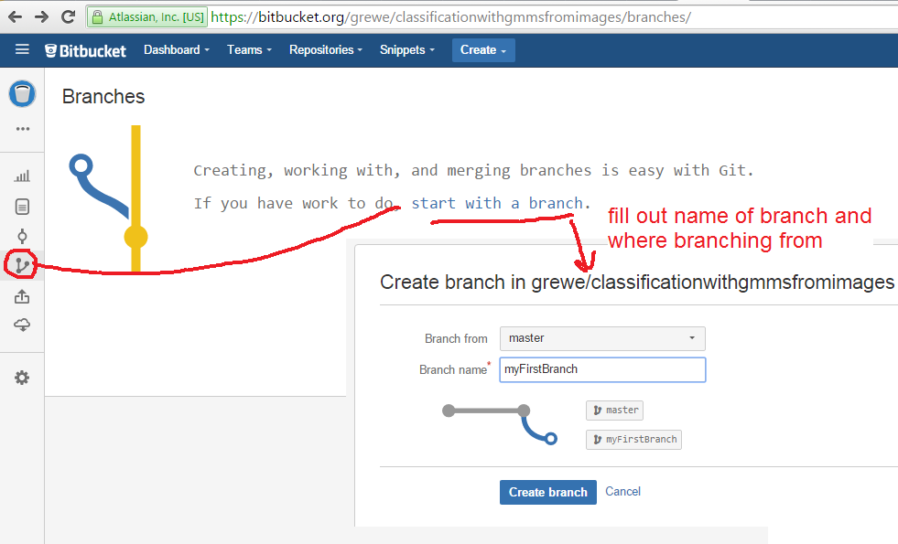
The tools we are using and bitbucket itself as GUI
Example creating a branch is easy inside BitBucket---

Slide 59
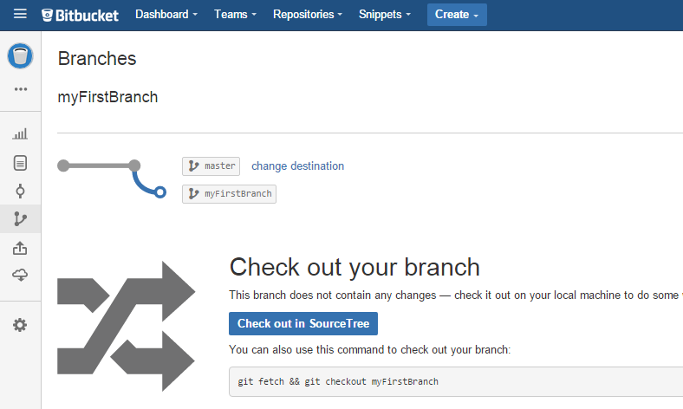
Result of using Bitbucket GUI to create new branch
Example creating a branch is easy inside BitBucket---

Slide 60
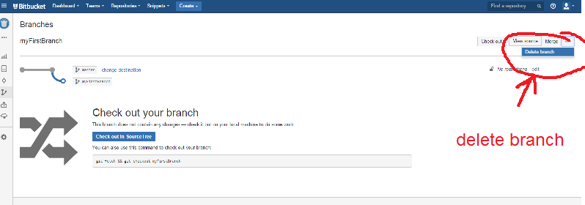
Use Bitbucket GUI to delete the branch we just created
Select branch and select delete

Slide 61
A few ending notes…

Slide 62
ADVICE: Git has a lot of commands
Learn a core subset of them
Use GUI tools (we use eGit in Eclipse with Bitbucket online remote Git repository)
Then learn the rest as you need them

Slide 63
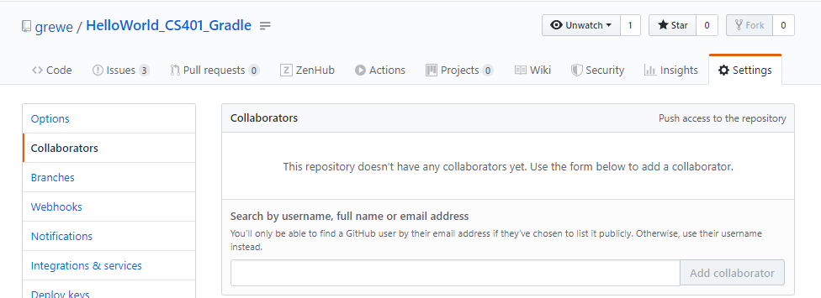
GitHub collaborators
Add team members to GitHub repository (that the Project Manager created as owner)
Read Github.com for latest
GO to repository and hit settings and choose collaborators --enter in name or email (as used by github)

Slide 64
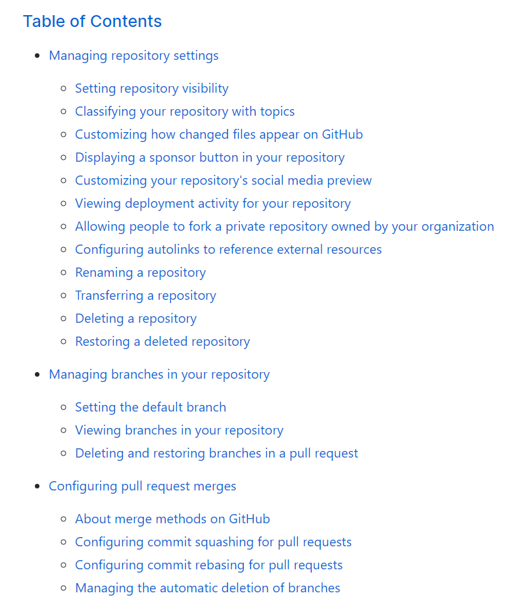
GitHub Settings
This is where you can setup rules to how others can use and access and even you as the owner the repository. How branches are merged and more.
Read GitHub documentation for how to do this
https://help.github.com/en/github/administering-a-repository

Slide 65
Have you heard of SVN –what is the difference with Git
….hmmmmm

Slide 66
SVN vs. Git
SVN:
  central repository approach – the main repository is the only “true” source, only the main repository has the complete file history
  Users check out local copies of the current version
Git:
  Distributed repository approach – every checkout of the repository is a full fledged repository, complete with history
  Greater redundancy and speed
  Branching and merging repositories is more heavily used as a result
Conclusion –use Git

Slide 67
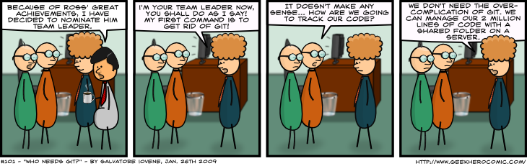
Who needs Git?
http://www.geekherocomic.com/2009/01/26/who-needs-git/

