Slide 1
Build & Release Management

Slide 2
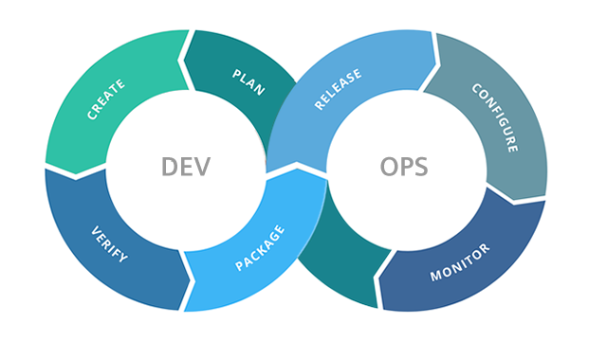
DevOps = Development & Operations
Development – plan, create, verify, package
Operations – release, configure, monitor

Slide 3
My IDE say “build” –what is the difference between build in build management and compile?
Building is done when preparing an application for release, which includes compiling, packaging, testing, etc.
Compiling is done at any time the compiler is involved in translating programming language code to machine code.
Lots of people use build and compile interchangeably –but
When we specifically speak about “Build Management” it means more

Slide 4
more….. Some related comments from Internet
Building is done when preparing an application for release" - don't tell that the continuous integration crowd ;) Or any other avid user of automatic builds, for that matter.
Continuous integration creates many "builds" over the lifetime of an application. However, any or all of these builds could be used in preparation for a public release. It depends on your build, test and approval processes”
”
SO MAYBE build management definition should simply be:
Building includes compiling, packaging, testing, etc.
BUILD MANAGEMENT = techniques and tools involved in Build Process

Slide 5
Stop ---what is “continuous integration”
Merging all developer working copies to a shared mainline several times a day, after applying a test-suite on the code for validation
Google Experience: (from my time at Faculty in Residence)
STEP 1: DEVELOPER TESTING: you do on your development environment your own testing. This included the running of pre-existing test cases and only if it passed you when to STEP 2.
STEP 2: CODE REVIEW: check in your code for “review”. This meant 2-3 other engineers possibly in your team or another team read through your code for correctness and for potential cross “module” problems, etc.
STEP 3: SUBMISSION FOR NEXT PHASE of Testing/Production

Slide 6
Build Management Techniques
Build Teams = these are teams that are responsible for integrating (often) code from multiple teams and there may be different levels of build teams like a “production build team” that creates production releases.
Agile and other SW Engineering paradigms = like Scrum that stipulates 2-week cycles (or something short) –it may be that some paradigms or company policies influence these “Build Cycles” (which are period of time between builds –thought of as releases of code which may be internal and not publicly released or may be publicly released).

Slide 7
Build Tools –some objectives
NOTE: not all build tools will equally
achieve these goals or some may not
even be present
Make development process transparent
Easy way to see the status of a project
Decrease training time for new developers
Bundle the various tools together for Build Management
Standardize the development infrastructure across company
Ease development and integration with other projects/teams
Provide standardized testing environment
Provide documentation (generation) ability
Associate Software Versioning Systems (also part of release management)
Provide Ability for delivery (release management)

Slide 8
Processes
Building Code in Project
Dependency Management
Parent Versioning
Release Management
Distribution Publication

Slide 9
Build Tools
There are MANY, MANY Build Tools
Integrating complex and large software is a tough job and there are enterprise solutions out there.
Some companies purchase solutions that involve many aspects like testing, delivery, documentation, issue tracking, etc.
Some companies use open source standards (Maven, Bazel)
Some companies create their own solutions because they find tools don’t meet their needs (that was the case at Google it was an in-house solution when I was there)

Slide 10
Build Tool Evolution
Because there are so MANY options –especially in the last 10 years –it is hard to show you this –but here are some different images depicting some of the tools (featuring more open source standards)
These open source standards do not fully achieve the goals stated for Build Tools –and in fact the earliest tools are
very limited

Slide 11
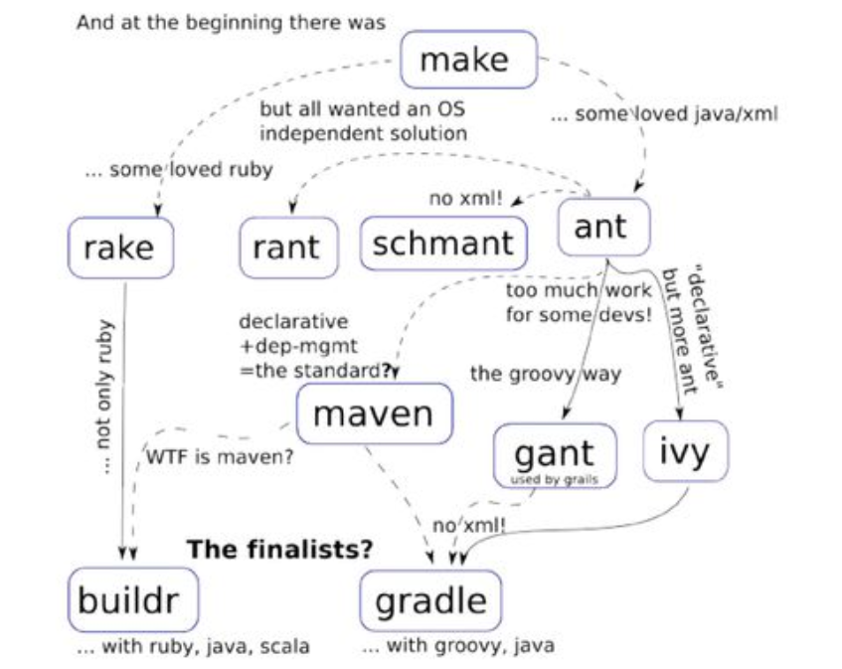
Build Tool Evolution
Evolution implies related changes…..

Slide 12
..opensource build tools
→ showing how build tool
usage in general changes
over time

Slide 13

Ant – Apache opensource for Java Projects
ANT predefined tasks:
  compilation: javac, jspc
  archive: jar, zip, rpm
  documentation: javadoc
  file management: checksum, copy, delete, move, mkdir, tempfile
  test: jUnit
Uses XML files to specify requirements
TIP: XML stands for eXtensible Markup Language. It is a language of tags (<>) like XHTML (the xml
compliant version of html). In this case the tags like <project> and <target> we will see in the next slide
are defined by the Ant protocol
Using a common build tool like Ant that is often supported by many IDEs
allows developers to choose which IDE they want to

Slide 14

Ant in IntelliJ
Example 1

Slide 15
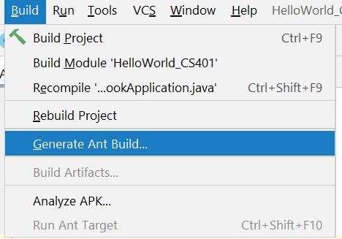
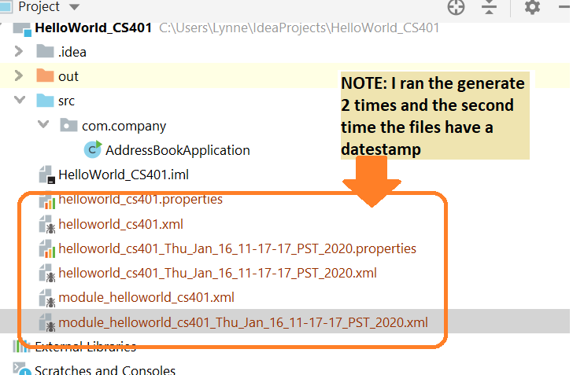
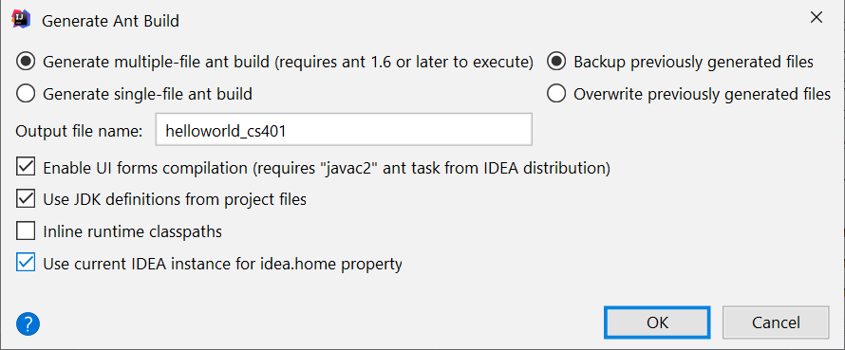
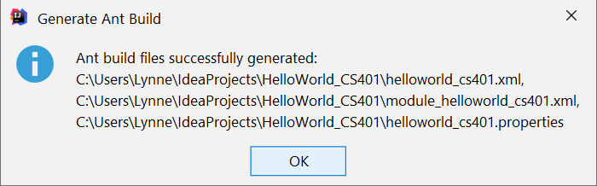
IntelliJ and Ant
By default IntelliJ has a tool to generate an Ant Build file
Build->Generate Ant Build
Let’s look what happens
for our simple HelloWorld
application

Slide 16
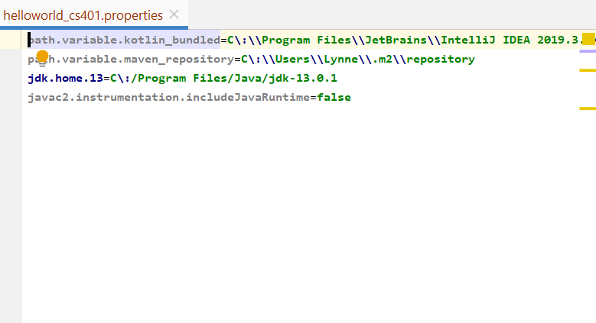
IntelliJ Ant generated build files: helloworld_cs401.properties
Tells about what jdk to use , etc.

Slide 17
IntelliJ and Ant generated code helloworld_cs401.xml
Root xml tag
<project name="helloworld_cs401“ default="all">
this XML file defines the complete project

Slide 18
ABOUT helloworld_cs401.xml
Specifies VARIOUS build values for entire project….
compiler settings like…
<property name="compiler.debug" value="on"/>
<property name="compiler.generate.no.warnings" value="off"/>
<property name="compiler.args" value=""/>
<property name="compiler.max.memory" value="700m"/>
JDK settings like…..
<property name="jdk.bin.13" value="${jdk.home.13}/bin"/>
List of modules to import for project (note I only have one):
<import file="${basedir}/module_helloworld_cs401.xml"/>
How to build, clean and build everything (modules and project):
<target name="clean" depends="clean.module.helloworld_cs401" description="cleanup all"/>
<target name="build.modules" depends="init, clean, compile.module.helloworld_cs401"
description="build all modules"/>
<target name="all" depends="build.modules" description="build all"/>
See NEXT slide where this module defined

Slide 19
IntelliJ and Ant generated code module_helloworld_cs401.xml
Root xml tag <project name="module_helloworld_cs401" default="compile.module.helloworld_cs401">
……this XML file defines THIS module in the project

Slide 20
ABOUT module_helloworld_cs401.xml
Specifies VARIOUS targets and build properties for THIS module like….
how to “clean the module”
<target name="clean.module.helloworld_cs401" description="cleanup module">
<delete dir="${helloworld_cs401.output.dir}"/>
<delete dir="${helloworld_cs401.testoutput.dir}"/>
</target>
how to “location and dependency for tests of module”
<target name="compile.module.helloworld_cs401.tests"
depends="register.custom.compilers,compile.module.helloworld_cs401.production"
description="compile module HelloWorld_CS401; test classes" unless="skip.tests"/>
The build setup for the module:
<target name="compile.module.helloworld_cs401"
depends="compile.module.helloworld_cs401.production,compile.module.helloworld_cs401.tests"
description="Compile module HelloWorld_CS401"/>
<target name="compile.module.helloworld_cs401.production" depends="register.custom.compilers"
description="Compile module HelloWorld_CS401; production classes">
<mkdir dir="${helloworld_cs401.output.dir}"/>
<javac2 destdir="${helloworld_cs401.output.dir}" debug="${compiler.debug}"
nowarn="${compiler.generate.no.warnings}" memorymaximumsize="${compiler.max.memory}"
fork="true" executable="${module.jdk.bin.helloworld_cs401}/javac">
<compilerarg line="${compiler.args.helloworld_cs401}"/>
<bootclasspath refid="helloworld_cs401.module.bootclasspath"/>
<classpath refid="helloworld_cs401.module.production.classpath"/>
<src refid="helloworld_cs401.module.sourcepath"/>
<patternset refid="excluded.from.compilation.helloworld_cs401"/>
</javac2>

Slide 21
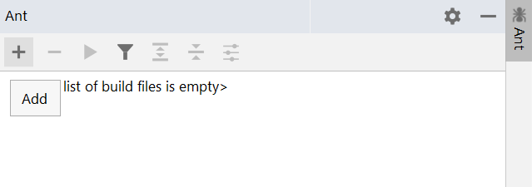
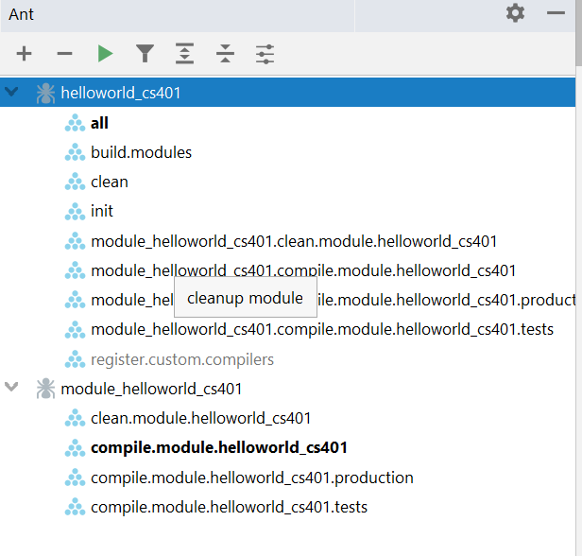
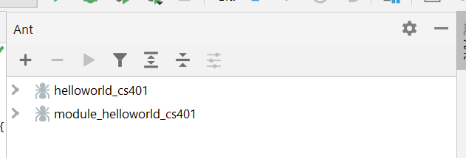
IntelliJ and Ant – adding the generated Ant build files
Read about Ant build tool in IntelliJ
There is an Ant build tool window where you can manually
add your previously generated ant files to it

Slide 22
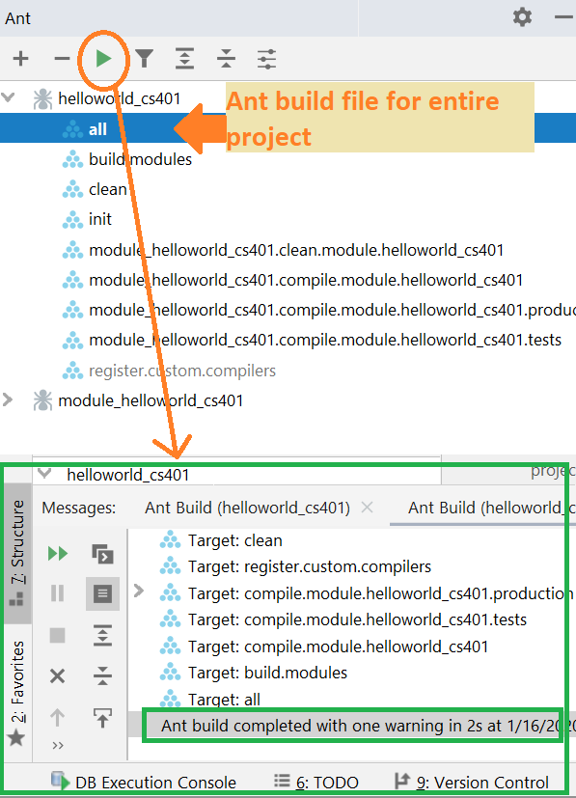
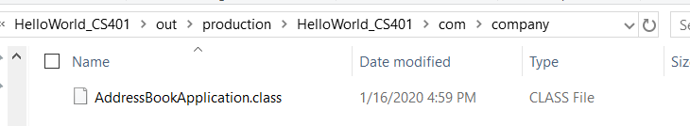
IntelliJ ---Building using Ant (not default IntelliJ build tool)
In Ant console hit “run” button
https://www.jetbrains.com/help/idea
/executing-ant-target.html

Slide 23
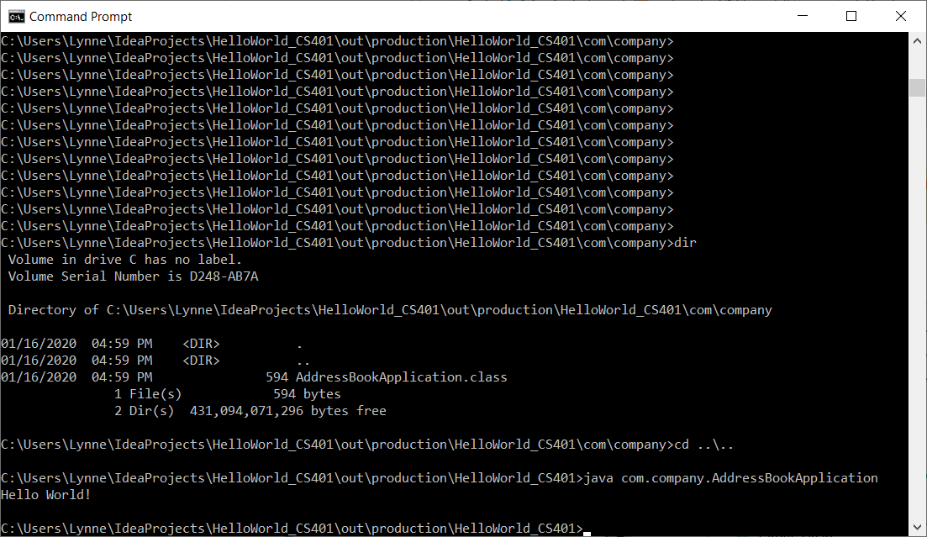
IntelliJ ---Running
Project after Ant Build OPTION 1 command line
(not default IntelliJ running -→ DOING on COMMAND LINE)
Here is location of our
production build Main
Application Class
Now lets run on
command line
via (java classname)

Slide 24
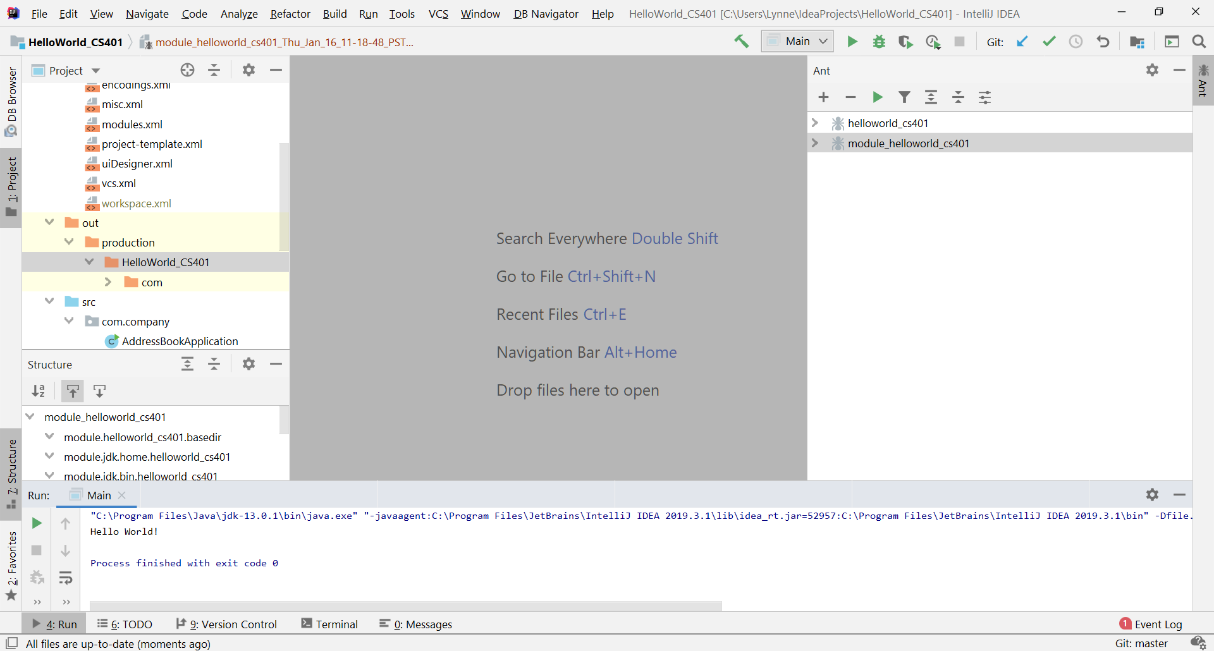
IntelliJ ---Running
Project after Ant Build OPTION 2 from IDE
(if IMMEDIATELY after running your ANT Build you do Run->Main it will execute the freshly built code)
CAUTION: IF you change the code after the ANT build and before executing the code it will re-build the code this time with the IDE’s built-in built tool and not ANT

Slide 25
Why would you want to use Ant over the native IntelliJ build tool ……
This way, I can use the same project both in UNIX systems (say continuous integration, etc) AND inside my favorite IDE...
QUOTE from Internet
This can also be flipped ---if someone maintains a master ANT file for the entire project (or as part of version control), each developer can have their own ANT files for modules and develop them with whatever IDE/Environment that supports ANT and then do integration testing with the overall project ANT files.
I work in small (very small 2-5 person) research teams: I use the native IDE build tools and we all use the same
IDE and do shared versioning control (shared remote repository) that supports issue tracking etc.
and use various SW Engineering tools (Trello, etc)…..so basically I do not use a high level continuous integration build
tool like the one we will talk about later in this lecture

Slide 26
Other options →MAVEN, GRADLE, and>>>

Slide 27
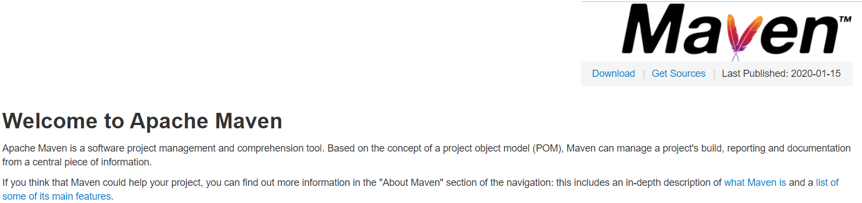
Maven → Apache OpenSource Build Management
https://maven.apache.org/
Model based builds: Maven is able to build any number of projects into predefined output types
  such as a JAR, WAR, or distribution based on metadata about the project, without the need to do any scripting in most cases.
Release management and distribution publication: Without much additional configuration, Maven will integrate with your source control system (such as Subversion or Git) and manage the release based on a certain tag
  can publish this to a distribution location for use by other projects.
  able to publish individual outputs such as a JAR, an archive including other dependencies and documentation, or as a source distribution.
Dependency management: encourages the use of a central repository of JARs and other dependencies.
  Maven comes with a mechanism that your project's clients can use to download any JARs required for building your project from a central JAR repository much like Perl's CPAN

Slide 28
Maven vs Ant
Maven is NEWER
ANT = CONFIGURATION based
  need to define everything i.e. source directory, build directory, target directory etc while
Maven = CONVENTION based
  has predefined project structure i.e. standard directory for source files, test files and resources.
  Read more: https://javarevisited.blogspot.com/2015/01/difference-between-maven-ant-jenkins-and-hudson.html#ixzz6BDqSCl00

Slide 29
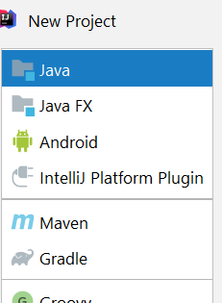
IDEs –can choose their own standard or allow for others
→IntelliJ has built-in IDEA build tool called IDEA
HOWEVER, IntelliJ lets you create from scratch Maven or Gradle (another build tool) project and as we saw will generate from your default project to Ant build files

Slide 30
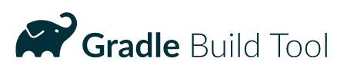
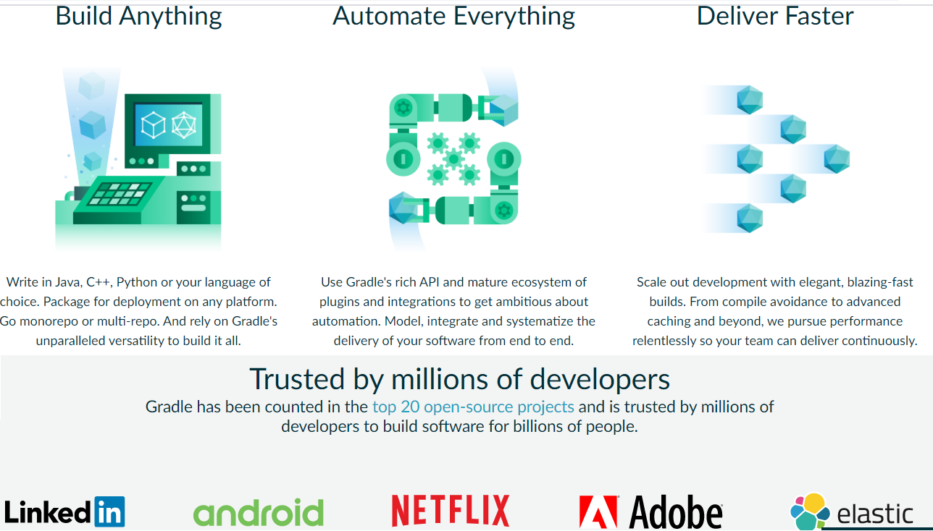
Gradle → OpenSource Build
Management
https://gradle.org/
is an open-source build-automation system that builds upon the concepts of Apache Ant and Apache Maven and introduces a Groovy-based domain-specific language (DSL) instead of the XML form used by Apache Maven for declaring the project configuration.
Became famous with Android
development → strong support
in IntelliJ

Slide 31
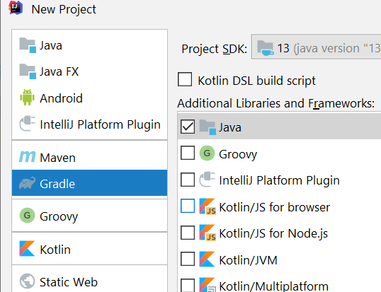
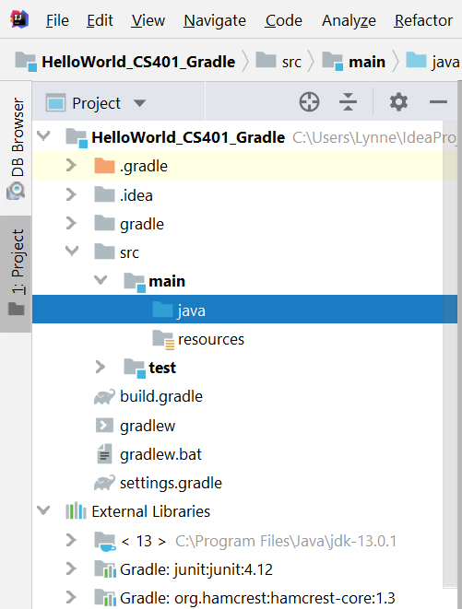
IntelliJ and creating a Gradle project
File->New Project
Select Gradle and
a Java Project
Add source code to
main->java
Add testing code to
test->java

Slide 32
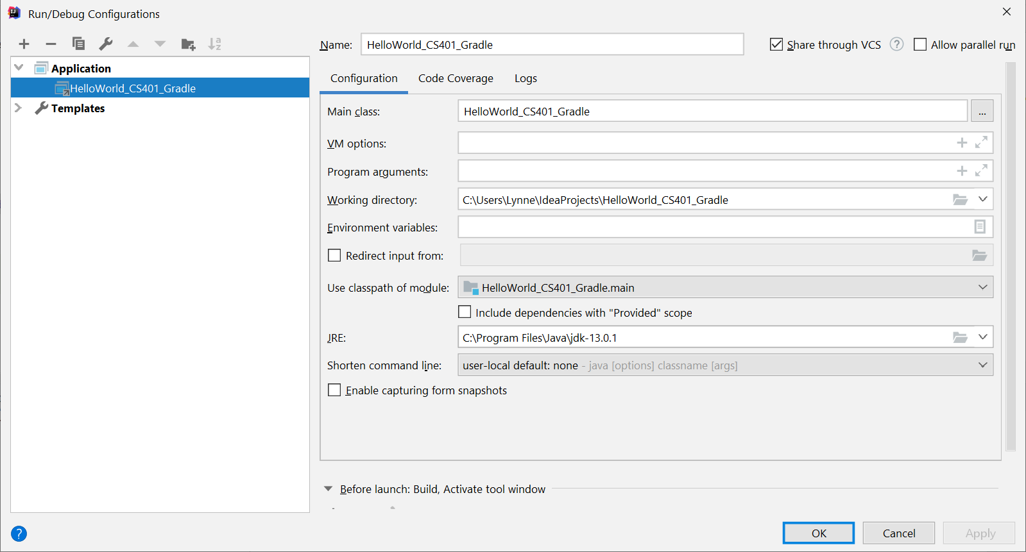
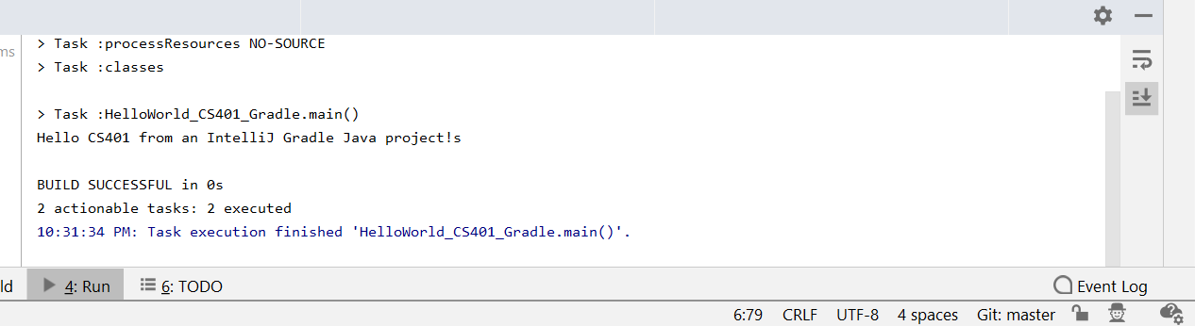
Running the Gradle Project in IntelliJ
Add run configuration
(one time setup..here
running the code in main->
java->
HelloWorld_CS401_Gradle.java
then Run it

Slide 33
STOP
what about continuous integration?

Slide 34
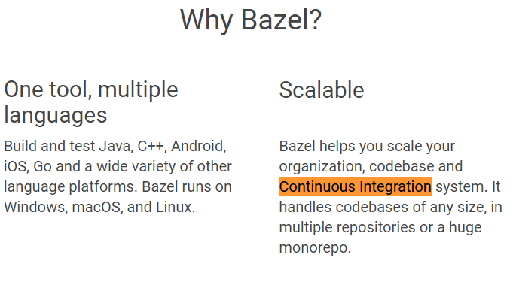
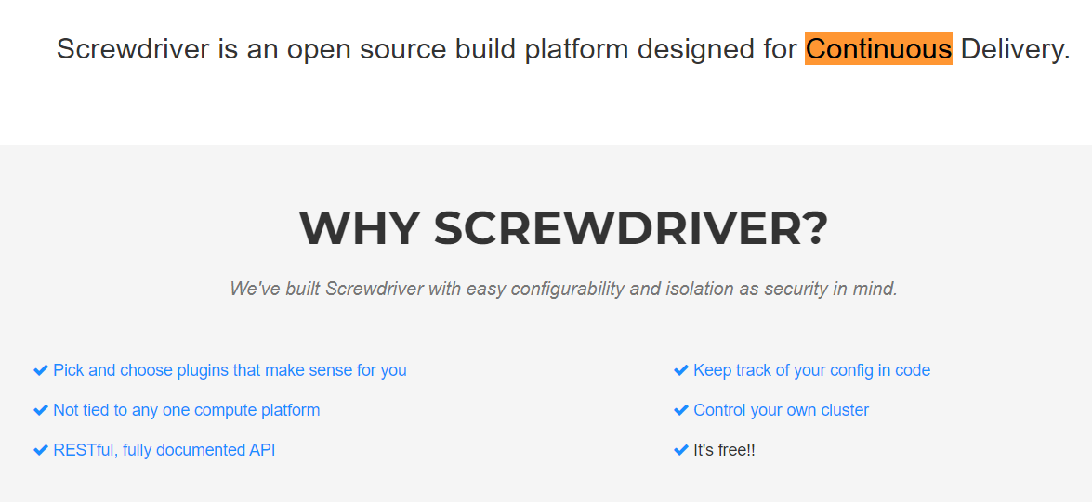
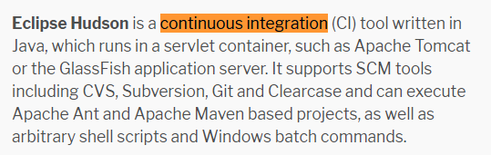
WAIT – what about continuous integration?
Now we are getting into the more MODERN build tools
Bazel, ScrewDriver, Hudson
(note: Hudson is retiring!)

Slide 35
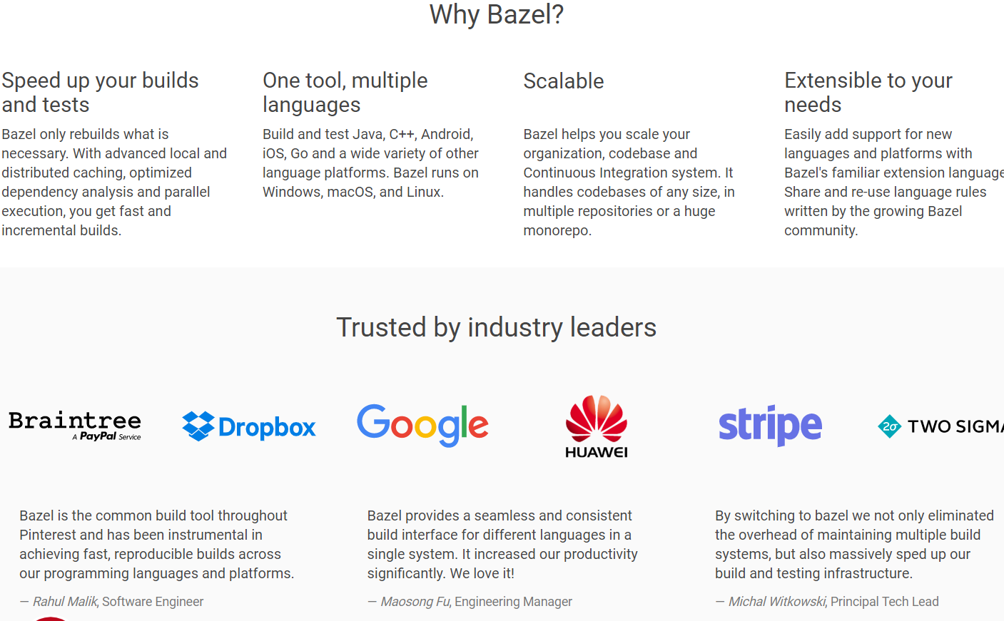
Google Open Source in house tools → Bazel
https://bazel.build/
You can do Bazel in
IntelliJ with some setup
Good for integrating
projects with multiple
different languages at
same time (Java, C++,
Python, etc)
>>was developed for
Speed –to be faster than
Gradle especially as
codebase grows
(#lines/files)

Slide 36
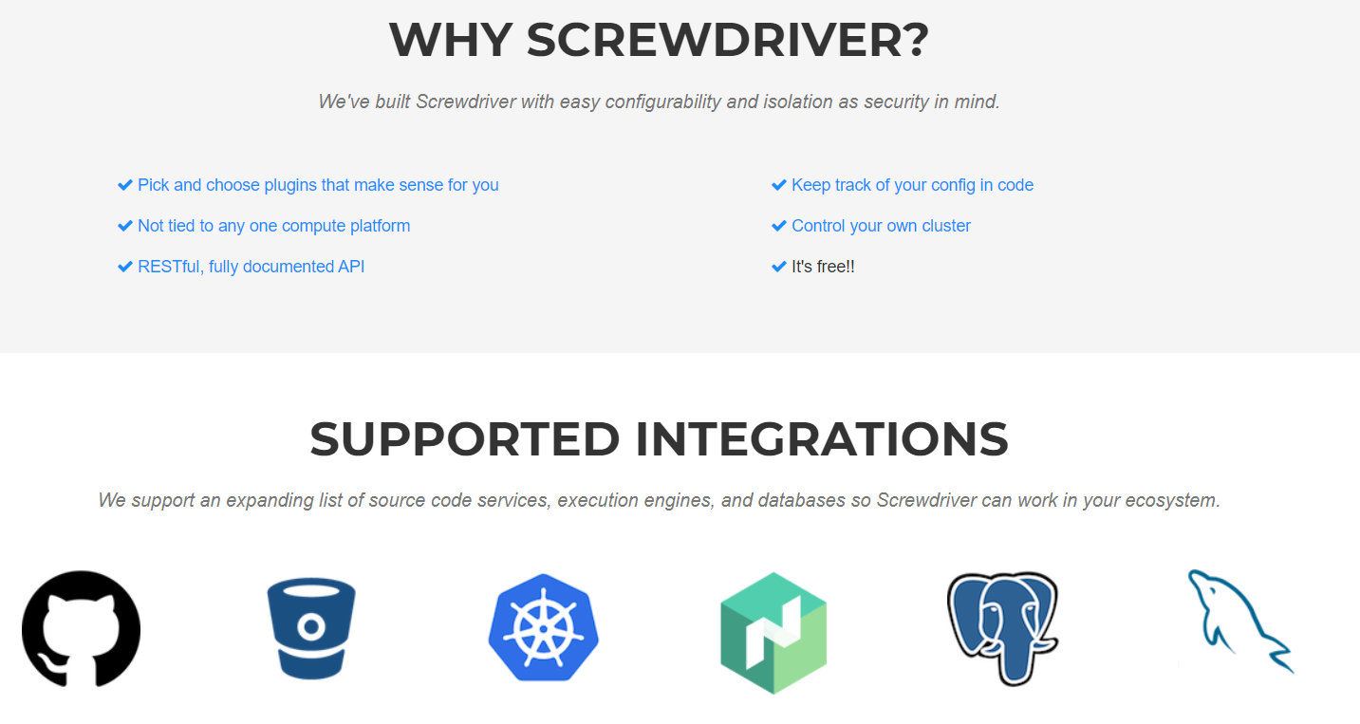
Yahoo! Open Sourced its in house tools → ScrewDriver
https://screwdriver.cd/

Slide 37
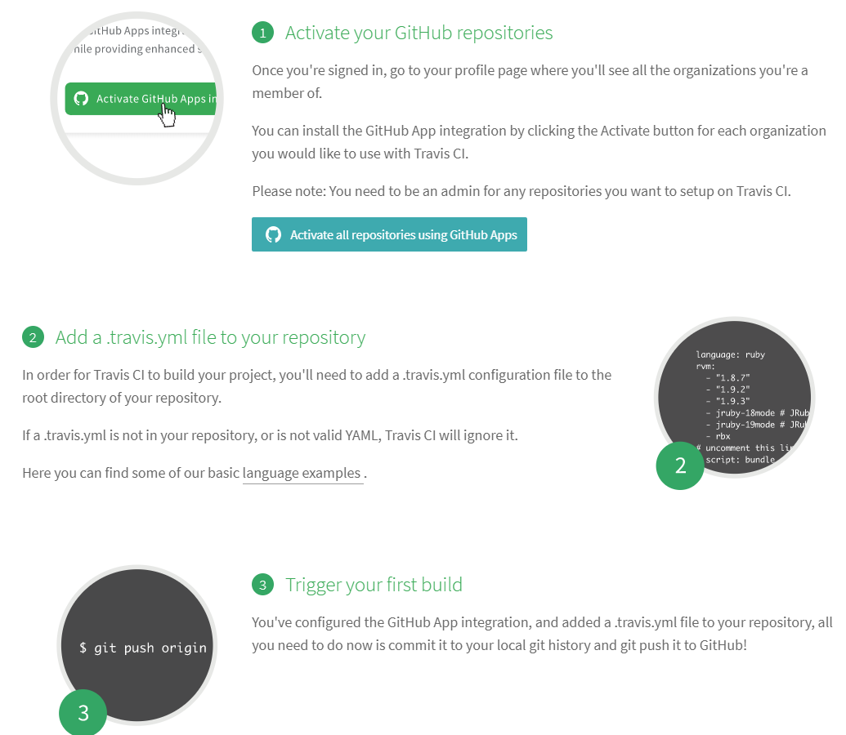
Build Management as a Service
Example Travis Ci
  hosted continuous integration
  service used to build and test
  software projects hosted at GitHub
STEP 2 - travis.yml file examples
for different languages.
NOTE: this requires that you use Gradle OR Maven OR Ant
build tool, not the default IntelliJ tool
→ For us it then makes more sense to consider it for Android that uses Gradle

Slide 38
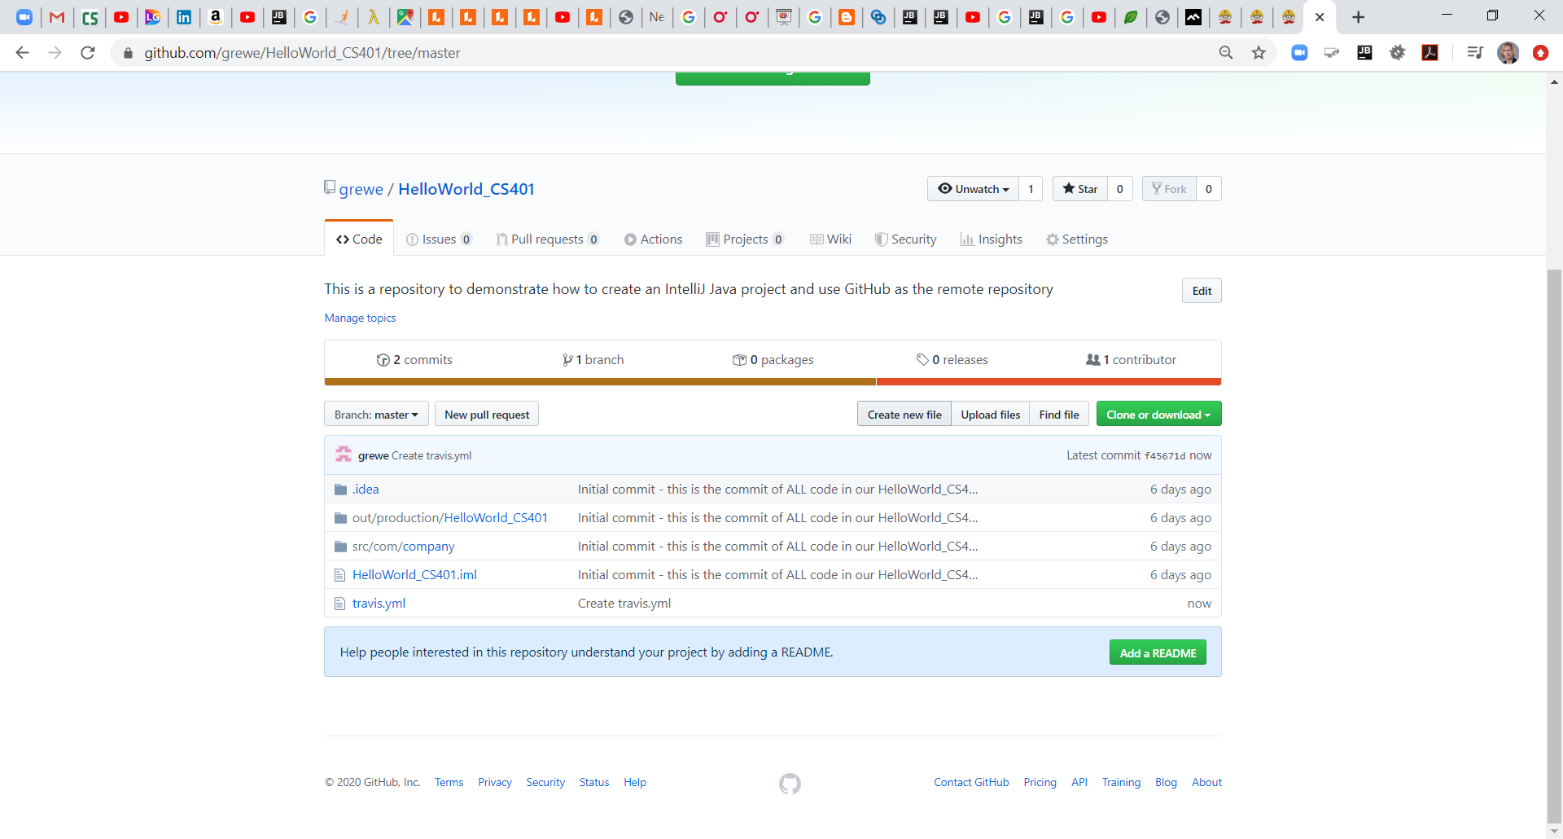
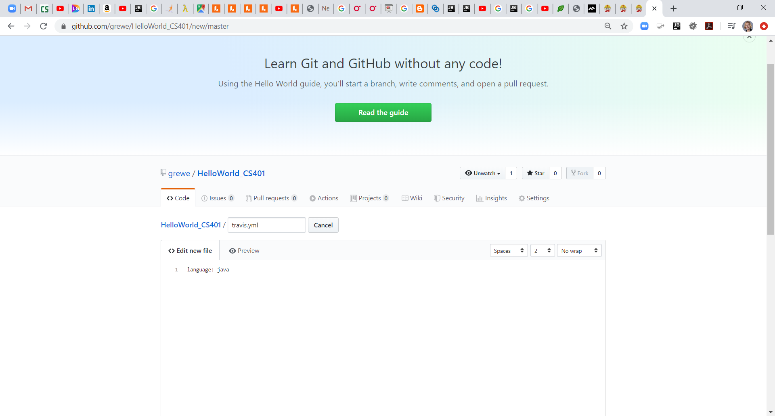
On GitHub creating .travis.yaml file
In Github go to your repository and hit Create New File in the Code tab
Then type in what you want & COMMIT AND PUSH
.travis.yml file where you can
specify SIMPLE tests to run ANY time a
new commit to associated GitHub
Repository takes place
→ACTS like a FLAG to STOP if a problem

Slide 39
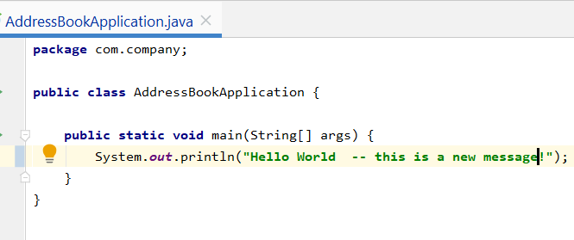
On GitHub creating .travis.yaml file
Follow tutorial at https://docs.travis-ci.com/user/tutorial/
COMMIT AND PUSH of any code now will trigger the Travis Ci build to run.
→ lets change some code in our AddressBookApplication.java file
ONLY tells you if it passed or failed.
HOWEVER it does not ALWAYS tell you the detailed results of testing ---
it is a kind of "STOP GAP" to not allow bad code --or rather to ALTER you bad code is entered.
You can also have separate scripts you choose to run in addition to TEST cases.

Slide 40
The important .travis.yml file
This is where you will say what tests you wish to run
 | EXAMPLE 1
 | language: java jdk: oraclejdk11
 | before_script:
 | - chmod +x gradlew
 | before_install:
 | - sudo apt-get install sendmail
 | script:
 | gradle build && gradle check && echo 'hello'
 | after_failure:
 | cat /home/travis/build/grewe/HelloWorld_CS401_Gradle/build/reports/tests/test/index.html &&
 | sendmail lynne.grewe@csueatbay.edu -m “problem with CS401_Gradle"
EXAMPLE 2
language: java
java:
- versions
sudo: required
services:
- docker
notifications:
email: true/lynne.grewe@csueastbay.edu
slack:
secure: uasdksdlf***the key ****fjdj93jf

Slide 41
Understanding Travis Ci & the yml build file
Travis Ci is a Continuous Integration tool which usually executes the same build command you would do locally, but automatically after every push to GitHub.
It requires a build mechanism being active.
Well, that is not totally true, but it requires you to specify a valid command in the script: section that can be executed on the Travis CI host trying to build your code. When the return code of the command is 0, the build is treated as SUCCESS. Otherwise, it is treated as FAILURE.
In short: Set up your project to use Maven or Gradle or your favorite build tool. You should be able to locally execute mvn clean verify (when using Maven). Then, set up your travis.yml:
    language: java
    sudo: false
    script: mvn clean verify
And commit & push it, together with the pom.xml (when using Maven). Now, Travis CI should work like a charm.

Slide 42
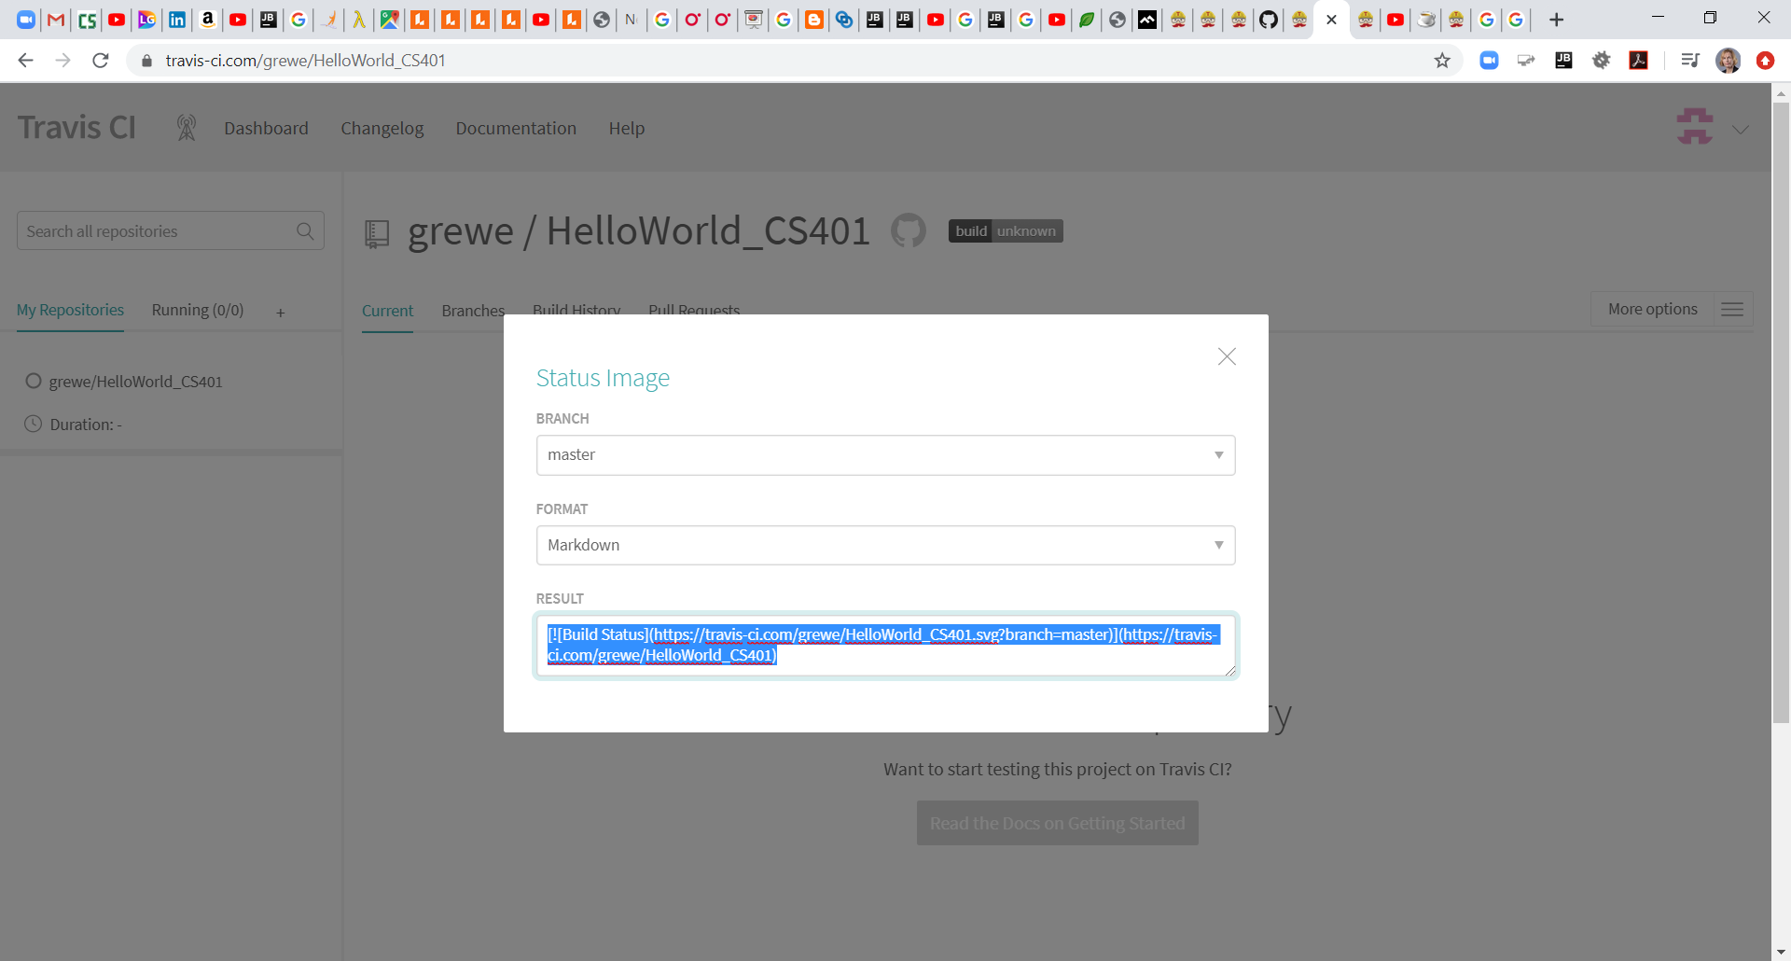
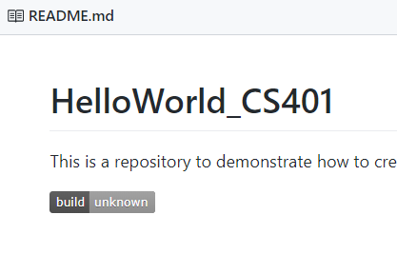
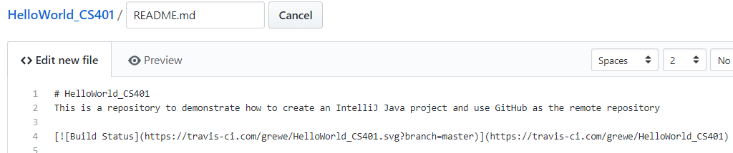
Add the Travis Ci report to your Github Readme to share Travis Ci build results with others
Go to Travis Ci window and hit the Build button in the repository window & copy the code/text you see in the result window for the markdown
NEXT, add to the readme file
on GitHub for your project
repository

Slide 43
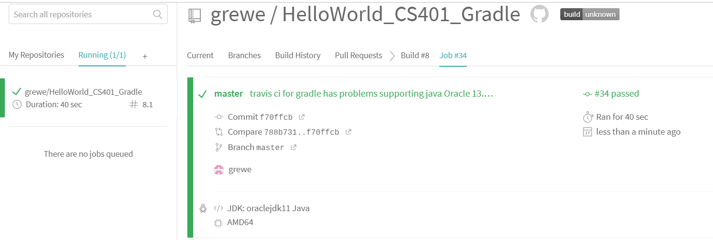
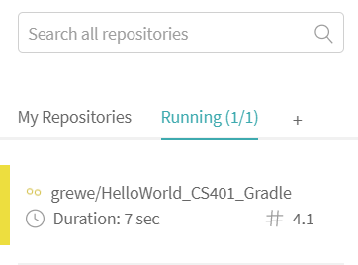
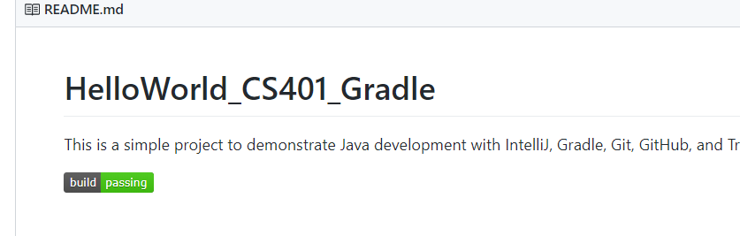
After pushing changes to GitHub you can see in Travis Ci console its build is running
Watch it go from RUNNING the .travis.yml instructions to the final results it passed
README file on GitHub has the updated tag showing it passed

Slide 44
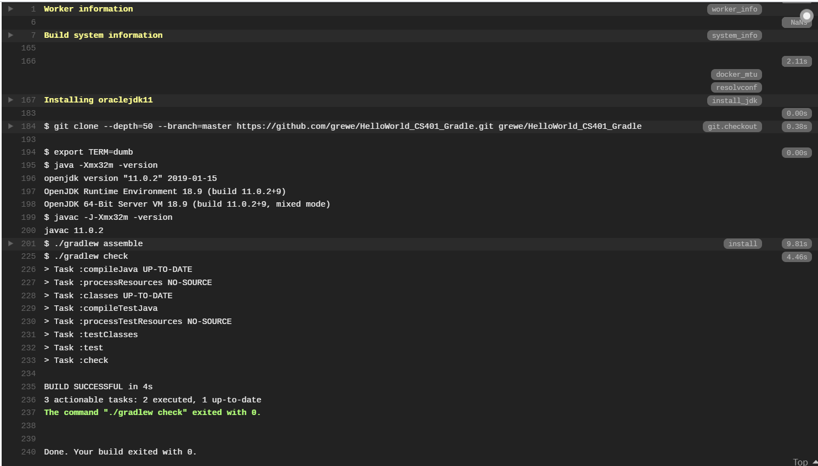
Lets add some test code
..the simple .travis.yml file will automatically using updated project gradle file execute the test cases
THE STEPS https://medium.com/@mglover/automated-java-tests-with-gradle-and-travis-ci-a6c8897231a2
Build and check(testing)
language: java
jdk: oraclejdk11
Both successful
NOTE: gradle check (or gradlew check) will run all of the specified Junit tests

Slide 45
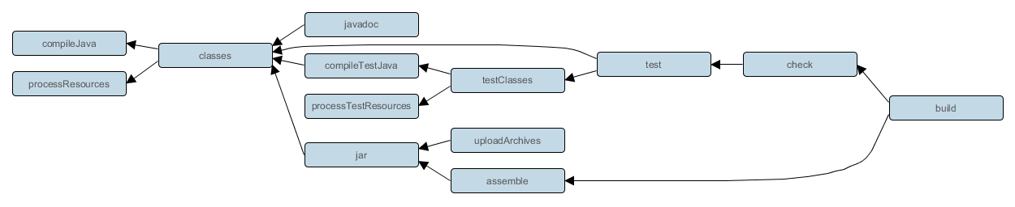
Gradle check will call test
language: java
jdk: oraclejdk11
Calling check
Runs tests
NOTE: gradle check (or gradlew check) will run all of the specified Junit tests

Slide 46
Add on to our .travis.yml file to do more than compile/build our code &lets add some test cases
https://travis-ci.community/ (Travis Ci forum –get help)
THE STEPS https://medium.com/@mglover/automated-java-tests-with-gradle-and-travis-ci-a6c8897231a2
language: java
jdk: oraclejdk11
before_script:
- chmod +x gradlew
script:
gradle build
//create your Junit tests in your project
import org.junit.Test;
public class SimpleTest {
@Test
public void test1() {
System.out.println("Test 1 works");
}
}
GO TO OUR website to see a real example

Slide 47
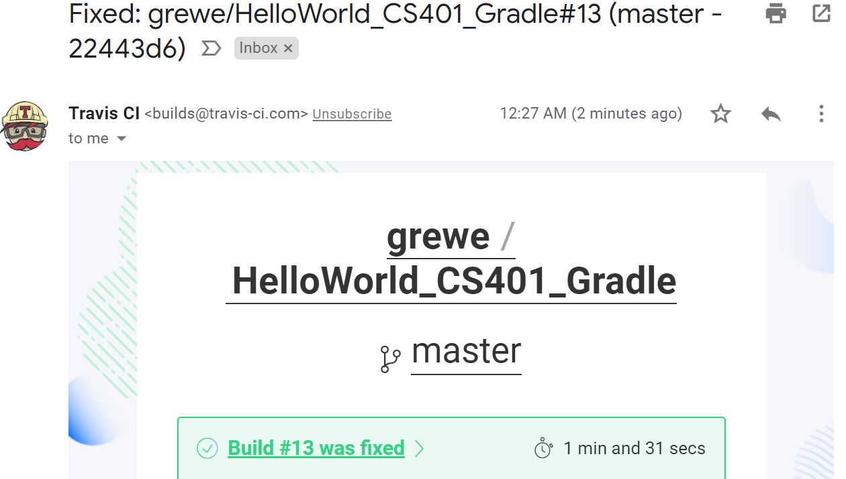
You can turn off but, getting emails from Travis Ci about build pass/fails

Slide 48
MORE to investigate on your own:
Cloud Services like Amazon and Google and Microsoft have Build tools as a service
THAT will not be covered in this class….take a cloud class you MAY have it covered.

