Slide 1
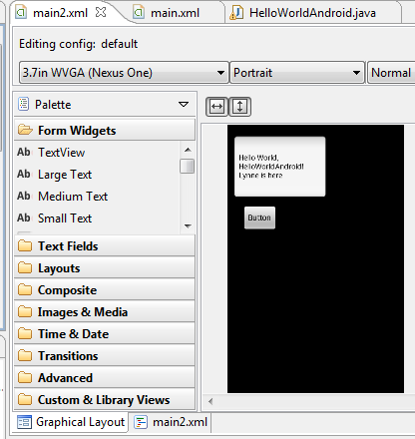
Android – Database → on device Database
L. Grewe

Slide 2
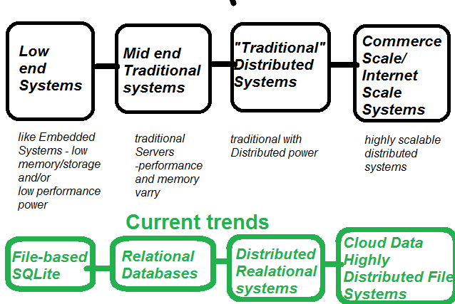
Whole range of Data solutions in general
ON Device Option

Slide 3

Outline
Motivation
SQLite
Create a Database
Create a Table
Making Data
Retrieving Data

Slide 4
Motivation – to store on device Database
When Data is particular to this user and does not need to be shared or does not need/want to be saved
Sometimes you can temporally sync your local database data to remotely stored data –so can work off line (no internet) or work “faster”.
ONLY for small amounts of data → if more than go to server-side data(base) solution
NOTE: android.database.sqlite.SQLiteDatabase.getMaximumSize() gives maximum size

Slide 5
Android Database = SQLite
SQLite has a relatively small memory footprint and decent speed.
SQLite is public domain.
Lots of firms (Adobe, Apple, Google, Sun, Symbian) and open source projects (Mozilla, PHP, Python) all ship products with SQLite.

Slide 6
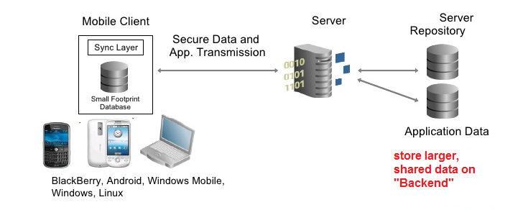
Data Architecture
You can have many different “types” of ways and places you store data
On the mobile device, In a backend (remote)
What you store locally may be different than what you store remotely
If it overlaps –you need to worry about synchronization or have a policy for how synched the data is

Slide 7
SQLite
The native API of SQLite is not JDBC.
JDBC might be too much overhead for a memory-limited device like a phone
Activities may access database directly in code OR access it via a content provider or service (that is another lecture)
Not a client/server architecture
Accessed via function calls from the application

Slide 8
SQLite – what it is meant for
SQLite is mainly focused on single-threaded use cases with smallish datasets.
Apple and Google chose to use it in iOS and Android respectively
For mobile – meant for use on single device

Slide 9
SQLite Database ---only your classes in your app’s package
You cannot access internal databases belonging to other apps or other packages from class it was created in
To do this you must use Content Providers or external SD resident DBs (ANOTHER TOPIC).

Slide 10
SQLite
SQLite uses version of SQL for queries (SELECT), data manipulation (INSERT, et. al.), and data definition (CREATE TABLE, et. al.).
SQLite has a few places where it deviates from the SQL-92 standard, no different than most SQL databases.
SQLite is space-efficient ---Android runtime can include all of SQLite.

Slide 11
SQLite Data types
The biggest difference from other SQL databases is data typing.
You can put whatever data you want in whatever column you want.
You can put a string in an INTEGER column and vice versa.
SQLite refers to this as "manifest typing“.
There are some standard SQL features not supported in SQLite:
FOREIGN KEY constraints,
nested transactions,
RIGHT OUTER JOIN and FULL OUTER JOIN,
and some flavors of ALTER TABLE.

Slide 12
SQLite data types
Some different than normal SQL data types so please read: http://www.sqlite.org/datatype3.html
NULL. The value is a NULL value.
INTEGER. The value is a signed integer, stored in 1, 2, 3, 4, 6, or 8 bytes depending on the magnitude of the value.
REAL. The value is a floating point value, stored as an 8-byte IEEE floating point number.
TEXT. The value is a text string, stored using the database encoding (UTF-8, UTF-16BE or UTF-16LE).
BLOB. The value is a blob of data, stored exactly as it was input.

Slide 13
Comparison of SQLite and normal SQL data types
Example Typenames From The CREATE TABLE Statement or CAST Expression | Resulting SQLite data type
INT INTEGER TINYINT SMALLINT MEDIUMINT BIGINT UNSIGNED BIG INT INT2 INT8 | INTEGER
CHARACTER(20) VARCHAR(255) VARYING CHARACTER(255) NCHAR(55) NATIVE CHARACTER(70) NVARCHAR(100) TEXT CLOB | TEXT
BLOB no datatype specified | NONE
REAL DOUBLE DOUBLE PRECISION FLOAT | REAL
NUMERIC DECIMAL(10,5) BOOLEAN DATE DATETIME | NUMERIC

Slide 14
Example uses SQLite data types to create a table
CREATE TABLE t1( t TEXT,
nu NUMERIC,
i INTEGER,
r REAL,
no BLOB);
NOTE SQLite allows and will convert to proper data type for you (easier than normal SQL which you must enter in correct data type)
INSERT INTO t1 VALUES('500.0', '500.0', '500.0', '500.0', '500.0');

Slide 15
android.database.sqlite
Contains the SQLite database management classes that an application would use to manage its own private database.

Slide 16
android.database.sqlite - Classes
SQLiteCloseable - An object created from a SQLiteDatabase that can be closed.
SQLiteCursor - A Cursor implementation that exposes results from a query on a SQLiteDatabase.
SQLiteDatabase - Exposes methods to manage a SQLite database.
SQLiteOpenHelper - A helper class to manage database creation and version management.
SQLiteProgram - A base class for compiled SQLite programs.
SQLiteQuery - A SQLite program that represents a query that reads the resulting rows into a CursorWindow.
SQLiteQueryBuilder - a convenience class that helps build SQL queries to be sent to SQLiteDatabase objects.
SQLiteStatement - A pre-compiled statement against a SQLiteDatabase that can be reused.

Slide 17
android.database.sqlite.SQLiteDatabase
Contains the methods for: creating, opening, closing, inserting, updating, deleting and quering an SQLite database
These methods are similar to JDBC but more method oriented than what we see with JDBC (remember there is not a RDBMS server running)

Slide 18
SQLite Concept of creating a Database in Android
No databases are automatically supplied to you by Android.
If you want to use SQLite, you have to create your own database, then populate it with your own tables, indexes, and data.

Slide 19
How to create Database in code
Option 1: SQLiteDatabase.openDatabase(*)
Option 2: SQLiteDatabase.openOrCreateDatabase(*)
Option 3:
using your own SQLiteOpenHelper class

Slide 20
Android Data base creation
Option 1 – using SQLiteDatabase.openDatabase(*)
This method will open an existing database or create one in the application data area

Slide 21
SQLiteDatabase.openDatabase(*)
public staticSQLiteDatabase.openDatabase(String path, SQLiteDatabase.CursorFactory factory, int flags ) android.database.sqlite.SQLiteDatabase db;
db =SQLiteDatabase.openDatabase("/data/data/ApplicationPACKAGE/databases/MyDB",
null, SQLiteDatabase.CREATE_IF_NECESSARY);
Open the database according to the flags OPEN_READWRITE OPEN_READONLY CREATE_IF_NECESSARY . Sets the locale of the database to the the system's current locale.
Parameters
path to database file to open and/or create
factory = optional factory class that is called to instantiate a cursor when query is called, or null for default
Flags to control database access mode
Returns the newly opened database
Throws SQLiteException if the database cannot be opened

Slide 22
Android Data base creation
Option 2 – using SQLiteDatabase.openOrCreateDatabase(*)
This method will open an existing database or create one in the application data area

Slide 23
SQLiteDatabase.openOrCreateDatabase(*)
public staticSQLiteDatabase.openOrCreateDatabase(String path, MODE, SQLiteDatabase.CursorFactory factory) SQLiteDatabase db; db = this.openOrCreateDatabase ("/data/data/ApplicationPACKAGE/databases/MyDB", MODE_PRIVATE, null);
Open the database according to the flags OPEN_READWRITE OPEN_READONLY CREATE_IF_NECESSARY . Sets the locale of the database to the system's current locale.
Parameters
1. path The prefix is assigned by Android as: /data/data/<app namespace>/databases/MyDB.
2.MODEcould be: MODE_PRIVATE, MODE_WORLD_READABLE, and MODE_WORLD_WRITEABLE. Meaningful for apps consisting of multiples activities.
3.Null refers to optional factory class parameter (skip for now)

Slide 24
Android Data base creation
Option 3 – using SQLiteOpenHelper.getWritableDatabase()

Slide 25
SQLiteOpenHelper.getWriteableDatabase(*) >> cover in detail more later
public SQLiteOpenHelper.getWritableDatabase() android.database.sqlite.SQLiteDatabase db; db= DatabaseHelper.getWriteableDatabase();
You must create DatabaseHelper class extending SQLiteOpenHelper. →
This method will open an existing database or create one in the application data area first time this is called, the database will be opened and onCreate(SQLiteDatabase), onUpgrade(SQLiteDatabase, int, int) and/or onOpen(SQLiteDatabase) will be called

Slide 26
DatabaseHelper extends SQLiteOpenHelper
Your subclass DatabaseHelper of SQLiteOpenHelper will need three methods:
DatabaseHelper(*) calling parent constructor.
onCreate(*), which passes you a SQLiteDatabase object that you need to populate with tables and initial data.
onUpgrade(*), which passes you a SQLiteDatabase object and the old and new version numbers, so you can figure out how best to convert the database from the old schema to the new one.

Slide 27
DatabaseHelper (SQLiteOpenHelper) Constructor
constructor takes Context (e.g., an Activity), the name of the database, an optional cursor factory (typically, just pass null), and an integer representing the version of the database schema you are using.
class DatabaseHelper extends SQLiteOpenHelper { private static final int DATABASE_VERSION = 2; private static final String DICTIONARY_TABLE_NAME = “myDB"; private static final String KEY_WORD = “TITLE”; private static final String KEY_DEFINITION = “DEFINITION”; private static final String DICTIONARY_TABLE_CREATE = "CREATE TABLE " + DICTIONARY_TABLE_NAME + " (" + KEY_WORD +" TEXT, “ + KEY_DEFINITION + " TEXT);";
DatabaseHelper(Context context) { super(context, DATABASE_NAME, null, DATABASE_VERSION); }
//more methods on next slides→
This DatabaseHelper class creates a table named myDB
Here we have sett he class variables DATABASE_NAME and DATABASE VERSION
Example:
static final String DATABASE_NAME = “myDB";
static final int DATABASE_VERSION = 2;

Slide 28
Creating a Database Table DatabaseHelper (SQLiteOpenHelper) onCreate()
call execSQL() on your SQLiteDatabase, providing the SQL statement you wish to apply against the database.
// INSIDE DatabaseHelper class
@Override
public void onCreate(SQLiteDatabase db)
{
try {
db.execSQL(DATABASE_CREATE);
} catch (SQLException e) {
e.printStackTrace();
}
}
Here we have set the class variables
DATABASE_CREATE This Code:
“create table myDB (TITLE Text, DESCRIPTON Text);”
Different Example:
static final String DATABASE_CREATE = "create table contacts (_id integer primary key autoincrement, “ + "name text not null, email text not null);";

Slide 29
DatabaseHelper (SQLiteOpenHelper) onUpgrade()
It passes you a SQLiteDatabase object and the old and new version numbers, you figure out how best to convert the database from the old schema to the new one.
The simplest, albeit least friendly, approach is to simply drop the old tables and create new ones.
// INSIDE DatabaseHelper class @Override
public void onUpgrade(SQLiteDatabase db, int oldVersion, int newVersion)
{
Log.w(TAG, "Upgrading database from version " + oldVersion + " to "
+ newVersion + ", which will destroy all old data");
db.execSQL("DROP TABLE IF EXISTS contacts"); //we simply drop the old table contacts
//in old database
onCreate(db); //create new database
}

Slide 30
Creating Database (SQLDatabase instance) using DatabaseHelper (SQLiteOpenHelper)
Use DatabaseHelper (SQLiteOpenHelper subclass) to create an instance using inherited methods: getReadableDatabase() or getWriteableDatabase(), depending upon whether or not you will be changing its contents:
db = (new DatabaseHelper(getContext())).getWritableDatabase();
return (db == null) ? false : true;
This will return a SQLiteDatabase instance, which you can then use to query the database, modify its data, or close the database.

Slide 31

DatabaseHelper --more
Later we will see another DatabaseHelper (extending SQLiteOpenHelper) that will read in the contents of a pre-exisiting database

Slide 32
Now we have a database ---how do we create tables, and perform CRUD commands
Doing it from code inside your Android App

Slide 33
Now you have a SQLiteDatabase instance –what do you do?
How to make tables, execute queries

Slide 34
Creating Tables
db = instance of SQLiteDatabase that was created prior, see previous slides Option 1, 2, and 3 to do this
A lot of times you may create the table using a management tool
As discussed before → instead of coding
Create a static string containing the SQLite CREATE statement, use the execSQL( ) method to execute it.
//setup SQL statement as a String
String createAuthor = "CREATE TABLE authors (
id INTEGER PRIMARY KEY AUTOINCREMENT,
fname TEXT,
lname TEXT);
db.execSQL(createAuthor);
execSQL =Execute a single SQL statement that is NOT a SELECT or any other SQL statement that returns data.

Slide 35
Tables and unique identifiers
SQLITE uses an invisible field called ROWID to uniquely identify each row in each table.
In the previous example the visible field “id” functions in the same manner (primary key)
//setup SQL statement as a String
String createAuthor = "CREATE TABLE authors (
id INTEGER PRIMARY KEY AUTOINCREMENT,
fname TEXT,
lname TEXT);
db.execSQL(createAuthor);

Slide 36
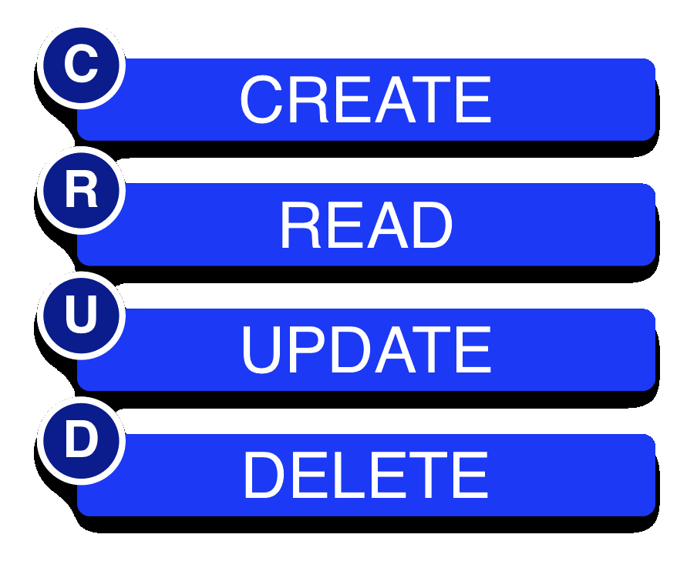
CRUD – the essence of what we want to do in a Database
Create (Insert)
Read (select)
Update
Delete

Slide 37
insert( )
Store data as Name,Value pairs using ContentValues class
long insert(String table, String nullColumnHack, ContentValues values)
import android.content.ContentValues;
ContentValues values = new ContentValues( ); //use to store name, value pairs
values.put("firstname" , "J.K.");
values.put("lastname" , "Rowling");
long newAuthorID = db.insert(“TableName" , "" , values);
2nd paramenter = optional; may be null. SQL doesn't allow inserting a completely empty row without naming at least one column name. If your provided values is empty, no column names are known and an empty row can't be inserted. If not set to null, the nullColumnHack parameter provides the name of nullable column name to explicitly insert a NULL into in the case where your values is empty.

Slide 38
update( )
Store data as Name,Value pairs using ContentValues class
int update(String table, ContentValues values, String whereClause, String[ ] whereArgs)
public void updateBookTitle(Integer bookId, String newTitle) {
ContentValues values = new ContentValues();
values.put("title" , newTitle);
db.update("tbl_books" , values ,"id=?" ,new String[ ] bookId.toString() } );
}
//here we update the table entries with new title
//where the id= bookID.toString()

Slide 39
delete( )
int delete(String table, String whereClause, String[] whereArgs)
public void deleteBook(Integer bookId) {
db.delete("tbl_books" , "id=?" ,
new String[ ] { bookId.toString( ) } ) ;
}
//delete all database entries in table tbl_books
// where id=bookID.toStrin()

Slide 40
Raw Queries --rawQuery()
Cursor c = db.rawQuery("SELECT name FROM sqlite_master WHERE type='table' AND name='constants'", null);
In the above statement, we query a SQLite system table (sqlite_master) to see if our constants table already exists.
The return value is a Cursor, which contains methods for iterating over results.

Slide 41
Raw Queries --rawQuery() with parameters
String mySQL= "select count(*) as Total “+ " from tblAmigo”+ " where recID> ?” + " and name = ?";
String[] args= {"1", "BBB"};
Cursor c1 = db.rawQuery(mySQL, args);
In the above statement, we query myTable getting count of entries where recID>1 and name =‘BBB’

Slide 42
Simple Queries –query()
The query() method takes the discrete pieces of a SELECT statement and builds the query from them.
The pieces, in order that they appear as parameters to query(), are:
The name of the table to query against
The list of columns to retrieve
The WHERE clause, optionally including positional parameters
The list of values to substitute in for those positional parameters
The GROUP BY clause, if any
The ORDER BY clause, if any
The HAVING clause, if any

Slide 43
query(**)
Method of SQLiteDatabase class and performs queries on the DB and returns the results in a Cursor object
Cursor c = db.query(p1,p2,p3,p4,p5,p6,p7)
p1 ; Table name (String)
p2 ; Columns to return (String array)
p3 ; WHERE clause (use null for all, ?s for selection args)
p4 ; selection arg values for ?s of WHERE clause
p5 ; GROUP BY ( null for none) (String)
p6 ; HAVING (null unless GROUP BY requires one) (String)
p7 ; ORDER BY (null for default ordering)(String)
p8 ; LIMIT (null for no limit) (String)

Slide 44
Simple Queries
returning a Cursor over the result set
which is positioned before the first entry.
Note: Cursors are not synchronized,
SQL - "SELECT * FROM ABC;" SQLite - Cursor c = db.query(“ABC”,null,null,null,null,null,null);
SQL - "SELECT * FROM ABC WHERE C1=5" SQLite –
Cursor c = db.query( “ABC”,null,"c1=?" , new String[ ] {"5"},null,null,null);
SQL – "SELECT title,id FROM BOOKS ORDER BY title ASC" SQLite –
String colsToReturn [ ] {"title","id"}; String sortOrder = "title ASC"; Cursor c = db.query(“BOOKS",colsToReturn, null,null,null,null,sortOrder);

Slide 45
How to Process Query Results --Using Cursors
After you execute the query, you get back a Cursor
Cursor
getCount() = Find out how many rows are in the result set
moveToFirst(), moveToNext(), and isAfterLast() = Iterate over the rows
getColumnNames()= Find out the names of the columns
getColumnIndex() =convert column names into column numbers via
getString(), getInt(), etc. = get values for the current row for a given column
requery() =Re-execute the query that created the cursor
close() =Release the cursor's resources

Slide 46
Example Processing Query Results --Using Cursors
Cursor result= db.rawQuery("SELECT ID, name, inventory FROM widgets");
result.moveToFirst(); //start at first entry/row in result set returned
while (!result.isAfterLast()) { //while there are more entries in result
int id=result.getInt(0); //get the first column as an int
String name=result.getString(1); //get the second column as a Strin
int inventory=result.getInt(2); //get the third column as an int
// do something useful with these values
Toast.makeText(this, “id” + id + “ name = “+name + “inventory= “ + inventory, ****);
result.moveToNext(); //go to next row/entry
}
result.close(); //close off Query
Note: Above assumes a table named “widets” and we ask for columns id, name and inventory in that order

Slide 47
Location of Database files
Remember SQLite is a file based on device database

Slide 48

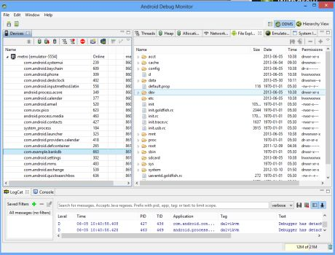
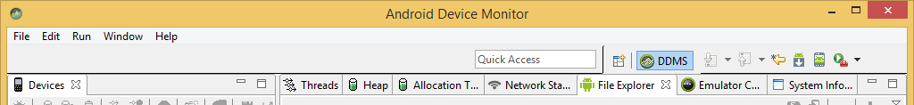
See files (and database) inside Android Studio
1.Run your application
2.Go to Tools--->Android---->Device Monitor
3.Find your application name in left panel
4.Then click on File Explorer tab
5.Select data/data.app_packagename
6.Click on your database name
7.On right-top window you have an option to pull file from device.
9.Click it and save it on your PC
10.Use FireFox Sqlite manager to attach it to your project.

Slide 49
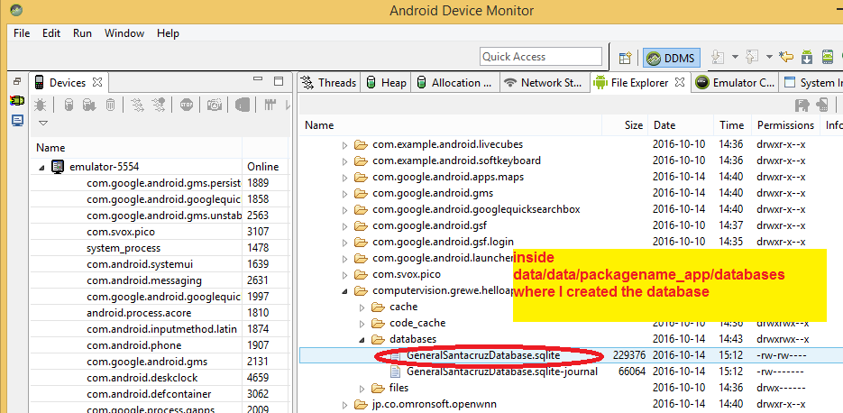
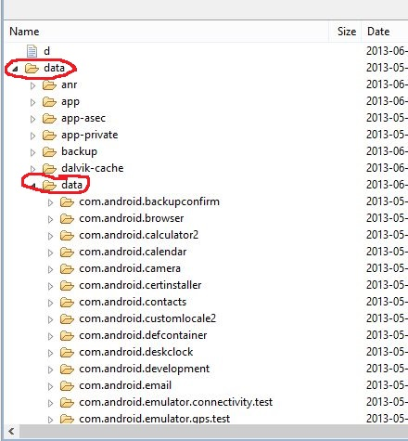
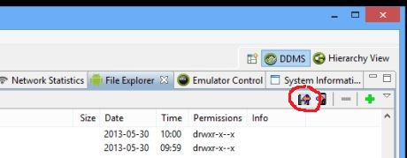
Here is data/data directory
your subdirectories and content will be different
You and add (push) or remove (pull) files from device using this Explorer
Select the application directory—then can see data files for that app here and push or pull files

Slide 50
See database inside command line adb sqlite3
From an adb remote shell, you can use the sqlite3 command-line program to manage SQLite databases created by Android applications.
Example to get databases in the folder /data/data/<package_name>/databases/
adb -s emulator-5554 shell # sqlite3 data/data/com.example.google.rss.rssexample/databases/rssitems.db SQLite version 3.3.12 Enter ".help" for instructions .... enter commands, then quit...
sqlite> .dump (THIS IS COMMAND TO PRINT OUT DATABASE) sqlite> .exit (THIS IS COMMAND TO EXIT)

Slide 51
Push/Pull files from to database from adb command line!!!
Copying Files to or from an Emulator/Device Instance
Use adb on command line
adb pull <remote> <local> To copy a file or directory (and its sub-directories) to the emulator or device, use
adb push <local> <remote> In the commands, <local> and <remote> refer to the paths to the target files/directory on your development machine (local) and on the emulator/device instance (remote). For example:
adb push foo.txt /sdcard/foo.txt
adb pull /data/data/PACAKAGE/databases/database_name /Users/somePathOnYourPC/

Slide 52
Viewing and editing AND Creating SQLite database → outside of code, Using a DBA tool
Being able to create,view,edit database file from DBA tool

Slide 53
Different options
Edit existing Database file on a device (must pull it from device onto the computer and edit it with DBA tool)
Create using a DBA tool a new sqlite database, or edit an already existing one on your machine

Slide 54
Grabing Existing SQLite file already on device →move to your machine for editing
STEP 1: Using the Android Studio’s Android Device Monitor (see previous slides) Pull the SQL database file if exists to your local machine so you can edit it.
STEP 2: Using a SQLite management tool (there are many) edit the file and save it
STEP 3: Push it up using the Android Device Monitor.
You and add (push) or remove (pull) files from device using this Explorer
Select the application directory—then can see data files for that app here and push or pull files

Slide 55
Editing (or creating new) Sqlite databases → use a DBA tool
There are many clients out there → search on web “sqlite management tool”
OPTION 1: plugin of firefox browser called SQLite Manager
OPTION 2: http://sqlitebrowser.org/
OPTION X: find your own DBA you like

Slide 56
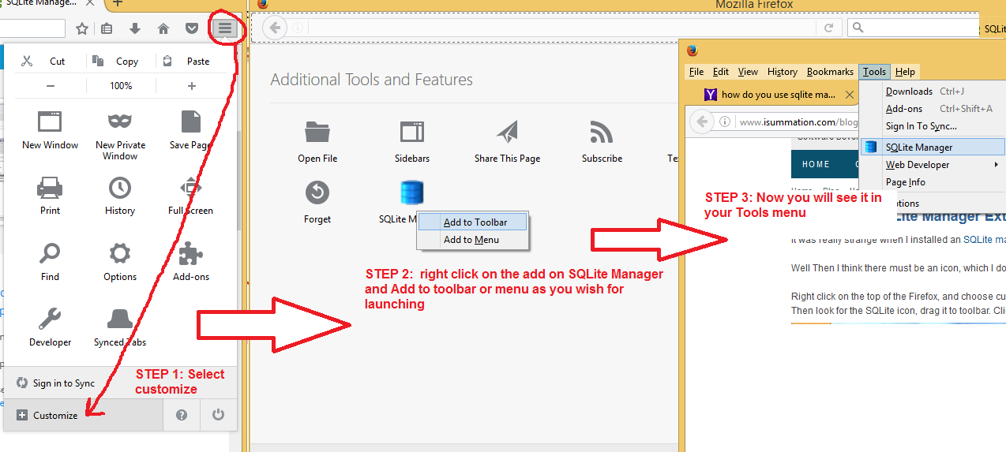
Option 1: SQLite Manager addon to Firefox browser
Install https://addons.mozilla.org/en-US/firefox/addon/sqlite-manager/ (or search for current link)
after installing it (search on web for addin for firefox browser, you can make sure it is part of your toolbar –see below for illustration on how to do in firefox)
“Tools" -> "SQLite Manager".
Once launched connect to your database file you downloaded

Slide 57
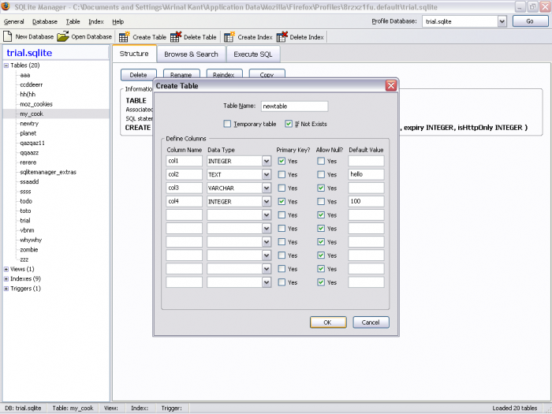
Option 1: SQLite Manager
Showing already opened (“connected”) to local sqlite db file on the machine you have firefox on.
Here shows creation of a table

Slide 58
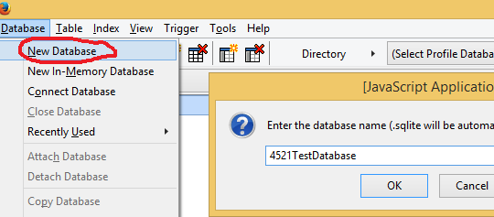
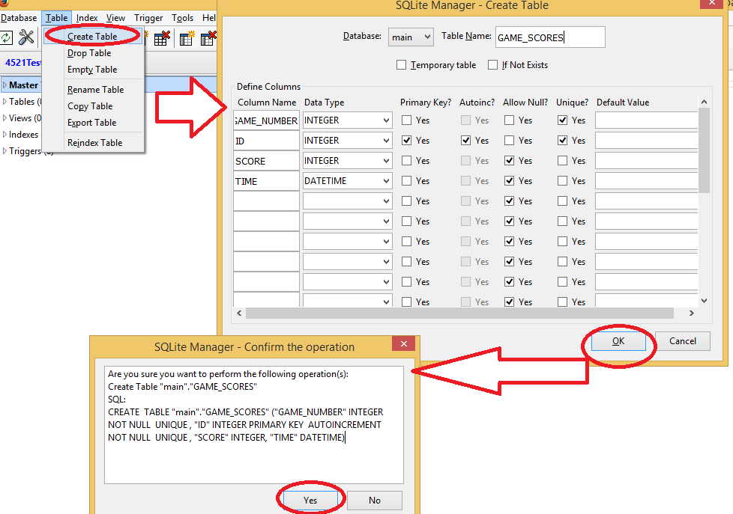
Option 1: SQLite Manager
Showing steps to create new table
Database-> New Database and name it →this is the name of sqlite file it will create and you will move to your project
Create table: Table->CreateTable name it GAME_SCORES, setup keys

Slide 59
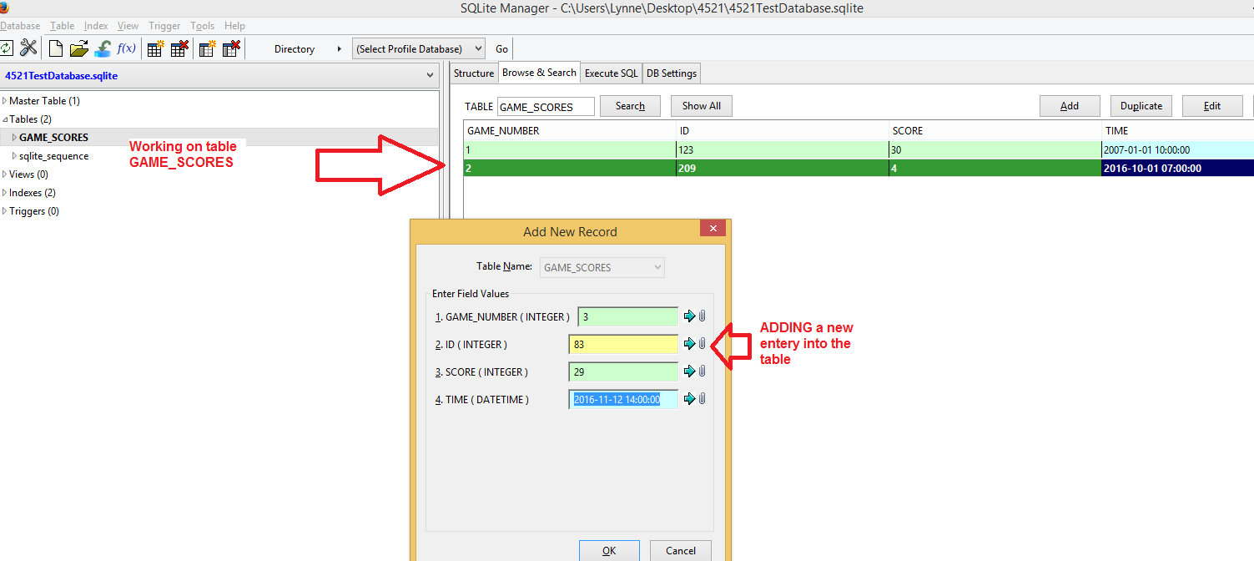
Option 1: SQLite Manager
Step 3: edit the table, add new entries

Slide 60
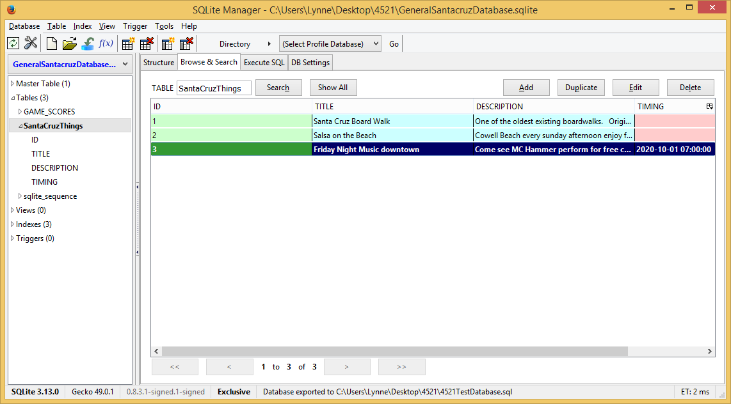
Here is another Database Table creating
Here created in database “GeneralSantacruzDatabase.sqlite” a new table SataCruzThings

Slide 61
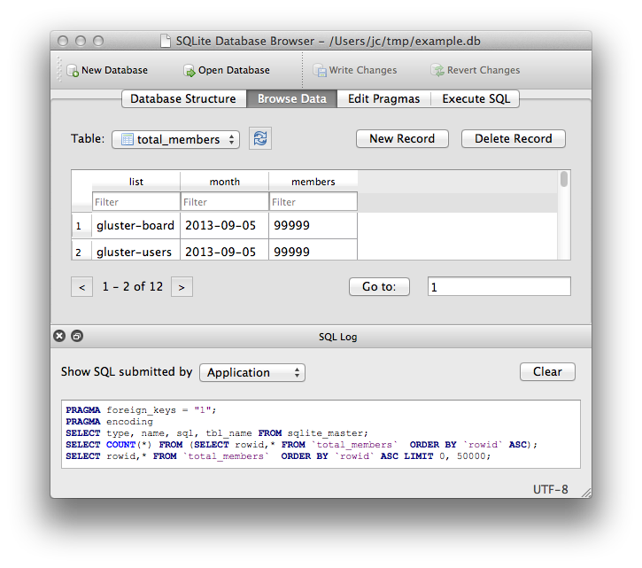
Option 2: DB Browser
http://sqlitebrowser.org/
Try it on your own,
Read the online documentation on how to use on your own

Slide 62
More options
Find your own favorite SQLite management tool online and learn how to use it

Slide 63
Moving externally created database file to project
--either a file you created new or one you edited on your machine. See also https://www.youtube.com/watch?v=aLnVhgYdVd8

Slide 64
Step 0: you must have an existing sqlite file (database) you want to add to your project
See previous slides showing Firefox’s SQLlite Manager tool creating a new sqlite database (file)

Slide 65
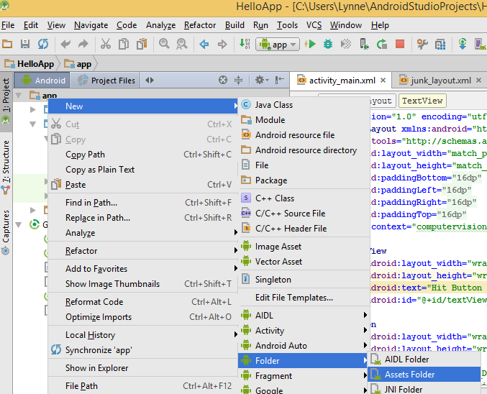
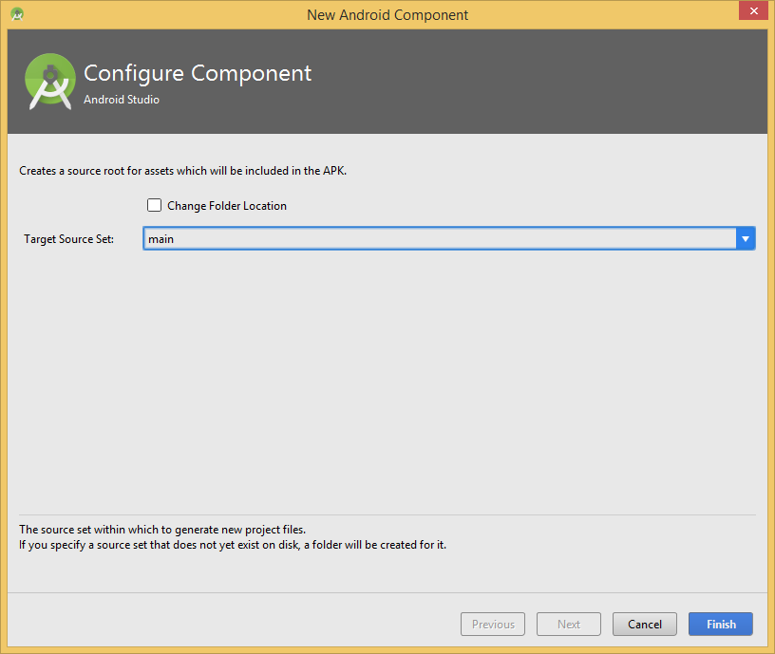
Step 1 make assess folder in your project
In Android view right click on “app” New->Folder->Assests Folder, select for main

Slide 66

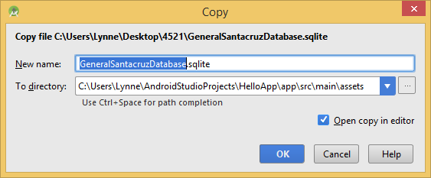
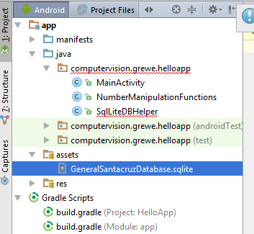
Step 2: copy filename**.sqlite into assets folder

Slide 67
STEP 3: Code to help load sqlite file put in assests directory of project and use it as DB
public class DBHelper extends SQLiteOpenHelper { private final static String DB_PATH = "/data/data/computervision.grewe.helloapp/databases/"; private static final String DATABASE_NAME="GeneralSantacruzDatabase.sqlite"; private static final int DATABASE_VERSION =1; String dbName; Context context; File dbFile; public DBHelper(Context context, String dbName, SQLiteDatabase.CursorFactory factory, int version) { super(context, dbName, factory, version); this.context = context; this.dbName = dbName; dbFile= new File(DB_PATH + dbName); }
public DBHelper(Context context){ //this will create an initially empty database on this device super(context,DATABASE_NAME, null, DATABASE_VERSION ); this.dbName = DATABASE_NAME; dbFile = new File(DB_PATH + dbName); this.context = context; }
Name of pre-existing sqlite file in the assets directory

Slide 68
STEP 3: Code CONTINUED
//get writable database and if does not exist create it and copy //contents from assets folder database file into it. @Override public synchronized SQLiteDatabase getWritableDatabase() { if(!dbFile.exists()){ //first time the database does not exist in data/data/packagename/databases/dbName SQLiteDatabase db = super.getWritableDatabase(); //create EMPTY db in this location copyDataBase(db.getPath()); //copy in the data from the assets folder into this location } return super.getWritableDatabase(); } // get readable database and if does not exist create it and copy //contents from assets folder database file into it. @Override public synchronized SQLiteDatabase getReadableDatabase() { if(!dbFile.exists()){ //if first time, db file does not exist SQLiteDatabase db = super.getReadableDatabase(); //create EMPTY db in this location copyDataBase(db.getPath()); //copy data from assets folder db into this new empty db } return super.getReadableDatabase(); }
@Override public void onCreate(SQLiteDatabase db) {//***whatever you want} @Override public void onUpgrade(SQLiteDatabase db, int oldVersion, int newVersion) {//**whatever you want}

Slide 69
STEP 3: Code CONTINUED
//copy pre-existing sqlite database file from assets folder into the
// application's data/data/packagename/databases directory. private void copyDataBase(String dbPath){ try{ InputStream assestDB = context.getAssets().open(dbName); //assumes have a sqlite file in assets folder of project
// currently empty database file dbPath = in data/data/packagename/databases/DatabasefileName OutputStream appDB = new FileOutputStream(dbPath,false); //COPY the data byte[] buffer = new byte[1024]; int length; while ((length = assestDB.read(buffer)) > 0) { appDB.write(buffer, 0, length); } //close the streams appDB.flush(); appDB.close(); assestDB.close(); }catch(IOException e){ e.printStackTrace();} } }

Slide 70
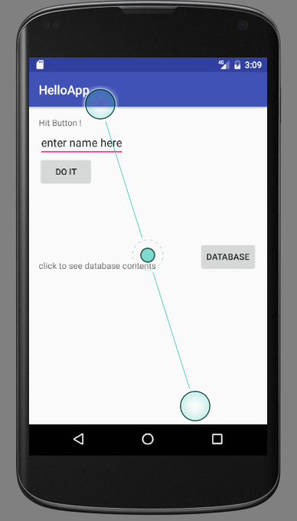
Using the DBHelper code
Have interface with ScrollView and in it a TextView that when Database button is hit, it will read the copied over assets database and populate the TextView with the entire contents of the database table “SantaCruzThings”

Slide 71
Here is the event handling code for the Database button INSIDE Activity
*********Class variable of Activity**********************************
DBHelper dbHelper = new DBHelper(this,"GeneralSantacruzDatabase.sqlite", null, 1);
********INSIDE onCreate of Activity******************************** //do a database dump from SQLite database into the textview inside scroll view based on event (hit button) b_database.setOnClickListener(new View.OnClickListener() { @Override public void onClick(View v) { //grab a writeable database which will actually do the copying SQLiteDatabase mySQLiteDB = dbHelper.getReadableDatabase(); //do a simple select * from the table SantaCruzThings Cursor c = mySQLiteDB.query("SantaCruzThings",null,null,null,null,null,null); c.moveToFirst(); String big = ""; while(!c.isAfterLast()){ int id = c.getInt(0); String title = c.getString(1); String description = c.getString(2); String date = c.getColumnName(3); big += "ID: " + id + " Event: " + title + "\n Descripton: " + description + "\n Date: " + date + "\n\n\n"; c.moveToNext(); } TextView tv = (TextView) findViewById(R.id.textView_DatabaseDump); tv.setText(big); } });

Slide 72
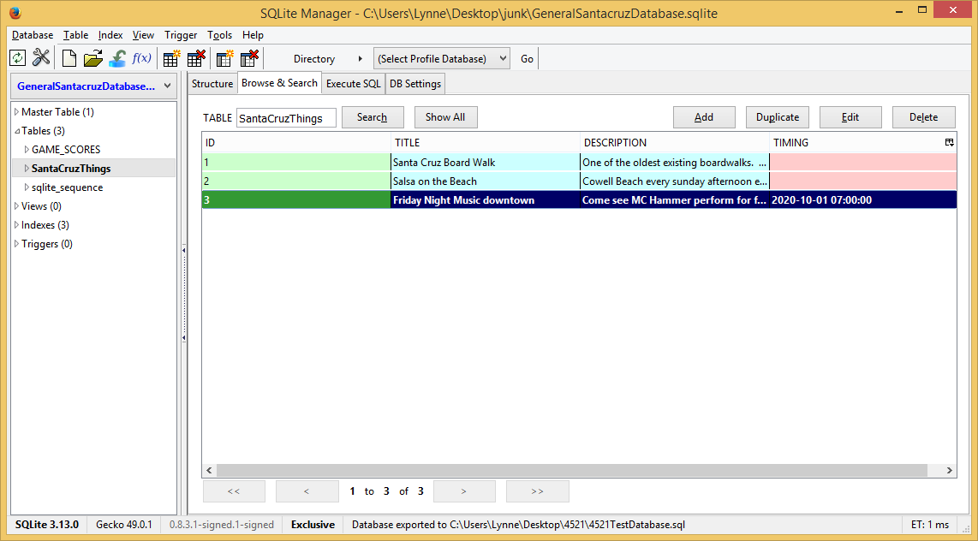
Running the code
Here is the database table SantaCruzThings

Slide 73
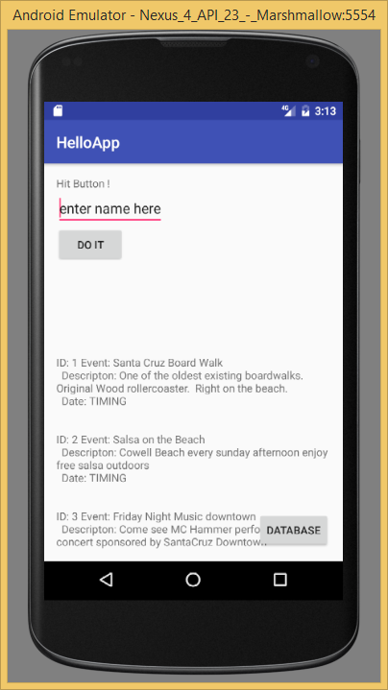
Running the code
As you can see here
The 3 entries in the database table are shown

Slide 74
SUPER IMPORTANT
When to create database with DBA and when do in code

Slide 75
Create DB in code
When the data is generated by the user
Example – Scores in a Game, Notes for a Meeting, etc.

Slide 76
Create DB ahead of time with DBA tool
When the data is not generated by the user
Example - Information about how to use a game, Information about say Yosemite park in a Yosemite park app.

Slide 77
Advanced –read on your own

Slide 78
Retrieving data with SQLiteQueryBuilder
Extends the query options of SQLiteDatabase methods
ADVANCED Material ---read on own as you need

Slide 79
SQLiteQueryBuilder Retrieving Data
offers richer query-building options, particularly for queries involving things like the union of multiple sub-query results.
A common pattern for your content provider's query() implementation is based on SQLiteQueryBuilder:
create a SQLiteQueryBuilder,
fill in some defaults,
then allow it to build up (and optionally execute) the full query combining the defaults with what is provided to the content provider on the query request.

Slide 80
public Cursor query(Uri url, String[] projection, String selection, String[] selectionArgs, String sort) {
SQLiteQueryBuilder qb=new SQLiteQueryBuilder();
qb.setTables(getTableName());
if (isCollectionUri(url)) {
qb.setProjectionMap(getDefaultProjection());
}
else {
qb.appendWhere(getIdColumnName()+"="+url.getPathSegments().get(1));
}
String orderBy;
if (TextUtils.isEmpty(sort)) {
orderBy=getDefaultSortOrder();
}

Slide 81
else {
orderBy=sort;
}
Cursor c=qb.query(db, projection, selection, selectionArgs, null, null, orderBy);
c.setNotificationUri(getContext().getContentResolver(), url);
return c;
}

Slide 82
Dissecting the Program
A SQLiteQueryBuilder is constructed
It is told the table to use for the query (setTables(getTableName()))
It is either told the default set of columns to return (setProjectionMap()), or is given a piece of a WHERE clause to identify a particular row in the table by an identifier extracted from the Uri supplied to the query() call (appendWhere())
Finally, it is told to execute the query. (qb.query(db, projection, selection, selectionArgs, null, null, orderBy))

Slide 83
Retrieving Data
Instead of having the SQLiteQueryBuilder execute the query directly, we could have called buildQuery() to have it generate and return the SQL SELECT statement we needed, which we could then execute ourselves.

Slide 84
Making Your Own Cursors
In Android, you can use your own Cursor subclass, rather than the stock implementation provided by Android.
You can use queryWithFactory() and rawQueryWithFactory() that take a SQLiteDatabase.CursorFactory instance as a parameter.
The factory is responsible for creating new cursors via its newCursor() implementation.

Slide 85
Tools to inspect and manipulate the contents of the database
With the Android emulator, you can inspect and manipulate the contents of the database, beyond merely the database's API, by
The sqlite3 program
SQLite clients (e.g., the SQLite Manager extension for Firefox)

