Slide 1
Patterns

Slide 2
Pattern is
Recurring solutions to common problems of design
Problem/Solution pairs in a Context

Slide 3
Patterns described
Name
Context - Tells how the problem occurs / when the solution works
Delineation of situations under which the pattern applies. Often includes background, discussions of why this pattern exists, and evidence for generality.
Problem
A description of relevant forces & constraints, & how they interact
Forces
Trade-offs, goals+constraints, motivating factors/concerns Tells why the problem is difficult
Solution - Tells how to generate the solution
The solution structure, its participants & collaborations
Examples (optional)
Resulting Context (optional)
Describes the end result, benefits and consequences. Shows how the forces were balanced/traded-off. Tells how solution works out
Rationale (optional)
Underlying principles/heuristics justifying the solution
Tells underpinnings of why the solution works out
Related Patterns
Patterns which are similar, or which may precede/follow this one
Known Uses
3 or more independent instances of "real world" success

Slide 4
Design vs Architectural Patterns
Design patterns are usually associated with code level commonalities.
  It provides various schemes for refining and building smaller subsystems
  Design patterns are medium-scale tactics that flesh out some of the structure and behavior of entities and their relationships.
Architectural patterns are seen as commonality at higher level than design patterns.
  Architectural patterns are high-level strategies that concerns large-scale components, the global properties and mechanisms of a system.

Slide 5
ArchitecTural Patterns

Slide 6
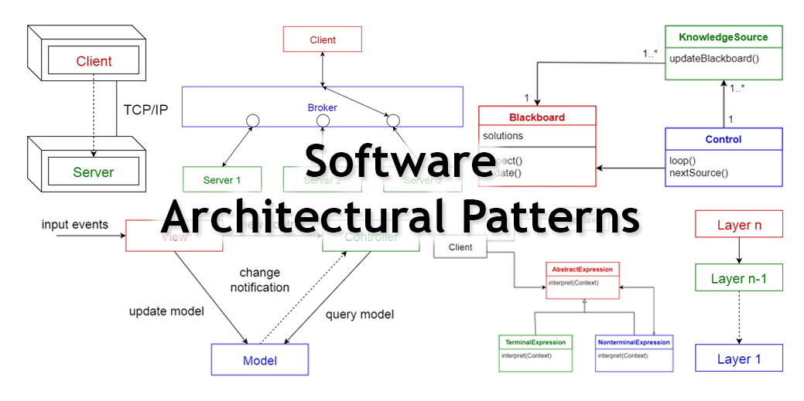
Architectural Patterns
Architectural: Model-View-Controller, Client/Server, Layered (3-layered: presentation, business, data), peer-to-peer

Slide 7
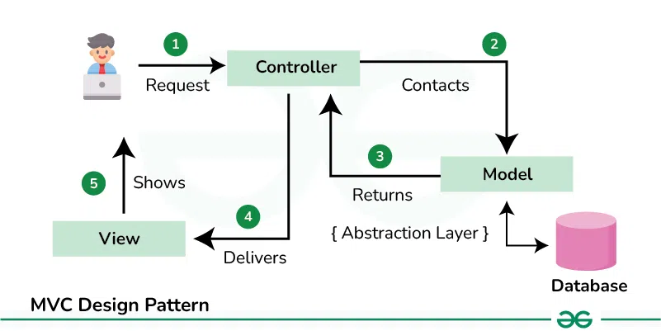
Model-View-Controller
Application (or GUI or X) consist of a data model, presentation information, and control information.
The pattern requires that each of these be separated into different objects.

Slide 8
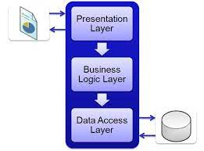
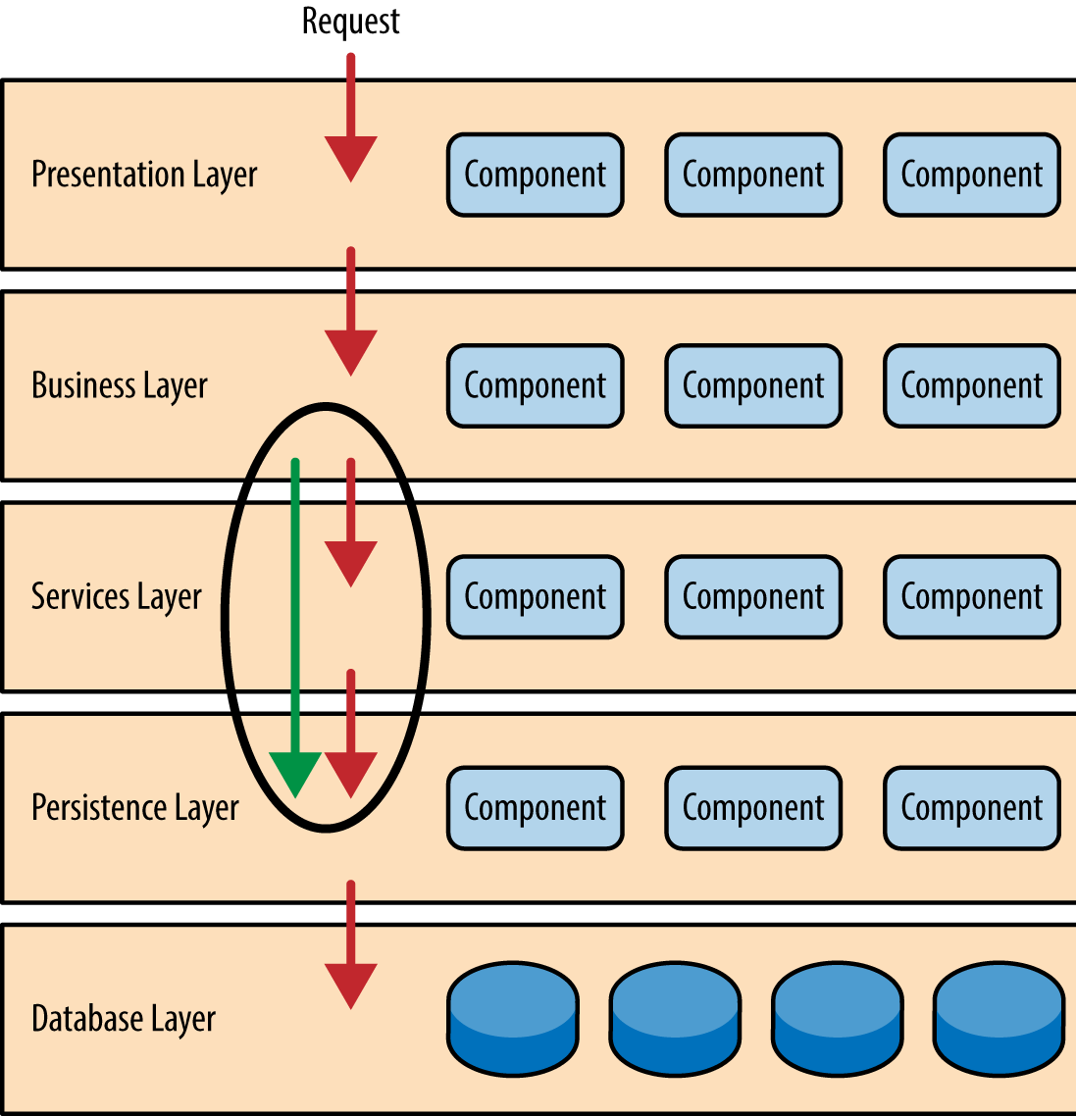
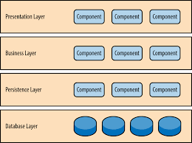
Layered Architecture
Pattern
A structural layout that separates the system into levels, each is in charge of carrying out particular duties.
3 layer, 4 layer, 5 layer…

Slide 9
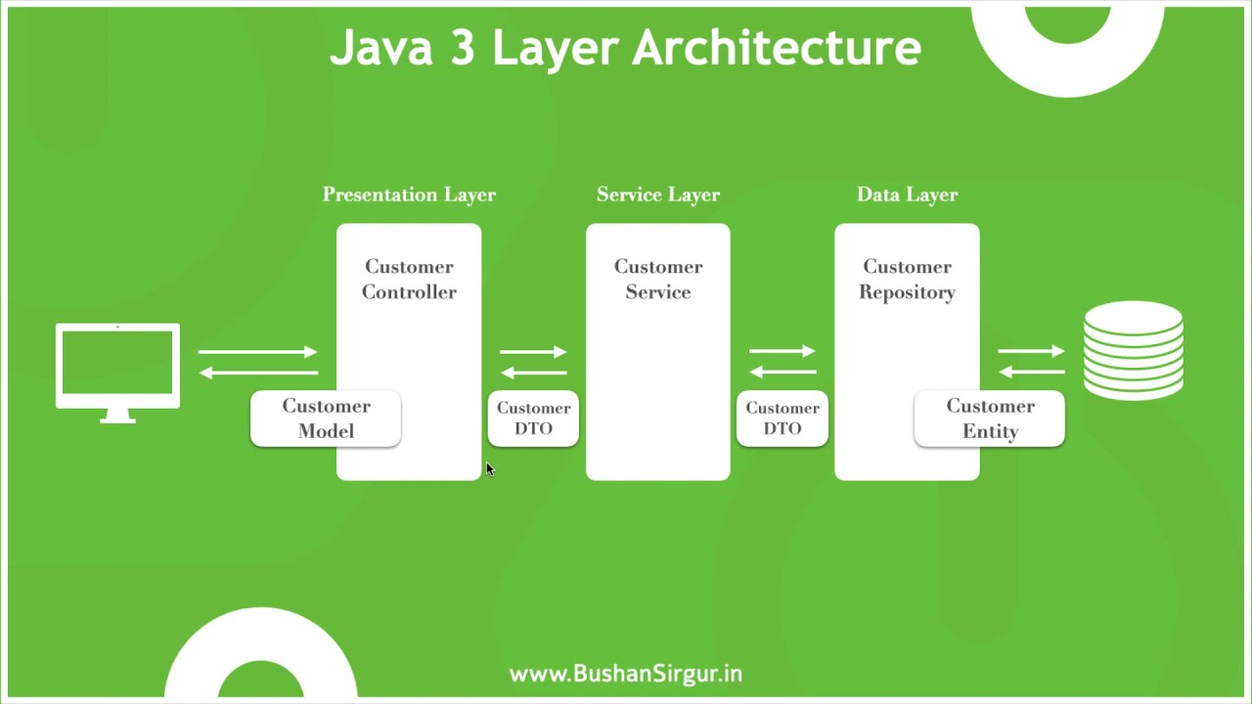
3Layer architecture pattern example

Slide 10
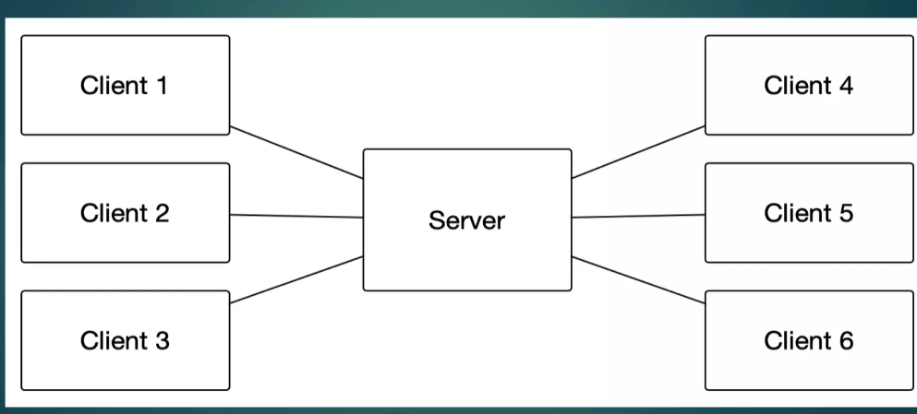
Client Server Architecture Pattern
architecture of a computer network in which many clients (remote processors) request and receive service from a centralized server (host computer)

Slide 11
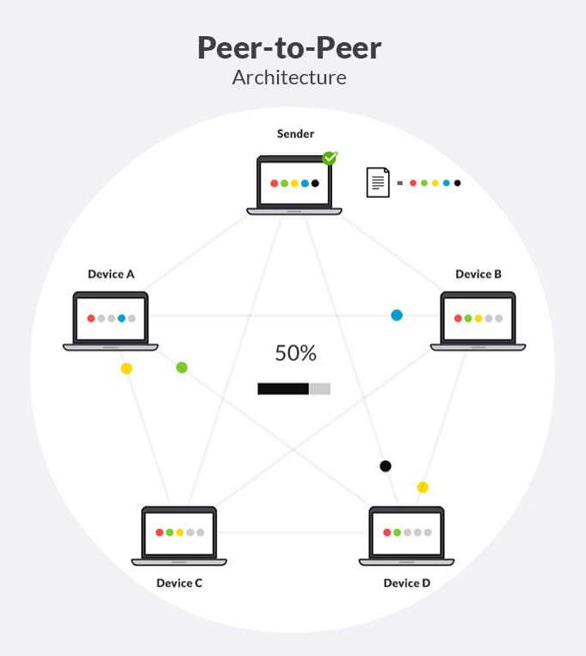
Peer-toper Architecture Pattern
A single system acts as both client and server.
Each system, also called a peer, sends requests to other peers in the network and at the same time receives and services requests from other peers, which are part of the network.

Slide 12
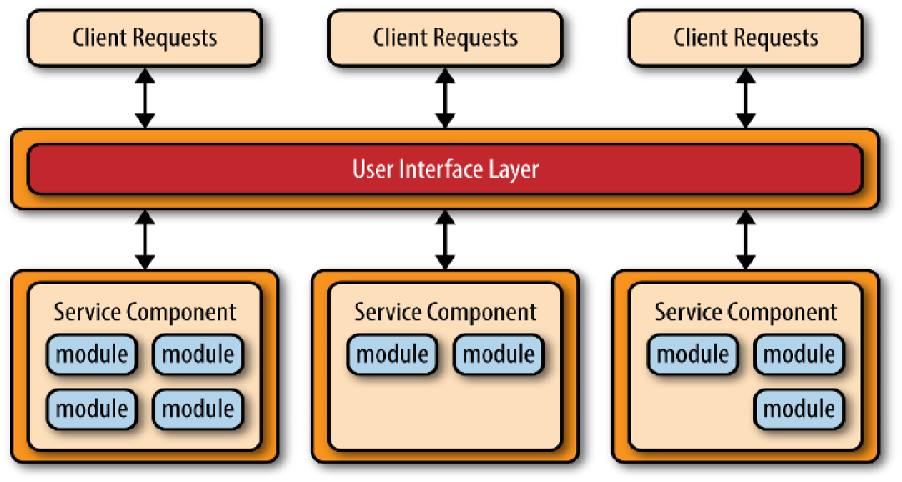
Microservices Pattern (architectural)
The microservices pattern involves creating multiple applications—or microservices—that can work interdependently.

Slide 13
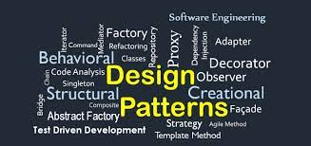
Design Patterns
  Design patterns are medium-scale tactics that flesh out some of the structure and behavior of entities and their relationships.

Slide 14
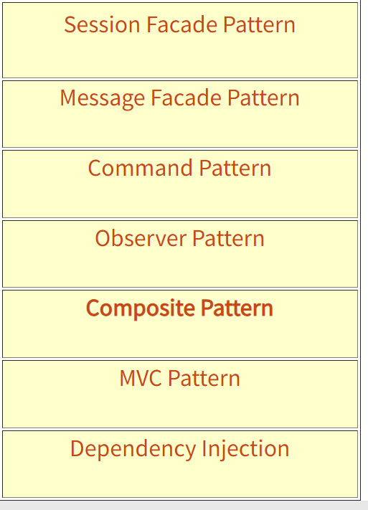
Design Patterns
Session façade, singleton, factory, dependency injection, …

Slide 15
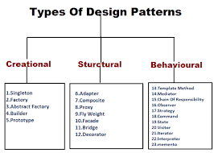
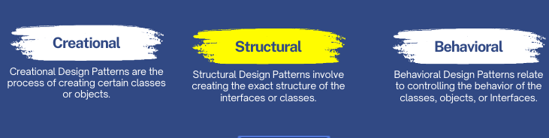
Types of Design Patterns

Slide 16
Pattern: Session Facade
facade is an object that serves as a front-facing interface masking more complex underlying or structural code
---session façade = encapsulates complex interactions of Business Objects that participate in processing a use case request

Slide 17
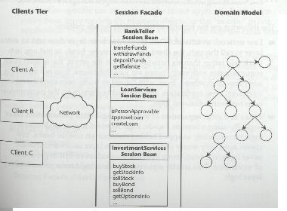
Session Facade Pattern
(structural design pattern)
Bank example invoked from a Client directly to Database
Problems:
Too many network requests (Client to database)....6
Not scalable as increase in number of clients will tie up resources(..database) while servicing client needs
A Solution.....
the Session
FacadePattern

Slide 18
Session Facade Description
WARNING: Creating session facade "SUPER Class" ...Sometimes developers want to put all the use cases in a system in one session façade class. This results in a bloated class that can reduce development productivity.
Name: Session Facade
Context
A client needs to execute business logic in order to
complete a use case.
Problem (forces)
How can a client execute a use case's business logic in one transaction and one bulk network call?
Solution
Wrap any business logic in a layer of session programs called the Sesion Facade. Clients should only have access to these session programs (beans) and not any underlying data layers, etc. The session programs (beans) ideally sit on same network/machine as data programs (entity beans) thus reducing network load.
Related Patterns: Message Facade, Data Transfer Object.

Slide 19
Pattern: MESSAGE Facade
facade is an object that serves as a front-facing interface masking more complex underlying or structural code
---providing a façade through the use of messaging

Slide 20
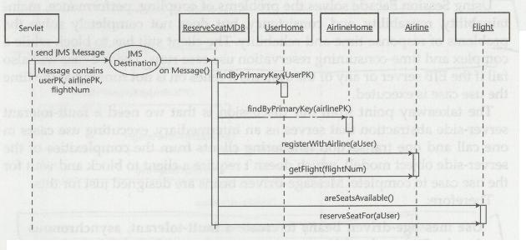
Message Facade Pattern
(structural design pattern)
Consider wanting to make an Airline Reservation. The client would need to have the system check the airline for availability and seating. This can involve a number of steps as outlined below. If the client had to request each and wait for a response this could be too long for most users to sit around....you may loose a customer.
Problems:
Client does not need immediate response....so why make client wait for responses.
A Solution.....
the Message
Façade Pattern
-- Have the service (airline
reservation) send
a Message to service
and then asynchronously
receive

Slide 21
Message Facade Description
TIP: Implementation will be language
dependent and rely on some kind of
Asynchronous programming
Synopsis: Message Facade
Name: Message Facade
Context
A client wants to invoke the methods of multiple programs within the context of one use case and does not require an immediate response from the server.
Problem (forces)
How can a client invoke methods of multiple classes within one transaction, without the need to block and wait for responses from each?
Solution
Use message-driven classes (beans) to create a fault-tolerant, asynchronous facade. Clients should have access to message-driven classes (beans) only, not the underlying data layer, business logic (entity and session beans).
Related Patterns -Session Facade.

Slide 22
Pattern: Inversion of Control w/ Dependency Injection
promotes the separation of concerns, making it easier to maintain, test, and extend your application.
--code receives dependencies from an external source, rather than creating them itself.

Slide 23
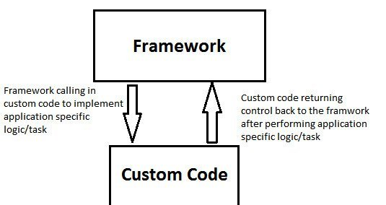
Inversion of Control w/Dependency Injection
Inversion of control (IoC) = a design pattern in which custom-written portions of a computer program receive the flow of control from a generic framework. "inversion" is historical: a software architecture with this design "inverts" control as compared to procedural programming.
Subroutine library
  User's program calls reused code.
  User designs structure of program.
Framework
  Reused code calls user's program
  Structure of program determined primarily by reused code.

Slide 24
How can we perform Inversion of Control
One way is through a Pattern called Dependency Injection
Let’s look at an example
Dependency Injection origin in a famous blog post by Martin Fowler
see http://martinfowler.com/articles/injection.html

Slide 25
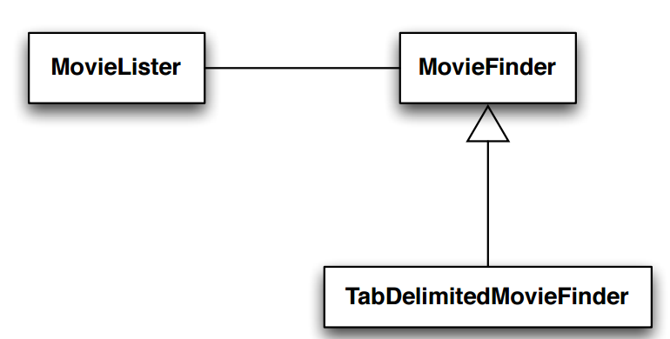
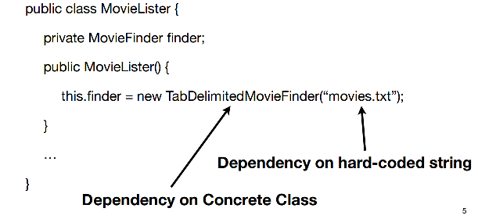
Movie Example
MovieLister class = lists movies with certain
characteristics after being provided a database of
movies by an instance of MovieFinder.
MovieFinder = interface
TabDelimitedMovieFinder = is a concrete class that can read in a movie database that is stored in a tab-delimited text file
Goal: Loosely coupled system = to avoid having our code depend
on concrete classes
DO NOT want dependencies on concrete code or hard coded values.
Problems with this code:
a reference to a concrete class that implements MovieFinder
a reference to a hard-coded string
The name of the movie database cannot change without causing MovieLister to be changed and recompiled
Format of the database cannot change without causing MovieLister to be changed to reference the name of the new concrete MovieFinder implementation

Slide 26
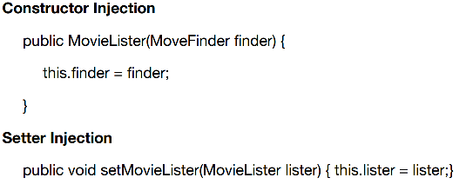
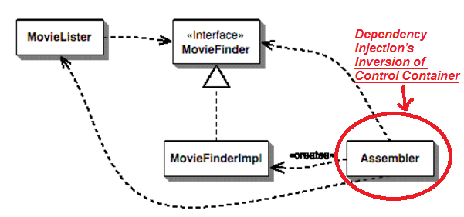
Movie Example –Solution w/Dependency Injection
classes in an application indicate their dependencies in ABSTRACT ways
MovieLister NEEDS A MovieFinder
Main NEEDS-A MovieLister
A third party injects (or inserts) a class that will meet that dependency at run-time --> The “third party” is known as a “Inversion of Control container” or a “dependency injection framework”
public class MovieLister {
private MovieFinder finder;
public MovieLister(MoveFinder finder) {
this.finder = finder;
}
…
}
Ways to inject
//Main Class (Assembler IoC container)
MovieFinderImpl mfi = nw MoviewFinderImpl();
MovieFinder myMovieFinder = new MovieFinder(mfi);

Slide 27
More on Dependency Injection
The CONCEPT -- from a non-framework perspective
"Dependency injection is basically providing the objects that an object needs (its dependencies) instead of having it construct them itself"
The CONCEPT - from a more framework perspective
"dependency injection is a software design pattern that implements inversion of control for resolving dependencies. A dependency is an object that can be used (a service). An injection is the passing of a dependency to a dependent object (a client) that would use it."

Slide 28

Pattern: Singleton
A class that has only a single instance

Slide 29
Restricting object creation
Problem: Sometimes we really only ever need (or want) one instance of a particular class.
  Examples: keyboard reader, bank data collection, game, UI
  We'd like to make it illegal to have more than one.
Issues:
  Creating lots of objects can take a lot of time.
  Extra objects take up memory.
  It is a pain to deal with different objects floating around if they are essentially the same.
  Multiple objects of a type intended to be unique can lead to bugs.
    What happens if we have more than one game UI, or account manager?

Slide 30
Singleton pattern
singleton: An object that is the only object of its type.
  (one of the most known / popular design patterns)
  Ensuring that a class has at most one instance.
  Providing a global access point to that instance.
    e.g. Provide an accessor method that allows users to see the instance.
Benefits:
  Takes responsibility of managing that instance away from the programmer (illegal to construct more instances).
  Saves memory.
  Avoids bugs arising from multiple instances.

Slide 31
Restricting objects
One way to avoid creating objects: use static methods
  Examples: Math, System in Java
  Is this a good alternative choice? Why or why not?
Disadvantage: Lacks flexibility.
  Static methods can't be passed as an argument, nor returned.
Disadvantage: Cannot be extended.
  Example: Static methods can't be subclassed and overridden like an object's methods could be.

Slide 32
Implementing Singleton
Make constructor(s) private so that they can not be called from outside by clients.
Declare a single private static instance of the class.
Write a public getInstance() or similar method that allows access to the single instance.
  May need to protect / synchronize this method to ensure that it will work in a multi-threaded program.

Slide 33
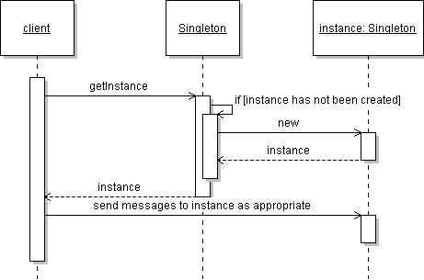
Singleton sequence diagram

Slide 34
Singleton example
Class RandomGenerator generates random numbers.
  public class RandomGenerator {
  private static final RandomGenerator gen =
  new RandomGenerator();
  public static RandomGenerator getInstance() {
  return gen;
  }
  private RandomGenerator() {}
  ...
  }

Slide 35
Lazy initialization
Can wait until client asks for the instance to create it:
  public class RandomGenerator {
  private static RandomGenerator gen = null;
  public static RandomGenerator getInstance() {
  if (gen == null) {
  gen = new RandomGenerator();
  }
  return gen;
  }
  private RandomGenerator() {}
  ...
  }

Slide 36
Singleton Comparator
Comparators make great singletons because they have no state:
  public class LengthComparator
  implements Comparator<String> {
  private static LengthComparator comp = null;
  public static LengthComparator getInstance() {
  if (comp == null) {
  comp = new LengthComparator();
  }
  return comp;
  }
  private LengthComparator() {}
  public int compare(String s1, String s2) {
  return s1.length() - s2.length();
  }
  }

Slide 37
Pattern: Iterator
objects that traverse collections

Slide 38
Iterator pattern
Problem: To access all members of a collection, must perform a specialized traversal for each data structure.
  Introduces undesirable dependences.
  Does not generalize to other collections.
Solution:
  Provide a standard iterator object supplied by all data structures.
  The implementation performs traversals, does bookkeeping.
    The implementation has knowledge about the representation.
  Results are communicated to clients via a standard interface.
Disadvantages:
  Iteration order is fixed by the implementation, not the client.
  Missing various potentially useful operations (add, set, etc.).

Slide 39
Pattern: Adapter
an object that fits another object into a given interface

Slide 40
Adapter pattern
Problem: We have an object that contains the functionality we need, but not in the way we want to use it.
  Cumbersome / unpleasant to use. Prone to bugs.
Example:
  We are given an Iterator, but not the collection it came from.
  We want to do a for-each loop over the elements,
  but you can't do this with an Iterator, only an Iterable:
  public void printAll(Iterator<String> itr) {
  // error: must implement Iterable
  for (String s : itr) {
  System.out.println(s);
  } }

Slide 41
Adapter in action
Solution: Create an adapter object that bridges the provided and desired functionality.
  public class IterableAdapter implements Iterable<String> {
  private Iterator<String> iterator;
  public IterableAdapter(Iterator<String> itr) {
  this.iterator = itr;
  }
  public Iterator<String> iterator() {
  return iterator;
  }
  }
  ...
  public void printAll(Iterator<String> itr) {
  IterableAdapter adapter = new IterableAdapter(itr);
  for (String s : adapter) { ... } // works
  }

Slide 42
Pattern USE
Leading to Frameworks

Slide 43
Using design patterns???
Does the pattern makes design more complex.
Does the pattern makes design more flexible.
Do you need that flexibility?
Is the complexity worth while?
Only use a pattern when it results in a simpler design than the alternatives.

