Slide 1
Framework Design

Slide 2
Framework is
Reusable Code, often domain specific (GUI, Net, Web, etc)
expressed as
a set of classes and
the way objects in those classes collaborate.

Slide 3
How a Framework is Used
build application by:
• Creating new subclasses
• Configuring objects together
• Modifying working examples
(editing scripts)

Slide 4
Customers are Programmers
Purpose of framework is to make it easier to build applications.
Apply these slogans to application programmers:
The customer is always right.
We are customer-driven.
Understand your customer.

Slide 5
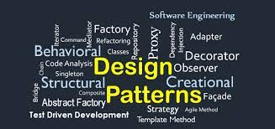
Frameworks will implement one or more patterns
Patterns = Problem solution pairings

Slide 6
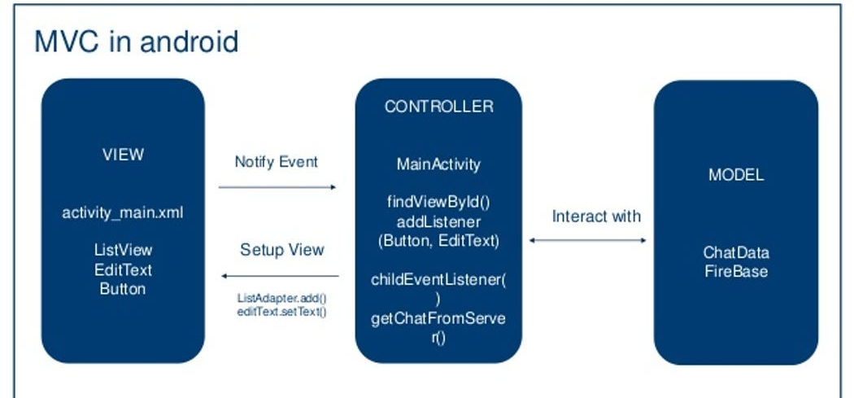
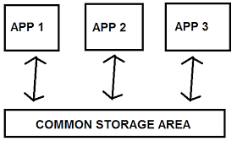
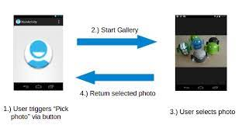
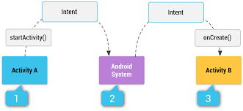
Mobile Framework - Android
Android Framework – implements MVC, Layered, numerous design patterns
MVC (an interpretation)
View = GUI elements
Model = Data Classes
Controller =Activity event handling
Singleton (one of many)
SharedPreferences.
Message Façade Pattern (an interpretation)
Intents = asynchronous call to launch an Activity, etc.

Slide 7
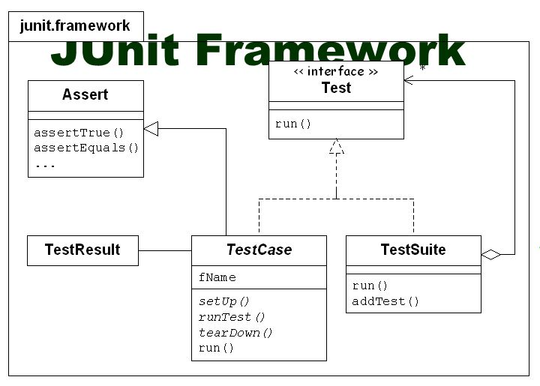
Another Example: Testing Framework (Junit)
Classes - Test, TestResult, TestSuite
Use by subclassing Test
Define instance methods to set up test, to perform tests
Define class methods to create a test suite

Slide 8
How to Design????

Slide 9
2 (“opposite”) Approaches to Design Clear-box vs. Opaque-box
Clear-box
Customize by sub-classing
Emphasize inheritance
Must know internals
Opaque-box
Customize by configuring
Emphasize polymorphism
Must know interfaces

Slide 10
(continued)
Clear-box
Simpler, easier to design
Harder to learn, requires more programming.
Opaque-box
Complex, harder to design
Easier to learn, requires less programming.

Slide 11
A Suggestions for Framework Design…………
Don't. Buy/Fine one instead.

Slide 12
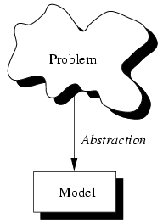
Relevant Principles
Downstream
Frameworks are abstractions.
You can do upstream or downstream abstraction.
people generalize from concrete examples
Designing reusable code requires iteration
Frameworks encode domain knowledge
Customer of framework is application programmer
Upstream
Window
Dialog
Prompt
Form

Slide 13
Example-driven Design
Generalization
Examples
Framework
Generalization is iterative.
Most changes are small.
A few big changes represent new ways of looking at the problem.

Slide 14
To Generalize (upstream):
Look at current example --
find things with different names that are really the same,
parameterize to eliminate differences,
break large things into small things so that similar components can be found, and
categorize things that are similar.

Slide 15
Finding Abstract Classes
Abstract classes are discovered by generalizing from concrete classes.
To give classes a common superclass:
• give operations common interface
• move operations with same implementation to superclass
• make operations with different implementation abstract

Slide 16
(continued)
• give them common interface
+ rename operations so classes use same names
+ reorder arguments, change types of arguments, etc.
+ refactor (split or combine) operations

Slide 17
Frameworks Require Iteration
Reusable code requires many iterations.
Basic law of software engineering
If it hasn't been tested, it doesn't work.
Corollary: software that hasn't been reused is not reusable.

Slide 18
Frameworks Encode Domain Knowledge
Frameworks solve a particular set of problems.
Not always application-domain specific, but domain specific. (GUI, distribution, structured drawing editor, business transaction processing, workflow)

Slide 19
Ideal Way to Develop Framework
Analysis
Design
Test
1) Analyze problem domain
• Learn well-known abstractions.
• Collect examples of programs to be built from framework. (Minimum of 4 or 5).

Slide 20
Ideal Way to Design Framework
2) Design abstraction that covers examples.
3) Test framework by using it to solve the examples.
• Each example is a separate application.
• Performing a test means writing software.

Slide 21
Designing Abstractions
Design phase: look for commonalities, represent each idea once.
Use architectural + design patterns
implies that experience is needed
Insight and ingenuity is always useful, but hard to schedule.

Slide 22
Patterns
Patterns can make designs more opaque-box.
Show how to represent something that changes as an object
Strategy -- algorithm
Prototype -- products
State -- state of an object
Mediator -- way objects interact

Slide 23
Using design patterns
Each pattern makes design more complex.
Each pattern makes design more flexible.
Do you need that flexibility?
Is the complexity worth while?
Only use a pattern when it results in a simpler design than the alternatives.

Slide 24
Iterative Development using multiple examples (applications)
Notice that many applications are similar.
Develop first application in that domain in an OO language.
Divide software into reusable and non-reusable parts.
Develop next application reusing as much software as possible and refine.

Slide 25
Surprise! Framework is not very reusable.
Fix it.
Develop next application reusing as much software as possible.

Slide 26
Summary of Process
Start with examples of desired applications
Iteratively develop abstractions
Test by building applications

Slide 27
Hints for Framework Design
Use object composition instead of inheritance
Incrementally apply patterns / lazy generalization
Framework should work out of the box

Slide 28
Strategic Concerns
Developing a framework is expensive, so look before you leap.
Framework development requires long term commitment.
Pick frameworks that will give you competitive advantage.

Slide 29
Start small and work up.
get experience with OOP
select and train good abstractors
build small frameworks first
generalize existing systems
keep user base small at first

Slide 30
Customers are Crucial
Get customers involved early, and use their feedback.
Make your initial customers succeed.
First set of customers are really part of the development team.

Slide 31
Reuse Scenarios
Ideal: Framework grows along with customer base.
Actual: Projects may customize the initial framework, and start competing streams of development.

Slide 32
Dealing with Iteration
Don't claim framework is useful until your customers say it is.
Keep customer base small while framework is evolving.
A successful framework must evolve to meet new customer needs.
Don't constantly tinker. Plan releases and coordinate with customers.

Slide 33
Documentation and Training
Documentation for framework costs several times non-framework application
how to use
how to extend / how it works
Software must be understandable to be usable.
Improving documentation can make software more reusable.

