Slide 1
NodeJS coding basics
L. Grewe

Slide 2
The simplest – a hello world server app
const http = require('http'); //requires the http module
const hostname = '127.0.0.1';
const port = 3000;
const server = http.createServer((req, res) => {
res.statusCode = 200; //building out the response
res.setHeader('Content-Type', 'text/plain');
res.end('Hello World\n');
});
server.listen(port, hostname, () => { //activate the server on port 3000
console.log(`Server running at http://${hostname}:${port}/`);
});

Slide 3
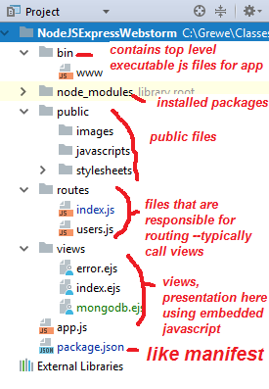
Well things are not that simple
We are going to use the WebStorm IDE.
When you make a new project
Note: even if you do not use an IDE but,
Create a NodeJS project using command line
npm tool you get a similar directory structure
NOTE: We created a NodeJS + Express project in WebStorm (this is one of a number of project types you can create)
See website for details on how to use Webstorm to create a project

Slide 4
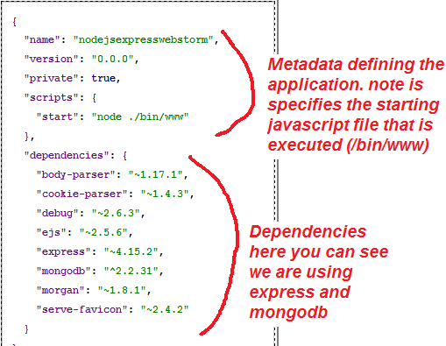
package.json
Here is a simple file
Like a ship’s manifest file

Slide 5
Modules in NodeJS
Like packages in Java or libraries in C++
Note the package.json refers to some standard NodeJS but, there are others mentioned including:
Express
EJS
MongoDB
Body-Parser
Cookie-Parser
Morgan
……..

Slide 6
To use a module it must be installed in your project and referenced in your package.json file
HOW TO INSTALL
in terminal window in project type the following:
npm install <module name>

Slide 7
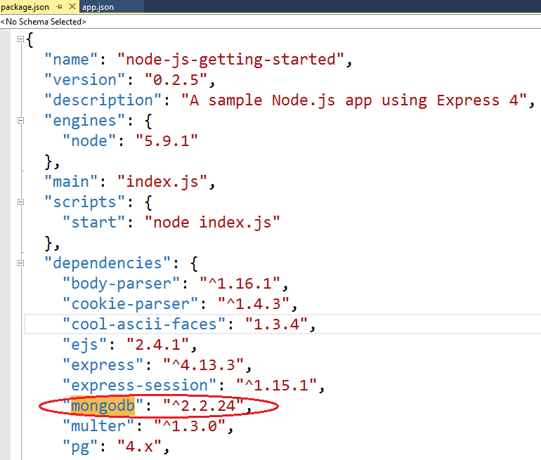
Example installing mongodb module
WEBSTORM: Bring up the terminal window in WebStorm (go to View->Tools Window-> Terminal) AND execute the following `NPM` command
npm install mongodb –save
Results in ALSO adding the dependency to the package.json
NOTE: we will learn later about MongoDB which
is a NOSql database

Slide 8
How do you add use of a module inside a NodeJS file → use the require method
// main.js
var greetings = require("./greetings.js");
// "Hello“
greetings.sayHelloInEnglish();
// "Hola“
greetings.sayHelloInSpanish();
Basically, you create an “object” variable in this case called greetings that represents the code in the loaded JS module (greetings.js)
Then to access a method you simply invoke variableName.methodName(****)

Slide 9
How do we receive requests and build responses in NodeJS
You can use the basic http module we saw in our hello world repeated below
OR we can use Express the E in MEAN – minimal and flexible Node.js web application framework that provides a robust set of features for web and mobile applications. Provides EASIER WAY (than just NodeJS)
const http = require('http'); //requires the http module
const hostname = '127.0.0.1';
const port = 3000;
const server = http.createServer((req, res) => {
res.statusCode = 200; //building out the response
res.setHeader('Content-Type', 'text/plain');
res.end('Hello World\n');
});
server.listen(port, hostname, () => { //activate the server on port 3000
console.log(`Server running at http://${hostname}:${port}/`);
});

Slide 10
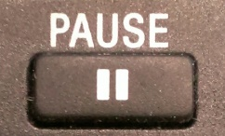
NEXT
Before learning MORE about NodeJS we need to start to learn about Express
There are many useful modules that relate/extend NodeJS capabilities (like the mongodb one) and we will learn them as we need them
….but you should be curious attend NodeJS meetups/ presentations and see what people are doing as well as go to the main NodeJS website. https://nodejs.org

