Slide 1
Bootstrap
L. Grewe

Slide 2
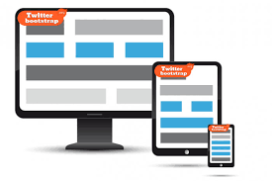
What is it?
api/framework developed by Twitter for mobile first, responsive (to changing devices it is displayed on) web sites/applications. (api of CSS, and javascript extensions)
And - HTML and CSS based design templates for typography, forms, buttons, tables, navigation, modals, image carousels and many other, as well as optional JavaScript plugins

Slide 3
You can develop on command line or Webstorm
If you don’t use the Webstorm IDE you have to go through the steps of downloading bootstrap and manually setting up (see appendix B of the Getting MEAN book)
We are using Webstorm and setup for it can be found on our webpage

Slide 4
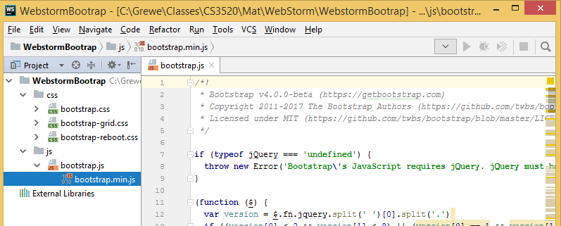
Webstorm option 1: create a bootstrap project
Create new bootstrap project
Will create series of static files that are delivered to client(e.g. browser) and not run on server (NodeJS)

Slide 5
Option 1: more on bootstrap project
Now your files that use bootstrap like my html file here called homepage.html must include the appropriate files
Here is an index.html page I created
<!DOCTYPE html>
<html lang="en">
<head>
<meta charset="UTF-8">
<title>HomePage using Bootstrap</title>
<link rel="stylesheet" href="../css/bootstrap.css">
<script src="../js/bootstrap.min.js"></script>
</head>
<body>
<div class="container">
<div class="row">
<div class="col-sm-6 col-md-4 col-lg-3"><p>Box 1</p></div>
<div class="col-sm-6 col-md-4 col-lg-3"><p>Box 2</p></div>
<div class="clearfix visible-sm-block"></div>

Slide 6
Option 2: existing project –add links to external CDN server
PROS: if you already have an existing Webstorm project (like a NodeJS project) and want to add Bootstrap to it --this is the easiest as you don't have to download any code.
NEGATIVES: possible a little more time to download to a client (browser) as your code coming from different server than CDN
GO TO http://getbootstrap.com/docs/4.0/getting-started/download/ to get the latest code!!!!!!!!!!!!!!!!
<script src="https://code.jquery.com/jquery-3.2.1.slim.min.js" integrity="sha384-KJ3o2DKtIkvYIK3UENzmM7KCkRr/rE9/Qpg6aAZGJwFDMVNA/GpGFF93hXpG5KkN" crossorigin="anonymous"></script>
<script src="https://cdnjs.cloudflare.com/ajax/libs/popper.js/1.11.0/umd/popper.min.js" integrity="sha384-b/U6ypiBEHpOf/4+1nzFpr53nxSS+GLCkfwBdFNTxtclqqenISfwAzpKaMNFNmj4" crossorigin="anonymous"></script>
<link rel="stylesheet" href="https://maxcdn.bootstrapcdn.com/bootstrap/4.0.0-beta/css/bootstrap.min.css" integrity="sha384-/Y6pD6FV/Vv2HJnA6t+vslU6fwYXjCFtcEpHbNJ0lyAFsXTsjBbfaDjzALeQsN6M" crossorigin="anonymous">
<script src="https://maxcdn.bootstrapcdn.com/bootstrap/4.0.0-beta/js/bootstrap.min.js" integrity="sha384-h0AbiXch4ZDo7tp9hKZ4TsHbi047NrKGLO3SEJAg45jXxnGIfYzk4Si90RDIqNm1" crossorigin="anonymous"></script>

Slide 7
Option 3: install manually bootstrap code
download Bootstrap files and add to existing project manually and do like #option 1
In terminal window of WebStorm ide of project type: (or whatever version you want) npm install bootstrap@4.0.0-beta
<!DOCTYPE html>
<html lang="en">
<head>
<meta charset="UTF-8">
<title>HomePage using Bootstrap</title>
<link rel="stylesheet" href="../css/bootstrap.css">
<script src="../js/bootstrap.min.js"></script>
</head>
<body>
<div class="container">
<div class="row">
<div class="col-sm-6 col-md-4 col-lg-3"><p>Box 1</p></div>
<div class="col-sm-6 col-md-4 col-lg-3"><p>Box 2</p></div>
<div class="clearfix visible-sm-block"></div>

Slide 8
What is Bootstrap – lets start with 12 grid structure
Bootstrap RESPONSIVENESS – through use of column span based on Device dimensions
Each “row” has up to 12 columns
You can specify how many columns any item spans
RESPONSIVE = Bootstrap will rearrange the columns depending on size of the screen

Slide 9
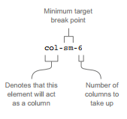
How do you specify column span
with class specification on item and you specify column span for a device size
First, lets define sizes of devices
Example
class = “col-sm-6”
Means span up to 6 columns –thus 12/6 =2 items / row”

Slide 10
Simple Bootstrap html example
NOTE: you can add bootstrap in HTML, EJS, Jade/Pug and other interface scripting languages that support Javascript
Here is the start of the file (continue next page)…..
<!DOCTYPE html>
<html lang="en">
<head>
<meta charset="utf-8">
<meta http-equiv="X-UA-Compatible" content="IE=edge">
<meta name="viewport" content="width=device-width, initial-scale=1">
<title>Example of Bootstrap 3 Multi-Column Grid Layout for All Devices</title>
<link rel="stylesheet" href="https://maxcdn.bootstrapcdn.com/bootstrap/3.3.7/css/bootstrap.min.css">
<script src="https://ajax.googleapis.com/ajax/libs/jquery/1.12.4/jquery.min.js"></script>
<script src="https://maxcdn.bootstrapcdn.com/bootstrap/3.3.7/js/bootstrap.min.js"></script>
</head>
<body>

Slide 11
<div class="container">
<div class="row">
<div class="col-sm-6 col-md-4 col-lg-3"><p>Box 1</p></div>
<div class="col-sm-6 col-md-4 col-lg-3"><p>Box 2</p></div>
<div class="clearfix visible-sm-block"></div>
<div class="col-sm-6 col-md-4 col-lg-3"><p>Box 3</p></div>
<div class="clearfix visible-md-block"></div>
<div class="col-sm-6 col-md-4 col-lg-3"><p>Box 4</p></div>
<div class="clearfix visible-sm-block"></div>
<div class="clearfix visible-lg-block"></div>
<div class="col-sm-6 col-md-4 col-lg-3"><p>Box 5</p></div>
<div class="col-sm-6 col-md-4 col-lg-3"><p>Box 6</p></div>
<div class="clearfix visible-sm-block"></div>
<div class="clearfix visible-md-block"></div>
<div class="col-sm-6 col-md-4 col-lg-3"><p>Box 7</p></div>
<div class="col-sm-6 col-md-4 col-lg-3"><p>Box 8</p></div>
<div class="clearfix visible-sm-block"></div>
<div class="clearfix visible-lg-block"></div>
<div class="col-sm-6 col-md-4 col-lg-3"><p>Box 9</p></div>
<div class="clearfix visible-md-block"></div>
<div class="col-sm-6 col-md-4 col-lg-3"><p>Box 10</p></div>
<div class="clearfix visible-sm-block"></div>
<div class="col-sm-6 col-md-4 col-lg-3"><p>Box 11</p></div>
<div class="col-sm-6 col-md-4 col-lg-3"><p>Box 12</p></div>
</div>
</div>
Sm devices have span 6 columns, md has span 4, large has span of 3
← will clear “row” for sm devices
← will clear “row” for md devices
← will clear “row” for lg devices

Slide 12
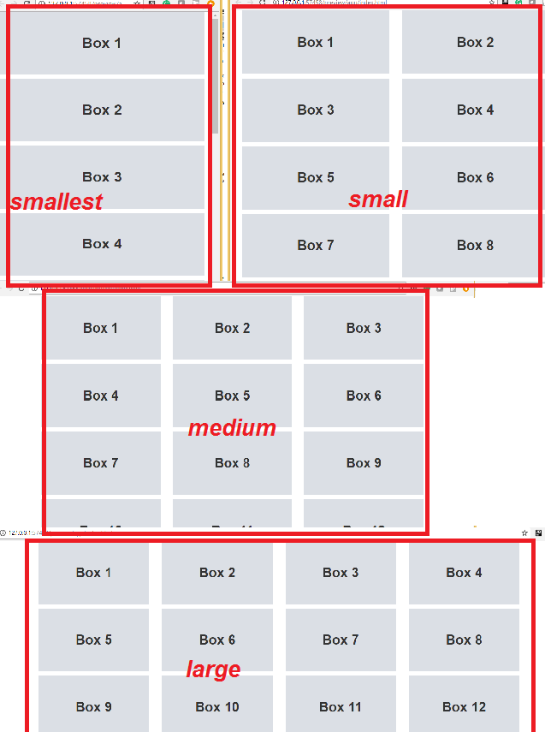
results
Depending on device number of items / “row” alters as expected

Slide 13
What is the <div class=“container”>
Bootstrap requires a containing element to wrap site contents and house our grid system.
2 CHOICES:
<div class="container"> ... </div>
Use .container for a responsive fixed width container.
<div class="container-fluid"> ... </div>
Use .container-fluid for a full width container, spanning the entire width of your viewport.
Bootstrap RESPONSIVENESS – fit width of viewport

Slide 14
For more info about Bootstrap defined css classes….
Go to https://getbootstrap.com/docs/3.3/css/

Slide 15
jade + Bootstrap example: and one row with xs column span of 12 (so this 1 item is in its own row)
doctype html
html
head
meta(name='viewport', content='width=device-width, initial-scale=1.0')
title= title
link(rel='stylesheet', href='/bootstrap/css/amelia.bootstrap.css')
link(rel='stylesheet', href='/stylesheets/style.css') body block content
script(src='/javascripts/jquery-1.11.1.min.js')
script(src='/bootstrap/js/bootstrap.min.js')
body
.row .col-xs-12 small © Simon Holmes 2014

Slide 16
Another HTML based Bootcamp example
<!DOCTYPE html>
<html lang="en">
<head>
<meta charset="utf-8">
<meta http-equiv="X-UA-Compatible" content="IE=edge">
<meta name="viewport" content="width=device-width, initial-scale=1">
<title>CS3520</title>
<!-- Bootstrap -->
<link href="../CSS/bootstrap.css" rel="stylesheet">
<link href="../CSS/Highlight_Styles.css" rel="stylesheet" type="text/css">
<!-- HTML5 shim and Respond.js for IE8 support of HTML5 elements and media queries -->
<!-- WARNING: Respond.js doesn't work if you view the page via file:// -->
<!--[if lt IE 9]>
<script src="https://oss.maxcdn.com/html5shiv/3.7.2/html5shiv.min.js"></script>
<script src="https://oss.maxcdn.com/respond/1.4.2/respond.min.js"></script>
<![endif]-->
</head>
Bootstrap that says make the width of the viewport
THIS is the RESPONSIVE
part

Slide 17
continued
<body style="padding-top: 70px">
<!-- jQuery (necessary for Bootstrap's JavaScript plugins) -->
<script src="../JS/jquery-1.11.3.min.js"></script>
<!-- Include all compiled plugins (below), or include individual files as needed -->
<nav class="navbar navbar-default navbar-fixed-top">
<div class="container-fluid">
<!-- Brand and toggle get grouped for better mobile display -->
<div class="btn-link">
<button type="button" class="navbar-toggle collapsed" data-toggle="collapse" data-target="#topFixedNavbar1" aria-expanded="false">
<span class="sr-only">Toggle navigation</span>
<span class="icon-bar"></span>
<span class="icon-bar"></span>
<span class="icon-bar"></span>
</button>
<a class="navbar-brand" href="../index.html">CS 3520</a>
<span class="navbar-brand2 hidden-xs"> Web Site Development </span>
</div>
Bootstrap says make this div tag fluid to width of device

Slide 18
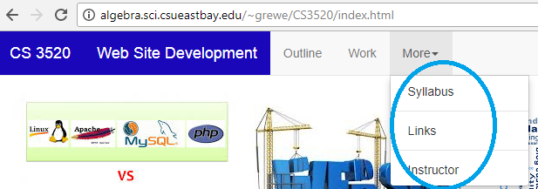
continued
Bootstrap --- navbar-collapse – depending on device will collapse navigaton
<!-- Collect the nav links, forms, and other content for toggling -->
<div class="collapse navbar-collapse" id="topFixedNavbar1">
<ul class="nav navbar-nav">
<li><a href="../outline.htm">Outline<span class="sr-only">(current)</span></a></li>
<li><a href="../work.html">Work</a></li>
<li class="dropdown"><a href="#" class="dropdown-toggle" data-toggle="dropdown" role="button" aria-haspopup="true" aria-expanded="false">More<span class="caret"></span></a>
<ul class="dropdown-menu">
<li><a href="../syllabus.htm">Syllabus</a></li>
<li role="separator" class="divider"></li>
<li>< href="../links.htm">Links</a></li>
<li role="separator" class="divider"></li>
<li><a href="../instructor.htm">Instructor</a></li>
</ul>
</li>
</ul>
</div>
<!-- /.navbar-collapse -->
</div>
<!-- /.container-fluid -->
</nav>
Bootstrap --- navbar-collapse, dropdown-toggle, etc.
Read online to find out what each of these do

Slide 19
NEXT- Assignment
You need to (ASSIGNED) go to W3 schools website on Bootstrap https://www.w3schools.com/bootstrap/bootstrap_get_started.asp AND GO OVER: 1) getting started 2) grid basics 3) spend 20 minutes more browsing the site to learn about Bootstrap
NOTE: we have concentrated on the CSS part of Bootstrap –you can specifically learn about the Bootsrap Javascript extensions at https://getbootstrap.com/docs/3.3/javascript/ SPEND 20 minutes browsing

