Slide 1
Intro to Java
L. Grewe

Slide 2
Java history
James Gosling and others at Sun, 1990 - 95
Internet application
  simple language for writing programs that can be transmitted over network

Slide 3
Some Goals
Portability
  Internet-wide distribution: PC, Unix, Mac
Reliability
  Avoid program crashes and error messages
Safety
  Programmer may be malicious
Simplicity and familiarity
  Appeal to average programmer; less complex than C++
Efficiency
  Important but secondary

Slide 4
Characteristics
Simplicity
  Everything an object
  All objects on heap, accessed through pointers
  no functions
  no multiple inheritance,
  no operator overloading
Portability
  Bytecode interpreter on many platforms
Reliability and Safety
  Run-time type and bounds checks
  Garbage collection

Slide 5
Java System
The Java programming language
Compiler and run-time system
  Programmer compiles code
  Compiled code transmitted on network
  Receiver executes on interpreter (JVM)
  Safety checks made before/during execution
Library, including graphics, security, etc.
  Large library
Interoperability
  Provision for “native” methods

Slide 6
Java Release History
1995 (1.0) – First public release
1997 (1.1) – Inner classes
2001 (1.4) – Assertions
  Verify programmers understanding of code
2004 (1.5) – Tiger
  Generics, foreach, Autoboxing/Unboxing,
  Typesafe Enums, Varargs, Static Import,
  Annotations, concurrency utility library
2006 (1.6) – SE 6

Slide 7
Enhancements since JDK 5 (= Java 1.5)
Generics
  Polymorphism and compile-time type safety (JSR 14)
Enhanced for Loop
  For iterating over collections and arrays (JSR 201)
Autoboxing/Unboxing
  Automatic conversion between primitive, wrapper types (JSR 201)
Typesafe Enums
  Enumerated types with arbitrary methods and fields (JSR 201)
Varargs
  Puts argument lists into an array; variable-length argument lists
Static Import
  Avoid qualifying static members with class names (JSR 201)
Annotations (Metadata)
  Enables tools to generate code from annotations (JSR 175)
Concurrency utility library

Slide 8
Language Terminology
Class, object
Field – data member
Method - member function
Static members - class fields and methods
this - self
Package - set of classes in shared namespace
Native method - method written in another language, often C

Slide 9
Java Classes and Objects
Syntax similar to C++
Object
  has fields and methods
  is allocated on heap, not run-time stack
  accessible through reference (only ptr assignment)
  garbage collected
Dynamic lookup
  Similar in behavior to other languages
  Static typing => more efficient than Smalltalk
  Dynamic linking, interfaces => slower than C++

Slide 10
Template for Class Definition
Import Statements
Class Comment
class
{
Class Name
Fields/Variables
Methods
(incl. Constructor)
}
Notes:
This is the template we use when creating programmer-defined classes.

Slide 11
Point Class
  class Point {
  private int x;
  protected void setX (int y) {x = y;}
  public int getX() {return x;}
  Point(int xval) {x = xval;} // constructor
  };

Slide 12
Object initialization
Java guarantees constructor call for each object
  Memory allocated
  Constructor called to initialize memory
  Some interesting issues related to inheritance

Slide 13
Garbage Collection and Finalize
Objects are garbage collected
  No explicit free
  Avoids dangling pointers and resulting type errors
Problem
  What if object has opened file or?
Solution
  finalize method, called by the garbage collector
    Before space is reclaimed, or when virtual machine exits

Slide 14
Encapsulation and packages
Every field, method belongs to a class
Every class is part of some package
  Can be unnamed default package
  File declares which package code belongs to
package
class
field
method
package
class
field
method

Slide 15
Access
Four access distinctions
  public, private, protected, package
Method can refer to
  private members of class it belongs to
  non-private members of all classes in same package
  protected members of superclasses (in diff package)
  public members of classes in visible packages
    Visibility determined by files system, etc. (outside language)
Qualified names (or use import)
  java.lang.String.substring()
package
class
method

Slide 16
Inheritance
Similar to Smalltalk, C++
Subclass inherits from superclass
  Single inheritance only (but Java has interfaces)

Slide 17
Example subclass
  class ColorPoint extends Point {
  // Additional fields and methods
  private Color c;
  protected void setC (Color d) {c = d;}
  public Color getC() {return c;}
  // Define constructor
  ColorPoint(int xval, Color cval) {
  super(xval); // call Point constructor
  c = cval; } // initialize ColorPoint field
  };

Slide 18
Class Object
Every class extends another class
  Superclass is Object if no other class named
Methods of class Object
  GetClass – return the Class object representing class of the object
  ToString – returns string representation of object
  equals – default object equality (not ptr equality)
  hashCode
  Clone – makes a duplicate of an object
  wait, notify, notifyAll – used with concurrency
  finalize

Slide 19
Constructors and Super
Java guarantees constructor call for each object
Different conventions for finalize and super
    Compiler does not force call to super finalize

Slide 20
Final classes and methods
Restrict inheritance
  Final classes and methods cannot be redefined
Example
  java.lang.String
Reasons for this feature
  Important for security
    Programmer controls behavior of all subclasses
    Critical because subclasses produce subtypes
  Compare to C++ virtual/non-virtual
    Method is “virtual” until it becomes final

Slide 21
Call-by-Value Parameter Passing
When a method is called,
  value of argument is passed to the matching parameter, separate memory space is allocated to store this value.
This way of passing the value of arguments is called a pass-by-value
Since separate memory space is allocated for each parameter during the execution of the method,
  the parameter is local to the method,
  changes made to the parameter will not affect the value of the corresponding argument.

Slide 22
Java Types
Two general kinds of types
  Primitive types – not objects
    Integers, Booleans, etc
  Reference types
    Classes, interfaces, arrays
    No syntax distinguishing Object * from Object

Slide 23
Classification of Java types
Reference Types
Object
Object[ ]
Throwable
Shape
Shape[ ]
Exception types
Circle
Square
Circle[ ]
Square[ ]
user-defined
arrays
Primitive Types
boolean
int
byte
…
float
long

Slide 24
Arrays
Automatically defined
  Can have for primitive types and objects.
  Multi-dimensional arrays T[ ] [ ]
Treated as reference type
  An array variable is a pointer to an array, can be null
  Example: Circle[] x = new Circle[array_size]
Every array type is a subtype of Object[ ], Object
  Length of array is not part of its static type

Slide 25
Interface example
  interface Shape {
  public float center();
  public void rotate(float degrees);
  }
  interface Drawable {
  public void setColor(Color c);
  public void draw();
  }
  class Circle implements Shape, Drawable {
  // does not inherit any implementation
  // but must define Shape, Drawable methods
  }

Slide 26
Interfaces
Flexibility
  Black box design….specify input/output but, not internals.

Slide 27
Java Exceptions
Similar basic functionality to C++
  Constructs to throw and catch exceptions
  Dynamic scoping of handler
Some differences
  An exception is an object from an exception class
  Subtyping between exception classes
    Use subtyping to match type of exception or pass it on …
  Type of method includes exceptions it can throw

Slide 28
Exception Classes
Throwable
Exception
Runtime
Exception
Error
checked
exceptions
User-defined
exception classes
Unchecked exceptions
If a method may throw a checked exception, then this must be in the type of the method

Slide 29
Try/finally blocks
Exceptions are caught in try blocks
  try {
  statements
  } catch (ex-type1 identifier1) {
  statements
  } catch (ex-type2 identifier2) {
  statements
  } finally {
  statements
  }

Slide 30
Keyword “this"
Object can use to refer to itself.
Can use to refer to its variables…see example.
class Person {
int age;
public void setAge(int val) {
this.age = val;
}
. . .
}

Slide 31
Overloaded Methods
Methods can share the same name as long as
  different number of parameters (Rule 1) or
  their parameters are of different types when the number of parameters is the same (Rule 2)
public void myMethod(int x, int y) { ... }
public void myMethod(int x) { ... }
Rule 1
public void myMethod(double x) { ... }
public void myMethod(int x) { ... }
Rule 2
Notes:
Notice that the difference in the return type alone is not enough to overload the methods. For example, the following declaration is invalid
public double convert(int num) { . . . }
public float convert(int num) { . . . }

Slide 32
Simple Console Application
Lets create Hello World in Java
Single class
Contains VERY special method with signature:
public static void main(String args) {
//your code here
}

Slide 33
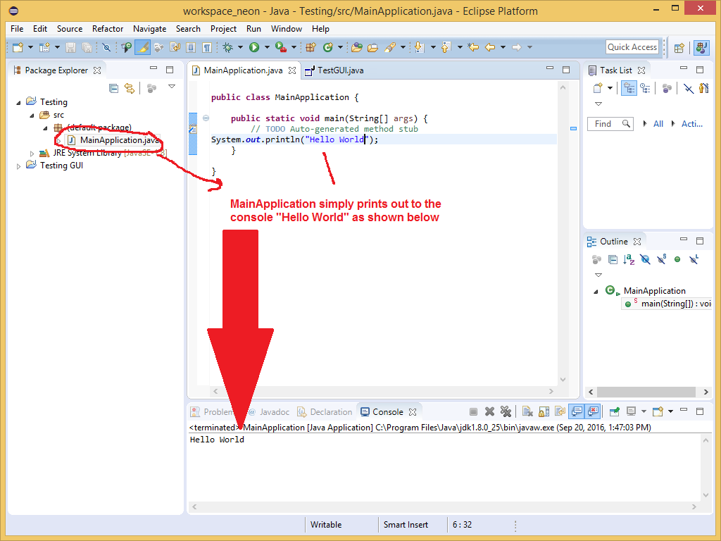
Simple Console Application
Here we see it in Eclipse

