Slide 1
Data Today
L. Grewe

Slide 2
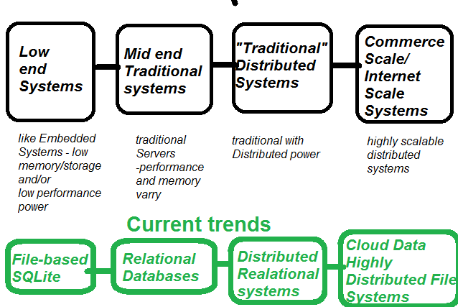
Whole range of solutions

Slide 3
This class
Focus on learning Mid-end Traditional Data Systems = Relational Database Systems
Note: if we do an mobile project you will have the option of learning “low-end systems” data.

Slide 4
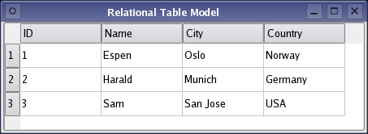
What are Relational Databases?
Uses construct of a “Table”
Uses Relational Math to manipulate tables.

Slide 5
Relational Table
Here we have a CUSTOMER Table
With 4 keys/columns
ID
Name
City
Country
EACH row in the table is a DATABASE ENTRY
Example: Entry = (ID=1,Name=Espen, City = Olso, Country = Norway)
Each Column is represented by a Key name.
One or more Keys can serve as a unique identifier (called a primary key)
Above ID is the primary key (no 2 entries can have the same ID value)

Slide 6
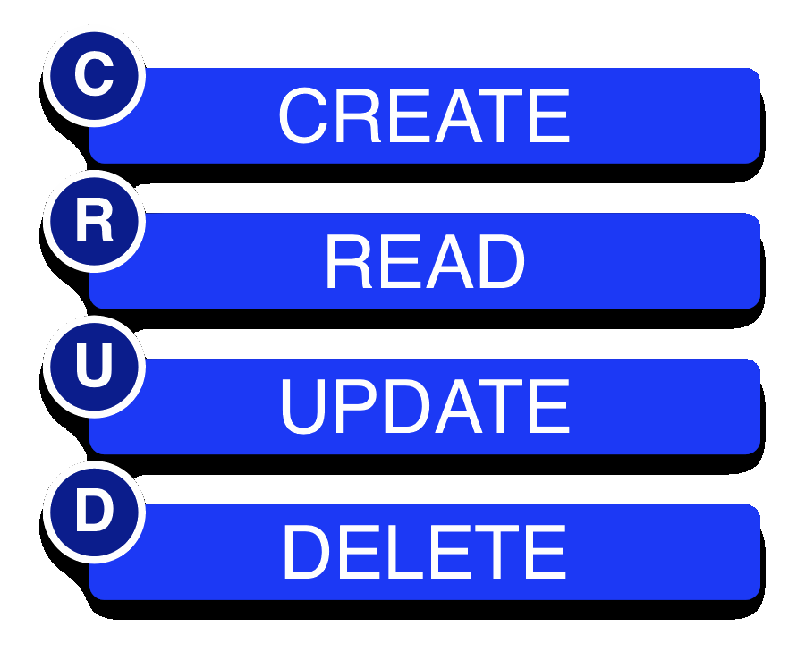
CRUD – the essence of what we want to do in a Relational Database Management System
Create
Read
Update
Delete

Slide 7
Output of a CRUD operation is another TABLE
The output of a CRUD operation is either the original table (select * from TABLENAME) or some sub-set of the table (select * form TABLENAME where ….)
CRUD operation

Slide 8
Some of the CRUD operations in Relational Databases done w/Relational Math
We are not going to worry about HOW Relational Databases accomplish the CRUD operations but, it is based on concepts form Relational math---set theory
Select is like Read operation.

Slide 9
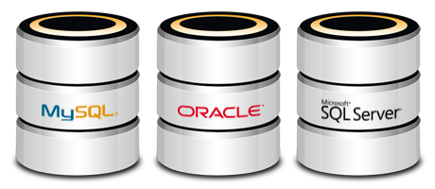
There are many Relational Databases
….here are a few

Slide 10
Most Relational Databases use SQL
SQL - structured query language is a language of commands that implement CRUD operations
We will have a separate lecture on SQL

Slide 11
Advanced….
So there is much more to understanding todays “Data Solutions”…..
To learn more consider taking a class like Web Systems featuring cloud, or distributed systems or…
But, here are a few more slides & things to think about.

Slide 12
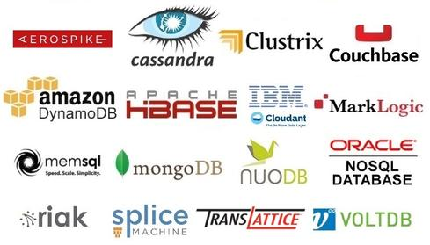
NO SQL Database –a trend
There is a movement to avoid some of the “Heaviness” of Relational SQL based databases --- that has lead to the creation of NO SQL databases
Example MongoDB (and others)

Slide 13
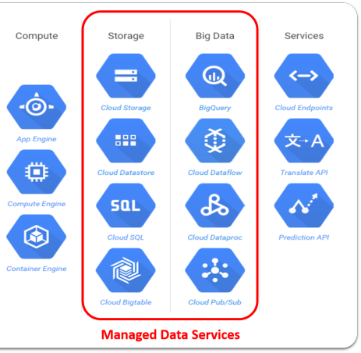
Differentiate solutions not based on performance/system level –but on kind of data
Some other differences between data solutions –are their intent –or rather the kind of data they store and serve

Slide 14
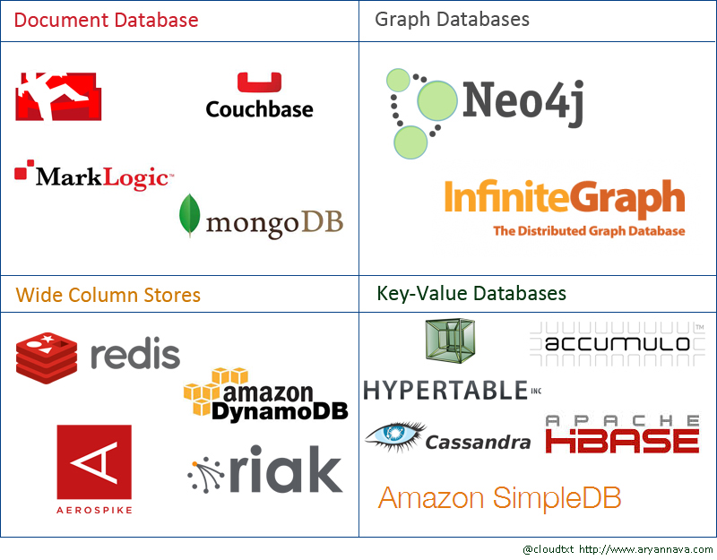
Differentiate based on technologies used

