Slide 1
Sorting and Searching Algorithms
CS3240

Slide 2
Sorting means . . .
The values stored in an array have keys of a type for which the relational operators are defined. (We also assume unique keys.)
Sorting rearranges the elements into either ascending or descending order within the array. (We’ll use ascending order.)

Slide 3
Straight Selection Sort
values [ 0 ]
[ 1 ]
[ 2 ]
[ 3 ]
[ 4 ]
36
24
10
6
12
Divides the array into two parts: already sorted, and not yet sorted.
On each pass, finds the smallest of the unsorted elements, and swaps it into its correct place, thereby increasing the number of sorted elements by one.

Slide 4
Selection Sort: Pass One
values [ 0 ]
[ 1 ]
[ 2 ]
[ 3 ]
[ 4 ]
36
24
10
6
12
U
N
S
O
R
T
E
D

Slide 5
Selection Sort: End Pass One
values [ 0 ]
[ 1 ]
[ 2 ]
[ 3 ]
[ 4 ]
6
24
10
36
12
SORTED
U
N
S
O
R
T
E
D

Slide 6
Selection Sort: Pass Two
values [ 0 ]
[ 1 ]
[ 2 ]
[ 3 ]
[ 4 ]
6
24
10
36
12
SORTED
U
N
S
O
R
T
E
D

Slide 7
Selection Sort: End Pass Two
values [ 0 ]
[ 1 ]
[ 2 ]
[ 3 ]
[ 4 ]
6
10
24
36
12
SORTED
U
N
S
O
R
T
E
D

Slide 8
Selection Sort: Pass Three
values [ 0 ]
[ 1 ]
[ 2 ]
[ 3 ]
[ 4 ]
6
10
24
36
12
SORTED
U
N
S
O
R
T
E
D

Slide 9
Selection Sort: End Pass Three
values [ 0 ]
[ 1 ]
[ 2 ]
[ 3 ]
[ 4 ]
6
10
12
36
24
S
O
R
T
E
D
UNSORTED

Slide 10
Selection Sort: Pass Four
values [ 0 ]
[ 1 ]
[ 2 ]
[ 3 ]
[ 4 ]
6
10
12
36
24
S
O
R
T
E
D
UNSORTED

Slide 11
Selection Sort: End Pass Four
values [ 0 ]
[ 1 ]
[ 2 ]
[ 3 ]
[ 4 ]
6
10
12
24
36
S
O
R
T
E
D

Slide 12
Selection Sort: How many comparisons?
values [ 0 ]
[ 1 ]
[ 2 ]
[ 3 ]
[ 4 ]
6
10
12
24
36
4 compares for values[0]
3 compares for values[1]
2 compares for values[2]
1 compare for values[3]
= 4 + 3 + 2 + 1

Slide 13
For selection sort in general
The number of comparisons when the array contains N elements is
Sum = (N-1) + (N-2) + . . . + 2 + 1

Slide 14
Notice that . . .
Sum = (N-1) + (N-2) + . . . + 2 + 1
+ Sum = 1 + 2 + . . . + (N-2) + (N-1)
2* Sum = N + N + . . . + N + N
2 * Sum = N * (N-1)
Sum = N * (N-1)
2

Slide 15
For selection sort in general
The number of comparisons when the array contains N elements is
Sum = (N-1) + (N-2) + . . . + 2 + 1
Sum = N * (N-1) /2
Sum = .5 N² - .5 N
Sum = O(N²)

Slide 16
template <class ItemType >
int MinIndex(ItemType values [ ], int start, int end)
// Post: Function value = index of the smallest value
// in values [start] . . values [end].
{
int indexOfMin = start ;
for(int index = start + 1 ; index <= end ; index++)
if (values[ index] < values [indexOfMin])
indexOfMin = index ;
return indexOfMin;
}
16

Slide 17
template <class ItemType >
void SelectionSort (ItemType values[ ],
int numValues )
// Post: Sorts array values[0 . . numValues-1 ]
// into ascending order by key
{
int endIndex = numValues - 1 ;
for (int current = 0 ; current < endIndex;
current++)
Swap (values[current],
values[MinIndex(values,current, endIndex)]);
}
17

Slide 18
Bubble Sort
values [ 0 ]
[ 1 ]
[ 2 ]
[ 3 ]
[ 4 ]
Compares neighboring pairs of array elements, starting with the last array element, and swaps neighbors whenever they are not in correct order.
On each pass, this causes the smallest element to “bubble up” to its correct place in the array.
36
24
10
6
12

Slide 19
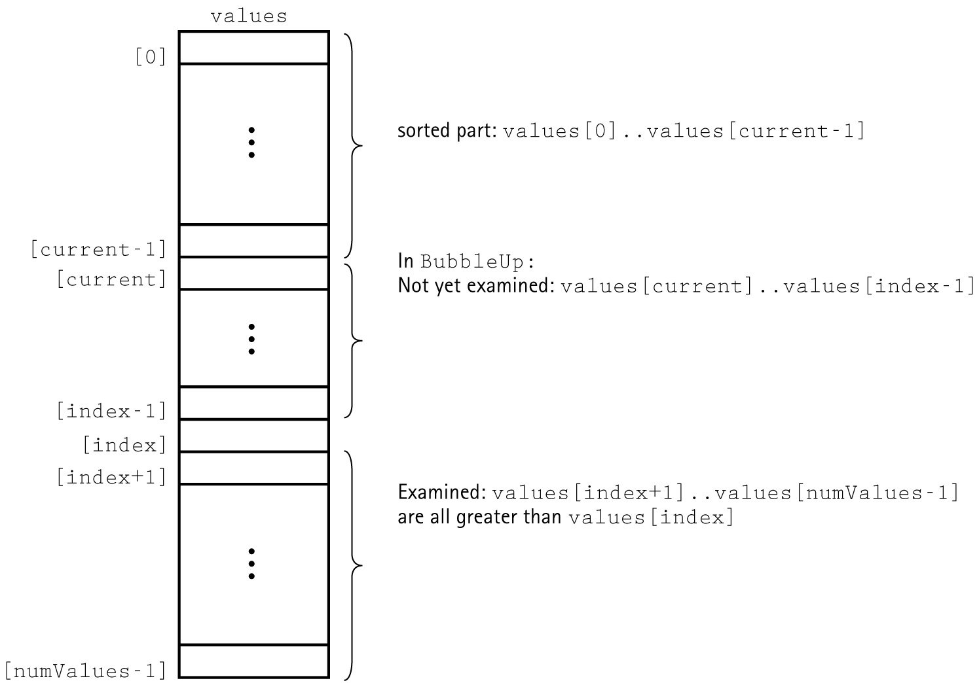
Snapshot of BubbleSort

Slide 20
Code for BubbleSort
template<class ItemType>
void BubbleSort(ItemType values[],
int numValues)
{
int current = 0;
while (current < numValues - 1)
{
BubbleUp(values, current, numValues-1);
current++;
}
}
20

Slide 21
Code for BubbleUp
template<class ItemType>
void BubbleUp(ItemType values[],
int startIndex, int endIndex)
// Post: Adjacent pairs that are out of
// order have been switched between
// values[startIndex]..values[endIndex]
// beginning at values[endIndex].
{
for (int index = endIndex;
index > startIndex; index--)
if (values[index] < values[index-1])
Swap(values[index], values[index-1]);
}

Slide 22
Observations on BubbleSort
This algorithm is always O(N²).
There can be a large number of intermediate swaps.
Can this algorithm be improved?

Slide 23
Insertion Sort
values [ 0 ]
[ 1 ]
[ 2 ]
[ 3 ]
[ 4 ]
36
24
10
6
12
One by one, each as yet unsorted array element is inserted into its proper place with respect to the already sorted elements.
On each pass, this causes the number of already sorted elements to increase by one.

Slide 24
Insertion Sort
Works like someone who “inserts” one more card at a time into a hand of cards that are already sorted.
To insert 12, we need to make room for it by moving first 36 and then 24.
6
10
24
36
12

Slide 25
Insertion Sort
Works like someone who “inserts” one more card at a time into a hand of cards that are already sorted.
To insert 12, we need to make room for it by moving first 36 and then 24.
6
10
24
36
12

Slide 26
Insertion Sort
Works like someone who “inserts” one more card at a time into a hand of cards that are already sorted.
To insert 12, we need to make room for it by moving first 36 and then 24.
6
10
24
36
12

Slide 27
Insertion Sort
Works like someone who “inserts” one more card at a time into a hand of cards that are already sorted.
To insert 12, we need to make room for it by moving first 36 and then 24.
12
24
6
10
36

Slide 28
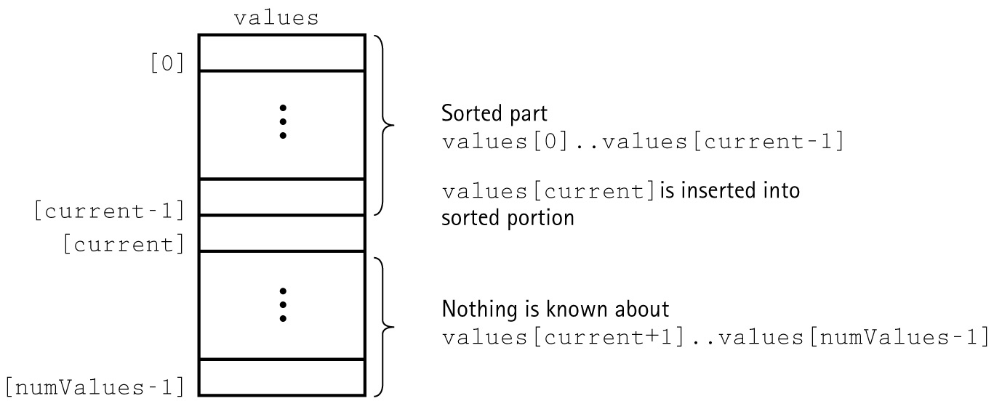
A Snapshot of the Insertion Sort Algorithm

Slide 29
template <class ItemType >
void InsertItem ( ItemType values [ ] , int start , int end )
// Post: Elements between values[start] and values
// [end] have been sorted into ascending order by key.
{
bool finished = false ;
int current = end ;
bool moreToSearch = (current != start);
while (moreToSearch && !finished )
{
if (values[current] < values[current - 1])
{
Swap(values[current], values[current - 1);
current--;
moreToSearch = ( current != start );
}
else
finished = true ;
}
}
29

Slide 30
template <class ItemType >
void InsertionSort ( ItemType values [ ] ,
int numValues )
// Post: Sorts array values[0 . . numValues-1 ] into
// ascending order by key
{
for (int count = 0 ; count < numValues; count++)
InsertItem ( values , 0 , count ) ;
}

Slide 31
Sorting Algorithms and Average Case Number of Comparisons
Simple Sorts
Straight Selection Sort
Bubble Sort
Insertion Sort
More Complex Sorts
Quick Sort
Merge Sort
Heap Sort
O(N²)
O(N*log N)
31

Slide 32
Recall that . . .
A heap is a binary tree that satisfies these
special SHAPE and ORDER properties:
Its shape must be a complete binary tree.
For each node in the heap, the value stored in that node is greater than or equal to the value in each of its children.

Slide 33
The largest element in a heap
is always found in the root node
root
70
60
12
40
30
8
10

Slide 34
The heap can be stored in an array
values
root
[ 0 ]
[ 1 ]
[ 2 ]
[ 3 ]
[ 4 ]
[ 5 ]
[ 6 ]
70
60
12
40
30
8
10
70
0
60
1
12
2
40
3
30
4
8
5
10
6

Slide 35
Heap Sort Approach
First, make the unsorted array into a heap by satisfying the order property. Then repeat the steps below until there are no more unsorted elements.
Take the root (maximum) element off the heap by swapping it into its correct place in the array at the end of the unsorted elements.
Reheap the remaining unsorted elements. (This puts the next-largest element into the root position).

Slide 36
After creating the original heap
values
[ 0 ]
[ 1 ]
[ 2 ]
[ 3 ]
[ 4 ]
[ 5 ]
[ 6 ]
70
60
12
40
30
8
10
root
70
0
60
1
12
2
40
3
30
4
8
5
10
6

Slide 37
Swap root element into last place in unsorted array
values
[ 0 ]
[ 1 ]
[ 2 ]
[ 3 ]
[ 4 ]
[ 5 ]
[ 6 ]
70
60
12
40
30
8
10
root
70
0
60
1
12
2
40
3
30
4
8
5
10
6

Slide 38
After swapping root element into it place
values
[ 0 ]
[ 1 ]
[ 2 ]
[ 3 ]
[ 4 ]
[ 5 ]
[ 6 ]
10
60
12
40
30
8
70
root
10
0
60
1
12
2
40
3
30
4
8
5
70
6
NO NEED TO CONSIDER AGAIN

Slide 39
After reheaping remaining unsorted elements
values
[ 0 ]
[ 1 ]
[ 2 ]
[ 3 ]
[ 4 ]
[ 5 ]
[ 6 ]
60
40
12
10
30
8
70
root
60
0
40
1
12
2
10
3
30
4
8
5
70
6

Slide 40
Swap root element into last place in unsorted array
values
[ 0 ]
[ 1 ]
[ 2 ]
[ 3 ]
[ 4 ]
[ 5 ]
[ 6 ]
60
40
12
10
30
8
70
root
60
0
40
1
12
2
10
3
30
4
8
5
70
6

Slide 41
After swapping root element into its place
values
[ 0 ]
[ 1 ]
[ 2 ]
[ 3 ]
[ 4 ]
[ 5 ]
[ 6 ]
8
40
12
10
30
60
70
root
8
0
40
1
12
2
10
3
30
4
60
5
70
6
NO NEED TO CONSIDER AGAIN

Slide 42
After reheaping remaining unsorted elements
values
[ 0 ]
[ 1 ]
[ 2 ]
[ 3 ]
[ 4 ]
[ 5 ]
[ 6 ]
40
30
12
10
6
60
70
root
40
0
30
1
12
2
10
3
6
4
60
5
70
6

Slide 43
Swap root element into last place in unsorted array
values
[ 0 ]
[ 1 ]
[ 2 ]
[ 3 ]
[ 4 ]
[ 5 ]
[ 6 ]
40
30
12
10
6
60
70
root
40
0
30
1
12
2
10
3
6
4
60
5
70
6

Slide 44
After swapping root element into its place
values
[ 0 ]
[ 1 ]
[ 2 ]
[ 3 ]
[ 4 ]
[ 5 ]
[ 6 ]
6
30
12
10
40
60
70
root
6
0
30
1
12
2
10
3
40
4
60
5
70
6
NO NEED TO CONSIDER AGAIN

Slide 45
After reheaping remaining unsorted elements
values
[ 0 ]
[ 1 ]
[ 2 ]
[ 3 ]
[ 4 ]
[ 5 ]
[ 6 ]
30
10
12
6
40
60
70
root
30
0
10
1
12
2
6
3
40
4
60
5
70
6

Slide 46
Swap root element into last place in unsorted array
values
[ 0 ]
[ 1 ]
[ 2 ]
[ 3 ]
[ 4 ]
[ 5 ]
[ 6 ]
30
10
12
6
40
60
70
root
30
0
10
1
12
2
6
3
40
4
60
5
70
6

Slide 47
After swapping root element into its place
values
[ 0 ]
[ 1 ]
[ 2 ]
[ 3 ]
[ 4 ]
[ 5 ]
[ 6 ]
6
10
12
30
40
60
70
root
6
0
10
1
12
2
30
3
40
4
60
5
70
6
NO NEED TO CONSIDER AGAIN

Slide 48
After reheaping remaining unsorted elements
values
[ 0 ]
[ 1 ]
[ 2 ]
[ 3 ]
[ 4 ]
[ 5 ]
[ 6 ]
12
10
6
30
40
60
70
root
12
0
10
1
6
2
30
3
40
4
60
5
70
6

Slide 49
Swap root element into last place in unsorted array
values
[ 0 ]
[ 1 ]
[ 2 ]
[ 3 ]
[ 4 ]
[ 5 ]
[ 6 ]
12
10
6
30
40
60
70
root
12
0
10
1
6
2
30
3
40
4
60
5
70
6

Slide 50
After swapping root element into its place
values
[ 0 ]
[ 1 ]
[ 2 ]
[ 3 ]
[ 4 ]
[ 5 ]
[ 6 ]
6
10
12
30
40
60
70
root
6
0
10
1
12
2
30
3
40
4
60
5
70
6
NO NEED TO CONSIDER AGAIN

Slide 51
After reheaping remaining unsorted elements
values
[ 0 ]
[ 1 ]
[ 2 ]
[ 3 ]
[ 4 ]
[ 5 ]
[ 6 ]
10
6
12
30
40
60
70
root
10
0
6
1
12
2
30
3
40
4
60
5
70
6

Slide 52
Swap root element into last place in unsorted array
values
[ 0 ]
[ 1 ]
[ 2 ]
[ 3 ]
[ 4 ]
[ 5 ]
[ 6 ]
10
6
12
30
40
60
70
root
10
0
6
1
12
2
30
3
40
4
60
5
70
6

Slide 53
After swapping root element into its place
values
[ 0 ]
[ 1 ]
[ 2 ]
[ 3 ]
[ 4 ]
[ 5 ]
[ 6 ]
6
10
12
30
40
60
70
root
6
0
10
1
12
2
30
3
40
4
60
5
70
6
ALL ELEMENTS ARE SORTED

Slide 54
template <class ItemType >
void HeapSort ( ItemType values [ ] , int numValues )
// Post: Sorts array values[ 0 . . numValues-1 ] into
// ascending order by key
{
int index ;
// Convert array values[0..numValues-1] into a heap
for (index = numValues/2 - 1; index >= 0; index--)
ReheapDown ( values , index , numValues - 1 ) ;
// Sort the array.
for (index = numValues - 1; index >= 1; index--)
{
Swap (values [0] , values[index]);
ReheapDown (values , 0 , index - 1);
}
}
54

Slide 55
ReheapDown
template< class ItemType >
void ReheapDown ( ItemType values [ ], int root,
int bottom )
// Pre: root is the index of a node that may violate the
// heap order property
// Post: Heap order property is restored between root and
// bottom
{
int maxChild ;
int rightChild ;
int leftChild ;
leftChild = root * 2 + 1 ;
rightChild = root * 2 + 2 ;
55

Slide 56
if (leftChild <= bottom) // ReheapDown continued
{
if (leftChild == bottom)
maxChild = leftChild;
else
{
if (values[leftChild] <= values [rightChild])
maxChild = rightChild ;
else
maxChild = leftChild ;
}
if (values[ root ] < values[maxChild])
{
Swap (values[root], values[maxChild]);
ReheapDown ( maxChild, bottom ;
}
}
}
56

Slide 57
Heap Sort: How many comparisons?
root
In reheap down, an element
is compared with its 2
children (and swapped
with the larger). But
only one element at
each level makes
this comparison,
and a complete
binary tree with
N nodes has
only O(log₂N)
levels.
24
0
60
1
12
2
30
3
40
4
8
5
10
6
15
7
6
8
18
9
70
10

Slide 58
Heap Sort of N elements: How many comparisons?
(N/2) * O(log N) compares to create original heap
(N-1) * O(log N) compares for the sorting loop
= O ( N * log N) compares total

Slide 59
Using quick sort algorithm
A . . Z
A . . L M . . Z
A . . F G . . L M . . R S . . Z

Slide 60
// Recursive quick sort algorithm
template <class ItemType >
void QuickSort ( ItemType values[ ] , int first , int last )
// Pre: first <= last
// Post: Sorts array values[ first . . last ] into ascending order
{
if ( first < last ) // general case
{
int splitPoint ;
Split ( values, first, last, splitPoint ) ;
// values [first]..values[splitPoint - 1] <= splitVal
// values [splitPoint] = splitVal
// values [splitPoint + 1]..values[last] > splitVal
QuickSort(values, first, splitPoint - 1);
QuickSort(values, splitPoint + 1, last);
}
} ;
60

Slide 61
Before call to function Split
splitVal = 9
GOAL: place splitVal in its proper position with
all values less than or equal to splitVal on its left
and all larger values on its right
9 20 6 18 14 3 60 11
values[first] [last]

Slide 62
After call to function Split
splitVal = 9
smaller values larger values
in left part in right part
6 3 9 18 14 20 60 11
values[first] [last]
splitVal in correct position

Slide 63
Quick Sort of N elements: How many comparisons?
N For first call, when each of N elements
is compared to the split value
2 * N/2 For the next pair of calls, when N/2
elements in each “half” of the original
array are compared to their own split values.
4 * N/4 For the four calls when N/4 elements in each
“quarter” of original array are compared to
their own split values.
.
.
. HOW MANY SPLITS CAN OCCUR?

Slide 64
Quick Sort of N elements: How many splits can occur?
It depends on the order of the original array elements!
If each split divides the subarray approximately in half,
there will be only log₂N splits, and QuickSort is O(N*log₂N).
But, if the original array was sorted to begin with, the
recursive calls will split up the array into parts of
unequal length, with one part empty, and the
other part containing all the rest of the array except for split value itself. In this case, there can be as many as N-1 splits, and QuickSort is O(N²).

Slide 65
Before call to function Split
splitVal = 9
GOAL: place splitVal in its proper position with
all values less than or equal to splitVal on its left
and all larger values on its right
9 20 26 18 14 53 60 11
values[first] [last]

Slide 66
After call to function Split
splitVal = 9
no smaller values larger values
empty left part in right part with N-1 elements
9 20 26 18 14 53 60 11
values[first] [last]
splitVal in correct position

Slide 67
Merge Sort Algorithm
Cut the array in half.
Sort the left half.
Sort the right half.
Merge the two sorted halves into one sorted array.
74 36 . . . 95
75 29 . . . 52
[first] [middle] [middle + 1]
[last]
36 74 . . . 95
29 52 . . . 75

Slide 68
// Recursive merge sort algorithm
template <class ItemType >
void MergeSort ( ItemType values[ ] , int first , int last )
// Pre: first <= last
// Post: Array values[first..last] sorted into
// ascending order.
{
if ( first < last ) // general case
{
int middle = ( first + last ) / 2 ;
MergeSort ( values, first, middle ) ;
MergeSort( values, middle + 1, last ) ;
// now merge two subarrays
// values [ first . . . middle ] with
// values [ middle + 1, . . . last ].
Merge(values, first, middle, middle + 1, last);
}
}
68

Slide 69
Using Merge Sort Algorithm with N = 16
16
8 8
4 4 4 4
2 2 2 2 2 2 2 2
1 1 1 1 1 1 1 1 1 1 1 1 1 1 1 1

Slide 70
Merge Sort of N elements: How many comparisons?
The entire array can be subdivided into halves
only log₂N times.
Each time it is subdivided, function Merge is called
to re-combine the halves. Function Merge uses a
temporary array to store the merged elements.
Merging is O(N) because it compares each element
in the subarrays.
Copying elements back from the temporary array
to the values array is also O(N).
MERGE SORT IS O(N*log₂N).

Slide 71
Comparison of Sorting Algorithms

Slide 72
Testing
To thoroughly test our sorting methods we should vary the size of the array they are sorting
Vary the original order of the array-test
Reverse order
Almost sorted
All identical elements

Slide 73
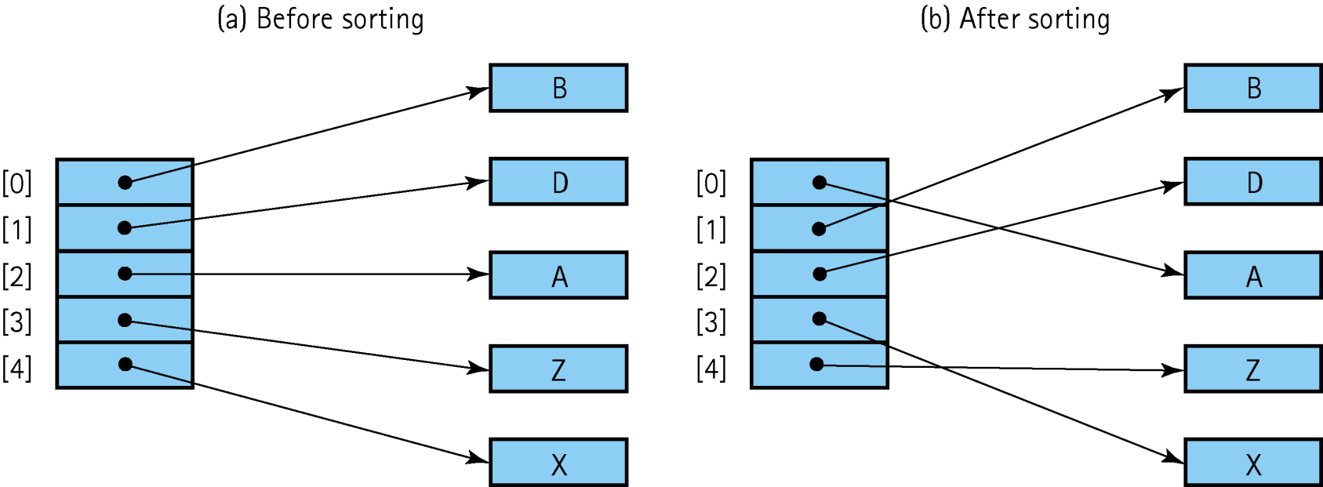
Sorting Objects
When sorting an array of objects we are manipulating references to the object, and not the objects themselves

Slide 74
Stability
Stable Sort: A sorting algorithm that preserves the order of duplicates
Of the sorts that we have discussed in this book, only heapSort and quickSort are inherently unstable

Slide 75
Function BinarySearch( )
BinarySearch takes sorted array info, and two subscripts, fromLoc and toLoc, and item as arguments. It returns false if item is not found in the elements info[fromLoc…toLoc]. Otherwise, it returns true.
BinarySearch is O(log₂N).

Slide 76
found = BinarySearch(info, 25, 0, 14 );
item fromLoc toLoc
indexes
0 1 2 3 4 5 6 7 8 9 10 11 12 13 14
info
0 2 4 6 8 10 12 14 16 18 20 22 24 26 28
16 18 20 22 24 26 28
24 26 28
24
NOTE: denotes element examined

Slide 77
template<class ItemType>
bool BinarySearch(ItemType info[ ], ItemType item,
int fromLoc , int toLoc )
// Pre: info [ fromLoc . . toLoc ] sorted in ascending order
// Post: Function value = ( item in info[fromLoc .. toLoc])
{
int mid ;
if ( fromLoc > toLoc ) // base case -- not found
return false ;
else
{
mid = ( fromLoc + toLoc ) / 2 ;
if ( info[mid] == item ) // base case-- found at mid
return true ;
else
if ( item < info[mid]) // search lower half
return BinarySearch( info, item, fromLoc, mid-1 );
else // search upper half
return BinarySearch( info, item, mid + 1, toLoc );
}
}
77

Slide 78
Hashing
is a means used to order and access elements in a list quickly -- the goal is O(1) time -- by using a function of the key value to identify its location in the list.
The function of the key value is called a hash function.
FOR EXAMPLE . . .

Slide 79
Using a hash function
values
[ 0 ]
[ 1 ]
[ 2 ]
[ 3 ]
[ 4 ]
.
.
.
Empty
4501
Empty
8903
8
10
HandyParts company
makes no more than 100
different parts. But the
parts all have four digit numbers.
This hash function can be used to
store and retrieve parts in an array.
Hash(key) = partNum % 100
[ 97]
[ 98]
[ 99]
7803
Empty
.
.
.
Empty
2298
3699

Slide 80
Placing Elements in the Array
values
[ 0 ]
[ 1 ]
[ 2 ]
[ 3 ]
[ 4 ]
.
.
.
Use the hash function
Hash(key) = partNum % 100
to place the element with
part number 5502 in the
array.
Empty
4501
Empty
8903
8
10
[ 97]
[ 98]
[ 99]
7803
Empty
.
.
.
Empty
2298
3699

Slide 81
Placing Elements in the Array
values
[ 0 ]
[ 1 ]
[ 2 ]
[ 3 ]
[ 4 ]
.
.
.
Next place part number
6702 in the array.
Hash(key) = partNum % 100
6702 % 100 = 2
But values[2] is already
occupied.
COLLISION OCCURS
Empty
4501
5502
[ 97]
[ 98]
[ 99]
7803
Empty
.
.
.
Empty
2298
3699

Slide 82
How to Resolve the Collision?
values
[ 0 ]
[ 1 ]
[ 2 ]
[ 3 ]
[ 4 ]
.
.
.
One way is by linear probing.
This uses the rehash function
(HashValue + 1) % 100
repeatedly until an empty location
is found for part number 6702.
Empty
4501
5502
[ 97]
[ 98]
[ 99]
7803
Empty
.
.
.
Empty
2298
3699

Slide 83
Resolving the Collision
values
[ 0 ]
[ 1 ]
[ 2 ]
[ 3 ]
[ 4 ]
.
.
.
Still looking for a place for 6702
using the function
(HashValue + 1) % 100
Empty
4501
5502
[ 97]
[ 98]
[ 99]
7803
Empty
.
.
.
Empty
2298
3699

Slide 84
Collision Resolved
values
[ 0 ]
[ 1 ]
[ 2 ]
[ 3 ]
[ 4 ]
.
.
.
Part 6702 can be placed at
the location with index 4.
Empty
4501
5502
[ 97]
[ 98]
[ 99]
7803
Empty
.
.
.
Empty
2298
3699

Slide 85
Collision Resolved
values
[ 0 ]
[ 1 ]
[ 2 ]
[ 3 ]
[ 4 ]
.
.
.
Part 6702 is placed at
the location with index 4.
Where would the part with
number 4598 be placed using
linear probing?
Empty
4501
5502
[ 97]
[ 98]
[ 99]
7803
6702
.
.
.
Empty
2298
3699

Slide 86
Radix Sort
Radix sort
Is not a comparison sort
Uses a radix-length array of queues of
records
Makes use of the values in digit positions in
the keys to select the queue into which a
record must be enqueued

Slide 87
Original Array

Slide 88
Queues After First Pass

Slide 89
Array After First Pass

Slide 90
Queues After Second Pass

Slide 91
Array After Second Pass

Slide 92
Queues After Third Pass

Slide 93
Array After Third Pass

