Slide 1
Graphs
CS3240, L. grewe

Slide 2
Goals
Define the following terms related to graphs:
Directed graph Complete graph
Undirected graph Weighted graph
Vertex Adjacency matrix
Edge Adjacency list
Path
Implement a graph using an adjacency matrix to represent the edges

Slide 3
Goals
Explain the difference between a depth-first and a breadth-first search and implement these searching strategies using stacks and queues for auxiliary storage
Implement a shortest-path operation, using a priority queue to access the edge with the minimum weight
Describe a set at the logical level and implement a set both explicitly and implicitly

Slide 4
Graphs
Graph
A data structure that consists of a set of models and a set of edges that relate the nodes to each other
Vertex
A node in a graph
Edge (arc)
A pair of vertices representing a connection between two nodes in a graph
Undirected graph
A graph in which the edges have no direction
Directed graph (digraph)
A graph in which each edge is directed from one vertex to another (or the same) vertex

Slide 5
Graphs
Formally a graph G is defined as follows
G = (V,E)
where
V(G) is a finite, nonempty set of vertices
E(G) is a set of edges (written as pairs of vertices)

Slide 6
Graphs
Vertex
Undirected
Graphs
have no
arrows
on the
edges
Edge or arc

Slide 7
Graphs
Directed edge

Slide 8
Graphs
What
other
structure
is this
?

Slide 9
Graphs
Adjacent vertices
Two vertices in a graph that are connected by an edge
Path
A sequence of vertices that connects two nodes in a graph
Complete graph
A graph in which every vertex is directly connected to every other vertex
Weighted graph
A graph in which each edge carries a value

Slide 10
Graphs
How many edges in
a directed graph with
N vertices?
How many edges in an
undirected graph with
N vertices?

Slide 11
Graphs
Weight

Slide 12
Graph Algorithms
Depth-first search algorithm
Visit all the nodes in a branch to its deepest point before moving up
Breadth-first search algorithm
Visit all the nodes on one level before going to the next level
Single-source shortest-path algorithm
An algorithm that displays the shortest path from a designated starting node to every other node in the graph

Slide 13
Graphs
Operations: The usual suspects
IsFull
IsEmpty
Initialize
Insert requires two operations
Add vertex
Add Edge
Others? Let's see.

Slide 14
Graphs
DepthFirstSearch
Set found to false
stack.Push(startVertex)
do
stack.Pop(vertex)
if vertex = endVertex
Write final vertex
Set found to true
else
Write this vertex
Push all adjacent vertices onto stack
while !stack.IsEmpty() AND !found
if (!found)
Write "Path does not exist"

Slide 15
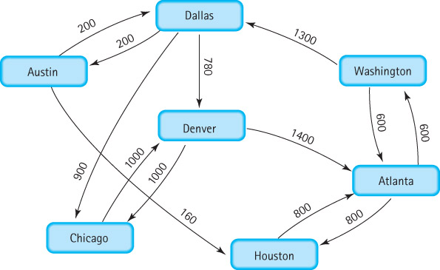
Graphs
Try depth first search from Austin

Slide 16
Graphs
Do you see a problem? Do you have a solution?

Slide 17
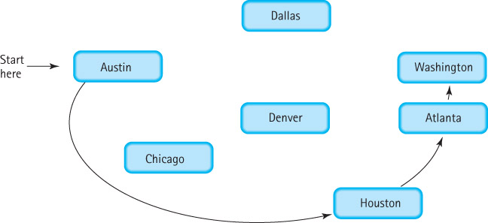
Graphs
We need to "mark" a vertex as visited
ClearMarks
MarkVertex(VertexType, vertex)
Boolean IsMarked(VertexType, vertex)

Slide 18
Graphs
BreadthFirstSearch
Set found to false
queue.Enqueue(startVertex)
do
queue.Dequeue(vertex)
if vertex = endVertex
Write final vertex
Set found to true
else
if (vertex is not marked)
Mark vertex
Write vertex
Get a queue of outgoing vertices from vertex
while (vertexQ is not empty)
vertexQ.Dequeue(Item)
if (item is not marked)
queue.Enqueue(item)
while queue IsEmpty() AND !found
if (!found)
Write "Path does not exist"

Slide 19
Graphs
Try depth breadth search from Austin

Slide 20
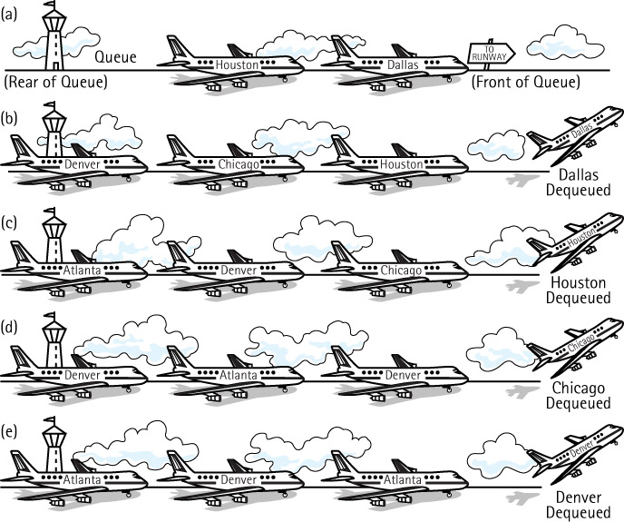
Graphs
DFS uses a stack; BFS uses a queue

Slide 21
Graphs
BFS result

Slide 22
Graphs
What other operation does the Graph ADT need?

Slide 23
Array-Based Implementation
Adjacency Matrix
For a graph with N nodes, an N by N table that shows the existence (and weights) of all edges in the graph
Mapping Array
An array that maps vertex names into array indexes
Marking
Associate a Boolean variable with each vertex: true if visited, false if not yet visited

Slide 24
Adjacency Matrix for Flight Connections
Where could marking variable be kept?

Slide 25
Linked Implementation
Adjacency List
A linked list that identifies all the vertices to which a particular vertex is connected; each vertex has its own adjacency list

Slide 26
Adjacency List Representation of Graphs
Where
could
a
marking
variable
go
?

