Slide 1
Recursion
CS3240

Slide 2
Goals
Discuss recursion as another form of repetition
Do the following tasks, given a recursive routine
Determine whether the routine halts
Determine the base case(s)
Determine the general case(s)
Determine what the routine does
Determine whether the routine is correct and, if it is not, correct it

Slide 3
Goals
Do the following tasks, given a simple recursive problem
Determine the base case(s)
Determine the general case(s)
Design and code the solution as a recursive void or value-returning function
Verify a recursive routine, according to the Three-Question Method
Decide whether a recursive solution is appropriate for a problem

Slide 4
Goals
Compare and contrast dynamic storage allocation and static storage allocation in relation to using recursion
Explain how recursion works internally by showing the contents of the run-time stack
Replace a recursive solution with iteration and/or the use of a stack
Explain why recursion may or may not be a good choice to implement the solution to a problem

Slide 5
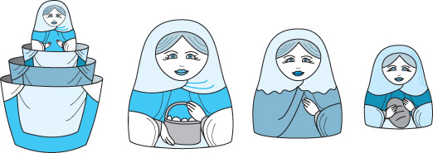
What Is Recursion?
How is recursion like a set of Russian dolls?

Slide 6
What Is Recursion?
Recursive call
A method call in which the method being called is the same as the one making the call
Direct recursion
Recursion in which a method directly calls itself
Indirect recursion
Recursion in which a chain of two or more method calls returns to the method that originated the chain

Slide 7
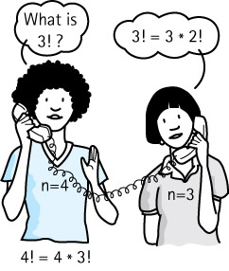
Example of Recursion
Recursive definition
A definition in which something is defined in terms of a smaller version of itself
What is 3 factorial?

Slide 8
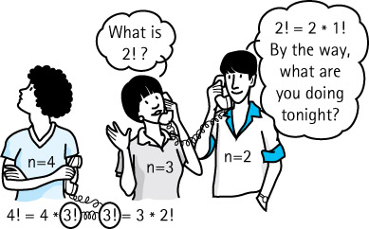
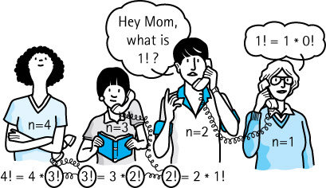
Example of Recursion

Slide 9
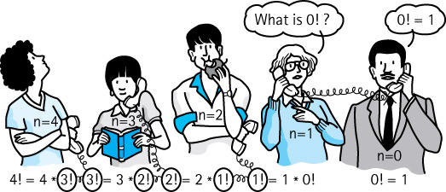
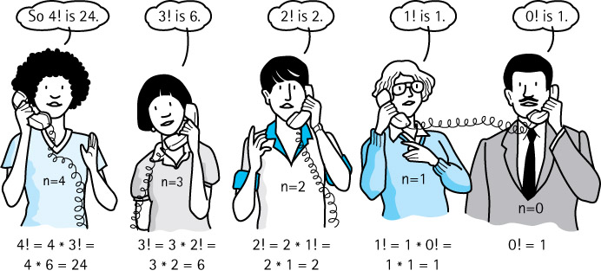
Examples of Recursion

Slide 10
Example of Recursion
Base case
The case for which the solution can be stated nonrecursively
General (recursive) case
The case for which the solution is expressed in terms of a smaller version of itself
Recursive algorithm
A solution that is expressed in terms of (a) a smaller instance(s) of itself and (b) a base case(s)

Slide 11
Writing Recursive Solutions
Algorithm for writing recursive solutions
Determine the size of the problem
Size is the factor that is getting smaller
Size is usually a parameter to the problem
Identify the base case(s)
The case(s) for which you know the answer
Identify the general case(s)
The case(s) that can be expressed as a smaller version of the size

Slide 12
Writing Recursive Solutions
Let’s try it
Problem: Calculate X^{n} (X to the nth power)
Recursive formulation: X*(X^{n-1})*(X^{n-2})*...*X⁰
What is the size of the problem?
Which case do you know the answer to?
Which case can you express as a smaller version of the size?

Slide 13
Writing Recursive Solutions
int Power(int number, int exponent)
{
if (exponent == 0)
return 1
else
return number * Power(number, exponent - 1)
}
Do we need a precondition?

Slide 14
Writing Recursive Solutions
Pattern of solution
if (some condition for which answer is know)
solution statement
else
function call
Recursive case
Base case

Slide 15
Writing Recursive Solutions
Shall we try it again?
Problem: Calculate Nth item in Fibonacci sequence
0, 1, 1, 2, 3, 5, 8, 13, 21, 34, 55
What is the next number?
What is the size of the problem?
Which case do you know the answer to?
Which case can you express as a smaller version of the size?

Slide 16
Writing Recursive Solutions
int Fibonacci(int n)
{
if (n == 0 || n == 1)
return n;
else
return Fibonacci(n-2) + Fibonacci(n-1);
)
That was easy, but it is not very efficient.
Why?

Slide 17
Verifying Recursive Solutions
How can we “prove” that the solution works?
Base-Case Question: Is there a nonrecursive way out of the function?
Smaller-Caller Question: Does each recursive function call involve a smaller case of the original problem leading to the base case?
General-Case Question: Assuming each recursive call works correctly, does the whole function work correctly?
Can you answer yes to all three questions?

Slide 18
Verifying Recursive Solutions
int Power(int number, int exponent)
{
if (exponent == 0)
return 1
else
return number * Power(number, exponent - 1)
}
Is there a nonrecursive way out?
Does each call involve a small case of original?
Assuming recursive call works, does the entire function work?

Slide 19
Writing Recursive Solutions
Shall we try it again?
Problem: Search a list of integers for a value and return true if it is in the list and false otherwise
What is the size of the problem?

Slide 20
Writing Recursive Solutions
bool ValueInList(ListType data, int value, int startIndex);
Which case do you know the answer to?
Which case can you express as a smaller version of the size?

Slide 21
Writing Recursive Solutions
bool ValueInList(ListType list, int value, int startIndex
{
if (list.info[startIndex] == value)
return true;
else if (startIndex == list.length -1)
return false;
else return ValueInList(list, value, startIndex + 1);
}
Base Case 1
Base Case 2
Recursive Case

Slide 22
Writing Recursive Solutions
Why use recursion?
True, these examples could more easily be solved using iteration
However, a recursive solution is a natural solution in certain cases, especially when pointers are involved

Slide 23
Writing Recursive Solutions
Printing a list in order
Size?
Base case?
Recursive (general) case?

Slide 24
Writing Reverse Solutions
void Print(NodeType* listPtr)
{
if (listPtr != NULL)
{
std::cout << listPtr->info << std::endl;
Print(listPrt->next);
}
}
Where is the base case?

Slide 25
Writing Recursive Solutions
Printing a list in reverse order
What must be changed from the in-order print to make the code print in reverse order?

Slide 26
Writing Recursive Solutions
Can you verify the RevPrint algorithm using the three-question method?
Base-Case question?
Smaller-Caller Question?
General-Case Question?

Slide 27
bool Mystery( ItemType info[ ], ItemType item,
int fromLoc, int toLoc )
{
int mid;
if ( fromLoc > toLoc ) return false;
else
{
mid = ( fromLoc + toLoc ) / 2 ;
if (info[mid] == item) return true ;
else
if (item < info[mid])
return Mystery (info, item, fromLoc, mid-1 );
else
return Mystery(info, item, mid + 1, toLoc) ;
}
}
What does this function return?

Slide 28
Writing Recursive Solutions
Problem: Insert item into list
What is the size of the problem?
Which case(s) do you know the answer to?
Which case can you express as a smaller version of the size?

Slide 29
Writing Recursive Solutions
void Insert(NodeType*& listPtr, ItemType item)
{
if (listPtr == NULL || item < listPtr->info)
{
NodeType* tempPtr = listPtr;
listPtr = new NodeType;
listPtr->info = iten;
listPtr->next = tempPtr;
}
else Insert(listPtr->next, item)
}
NodeType*&: Is the *& important?

Slide 30
How Recursion Works
Binding Time
The time at which a variable is assigned to a memory address
Static Storage Allocation
Binding occurs during compilation
Dynamic Storage Allocation
Binding occurs during run time
Global variables are bound at compile time.
When are parameters bound to an address?

Slide 31
How Recursion Works
Transfer of Control
When a function is called, control is passed to the first executable statement in the function
How does control get passed back to the calling code?
Return Address
The address of the instruction in the calling code that immediately follows the function call
How does the function access the return address?

Slide 32
How Recursion Works
Activation Record (Stack Frame)
A record used at run time to store information about a function call, including the parameters, local variables, return address, and function return value (if a value-returning function)
Run-time Stack
A data structure that keeps track of activation records during the execution of a program

Slide 33
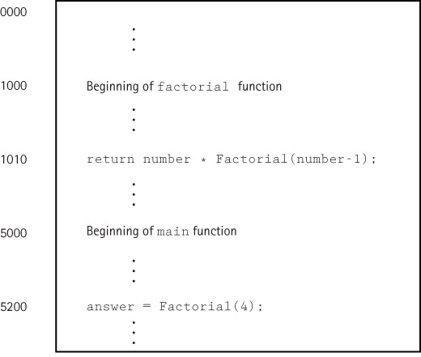
How Recursion Works
Function
Factorial
loaded
in
memory

Slide 34
How Recursion Works
answer = Factorial(4);
return number * Factorial(number-1);

Slide 35
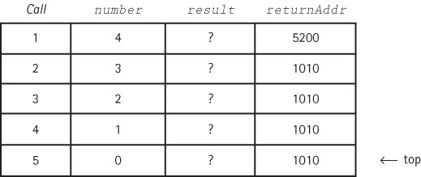
How Recursion Wroks
return number * Factorial(number-1); (2)
return number * Factorial(number-1); (1)
return number * Factorial(number-1); (0)
So now what?

Slide 36
How Recursion Works
return number * Factorial(number-1); (2)
return number * Factorial(number-1); (1) popped
return number * Factorial(number-1); (0) popped

Slide 37
How Recursion Works
return number * Factorial(number-1); (4)
return number * Factorial(number-1); (3) popped
return number * Factorial(number-1); (2) popped
result from previous call (6) is multiplied by
current number giving 24. Now what happens?

Slide 38
How Recursion Works
void Insert(NodeType*& listPtr, ItemType item)
Did you figure out why it must be NodeType*&?
Let’s trace Insert(listData, 11)

Slide 39
How Recursion Works
R0 is non-
recursive call

Slide 40
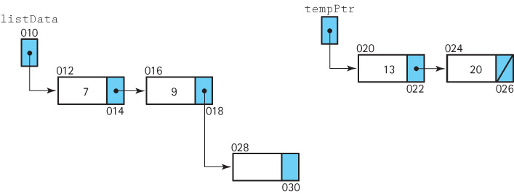
How Recursion Works
listPtr->next = tempPtr;
See
why
it
works
?

Slide 41
Removing Recursion
Tail Recursion
The case in which a function contains only a single recursive invocation and it is the last statement to be executed in the function
A tail recursive function can be replaced with iteration
Stacking
Using a stack to keep track of each local environment, i.e., simulate the run-time stack

Slide 42
When To Use Recursion
Depth of recursive calls is relatively “shallow” compared to the size of the problem
Recursive version does about the same amount of work as the nonrecursive version (same Big-O)
The recursive version is shorter and simpler than the nonrecursive solution
SHALLOW DEPTH EFFICIENCY CLARITY

