Slide 1
YQL how to build an application
L. Grewe

Slide 2
YQL – what is it
Yahoo! Query Language

Slide 3
Make Applications – Mashups with YQL
Take data from a service on the web (or your own data) and access it through YQL.
Take this data an use it in an application of your own making
Example: Take some News like Yahoo! News and put in in your application and place it in a Google Map

Slide 4
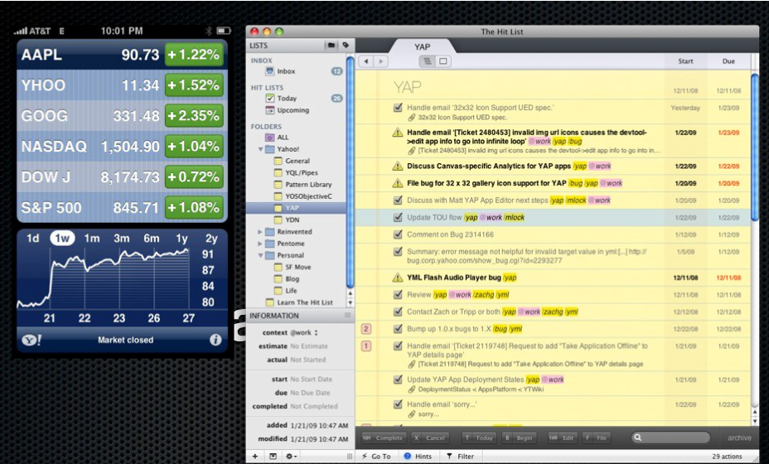
Some Examples

Slide 5
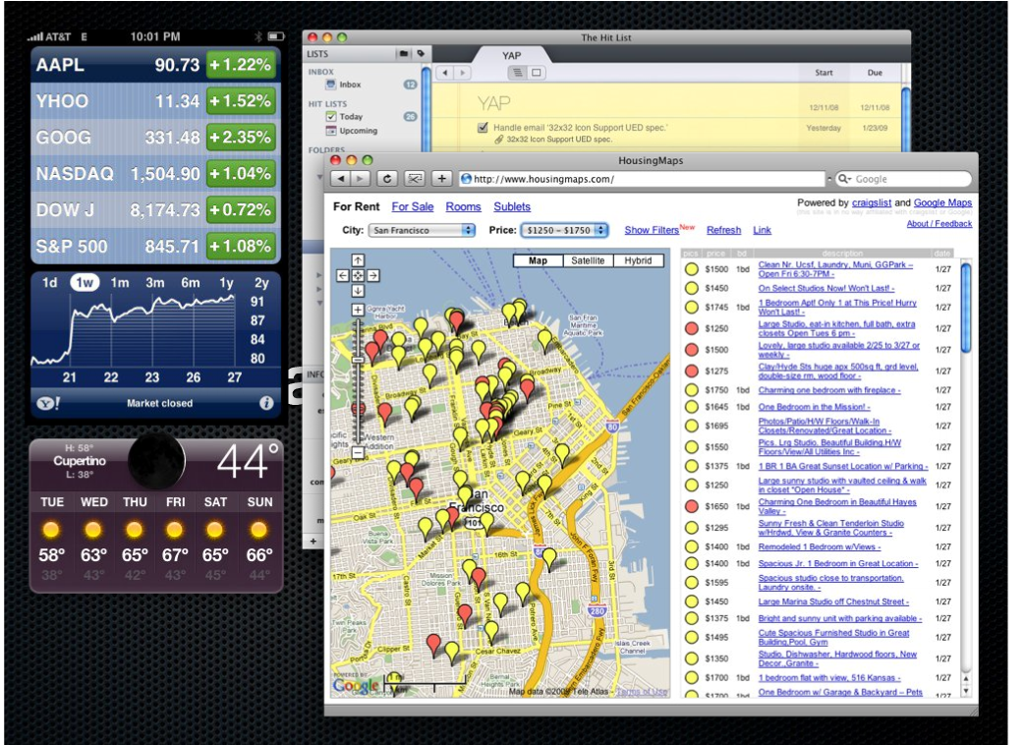
More

Slide 6
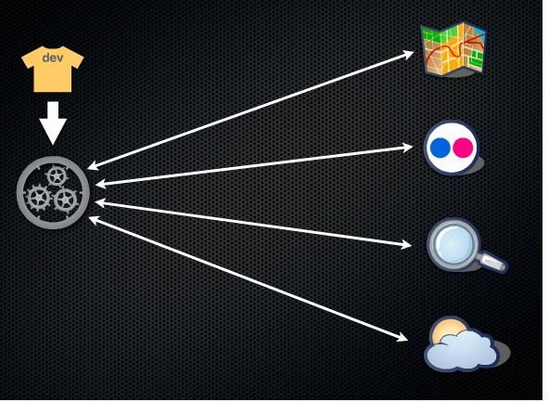
Mashup Idea
Developer must connect to different web services

Slide 7
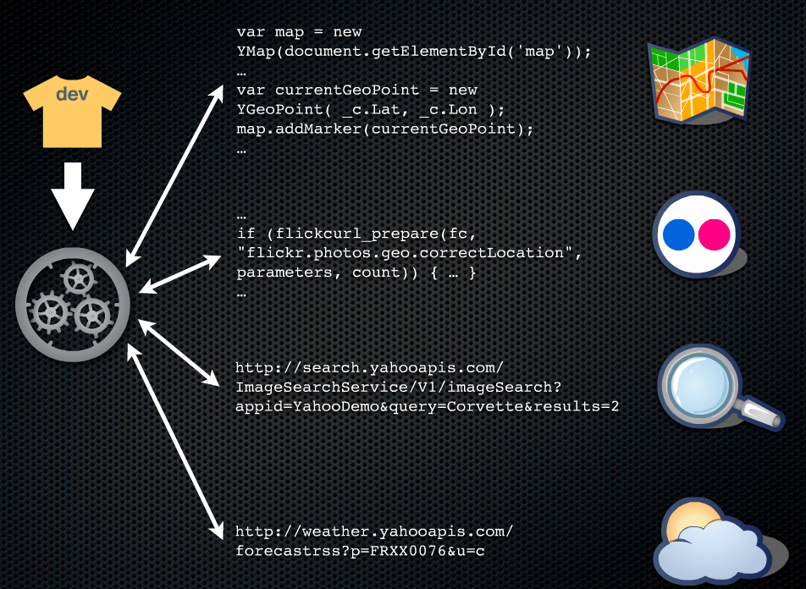
Mashup Idea
Without YQL –must write code to each

Slide 8
Problems ???
Well each API is different, you have to learn each and get different kinds of output formats you have to parse.
SOLUTION?
YQL can wrap the requests in a SQL/ database like request
YQL can return results in JSON or XML

Slide 9
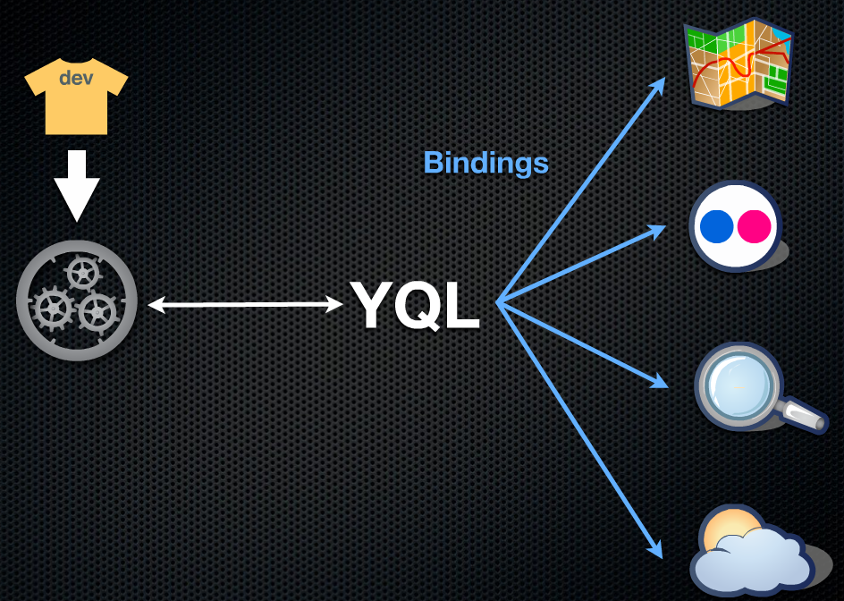
YQL Mashup

Slide 10
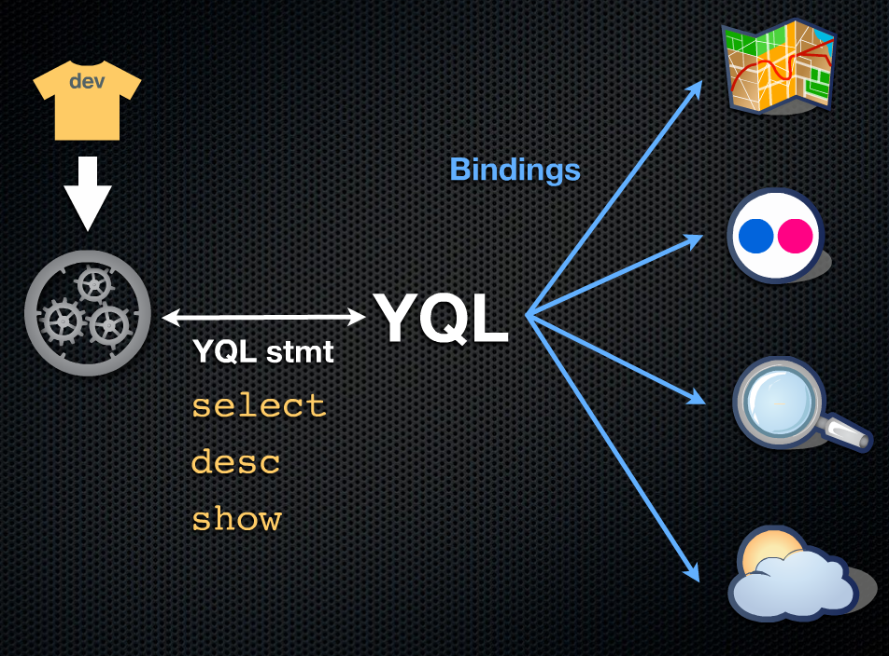
YQL is like database language SQL

Slide 11
YQL application mashup
Application = Data from a web service(s)
+
Display/Visualization
+
Any additional functionality

Slide 12
YQL looks like SQL
Leverages the fact that many web application developers know SQL.
YQL looks like SQL
example getting photos from flickr using YQL becomes
select * from flickr.photos.search where text='cat'
Translating a text to French becomes using YQL:
select * from google.translate where q='hubcap' and target='fr'
You can also mix and match different sources, for example you can get the latest headlines from yahoo’s top stories and translate them to French:
select * from google.translate where target='fr' and q in (
select title from rss where url='http://rss.news.yahoo.com/rss/topstories'
)

Slide 13
Why YQL?
Thousands of Web Services that are useful
Each has its own API –lots to learn and maintain
YQL can do this as well as promote combining, shaping data that is received from these web services

Slide 14
YQL Statement
show: lists supported tables
desc: describes structure of table
select: fetches data
use: use a Open Data Table

Slide 15
YQL Select statement
SELECT what
FROM collection
WHERE filter condition
IN (sub-select)
LIMIT n OFFSET n

Slide 16
YQL access
We submit YQL statements through the web.
Example:
SELECT * FROM flickr.photos.search WHERE text="cat"
To access the YQL Web Service, a Web application can call HTTP GET, passing the YQL statement as a URL parameter, for example:
http://query.yahooapis.com/v1/public/yql?q=SELECT * FROM flickr.photos.search WHERE text="Cat"
Here are the results of typing in the above URL in a browser....this is the 10 videos at that moment for cats on flicker:
<query yahoo:count="9" yahoo:created="2011-02-18T19:54:58Z" yahoo:lang="en-US">
<results>
<photo farm="6" id="5456857132" isfamily="0" isfriend="0" ispublic="1" owner="66972807@N00" secret="0158d7bdba" server="5131" title="Still Life With New Clock"/>
<photo farm="6" id="5456241213" isfamily="0" isfriend="0" ispublic="1" owner="47372746@N00" secret="2f1877fed0" server="5216" title="RIP Frodo: 1995 - 2011"/>
<photo farm="6" id="5456252599" isfamily="0" isfriend="0" ispublic="1" owner="20846638@N04" secret="5879cee952" server="5252" title="A Hairless Cat's Ear?"/>
<photo farm="6" id="5456251657" isfamily="0" isfriend="0" ispublic="1" owner="32276183@N00" secret="5343a104c2" server="5215" title="Clare and Dora"/>
<photo farm="6" id="5456246703" isfamily="0" isfriend="0" ispublic="1" owner="92349717@N00" secret="d482c055ae" server="5255" title="Just another lazy day... in my favorite sunny spot"/>
<photo farm="6" id="5456850878" isfamily="0" isfriend="0" ispublic="1" owner="32276183@N00" secret="c0b90c636b" server="5131" title="Clare and Dora"/>
<photo farm="6" id="5456252359" isfamily="0" isfriend="0" ispublic="1" owner="7604309@N06" secret="ca3e2af9a4" server="5134" title="Weird ass cats"/>
<photo farm="6" id="5456238607" isfamily="0" isfriend="0" ispublic="1" owner="78394733@N00" secret="c5ba2b11de" server="5298" title="Smoke"/>
<photo farm="6" id="5456235155" isfamily="0" isfriend="0" ispublic="1" owner="78394733@N00" secret="15a551e55e" server="5175" title="Smoke"/>
</results>
</query>
What now --- you need to know how to use this information from Flickr to bring up the actual images.

Slide 17
YQL Access points
Public Endpoint
http://query.yahooapis.com/v1/yql?q=*****
Oauth Endpoint (requires authentication)
http://query.qyahooapis.com/v1/public/yql?q=***
YQL Console (testing)
http://developer.yahoo.com/yal/console

Slide 18
YQL --- you can create a table for your own personal Web Service
Great way to make it easy for YQL developers to use your web service.
See Yahoo! YQL website for details.

Slide 19
What is missing? How to display the returned information
How you visualize that data
Use HTML, CSS
USE Javascript / AJAX to make the call to YQL and get back the data and process it and display it dynamically
Something else from Yahoo! for helping with visualization ---loot at YUI

